Slide 1
Summary of the Last Lecture
This is our second lecture. In our first lecture, we discussed
The vector spaces briefly and proved some basic inequalities
like Hӧlder’s and Minkowski’s inequalities. In this lecture we
introduce some more definitions and results related to
Vector spaces and then the same for normed
spaces.

Slide 2
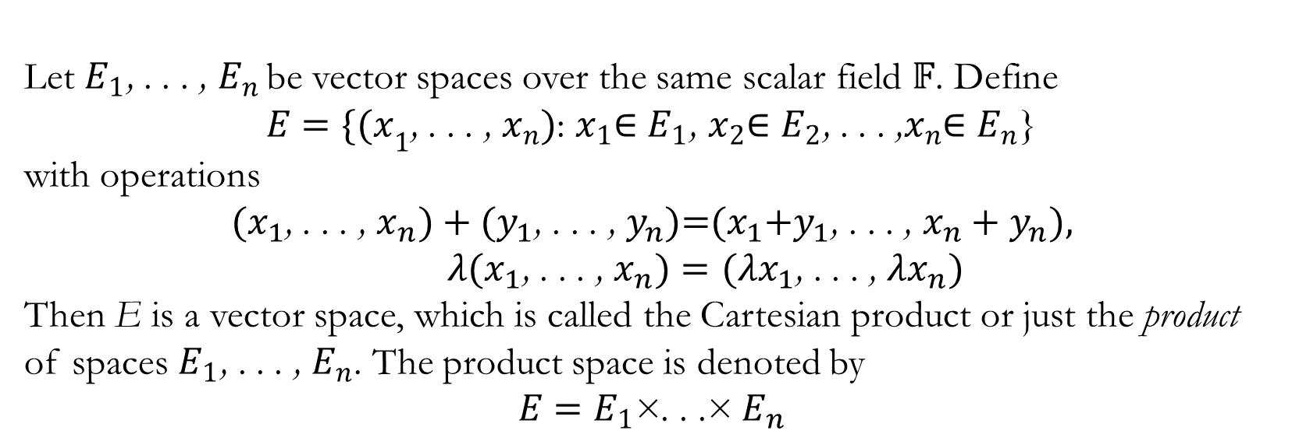
Product of Spaces
Let $E_{1}$, . . . ,$E_{n }$be vector spaces over the same scalar field $𝔽$. Define
$E=\{{(x}_{1}$, . . . , $x_{n})$: $x_{1}$∈ $E_{1}$, $x_{2}$∈ $E_{2}$, . . . ,$x_{n}$∈ $E_{n}$}
with operations
${(x}_{1}$, . . . , $x_{n})+{(y}_{1}\text{, . . . , }y_{n})\text{=}{(x}_{1}+y_{1}\text{, . . . , }x_{n}+y_{n})\text{,}$
${λ(x}_{1}\text{, . . . , }x_{n})={(λx}_{1}\text{, . . . , }{λx}_{n})$
Then E is a vector space, which is called the Cartesian productor just the product of spaces $E_{1}$, . . . , $E_{n}$. The product space is denoted by
$$E=E_{1}\text{×}\text{. . .}\text{×}{ E}_{n}$$

Slide 3
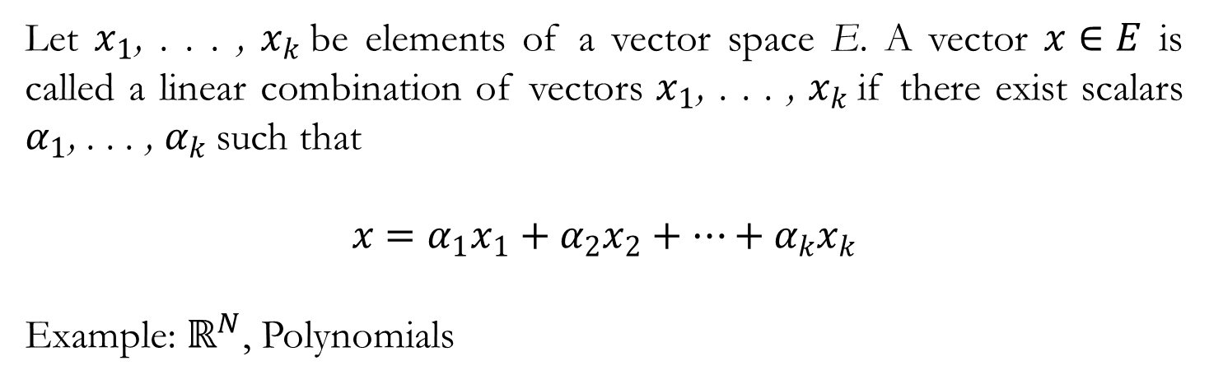
Linear Combination
Let $x_{1}$, . . . ,$x_{k}$be elements of a vector space E. A vector $x∈E$is called a linear combinationof vectors $x_{1}$, . . . ,$x_{k}$if there exist scalars $α_{1}$, . . . ,$α_{k}$such that
$$x=α_{1}x_{1}+α_{2}x_{2}+…+α_{k}x_{k}$$
Example: $ℝ^{N}$, Polynomials

Slide 4
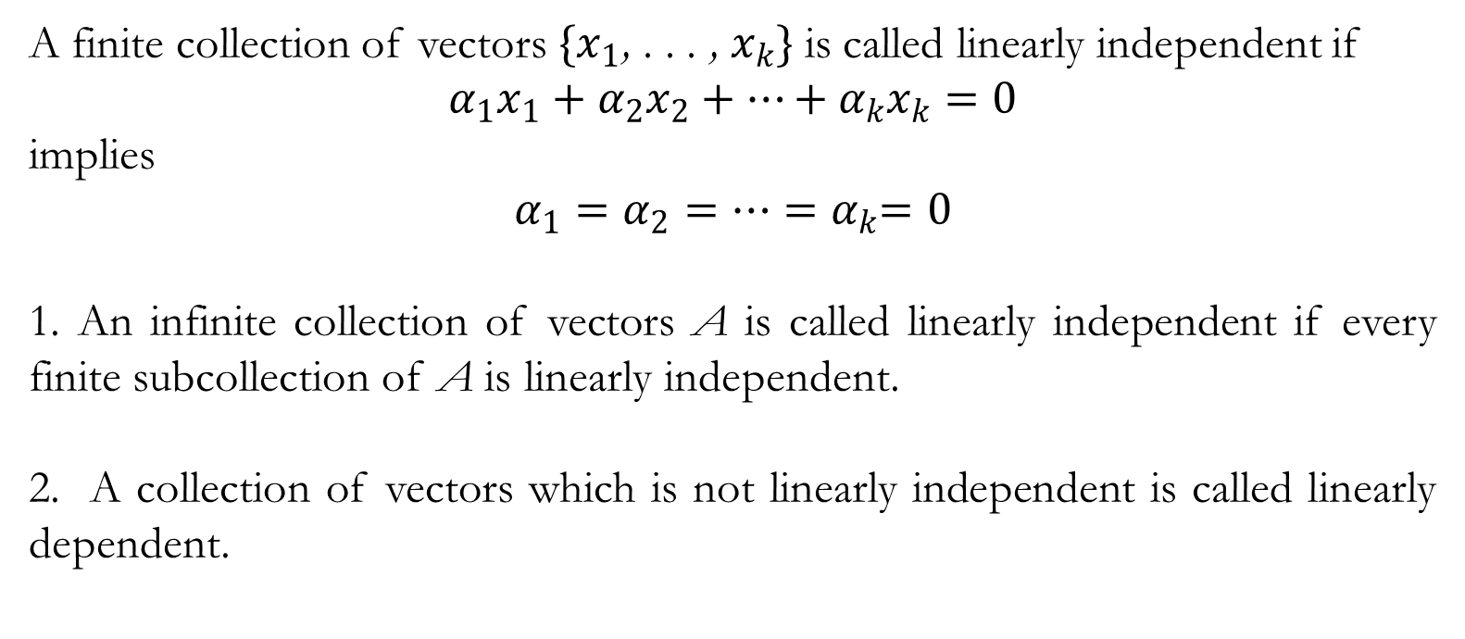
Linear Dependence and Independence
A finite collection of vectors $\{x_{1}\text{, . . . ,} x_{k}\}$is called linearly independentif
$α_{1}x_{1}+α_{2}x_{2}+…+α_{k}x_{k}=0$
implies
$α_{1}=α_{2}=…{=α}_{k}=0$
1. An infinite collection of vectors A is called linearly independent if every finite subcollectionof A is linearly independent.
2. A collection of vectors which is not linearly independent is called linearly dependent.

Slide 5
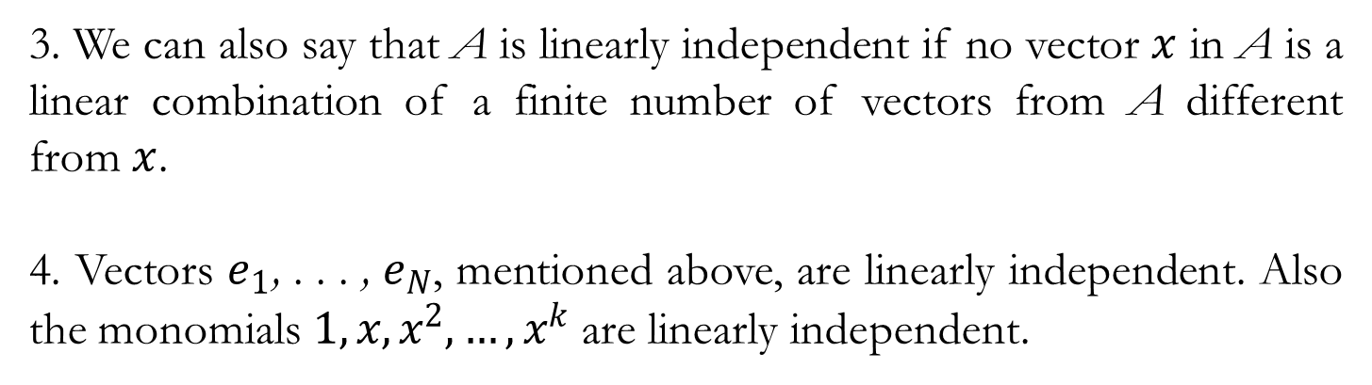
3. We can also say that A is linearly independent if no vector $x$in A is a linear combination of a finite number of vectors from A different from $x$.
4. Vectors $e_{1}\text{, . . . ,} e_{N}$, mentioned above, are linearly independent. Also the monomials $1, x,x^{2},…, x^{k}$ are linearly independent.

Slide 6
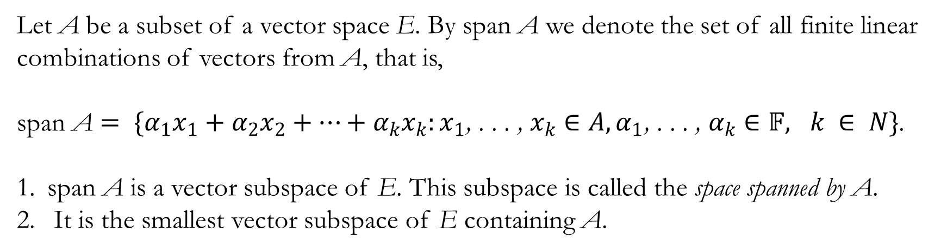
Span of a Vector Space
Let A be a subset of a vector space E. By span A we denote the set of all finite linear combinations of vectors from A, that is,
span A $= \{α_{1}x_{1}+α_{2}x_{2}+…+α_{k}x_{k}:x_{1}\text{, . . . ,} x_{k}∈A,α_{1}\text{, . . . ,} α_{k}∈𝔽, k ∈ N\}$.
span A is a vector subspace of E. This subspace is called the space spanned by A.
It is the smallest vector subspace of E containing A.

Slide 7
Basis of a Vector Space E
Definition: A set of vectors B ⊂ E is called a basis of E if B is linearly independent and span B = E.

Slide 8
Finite and Infinite Dimensional Vector Space
If there exists a finite basis in E, then E is called a finite dimensional vector space. Otherwise we say that E is infinite dimensional.
The number of vectors in any basis of E is the same.
If, for example, E has a basis that consists of exactly n vectors, then any other basis has exactly n vectors. In such a case n is called the
dimension of E and we write dim E = n.

Slide 9
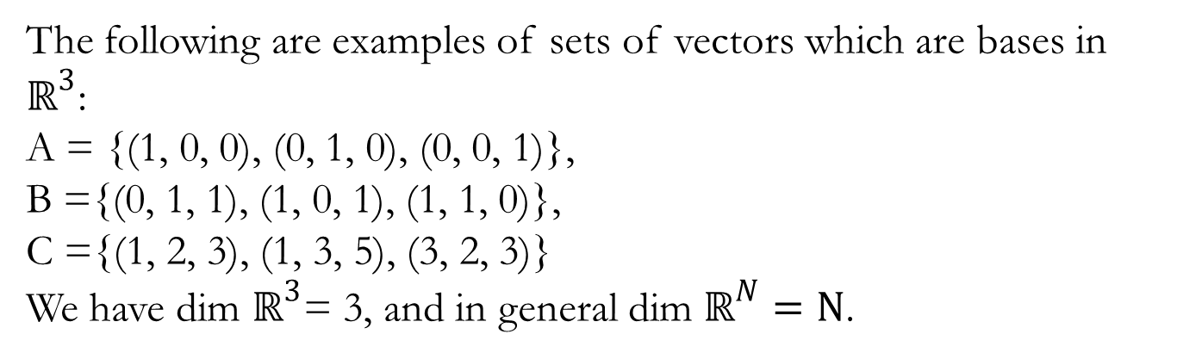
Example
The following are examples of sets of vectors which are bases in $ℝ^{3}$:
A = {(1, 0, 0), (0, 1, 0), (0, 0, 1)},
B ={(0, 1, 1), (1, 0, 1), (1, 1, 0)},
C ={(1, 2, 3), (1, 3, 5), (3, 2, 3)}
We have dim $ℝ^{3}$= 3, and in general dim $ℝ^{N}=N$.

Slide 10
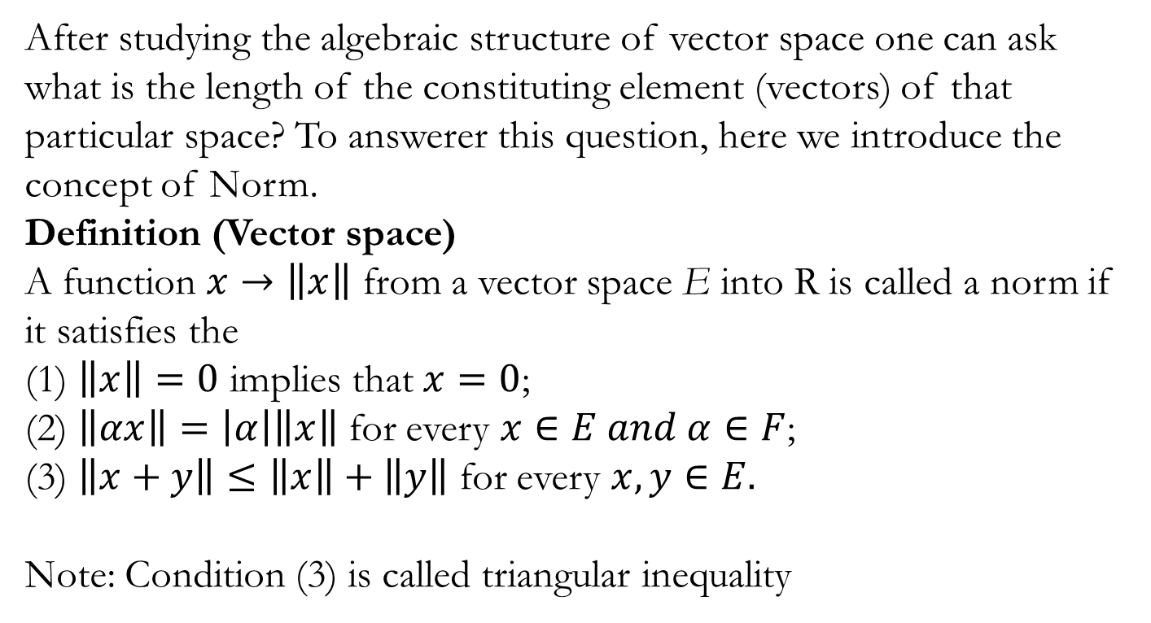
Normed Vector Spaces
After studying the algebraic structure of vector space one can ask what is the length of the constituting element (vectors) of that particular space? To answerer this question, here we introduce the concept of Norm.
Definition (Vector space)
A function $x→\left\|x\right\|$from a vector space E into R is called a norm if it satisfies the
(1) $\left\|x\right\|=0$impliesthat$x=0$;
(2) $\left\|αx\right\|=\left|α\right|\left\|x\right\|$forevery$x∈E and α∈F$;
(3) $\left\|x+y\right\|≤\left\|x\right\|+\left\|y\right\|$forevery$x,y∈E.$
Note: Condition (3) is called triangular inequality

Slide 11
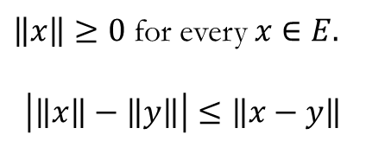
Quiz 1.
$\left\|x\right\|≥0$ for every $x∈E.$
$$\left|\left\|x\right\|−\left\|y\right\|\right|≤\left\|x−y\right\|$$

Slide 12
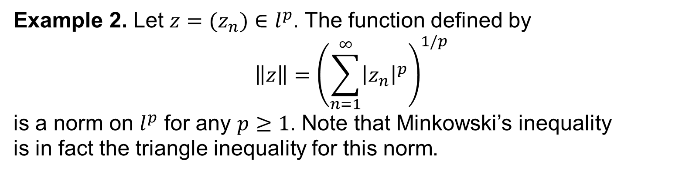
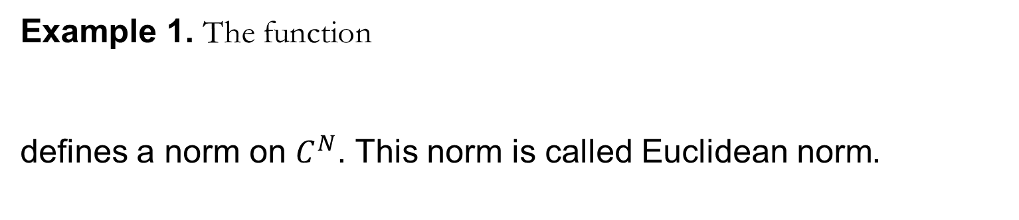
Example 1. The function
defines a norm on $C^{N}$. This norm is called Euclidean norm.
Example 2. Let $z=(z_{n})∈l^{p}$. The function defined by
$$\left\|z\right\|={\left(\sum_{n=1}^{∞}{{\left|z_{n}\right|}^{p}}\right)}^{1/p}$$
is a norm on $l^{p}$for any $p≥1$. Note that Minkowski’sinequality
is in fact the triangle inequality for this norm.

Slide 13
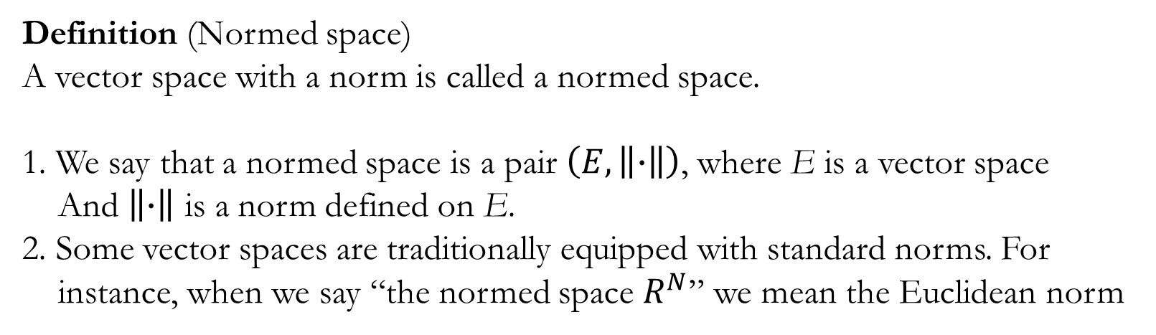
Normed Space
Definition (Normed space)
A vector space with a norm is called a normed space.
1. We say that a normed space is a pair $\left(E,\left\|∙\right\|\right)$, where E is a vector space
And $\left\|∙\right\|$ is a norm defined on E.
2. Some vector spaces are traditionally equipped with standard norms. For
instance, when we say “the normed space $R^{N}$” we mean the Euclidean norm

Slide 14
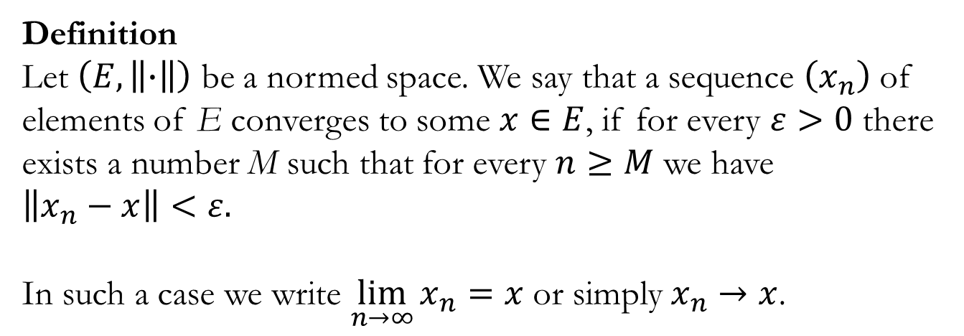
Convergence in a normed space
Definition
Let $\left(E,\left\|∙\right\|\right)$ be a normed space. We say that a sequence $\left(x_{n}\right)$of elements of E converges to some $x∈E$, if for every $ε>0$ there exists a number M such that for every $n≥M$we have
$\left\|x_{n}−x\right\|<ε.$
In such a case we write$\lim_{n→∞}{x_{n}=x}$ or simply$x_{n}→x$.

Slide 15
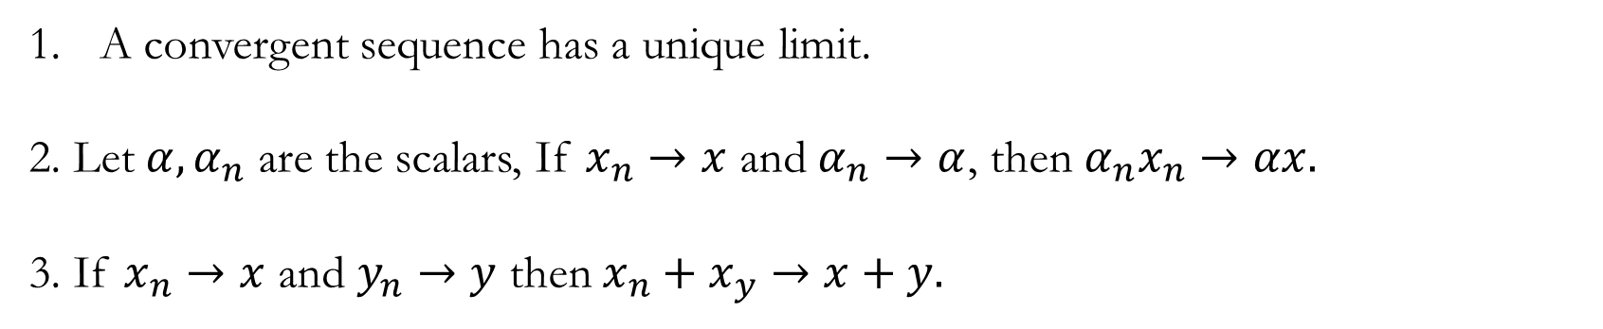
Note
A convergent sequence has a unique limit.
2. Let $α,α_{n}$ are the scalars, If $x_{n}→x$ and $α_{n}→α$, then $α_{n}x_{n}→αx.$
3. If $x_{n}→x$ and $y_{n}→y$ then $x_{n}+x_{y}→x+y.$

Slide 16
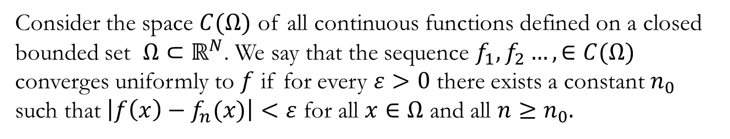
Uniform Convergence
Consider the space $C(Ω)$of all continuous functions defined on a closed bounded set $Ω⊂ℝ^{N}$. We say that the sequence $f_{1},f_{2}…,∈C(Ω)$ converges uniformly to $f$ if for every $ε>0$ there exists a constant $n_{0}$ such that $\left|f\left(x\right)−f_{n}(x)\right|<ε$ for all $x∈Ω$ and all $n≥n_{0}.$

Slide 17
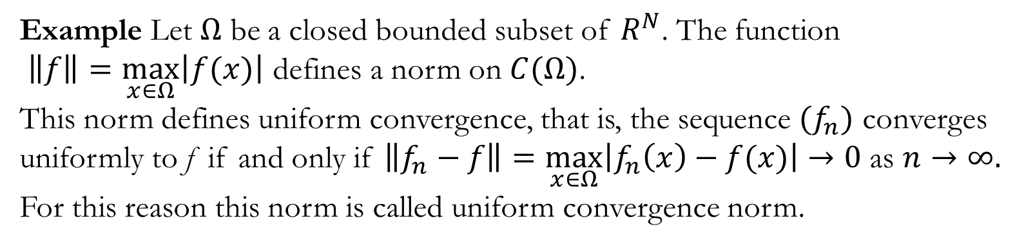
Example Let $Ω$be a closed bounded subset of $R^{N}$. The function
$\left\|f\right\|=\max_{x∈Ω}\left|f(x)\right|$ defines a norm on $C(Ω)$.
This norm defines uniform convergence, that is, the sequence ${(f}_{n})$ converges uniformly to f if and only if $\left\|f_{n}−f\right\|=\max_{x∈Ω}\left|f_{n}\left(x\right)−f(x)\right|→0$ as $n→∞.$
For this reason this norm is called uniform convergence norm.

Slide 18
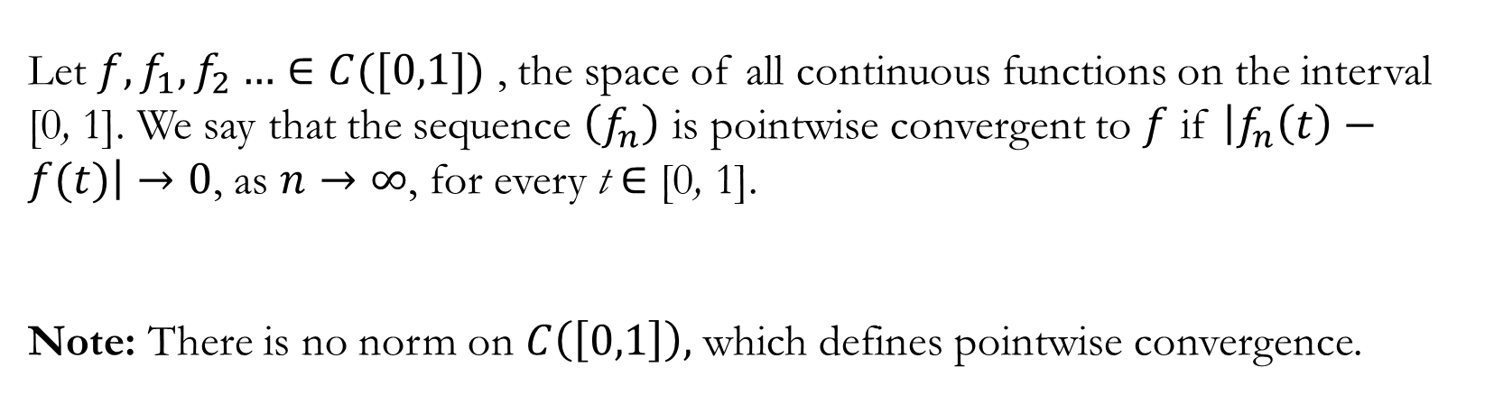
Pointwise convergence
Let ${f,f}_{1},f_{2}…∈C([0,1])$, the space of all continuous functions on the interval [0, 1]. We say that the sequence $\left(f_{n}\right)$is pointwise convergent to $f$if $\left|f_{n}\left(t\right)−f(t)\right|→0$, as $n→∞$, for every t ∈ [0, 1].
Note: There is no norm on $C\left(\left[0,1\right]\right),$ which defines pointwise convergence.

Slide 19
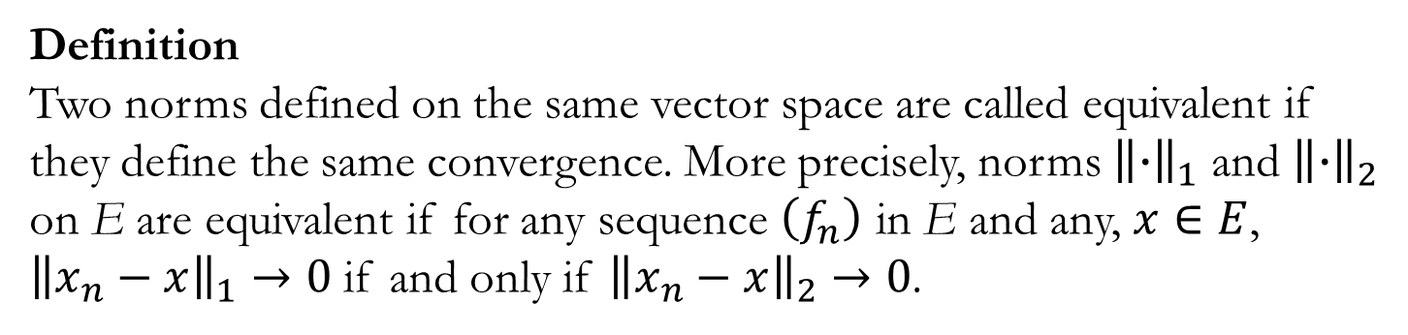
Equivalence of norms
Definition
Two norms defined on the same vector space are called equivalentif they define the same convergence. More precisely, norms ${\left\|∙\right\|}_{1}$ and ${\left\|∙\right\|}_{2}$on E are equivalent if for any sequence $\left(f_{n}\right)$ in E and any, $x∈E$,
${\left\|x_{n}−x\right\|}_{1}→0$ if and only if ${\left\|x_{n}−x\right\|}_{2}→0$.

Slide 20
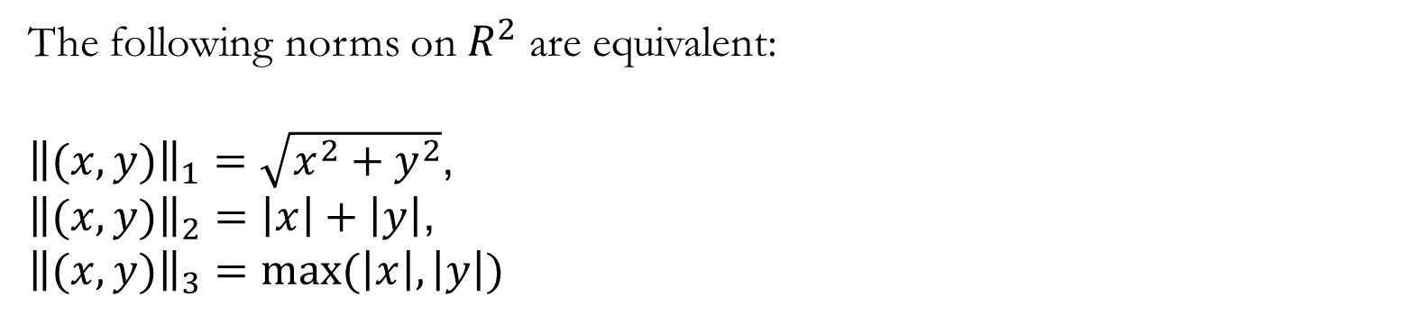
Example
The following norms on $R^{2}$are equivalent:
${\left\|(x,y)\right\|}_{1}=\sqrt{x^{2}+y^{2}}$,
${\left\|(x,y)\right\|}_{2}=\left|x\right|+\left|y\right|$,
$${\left\|(x,y)\right\|}_{3}=max⁡(\left|x\right|,\left|y\right|)$$

Slide 21
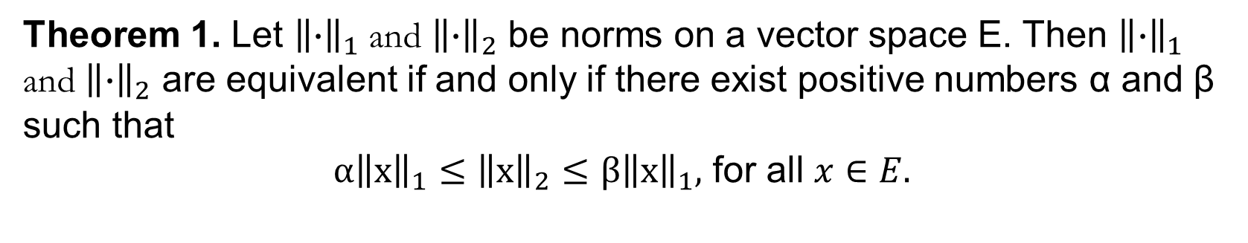
Theorem on Equivalence of Norm
Theorem 1. Let ${\left\|∙\right\|}_{1}$and ${\left\|∙\right\|}_{2}$be norms on a vector space E. Then ${\left\|∙\right\|}_{1}$ and ${\left\|∙\right\|}_{2}$ are equivalent if and only if there exist positive numbers α and β such that
$α{\left\|x\right\|}_{1}≤{\left\|x\right\|}_{2}≤β{\left\|x\right\|}_{1},$ for all $x∈E.$

Slide 23
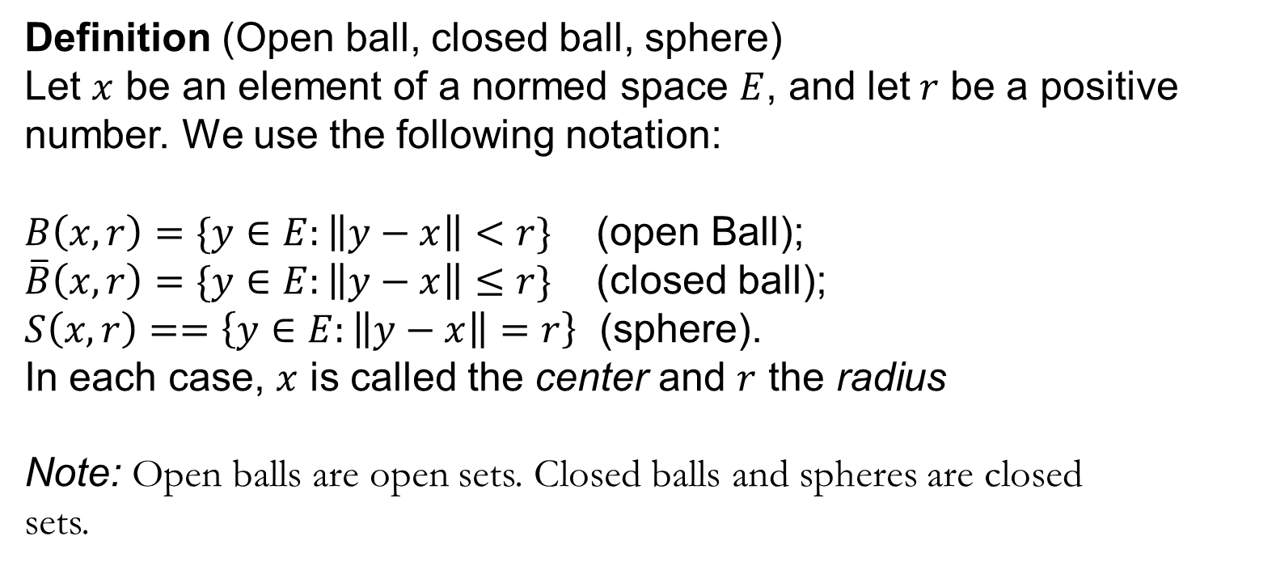
Topological properties of normed space
Definition (Open ball, closed ball, sphere)
Let $x$be an element of a normed space $E$, and let$r$be a positive number. We use the following notation:
$B\left(x,r\right)=\{y∈E:\left\|y−x\right\|<r\}$(open Ball);
$\overline{B}\left(x,r\right)=\{y∈E:\left\|y−x\right\|≤r\}$ (closed ball);
$S\left(x,r\right)==\left\{y∈E:\left\|y−x\right\|=r\right\}$ (sphere).
In each case, $x$ is called the center and $r$ the radius
Note: Open balls are open sets. Closed balls and spheres are closed
sets.

Slide 24
Topological properties of normed space
Theorem 3.
(a) The union of any collection of open sets is open.
(b) The intersection of a finite number of open sets is open.
(c) The union of a finite number of closed sets is closed.
(d) The intersection of any collection of closed sets is closed.
(e) The empty set and the whole space are both open and closed.
The proofs are left as exercises.

Slide 25
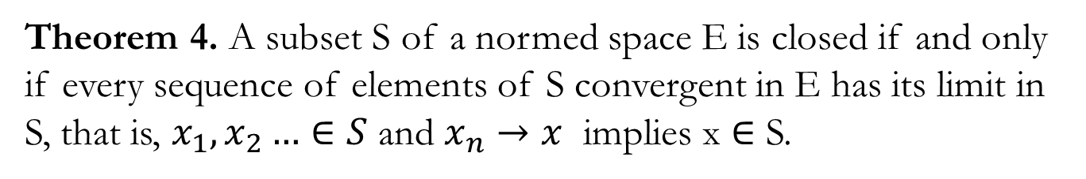
Topological properties of normed space
Theorem 4. A subset S of a normed space E is closed if and only if every sequence of elements of S convergent in E has its limit in S, that is, $x_{1},x_{2}…∈S$and $x_{n}→x$implies x ∈ S.

Slide 26
Topological properties of normed space
Definition (Closure)
Let S be a subset of a normed space E. By the closure of S, denoted by cl S, we mean the intersection of all closed sets containing S.
1. The closure of a set is always a closed set.
2. It is the smallest closed set which contains S.

Slide 27
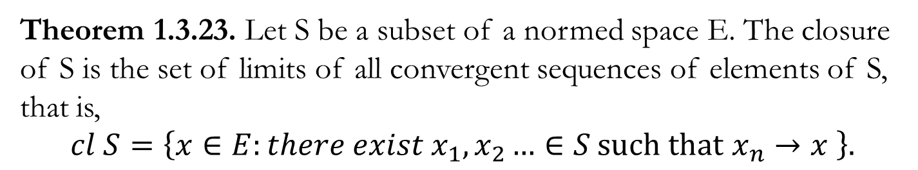
Topological properties of normed space
Theorem 1.3.23. Let S be a subset of a normed space E. The closure of S is the set of limits of all convergent sequences of elements of S, that is,
$$cl S=\left\{x∈E:there exist{ x}_{1},x_{2}…∈S \text{such} \text{that} x_{n}→x \right\}.$$

Slide 28
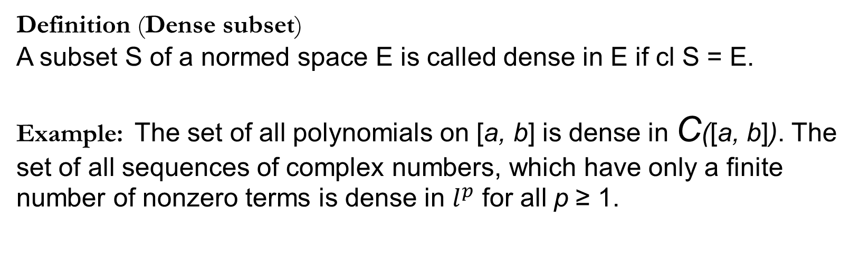
Topological properties of normed space
Definition (Dense subset)
A subset S of a normed space E is called dense in E if cl S = E.
Example:The set of all polynomials on [a, b] is dense in C([a, b]). The set of all sequences of complex numbers, which have only a finite number of nonzero terms is dense in $l^{p}$ for all p ≥ 1.

Slide 29
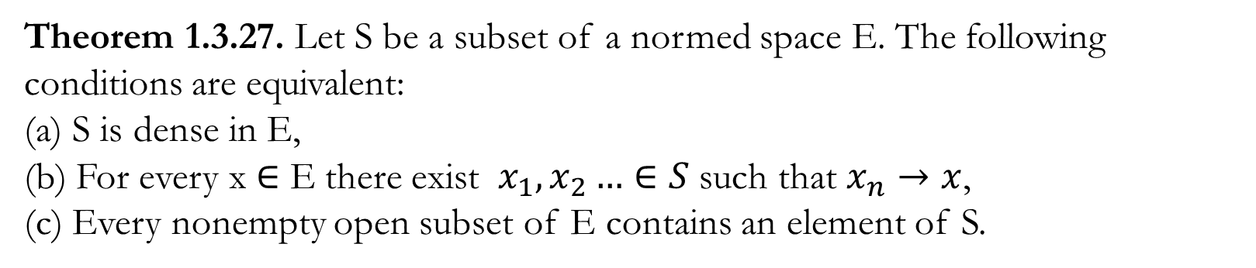
Topological properties of normed space
Theorem 1.3.27. Let S be a subset of a normed space E. The following conditions are equivalent:
(a) S is dense in E,
(b) For every x ∈ E there exist ${ x}_{1},x_{2}…∈S \text{such} \text{that} x_{n}→x$,
(c) Every nonempty open subset of E contains an element of S.

Slide 30
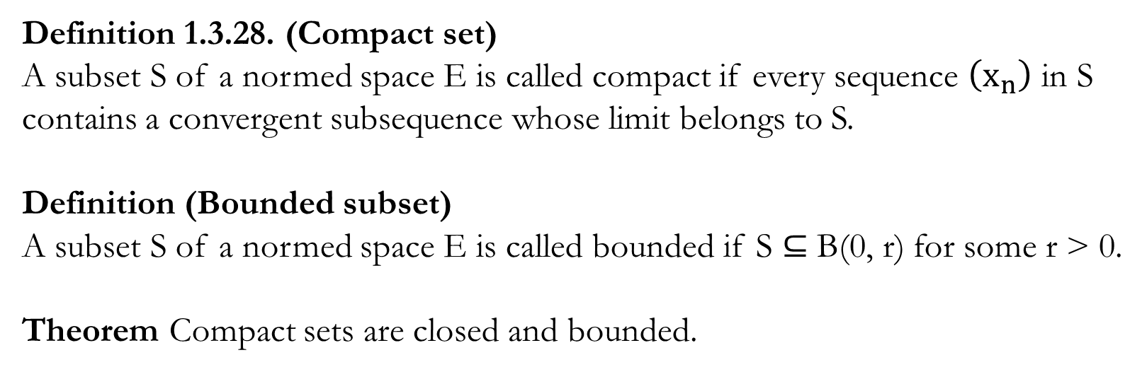
Topological properties of normed space
Definition 1.3.28. (Compact set)
A subset S of a normed space E is called compact if every sequence $\left(x_{n}\right)$in S contains a convergent subsequence whose limit belongs to S.
Definition (Bounded subset)
A subset S of a normed space E is called bounded if S ⊆ B(0, r) for some r > 0.
Theorem Compact sets are closed and bounded.

Slide 31
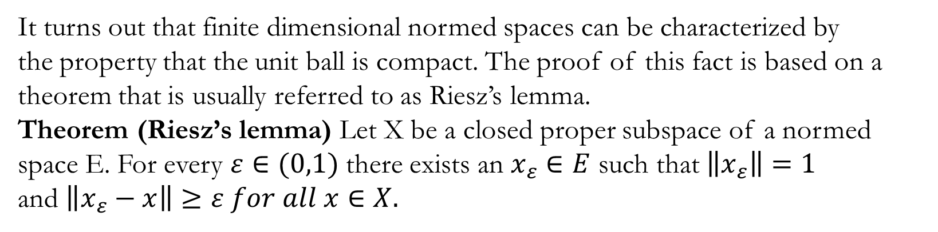
Topological properties of normed space
It turns out that finite dimensional normed spaces can be characterized by
the property that the unit ball is compact. The proof of this fact is based on a
theorem that is usually referred to as Riesz’s lemma.
Theorem (Riesz’s lemma) Let X be a closed proper subspace of a normed space E. For every $ε∈(0,1)$ there exists an $x_{ε}∈E$such that $\left\|x_{ε}\right\|=1$
and $\left\|x_{ε}−x\right\|≥ε for all x∈X.$

Slide 32
Topological properties of normed space
Theorem 1.3.34. A normed space E is finite dimensional if and only if the closed unit ball in E is compact.

