Slide 1
Introduction To Hilbert Spaces with Applications
Lokenath Debnath and Piotr Mikusinski
Course Teacher: Dr. Amjad Hussain

Slide 2
Summary of the Last Lecture
In our last lecture, we considered bilinear operators and quadratic forms. Polarization identity was proved and several theorems were stated and then proved on the basis of these definitions.

Slide 3
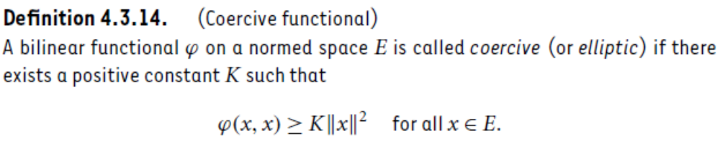
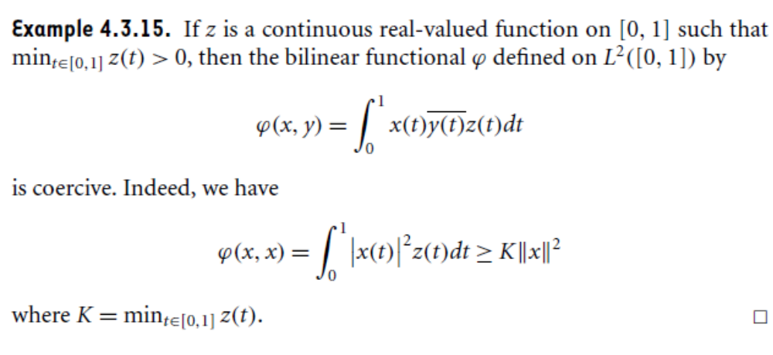

Slide 4
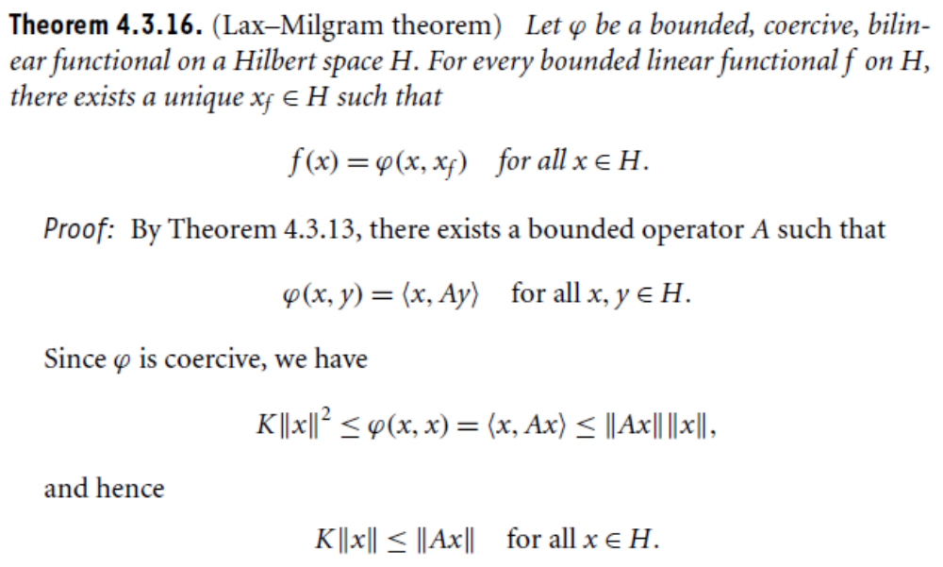

Slide 5
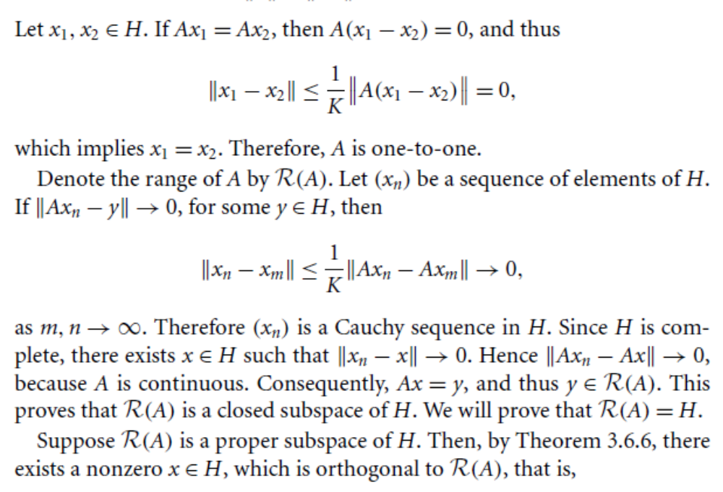

Slide 6
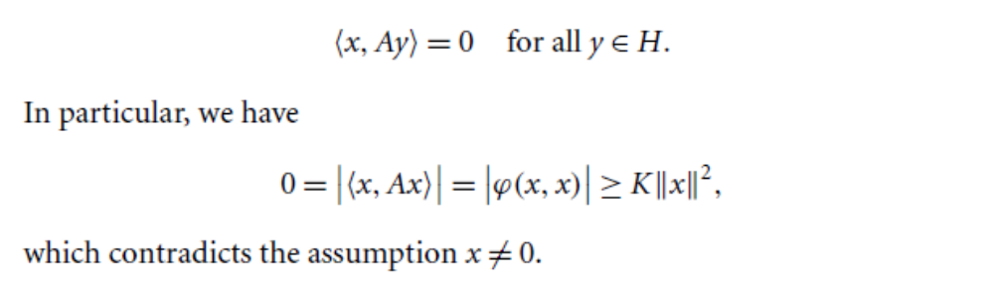
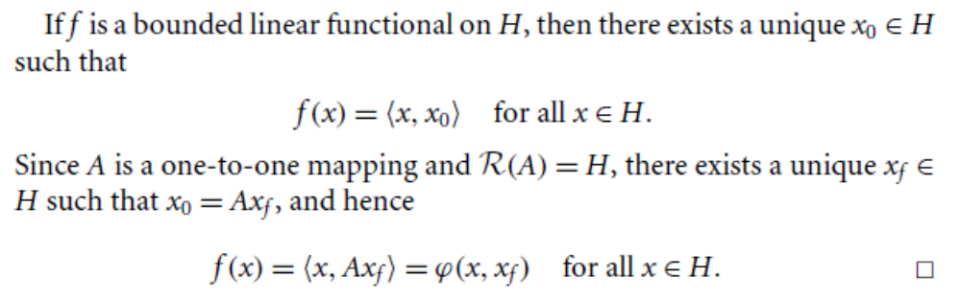

Slide 7
Adjoint and Self-Adjoint Operator

Slide 8
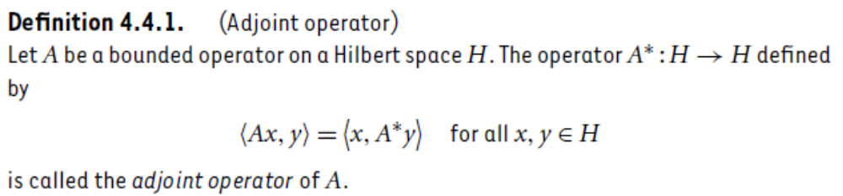
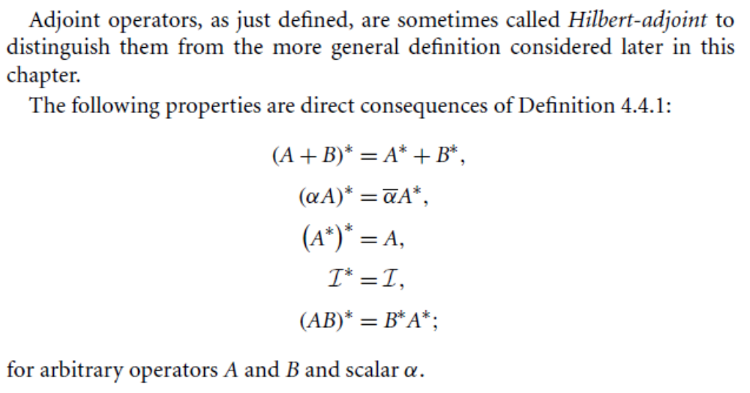

Slide 9
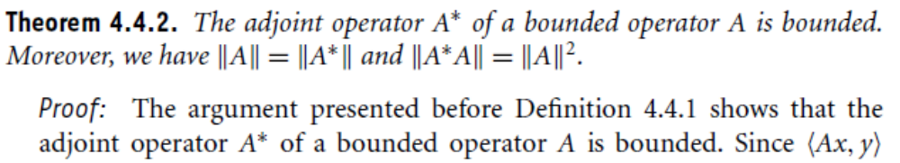
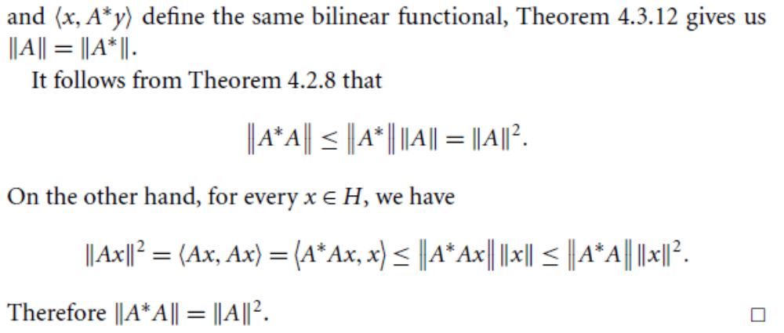

Slide 10
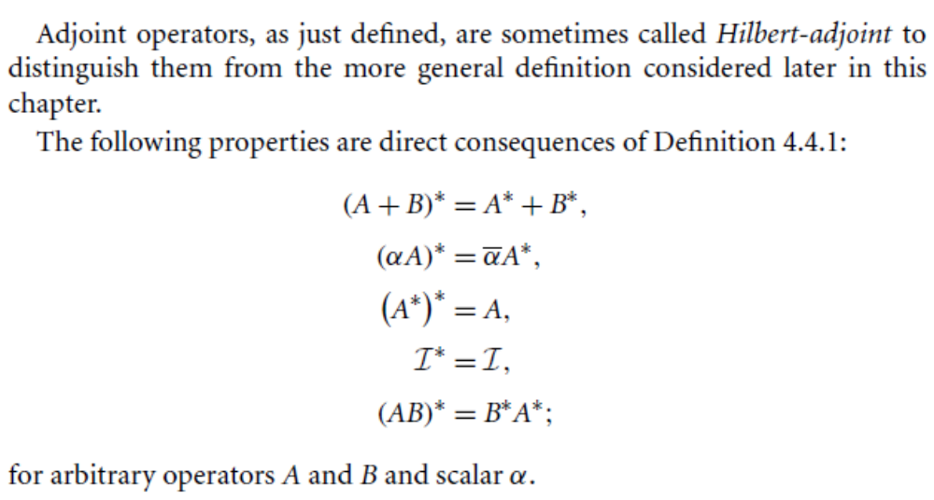

Slide 11
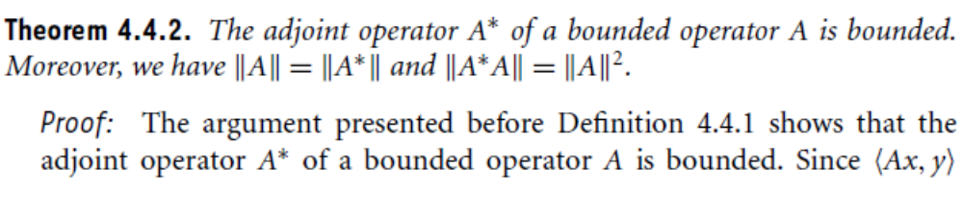
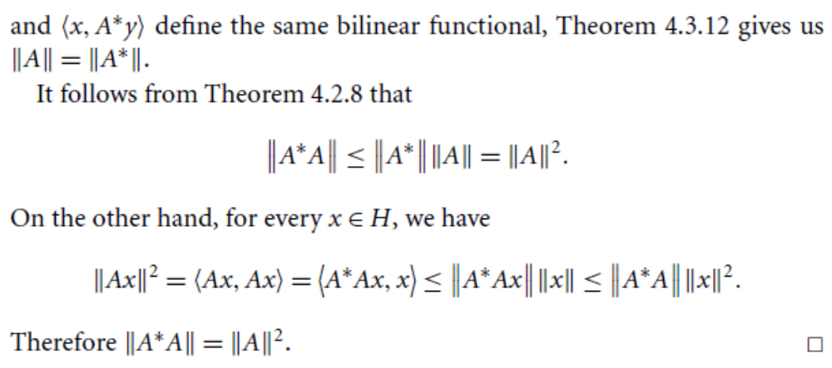

Slide 12
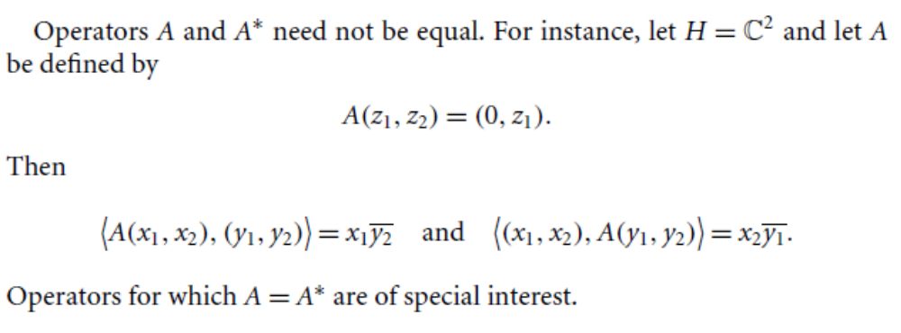
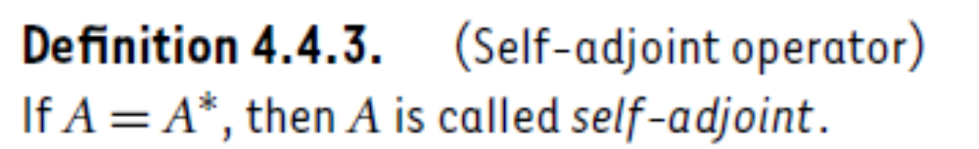

Slide 13
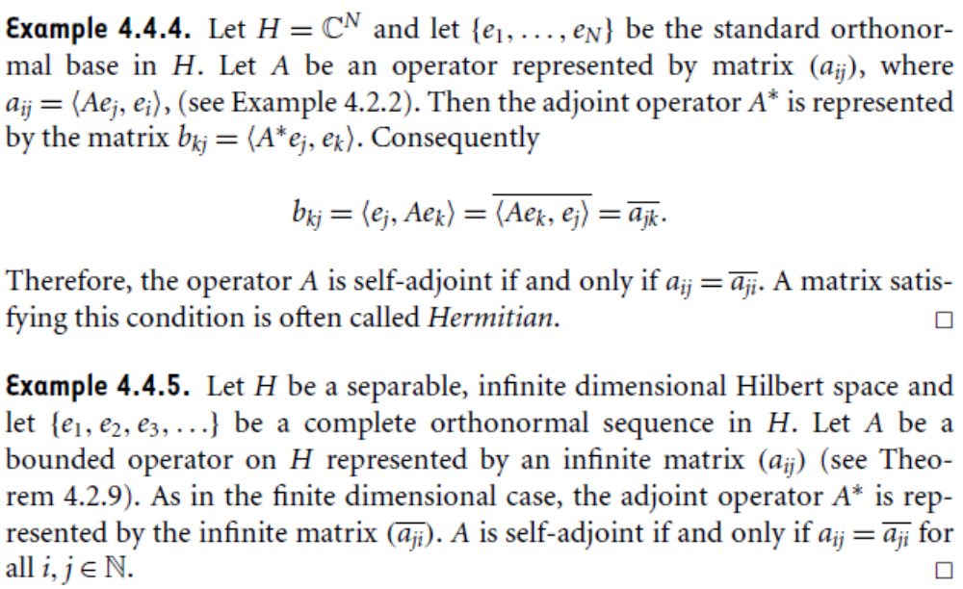

Slide 14
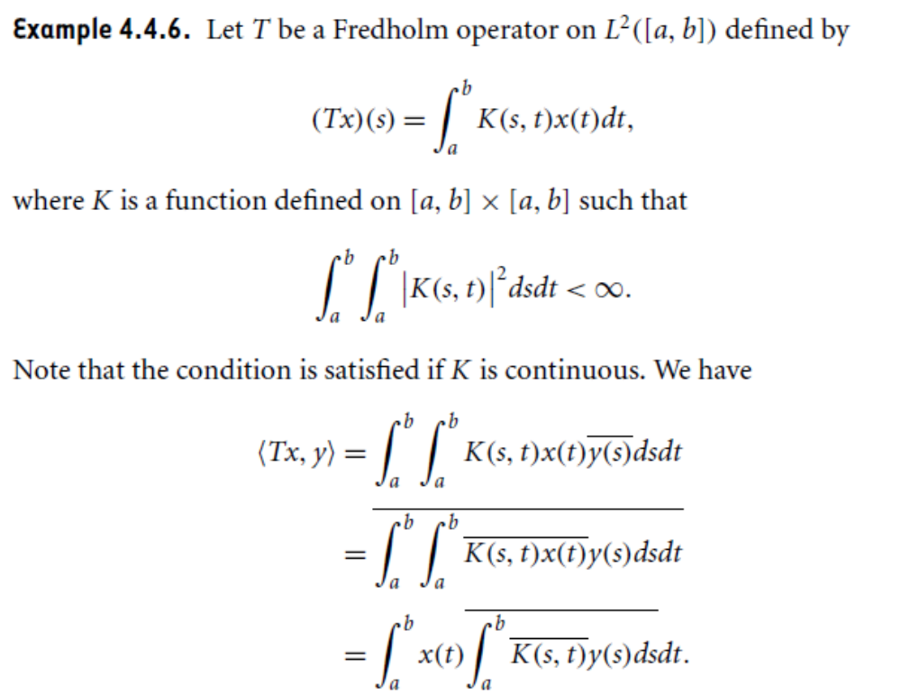

Slide 15
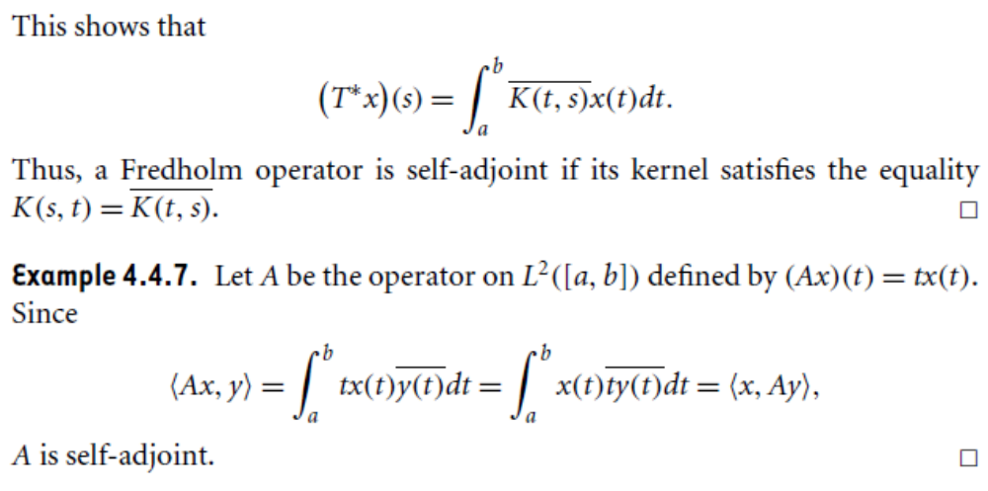

Slide 16
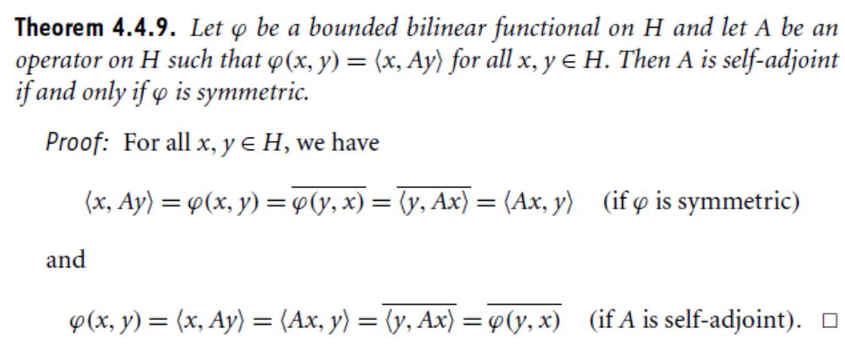

Slide 17
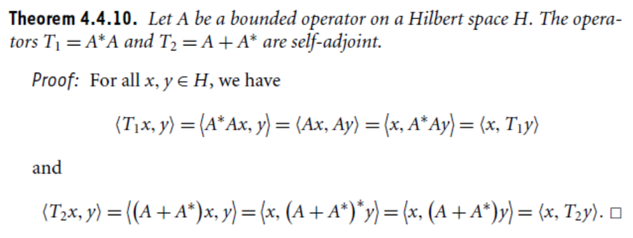

Slide 18
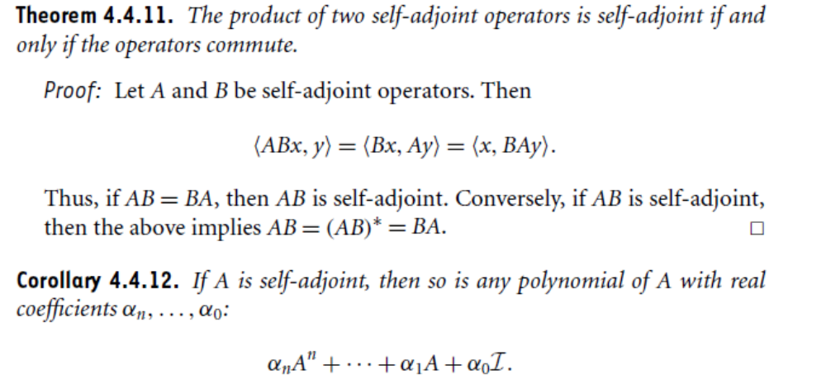

Slide 19
Summary of the today’s Lecture
In our today’s lecture, we consider coercive functionals with Lax Miligram theorem. We then turned into adjoint operators and give some examples and related theorems. Finally self adjoint operators are discussed at the end.

