Slide 1
Introduction To Hilbert Spaces with Applications
Lokenath Debnath and Piotr Mikusinski
Course Teacher: Dr. Amjad Hussain

Slide 2
Summary of the Last Lecture
In our last lecture, we started a new chapter that is Chapter 3. We then define terminology regarding linear operators and give many examples of such operators along with some theorem and their proofs.

Slide 3
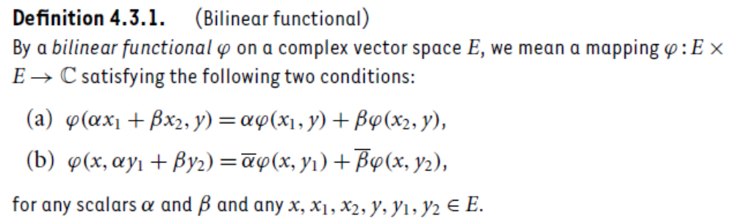
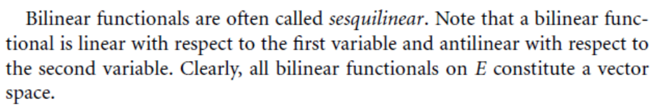
Bilinear Functionals and Quadratic Form

Slide 5
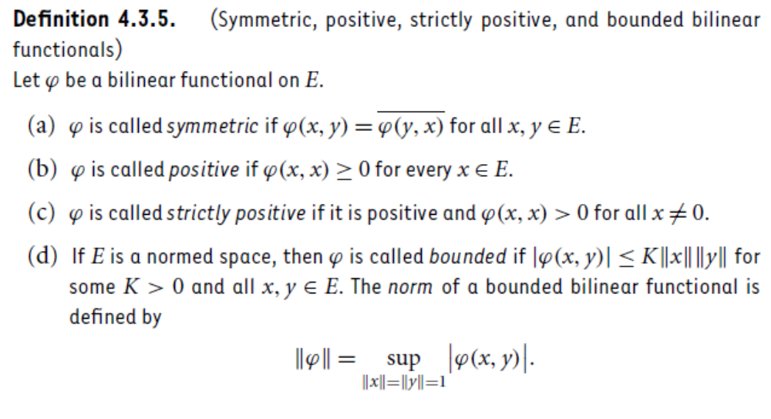

Slide 6
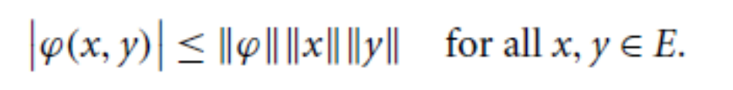
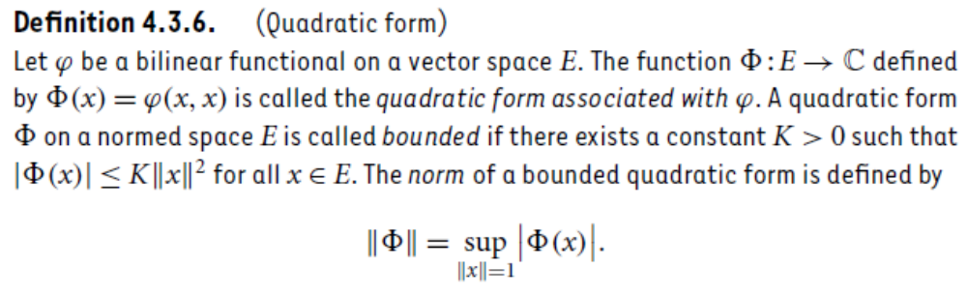

Note: For a bounded bilinear functional $φ on E.$
What about properties of bilinear functional and associated quadratic form?

Slide 7
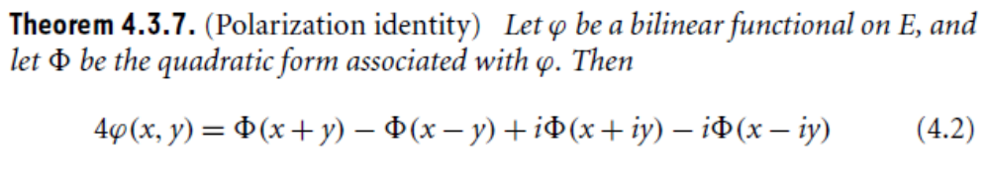
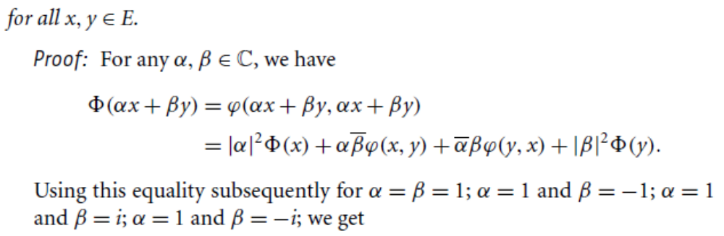

Slide 8
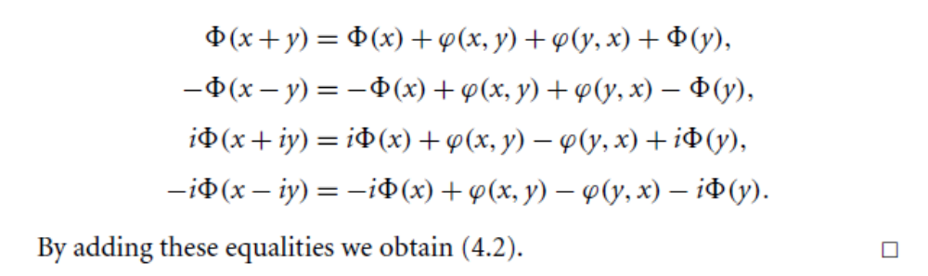
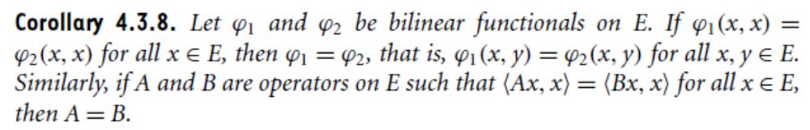

Slide 9
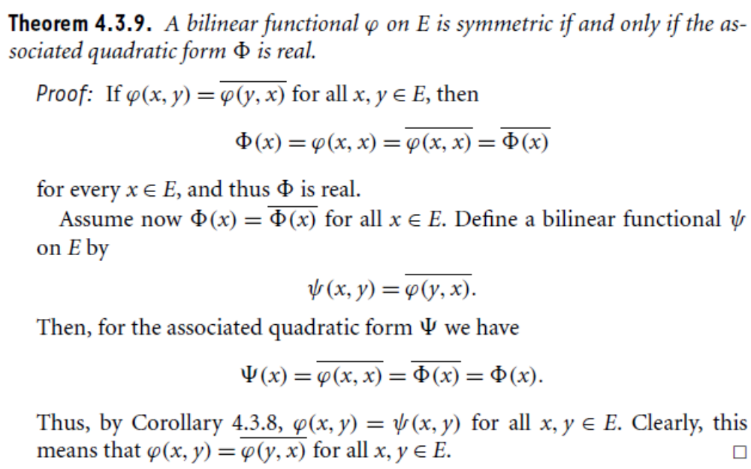

Slide 10
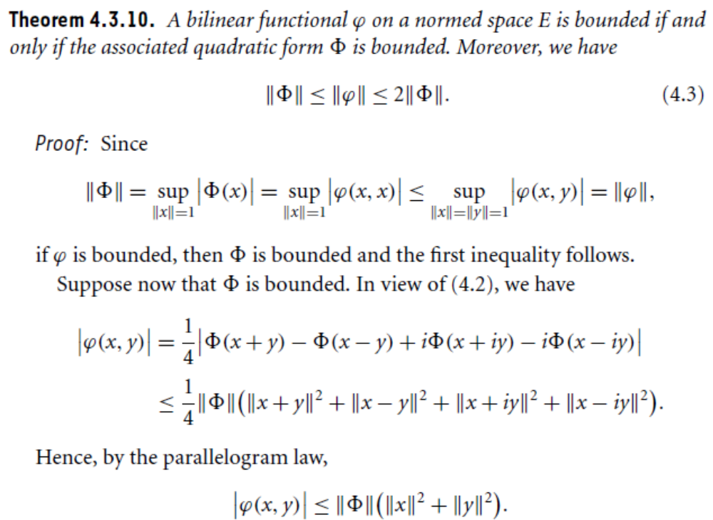

Slide 11
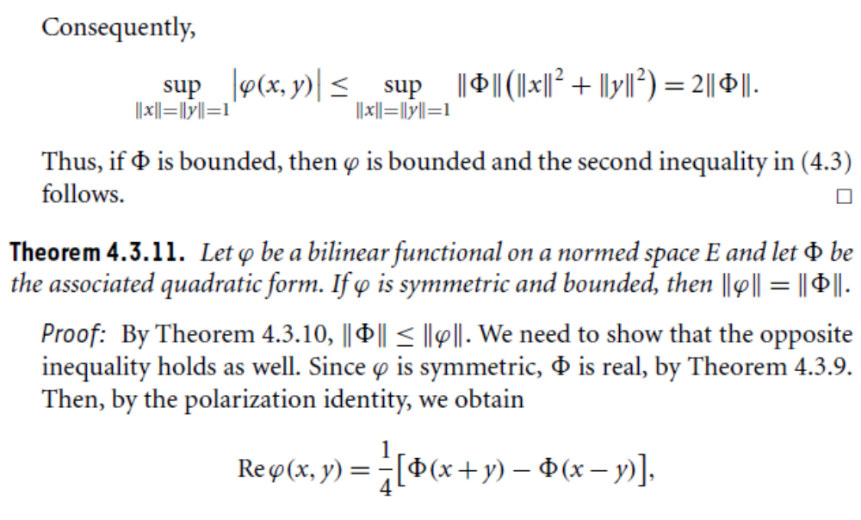

Slide 12
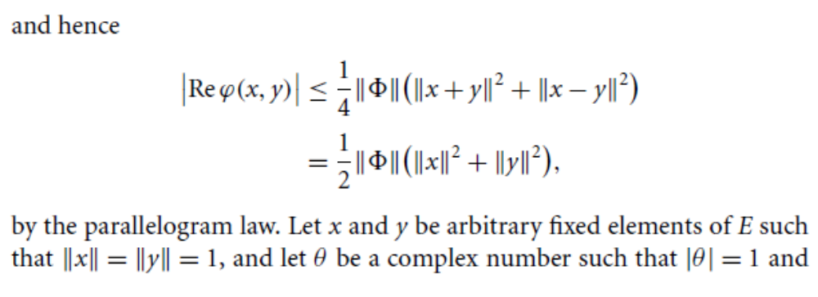
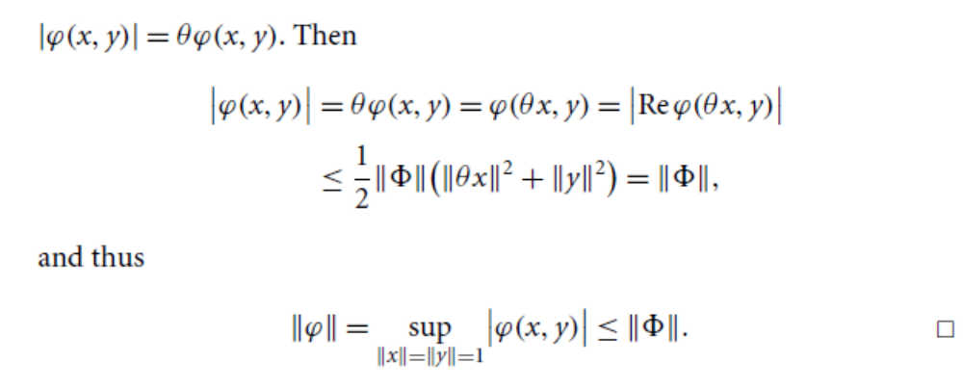

Slide 13
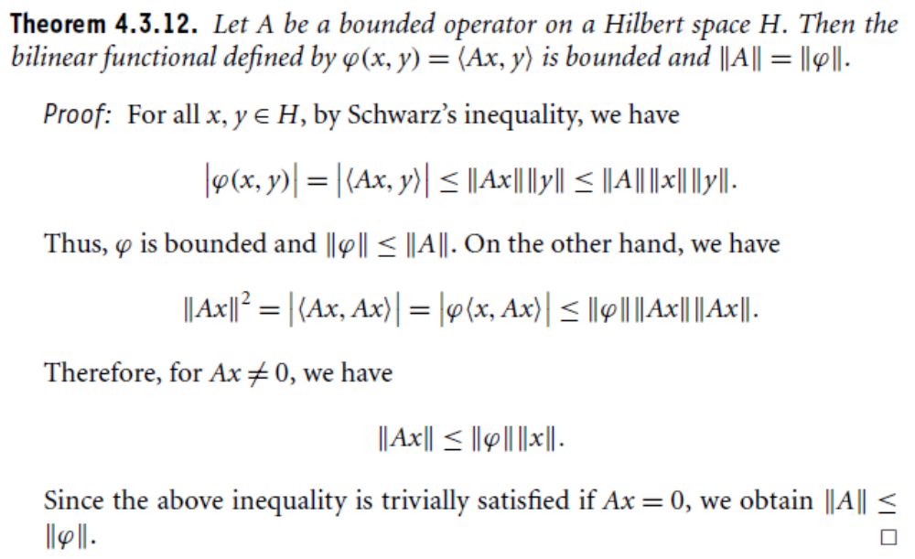

Slide 14
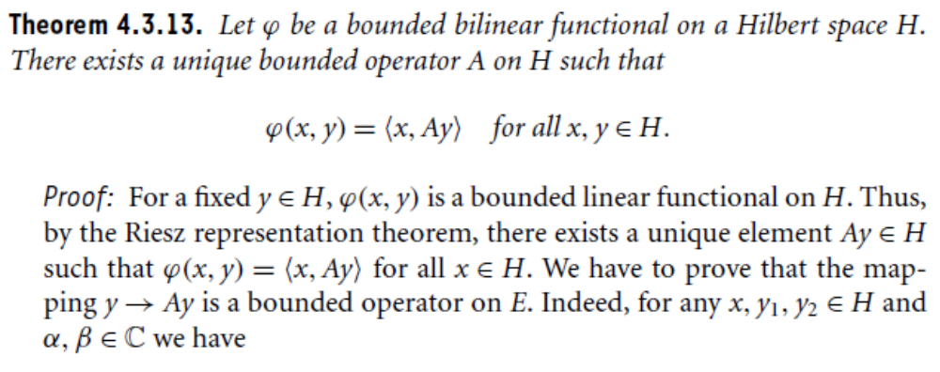
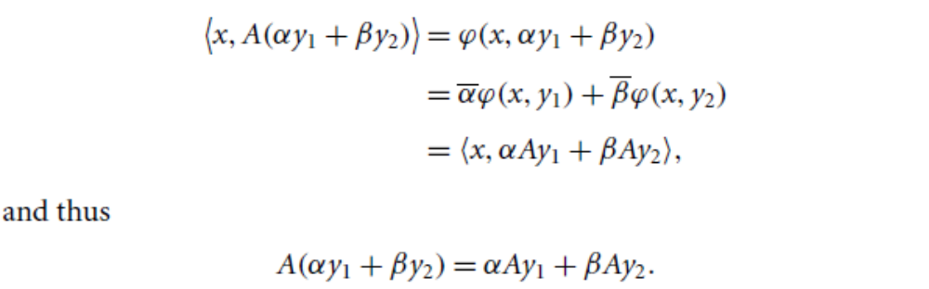

Slide 15
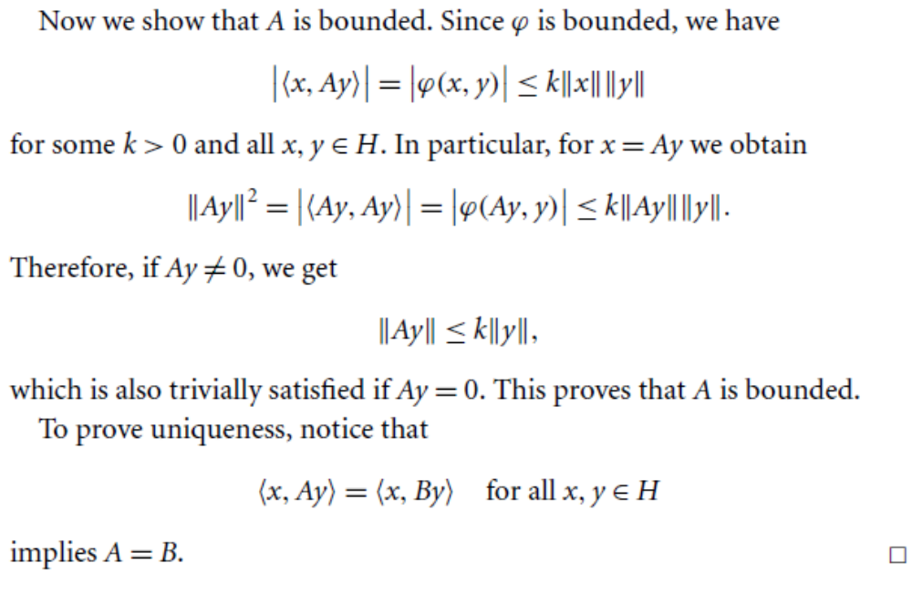

Slide 16
Summary of the today’s Lecture
In our today’s lecture, we consider bilinear operators and quadratic forms. Polarization identity is proved and several theorems are stated and then proved on the basis of these definitions.

