Slide 1
Introduction To Hilbert Spaces with Applications
Lokenath Debnath and Piotr Mikusinski
Course Teacher: Dr. Amjad Hussain

Slide 2
Summary of the Last Lecture
In our last lecture, we revisited some theorems related to orthonormal complements and orthonormal projections. Finally, properties of bounded linear functional are utilized to prove Riesz Representation theorem.

Slide 3
Summary of the Chapter 2
Inner Product Space
Hilbert Space
Orthogonal and Orthonormal Systems
Orthogonal Complements and projections
Linear Functionals and Riesz Representation Theorem

Slide 4
Chapter 4. Linear Operators on Hilbert Spaces
Bounded Operator
Norm of an operator
Boundedness vs Norm
Continuity and boundedness

Slide 5
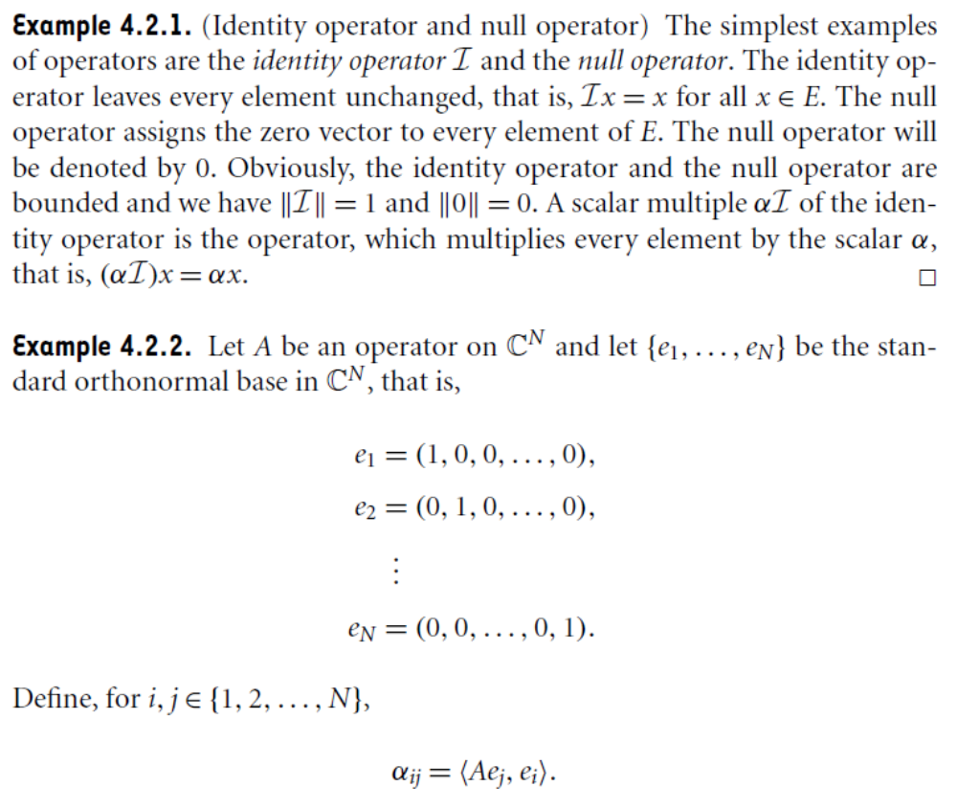

Slide 6
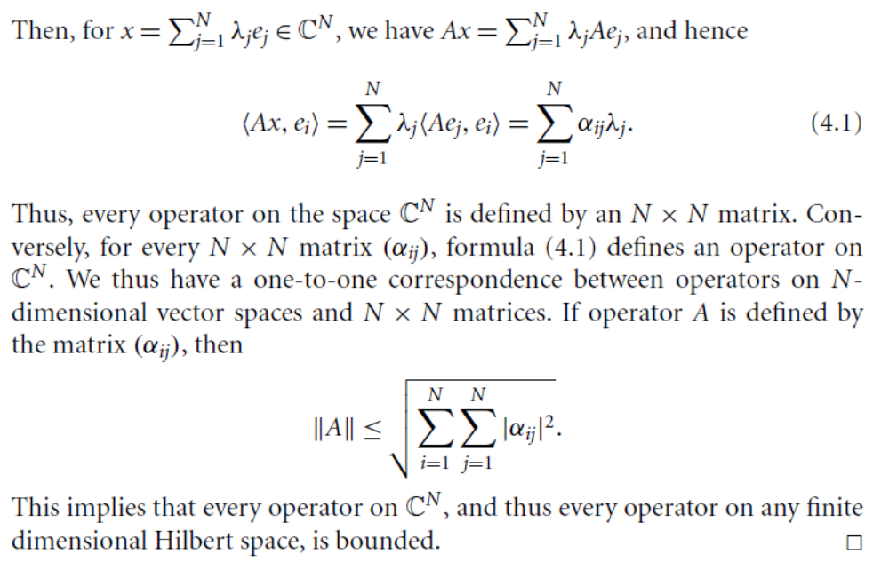

Slide 7
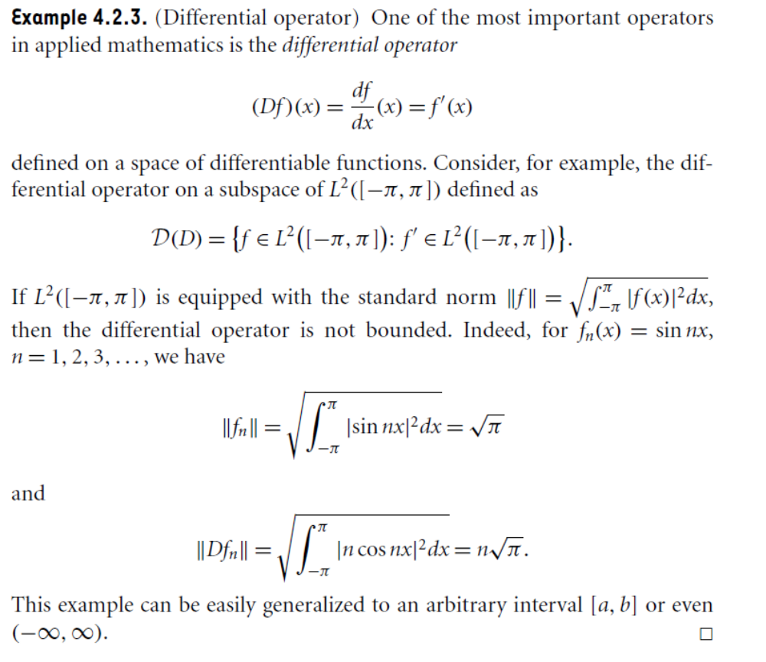

Slide 9
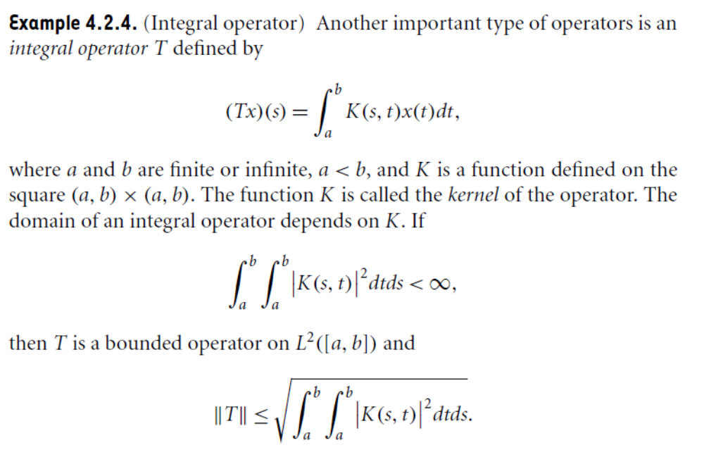

Slide 10
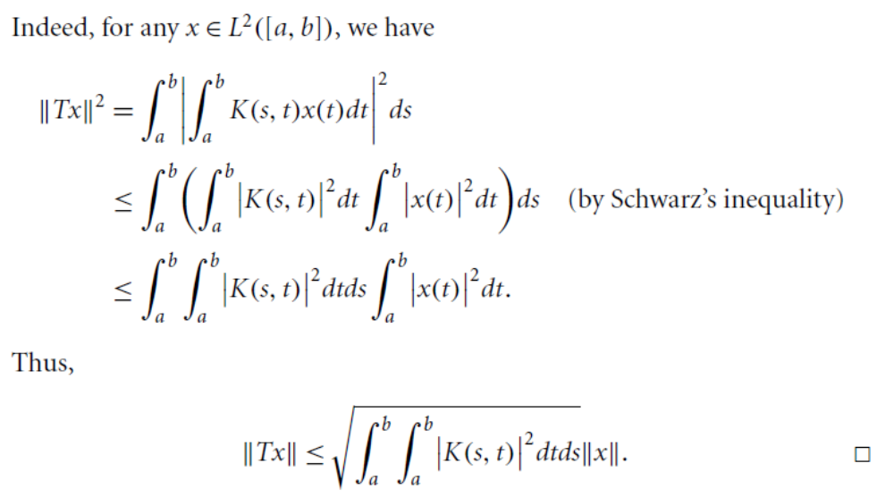

Slide 12
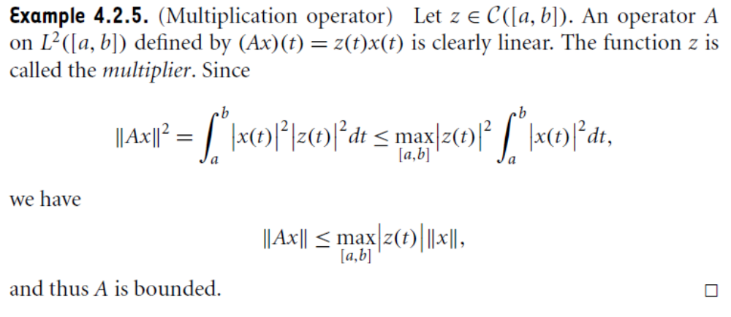

Slide 13
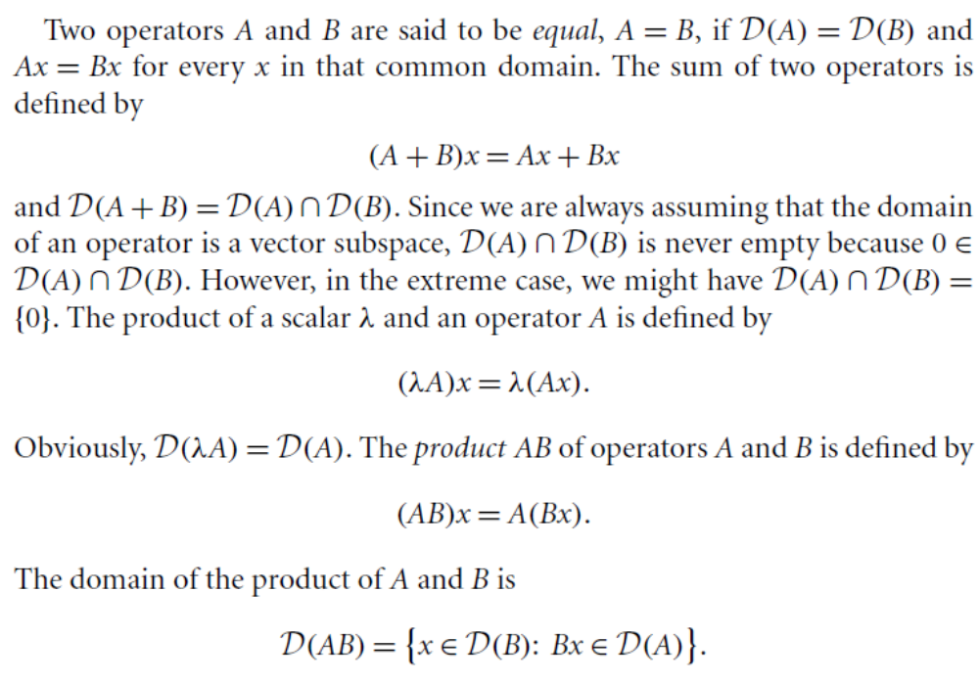

Slide 14
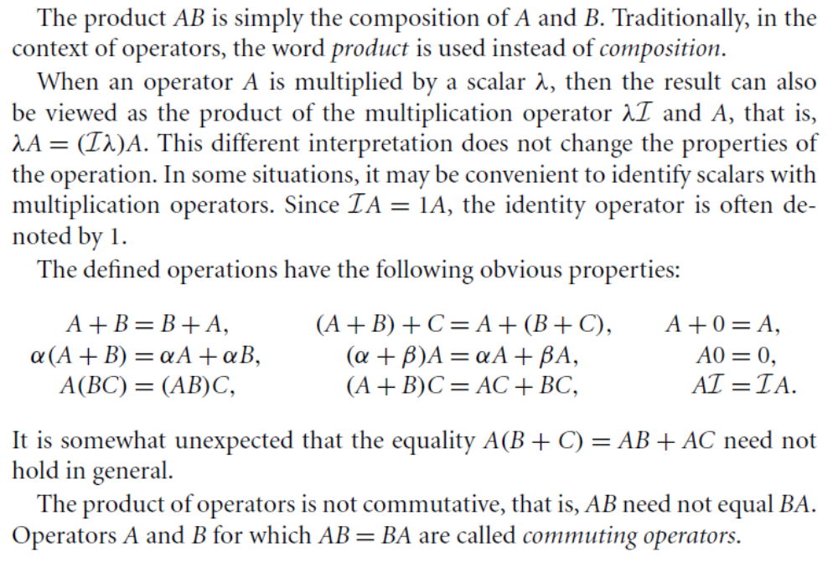

Slide 15
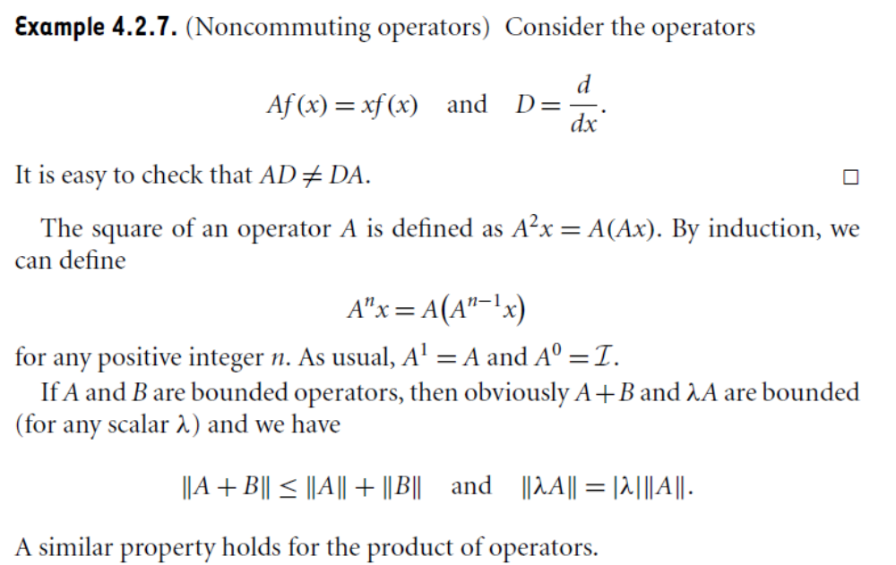

Slide 16
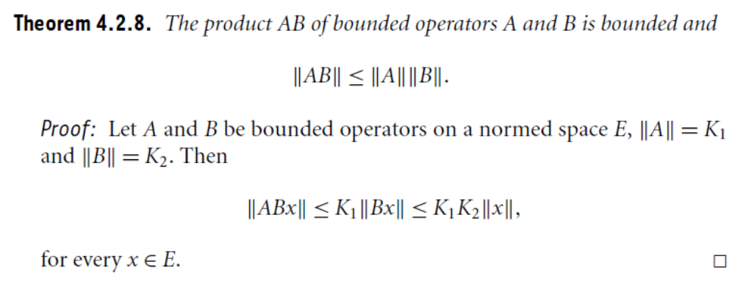

Slide 17
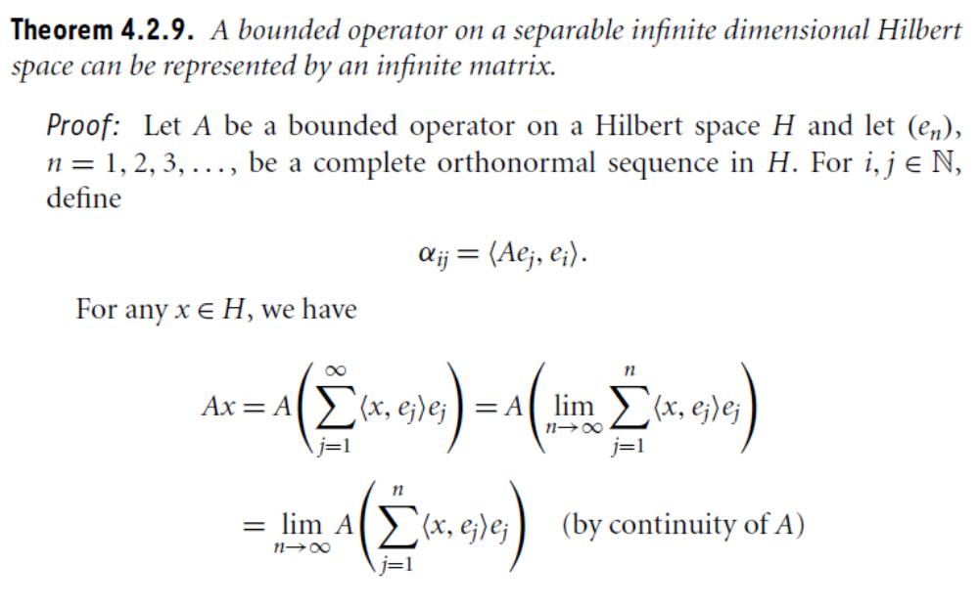

Slide 18
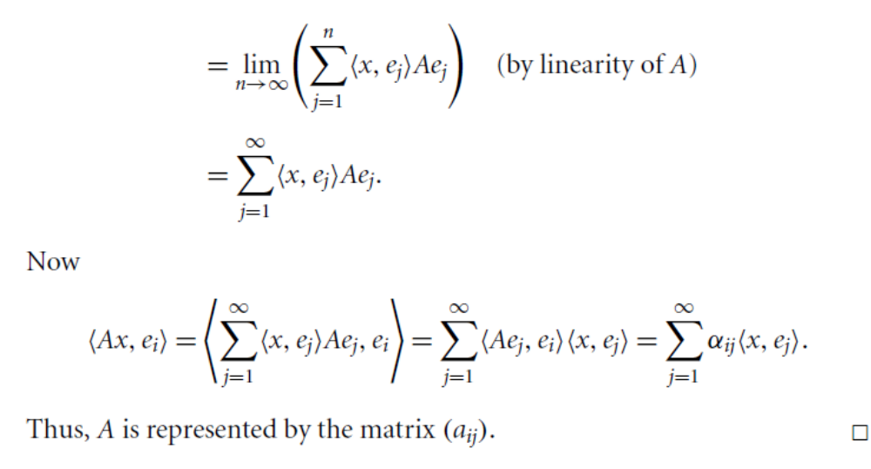

Slide 19
Summary of the today’s Lecture
In our today’s lecture, we give the summary of Chapter 2 and started a new chapter that is Chapter 3. We then define terminology regarding linear operators and give many examples of such operators along with some theorem and their proofs.

