Slide 1
Introduction To Hilbert Spaces with Applications
Lokenath Debnath and Piotr Mikusinski
Course Teacher: Dr. Amjad Hussain

Slide 2
Summary of the Last Lecture
In our last lecture, we mainly discussed orthonormal complements and orthonormal projections. Some Theorem related to these topics were stated and proved.

Slide 3
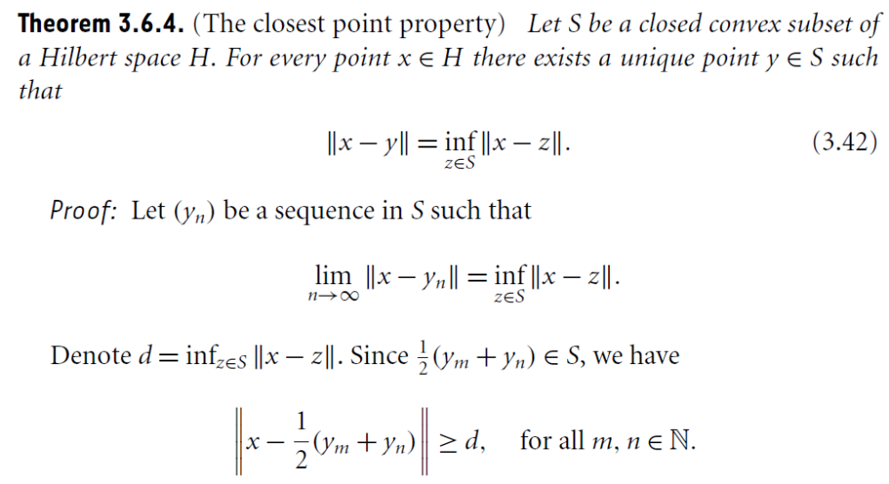

Slide 4
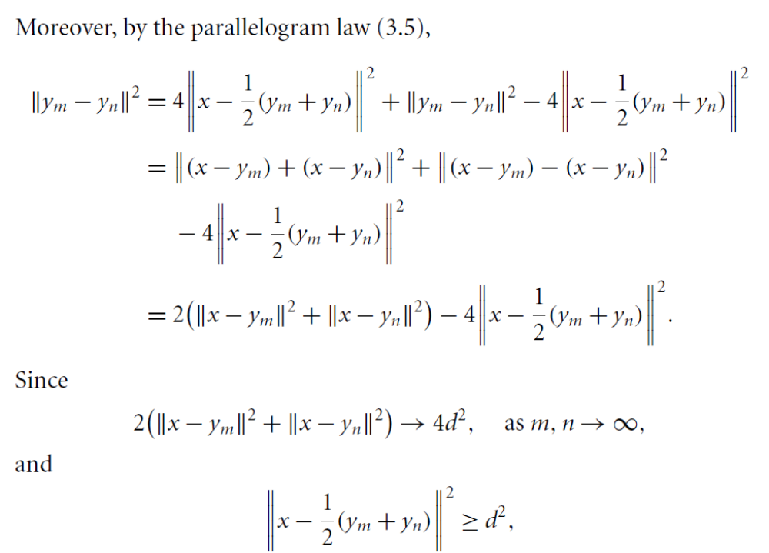

Slide 7
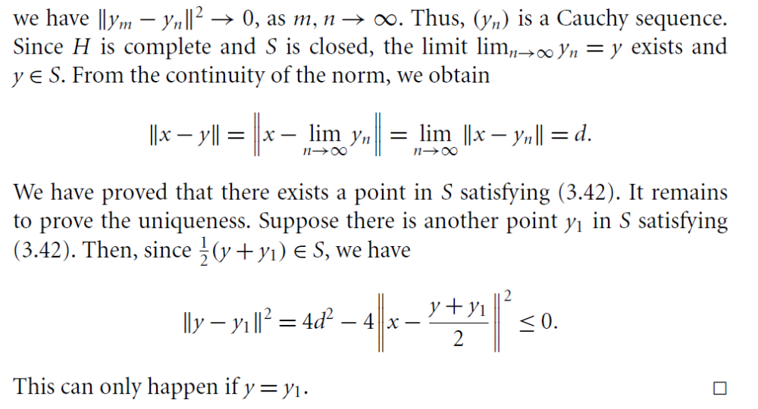

Slide 8
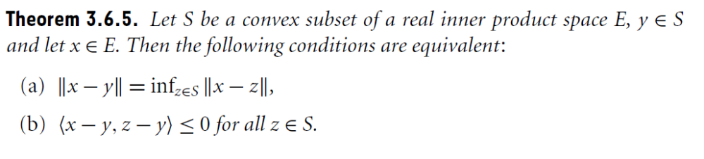
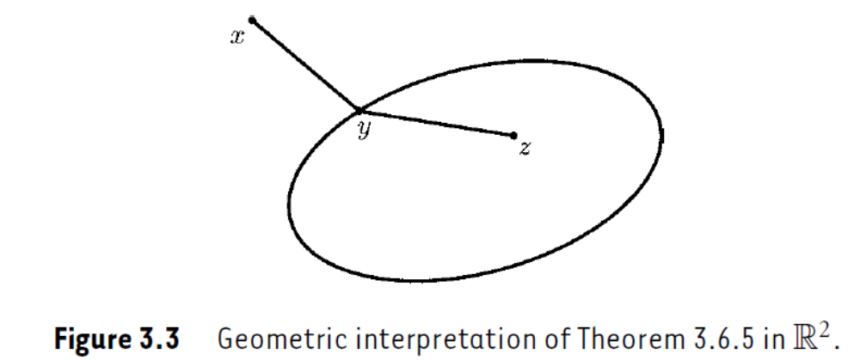

Slide 9
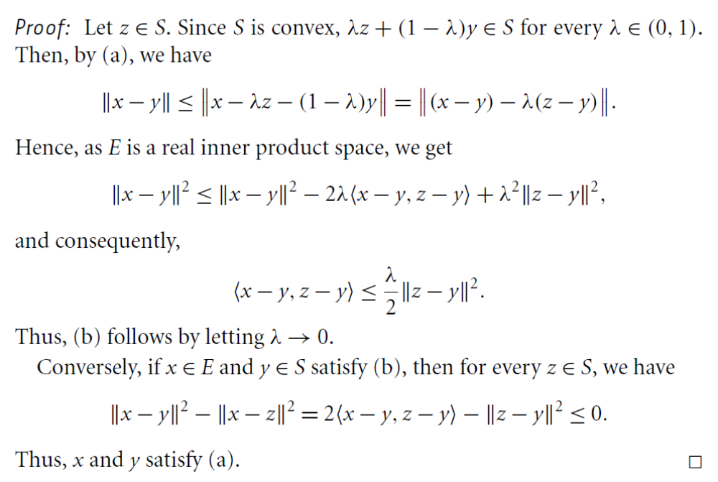

Slide 11
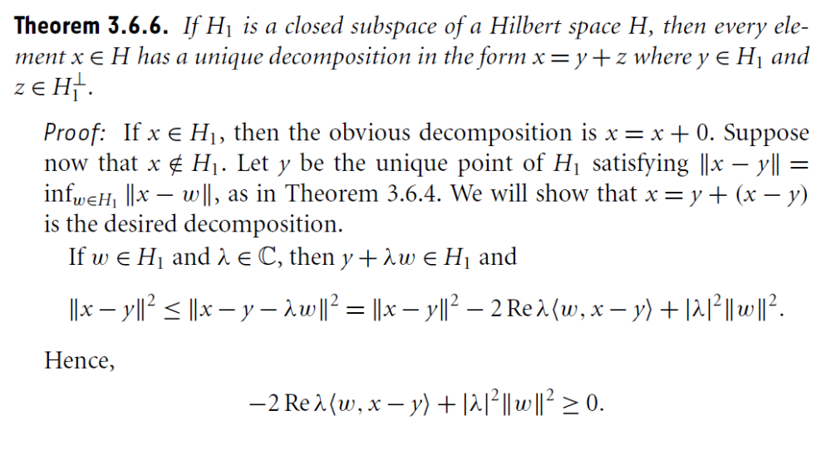

Slide 12
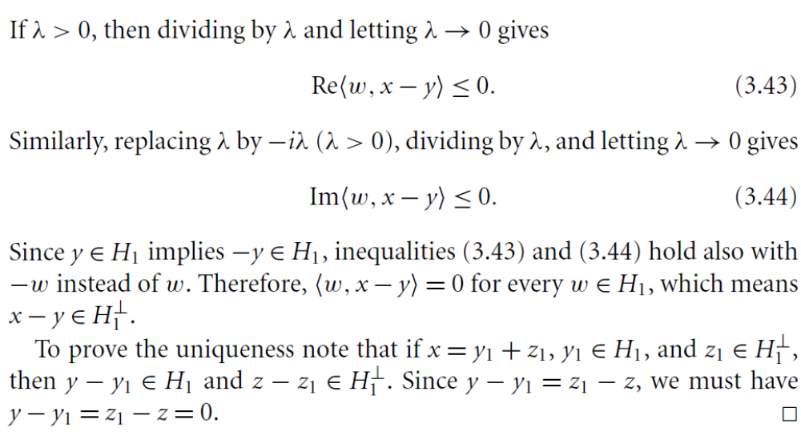

Slide 13
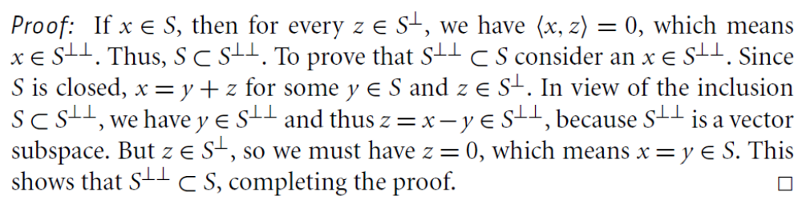

Slide 14
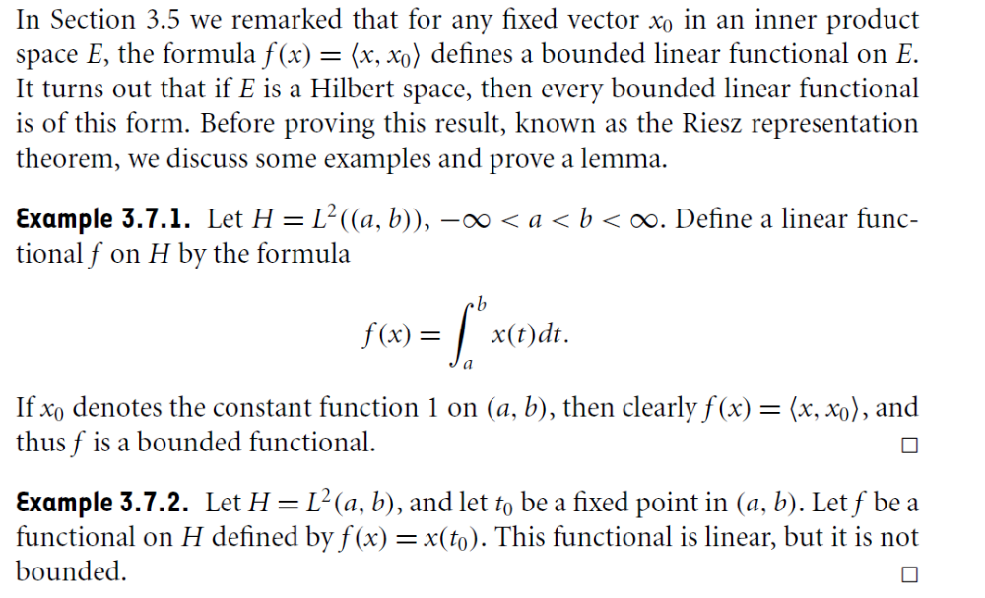
Linear Functional and the Riesz
Representation Theorem

Slide 15
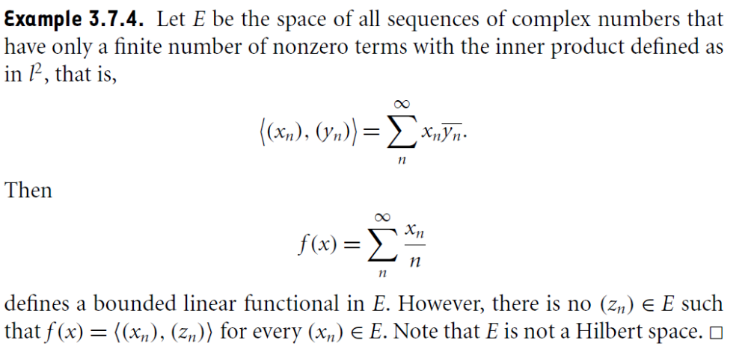

Slide 16
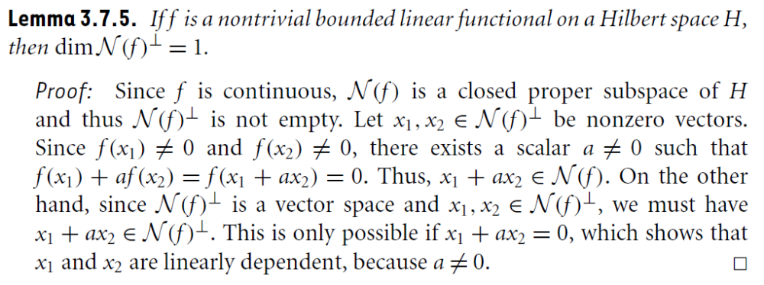

Slide 17
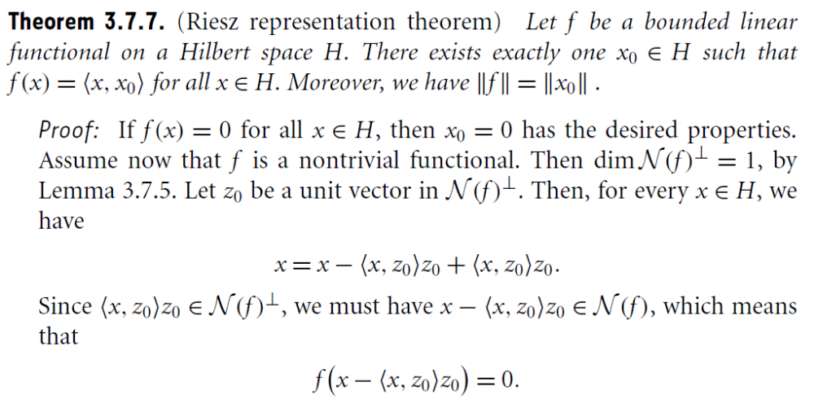

Slide 18
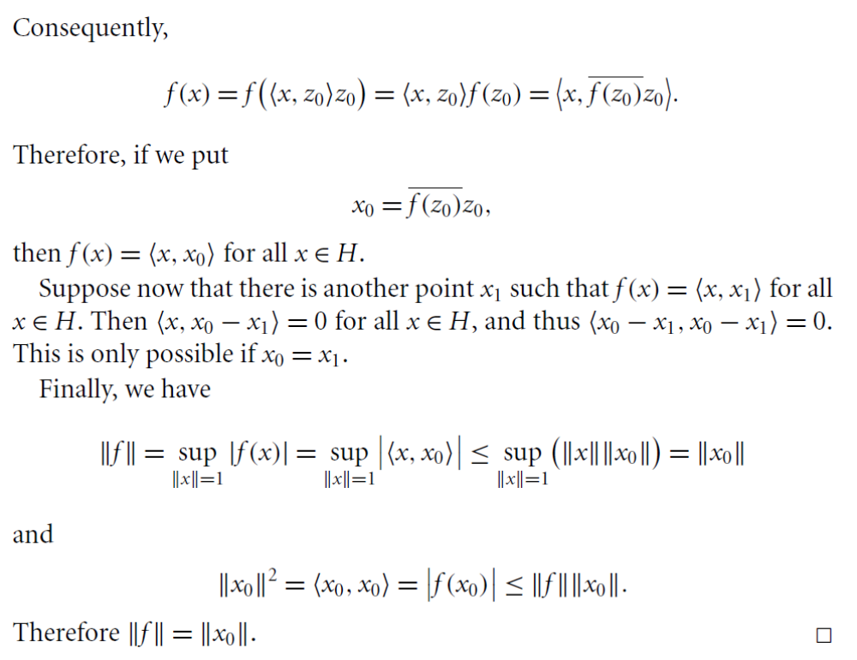

Slide 19
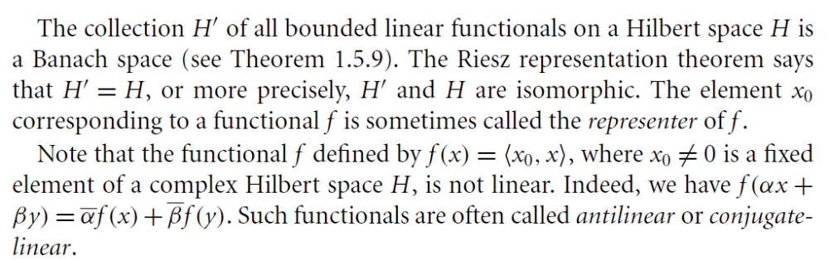

Slide 20
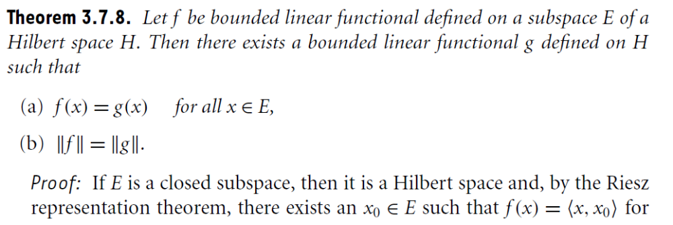
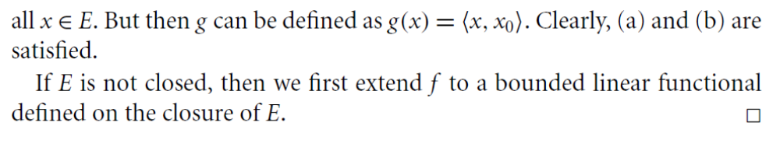

Slide 21
Summary of the today’s Lecture
In our today’s lecture, we revisit some theorems related to orthonormal complements and orthonormal projections. Finally, properties of bounded linear functional are utilized to prove Riesz Representation theorem.

