Slide 1
Introduction To Hilbert Spaces with Applications
Lokenath Debnath and Piotr Mikusinski
Course Teacher: Dr. Amjad Hussain

Slide 2
Summary of the Last Lecture
In our last lecture, we furnished an example in 3D to explain the Gram Schmidth Process of orthonormalization and redefined the complete orthonormal sequence, orthonormal basis and a theorem related to these terms. Finally, separble Hilbert space and related theorem were proved there.

Slide 3
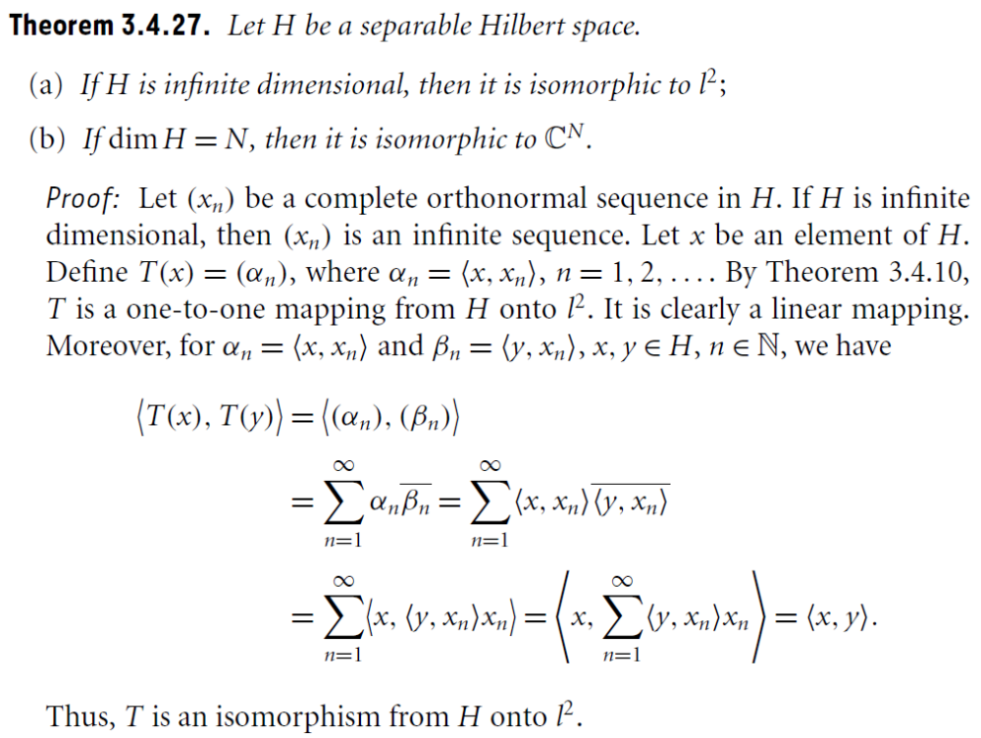

Slide 5
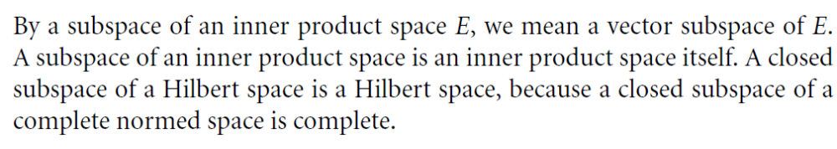
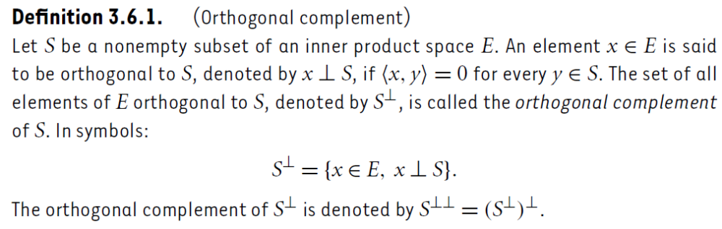
Orthogonal Complement and Projections

Slide 6
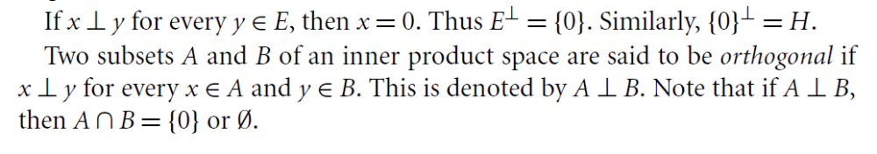

Slide 7
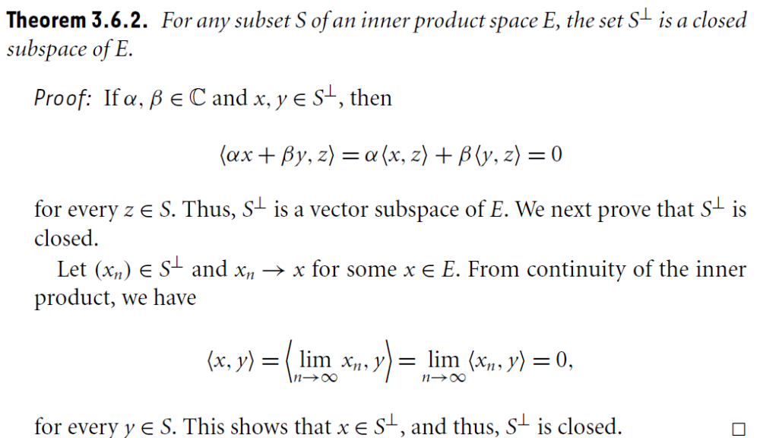
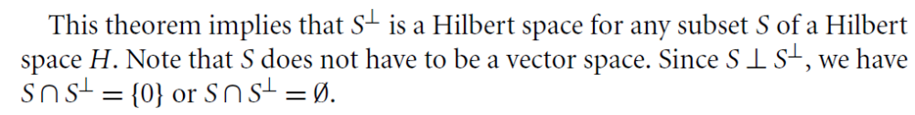

Slide 8
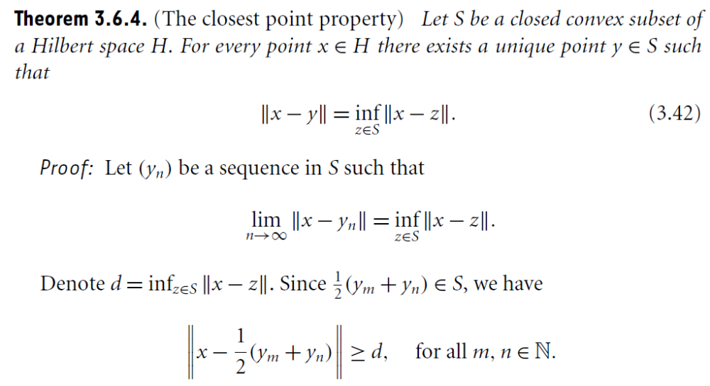

Slide 9
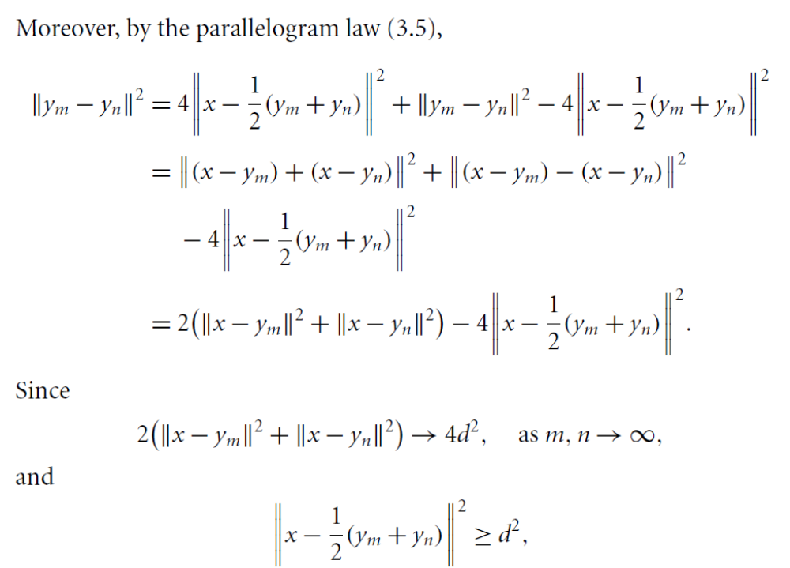

Slide 10
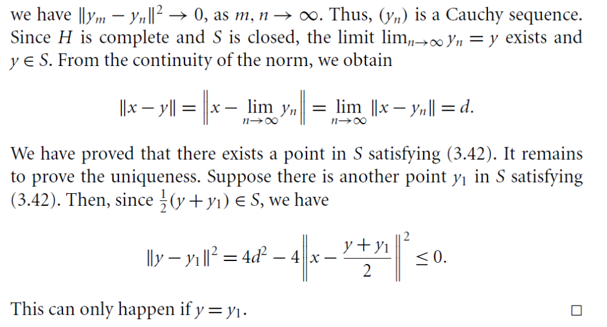

Slide 11
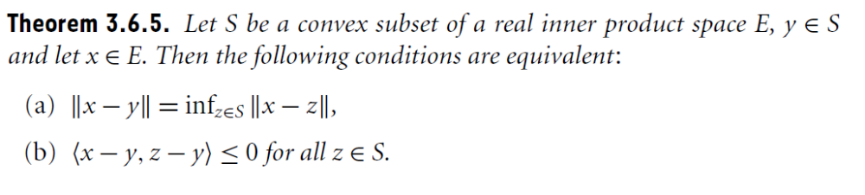
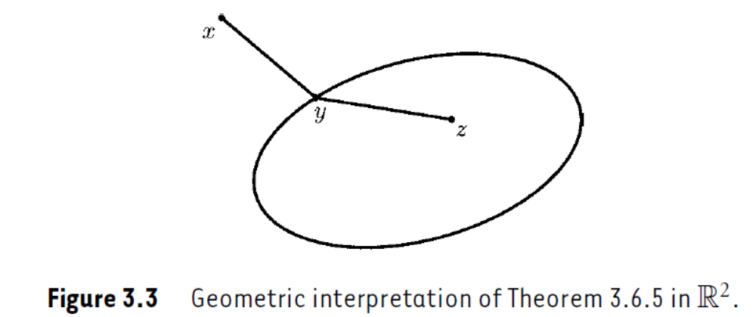

Slide 12
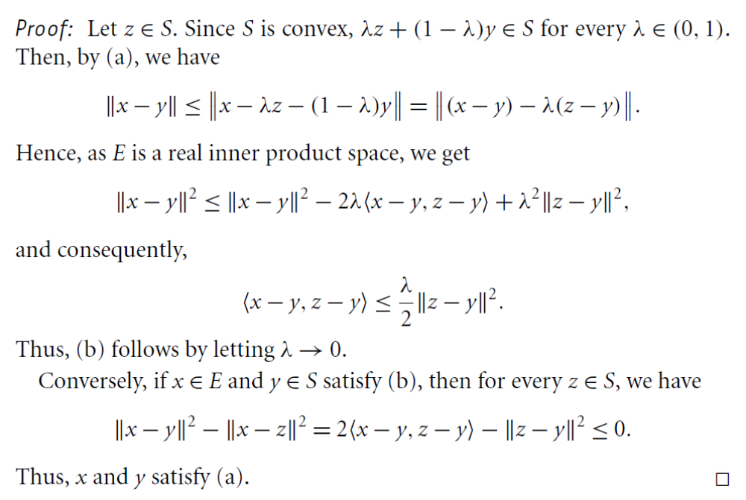

Slide 13
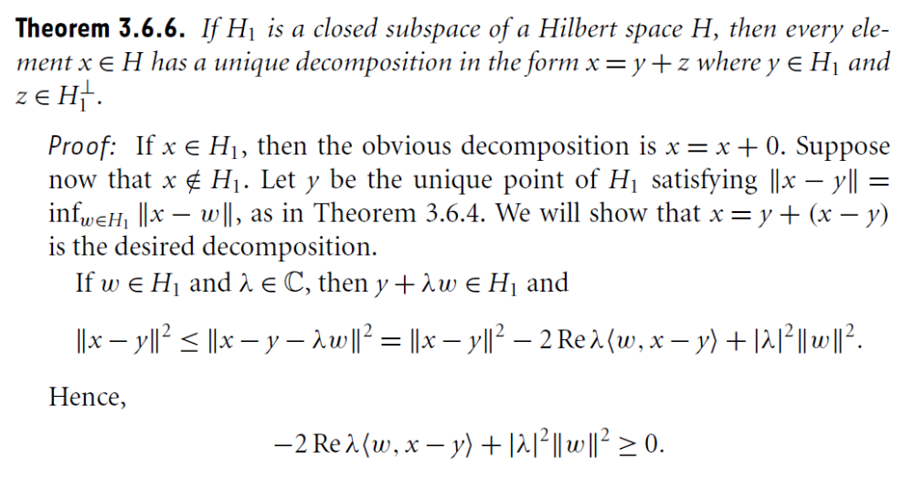

Slide 14
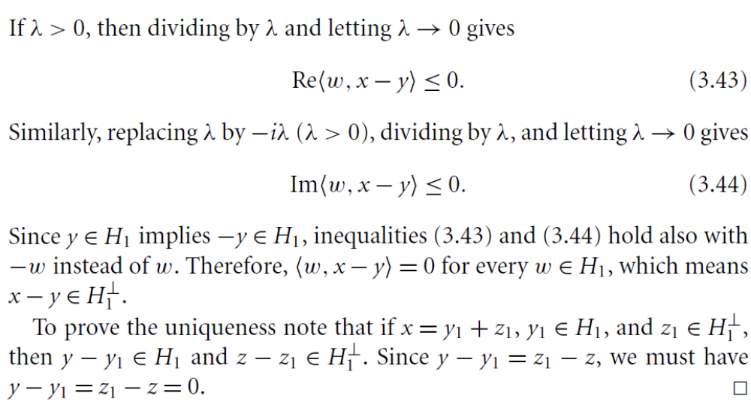

Slide 15
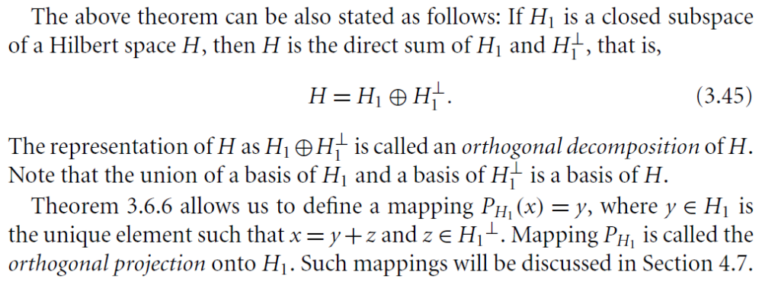
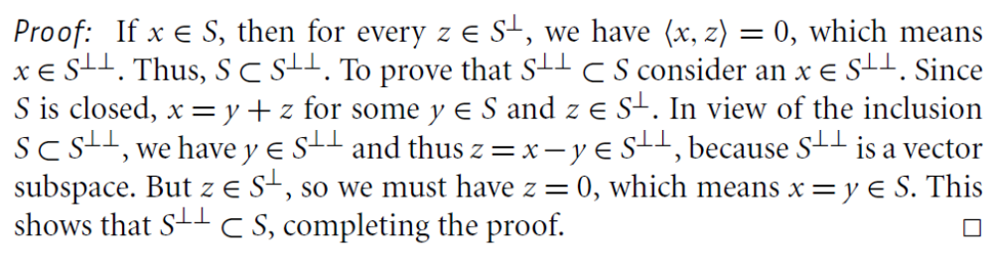

Slide 16
Summary of the today’s Lecture
In our today’s lecture, we mainly discussed orthonormal complements and orthonormal projections. Some Theorem related to these topics are stated and proved.

