Slide 1
Introduction To Hilbert Spaces with Applications
Lokenath Debnath and Piotr Mikusinski
Course Teacher: Dr. Amjad Hussain

Slide 2
Summary of the Last Lecture
In our last lecture, we discussed the Hermite polynomials. We then explained the Gram Schmidth process of orthonormalization. We revisit Pythagorian formula. Bessel’s equality and inequality
along with the definition of orthonormal basis were briefly studied at there.

Slide 3
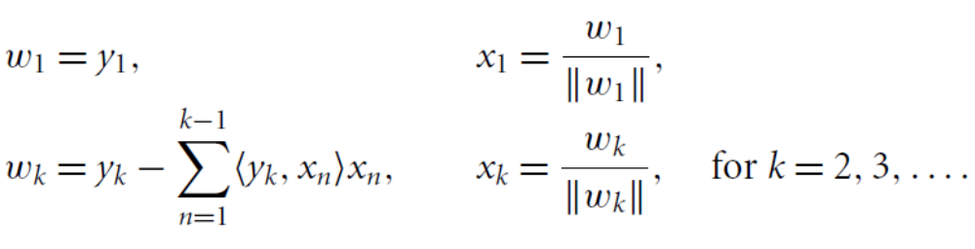
Examples of Gram-Schmidt Orthonormalization
Process

Slide 6
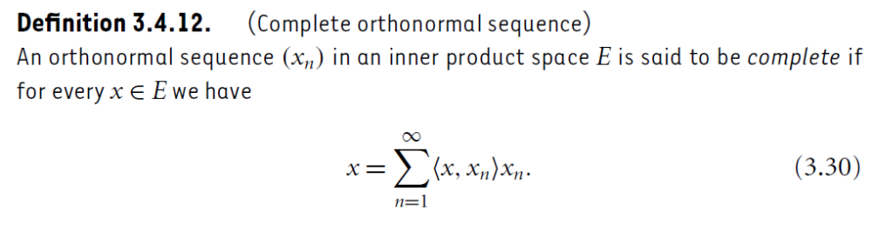
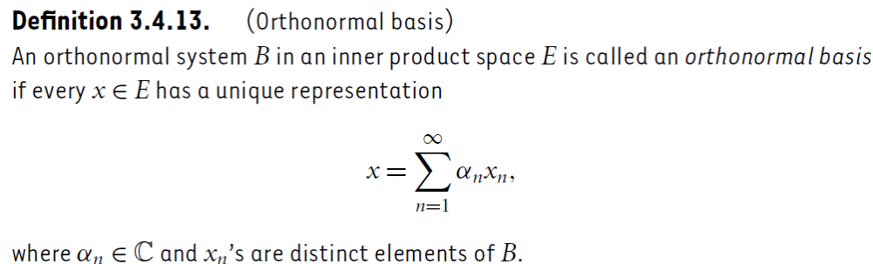

Slide 7
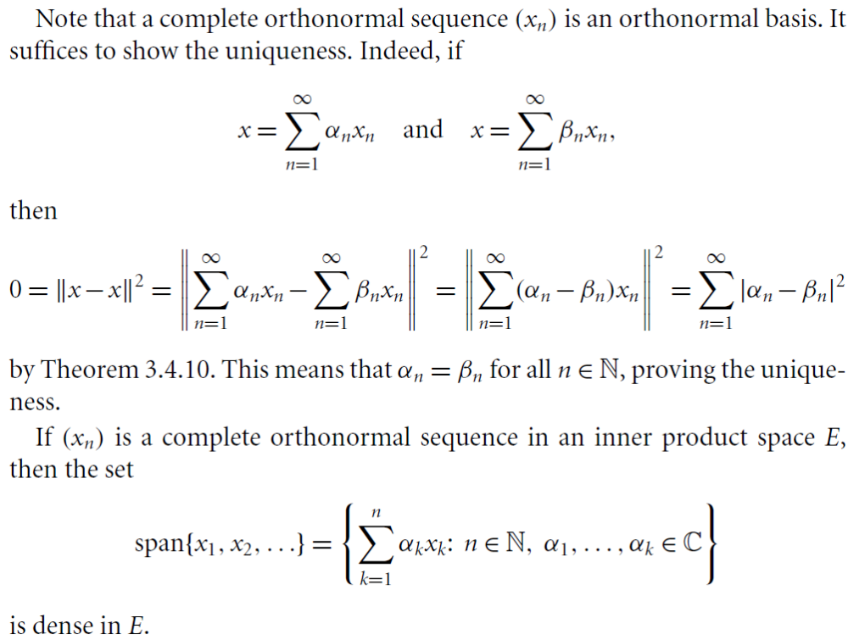

Slide 8
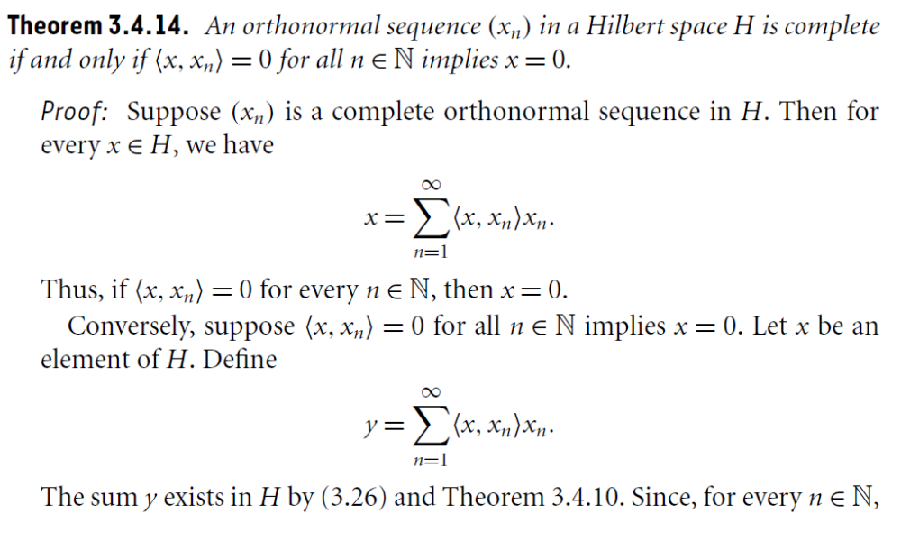

Slide 9
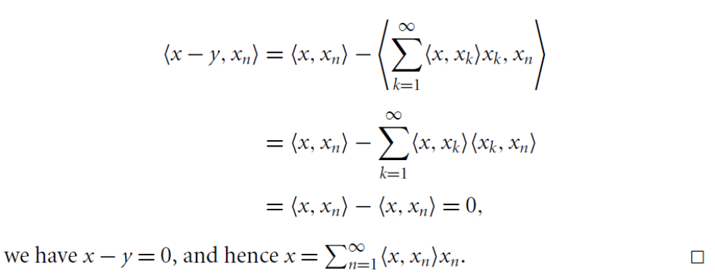

Slide 10
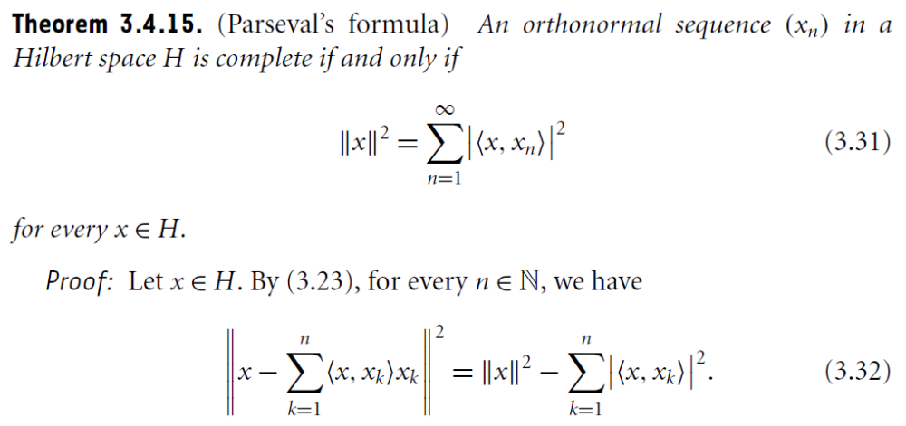

Slide 11
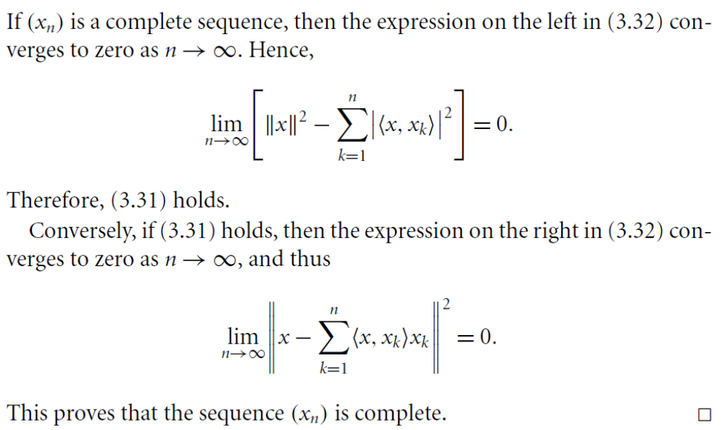

Slide 12
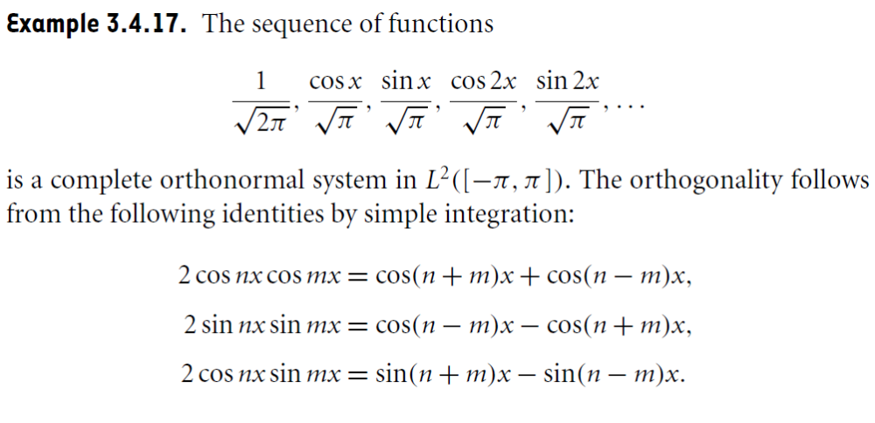
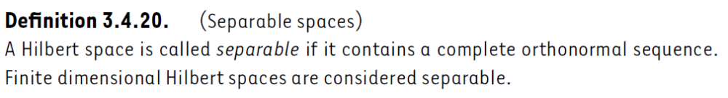

Slide 13
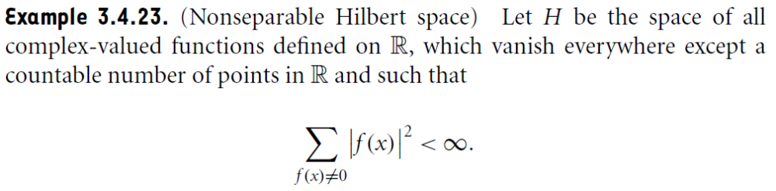
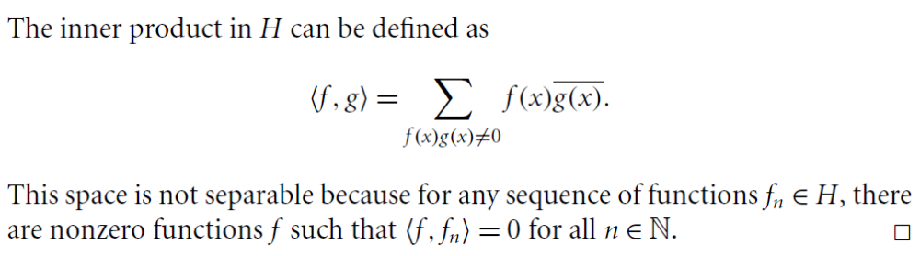

Slide 14
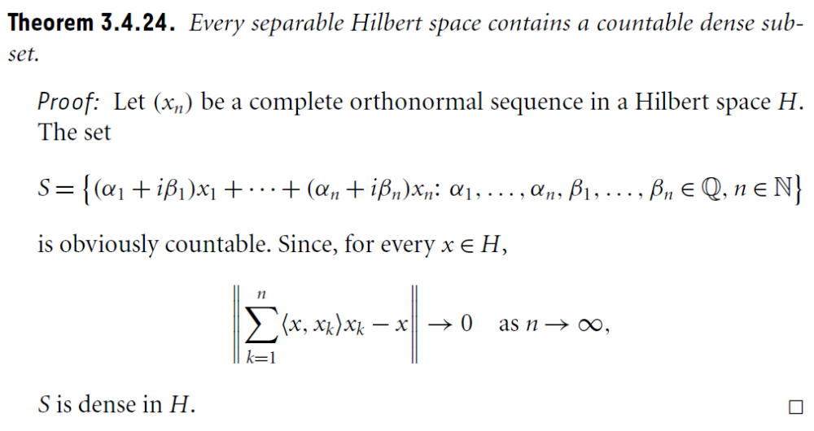

Slide 15
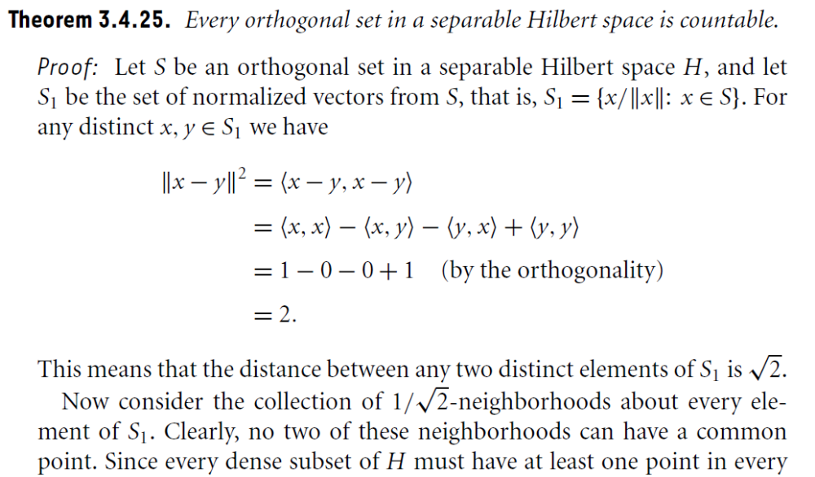
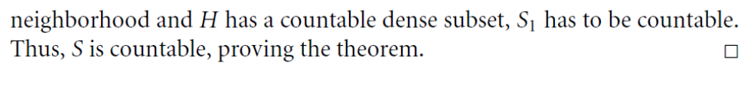

Slide 16
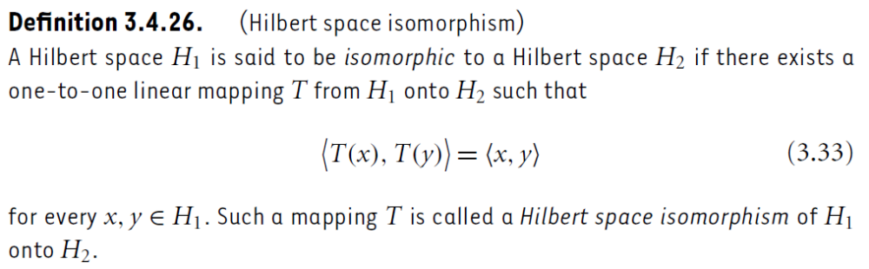

Slide 17
Summary of the today’s Lecture
In our today’s lecture, we furnished an example in 3D to explain the Gram Schmidth Process of orthonormalization and redefine the complete orthonormal sequence, orthonormal basis and a theorem related to these terms. Finally, separble Hilbert space and related theorem are proved.

