Slide 1
Introduction To Hilbert Spaces with Applications
Lokenath Debnath and Piotr Mikusinski
Course Teacher: Dr. Amjad Hussain

Slide 2
Summary of the Last Lecture
In our last lecture, we considered further result regarding strong and weak convergence. Then, orthogonal and orthonormal systems were introduced. Lagendre polynomials were discussed briefly.

Slide 3
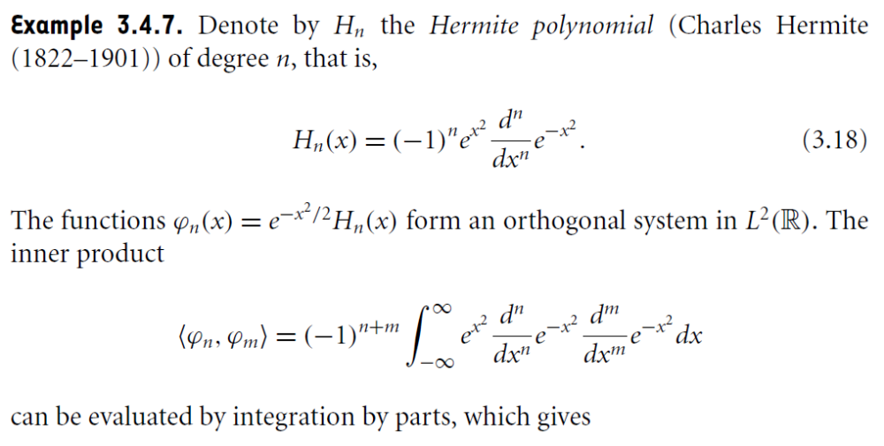
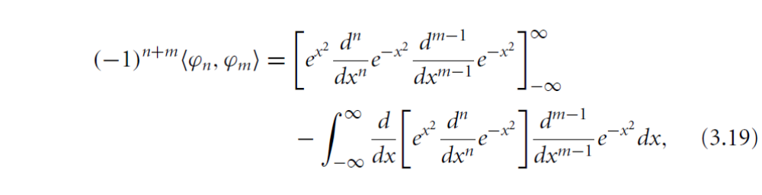

Slide 4
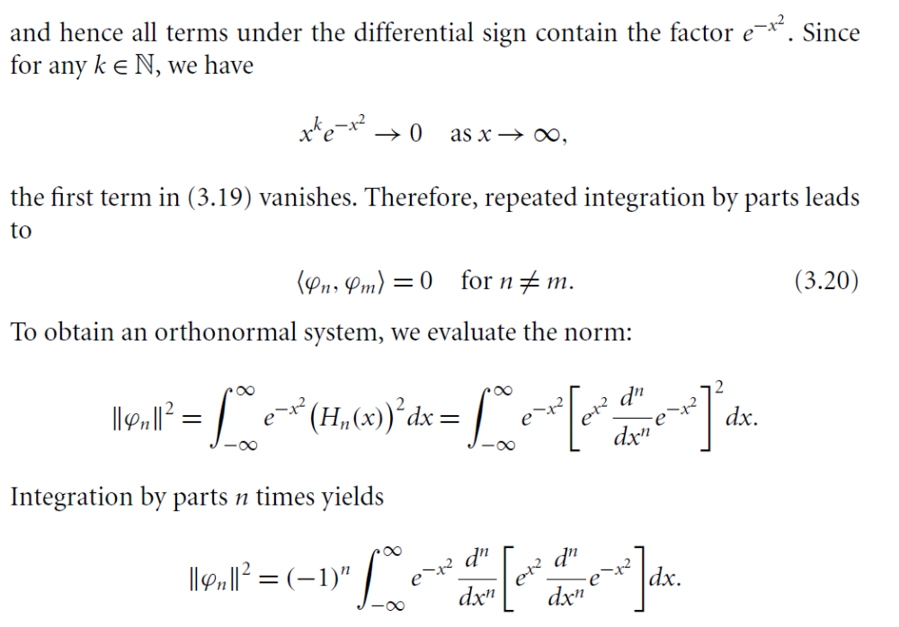

Slide 5
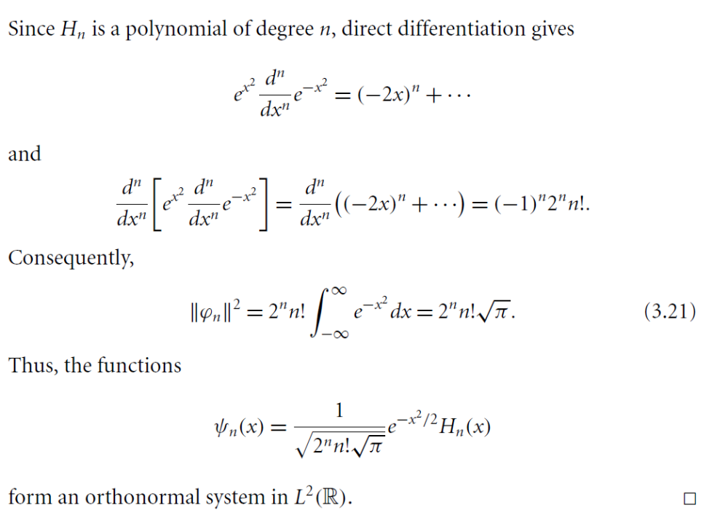

Slide 6
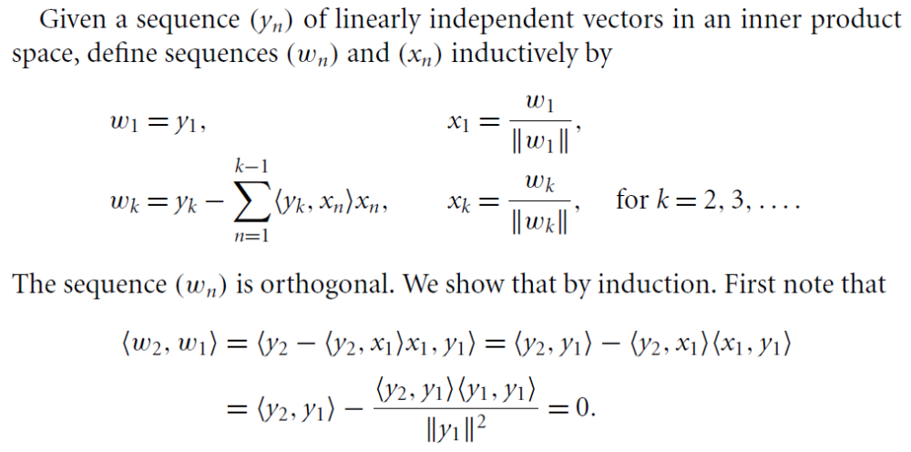
Gram-Schmidt Orthonormalization Process

Slide 9
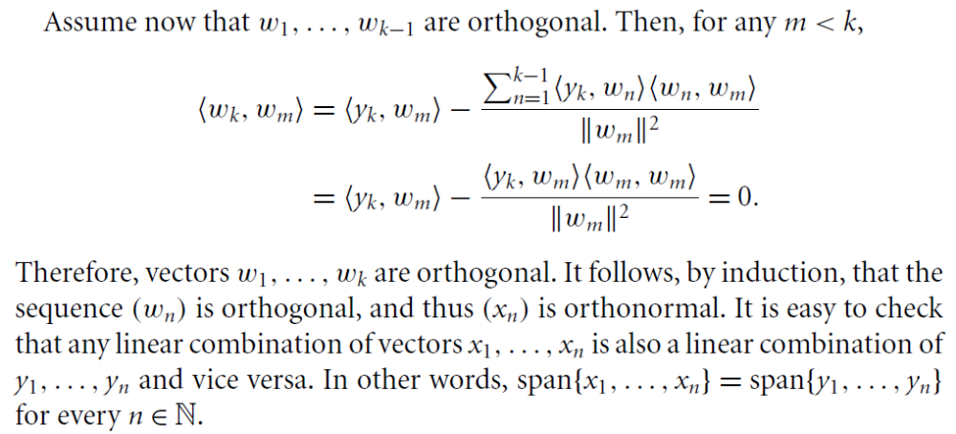

Slide 10
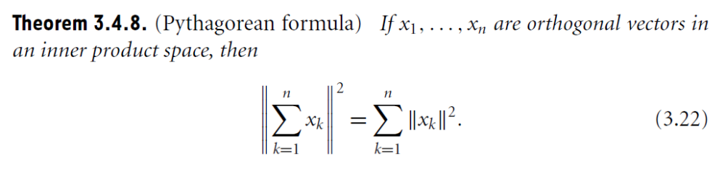
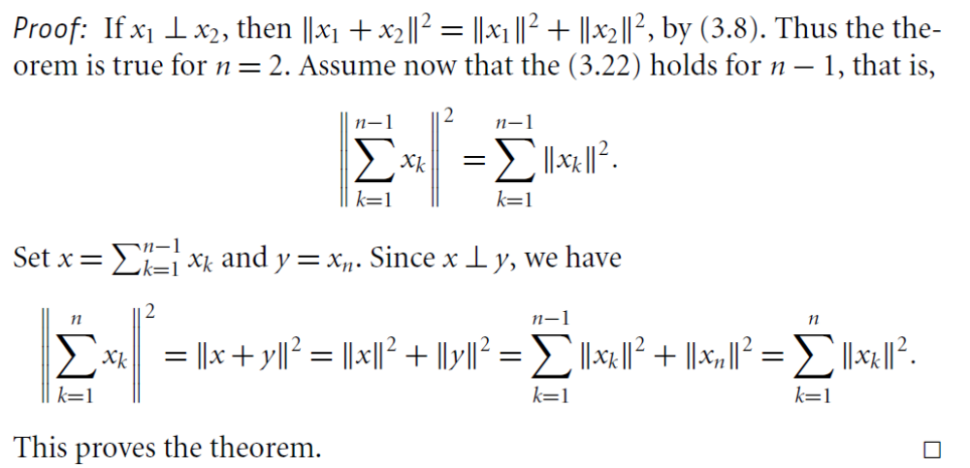

Slide 11
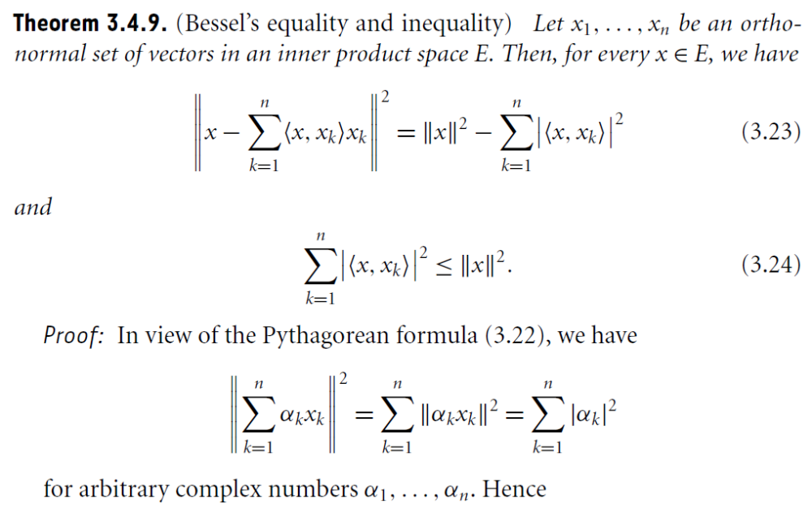

Slide 12
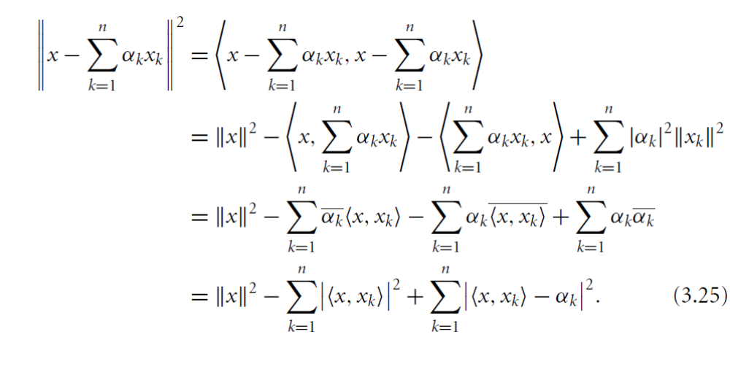
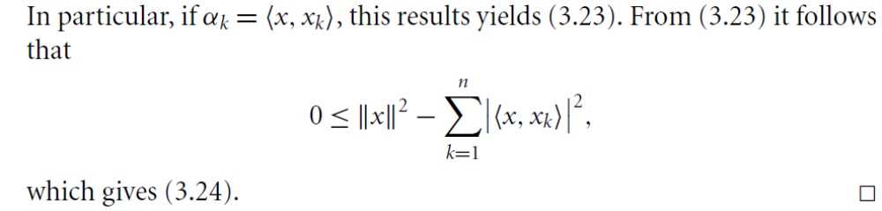

Slide 13
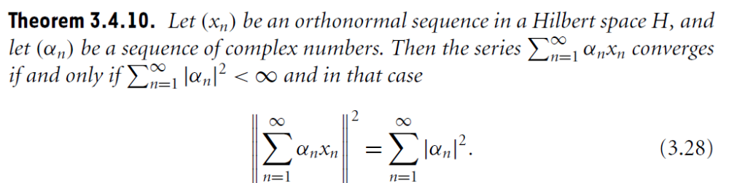
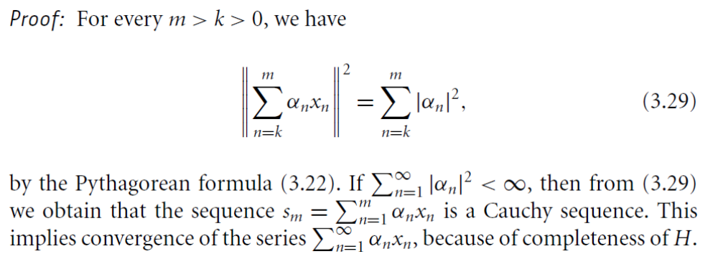

Slide 14
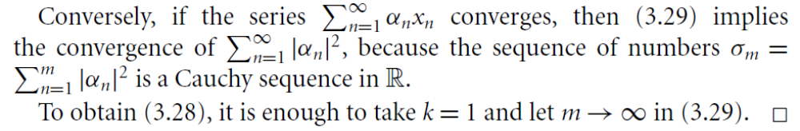
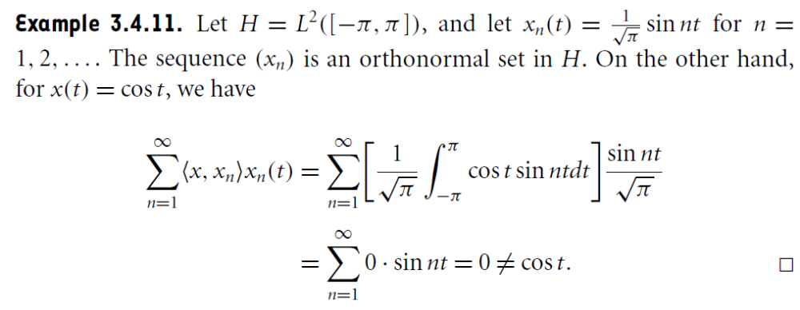

Slide 15
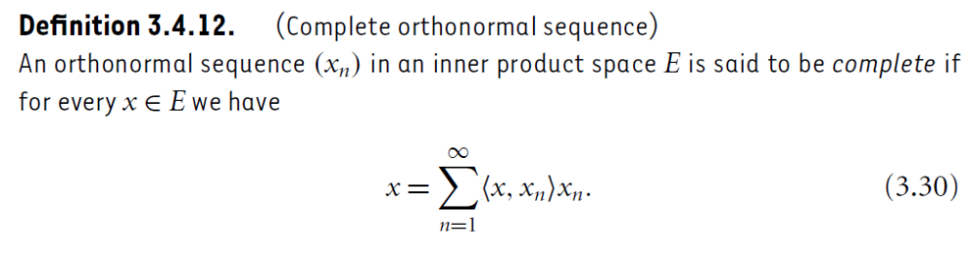
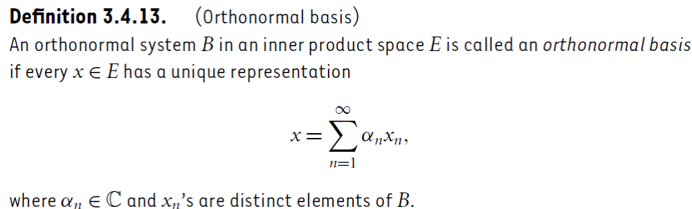

Slide 16
Summary of the today’s Lecture
In our today’s lecture, we discussed the Hermite polynomials and then explained the Gram Schmidth Process of orthonormalization. Bessel equality and inequality along with the concept of complete sequence and orthonormal basis is studied as well.

