Slide 1
Introduction To Hilbert Spaces with Applications
Lokenath Debnath and Piotr Mikusinski
Course Teacher: Dr. Amjad Hussain

Slide 2
Summary of the Last Lecture
In our last lecture, we gave the definition of inner product and proved that an inner product space is a norm vector space. Then strong and weak convergence is defined and some theorem were proved there.

Slide 3
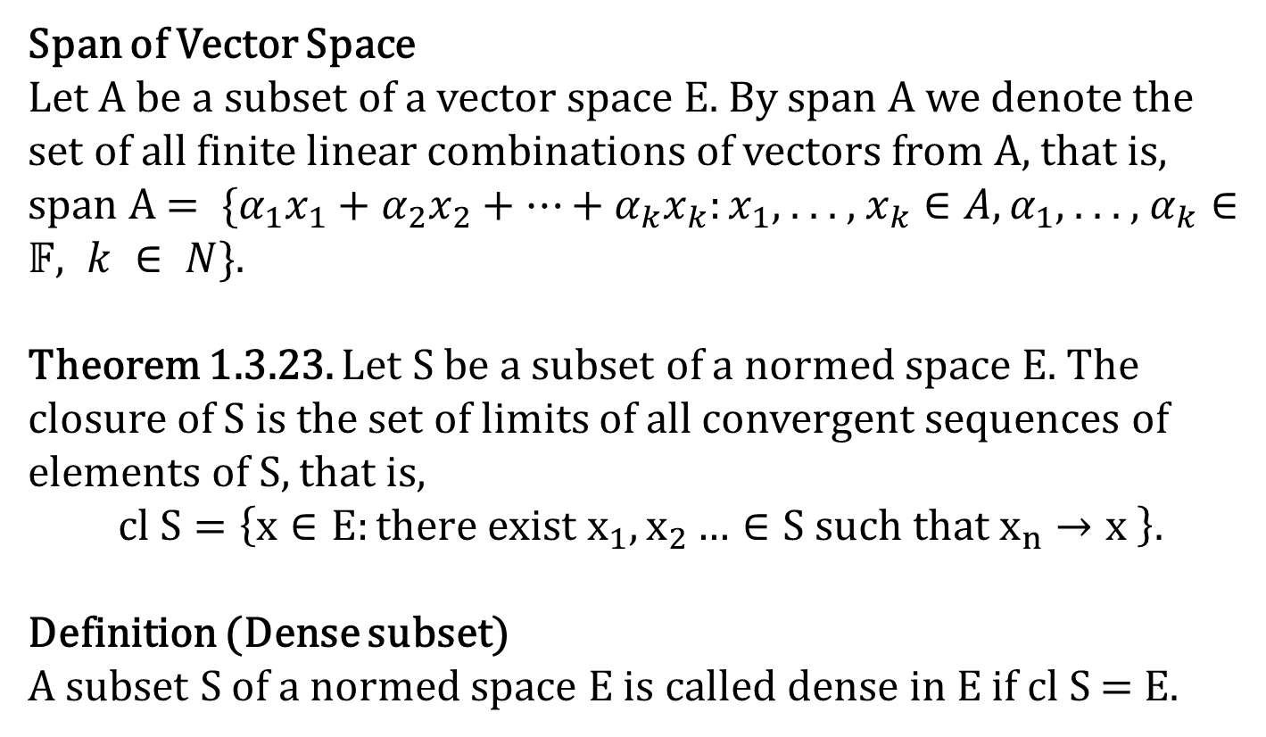
Span of Vector Space
Let A be a subset of a vector space E. By span A we denote the set of all finite linear combinations of vectors from A, that is,
span A $= \{α_{1}x_{1}+α_{2}x_{2}+…+α_{k}x_{k}:x_{1}\text{, . . . , }x_{k}∈A,α_{1}\text{, . . . , }α_{k}∈𝔽, k ∈ N\}$.
Theorem 1.3.23. Let S be a subset of a normed space E. The closure of S is the set of limits of all convergent sequences of elements of S, that is,
$$cl S=\left\{x∈E:there exist{ x}_{1},x_{2}…∈S \text{such} \text{that} x_{n}→x \right\}.$$
Definition (Dense subset)
A subset S of a normed space E is called dense in E if cl S = E.

Slide 4
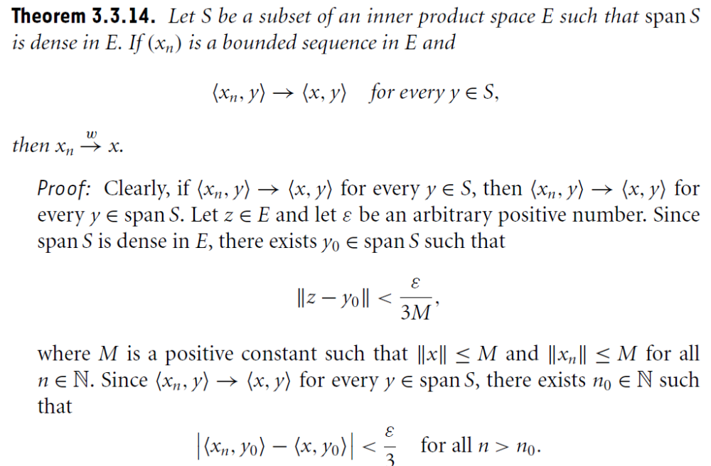

Slide 5
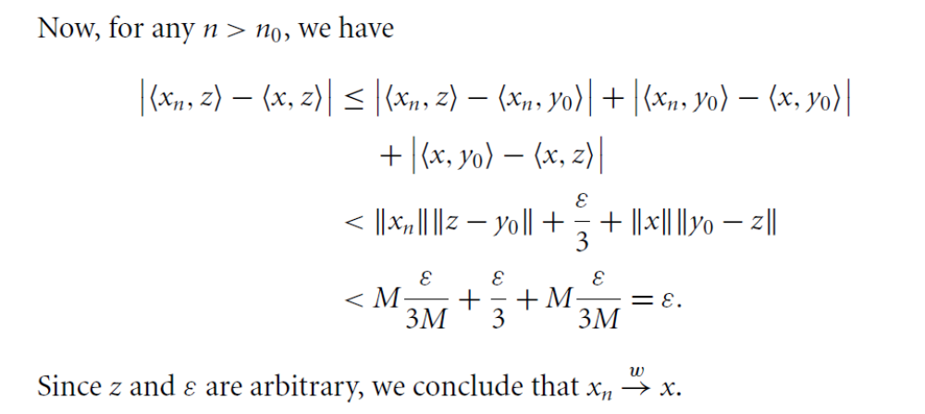
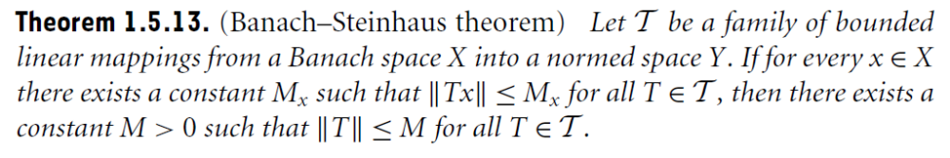

Slide 7
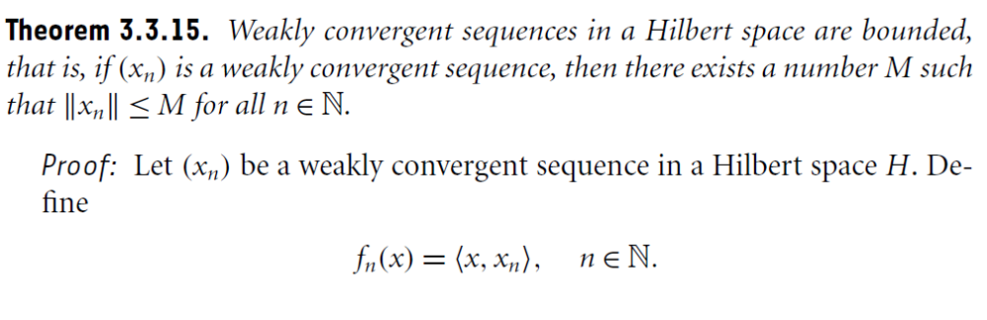
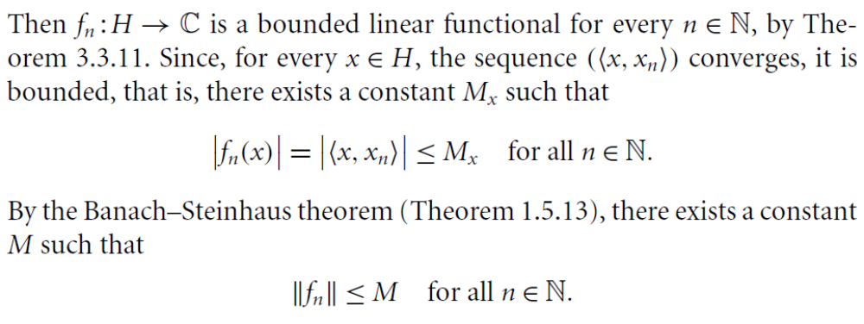

Slide 8
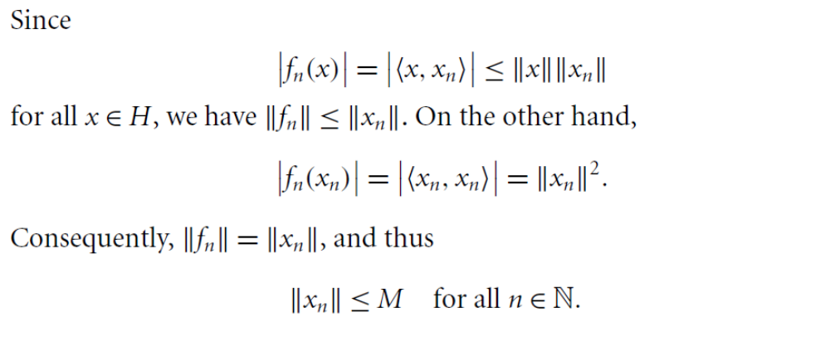

Slide 9
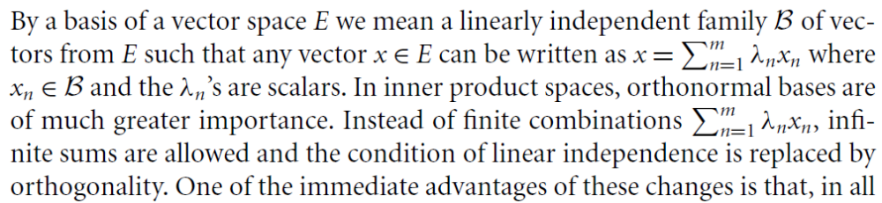
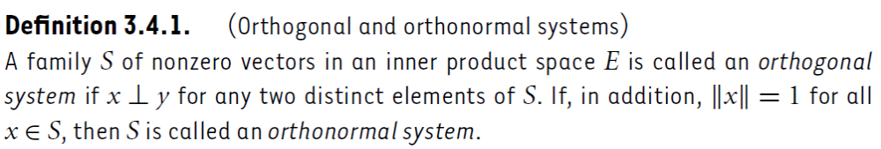
Orthogonal and Orthonormal Systems

Slide 10
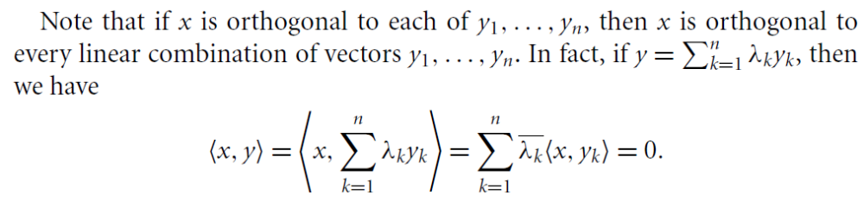
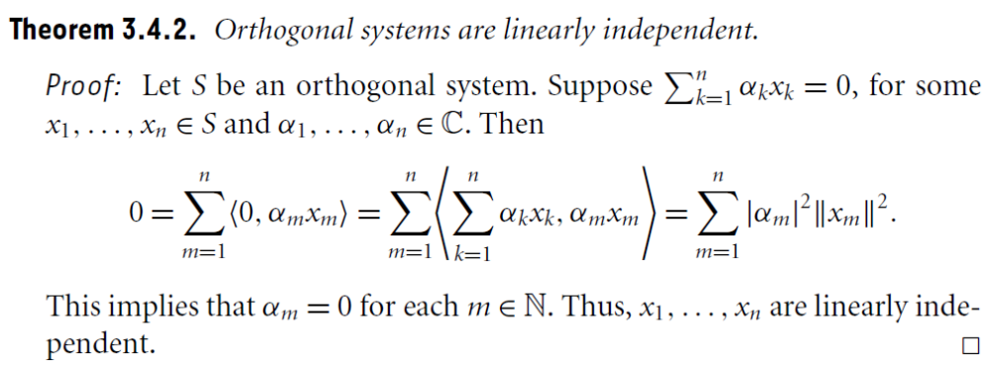

Slide 11
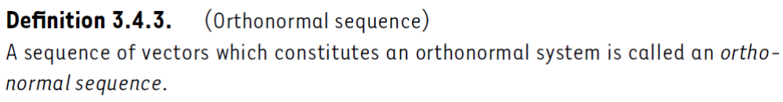
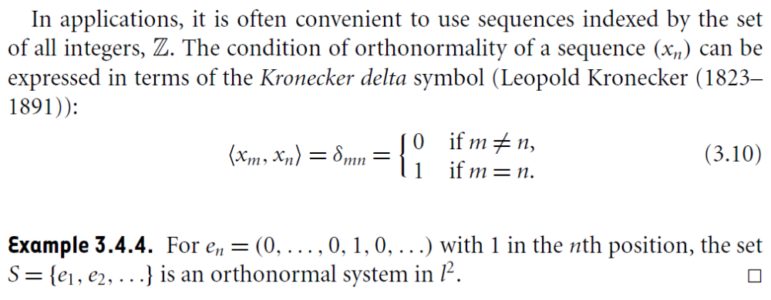

Slide 12
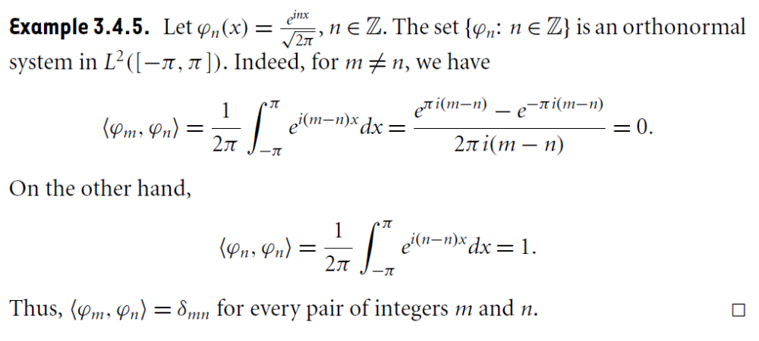

Slide 13
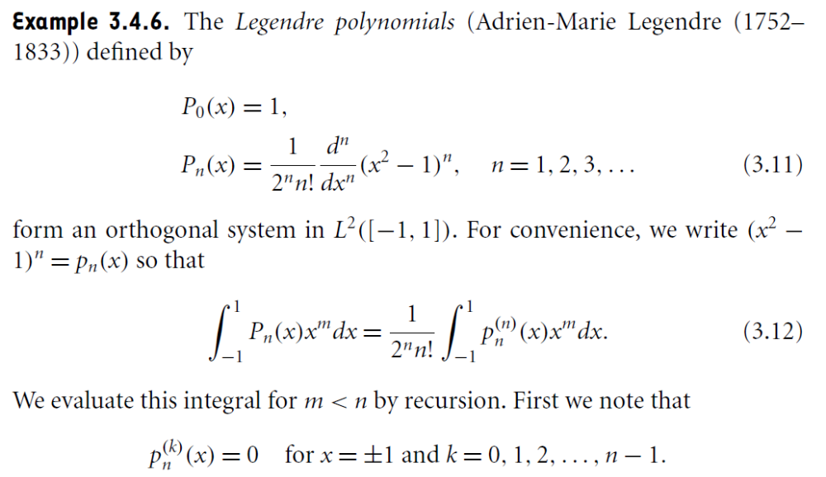

Slide 15
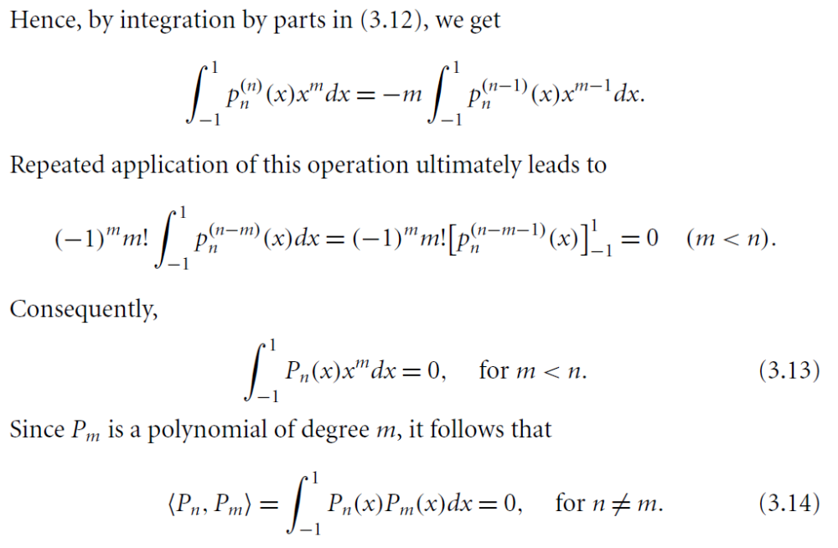

Slide 16
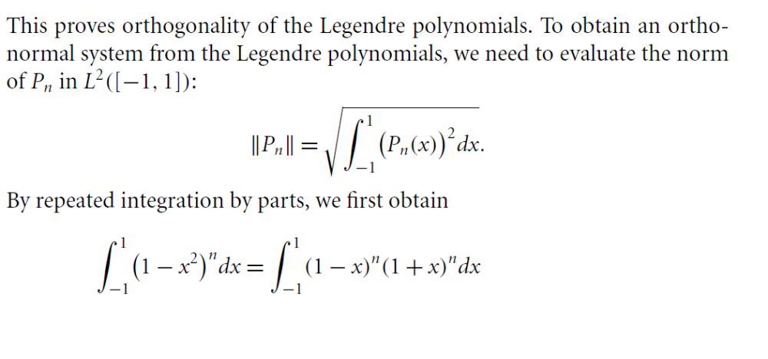
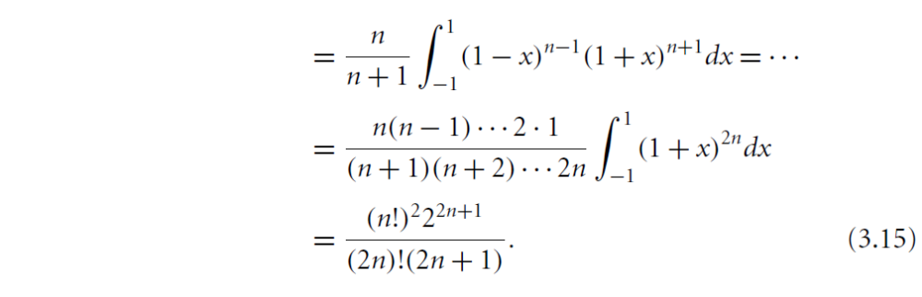

Slide 17
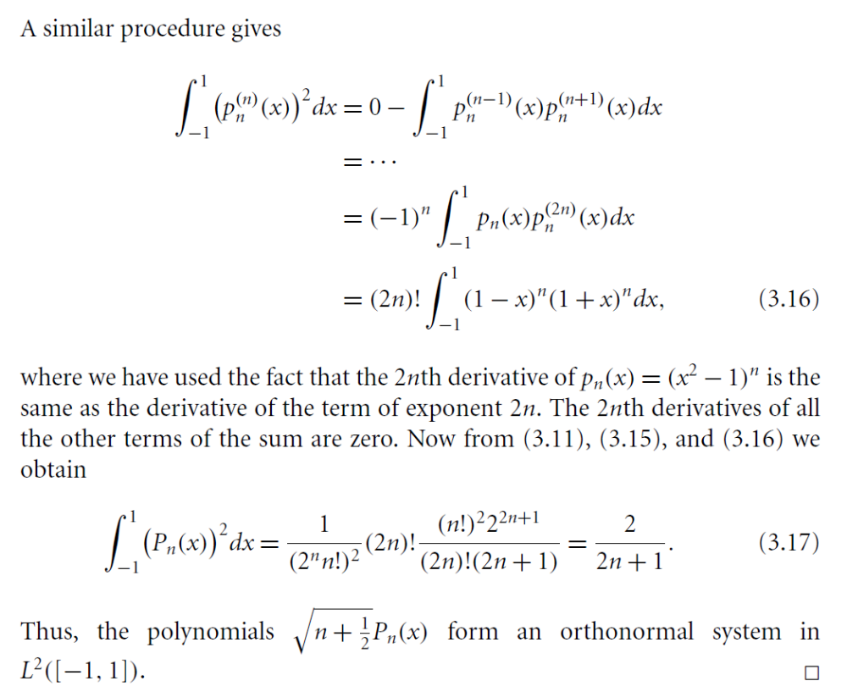

Slide 18
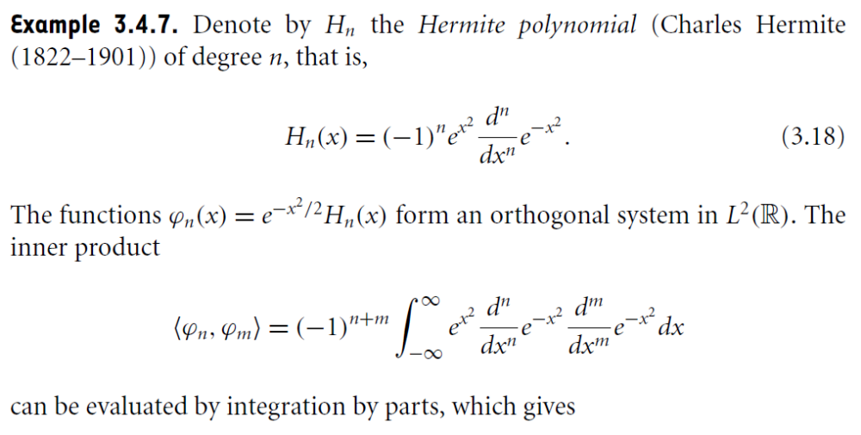
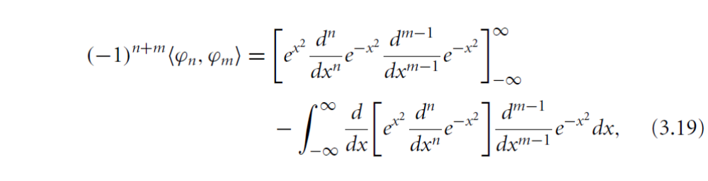

Slide 19
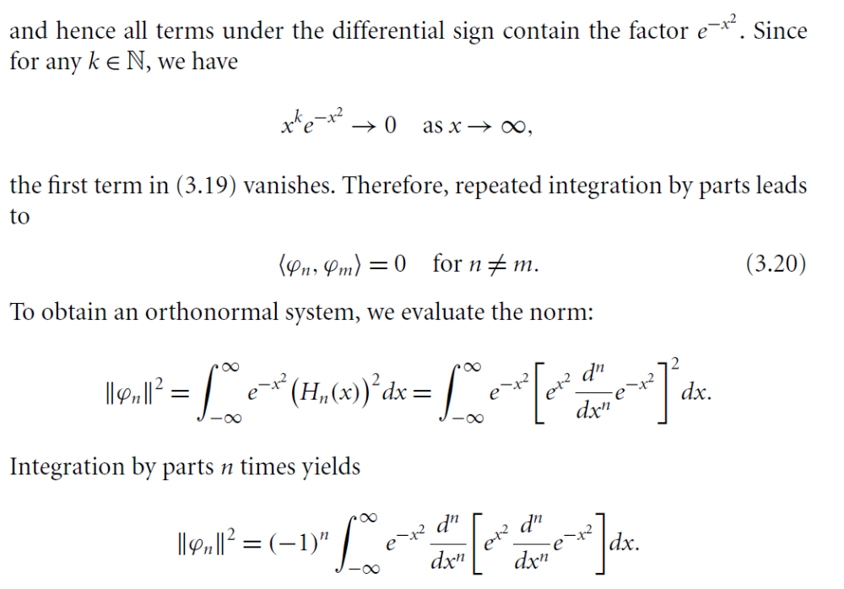

Slide 20
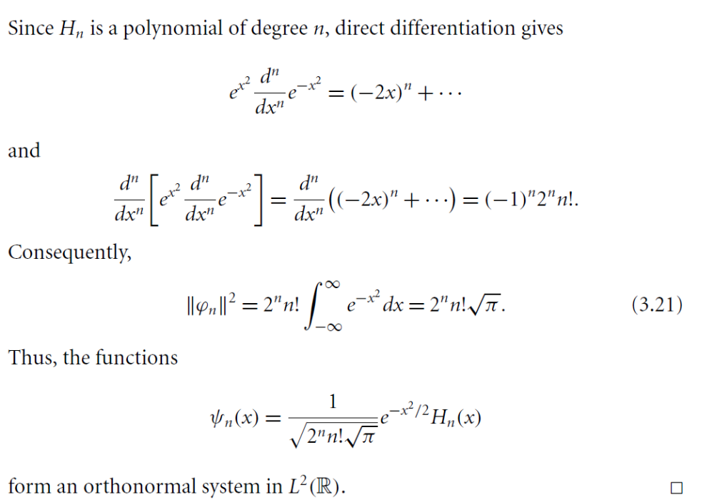

Slide 21
Summary of the today’s Lecture
In our today’s lecture, we consider further result regarding strong and weak convergence. Then, orthogonal and orthonormal systems were introduced. Lagendre and Hermite polynomials are discussed briefly.

