Slide 1
Introduction To Hilbert Spaces with Applications
Lokenath Debnath and Piotr Mikusinski
Course Teacher: Dr. Amjad Hussain

Slide 2
Summary of the Last Lecture
In our last lecture, we gave the definition of inner product space and explained it by giving some examples. In addition, Cauchy Schwartz inequality was proved and successfully applied to prove the triangular inequality.

Slide 3
Can every normed space be inner
product space?
Parallelogram Law

Slide 5
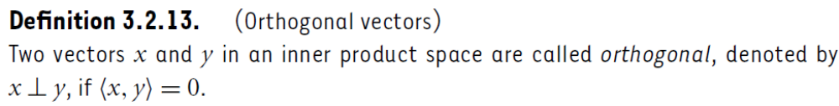
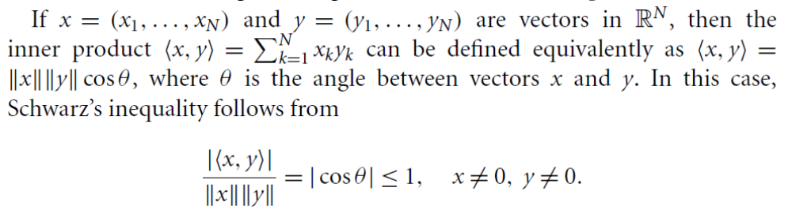
Pythagorean Formula

Slide 7
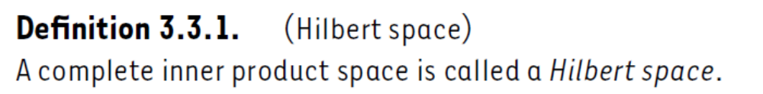
Hilbert Space
Complete and Incomplete inner Product Spaces

Slide 8
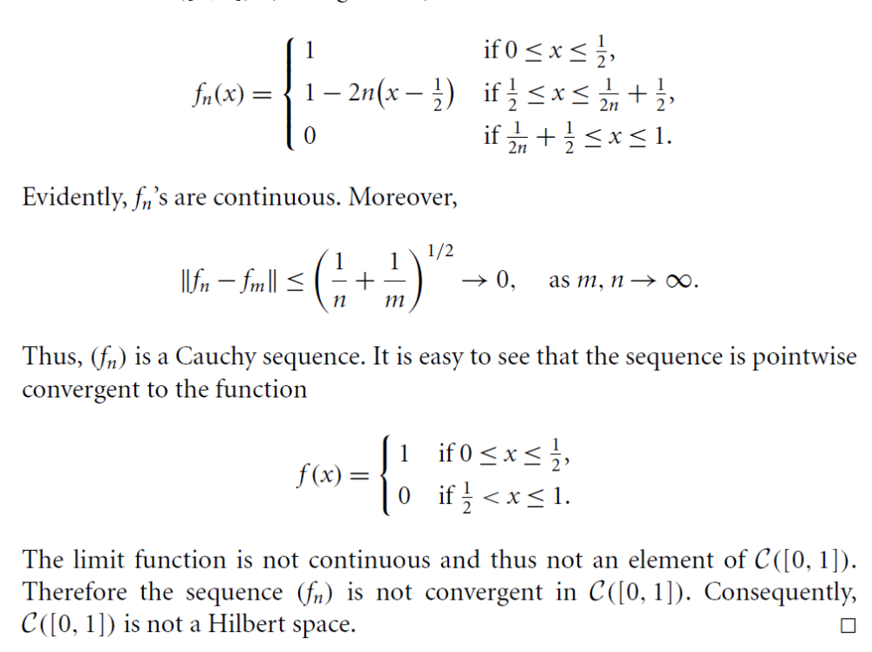

Slide 9
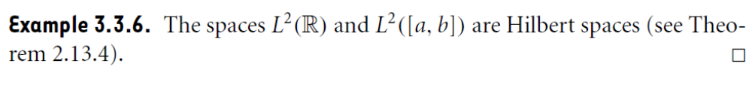
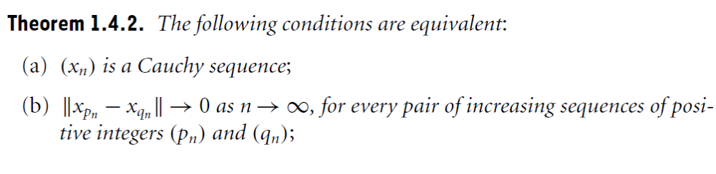

Slide 10
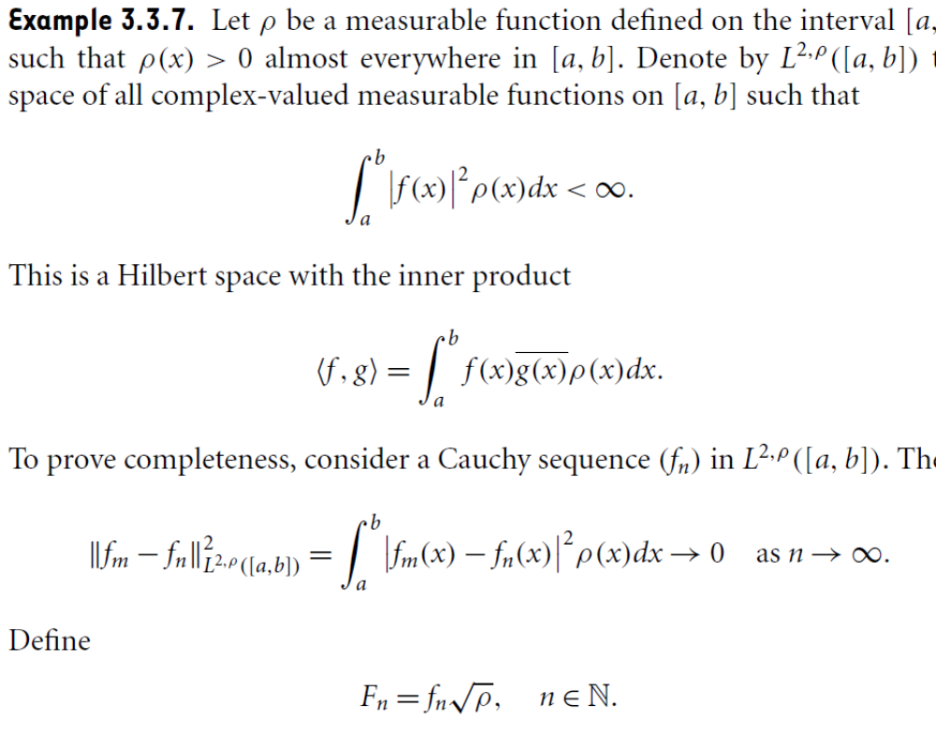

Slide 11
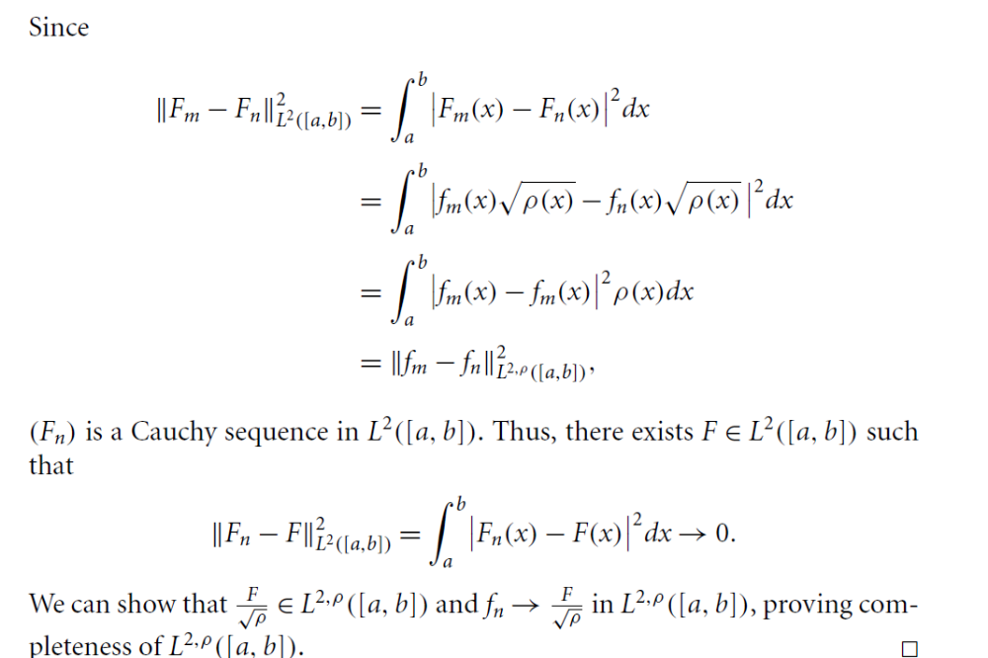

Slide 12
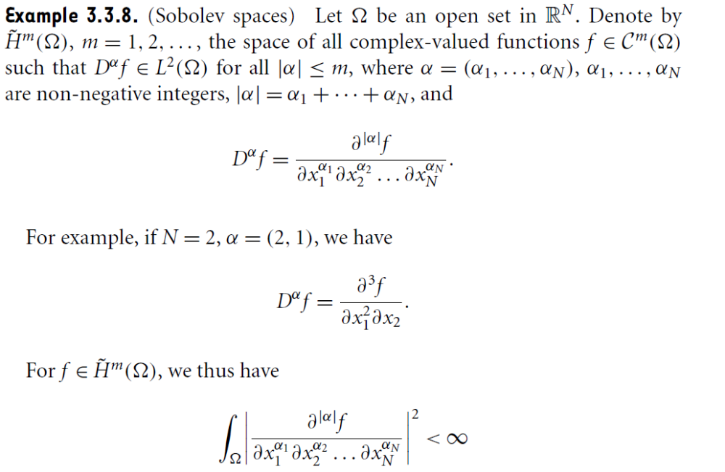

Slide 13
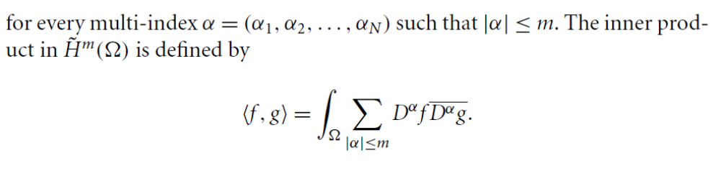
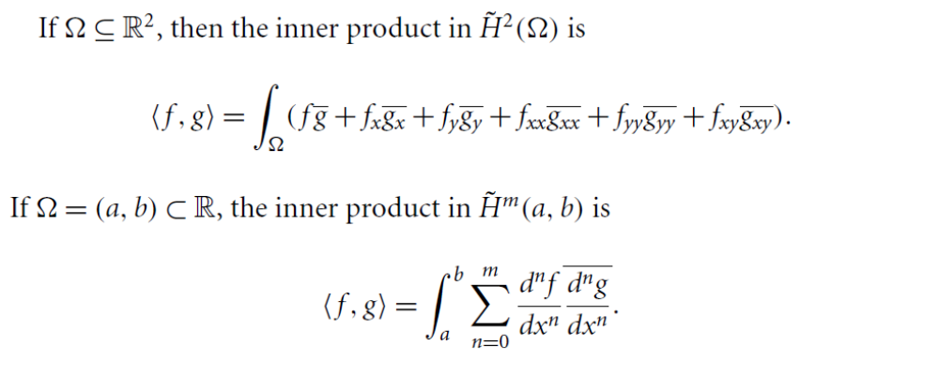

Slide 14
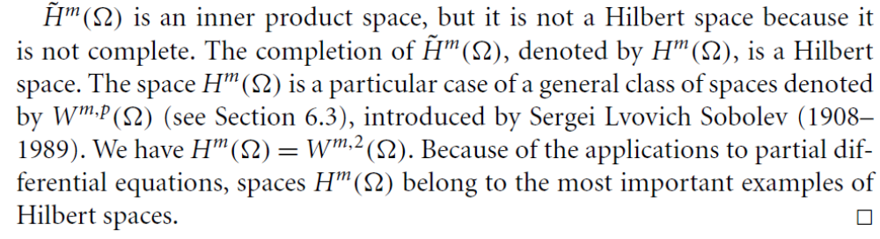
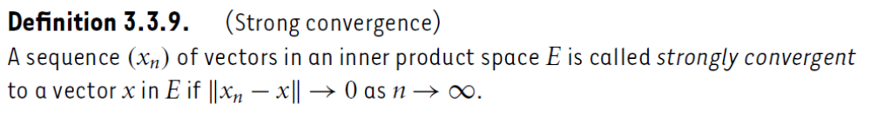

Slide 15
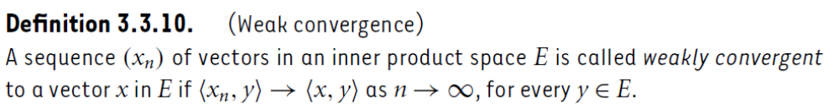
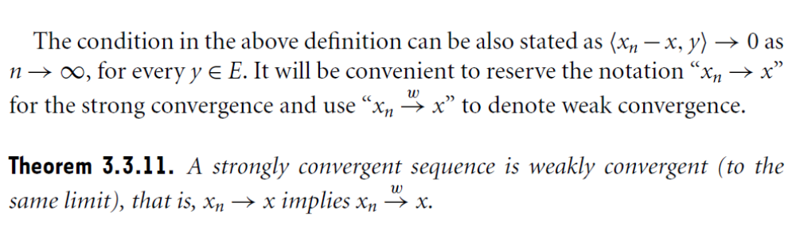

Slide 16
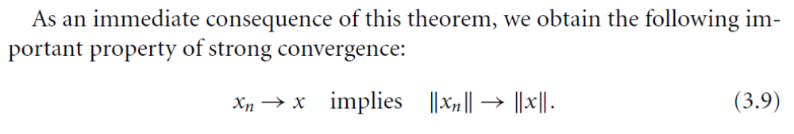

Slide 17
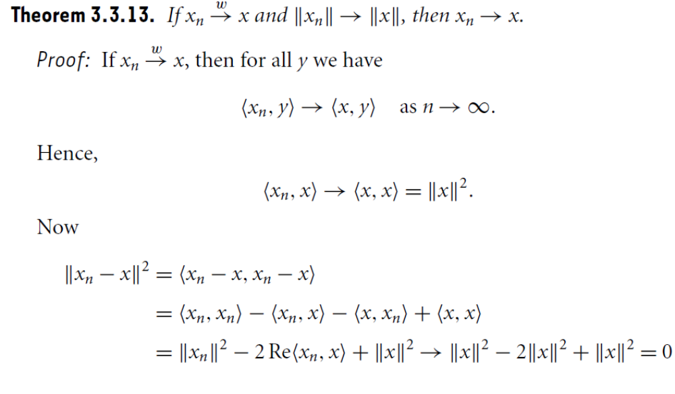

Slide 18
Summary of the today’s Lecture
In our today’s lecture, we parallelogram law. Define Hilbert space and give some examples. Strong and weak convergence is introduced and related theorem have been proved.

