Slide 1
Introduction To Hilbert Spaces with Applications
Lokenath Debnath and Piotr Mikusinski
Course Teacher: Dr. Amjad Hussain

Slide 2
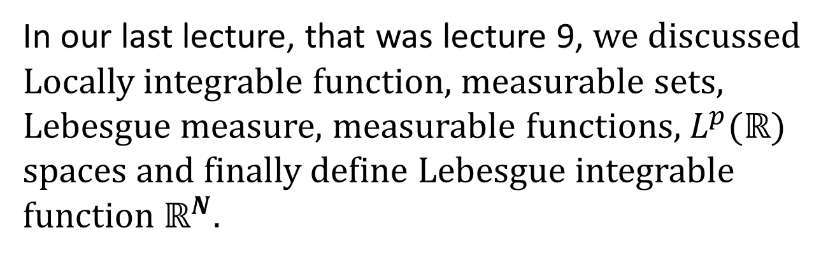
Summary of the Last Lecture
In our last lecture, that was lecture 9, we discussed Locally integrable function, measurable sets, Lebesgue measure, measurable functions, $L^{p}(ℝ)$spaces and finally define Lebesgue integrable function $ℝ^{N}$.

Slide 3
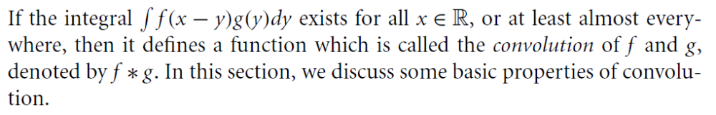
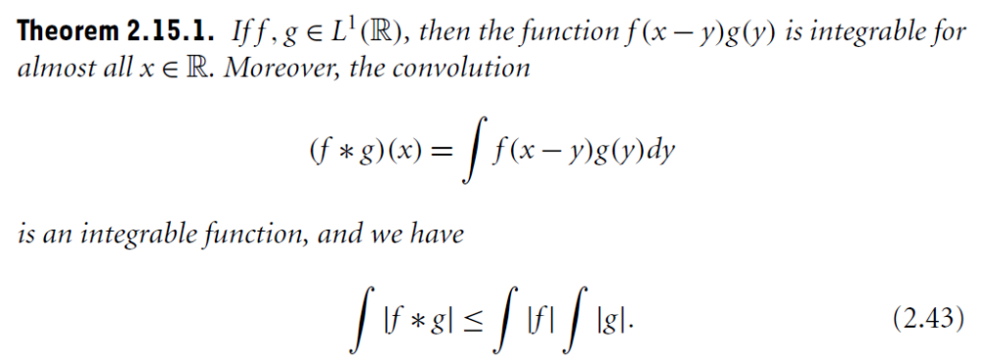
Convolution
Theorem 1

Slide 4
Theorem 2
Theorem 3
End of Chapter 2

Slide 5
Chapter 3
Hilbert Spaces and Orthonormal System

Slide 6
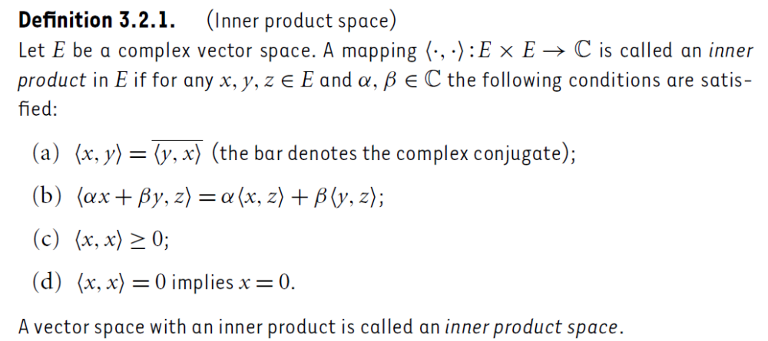
Inner Product Spaces
Definition

Slide 7
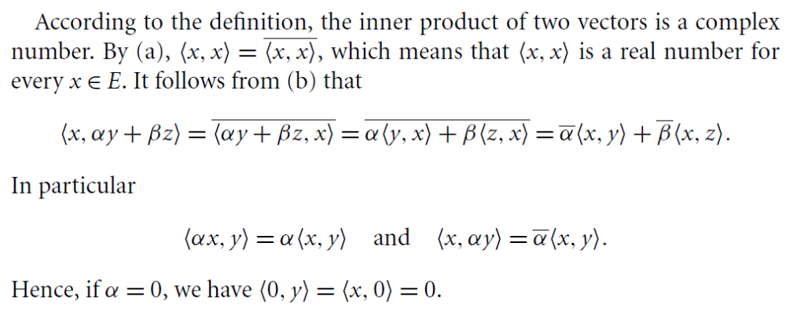

Slide 8
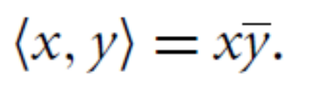
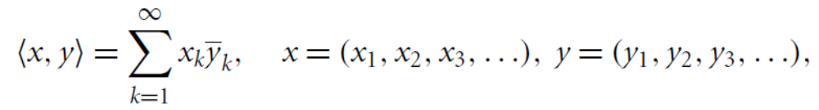
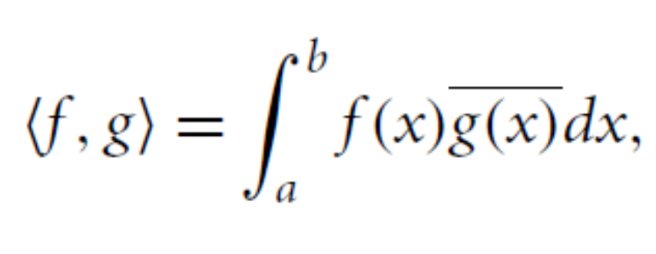
Some Common Example of Inner Product Spaces

Slide 9
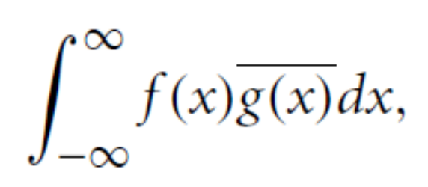
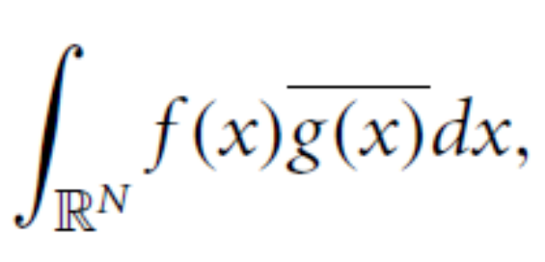
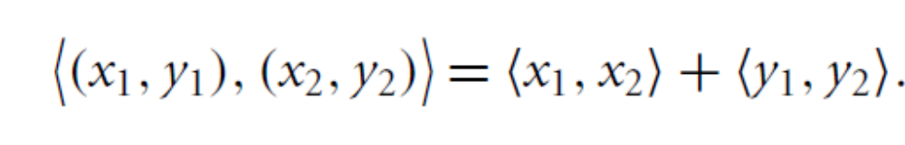

Slide 10
Is Inner Product Spaces are Normed Spaces?

Slide 11
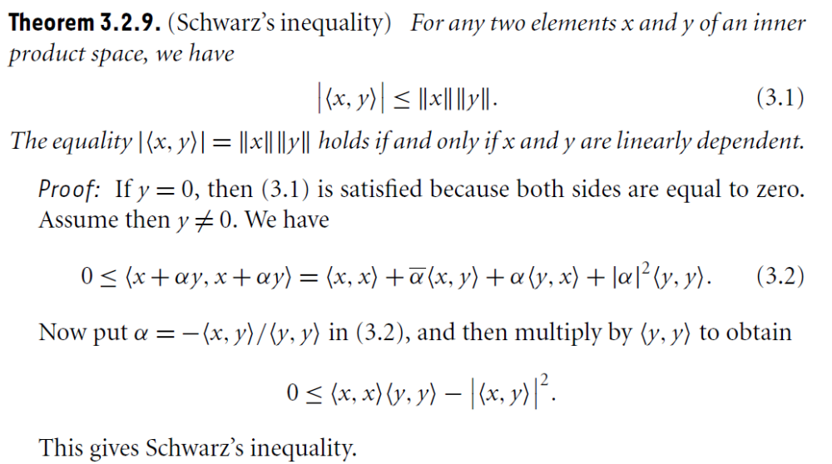

Slide 14
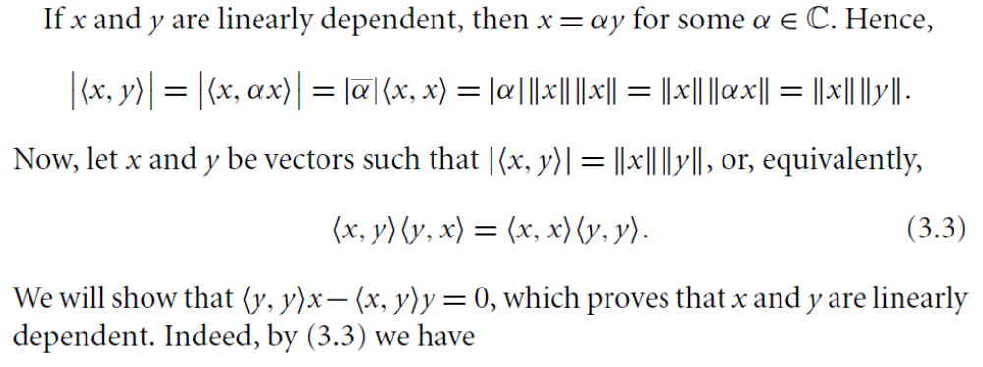
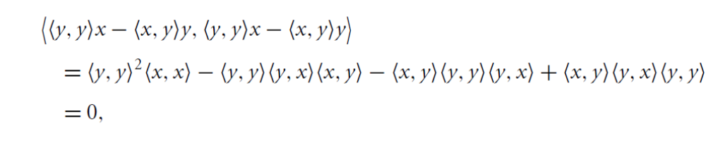

Slide 16
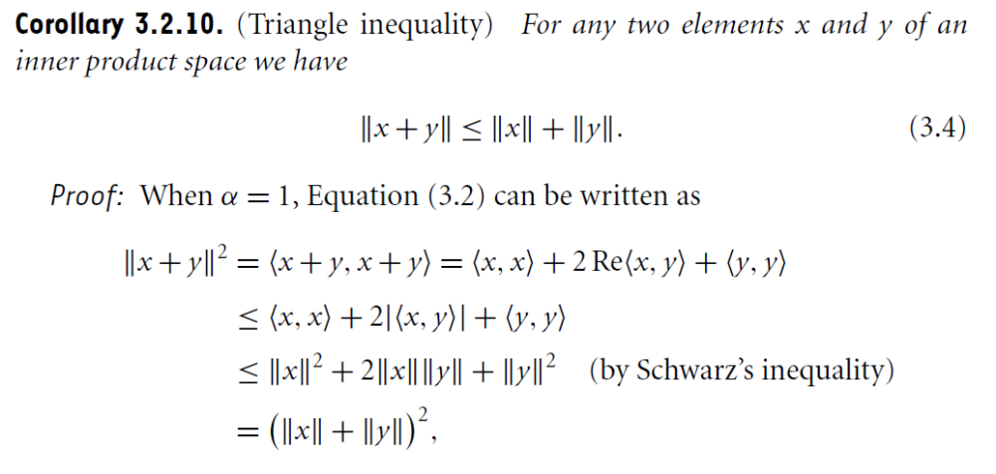
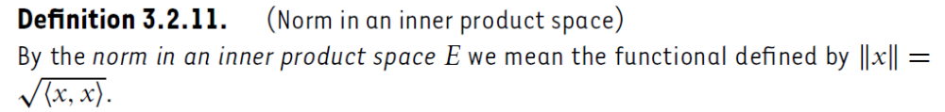

Slide 18
Summary of the today’s Lecture
In our today’s lecture, we give the definition of convolution and state some results regarding this topic. With this we finish chapter 2. In Chapter 3, we define inner product and proved that an inner product space is a norm vector space.

