Slide 1
Teacher’s Introduction
Name: Dr. Amjad Hussain
Highest Qualification: PhD Mathematics
PhD Topic: Some Operators and Commutators
on Function Spaces
PhD University: Zhejiang University,
Hangzhou, P. R. China
Research Interest: Harmonic Analysis, Herz type spaces,
Hilbert spaces, Analytical Dynamic
Designation: Assistant Professor, CIIT Wah Campus
Department: Mathematics

Slide 2
Introduction To Hilbert Spaces

Slide 3
Course Objective
At the end of this course the students will be able to understand the in depth knowledge of one specific area, to give students an ability to communicate a convincing and reasoned argument of a mathematical nature in both written and oral form. The students will understand what constitutes a rigorous mathematical argument and how to use reasoning effectively to solve problems. The definition and fundamental properties of Hilbert spaces, and bounded linear maps between them; how basic concepts of geometry and linear algebra can be generalized to infinite dimensional spaces. Prove simple results about Hilbert spaces; analyze bounded linear maps between Hilbert spaces. Apply general results on Hilbert spaces to solve problems in other areas of mathematics and physics, including numerical methods and differential equations.

Slide 4
Course Contents
Vector Space, Inner product spaces, Completion of Inner product spaces, Hilbert spaces examples and properties of the Hilbert spaces. Linear operators, Linear functional, Orthogonal Complements and orthonormal sets and sequences with examples ( Legendre, Hermite, and Laguerre polynomials). Riesz representation theorem, Hilbert-adjoint operators,
Unitary and Normal operators.

Slide 5

Course Book
Book Title: Introduction to Hibert Spaces with Applications
Authors:
1. Lokenath Debnath
University of Texas—Pan American
2. Piotr Mikusinski
University of Central Florida
Publisher: Elsevier
Edition: 3rd Edition

Slide 6
Background Requirements
The basic algebraic concepts in the theory of Hilbert spaces are those of a vector space and an inner product. The inner product defines a norm, and thus every Hilbert space is a normed space. Since the norm plays a very important role in the theory, it is not possible to study Hilbert spaces without familiarity with basic concepts and properties of normed spaces.

Slide 7
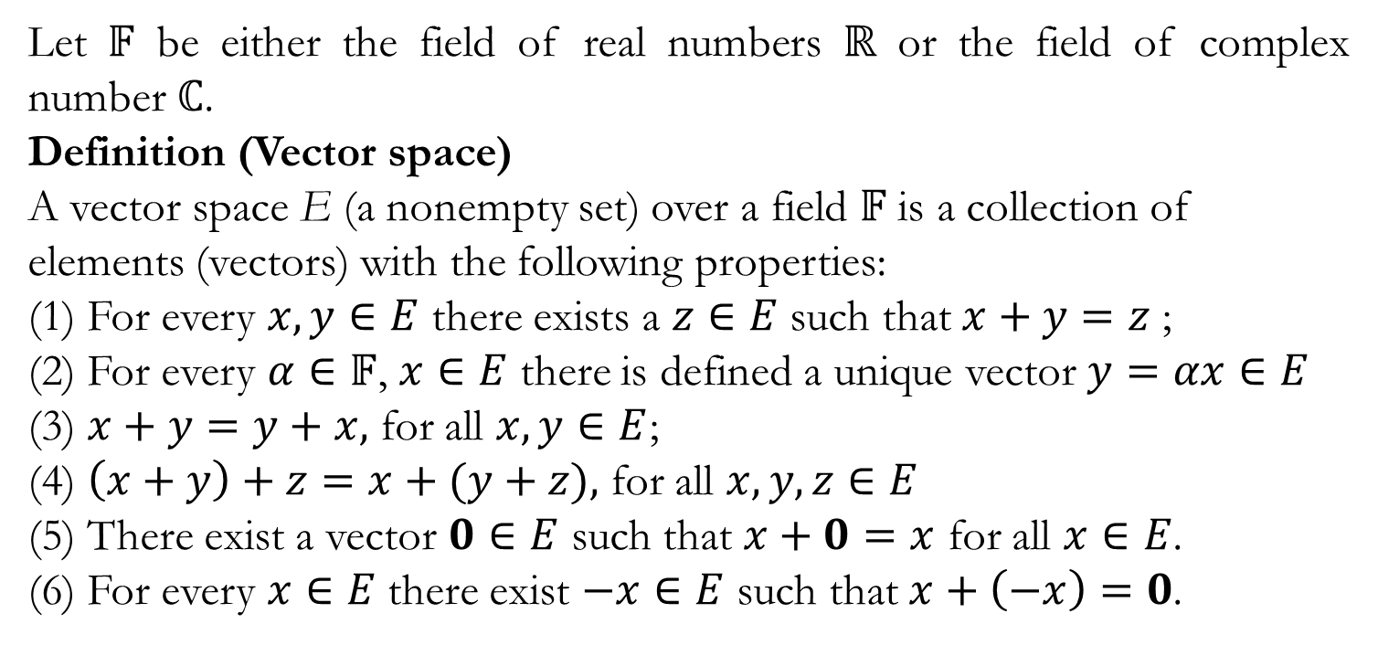
Vector Spaces
Let $𝔽$ be either the field of real numbers $ℝ$ or the field of complex number $ℂ$.
Definition (Vector space)
A vector space E (a nonempty set) over a field $𝔽$ is a collection of elements (vectors) with the following properties:
(1) For every $x,y∈E$there exists a $z∈E$such that $x+y=z$ ;
(2) For every $α∈𝔽$, $x∈E$ there is defined a unique vector $y=αx∈E$
(3) $x+y=y+x,$forall$x,y∈E$;
(4) $\left(x+y\right)+z=x+(y+z),$forall$x,y,z∈E$
(5) There exist a vector $0∈E$such that $x+0=x$ for all $x∈E$.
(6) For every $x∈E$there exist $−x∈E$such that $x+\left(−x\right)=0$.

Slide 8
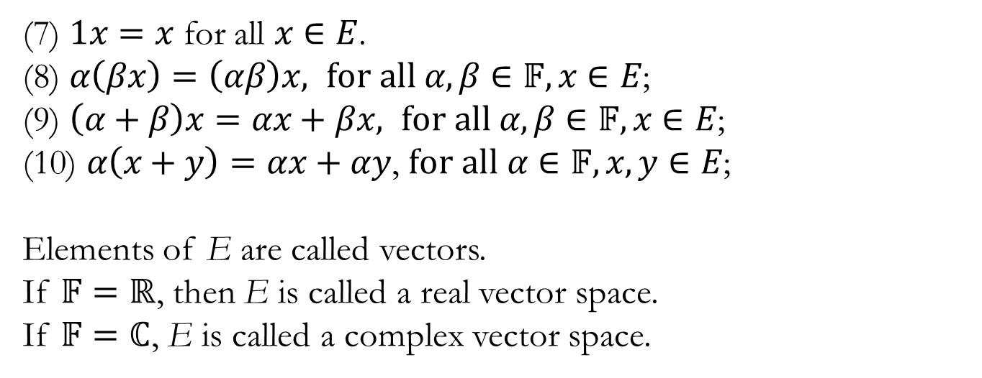
(7) $1x=x$for all $x∈E$.
(8) $α\left(βx\right)=\left(αβ\right)x, for all α,β∈𝔽,x∈E$;
(9) $\left(α+β\right)x=αx+βx, for all α,β∈𝔽,x∈E$;
(10) $α\left(x+y\right)=αx+αy$, $for all α∈𝔽,x,y∈E$;
Elements of E are called vectors.
If $𝔽=ℝ$, then E is called a real vector space.
If $𝔽=ℂ$, E is called a complex vector space.

Slide 9
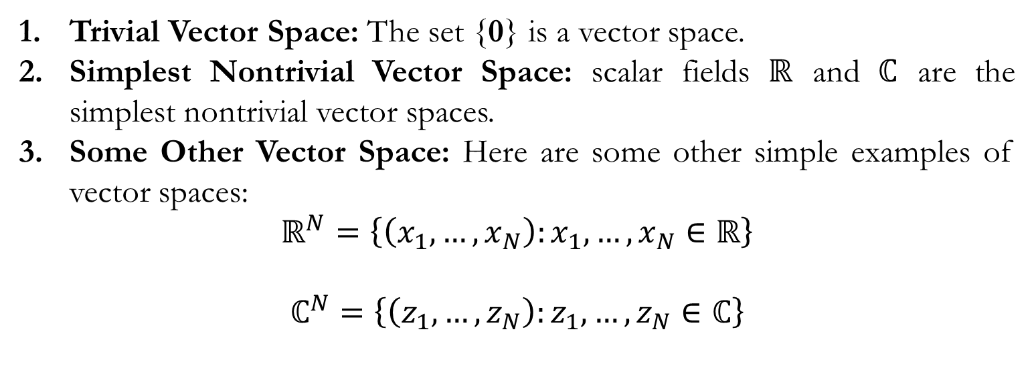
Examples
Trivial Vector Space: The set {0} is a vector space.
Simplest Nontrivial Vector Space:scalar fields $ℝ$and $ℂ$are the simplest nontrivial vector spaces.
Some Other Vector Space: Here are some other simple examples of vector spaces:
$$ℝ^{N}=\left\{\left(x_{1},…,x_{N}\right):x_{1},…,x_{N}∈ℝ\right\}$$
$$ℂ^{N}=\left\{\left(z_{1},…,z_{N}\right):z_{1},…,z_{N}∈ℂ\right\}$$

Slide 10
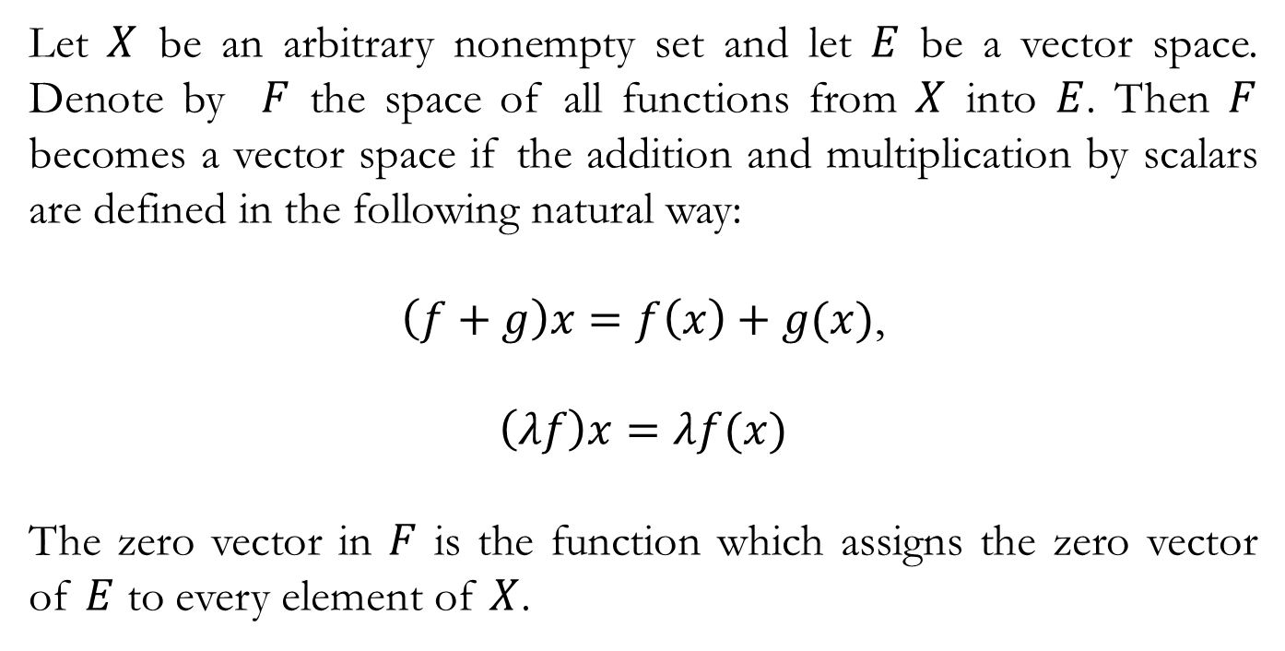
Function spaces
Let $X$ be an arbitrary nonempty set and let $E$be a vector space. Denote by $F$ the space of all functions from $X$into $E$. Then $F$becomes a vector space if the addition and multiplication by scalars are defined in the following natural way:
$\left(f+g\right)x=f\left(x\right)+g(x)$,
$$\left(λf\right)x=λf(x)$$
The zero vector in $F$is the function which assigns the zero vector of $E$to every element of $X$.

Slide 11
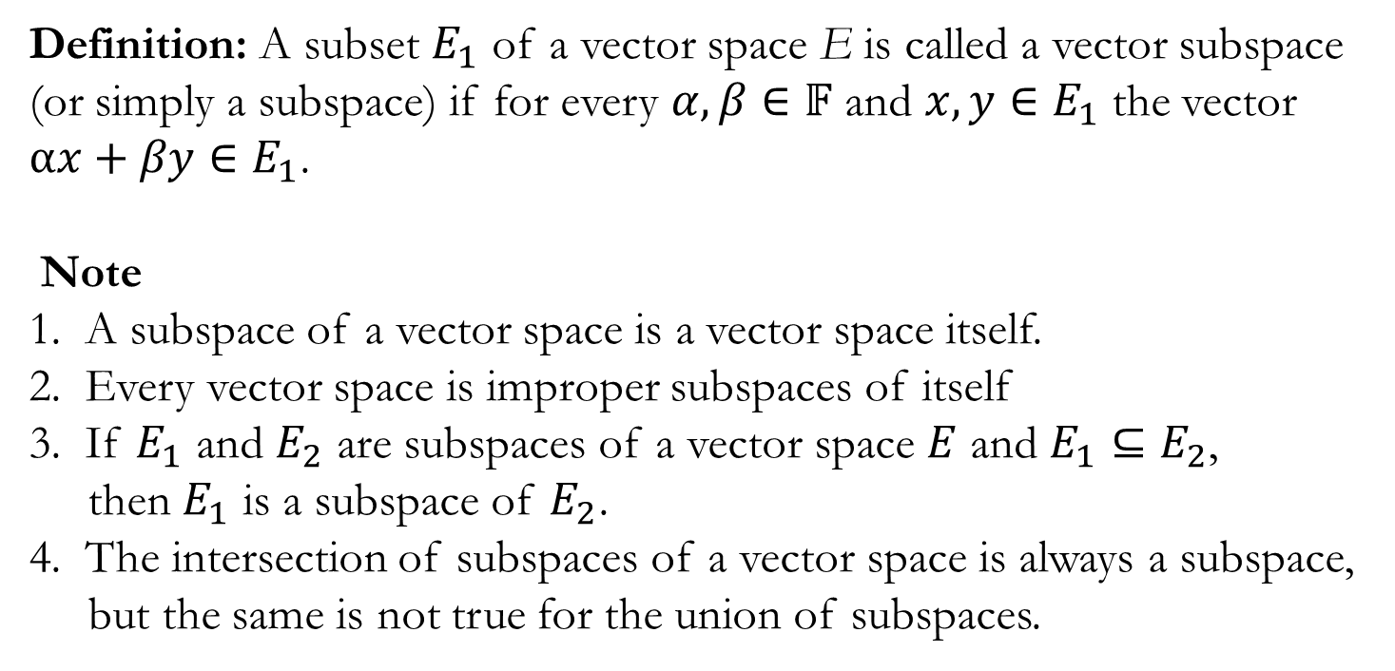
Vector Subspace
Definition: A subset $E_{1}$of a vector space E is called a vector subspace (or simply a subspace) if for every $α,β∈𝔽$and $x,y∈E_{1}$ the vector $αx+βy∈E_{1}$.
Note
1. A subspace of a vector space is a vector space itself.
2. Every vector space is improper subspaces of itself
3. If $E_{1}$ and $E_{2}$ are subspaces of a vector space $E$and $E_{1}⊆E_{2}$,
then $E_{1}$ is a subspace of $E_{2}$.
4. The intersection of subspaces of a vector space is always a subspace,
but the same is not true for the union of subspaces.

Slide 12
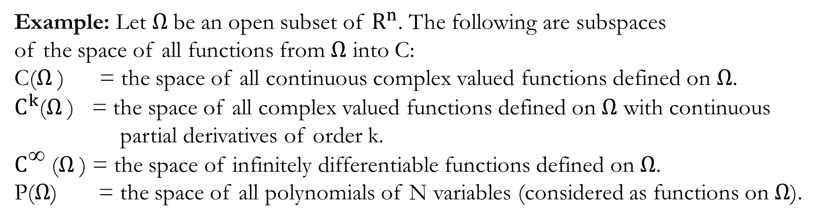
Example: Let $Ω$be an open subset of $R^{n}$. The following are subspaces
of the space of all functions from $Ω$ into C:
C($Ω$) = the space of all continuous complex valued functions defined on $Ω$.
$C^{k}$($Ω$) = the space of all complex valued functions defined on $Ω$ with continuous
partial derivatives of order k.
$C^{\text{∞}}$ ($Ω$) = the space of infinitely differentiable functions defined on $Ω$.
P($Ω$) = the space of all polynomials of N variables (considered as functions on $Ω$).

Slide 13

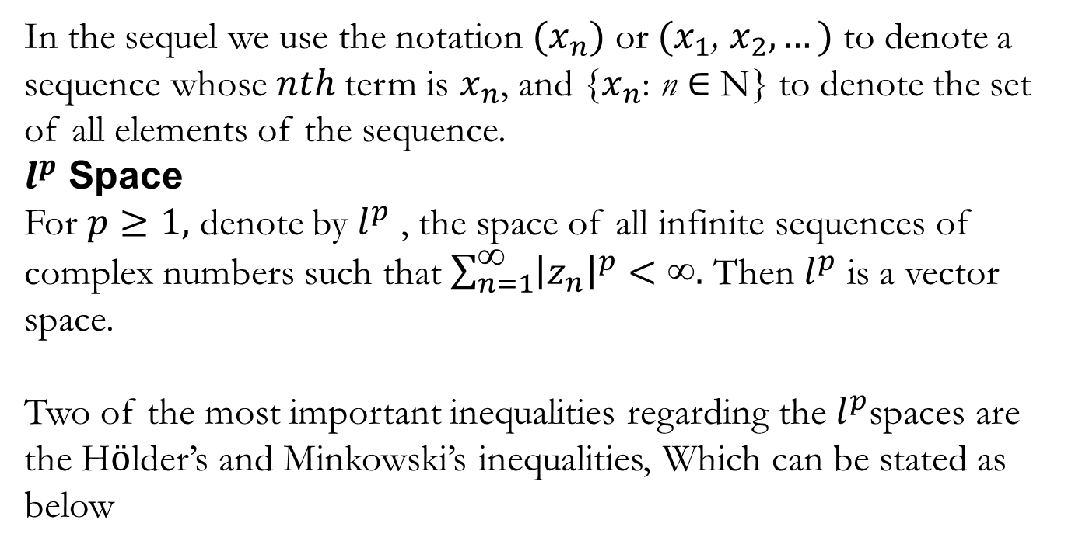
$l^{p}$ Space
In the sequel we use the notation $(x_{n})$or $(x_{1}$, $x_{2},…)$to denote a sequence whose $nth$term is $x_{n}$, and {$x_{n}$: n ∈ N} to denote the set of all elements of the sequence.
$l^{p}$Space
For $p≥1,$ denote by $l^{p}$ , the space of all infinite sequences of complex numbers such that $\sum_{n=1}^{\text{∞}}{{\left|z_{n}\right|}^{p}<\text{∞}.}$ Then $l^{p}$ is a vector space.
Two of the most important inequalities regarding the $l^{p}$spaces are the Hӧlder’s and Minkowski’s inequalities, Which can be stated as below

Slide 14
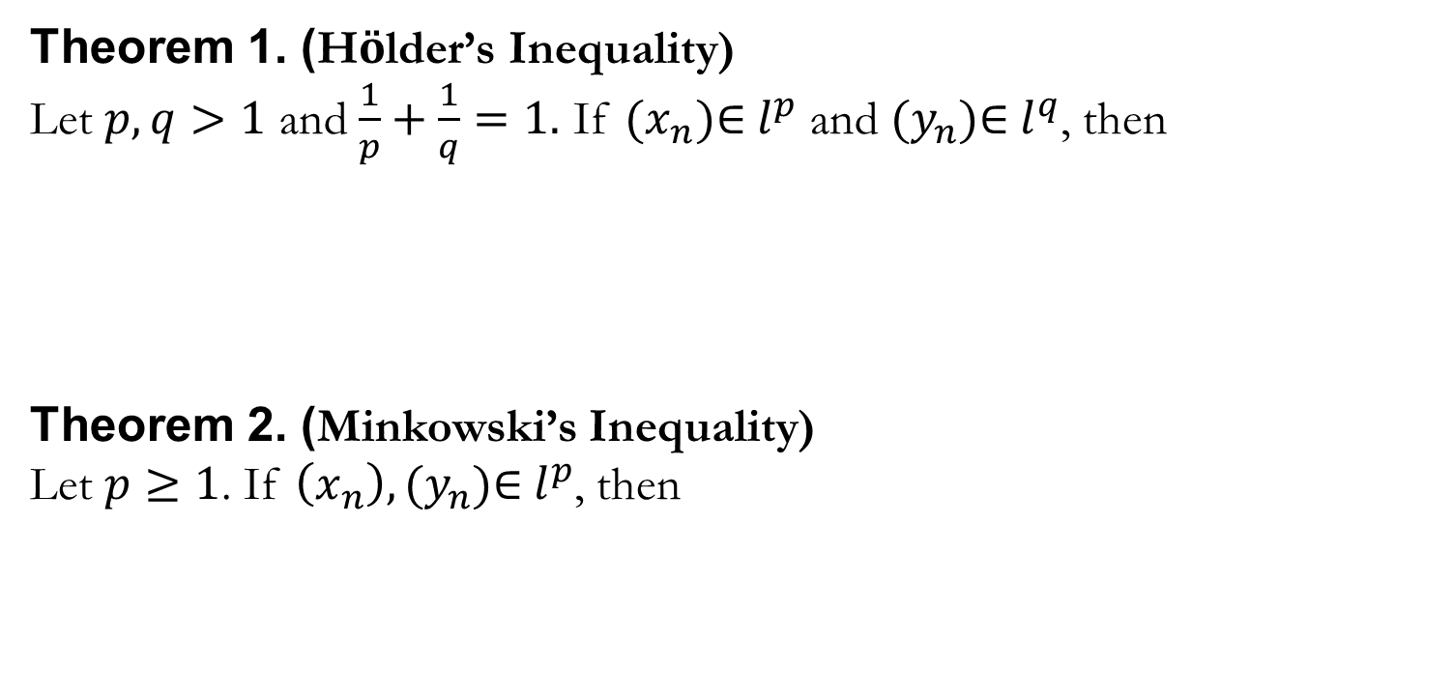
Theorem 1. (Hӧlder’s Inequality)
Let $p,q>1$and $\frac{1}{p}+\frac{1}{q}=1.$ If $({x_{n})\text{∈} l}^{p}$ and $({y_{n})\text{∈} l}^{q}$, then
Theorem 2. (Minkowski’s Inequality)
Let $p≥1$. If $\left(x_{n}\right), ({y_{n})\text{∈} l}^{p}$, then

