Slide 1
Course Outline
Kinematics (Chapter 4 + Extra)
Rotating coordinate systems, Rotation matrix,
Velocity and acceleration in cylindrical and spherical coordinates
Lagrangian Mechanics (Chapter 1 + 2)
Generalized coordinates, Constraints, Degrees of freedom, Generalized velocities, Generalized forces, Kinetic energy

Slide 2
Course Outline Cont’d...
Lagrange's Equations (Chapter 1)
Principle of d'Alembert, Lagrange equations of motion, Lagrange multipliers, Equations of motion for holonomic and nonholonomic systems with multipliers
Variational Calculus (Chapter 2 + 9 + 10)
Hamilton's principle, Canonical equations, Ignorable coordinates, Hamilton-Jacobi theory, Theory of small oscillations or canonical transformations

Slide 3
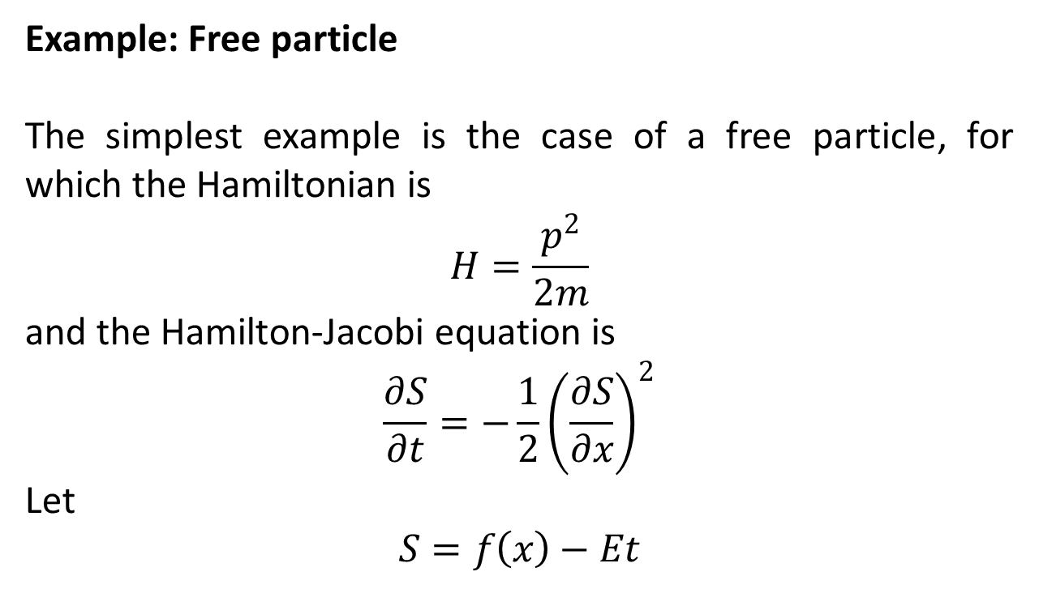
Miscellaneous Problems
Example: Free particle
The simplest example is the case of a free particle, for which the Hamiltonian is
$$H=\frac{p^{2}}{2m}$$
and the Hamilton-Jacobi equation is
$$\frac{∂S}{∂t}=−\frac{1}{2}{\left(\frac{∂S}{∂x}\right)}^{2}$$
Let
$$S=f\left(x\right)−Et$$

Slide 4
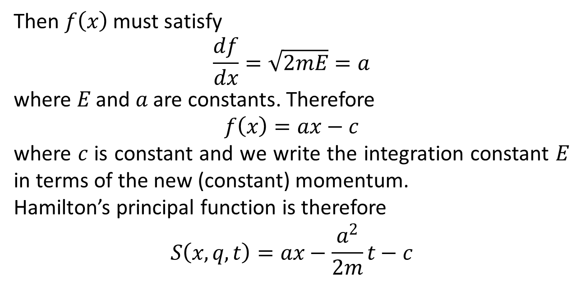
Then $f\left(x\right)$ must satisfy
$$\frac{df}{dx}=\sqrt{2mE}=a$$
where $E$ and $a$ are constants. Therefore
$$f\left(x\right)=ax−c$$
where $c$ is constant and we write the integration constant $E$ in terms of the new (constant) momentum.
Hamilton’s principal function is therefore
$$S\left(x,q,t\right)=ax−\frac{a^{2}}{2m}t−c$$

Slide 5
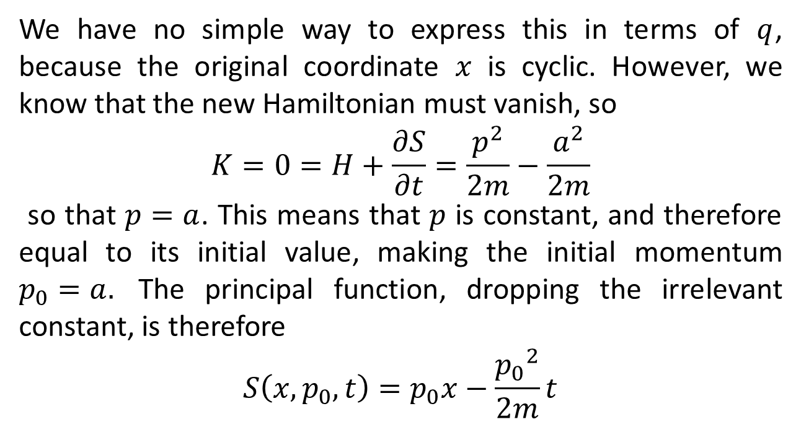
We have no simple way to express this in terms of $q$, because the original coordinate $x$ is cyclic. However, we know that the new Hamiltonian must vanish, so
$$K=0=H+\frac{∂S}{∂t}=\frac{p^{2}}{2m}−\frac{a^{2}}{2m}$$
so that $p=a$. This means that $p$ is constant, and therefore equal to its initial value, making the initial momentum $p_{0}=a.$ The principal function, dropping the irrelevant constant, is therefore
$$S\left(x,p_{0},t\right)=p_{0}x−\frac{{p_{0}}^{2}}{2m}t$$

Slide 6
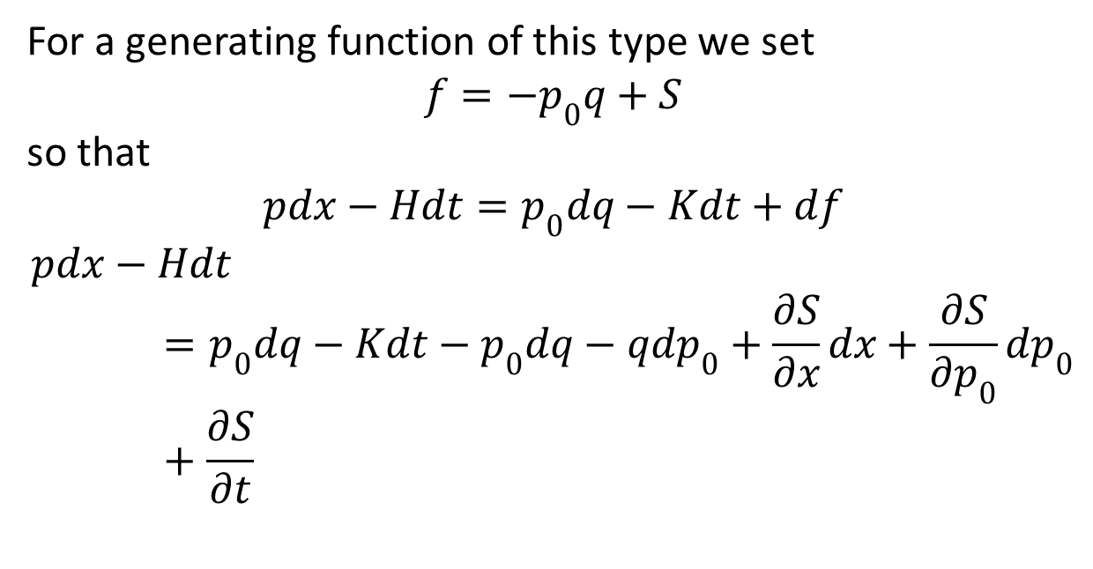
For a generating function of this type we set
$$f=−p_{0}q+S$$
so that
$$pdx−Hdt=p_{0}dq−Kdt+df$$
$$pdx−Hdt=p_{0}dq−Kdt−p_{0}dq−qdp_{0}+\frac{∂S}{∂x}dx+\frac{∂S}{∂p_{0}}dp_{0}+\frac{∂S}{∂t}$$

Slide 7
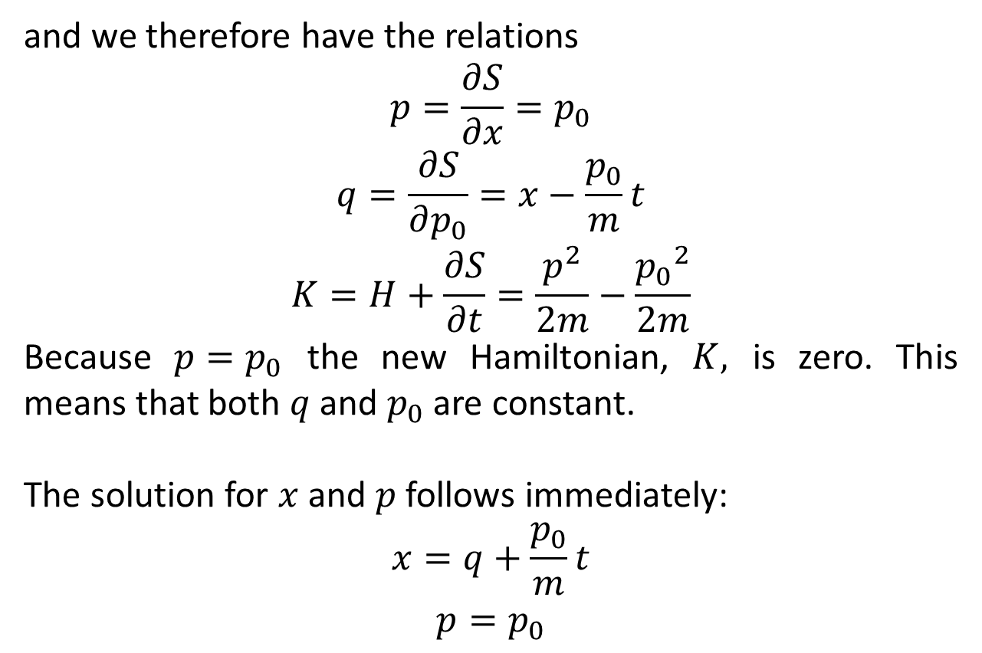
and we therefore have the relations
$$p=\frac{∂S}{∂x}=p_{0}$$
$$q=\frac{∂S}{∂p_{0}}=x−\frac{p_{0}}{m}t$$
$$K=H+\frac{∂S}{∂t}=\frac{p^{2}}{2m}−\frac{{p_{0}}^{2}}{2m}$$
Because $p=p_{0}$ the new Hamiltonian, $K,$ is zero. This means that both $q$ and $p_{0}$ are constant.
The solution for $x$ and $p$ follows immediately:
$$x=q+\frac{p_{0}}{m}t$$
$$p=p_{0}$$

Slide 8
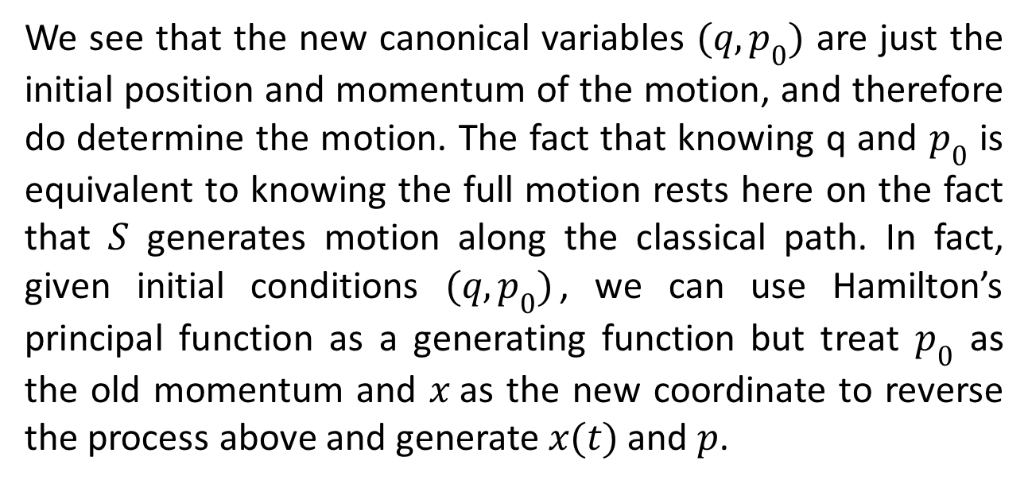
We see that the new canonical variables $(q,p_{0})$ are just the initial position and momentum of the motion, and therefore do determine the motion. The fact that knowing q and $p_{0}$ is equivalent to knowing the full motion rests here on the fact that $S$ generates motion along the classical path. In fact, given initial conditions $(q,p_{0})$, we can use Hamilton’s principal function as a generating function but treat $p_{0}$ as the old momentum and $x$as the new coordinate to reverse the process above and generate $x(t)$ and $p$.

Slide 9
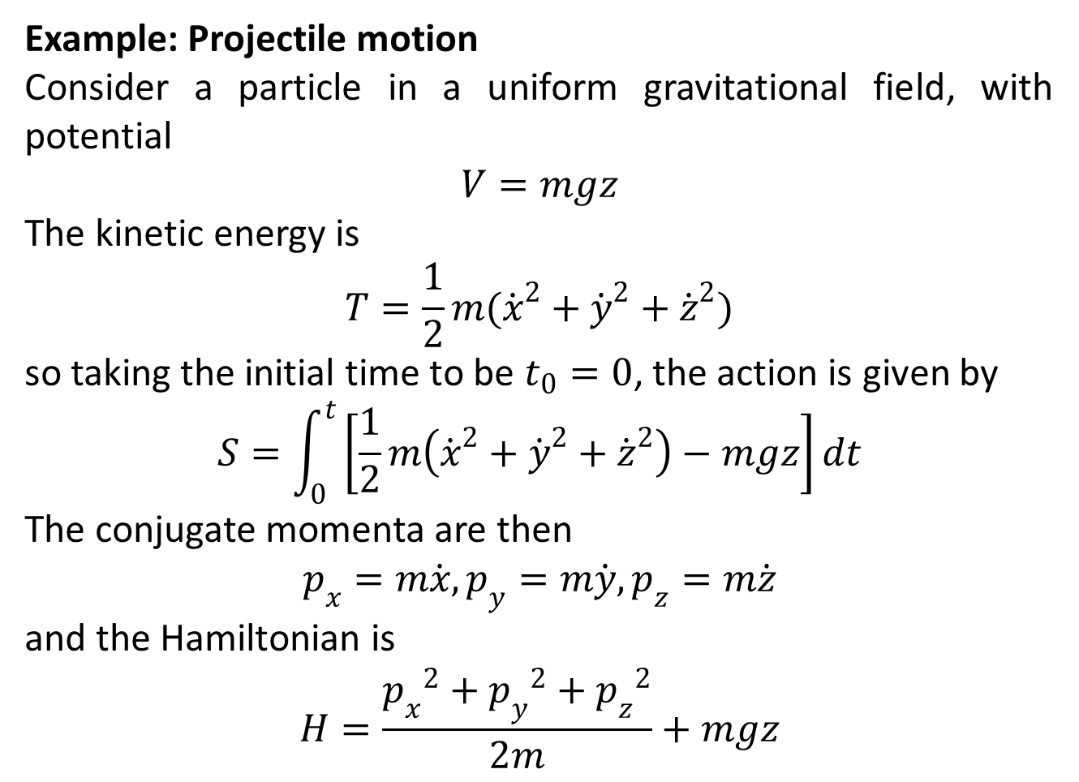
Example: Projectile motion
Consider a particle in a uniform gravitational field, with potential
$$V=mgz$$
The kinetic energy is
$$T=\frac{1}{2}m({\dot{x}}^{2}+{\dot{y}}^{2}+{\dot{z}}^{2})$$
so taking the initial time to be $t_{0}=0$, the action is given by
$$S=\int_{0}^{t}{\left[\frac{1}{2}m\left({\dot{x}}^{2}+{\dot{y}}^{2}+{\dot{z}}^{2}\right)−mgz\right]dt}$$
The conjugate momenta are then
$$p_{x}=m\dot{x}, p_{y}=m\dot{y}, p_{z}=m\dot{z}$$
and the Hamiltonian is
$$H=\frac{{p_{x}}^{2}+{p_{y}}^{2}+{p_{z}}^{2}}{2m}+mgz$$

Slide 10
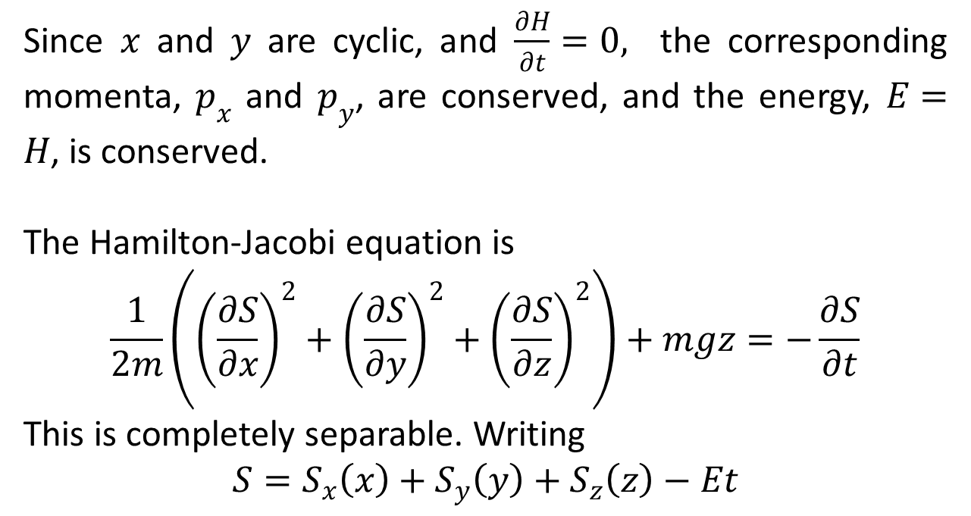
Since $x$ and $y$ are cyclic, and $\frac{∂H}{∂t}=0,$ the corresponding momenta, $p_{x}$ and $p_{y}$, are conserved, and the energy, $E=H$, is conserved.
The Hamilton-Jacobi equation is
$$\frac{1}{2m}\left({\left(\frac{∂S}{∂x}\right)}^{2}+{\left(\frac{∂S}{∂y}\right)}^{2}+{\left(\frac{∂S}{∂z}\right)}^{2}\right)+mgz=−\frac{∂S}{∂t}$$
This is completely separable. Writing
$$S=S_{x}\left(x\right)+S_{y}\left(y\right)+S_{z}\left(z\right)−Et$$

Slide 11
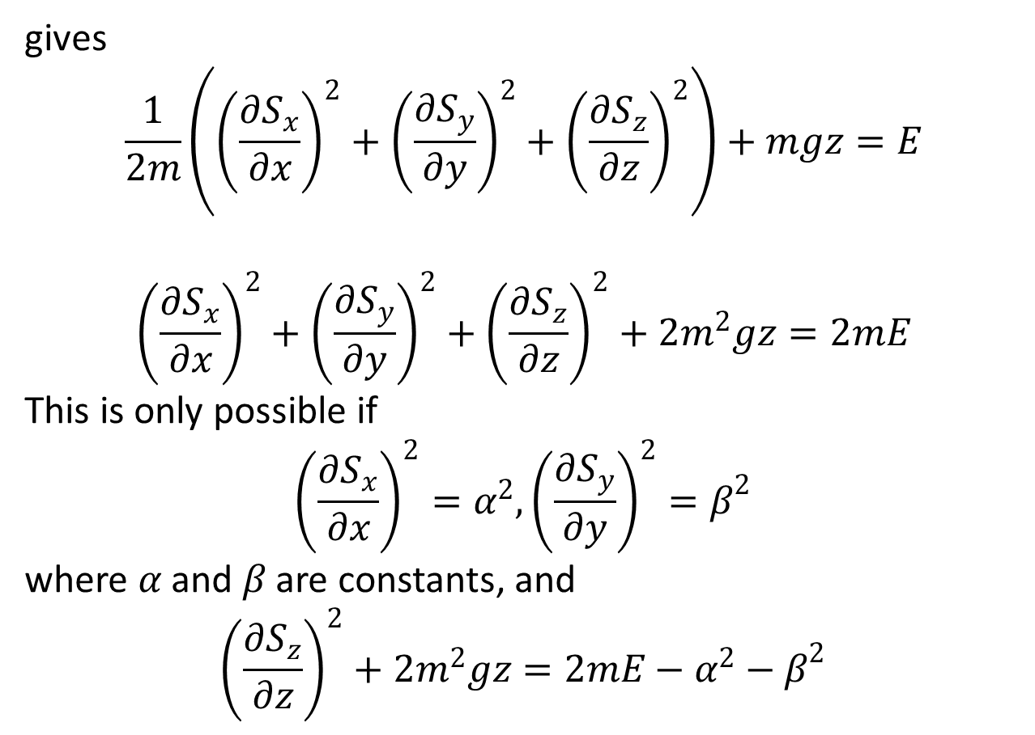
gives
$$\frac{1}{2m}\left({\left(\frac{∂S_{x}}{∂x}\right)}^{2}+{\left(\frac{∂S_{y}}{∂y}\right)}^{2}+{\left(\frac{∂S_{z}}{∂z}\right)}^{2}\right)+mgz=E$$
$${\left(\frac{∂S_{x}}{∂x}\right)}^{2}+{\left(\frac{∂S_{y}}{∂y}\right)}^{2}+{\left(\frac{∂S_{z}}{∂z}\right)}^{2}+2m^{2}gz=2mE$$
This is only possible if
$${\left(\frac{∂S_{x}}{∂x}\right)}^{2}=α^{2},{\left(\frac{∂S_{y}}{∂y}\right)}^{2}=β^{2}$$
where $α$ and $β$ are constants, and
$${\left(\frac{∂S_{z}}{∂z}\right)}^{2}+2m^{2}gz=2mE−α^{2}−β^{2}$$

Slide 12
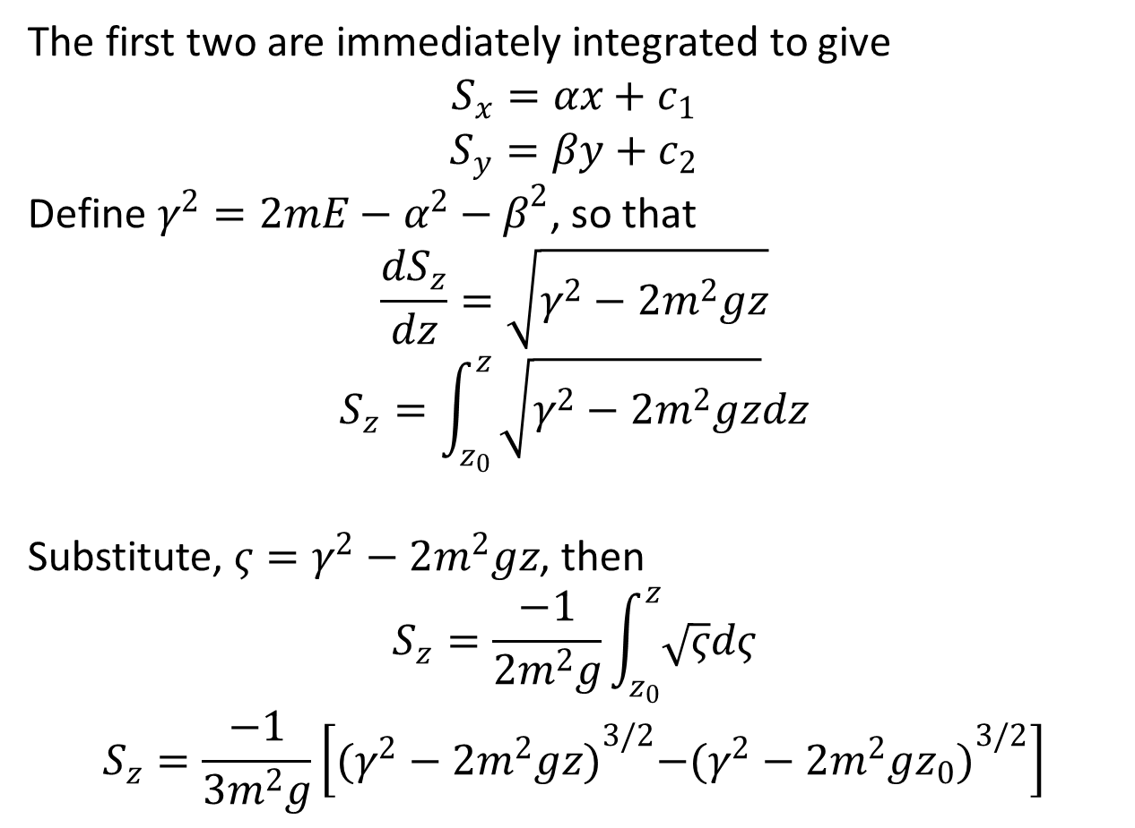
The first two are immediately integrated to give
$$S_{x}=αx+c_{1}$$
$$S_{y}=βy+c_{2}$$
Define $γ^{2}=2mE−α^{2}−β^{2}$, so that
$$\frac{dS_{z}}{dz}=\sqrt{γ^{2}−2m^{2}gz}$$
$$S_{z}=\int_{z_{0}}^{z}{\sqrt{γ^{2}−2m^{2}gz}dz}$$
Substitute, $ς=γ^{2}−2m^{2}gz$, then
$$S_{z}=\frac{−1}{2m^{2}g}\int_{z_{0}}^{z}{\sqrt{ς}dς}$$
$$S_{z}=\frac{−1}{3m^{2}g}\left[{(γ^{2}−2m^{2}gz)}^{3/2}−{(γ^{2}−2m^{2}gz_{0})}^{3/2}\right]$$

Slide 13
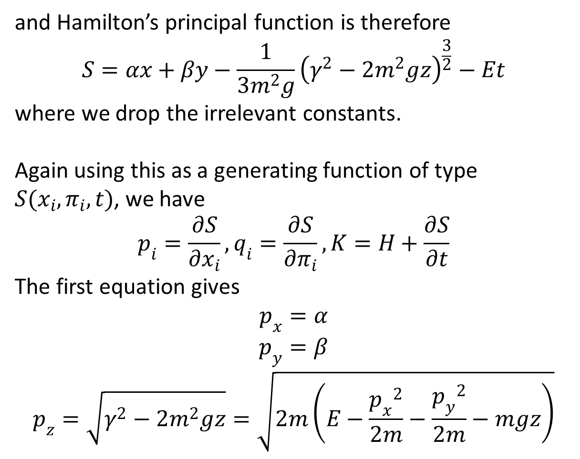
and Hamilton’s principal function is therefore
$$S=αx+βy−\frac{1}{3m^{2}g}{\left(γ^{2}−2m^{2}gz\right)}^{\frac{3}{2}}−Et$$
where we drop the irrelevant constants.
Again using this as a generating function of type $S(x_{i},π_{i},t)$, we have
$$p_{i}=\frac{∂S}{∂x_{i}},q_{i}=\frac{∂S}{∂π_{i}},K=H+\frac{∂S}{∂t}$$
The first equation gives
$$p_{x}=α$$
$$p_{y}=β$$
$$p_{z}=\sqrt{γ^{2}−2m^{2}gz}=\sqrt{2m\left(E−\frac{{p_{x}}^{2}}{2m}−\frac{{p_{y}}^{2}}{2m}−mgz\right)}$$

Slide 14
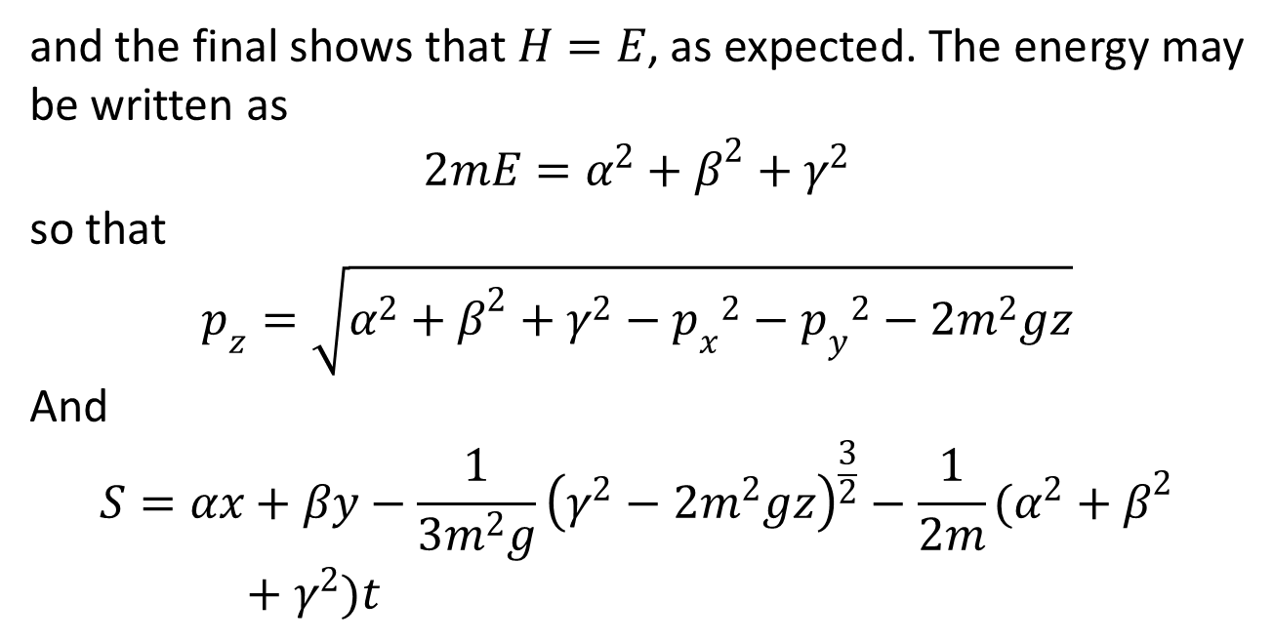
and the final shows that $H=E$, as expected. The energy may be written as
$$2mE=α^{2}+β^{2}+γ^{2}$$
so that
$$p_{z}=\sqrt{α^{2}+β^{2}+γ^{2}−{p_{x}}^{2}−{p_{y}}^{2}−2m^{2}gz}$$
And
$$S=αx+βy−\frac{1}{3m^{2}g}{\left(γ^{2}−2m^{2}gz\right)}^{\frac{3}{2}}−\frac{1}{2m}(α^{2}+β^{2}+γ^{2})t$$

Slide 15
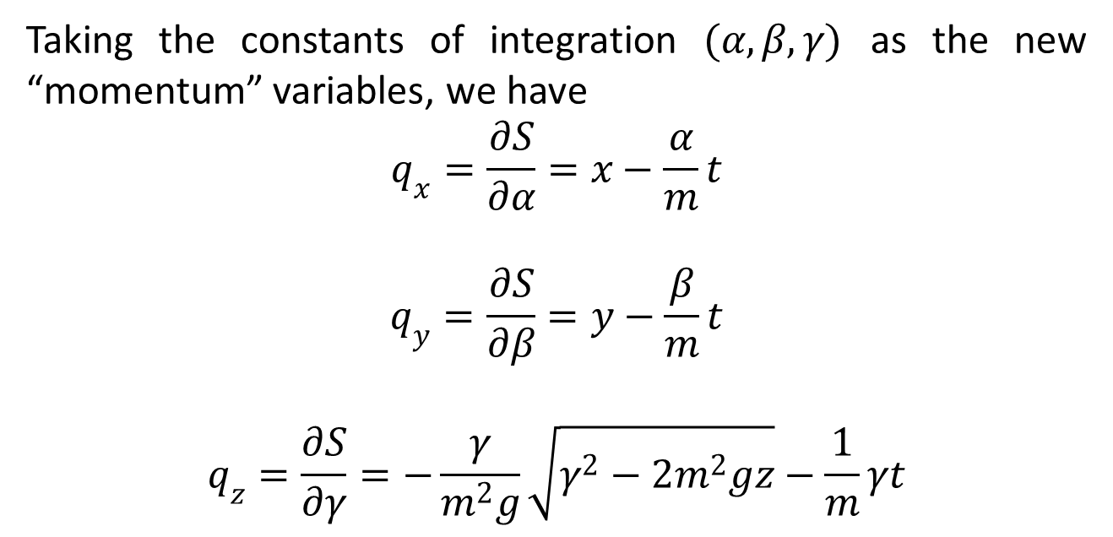
Taking the constants of integration $(α,β,γ)$ as the new “momentum” variables, we have
$$q_{x}=\frac{∂S}{∂α}=x−\frac{α}{m}t$$
$$q_{y}=\frac{∂S}{∂β}=y−\frac{β}{m}t$$
$$q_{z}=\frac{∂S}{∂γ}=−\frac{γ}{m^{2}g}\sqrt{γ^{2}−2m^{2}gz}−\frac{1}{m}γt$$

Slide 16
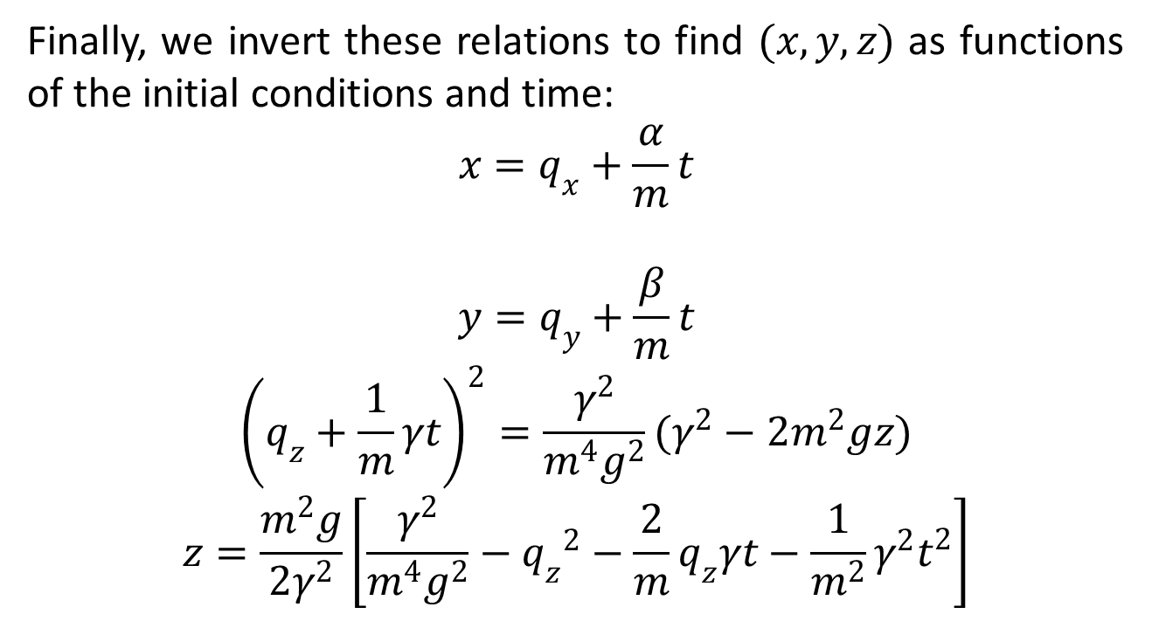
Finally, we invert these relations to find $(x,y,z)$ as functions of the initial conditions and time:
$$x=q_{x}+\frac{α}{m}t$$
$$y=q_{y}+\frac{β}{m}t$$
$${\left(q_{z}+\frac{1}{m}γt\right)}^{2}=\frac{γ^{2}}{m^{4}g^{2}}(γ^{2}−2m^{2}gz)$$
$$z=\frac{m^{2}g}{2γ^{2}}\left[\frac{γ^{2}}{m^{4}g^{2}}−{q_{z}}^{2}−\frac{2}{m}q_{z}γt−\frac{1}{m^{2}}γ^{2}t^{2}\right]$$

Slide 17

and we may identify
$$z_{0}=\frac{γ^{2}}{{2m}^{2}g}−\frac{m^{2}g{q_{z}}^{2}}{2γ^{2}}$$
$$\dot{z_{0}}=−\frac{mgq_{z}}{γ}$$

Slide 18
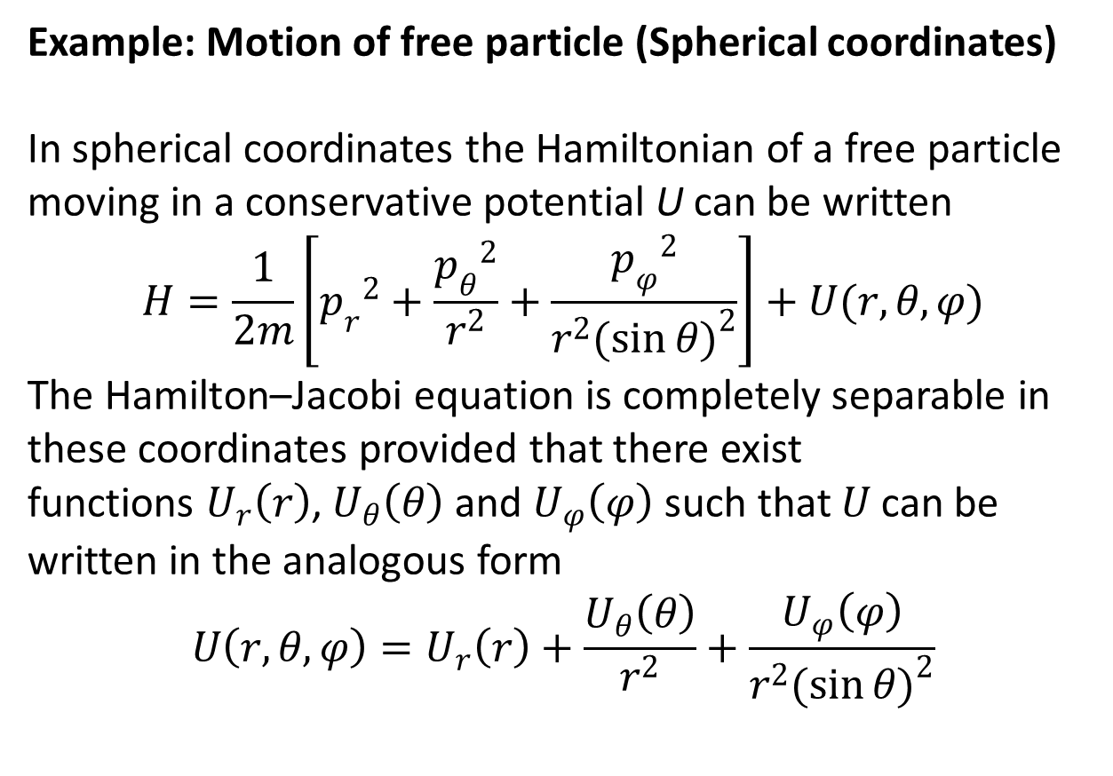
Example: Motion of free particle (Spherical coordinates)
In spherical coordinates the Hamiltonian of a free particle moving in a conservative potential U can be written
$$H=\frac{1}{2m}\left[{p_{r}}^{2}+\frac{{p_{θ}}^{2}}{r^{2}}+\frac{{p_{φ}}^{2}}{r^{2}{(\sin{θ})}^{2}}\right]+U(r,θ,φ)$$
The Hamilton–Jacobi equation is completely separable in these coordinates provided that there exist functions $U_{r}\left(r\right)$, $U_{θ}\left(θ\right)$ and $U_{φ}\left(φ\right)$ such that $U$ can be written in the analogous form
$$U\left(r,θ,φ\right)=U_{r}\left(r\right)+\frac{U_{θ}\left(θ\right)}{r^{2}}+\frac{U_{φ}\left(φ\right)}{r^{2}{(\sin{θ})}^{2}}$$

Slide 19
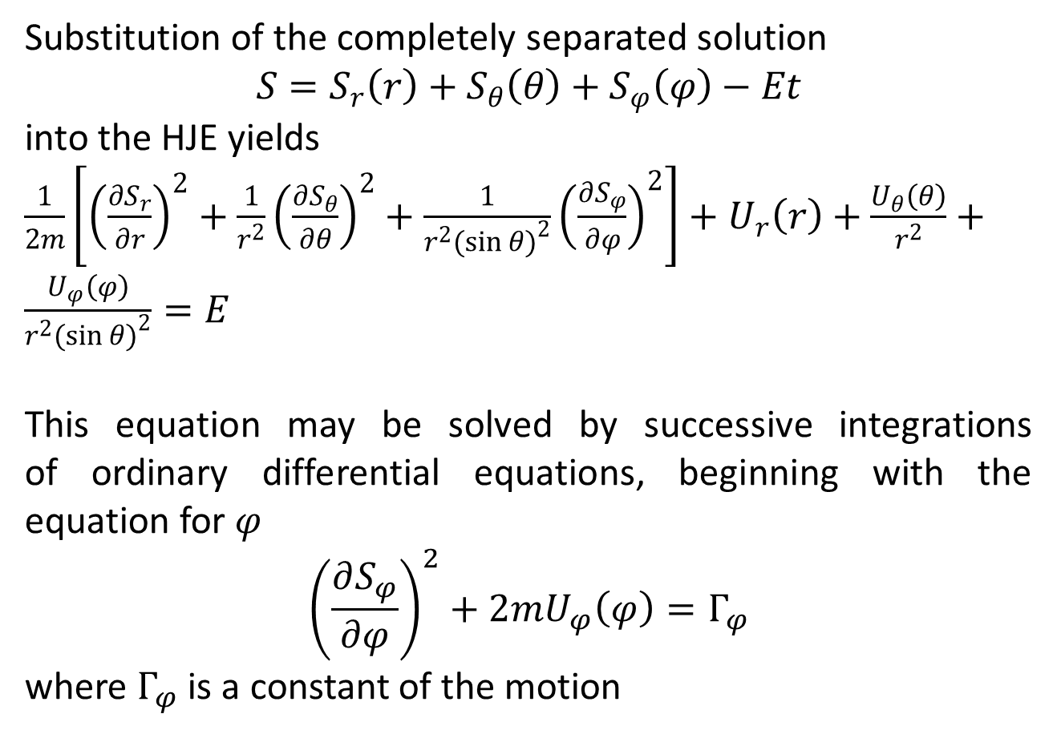
Substitution of the completely separated solution
$$S=S_{r}\left(r\right)+S_{θ}\left(θ\right)+S_{φ}\left(φ\right)−Et$$
into the HJE yields
$\frac{1}{2m}\left[{\left(\frac{∂S_{r}}{∂r}\right)}^{2}+\frac{1}{r^{2}}{\left(\frac{∂S_{θ}}{∂θ}\right)}^{2}+\frac{1}{r^{2}{(\sin{θ})}^{2}}{\left(\frac{∂S_{φ}}{∂φ}\right)}^{2}\right]+U_{r}\left(r\right)+\frac{U_{θ}\left(θ\right)}{r^{2}}+\frac{U_{φ}\left(φ\right)}{r^{2}{(\sin{θ})}^{2}}=E$
This equation may be solved by successive integrations of ordinary differential equations, beginning with the equation for $φ$
$${\left(\frac{∂S_{φ}}{∂φ}\right)}^{2}+2mU_{φ}\left(φ\right)=Γ_{φ}$$
where $Γ_{φ}$ is a constant of the motion

Slide 20
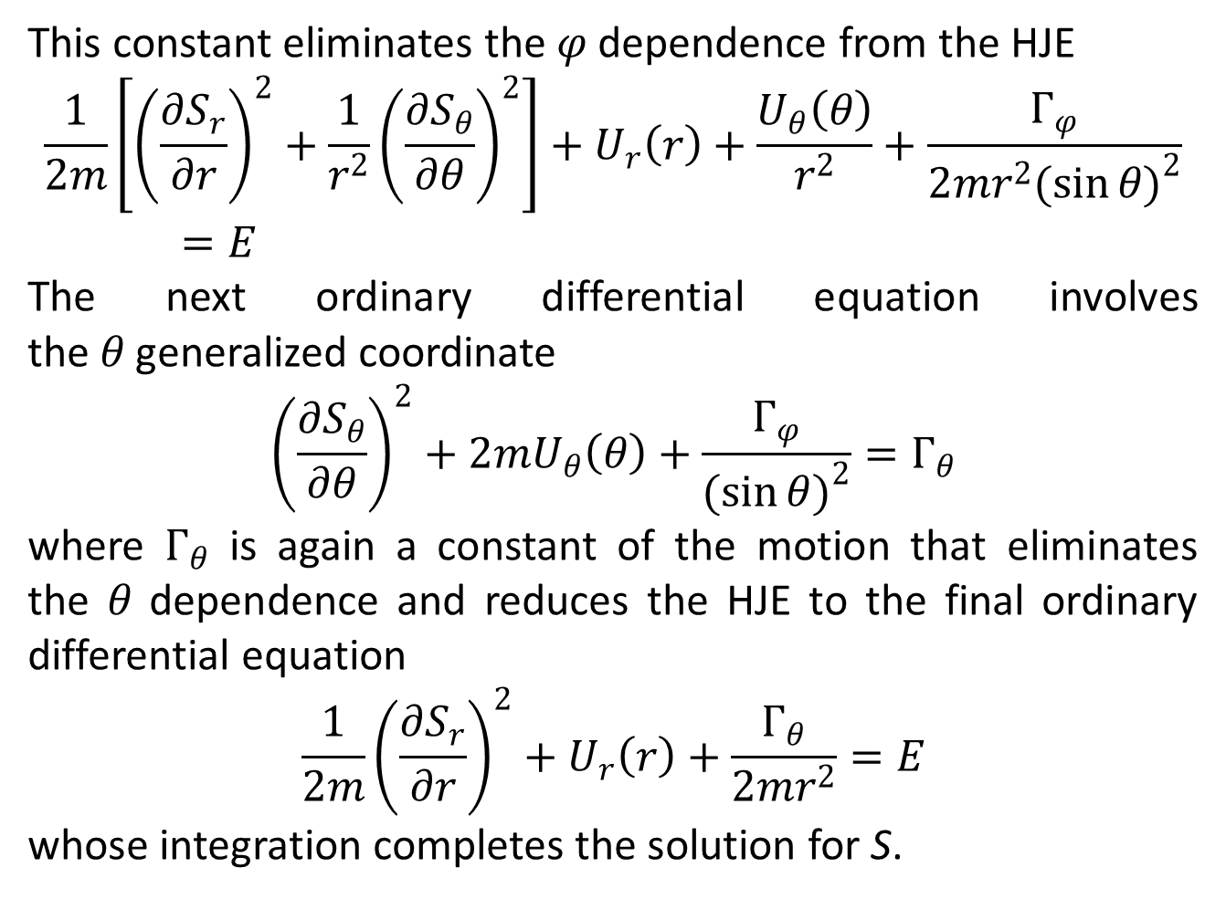
This constant eliminates the $φ$ dependence from the HJE
$$\frac{1}{2m}\left[{\left(\frac{∂S_{r}}{∂r}\right)}^{2}+\frac{1}{r^{2}}{\left(\frac{∂S_{θ}}{∂θ}\right)}^{2}\right]+U_{r}\left(r\right)+\frac{U_{θ}\left(θ\right)}{r^{2}}+\frac{Γ_{φ}}{2mr^{2}{(\sin{θ})}^{2}}=E$$
The next ordinary differential equation involves the $θ$ generalized coordinate
$${\left(\frac{∂S_{θ}}{∂θ}\right)}^{2}+2mU_{θ}\left(θ\right)+\frac{Γ_{φ}}{{(\sin{θ})}^{2}}=Γ_{θ}$$
where $Γ_{θ}$ is again a constant of the motion that eliminates the $θ$ dependence and reduces the HJE to the final ordinary differential equation
$$\frac{1}{2m}{\left(\frac{∂S_{r}}{∂r}\right)}^{2}+U_{r}\left(r\right)+\frac{Γ_{θ}}{2mr^{2}}=E$$
whose integration completes the solution for S.

Slide 22
The End

