Slide 1
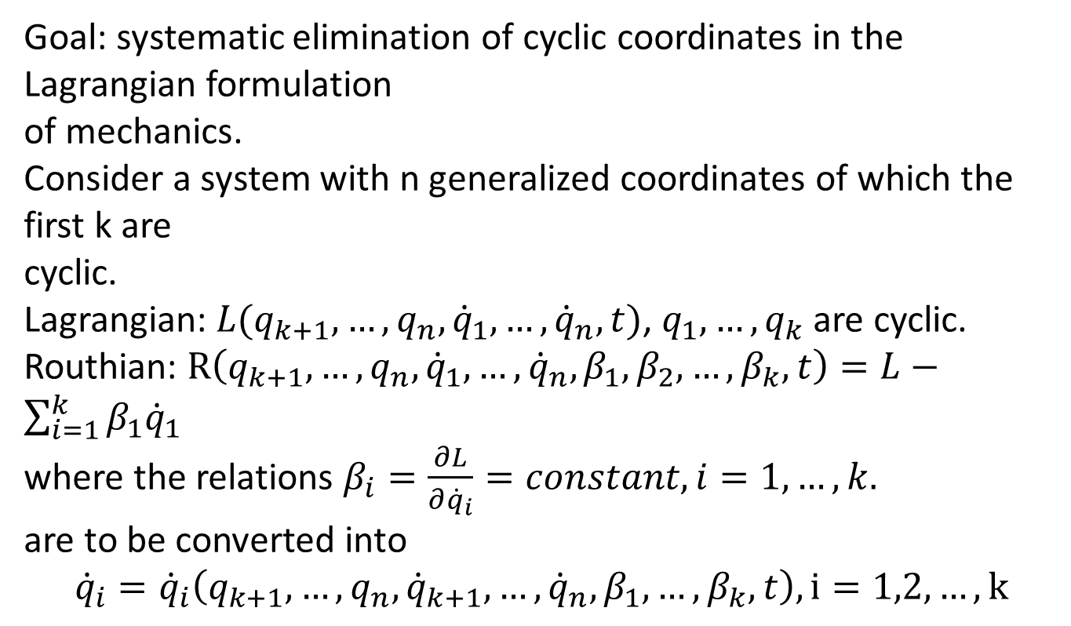
Routhian Function
Piggi):

Slide 2
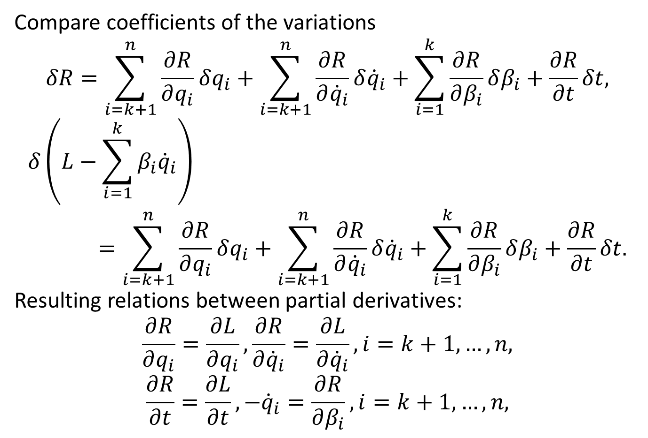
Compare coefficients of the variations
$$δR=\sum_{i=k+1}^{n}{\frac{∂R}{∂q_{i}}δq_{i}}+\sum_{i=k+1}^{n}{\frac{∂R}{∂{\dot{q}}_{i}}δ{\dot{q}}_{i}}+\sum_{i=1}^{k}{\frac{∂R}{∂β_{i}}δβ_{i}}+\frac{∂R}{∂t}δt,$$
$$δ\left(L−\sum_{i=1}^{k}{β_{i}{\dot{q}}_{i}}\right)=\sum_{i=k+1}^{n}{\frac{∂R}{∂q_{i}}δq_{i}}+\sum_{i=k+1}^{n}{\frac{∂R}{∂{\dot{q}}_{i}}δ{\dot{q}}_{i}}+\sum_{i=1}^{k}{\frac{∂R}{∂β_{i}}δβ_{i}}+\frac{∂R}{∂t}δt.$$
Resulting relations between partial derivatives:
$$\frac{∂R}{∂q_{i}}=\frac{∂L}{∂q_{i}},\frac{∂R}{∂{\dot{q}}_{i}}=\frac{∂L}{∂{\dot{q}}_{i}},i=k+1,…,n,$$
$$\frac{∂R}{∂t}=\frac{∂L}{∂t},−{\dot{q}}_{i}=\frac{∂R}{∂β_{i}},i=k+1,…,n,$$

Slide 3
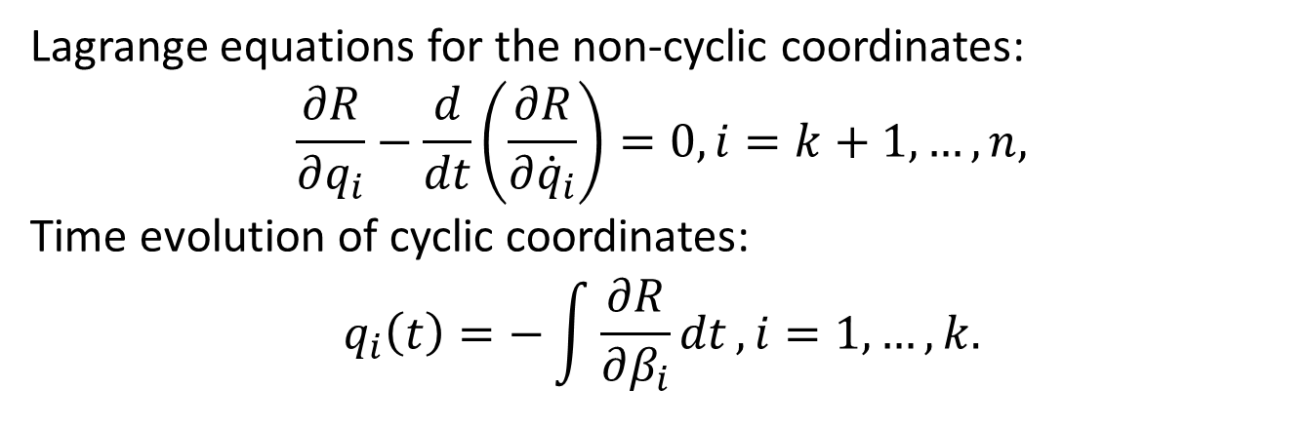
Lagrange equations for the non-cyclic coordinates:
$$\frac{∂R}{∂q_{i}}−\frac{d}{dt}\left(\frac{∂R}{∂{\dot{q}}_{i}}\right)=0,i=k+1,…,n,$$
Time evolution of cyclic coordinates:
$$q_{i}\left(t\right)=−\int{\frac{∂R}{∂β_{i}}dt},i=1,…,k.$$

Slide 4
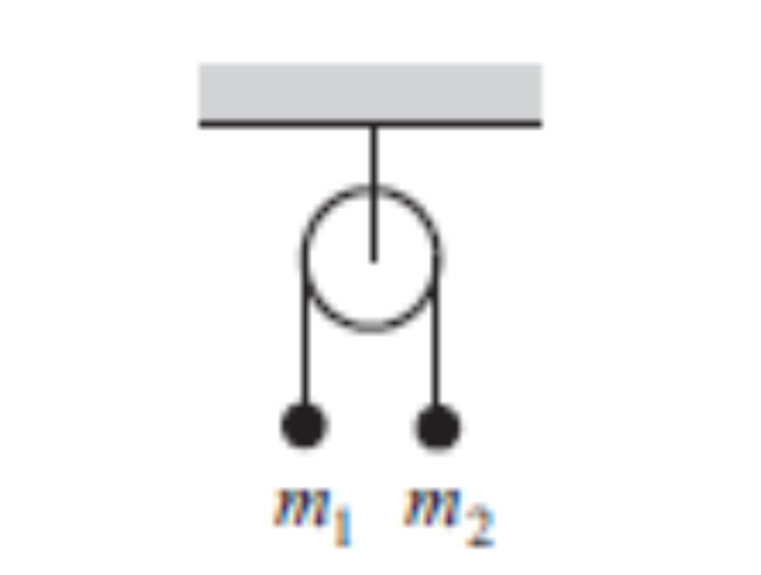
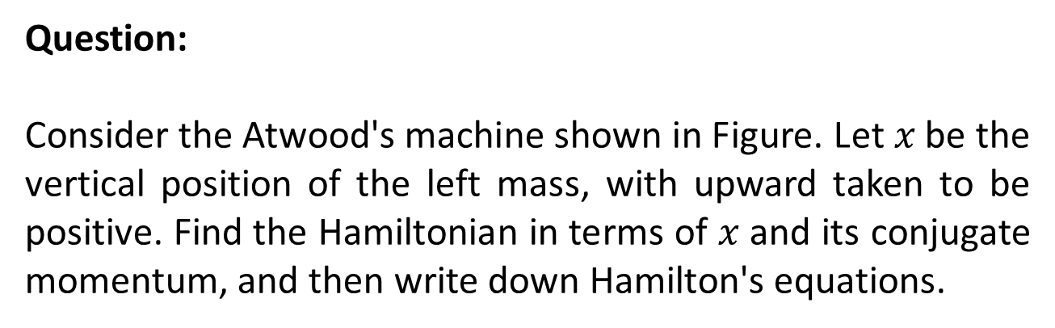
Miscalleneous Problems
Question:
Consider the Atwood's machine shown in Figure. Let $x$be the vertical position of the left mass, with upward taken to be positive. Find the Hamiltonian in terms of $x$and its conjugate momentum, and then write down Hamilton's equations.

Slide 5
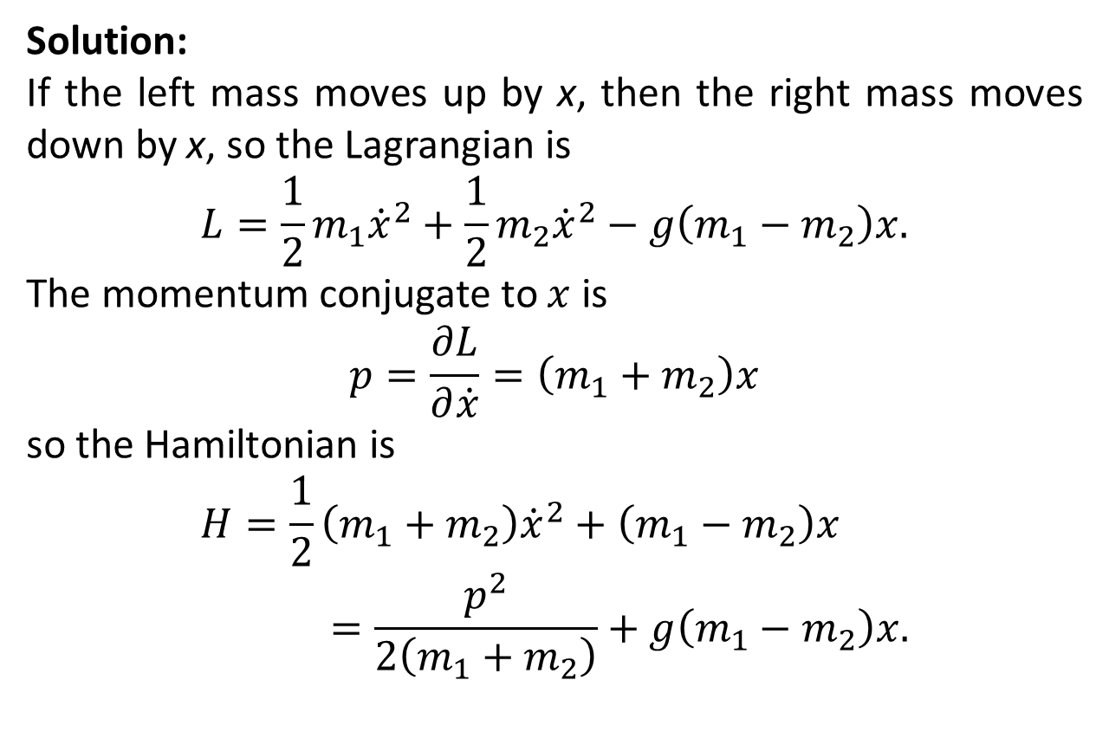
Solution:
If the left mass moves up by x, then the right mass moves down by x, so the Lagrangian is
$$L=\frac{1}{2}m_{1}{\dot{x}}^{2}+\frac{1}{2}m_{2}{\dot{x}}^{2}−g\left(m_{1}−m_{2}\right)x.$$
The momentum conjugate to $x$is
$$p=\frac{∂L}{∂\dot{x}}=\left(m_{1}+m_{2}\right)x$$
so the Hamiltonian is
$$H=\frac{1}{2}\left(m_{1}+m_{2}\right){\dot{x}}^{2}+\left(m_{1}−m_{2}\right)x=\frac{p^{2}}{2\left(m_{1}+m_{2}\right)}+g\left(m_{1}−m_{2}\right)x.$$

Slide 7
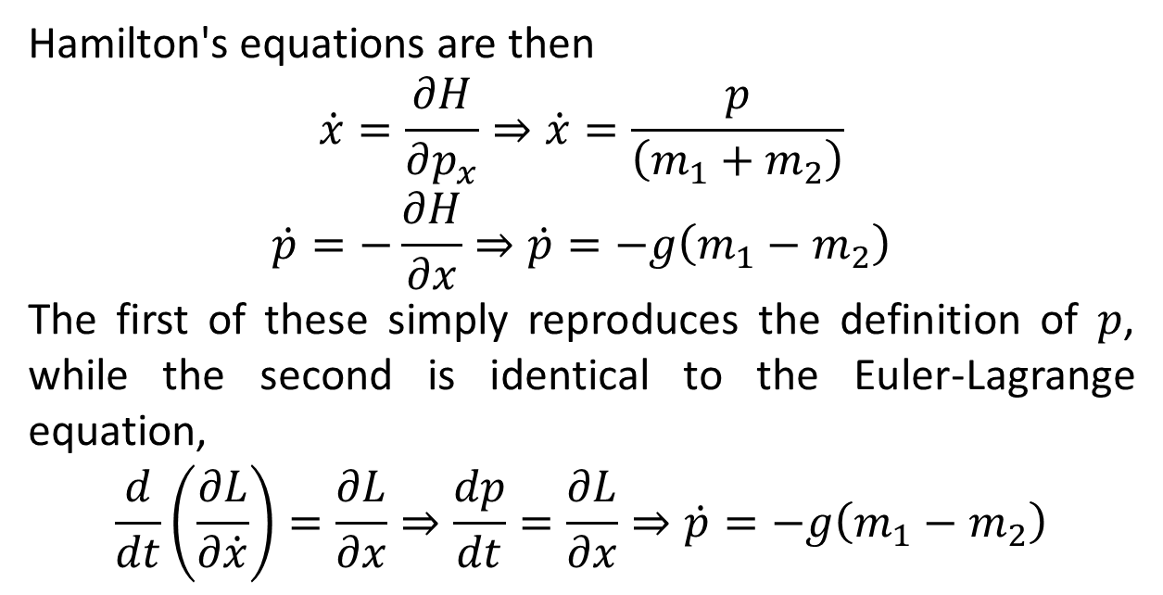
Hamilton's equations are then
$$\dot{x}=\frac{∂H}{∂p_{x}}⇒\dot{x}=\frac{p}{\left(m_{1}+m_{2}\right)}$$
$$\dot{p}=−\frac{∂H}{∂x}⇒\dot{p}=−g\left(m_{1}−m_{2}\right)$$
The first of these simply reproduces the definition of $p$, while the second is identical to the Euler-Lagrange equation,
$$\frac{d}{dt}\left(\frac{∂L}{∂\dot{x}}\right)=\frac{∂L}{∂x}⇒\frac{dp}{dt}=\frac{∂L}{∂x}⇒\dot{p}=−g\left(m_{1}−m_{2}\right)$$

Slide 8
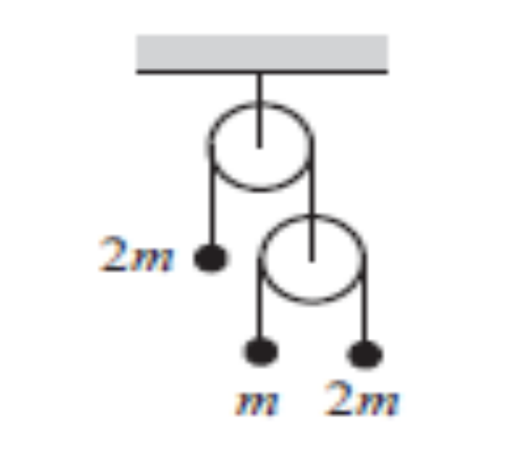
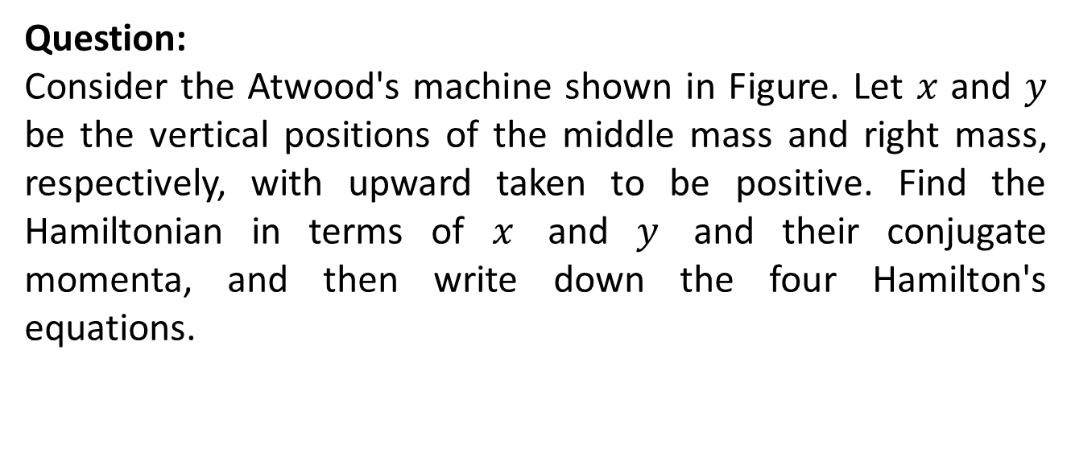
Question:
Consider the Atwood's machine shown in Figure. Let $x$and $y$be the vertical positions of the middle mass and right mass, respectively, with upward taken to be positive. Find the Hamiltonian in terms of $x$and $y$and their conjugate momenta, and then write down the four Hamilton's equations.

Slide 9
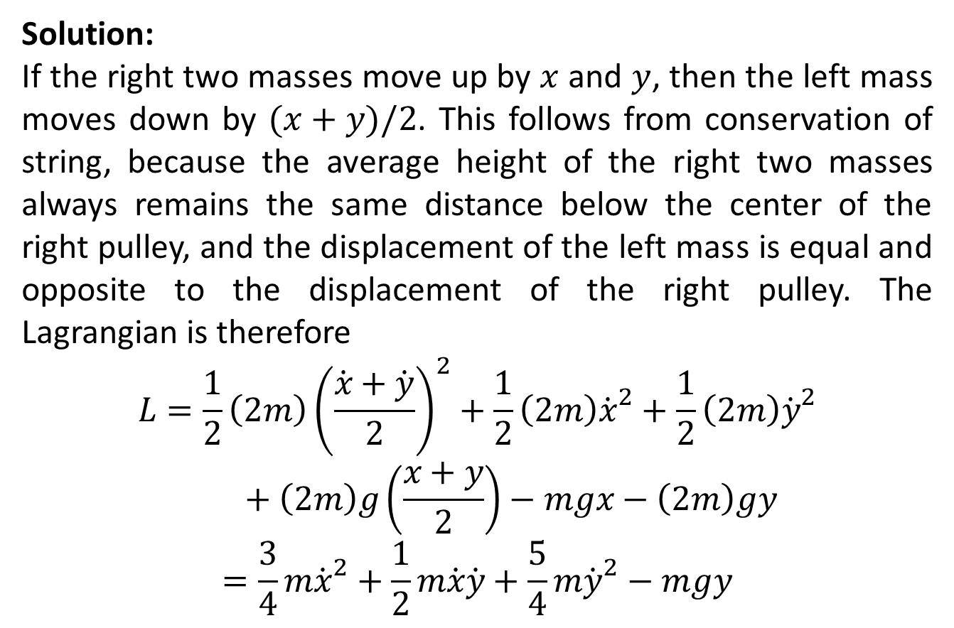
Solution:
If the right two masses move up by $x$and $y$, then the left mass moves down by $(x+y)/2$. This follows from conservation of string, because the average height of the right two masses always remains the same distance below the center of the right pulley, and the displacement of the left mass is equal and opposite to the displacement of the right pulley. The Lagrangian is therefore
$$L=\frac{1}{2}\left(2m\right){\left(\frac{\dot{x}+\dot{y}}{2}\right)}^{2}+\frac{1}{2}\left(2m\right){\dot{x}}^{2}+\frac{1}{2}\left(2m\right){\dot{y}}^{2}+\left(2m\right)g\left(\frac{x+y}{2}\right)−mgx−\left(2m\right)gy$$
$$=\frac{3}{4}m{\dot{x}}^{2}+\frac{1}{2}m\dot{x}\dot{y}+\frac{5}{4}m{\dot{y}}^{2}−mgy$$

Slide 11
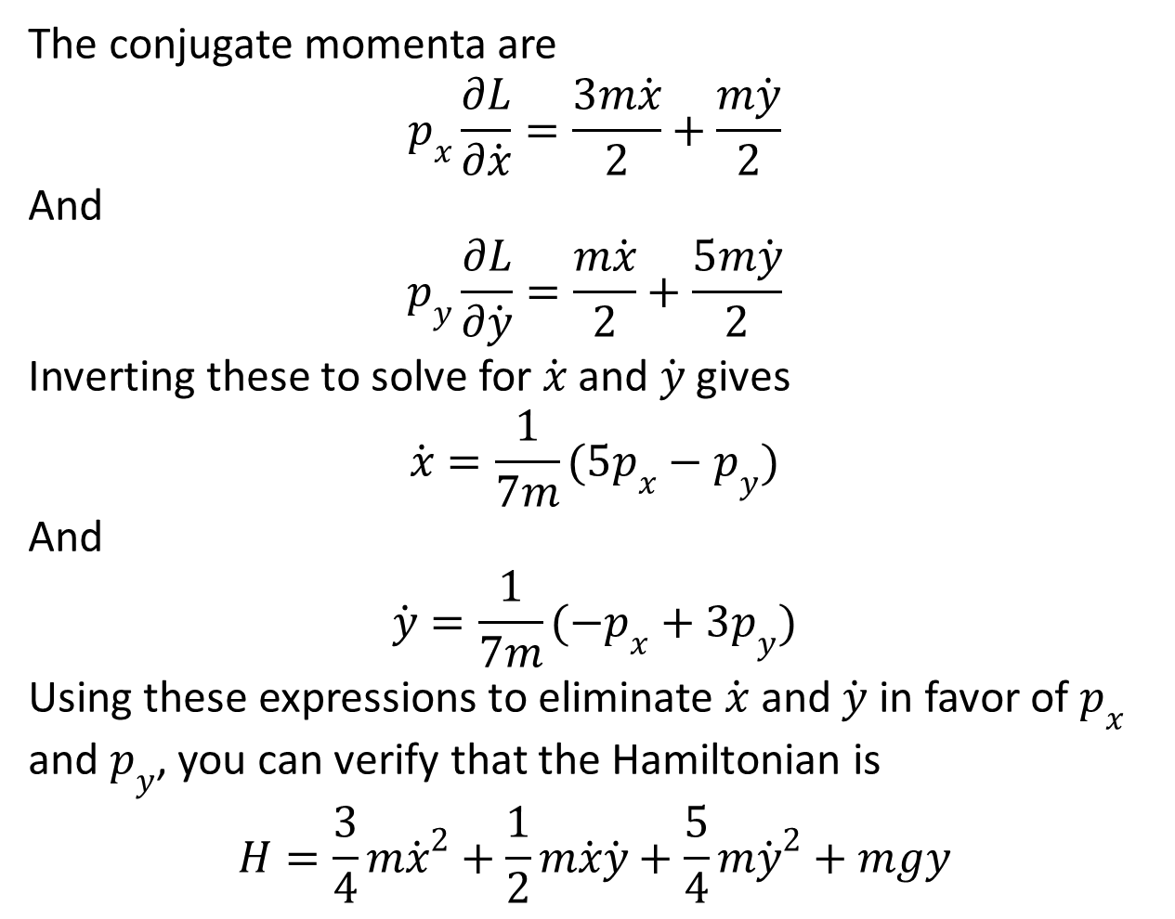
The conjugate momenta are
$$p_{x}\frac{∂L}{∂\dot{x}}=\frac{3m\dot{x}}{2}+\frac{m\dot{y}}{2}$$
And
$$p_{y}\frac{∂L}{∂\dot{y}}=\frac{m\dot{x}}{2}+\frac{5m\dot{y}}{2}$$
Inverting these to solve for $\dot{x}$ and $\dot{y}$ gives
$$\dot{x}=\frac{1}{7m}(5p_{x}−p_{y})$$
And
$$\dot{y}=\frac{1}{7m}(−p_{x}+3p_{y})$$
Using these expressions to eliminate $\dot{x}$ and $\dot{y}$ in favor of $p_{x}$and $p_{y}$, you can verify that the Hamiltonian is
$$H=\frac{3}{4}m{\dot{x}}^{2}+\frac{1}{2}m\dot{x}\dot{y}+\frac{5}{4}m{\dot{y}}^{2}+mgy$$

Slide 13
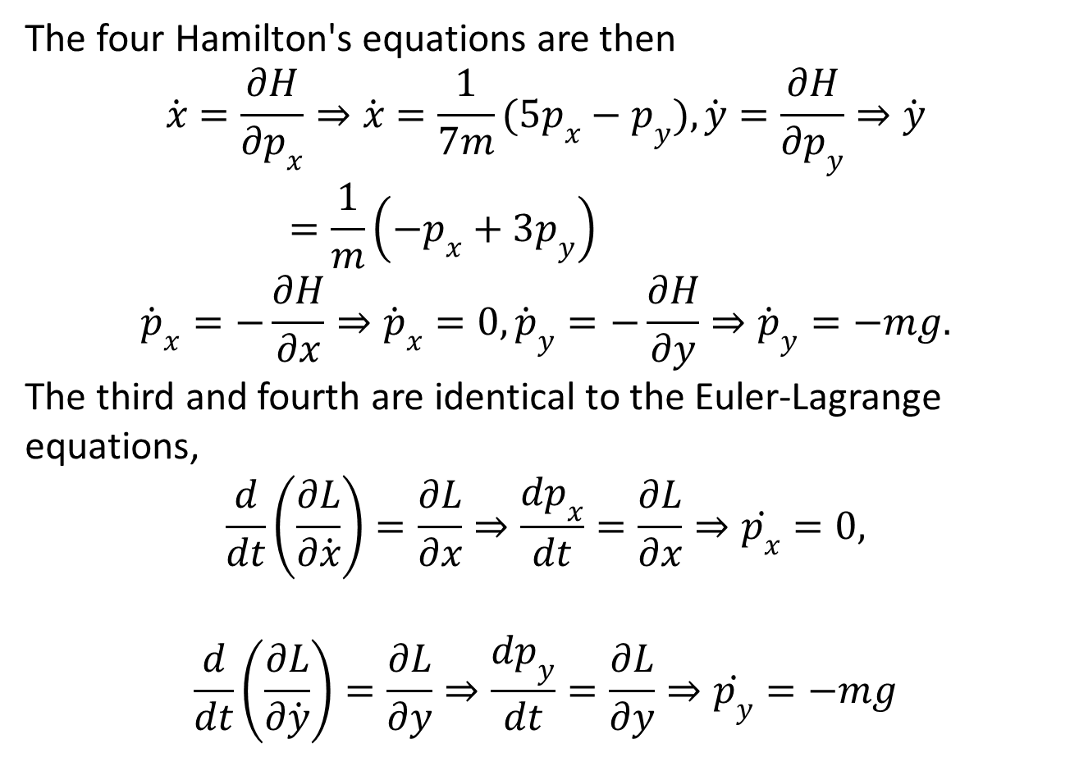
The four Hamilton's equations are then
$$\dot{x}=\frac{∂H}{∂p_{x}}⇒\dot{x}=\frac{1}{7m}(5p_{x}−p_{y}),\dot{y}=\frac{∂H}{∂p_{y}}⇒\dot{y}=\frac{1}{m}\left(−p_{x}+{3p}_{y}\right)$$
$${\dot{p}}_{x}=−\frac{∂H}{∂x}⇒{\dot{p}}_{x}=0,{\dot{p}}_{y}=−\frac{∂H}{∂y}⇒{\dot{p}}_{y}=−mg.$$
The third and fourth are identical to the Euler-Lagrange equations,
$$\frac{d}{dt}\left(\frac{∂L}{∂\dot{x}}\right)=\frac{∂L}{∂x}⇒\frac{dp_{x}}{dt}=\frac{∂L}{∂x}⇒\dot{p_{x}}=0,$$
$$\frac{d}{dt}\left(\frac{∂L}{∂\dot{y}}\right)=\frac{∂L}{∂y}⇒\frac{dp_{y}}{dt}=\frac{∂L}{∂y}⇒\dot{p_{y}}=−mg$$

Slide 15
Example: A Particle Confined to Move on a Cylinder
Consider a particle of mass m constrained to move on a frictionless cylinder of radius R, given by the equation ρ = R in cylindrical polar coordinates (ρ, φ, z). Besides the force of constraint (the normal force on the cylinder), the only force on the mass is a force F = −kr directed toward the origin. Using z and φ as generalized coordinates, find the Lagrangian L. Write down and solve Lagrange’s equations and describe the motion.

Slide 16
Solution:
We are already told what the generalized coordinates are, so we can now proceed to find the Lagrangian L = T – U. To get the kinetic energy, we need the velocity in terms of the generalized coordinates. The z velocity is easy, just The φ velocity (azimuthal) is just Thus, the kinetic energy is just
ρ = R

Slide 17
  Now we need the potential energy (due to this central spring force), which is:
  Notice that we could drop the R² term, since it is constant, but it will not survive the Lagrange equation anyway. Putting these together, the Lagrangian is
  Now we form the Lagrange equations (one for z and one for φ) and solve. The z equation is

Slide 18
  The φ equation is
  This just says that the angular momentum mR²ω = constant. Thus, the particle executes simple harmonic motion in z, but rotates in φ at a constant rate around the cylinder.

Slide 19
Example: A Block Sliding on a Wedge
Let’s now do a non-trivial two-coordinate problem—the block sliding down a wedge as shown in the Figure.
We will take the generalized coordinates as shown in the figure. Notice that the first coordinate q₁ is along the plane, so that it has no component in the constraint force direction. Also, q₁ is measured relative to the (moving) wedge.
The velocity of the wedge is just , but the velocity of the block has components from both q₁ and q₂:
q₁
q₂
α

Slide 20
Thus, the total kinetic energy is
The potential energy of the wedge can be taken as zero, and the block is just
Putting these together, the Lagrangian is
There are two generalized coordinates, and so there are two Lagrange equations. The second is simplest:

Slide 21
Note that this is conservation of momentum in the x direction.
The first one is
This has two unknowns, but we can get another equation for the accelerations by differentiating the q₂ relation:
Finally, plug this into the above equation and solve

Slide 22
Example: Bead on a Spinning Wire Hoop
Let’s do another one. How many coordinates? Since it is a wire, there is only one degree of freedom, angle θ. What is the velocity to insert into the kinetic energy? This is a little tricky. The bead can slide up and down on the wire, which clearly has a velocity But the hoop is also rotating, so there is another motion with velocity . The kinetic energy is then
The potential energy relative to its position at the bottom of the hoop (when the hoop is not rotating and θ = 0), is
ω
R
θ

Slide 23
The Lagrangian is
The sole Lagrange equation is then
Solving for the angular acceleration:
For no rotation (ω = 0), the bead will act like a pendulum—equation
But for a rotating hoop, the bead will move up the wire and we might expect a new equilibrium. Recall that at equilibrium the bead will be at rest, i.e. which occurs at either θ = 0 (which we have already examined) or at

Slide 24
Solving for the equilibrium position
We can find the oscillation frequency for small displacements θ = θ_{ο} + ε.

Slide 25
The End

