Slide 1
Revision

Slide 2
Rotation Matrix

Slide 6
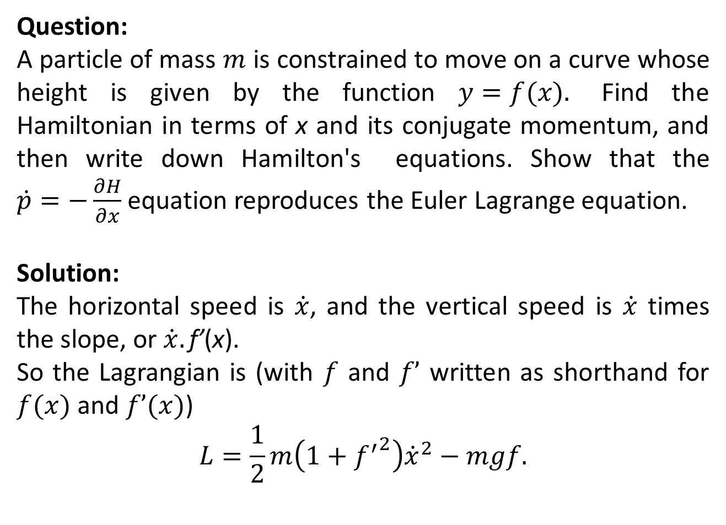
Miscellaneous Problems
Question:
A particle of mass $m$is constrained to move on a curve whose height is given by the function $y=f(x).$ Find the Hamiltonian in terms of x and its conjugate momentum, and then write down Hamilton's equations. Show that the $\dot{p}=−\frac{∂H}{∂x}$equation reproduces the Euler Lagrange equation.
Solution:
The horizontal speed is $\dot{x}$, and the vertical speed is $\dot{x}$ times the slope, or $\dot{x}.\text{f}\text{’}\text{(}\text{x}\text{).}$
So the Lagrangian is (with $f$and $f’$written as shorthand for $f(x)$ and $f’(x)$)
$$L=\frac{1}{2}m\left(1+{f^{′}}^{2}\right){\dot{x}}^{2}−mgf.$$

Slide 7
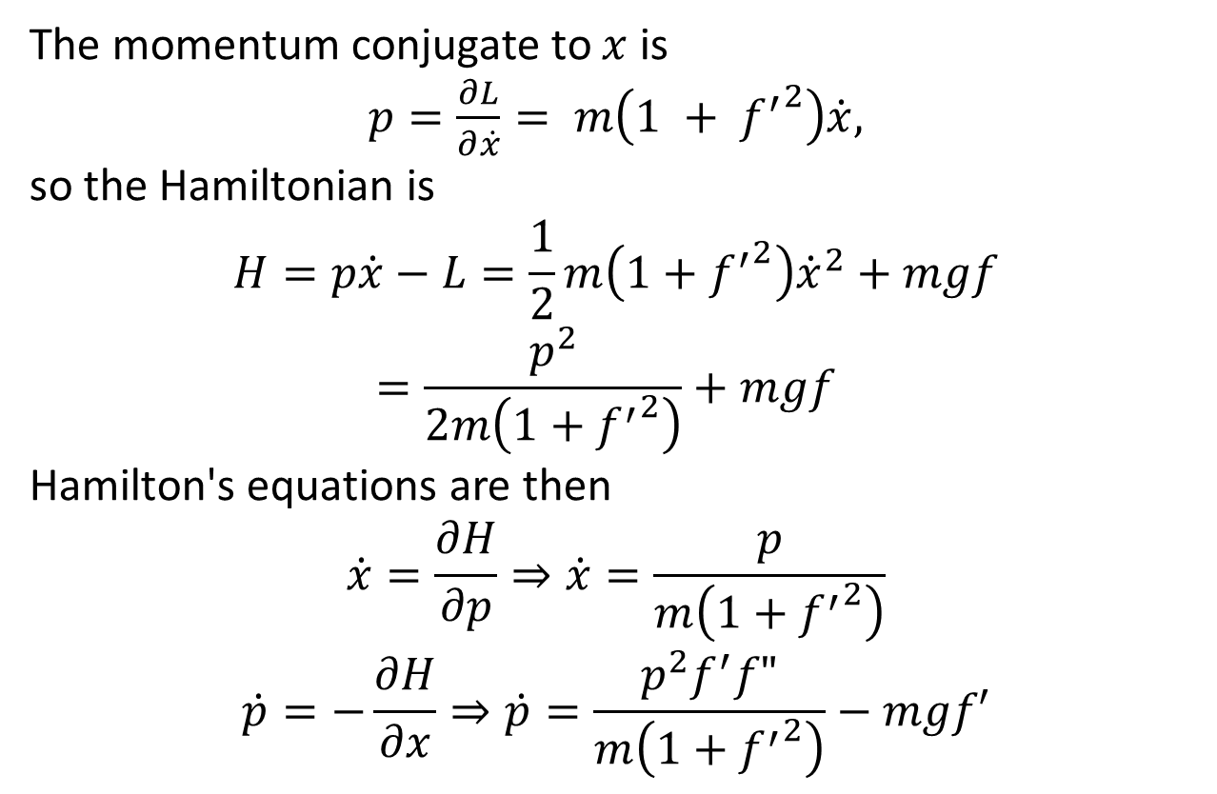
The momentum conjugate to $x$is
$p=\frac{∂L}{∂\dot{x}}= m\left(1 + {f^{′}}^{2}\right)\dot{x},$
so the Hamiltonian is
$$H=p\dot{x}−L=\frac{1}{2}m\left(1+{f^{′}}^{2}\right){\dot{x}}^{2}+mgf=\frac{p^{2}}{2m\left(1+{f^{′}}^{2}\right)}+mgf$$
Hamilton's equations are then
$$\dot{x}=\frac{∂H}{∂p}⇒\dot{x}=\frac{p}{m\left(1+{f^{′}}^{2}\right)}$$
$$\dot{p}=−\frac{∂H}{∂x}⇒\dot{p}=\frac{p^{2}f^{′}f"}{m\left(1+{f^{′}}^{2}\right)}−mgf′$$

Slide 8
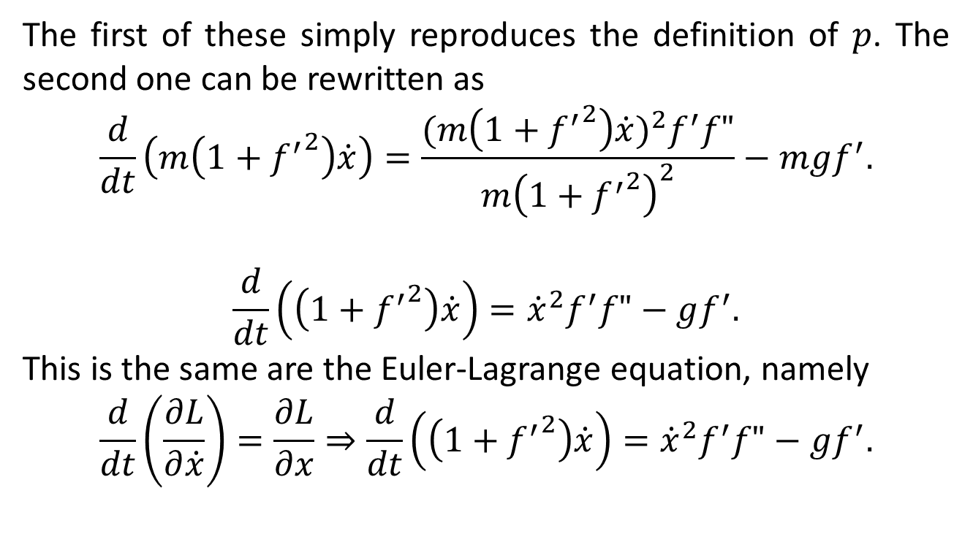
The first of these simply reproduces the definition of $p$. The second one can be rewritten as
$$\frac{d}{dt}\left(m\left(1+{f^{′}}^{2}\right)\dot{x}\right)=\frac{{(m\left(1+{f^{′}}^{2}\right)\dot{x})}^{2}f^{′}f"}{m{\left(1+{f^{′}}^{2}\right)}^{2}}−mgf^{′}.$$
$$\frac{d}{dt}\left(\left(1+{f^{′}}^{2}\right)\dot{x}\right)={\dot{x}}^{2}f^{′}f"−gf^{′}.$$
This is the same are the Euler-Lagrange equation, namely
$$\frac{d}{dt}\left(\frac{∂L}{∂\dot{x}}\right)=\frac{∂L}{∂x}⇒\frac{d}{dt}\left(\left(1+{f^{′}}^{2}\right)\dot{x}\right)={\dot{x}}^{2}f^{′}f"−gf^{′}.$$

Slide 9
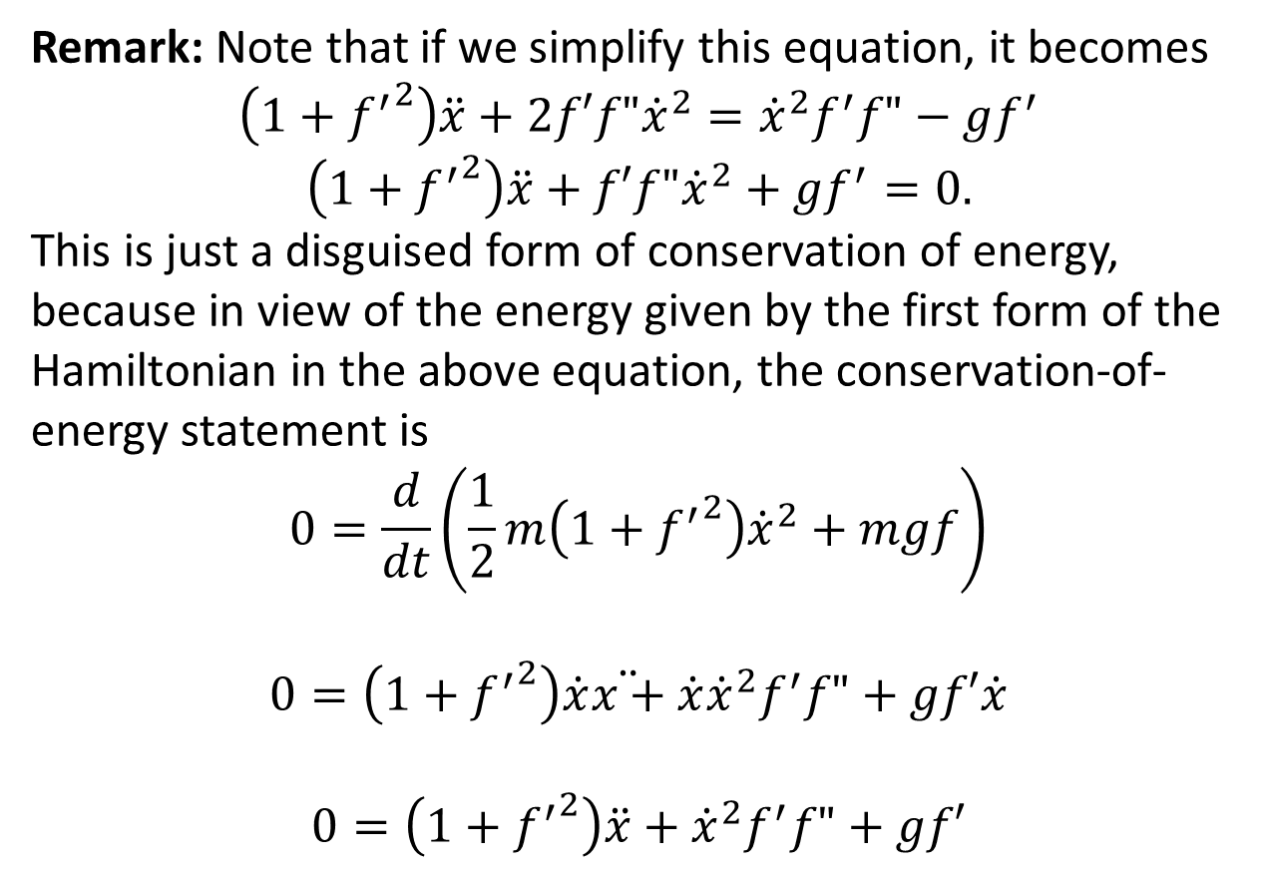
Remark: Note that if we simplify this equation, it becomes
$$\left(1+{f^{′}}^{2}\right)\ddot{x}+2f′f"{\dot{x}}^{2}={\dot{x}}^{2}f^{′}f"−gf^{′}$$
$$\left(1+{f^{′}}^{2}\right)\ddot{x}+f′f"{\dot{x}}^{2}+gf^{′}=0.$$
This is just a disguised form of conservation of energy, because in view of the energy given by the first form of the Hamiltonian in the above equation, the conservation-of-energy statement is
$$0=\frac{d}{dt}\left(\frac{1}{2}m\left(1+{f^{′}}^{2}\right){\dot{x}}^{2}+mgf\right)$$
$$0=\left(1+{f^{′}}^{2}\right)\dot{x}\ddot{x+}\dot{x}{\dot{x}}^{2}f^{′}f"+gf′\dot{x}$$
$$0=\left(1+{f^{′}}^{2}\right)\ddot{x}+{\dot{x}}^{2}f^{′}f"+gf′$$

Slide 10
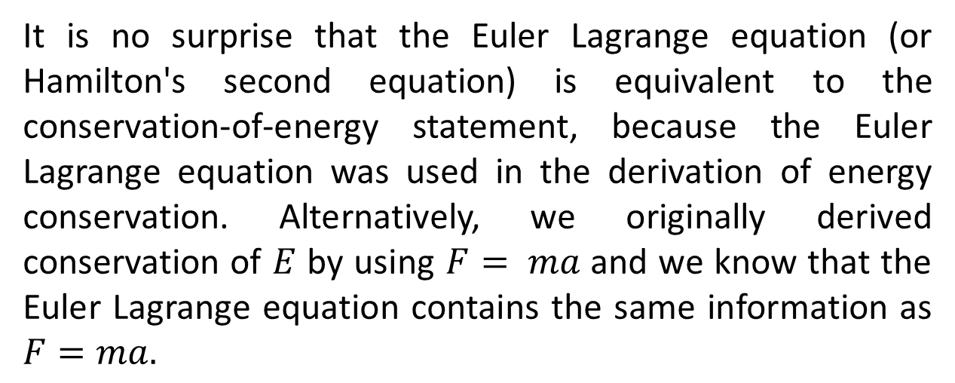
It is no surprise that the Euler Lagrange equation (or Hamilton's second equation) is equivalent to the conservation-of-energy statement, because the Euler Lagrange equation was used in the derivation of energy conservation. Alternatively, we originally derived conservation of $E$by using $F= ma$and we know that the Euler Lagrange equation contains the same information as $F=ma.$

Slide 11
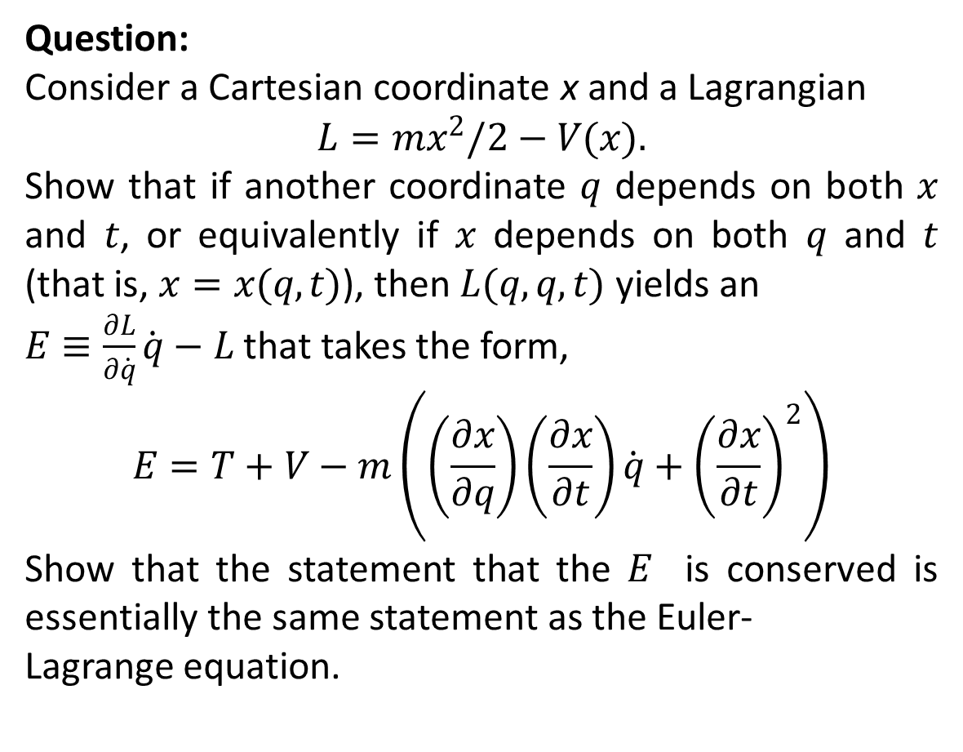
Question:
Consider a Cartesian coordinate x and a Lagrangian
$$L=mx^{2}/2−V(x).$$
Show that if another coordinate $q$depends on both $x$and $t$, or equivalently if $x$depends on both $q$and $t$(that is, $x=x(q,t)$), then $L(q,q,t)$ yields an
$E≡\frac{∂L}{∂\dot{q}}\dot{q}−L$that takes the form,
$$E=T+V−m\left(\left(\frac{∂x}{∂q}\right)\left(\frac{∂x}{∂t}\right)\dot{q}+{\left(\frac{∂x}{∂t}\right)}^{2}\right)$$
Show that the statement that the $E$ is conserved is essentially the same statement as the Euler-
Lagrange equation.

Slide 15
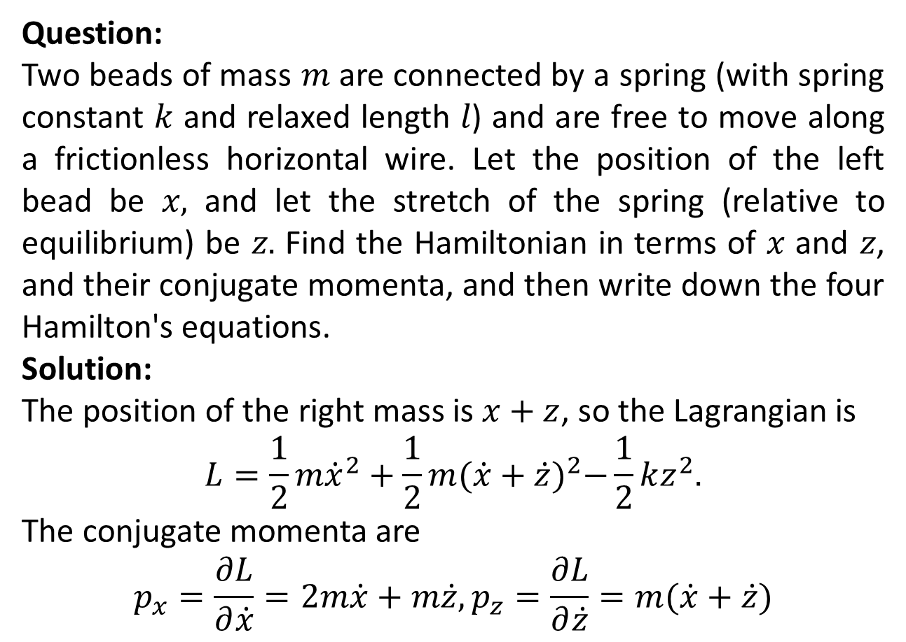
Question:
Two beads of mass $m$are connected by a spring (with spring constant $k$and relaxed length $l$) and are free to move along a frictionless horizontal wire. Let the position of the left bead be $x,$ and let the stretch of the spring (relative to equilibrium) be $z.$ Find the Hamiltonian in terms of $x$and $z$,and their conjugate momenta, and then write down the four Hamilton's equations.
Solution:
The position of the right mass is $x+z$, so the Lagrangian is
$$L=\frac{1}{2}m{\dot{x}}^{2}+\frac{1}{2}m{(\dot{x}+\dot{z})}^{2}−\frac{1}{2}kz^{2}.$$
The conjugate momenta are
$$p_{x}=\frac{∂L}{∂\dot{x}}=2m\dot{x}+m\dot{z},p_{z}=\frac{∂L}{∂\dot{z}}=m(\dot{x}+\dot{z})$$

Slide 17
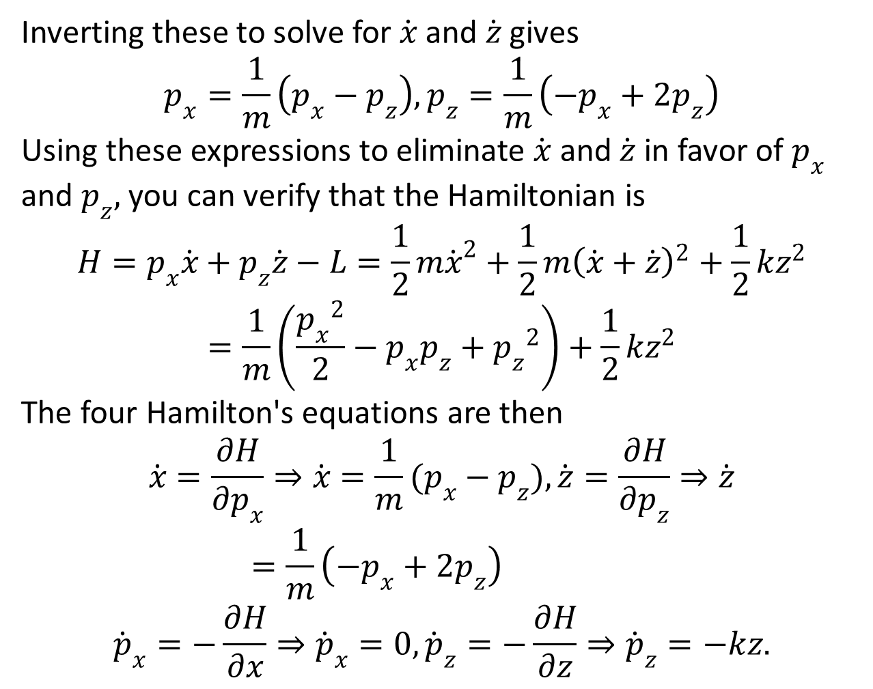
Inverting these to solve for $\dot{x}$ and $\dot{z}$ gives
$$p_{x}=\frac{1}{m}\left(p_{x}−p_{z}\right),p_{z}=\frac{1}{m}\left(−p_{x}+{2p}_{z}\right)$$
Using these expressions to eliminate $\dot{x}$ and $\dot{z}$ in favor of $p_{x}$and $p_{z},$ you can verify that the Hamiltonian is
$$H=p_{x}\dot{x}+p_{z}\dot{z}−L=\frac{1}{2}m{\dot{x}}^{2}+\frac{1}{2}m{\left(\dot{x}+\dot{z}\right)}^{2}+\frac{1}{2}kz^{2}$$
$$=\frac{1}{m}\left(\frac{{p_{x}}^{2}}{2}−p_{x}p_{z}+{p_{z}}^{2}\right)+\frac{1}{2}kz^{2}$$
The four Hamilton's equations are then
$$\dot{x}=\frac{∂H}{∂p_{x}}⇒\dot{x}=\frac{1}{m}(p_{x}−p_{z}),\dot{z}=\frac{∂H}{∂p_{z}}⇒\dot{z}=\frac{1}{m}\left(−p_{x}+{2p}_{z}\right)$$
$${\dot{p}}_{x}=−\frac{∂H}{∂x}⇒{\dot{p}}_{x}=0,{\dot{p}}_{z}=−\frac{∂H}{∂z}⇒{\dot{p}}_{z}=−kz.$$

Slide 19
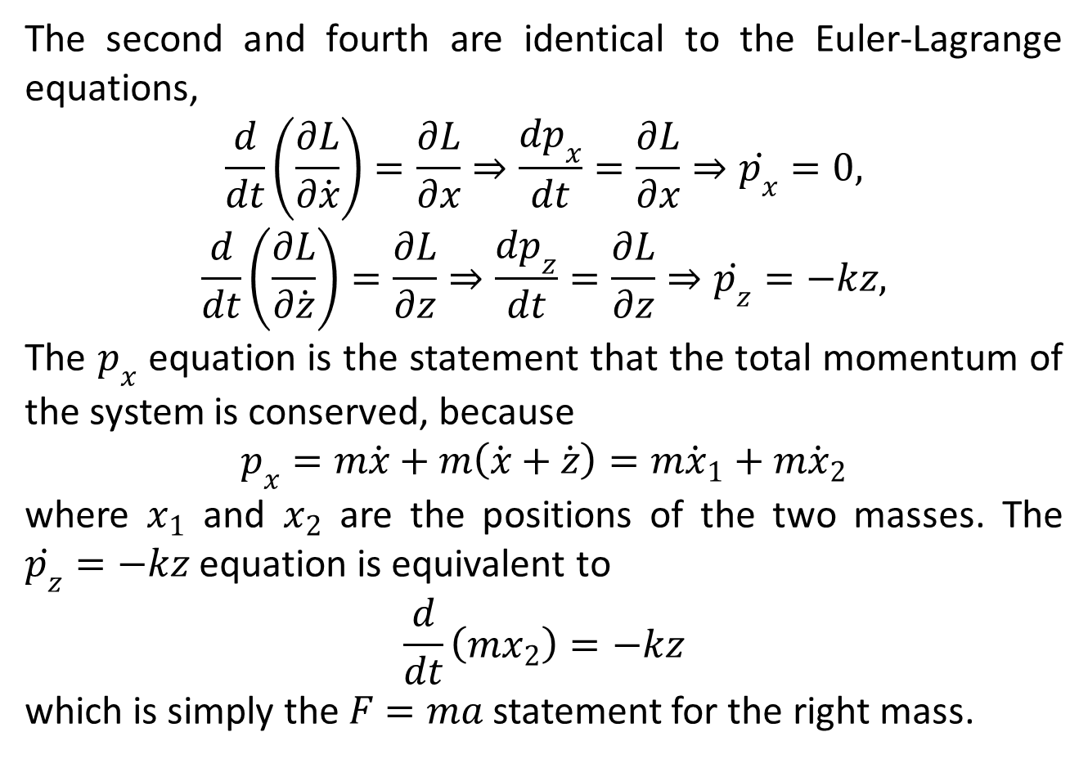
The second and fourth are identical to the Euler-Lagrange equations,
$$\frac{d}{dt}\left(\frac{∂L}{∂\dot{x}}\right)=\frac{∂L}{∂x}⇒\frac{dp_{x}}{dt}=\frac{∂L}{∂x}⇒\dot{p_{x}}=0,$$
$$\frac{d}{dt}\left(\frac{∂L}{∂\dot{z}}\right)=\frac{∂L}{∂z}⇒\frac{dp_{z}}{dt}=\frac{∂L}{∂z}⇒\dot{p_{z}}=−kz,$$
The $p_{x}$equation is the statement that the total momentum of the system is conserved, because
$$p_{x}=m\dot{x}+m\left(\dot{x}+\dot{z}\right)=m{\dot{x}}_{1}+m{\dot{x}}_{2}$$
where $x_{1}$ and $x_{2}$ are the positions of the two masses. The $\dot{p_{z}}=−kz$equation is equivalent to
$$\frac{d}{dt}\left(mx_{2}\right)=−kz$$
which is simply the $F=ma$statement for the right mass.

Slide 20
The End

