Slide 1
Revision

Slide 2
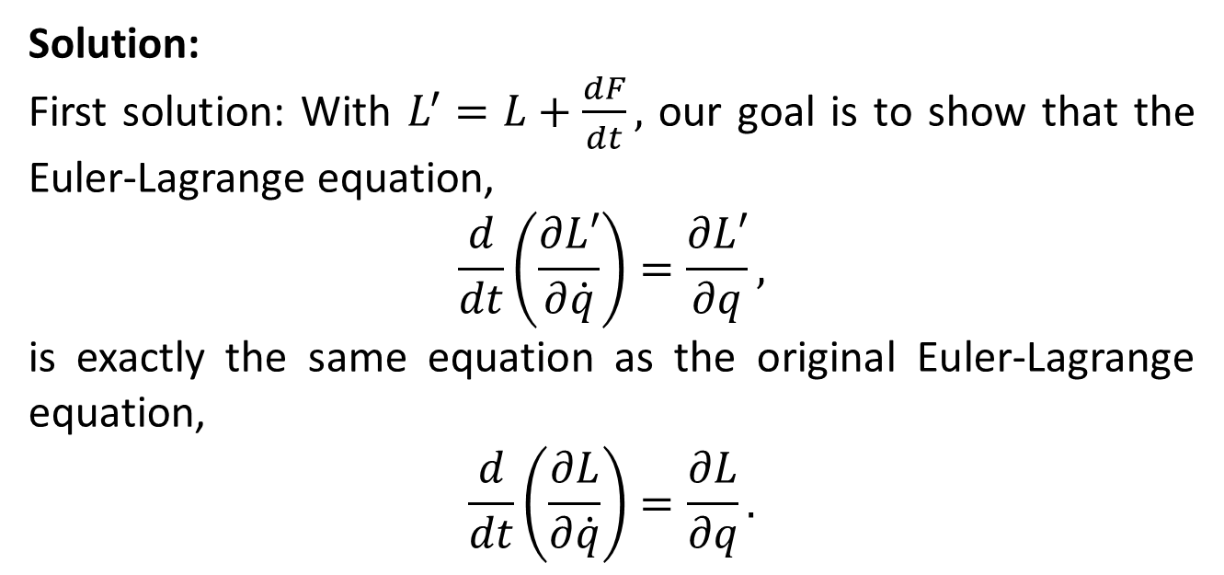
Solution:
First solution: With $L^{′}=L+\frac{dF}{dt},$ our goal is to show that the Euler-Lagrange equation,
$$\frac{d}{dt}\left(\frac{∂L′}{∂\dot{q}}\right)=\frac{∂L′}{∂q},$$
is exactly the same equation as the original Euler-Lagrange equation,
$$\frac{d}{dt}\left(\frac{∂L}{∂\dot{q}}\right)=\frac{∂L}{∂q}.$$

Slide 3
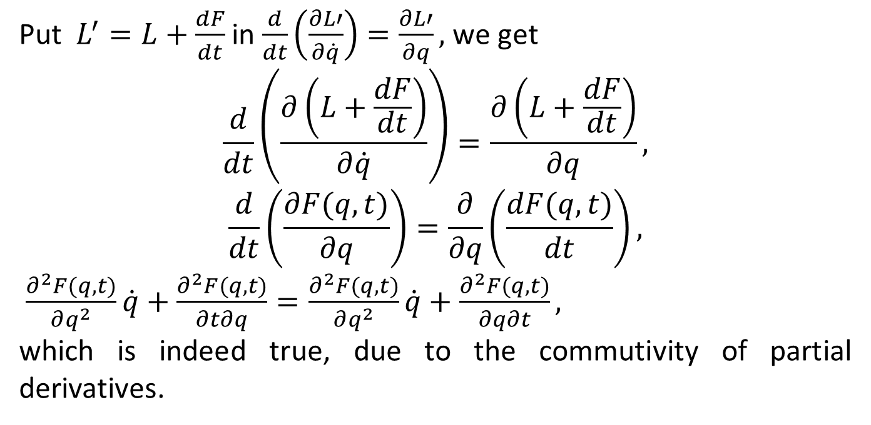
Put $L^{′}=L+\frac{dF}{dt}$ in $\frac{d}{dt}\left(\frac{∂L′}{∂\dot{q}}\right)=\frac{∂L′}{∂q},$ we get
$$\frac{d}{dt}\left(\frac{∂\left(L+\frac{dF}{dt}\right)}{∂\dot{q}}\right)=\frac{∂\left(L+\frac{dF}{dt}\right)}{∂q},$$
$$\frac{d}{dt}\left(\frac{∂F(q,t)}{∂q}\right)=\frac{∂}{∂q}\left(\frac{dF(q,t)}{dt}\right),$$
$\frac{∂^{2}F(q,t)}{∂q^{2}}\dot{q}+\frac{∂^{2}F(q,t)}{∂t∂q}=\frac{∂^{2}F(q,t)}{∂q^{2}}\dot{q}+\frac{∂^{2}F(q,t)}{∂q∂t},$
which is indeed true, due to the commutivity of partial derivatives.

Slide 6
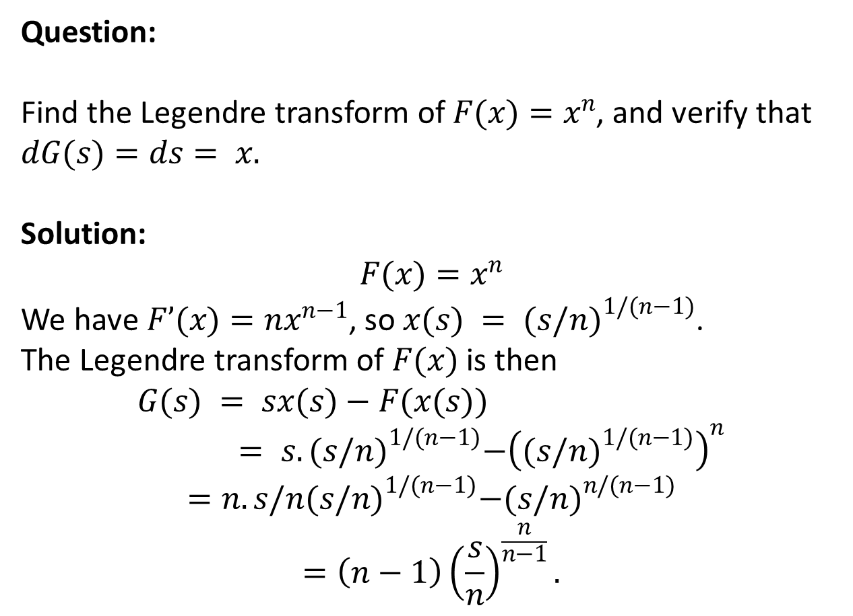
Question:
Find the Legendre transform of $F(x)=x^{n}$, and verify that $dG(s)=ds= x.$
Solution:
$$F(x)=x^{n}$$
We have $F’(x)=nx^{n−1}$, so $x(s) = {(s/n)}^{1/(n−1)}$.
The Legendre transform of $F(x)$ is then
$$G(s) = sx(s)−F(x(s))= s. {(s/n)}^{1/(n−1)}−{\left({(s/n)}^{1/(n−1)}\right)}^{n}$$
$$=n.s/n{(s/n)}^{1/(n−1)}−{(s/n)}^{n/(n−1)}$$
$$=\left(n−1\right){\left(\frac{s}{n}\right)}^{\frac{n}{n−1}}.$$

Slide 7
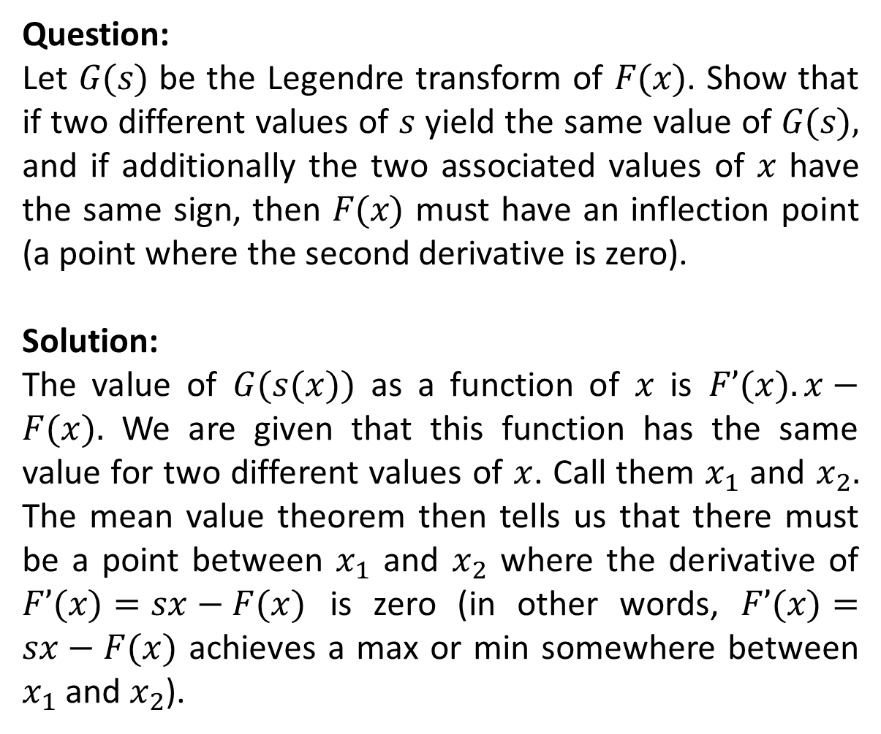
Question:
Let $G(s)$ be the Legendre transform of $F(x)$. Show that if two different values of $s$ yield the same value of $G(s),$ and if additionally the two associated values of $x$ have the same sign, then $F(x)$ must have an inflection point (a point where the second derivative is zero).
Solution:
The value of $G(s(x))$ as a function of $x$ is $F’(x).x−F(x).$ We are given that this function has the same value for two different values of $x$. Call them $x_{1}$ and $x_{2}.$ The mean value theorem then tells us that there must be a point between $x_{1}$ and $x_{2}$ where the derivative of $F’(x)=sx−F(x)$ is zero (in other words, $F’(x)=sx−F(x)$ achieves a max or min somewhere between $x_{1}$ and $x_{2}$).

Slide 8
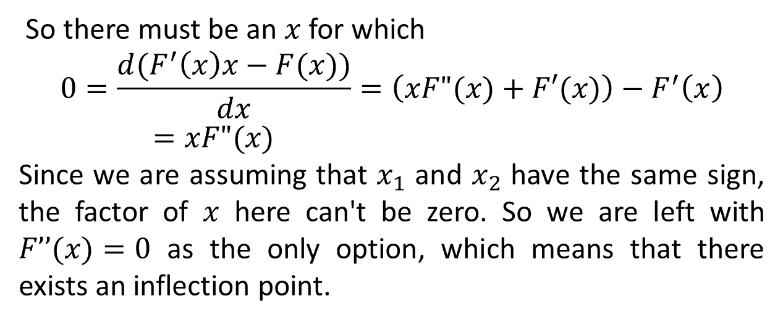
So there must be an $x$ for which
$$0=\frac{d(F^{′}\left(x\right)x−F(x))}{dx}=\left(xF"(x)+F′(x)\right)−F^{′}\left(x\right)=xF"(x)$$
Since we are assuming that $x_{1}$ and $x_{2}$ have the same sign, the factor of $x$ here can't be zero. So we are left with $F’’(x)=0$ as the only option, which means that there exists an inflection point.

Slide 9
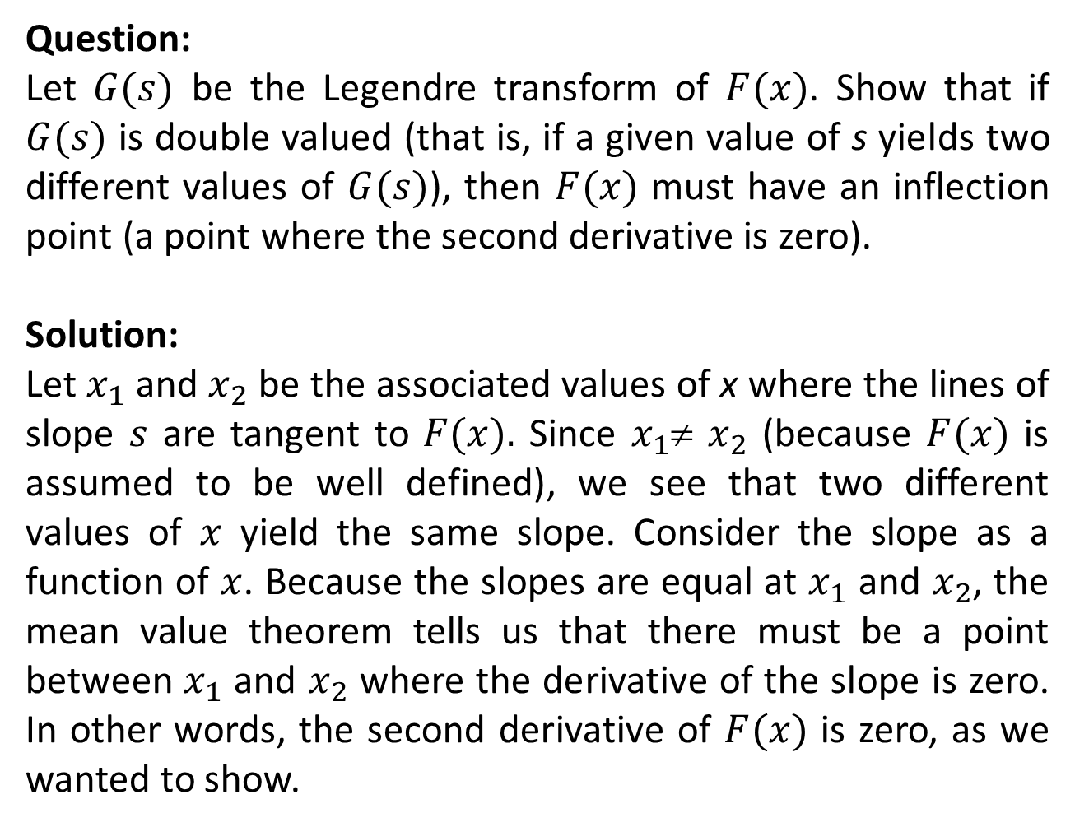
Question:
Let $G(s)$ be the Legendre transform of $F(x)$. Show that if $G(s)$ is double valued (that is, if a given value of s yields two different values of $G(s)$), then $F(x)$ must have an inflection point (a point where the second derivative is zero).
Solution:
Let $x_{1}$ and $x_{2}$ be the associated values of x where the lines of slope $s$ are tangent to $F(x).$ Since $x_{1}$≠ $x_{2}$ (because $F(x)$ is assumed to be well defined), we see that two different values of $x$ yield the same slope. Consider the slope as a function of $x$. Because the slopes are equal at $x_{1}$ and $x_{2}$, the mean value theorem tells us that there must be a point between $x_{1}$ and $x_{2}$ where the derivative of the slope is zero. In other words, the second derivative of $F(x)$ is zero, as we wanted to show.

Slide 10
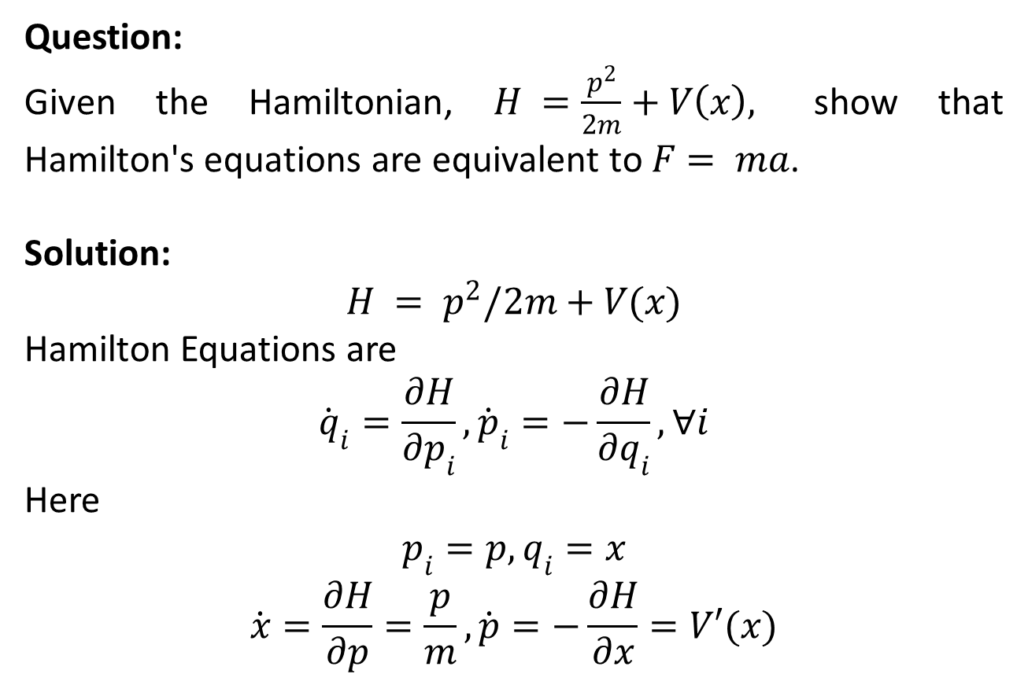
Question:
Given the Hamiltonian, $H =\frac{p^{2}}{2m}+V\left(x\right),$ show that Hamilton's equations are equivalent to $F= ma$.
Solution:
$$H = p^{2}/2m+V(x)$$
Hamilton Equations are
$${\dot{q}}_{i}=\frac{∂H}{∂p_{i}},{\dot{p}}_{i}=−\frac{∂H}{∂q_{i}},∀i$$
Here
$$p_{i}=p,q_{i}=x$$
$$\dot{x}=\frac{∂H}{∂p}=\frac{p}{m},\dot{p}=−\frac{∂H}{∂x}=V′(x)$$

Slide 11
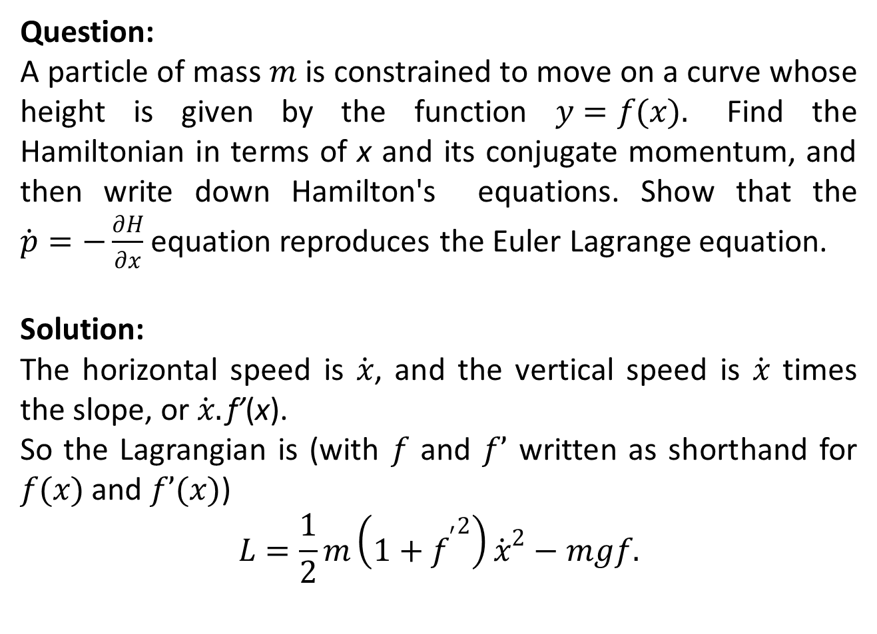
Question:
A particle of mass $m$ is constrained to move on a curve whose height is given by the function $y=f(x).$ Find the Hamiltonian in terms of x and its conjugate momentum, and then write down Hamilton's equations. Show that the $\dot{p}=−\frac{∂H}{∂x}$ equation reproduces the Euler Lagrange equation.
Solution:
The horizontal speed is $\dot{x}$, and the vertical speed is $\dot{x}$ times the slope, or $\dot{x}.\text{f}\text{’}\text{(}\text{x}\text{).}$
So the Lagrangian is (with $f$ and $f’$ written as shorthand for $f(x)$ and $f’(x)$)
$$L=\frac{1}{2}m\left(1+{f^{′}}^{2}\right){\dot{x}}^{2}−mgf.$$

Slide 12
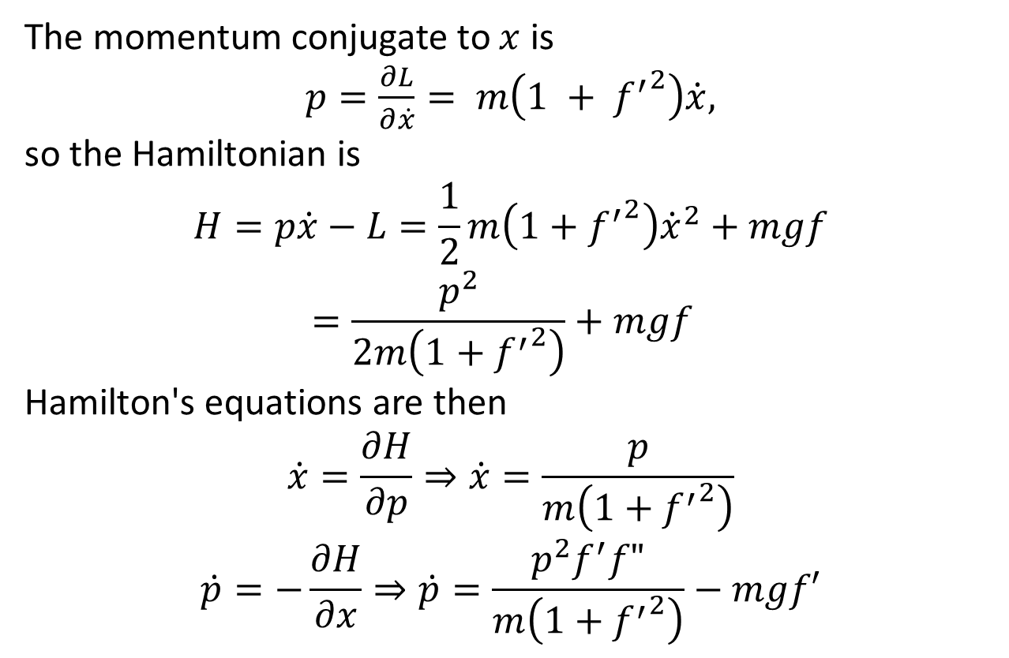
The momentum conjugate to $x$ is
$p=\frac{∂L}{∂\dot{x}}= m\left(1 + {f^{′}}^{2}\right)\dot{x},$
so the Hamiltonian is
$$H=p\dot{x}−L=\frac{1}{2}m\left(1+{f^{′}}^{2}\right){\dot{x}}^{2}+mgf=\frac{p^{2}}{2m\left(1+{f^{′}}^{2}\right)}+mgf$$
Hamilton's equations are then
$$\dot{x}=\frac{∂H}{∂p}⇒\dot{x}=\frac{p}{m\left(1+{f^{′}}^{2}\right)}$$
$$\dot{p}=−\frac{∂H}{∂x}⇒\dot{p}=\frac{p^{2}f^{′}f"}{m\left(1+{f^{′}}^{2}\right)}−mgf′$$

Slide 13
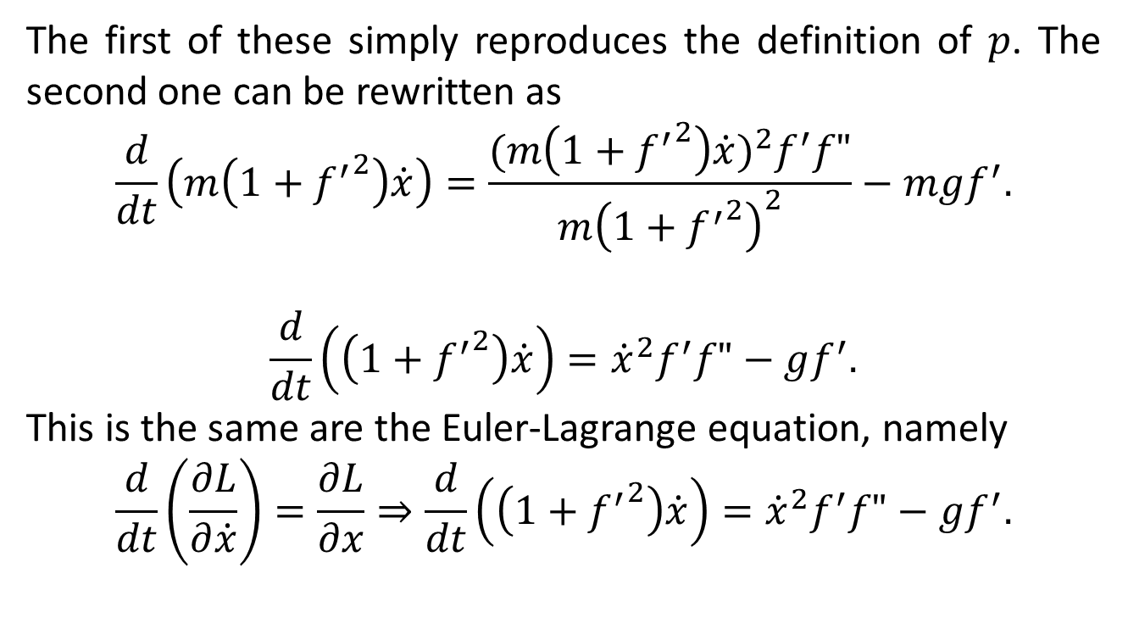
The first of these simply reproduces the definition of $p$. The second one can be rewritten as
$$\frac{d}{dt}\left(m\left(1+{f^{′}}^{2}\right)\dot{x}\right)=\frac{{(m\left(1+{f^{′}}^{2}\right)\dot{x})}^{2}f^{′}f"}{m{\left(1+{f^{′}}^{2}\right)}^{2}}−mgf^{′}.$$
$$\frac{d}{dt}\left(\left(1+{f^{′}}^{2}\right)\dot{x}\right)={\dot{x}}^{2}f^{′}f"−gf^{′}.$$
This is the same are the Euler-Lagrange equation, namely
$$\frac{d}{dt}\left(\frac{∂L}{∂\dot{x}}\right)=\frac{∂L}{∂x}⇒\frac{d}{dt}\left(\left(1+{f^{′}}^{2}\right)\dot{x}\right)={\dot{x}}^{2}f^{′}f"−gf^{′}.$$

Slide 15
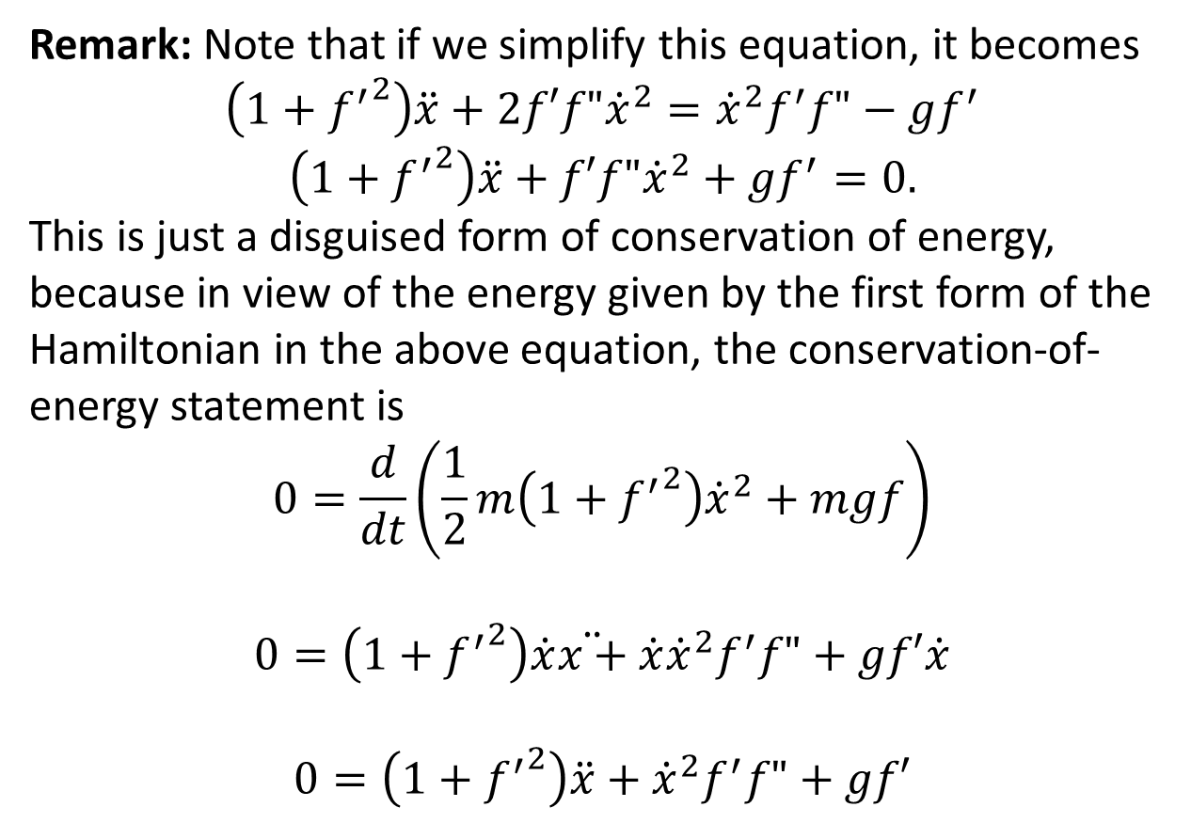
Remark: Note that if we simplify this equation, it becomes
$$\left(1+{f^{′}}^{2}\right)\ddot{x}+2f′f"{\dot{x}}^{2}={\dot{x}}^{2}f^{′}f"−gf^{′}$$
$$\left(1+{f^{′}}^{2}\right)\ddot{x}+f′f"{\dot{x}}^{2}+gf^{′}=0.$$
This is just a disguised form of conservation of energy, because in view of the energy given by the first form of the Hamiltonian in the above equation, the conservation-of-energy statement is
$$0=\frac{d}{dt}\left(\frac{1}{2}m\left(1+{f^{′}}^{2}\right){\dot{x}}^{2}+mgf\right)$$
$$0=\left(1+{f^{′}}^{2}\right)\dot{x}\ddot{x+}\dot{x}{\dot{x}}^{2}f^{′}f"+gf′\dot{x}$$
$$0=\left(1+{f^{′}}^{2}\right)\ddot{x}+{\dot{x}}^{2}f^{′}f"+gf′$$

Slide 16
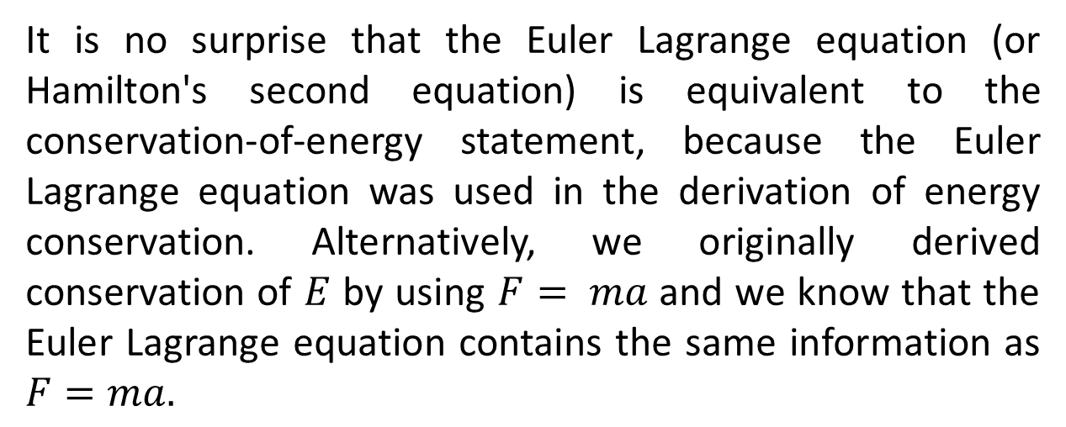
It is no surprise that the Euler Lagrange equation (or Hamilton's second equation) is equivalent to the conservation-of-energy statement, because the Euler Lagrange equation was used in the derivation of energy conservation. Alternatively, we originally derived conservation of $E$ by using $F= ma$ and we know that the Euler Lagrange equation contains the same information as $F=ma.$

Slide 17
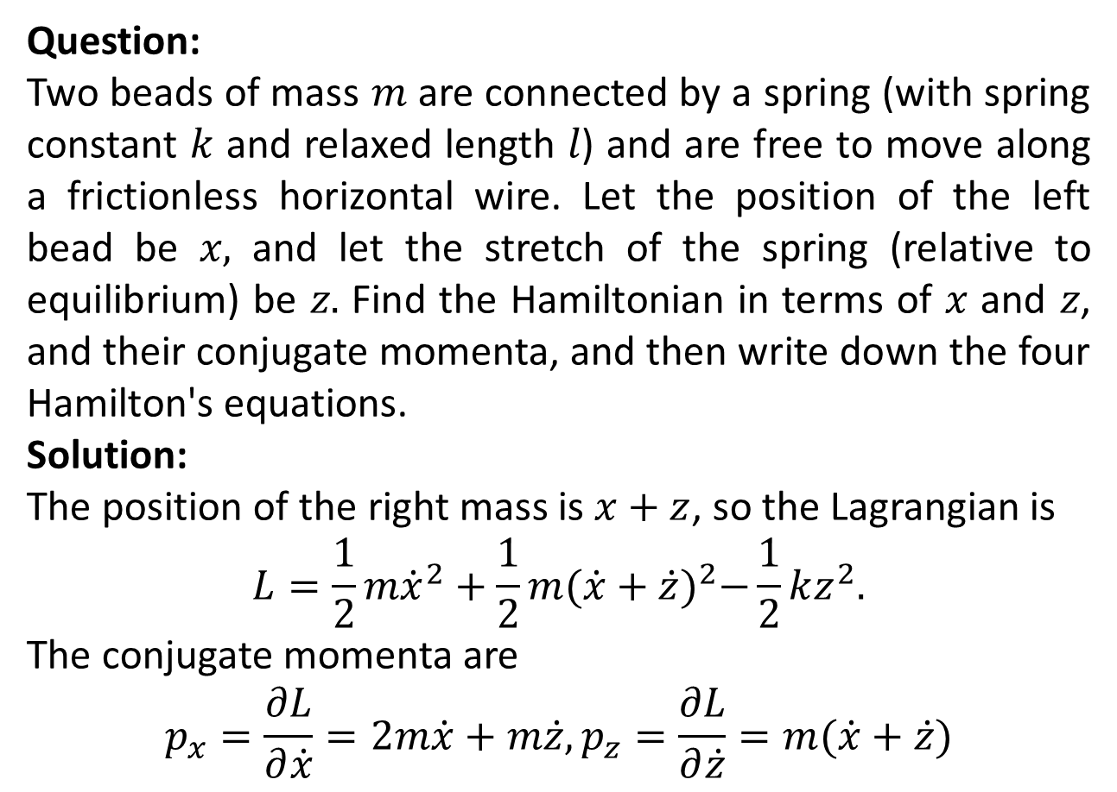
Question:
Two beads of mass $m$ are connected by a spring (with spring constant $k$ and relaxed length $l$) and are free to move along a frictionless horizontal wire. Let the position of the left bead be $x,$ and let the stretch of the spring (relative to equilibrium) be $z.$ Find the Hamiltonian in terms of $x$ and $z$, and their conjugate momenta, and then write down the four Hamilton's equations.
Solution:
The position of the right mass is $x+z$, so the Lagrangian is
$$L=\frac{1}{2}m{\dot{x}}^{2}+\frac{1}{2}m{(\dot{x}+\dot{z})}^{2}−\frac{1}{2}kz^{2}.$$
The conjugate momenta are
$$p_{x}=\frac{∂L}{∂\dot{x}}=2m\dot{x}+m\dot{z},p_{z}=\frac{∂L}{∂\dot{z}}=m(\dot{x}+\dot{z})$$

Slide 19
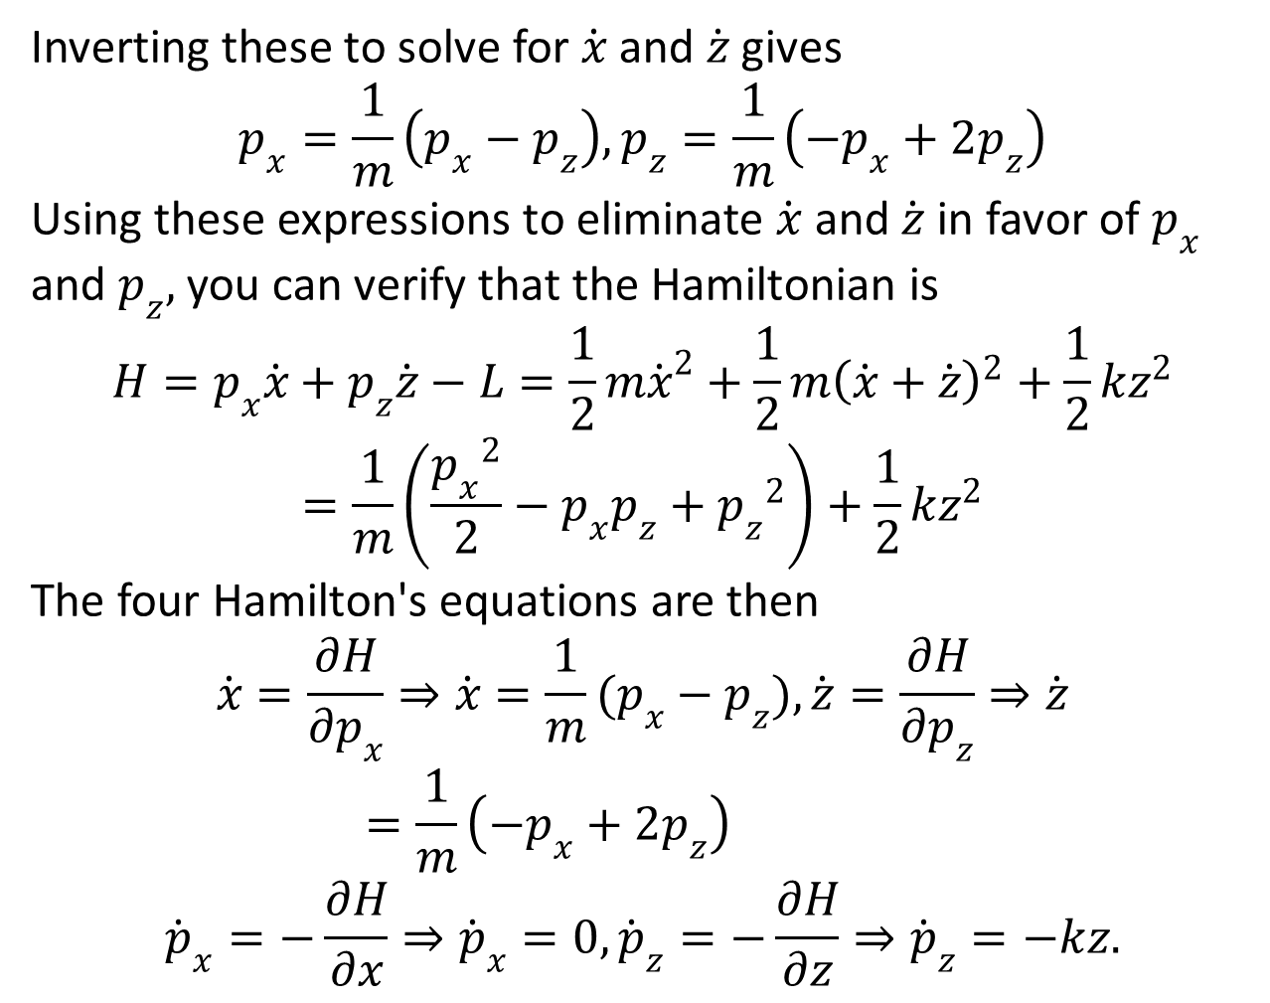
Inverting these to solve for $\dot{x}$ and $\dot{z}$ gives
$$p_{x}=\frac{1}{m}\left(p_{x}−p_{z}\right),p_{z}=\frac{1}{m}\left(−p_{x}+{2p}_{z}\right)$$
Using these expressions to eliminate $\dot{x}$ and $\dot{z}$ in favor of $p_{x}$ and $p_{z},$ you can verify that the Hamiltonian is
$$H=p_{x}\dot{x}+p_{z}\dot{z}−L=\frac{1}{2}m{\dot{x}}^{2}+\frac{1}{2}m{\left(\dot{x}+\dot{z}\right)}^{2}+\frac{1}{2}kz^{2}$$
$$=\frac{1}{m}\left(\frac{{p_{x}}^{2}}{2}−p_{x}p_{z}+{p_{z}}^{2}\right)+\frac{1}{2}kz^{2}$$
The four Hamilton's equations are then
$$\dot{x}=\frac{∂H}{∂p_{x}}⇒\dot{x}=\frac{1}{m}(p_{x}−p_{z}),\dot{z}=\frac{∂H}{∂p_{z}}⇒\dot{z}=\frac{1}{m}\left(−p_{x}+{2p}_{z}\right)$$
$${\dot{p}}_{x}=−\frac{∂H}{∂x}⇒{\dot{p}}_{x}=0,{\dot{p}}_{z}=−\frac{∂H}{∂z}⇒{\dot{p}}_{z}=−kz.$$

Slide 21
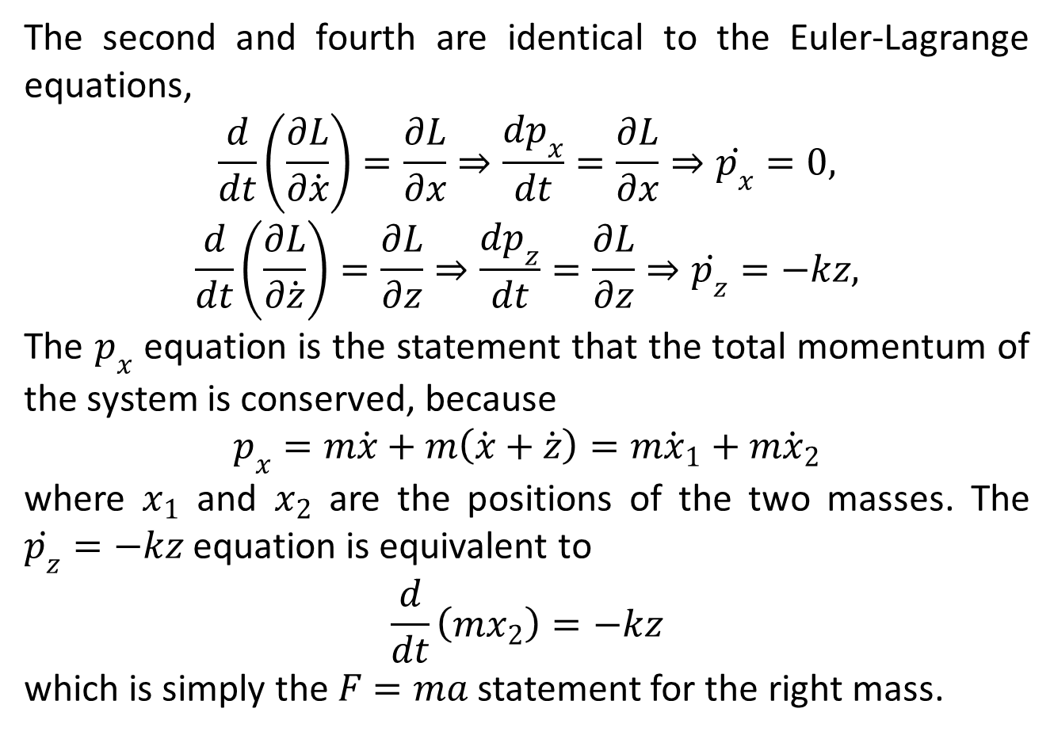
The second and fourth are identical to the Euler-Lagrange equations,
$$\frac{d}{dt}\left(\frac{∂L}{∂\dot{x}}\right)=\frac{∂L}{∂x}⇒\frac{dp_{x}}{dt}=\frac{∂L}{∂x}⇒\dot{p_{x}}=0,$$
$$\frac{d}{dt}\left(\frac{∂L}{∂\dot{z}}\right)=\frac{∂L}{∂z}⇒\frac{dp_{z}}{dt}=\frac{∂L}{∂z}⇒\dot{p_{z}}=−kz,$$
The $p_{x}$ equation is the statement that the total momentum of the system is conserved, because
$$p_{x}=m\dot{x}+m\left(\dot{x}+\dot{z}\right)=m{\dot{x}}_{1}+m{\dot{x}}_{2}$$
where $x_{1}$ and $x_{2}$ are the positions of the two masses. The $\dot{p_{z}}=−kz$ equation is equivalent to
$$\frac{d}{dt}\left(mx_{2}\right)=−kz$$
which is simply the $F=ma$ statement for the right mass.

Slide 22
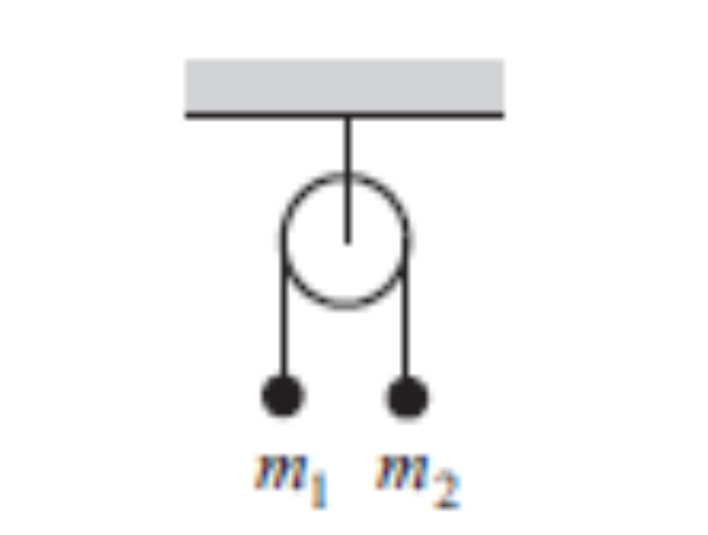
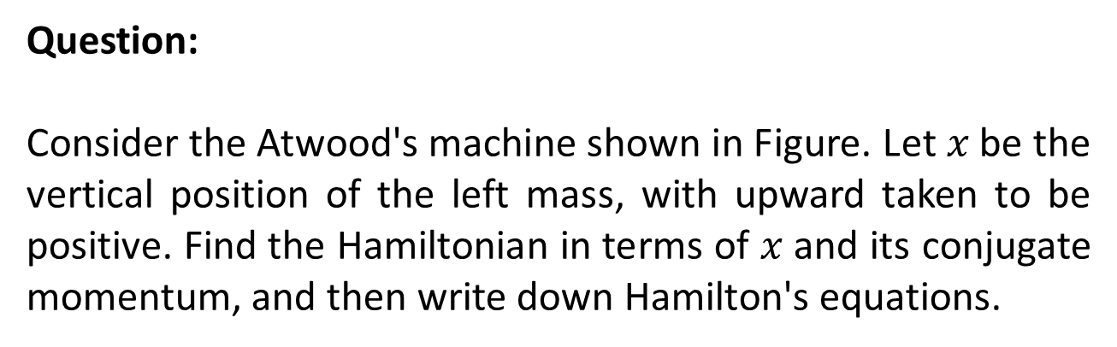
Question:
Consider the Atwood's machine shown in Figure. Let $x$ be the vertical position of the left mass, with upward taken to be positive. Find the Hamiltonian in terms of $x$ and its conjugate momentum, and then write down Hamilton's equations.

Slide 23
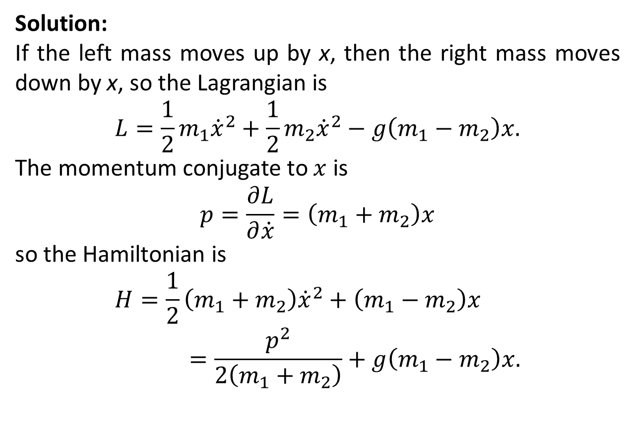
Solution:
If the left mass moves up by x, then the right mass moves down by x, so the Lagrangian is
$$L=\frac{1}{2}m_{1}{\dot{x}}^{2}+\frac{1}{2}m_{2}{\dot{x}}^{2}−g\left(m_{1}−m_{2}\right)x.$$
The momentum conjugate to $x$ is
$$p=\frac{∂L}{∂\dot{x}}=\left(m_{1}+m_{2}\right)x$$
so the Hamiltonian is
$$H=\frac{1}{2}\left(m_{1}+m_{2}\right){\dot{x}}^{2}+\left(m_{1}−m_{2}\right)x=\frac{p^{2}}{2\left(m_{1}+m_{2}\right)}+g\left(m_{1}−m_{2}\right)x.$$

Slide 24
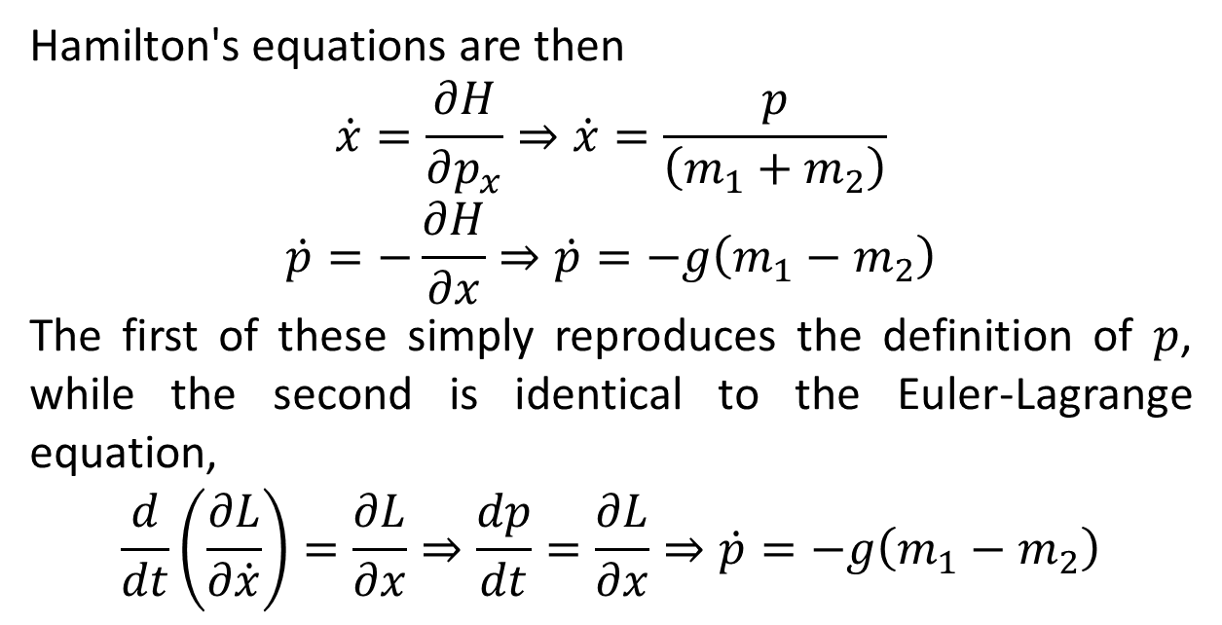
Hamilton's equations are then
$$\dot{x}=\frac{∂H}{∂p_{x}}⇒\dot{x}=\frac{p}{\left(m_{1}+m_{2}\right)}$$
$$\dot{p}=−\frac{∂H}{∂x}⇒\dot{p}=−g\left(m_{1}−m_{2}\right)$$
The first of these simply reproduces the definition of $p$, while the second is identical to the Euler-Lagrange equation,
$$\frac{d}{dt}\left(\frac{∂L}{∂\dot{x}}\right)=\frac{∂L}{∂x}⇒\frac{dp}{dt}=\frac{∂L}{∂x}⇒\dot{p}=−g\left(m_{1}−m_{2}\right)$$

Slide 25
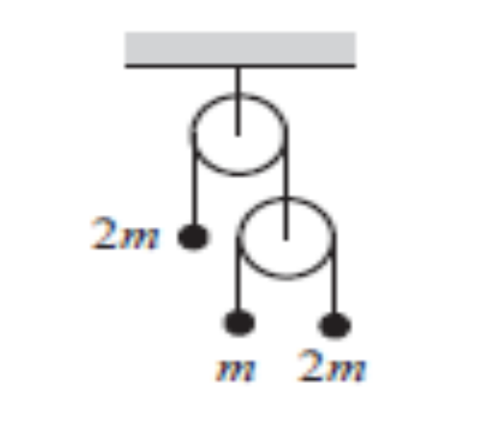
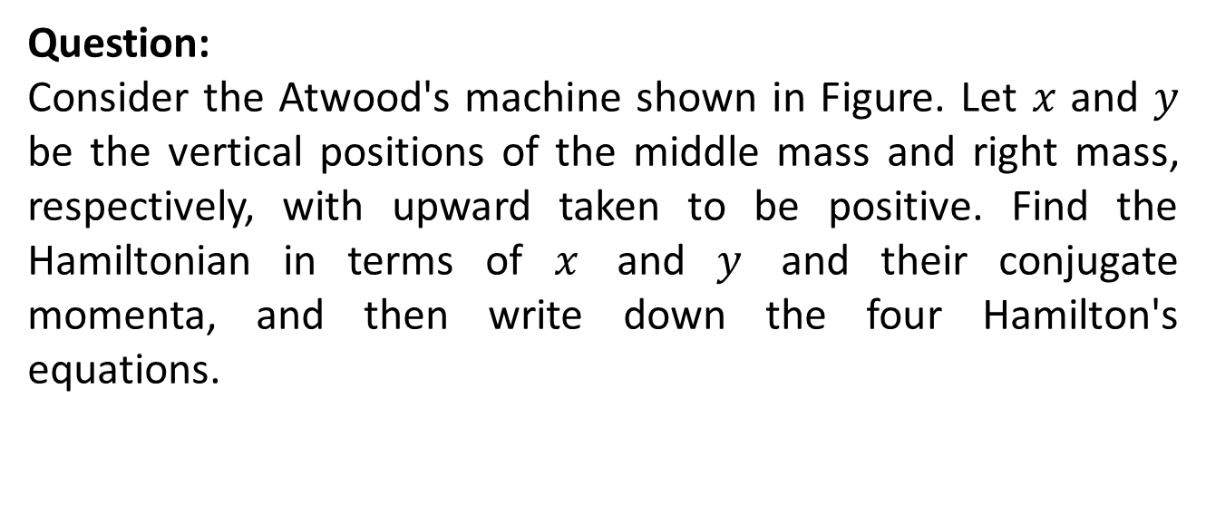
Question:
Consider the Atwood's machine shown in Figure. Let $x$ and $y$ be the vertical positions of the middle mass and right mass, respectively, with upward taken to be positive. Find the Hamiltonian in terms of $x$ and $y$ and their conjugate momenta, and then write down the four Hamilton's equations.

Slide 26
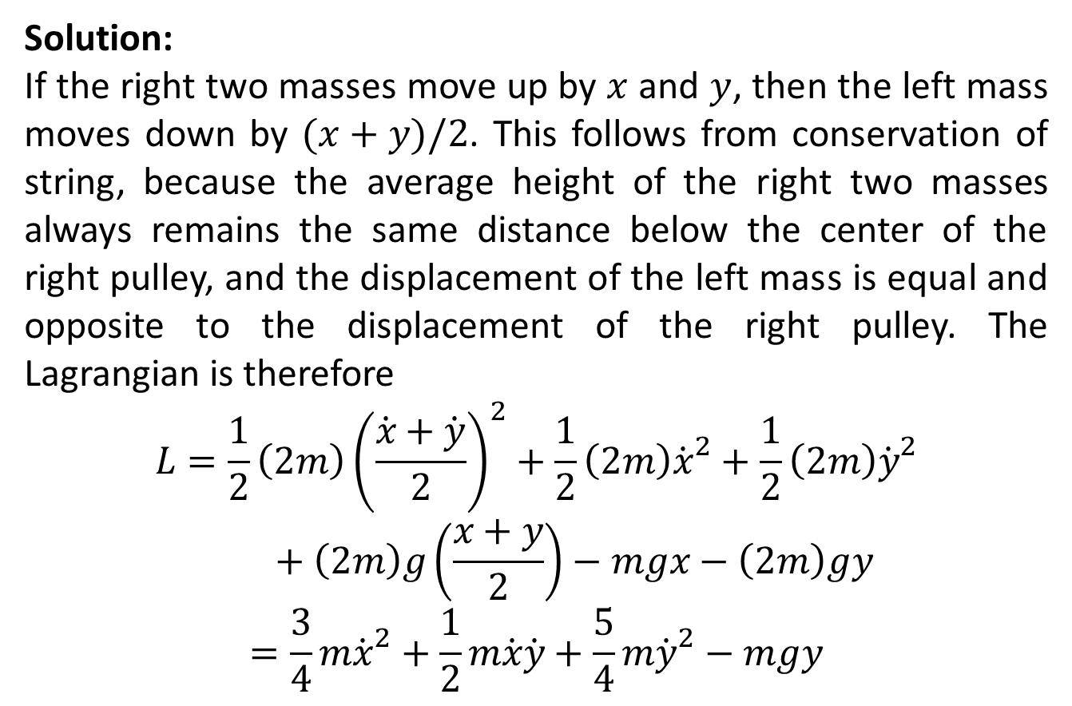
Solution:
If the right two masses move up by $x$ and $y$, then the left mass moves down by $(x+y)/2$. This follows from conservation of string, because the average height of the right two masses always remains the same distance below the center of the right pulley, and the displacement of the left mass is equal and opposite to the displacement of the right pulley. The Lagrangian is therefore
$$L=\frac{1}{2}\left(2m\right){\left(\frac{\dot{x}+\dot{y}}{2}\right)}^{2}+\frac{1}{2}\left(2m\right){\dot{x}}^{2}+\frac{1}{2}\left(2m\right){\dot{y}}^{2}+\left(2m\right)g\left(\frac{x+y}{2}\right)−mgx−\left(2m\right)gy$$
$$=\frac{3}{4}m{\dot{x}}^{2}+\frac{1}{2}m\dot{x}\dot{y}+\frac{5}{4}m{\dot{y}}^{2}−mgy$$

Slide 27
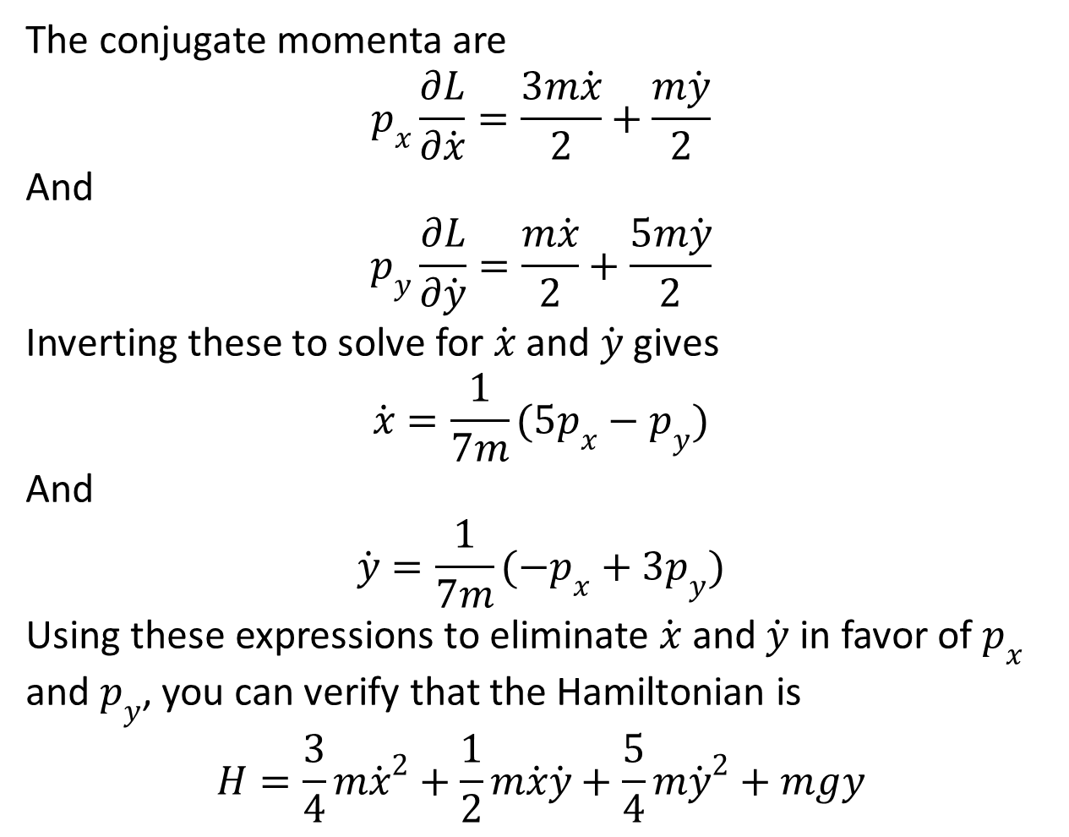
The conjugate momenta are
$$p_{x}\frac{∂L}{∂\dot{x}}=\frac{3m\dot{x}}{2}+\frac{m\dot{y}}{2}$$
And
$$p_{y}\frac{∂L}{∂\dot{y}}=\frac{m\dot{x}}{2}+\frac{5m\dot{y}}{2}$$
Inverting these to solve for $\dot{x}$ and $\dot{y}$ gives
$$\dot{x}=\frac{1}{7m}(5p_{x}−p_{y})$$
And
$$\dot{y}=\frac{1}{7m}(−p_{x}+3p_{y})$$
Using these expressions to eliminate $\dot{x}$ and $\dot{y}$ in favor of $p_{x}$ and $p_{y}$, you can verify that the Hamiltonian is
$$H=\frac{3}{4}m{\dot{x}}^{2}+\frac{1}{2}m\dot{x}\dot{y}+\frac{5}{4}m{\dot{y}}^{2}+mgy$$

Slide 29
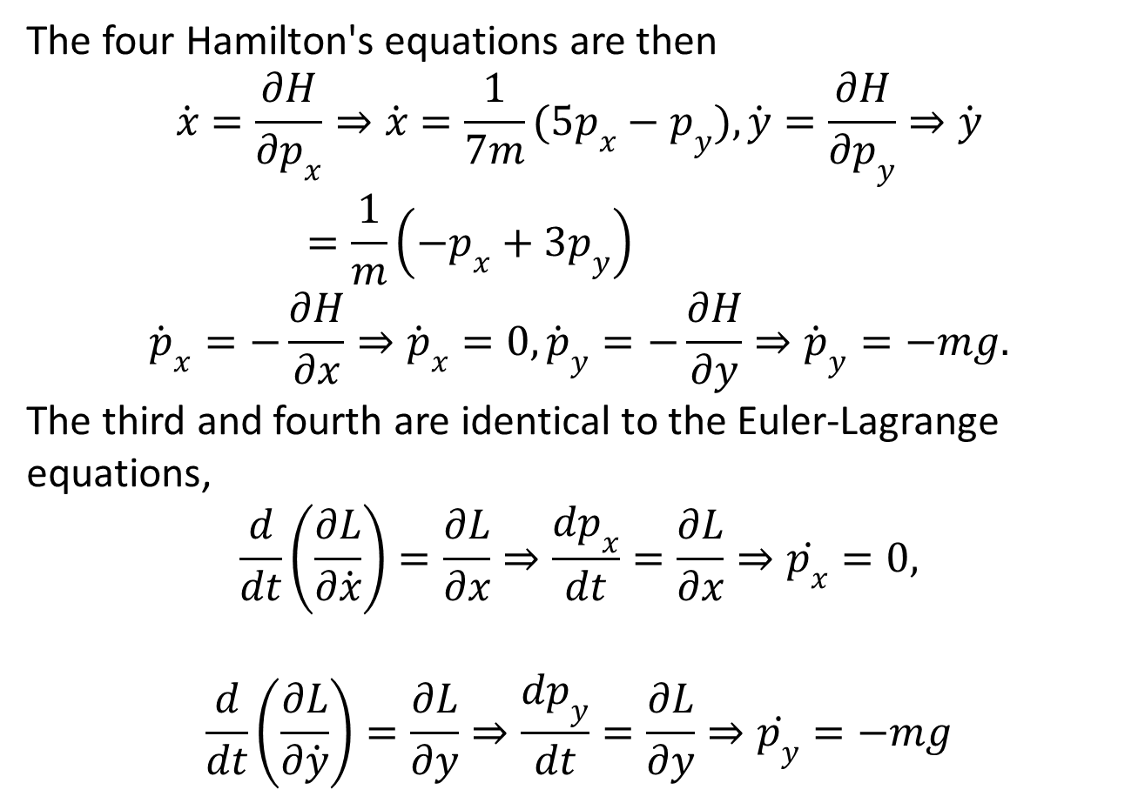
The four Hamilton's equations are then
$$\dot{x}=\frac{∂H}{∂p_{x}}⇒\dot{x}=\frac{1}{7m}(5p_{x}−p_{y}),\dot{y}=\frac{∂H}{∂p_{y}}⇒\dot{y}=\frac{1}{m}\left(−p_{x}+{3p}_{y}\right)$$
$${\dot{p}}_{x}=−\frac{∂H}{∂x}⇒{\dot{p}}_{x}=0,{\dot{p}}_{y}=−\frac{∂H}{∂y}⇒{\dot{p}}_{y}=−mg.$$
The third and fourth are identical to the Euler-Lagrange equations,
$$\frac{d}{dt}\left(\frac{∂L}{∂\dot{x}}\right)=\frac{∂L}{∂x}⇒\frac{dp_{x}}{dt}=\frac{∂L}{∂x}⇒\dot{p_{x}}=0,$$
$$\frac{d}{dt}\left(\frac{∂L}{∂\dot{y}}\right)=\frac{∂L}{∂y}⇒\frac{dp_{y}}{dt}=\frac{∂L}{∂y}⇒\dot{p_{y}}=−mg$$

Slide 31
The End

