Slide 1
Revision
Previous lecture was about
Legendre Transformations

Slide 2
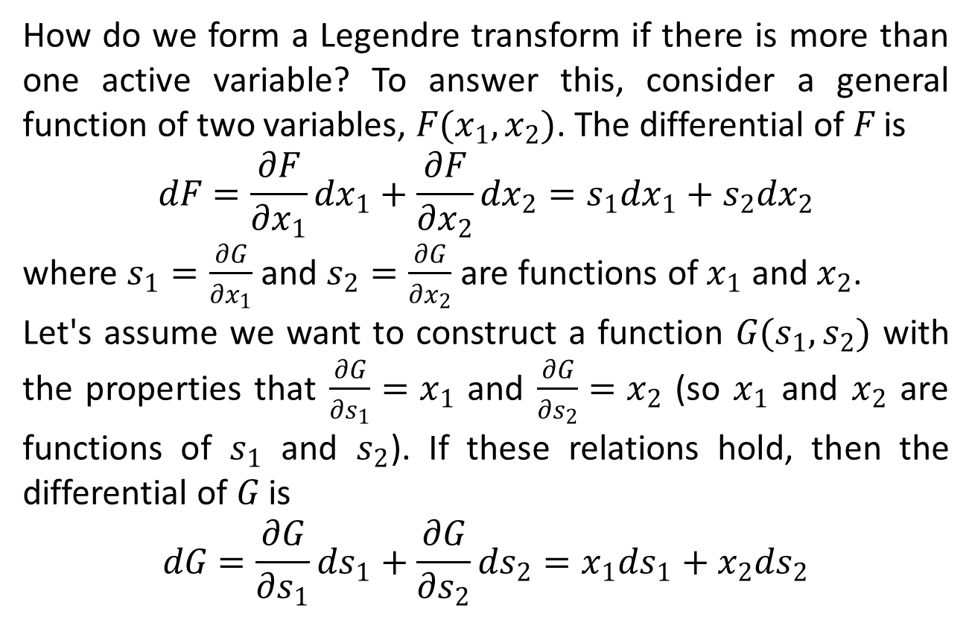
Legendre Transform (Many Variables)
How do we form a Legendre transform if there is more than one active variable? To answer this, consider a general function of two variables, $F(x_{1},x_{2})$. The differential of $F$is
$$dF=\frac{∂F}{∂x_{1}}dx_{1}+\frac{∂F}{∂x_{2}}dx_{2}=s_{1}dx_{1}+s_{2}dx_{2}$$
where $s_{1}=\frac{∂G}{∂x_{1}}$ and $s_{2}=\frac{∂G}{∂x_{2}}$ are functions of $x_{1}$ and $x_{2}$.
Let's assume we want to construct a function $G(s_{1},s_{2})$ with the properties that$\frac{∂G}{∂s_{1}}=x_{1}$ and $\frac{∂G}{∂s_{2}}=x_{2}$ (so $x_{1}$ and $x_{2}$ are functions of $s_{1}$ and $s_{2}$). If these relations hold, then the differential of $G$is
$$dG=\frac{∂G}{∂s_{1}}ds_{1}+\frac{∂G}{∂s_{2}}ds_{2}=x_{1}ds_{1}+x_{2}ds_{2}$$

Slide 3
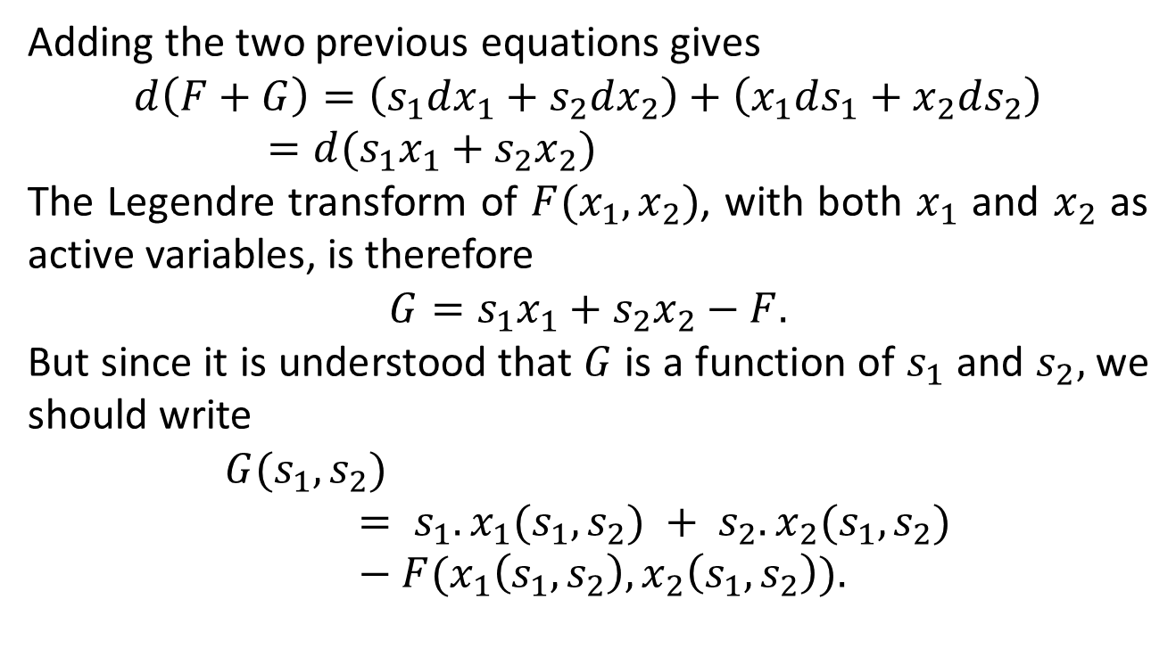
Adding the two previous equations gives
$$d\left(F+G\right)=\left(s_{1}dx_{1}+s_{2}dx_{2}\right)+\left(x_{1}ds_{1}+x_{2}ds_{2}\right)=d(s_{1}x_{1}+s_{2}x_{2})$$
The Legendre transform of $F(x_{1},x_{2})$, with both $x_{1}$ and $x_{2}$ as active variables, is therefore
$$G=s_{1}x_{1}+s_{2}x_{2}−F.$$
But since it is understood that $G$is a function of $s_{1}$ and $s_{2},$ we should write
$$G(s_{1},s_{2}) = s_{1}.x_{1}(s_{1},s_{2}) + s_{2}.x_{2}(s_{1},s_{2})−F(x_{1}\left(s_{1},s_{2}\right),x_{2}\left(s_{1},s_{2}\right)).$$

Slide 4
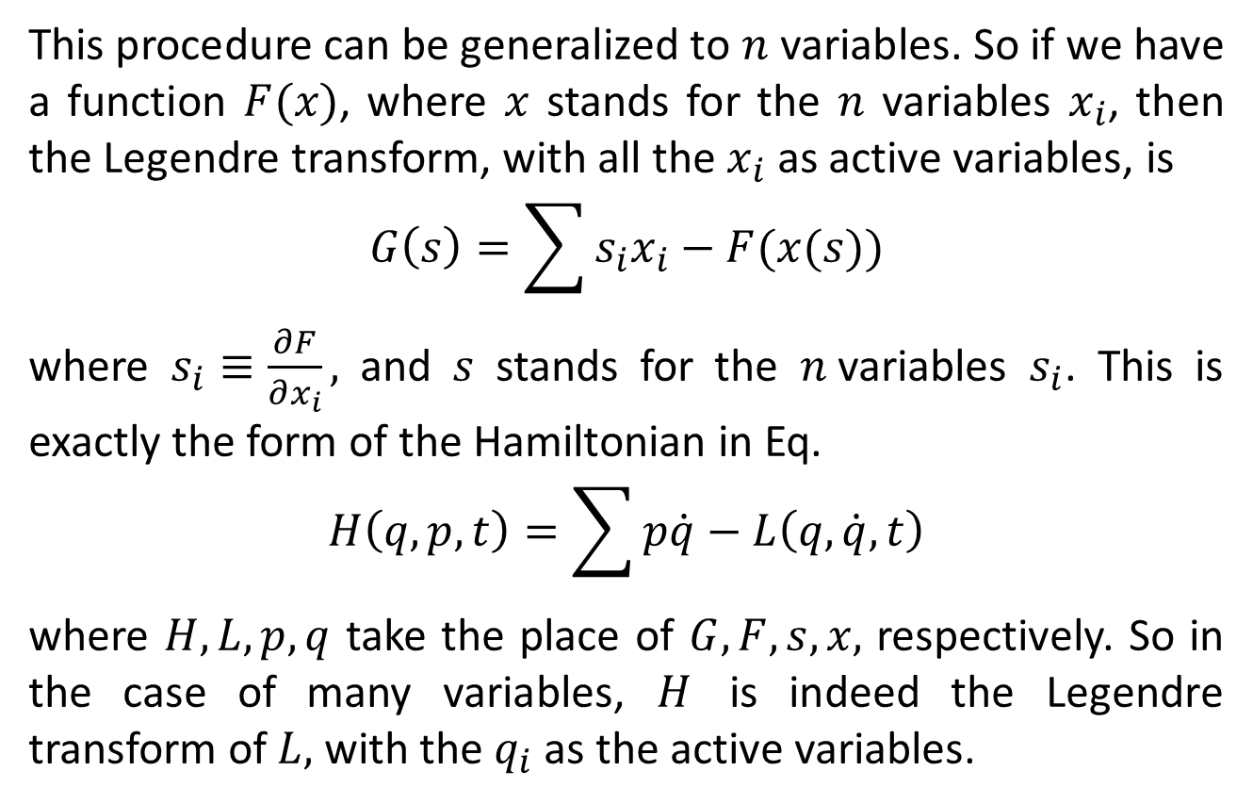
This procedure can be generalized to $n$variables. So if we have a function $F(x)$, where $x$stands for the $n$variables $x_{i}$, then the Legendre transform, with all the $x_{i}$as active variables, is
$$G\left(s\right)=\sum{s_{i}x_{i}}−F(x(s))$$
where $s_{i}≡\frac{∂F}{∂x_{i}},$ and $s$stands for the $n$variables $s_{i}$. This is exactly the form of the Hamiltonian in Eq.
$$H\left(q,p,t\right)=\sum{p\dot{q}}−L\left(q,\dot{q},t\right)$$
where $H,L,p,q$ take the place of $G,F,s,x,$ respectively. So in the case of many variables, $H$is indeed the Legendre transform of $L,$ with the $q_{i}$as the active variables.

Slide 5
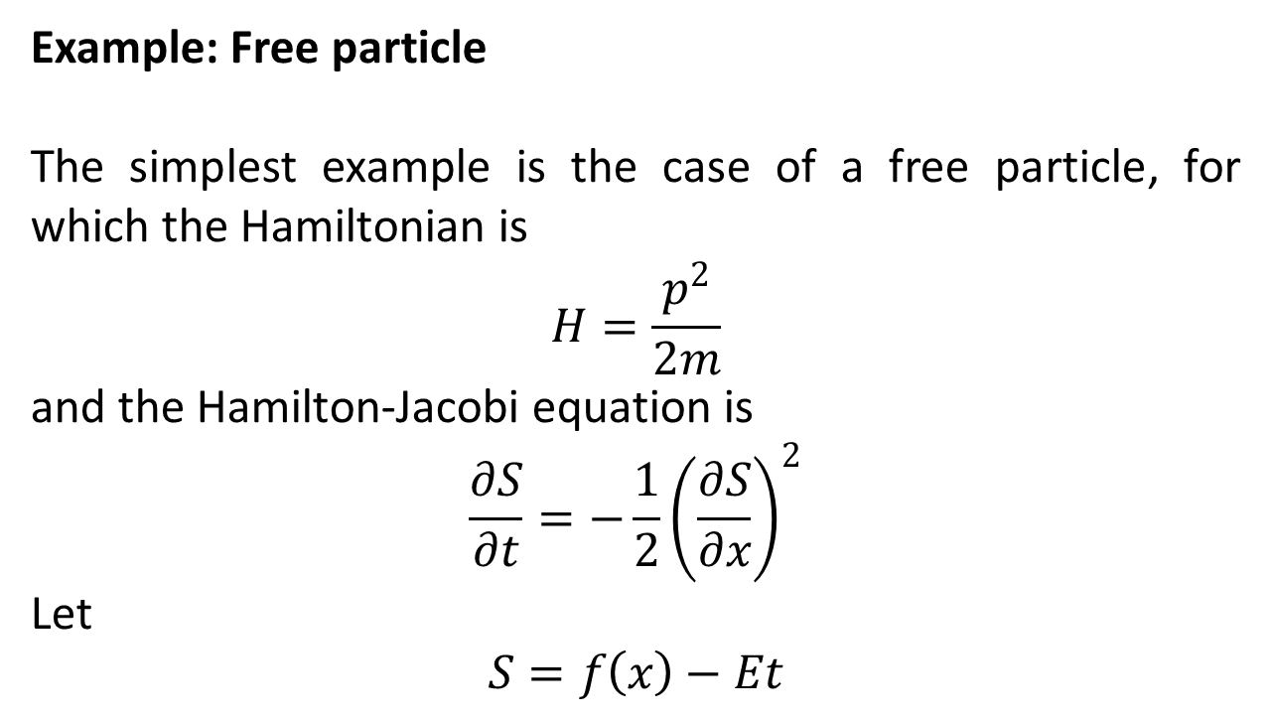
Hamilton-Jacobi Equations
Example: Free particle
The simplest example is the case of a free particle, for which the Hamiltonian is
$$H=\frac{p^{2}}{2m}$$
and the Hamilton-Jacobi equation is
$$\frac{∂S}{∂t}=−\frac{1}{2}{\left(\frac{∂S}{∂x}\right)}^{2}$$
Let
$$S=f\left(x\right)−Et$$

Slide 6
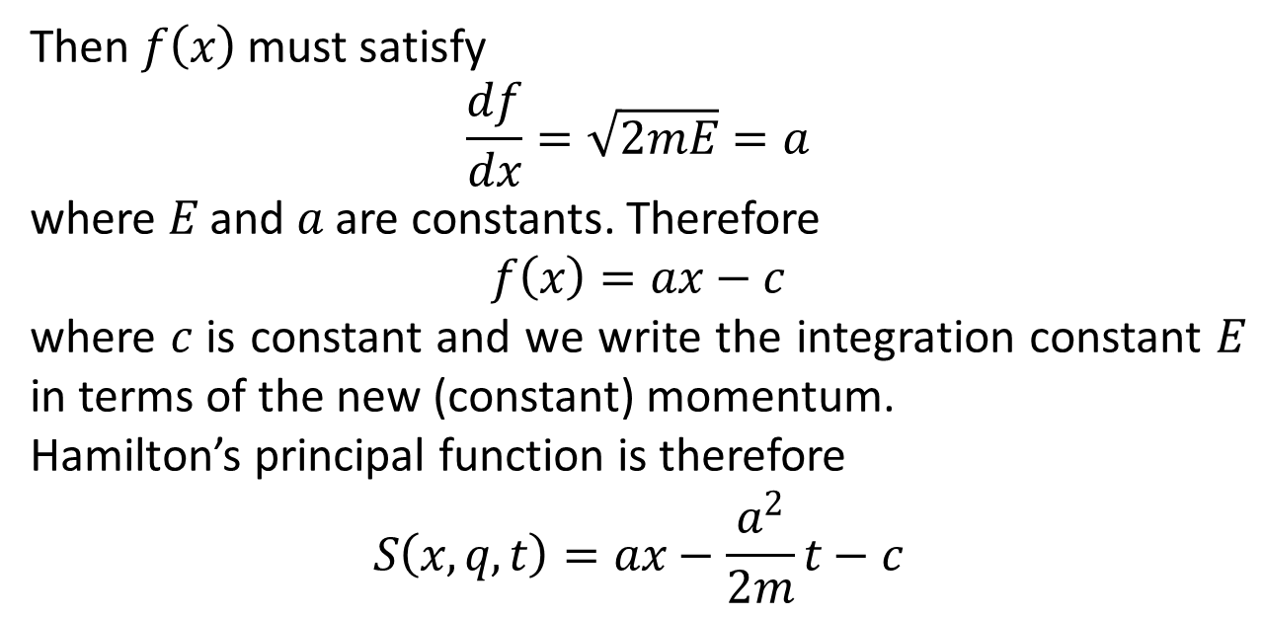
Then $f\left(x\right)$ must satisfy
$$\frac{df}{dx}=\sqrt{2mE}=a$$
where $E$ and $a$ are constants. Therefore
$$f\left(x\right)=ax−c$$
where $c$ is constant and we write the integration constant $E$ in terms of the new (constant) momentum.
Hamilton’s principal function is therefore
$$S\left(x,q,t\right)=ax−\frac{a^{2}}{2m}t−c$$

Slide 7
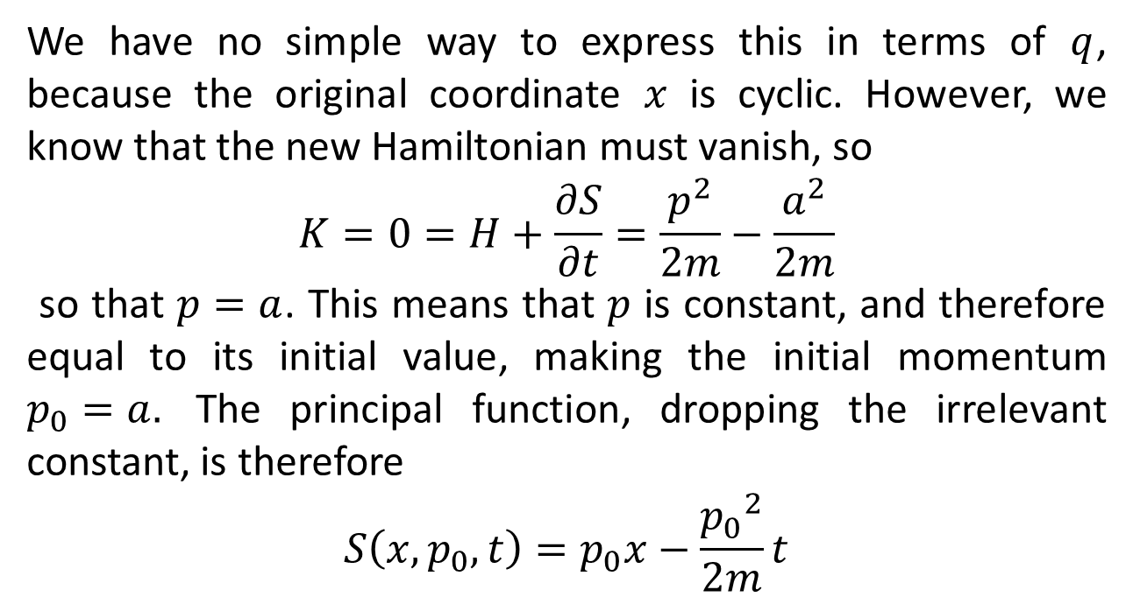
We have no simple way to express this in terms of $q$, because the original coordinate $x$ is cyclic. However, we know that the new Hamiltonian must vanish, so
$$K=0=H+\frac{∂S}{∂t}=\frac{p^{2}}{2m}−\frac{a^{2}}{2m}$$
so that $p=a$. This means that $p$ is constant, and therefore equal to its initial value, making the initial momentum $p_{0}=a.$ The principal function, dropping the irrelevant constant, is therefore
$$S\left(x,p_{0},t\right)=p_{0}x−\frac{{p_{0}}^{2}}{2m}t$$

Slide 8
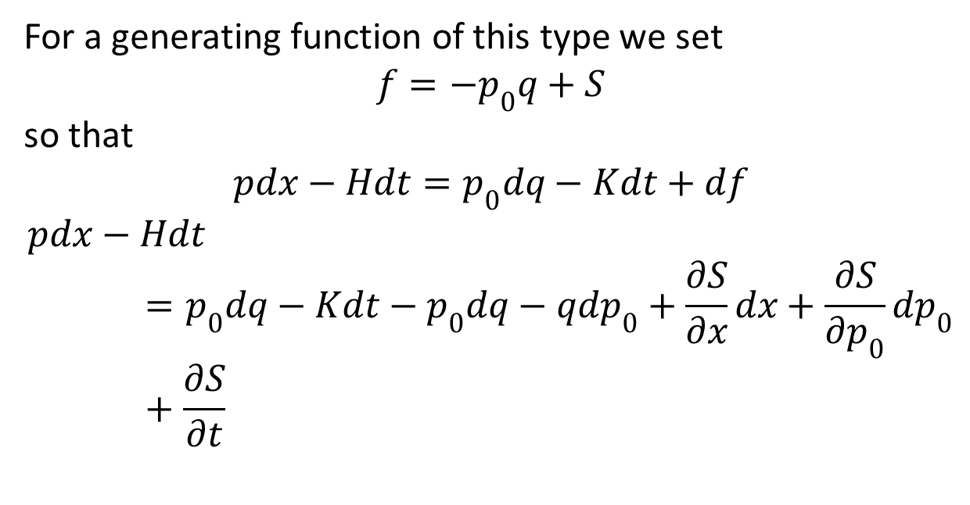
For a generating function of this type we set
$$f=−p_{0}q+S$$
so that
$$pdx−Hdt=p_{0}dq−Kdt+df$$
$$pdx−Hdt=p_{0}dq−Kdt−p_{0}dq−qdp_{0}+\frac{∂S}{∂x}dx+\frac{∂S}{∂p_{0}}dp_{0}+\frac{∂S}{∂t}$$

Slide 9
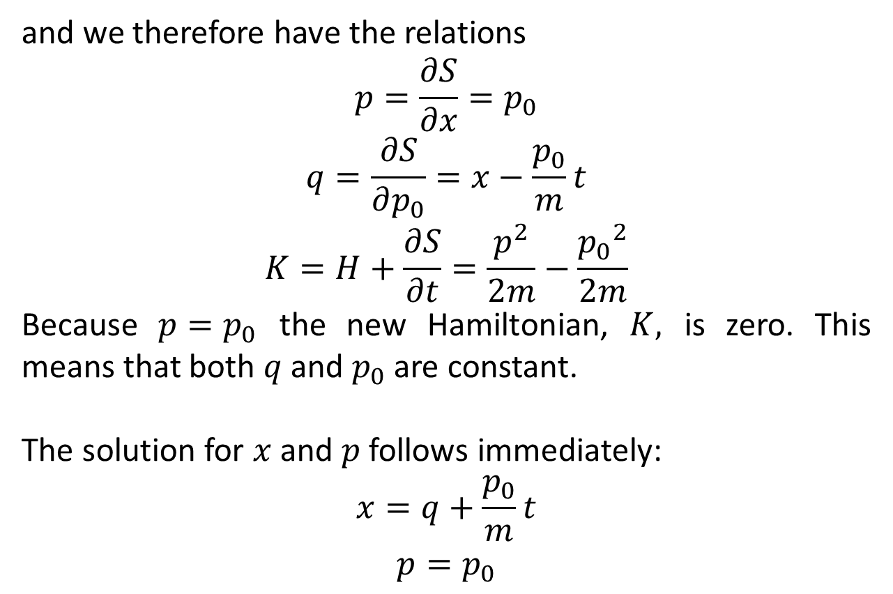
and we therefore have the relations
$$p=\frac{∂S}{∂x}=p_{0}$$
$$q=\frac{∂S}{∂p_{0}}=x−\frac{p_{0}}{m}t$$
$$K=H+\frac{∂S}{∂t}=\frac{p^{2}}{2m}−\frac{{p_{0}}^{2}}{2m}$$
Because $p=p_{0}$ the new Hamiltonian, $K,$ is zero. This means that both $q$ and $p_{0}$ are constant.
The solution for $x$ and $p$ follows immediately:
$$x=q+\frac{p_{0}}{m}t$$
$$p=p_{0}$$

Slide 10
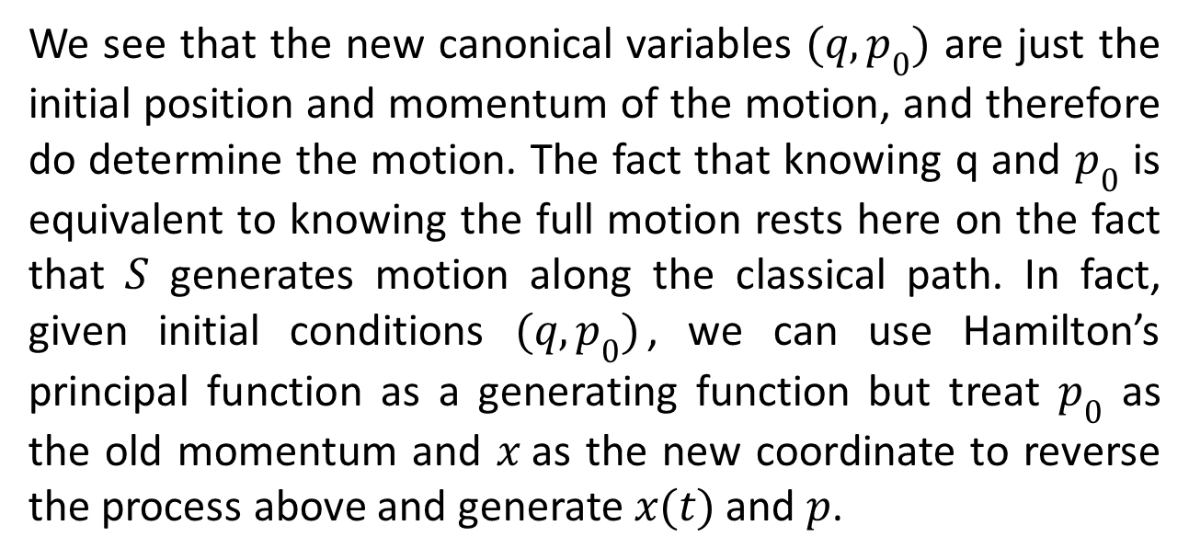
We see that the new canonical variables $(q,p_{0})$ are just the initial position and momentum of the motion, and therefore do determine the motion. The fact that knowing q and $p_{0}$ is equivalent to knowing the full motion rests here on the fact that $S$ generates motion along the classical path. In fact, given initial conditions $(q,p_{0})$, we can use Hamilton’s principal function as a generating function but treat $p_{0}$ as the old momentum and $x$as the new coordinate to reverse the process above and generate $x(t)$ and $p$.

