Slide 1
Revision
Previous lecture was about
Hamiltonian as Total Energy of the Sytem

Slide 2
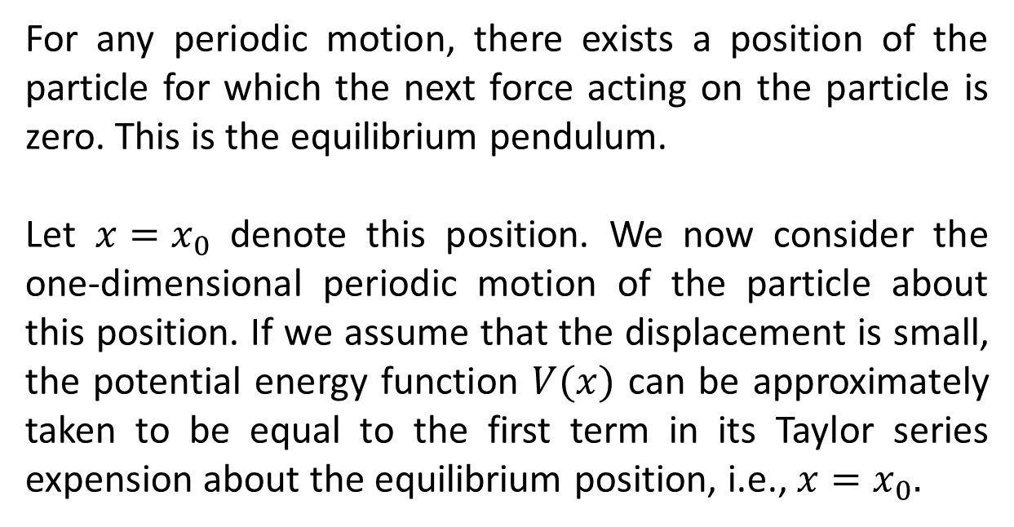
Simple Harmonic Oscillator
For any periodic motion, there exists a position of the particle for which the next force acting on the particle is zero. This is the equilibrium pendulum.
Let $x=x_{0}$ denote this position. We now consider the one-dimensional periodic motion of the particle about this position. If we assume that the displacement is small, the potential energy function $V(x)$ can be approximately taken to be equal to the first term in its Taylor series expension about the equilibrium position, i.e., $x=x_{0}.$

Slide 3
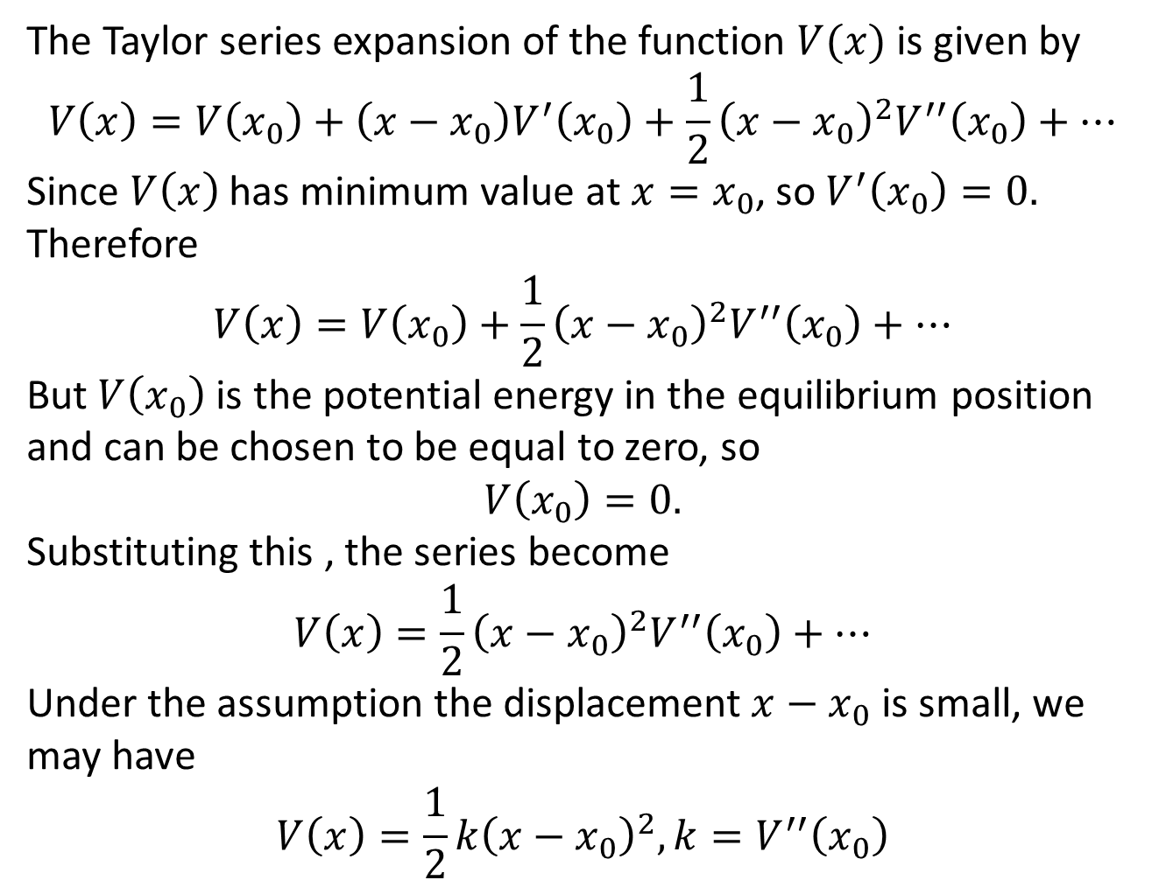
The Taylor series expansion of the function $V(x)$ is given by
$$V\left(x\right)=V\left(x_{0}\right)+\left(x−x_{0}\right)V^{′}\left(x_{0}\right)+\frac{1}{2}{\left(x−x_{0}\right)}^{2}V^{′′}\left(x_{0}\right)+…$$
Since $V\left(x\right)$ has minimum value at $x=x_{0}$, so $V^{′}\left(x_{0}\right)=0.$ Therefore
$$V\left(x\right)=V\left(x_{0}\right)+\frac{1}{2}{\left(x−x_{0}\right)}^{2}V^{′′}\left(x_{0}\right)+…$$
But $V\left(x_{0}\right)$ is the potential energy in the equilibrium position and can be chosen to be equal to zero, so
$$V\left(x_{0}\right)=0.$$
Substituting this , the series become
$$V\left(x\right)=\frac{1}{2}{\left(x−x_{0}\right)}^{2}V^{′′}\left(x_{0}\right)+…$$
Under the assumption the displacement $x−x_{0}$ is small, we may have
$$V\left(x\right)=\frac{1}{2}k{\left(x−x_{0}\right)}^{2}, k=V^{′′}\left(x_{0}\right)$$

Slide 4
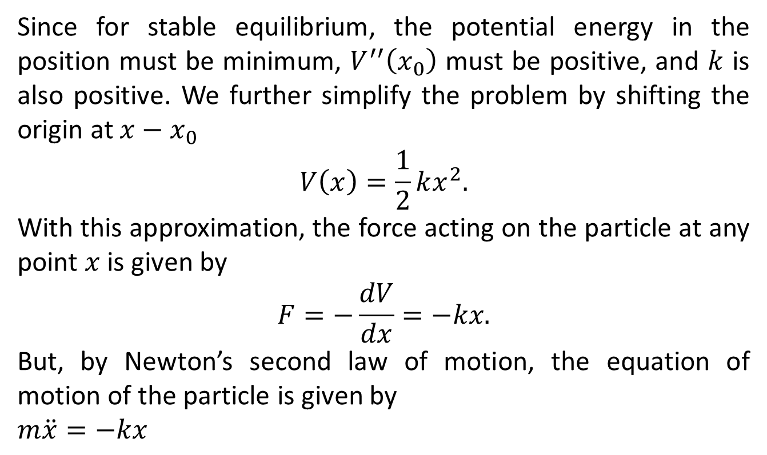
Since for stable equilibrium, the potential energy in the position must be minimum, $V^{′′}\left(x_{0}\right)$ must be positive, and $k$ is also positive. We further simplify the problem by shifting the origin at $x−x_{0}$
$$V\left(x\right)=\frac{1}{2}kx^{2}.$$
With this approximation, the force acting on the particle at any point $x$ is given by
$$F=−\frac{dV}{dx}=−kx.$$
But, by Newton’s second law of motion, the equation of motion of the particle is given by
$m\ddot{x}=−kx$

Slide 5
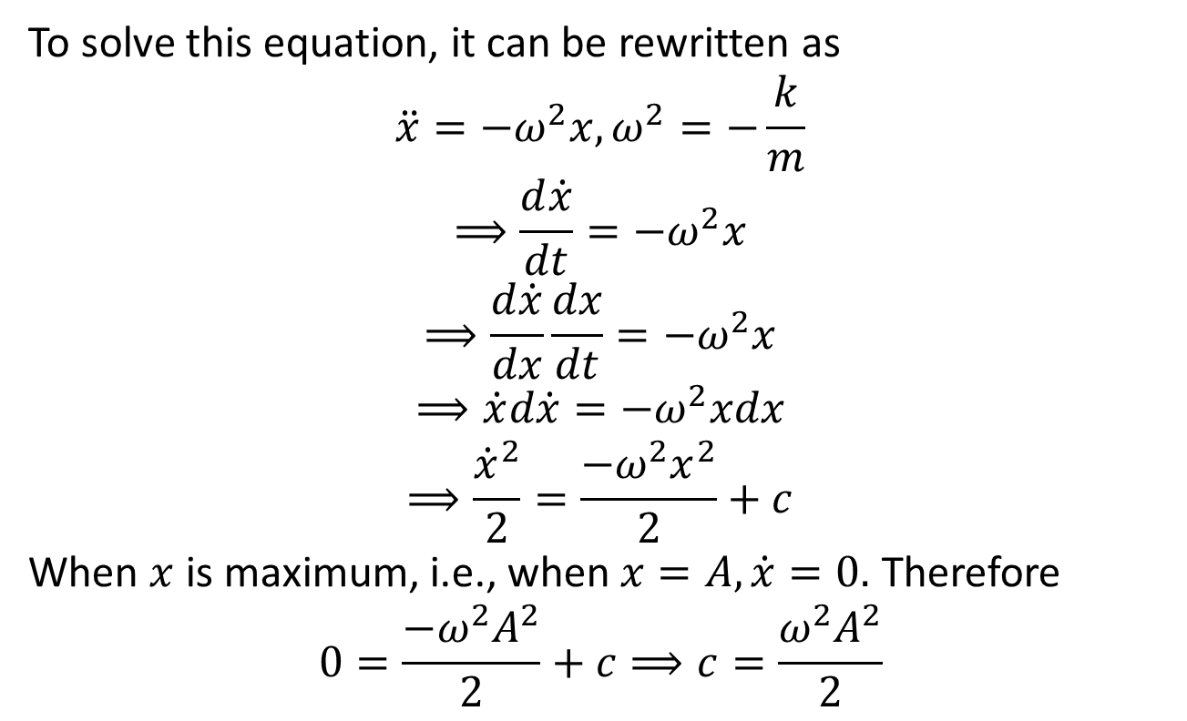
To solve this equation, it can be rewritten as
$$\ddot{x}=−ω^{2}x,ω^{2}=−\frac{k}{m}$$
$$⟹\frac{d\dot{x}}{dt}=−ω^{2}x$$
$$⟹\frac{d\dot{x}}{dx}\frac{dx}{dt}=−ω^{2}x$$
$$⟹\dot{x}d\dot{x}=−ω^{2}xdx$$
$$⟹\frac{{\dot{x}}^{2}}{2}=\frac{{−ω^{2}x}^{2}}{2}+c$$
When $x$ is maximum, i.e., when $x=A, \dot{x}=0.$ Therefore
$$0=\frac{{−ω^{2}A}^{2}}{2}+c⟹c=\frac{{ω^{2}A}^{2}}{2}$$

Slide 6
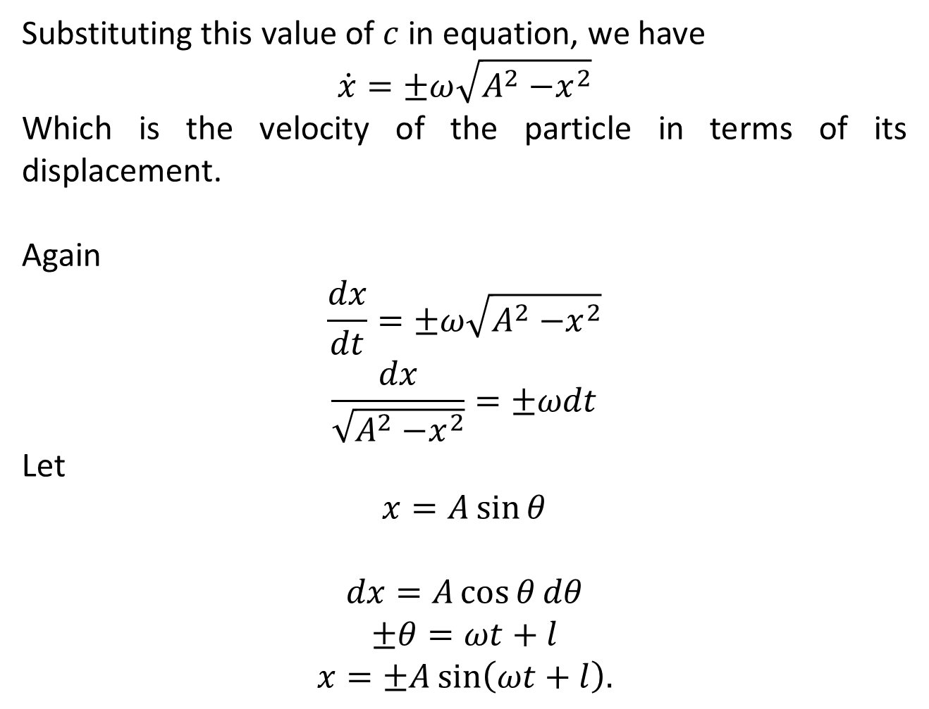
Substituting this value of $c$ in equation, we have
$$\dot{x}=±ω\sqrt{A^{2}{−x}^{2}}$$
Which is the velocity of the particle in terms of its displacement.
Again
$$\frac{dx}{dt}=±ω\sqrt{A^{2}{−x}^{2}}$$
$$\frac{dx}{\sqrt{A^{2}{−x}^{2}}}=±ωdt$$
Let
$$x=A\sin{θ}$$
$$dx=A\cos{θ}dθ$$
$$±θ=ωt+l$$
$$x=±A\sin\left(ωt+l\right).$$

Slide 7
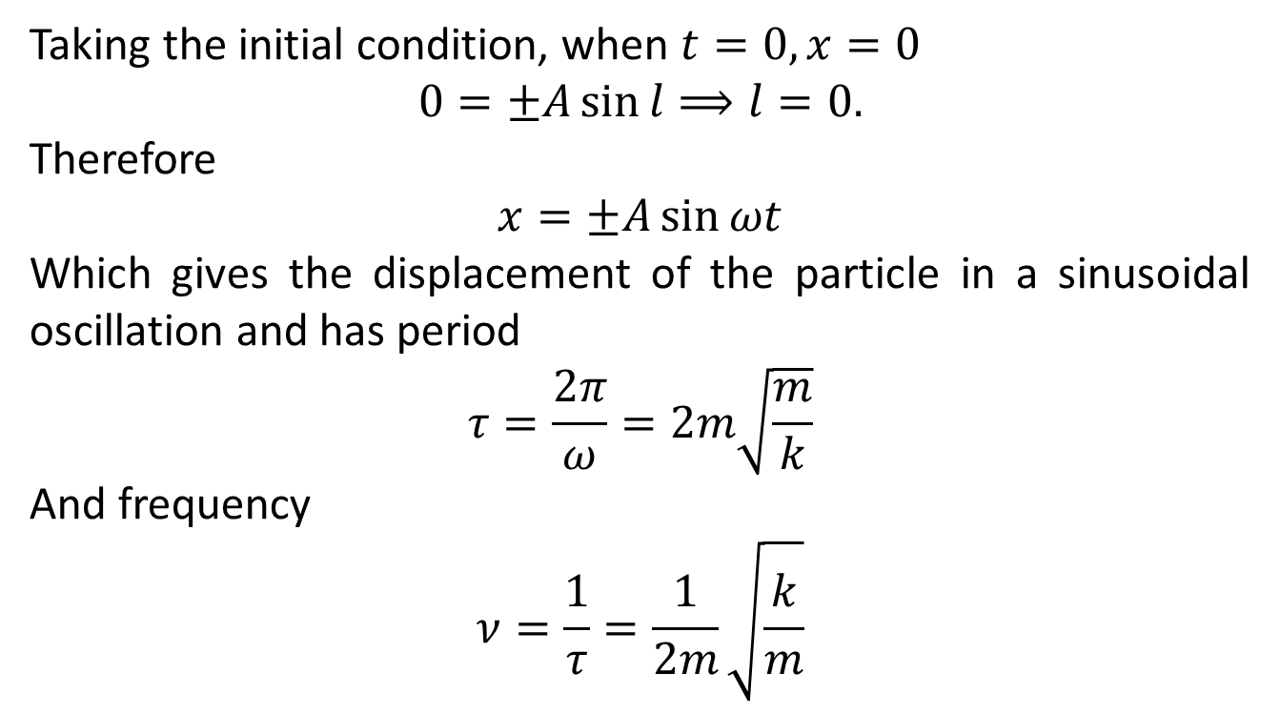
Taking the initial condition, when $t=0,x=0$
$$0=±A\sin{l⟹l=0.}$$
Therefore
$$x=±A\sin{ωt}$$
Which gives the displacement of the particle in a sinusoidal oscillation and has period
$$τ=\frac{2π}{ω}=2m\sqrt{\frac{m}{k}}$$
And frequency
$$ν=\frac{1}{τ}=\frac{1}{2m}\sqrt{\frac{k}{m}}$$

Slide 8
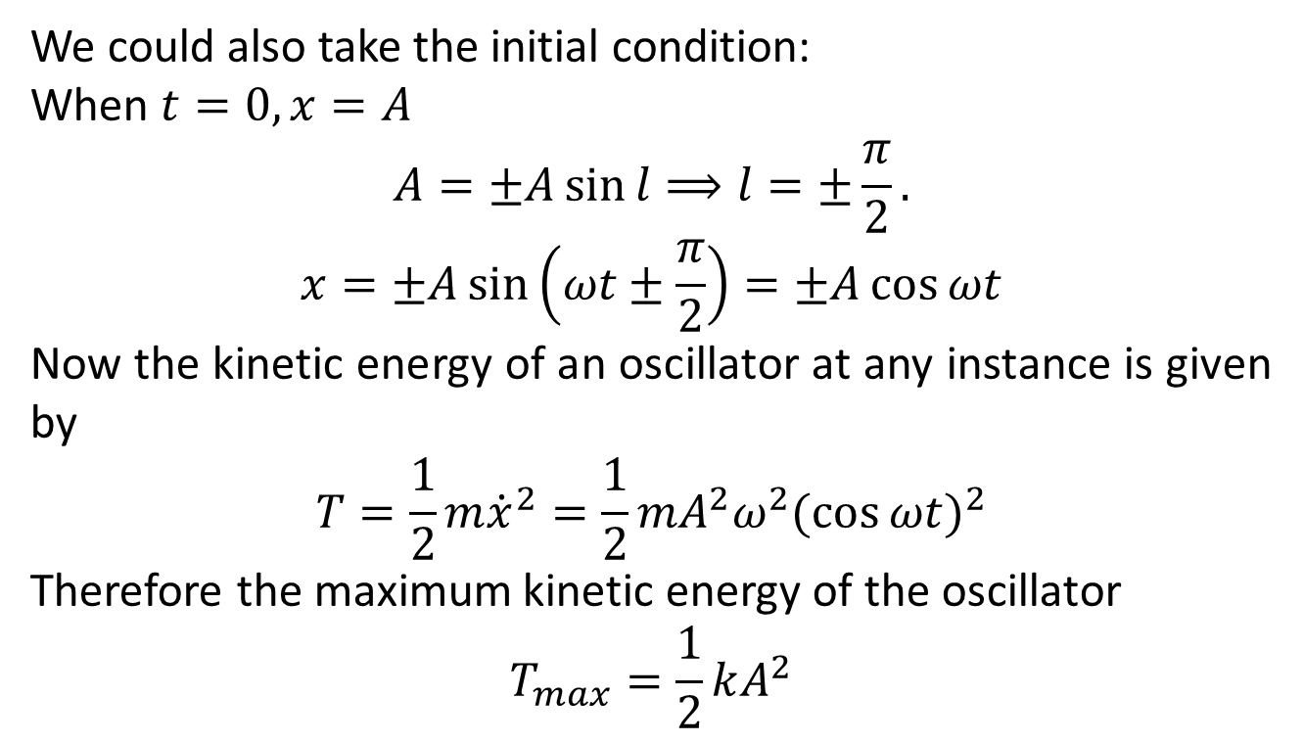
We could also take the initial condition:
When $t=0,x=A$
$$A=±A\sin{l⟹l=±\frac{π}{2}.}$$
$$x=±A\sin\left(ωt±\frac{π}{2}\right)=±A\cos{ωt}$$
Now the kinetic energy of an oscillator at any instance is given by
$$T=\frac{1}{2}m{\dot{x}}^{2}=\frac{1}{2}mA^{2}ω^{2}{(\cos{ωt})}^{2}$$
Therefore the maximum kinetic energy of the oscillator
$$T_{max}=\frac{1}{2}kA^{2}$$

Slide 9
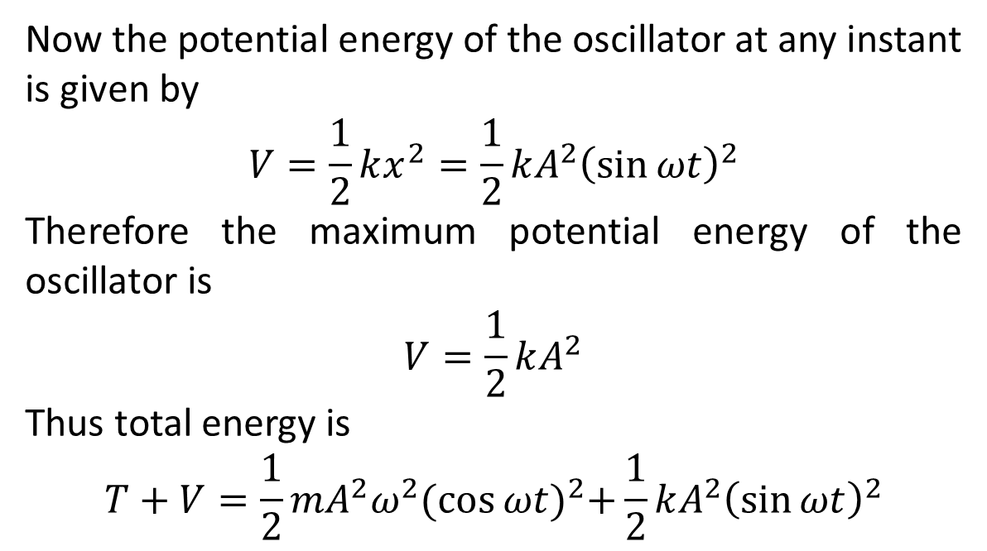
Now the potential energy of the oscillator at any instant is given by
$$V=\frac{1}{2}kx^{2}=\frac{1}{2}kA^{2}{\left(\sin{ωt}\right)}^{2}$$
Therefore the maximum potential energy of the oscillator is
$$V=\frac{1}{2}kA^{2}$$
Thus total energy is
$$T+V=\frac{1}{2}mA^{2}ω^{2}{(\cos{ωt})}^{2}+\frac{1}{2}kA^{2}{\left(\sin{ωt}\right)}^{2}$$

Slide 10
The End

