Slide 1
Revision
Previous lecture was about
Lagrangian Mechanics
Hamiltonian Mechanics
Hamilton-Jacobi Equations
Applications of Hamiltonian-Jacobi Equations

Slide 2
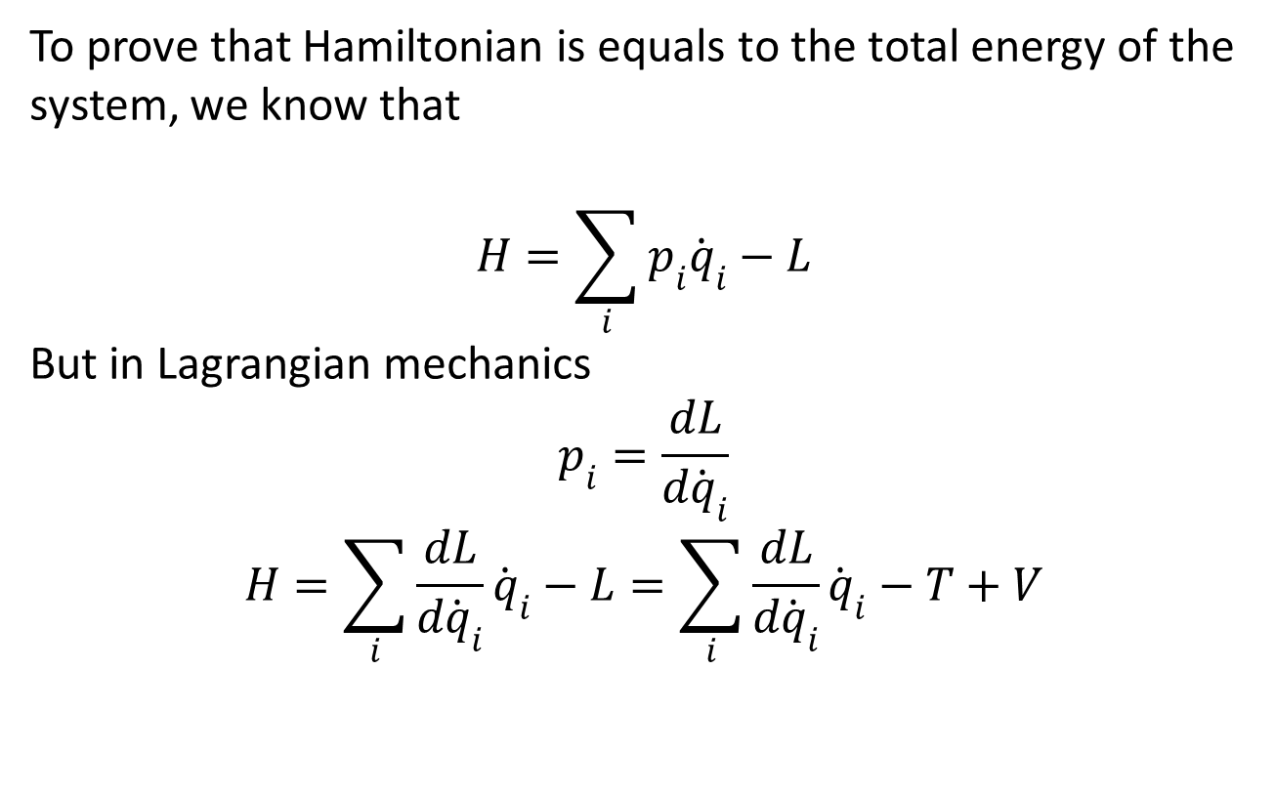
Hamiltonian as Total Energy
To prove that Hamiltonian is equals to the total energy of the system, we know that
$$H=\sum_{i}{p_{i}{\dot{q}}_{i}}−L$$
But in Lagrangian mechanics
$$p_{i}=\frac{dL}{d{\dot{q}}_{i}}$$
$$H=\sum_{i}{\frac{dL}{d{\dot{q}}_{i}}{\dot{q}}_{i}}−L=\sum_{i}{\frac{dL}{d{\dot{q}}_{i}}{\dot{q}}_{i}}−T+V$$

Slide 3
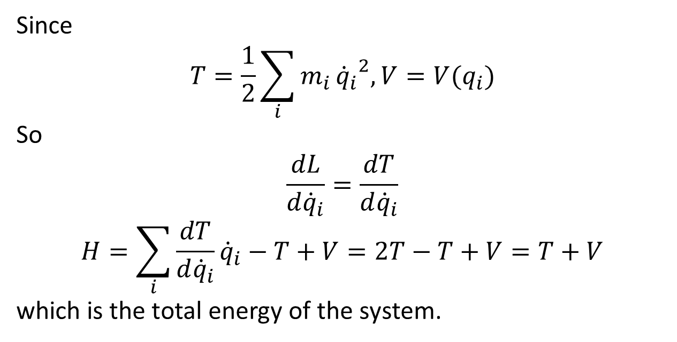
Since
$$T=\frac{1}{2}\sum_{i}{m_{i}}{{\dot{q}}_{i}}^{2}, V=V(q_{i})$$
So
$$\frac{dL}{d{\dot{q}}_{i}}=\frac{dT}{d{\dot{q}}_{i}}$$
$$H=\sum_{i}{\frac{dT}{d{\dot{q}}_{i}}{\dot{q}}_{i}}−T+V=2T−T+V=T+V$$
which is the total energy of the system.

Slide 4
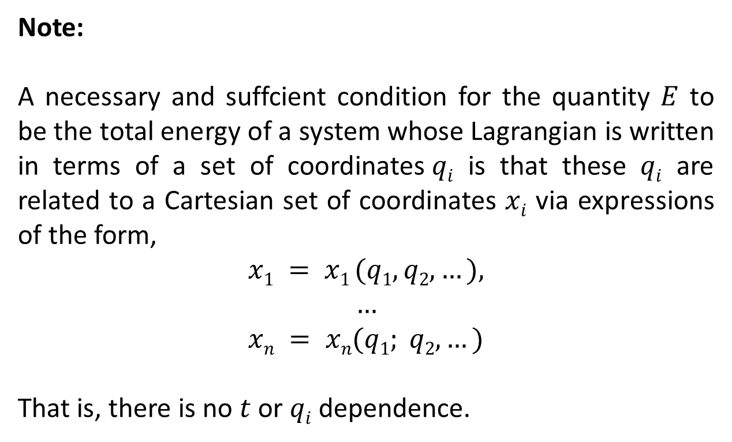
Note:
A necessary and suffcientcondition for the quantity $E$ to be the total energy of a system whose Lagrangian is written in terms of a set of coordinates$qi$ is that these $qi$are related to a Cartesian set of coordinates $xi$ via expressions of the form,
$$x1 = x1 (q1,q2,…),$$
$$…$$
$$xn = xn(q1; q2,…)$$
That is, there is no $t$ or $qi$ dependence.

Slide 5
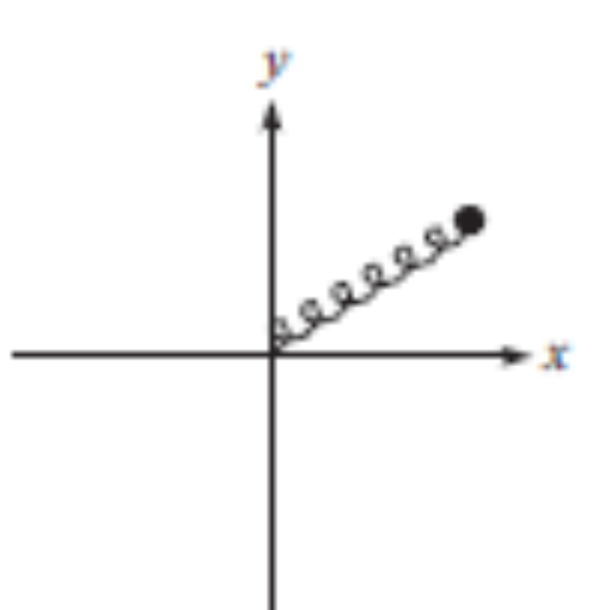
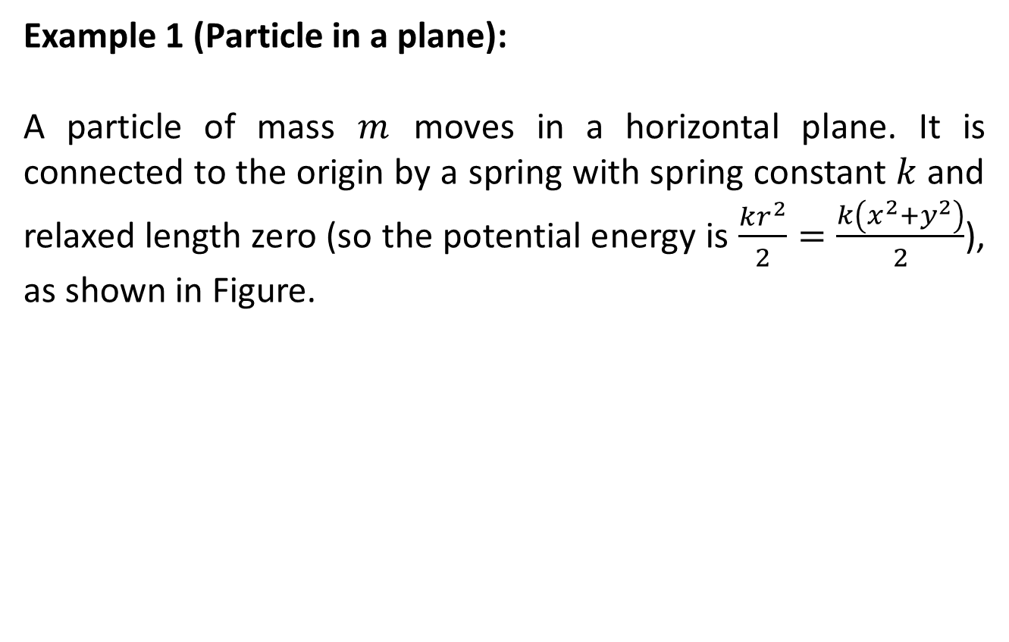
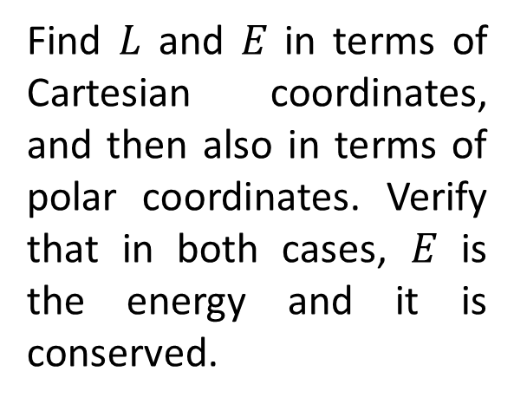
Example 1 (Particle in a plane):
A particle of mass $m$moves in a horizontal plane. It is connected to the origin by a spring with spring constant $k$and relaxed length zero (so the potential energy is $\frac{kr^{2}}{2}=\frac{k\left(x^{2}+y^{2}\right)}{2}$), as shown in Figure.
Find $L$and $E$in terms of Cartesian coordinates, and then also in terms of polar coordinates. Verify that in both cases, $E$is the energy and it is conserved.

Slide 6
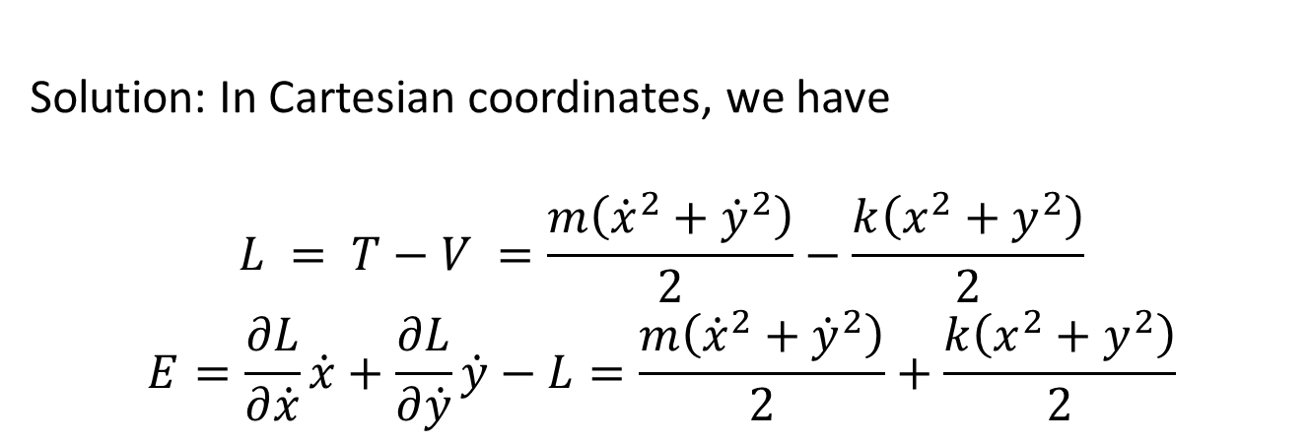
Solution: In Cartesian coordinates, we have
$$L = T−V =\frac{m\left({\dot{x}}^{2}+{\dot{y}}^{2}\right)}{2}−\frac{k\left(x^{2}+y^{2}\right)}{2}$$
$$E=\frac{∂L}{∂\dot{x}}\dot{x}+\frac{∂L}{∂\dot{y}}\dot{y}−L=\frac{m\left({\dot{x}}^{2}+{\dot{y}}^{2}\right)}{2}+\frac{k\left(x^{2}+y^{2}\right)}{2}$$

Slide 7
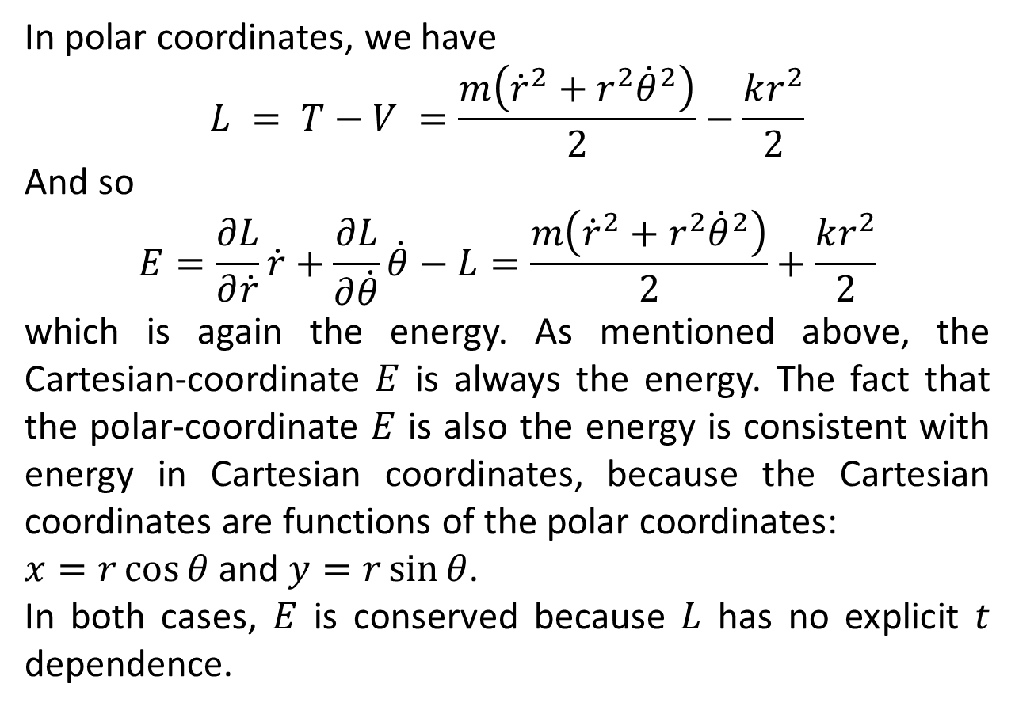
In polar coordinates, we have
$$L = T−V =\frac{m\left({\dot{r}}^{2}+r^{2}{\dot{θ}}^{2}\right)}{2}−\frac{kr^{2}}{2}$$
And so
$$E=\frac{∂L}{∂\dot{r}}\dot{r}+\frac{∂L}{∂\dot{θ}}\dot{θ}−L=\frac{m\left({\dot{r}}^{2}+r^{2}{\dot{θ}}^{2}\right)}{2}+\frac{kr^{2}}{2}$$
which is again the energy. As mentioned above, the Cartesian-coordinate $E$is always the energy. The fact that the polar-coordinate $E$is also the energy is consistent with energy in Cartesian coordinates, because the Cartesian coordinates are functions of the polar coordinates:
$x=r\cos{θ}$and $y=r\sin{θ}$.
In both cases, $E$is conserved because $L$has no explicit $t$dependence.

Slide 8
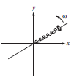
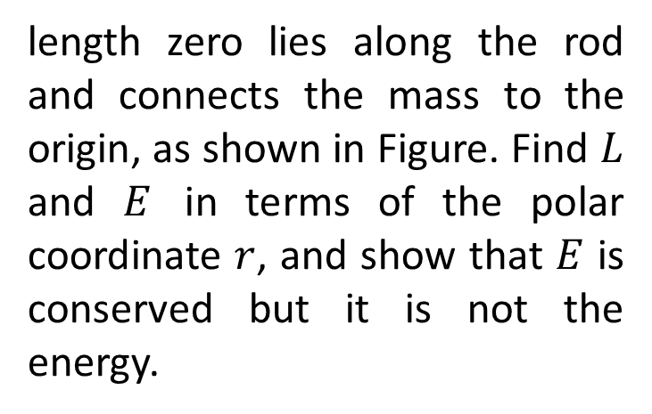
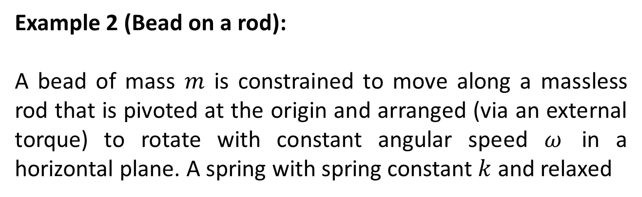
Example 2 (Bead on a rod):
A bead of mass $m$is constrained to move along a massless rod that is pivoted at the origin and arranged (via an external torque) to rotate with constant angular speed $ω$in a horizontal plane. A spring with spring constant $k$and relaxed
length zero lies along the rod and connects the mass to the origin, as shown in Figure. Find $L$and $E$in terms of the polar coordinate $r$, and show that $E$is conserved but it is not the energy.

Slide 9
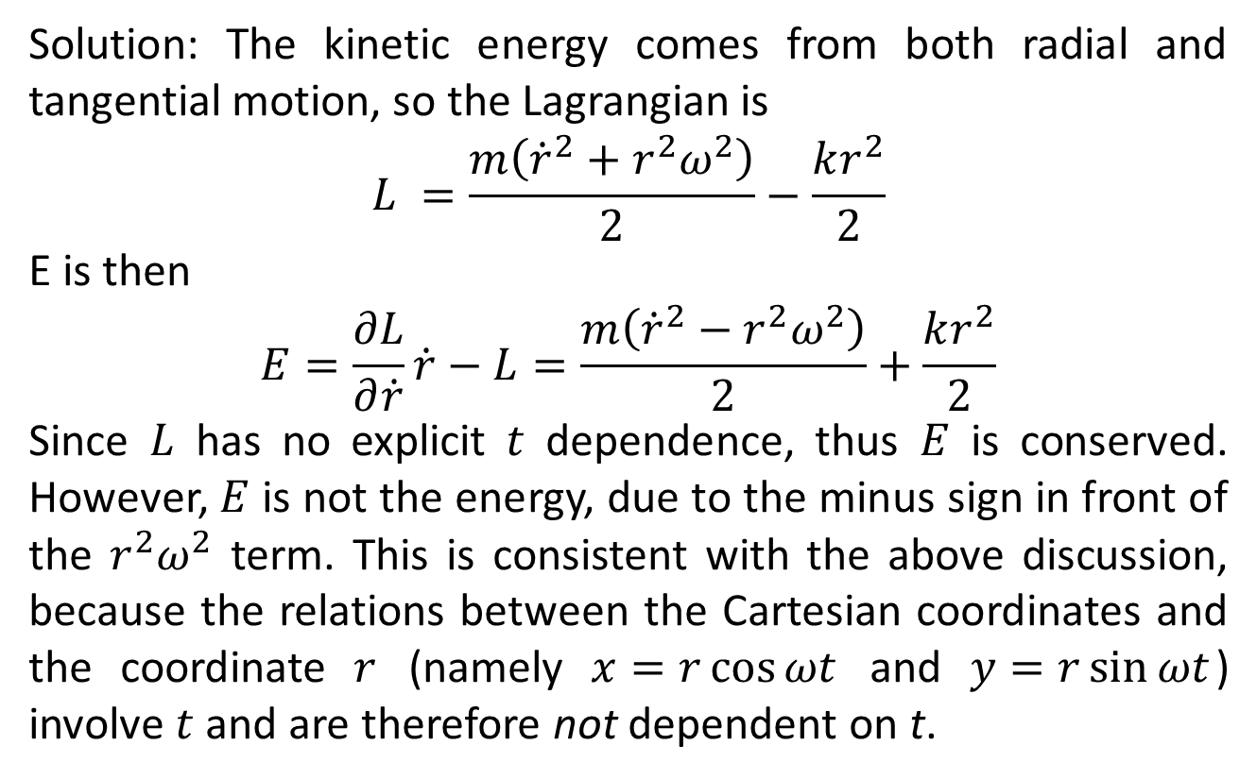
Solution: The kinetic energy comes from both radial and tangential motion, so the Lagrangianis
$$L =\frac{m\left({\dot{r}}^{2}+r^{2}ω^{2}\right)}{2}−\frac{kr^{2}}{2}$$
E is then
$$E=\frac{∂L}{∂\dot{r}}\dot{r}−L=\frac{m\left({\dot{r}}^{2}−r^{2}ω^{2}\right)}{2}+\frac{kr^{2}}{2}$$
Since $L$has no explicit $t$dependence, thus $E$is conserved. However, $E$is not the energy, due to the minus sign in front of the $r^{2}ω^{2}$ term. This is consistent with the above discussion, because the relations between the Cartesian coordinates and the coordinate $r$(namely $x=r\cos{ωt}$and $y=r\sin{ωt}$) involve $t$and are therefore not dependent on t.

Slide 10

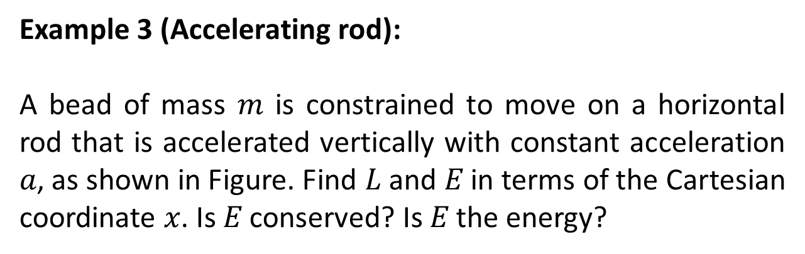
Example 3 (Accelerating rod):
A bead of mass $m$is constrained to move on a horizontal rod that is accelerated vertically with constant acceleration $a$, as shown in Figure. Find $L$and $E$in terms of the Cartesian coordinate $x$. Is $E$conserved? Is $E$the energy?

Slide 11
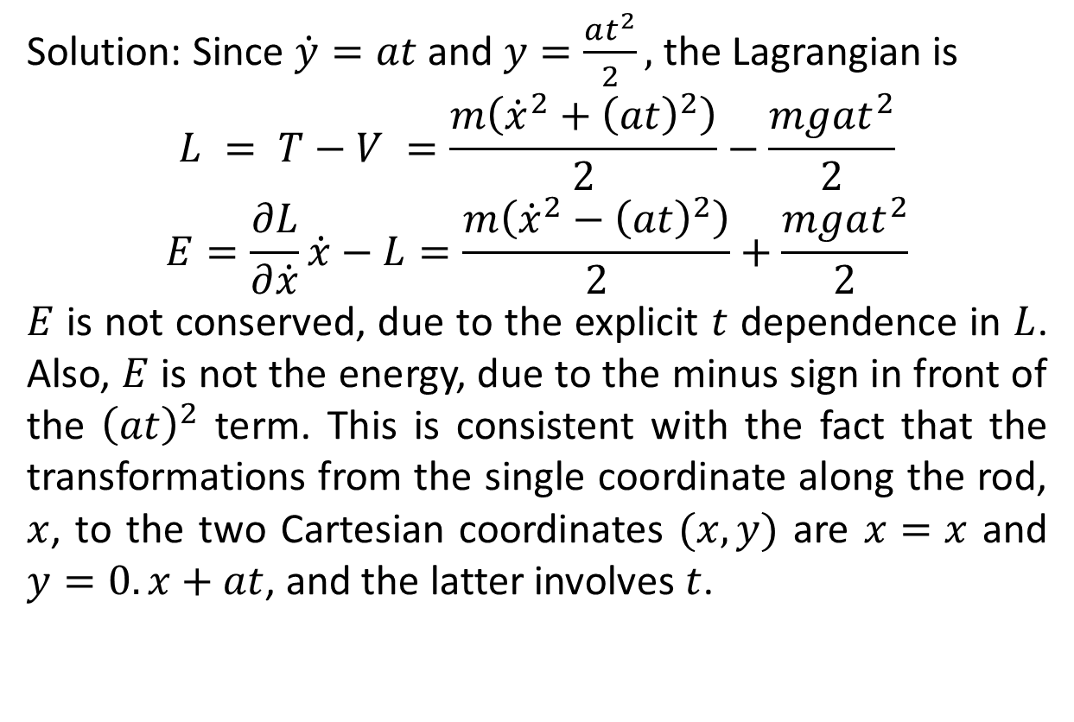
Solution: Since $\dot{y}=at$and $y=\frac{at^{2}}{2},$ the Lagrangian is
$$L = T−V =\frac{m\left({\dot{x}}^{2}+{\left(at\right)}^{2}\right)}{2}−\frac{mgat^{2}}{2}$$
$$E=\frac{∂L}{∂\dot{x}}\dot{x}−L=\frac{m\left({\dot{x}}^{2}−{\left(at\right)}^{2}\right)}{2}+\frac{mgat^{2}}{2}$$
$E$is not conserved, due to the explicit $t$dependence in $L$. Also, $E$is not the energy, due to the minus sign in front of the ${\left(at\right)}^{2}$ term. This is consistent with the fact that the transformations from the single coordinate along the rod, $x$, to the two Cartesian coordinates $(x,y)$ are $x=x$and $y=0.x+at$, and the latter involves $t$.

Slide 12
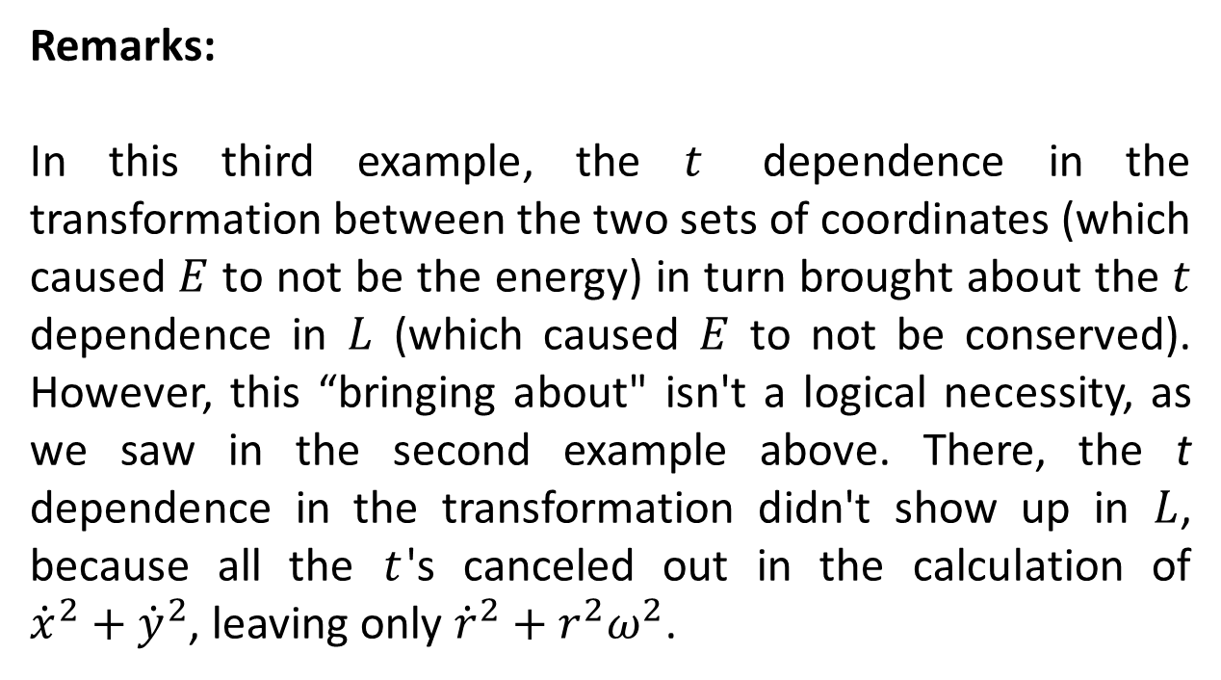
Remarks:
In this third example, the $t$dependence in the transformation between the two sets of coordinates (which caused $E$to not be the energy) in turn brought about the $t$dependence in $L$(which caused $E$to not be conserved). However, this “bringing about" isn't a logical necessity, as we saw in the second example above. There, the t dependence in the transformation didn't show up in $L$, because all the $t$'s canceled out in the calculation of ${\dot{x}}^{2}+{\dot{y}}^{2}$, leaving only ${\dot{r}}^{2}+r^{2}ω^{2}$.

Slide 13
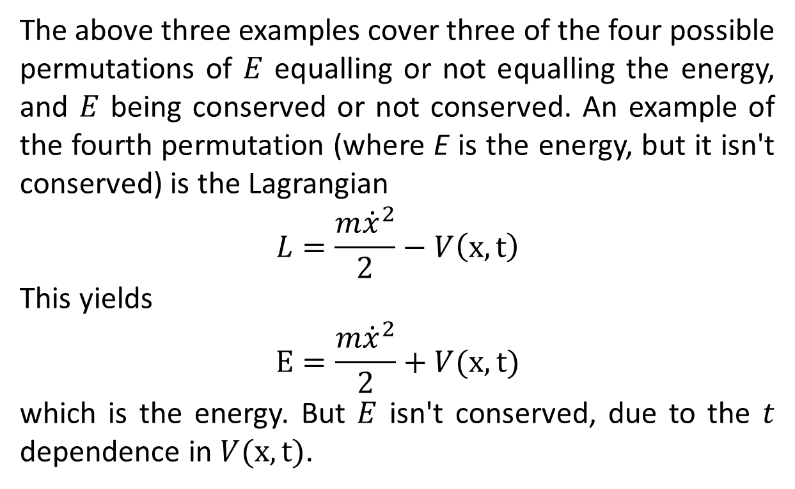
The above three examples cover three of the four possible permutations of $E$equalling or not equalling the energy, and $E$being conserved or not conserved. An example of the fourth permutation (where E is the energy, but it isn't conserved) is the Lagrangian
$$L=\frac{m{\dot{x}}^{2}}{2}−V\left(x,t\right)$$
This yields
$$E=\frac{m{\dot{x}}^{2}}{2}+V(x,t)$$
which is the energy. But $E$isn't conserved, due to the $t$dependence in $V(x,t)$.

Slide 14
The End

