Slide 1
Revision
Previous lecture was about
Generating Function Approach
Derivation of Conservation Laws
via Lagrangian
via Hamiltonian

Slide 2
Lagrangian Mechanics
Lagrangian mechanics is a re-formulation of classical mechanics using Hamilton's Principle of stationary action. Lagrangian mechanics applies to systems whether or not they conserve energy or momentum, and it provides conditions under which energy and/or momentum are conserved. It was introduced by the Italian-French mathematician Joseph-Louis Lagrange in 1788.

Slide 3
In Lagrangian mechanics, the trajectory of a system of particles is derived by solving the Lagrange equations in one of two forms, either the Lagrange equations of the first kind, which treat constraints explicitly as extra equations, often using Lagrange multipliers; or the Lagrange equations of the second kind, which incorporate the constraints directly by judicious choice of generalized coordinates. The fundamental lemma of the calculus of variations shows that solving the Lagrange equations is equivalent to finding the path for which the action functional is stationary, a quantity that is the integral of the Lagrangian over time.

Slide 4
The use of generalized coordinates may considerably simplify a system's analysis. For example, consider a small frictionless bead traveling in a groove. If one is tracking the bead as a particle, calculation of the motion of the bead using Newtonian mechanics would require solving for the time-varying constraint force required to keep the bead in the groove. For the same problem using Lagrangian mechanics, one looks at the path of the groove and chooses a set of independent generalized coordinates that completely characterize the possible motion of the bead. This choice eliminates the need for the constraint force to enter into the resultant system of equations. There are fewer equations since one is not directly calculating the influence of the groove on the bead at a given moment.

Slide 5
Hamiltonian Mechanics
Hamiltonian mechanics is a reformulation of classical mechanics that was introduced in 1833 by Irish mathematician William Rowan Hamilton.
It arose from Lagrangian mechanics, a previous reformulation of classical mechanics introduced by Joseph Louis Lagrange in 1788, but can be formulated without recourse to Lagrangian mechanics using symplectic spaces. The Hamiltonian method differs from the Lagrangian method in that instead of expressing second-order differential constraints on an n-dimensional coordinate space (where n is the number of degrees of freedom of the system), it expresses first-order constraints on a 2n-dimensional phase space.

Slide 6
As with Lagrangian mechanics, Hamilton’s equations provide a new and equivalent way of looking at Newtonian physics. Generally, these equations do not provide a more convenient way of solving a particular problem in classical mechanics. Rather, they provide deeper insights into both the general structure of classical mechanics and its connection to quantum mechanics as understood through Hamiltonian mechanics, as well as its connection to other areas of science.

Slide 7
Hamilton-Jacobi’s Equations
In mathematics, the Hamilton–Jacobi equations is a necessary condition describing extremal geometry in generalizations of problems from the calculus of variations. It is named for William Rowan Hamilton and Carl Gustav Jacob Jacobi. In physics, it is a formulation of classical mechanics, equivalent to other formulations such as Newton's laws of motion, Lagrangian mechanics and Hamiltonian mechanics. The Hamilton–Jacobi equation is particularly useful in identifying conserved quantities for mechanical systems, which may be possible even when the mechanical problem itself cannot be solved completely.

Slide 8
The Hamilton–Jacobi equations is also the only formulation of mechanics in which the motion of a particle can be represented as a wave. In this sense, the Hamilton–Jacobi equations fulfilled a long-held goal of theoretical physics (dating at least to Johann Bernoulli in the 18th century) of finding an analogy between the propagation of light and the motion of a particle. The wave equation followed by mechanical systems is similar to, but not identical with, Schrödinger's equations, as described below; for this reason, the Hamilton–Jacobi equation is considered the "closest approach" of classical mechanics to quantum mechanics

Slide 9
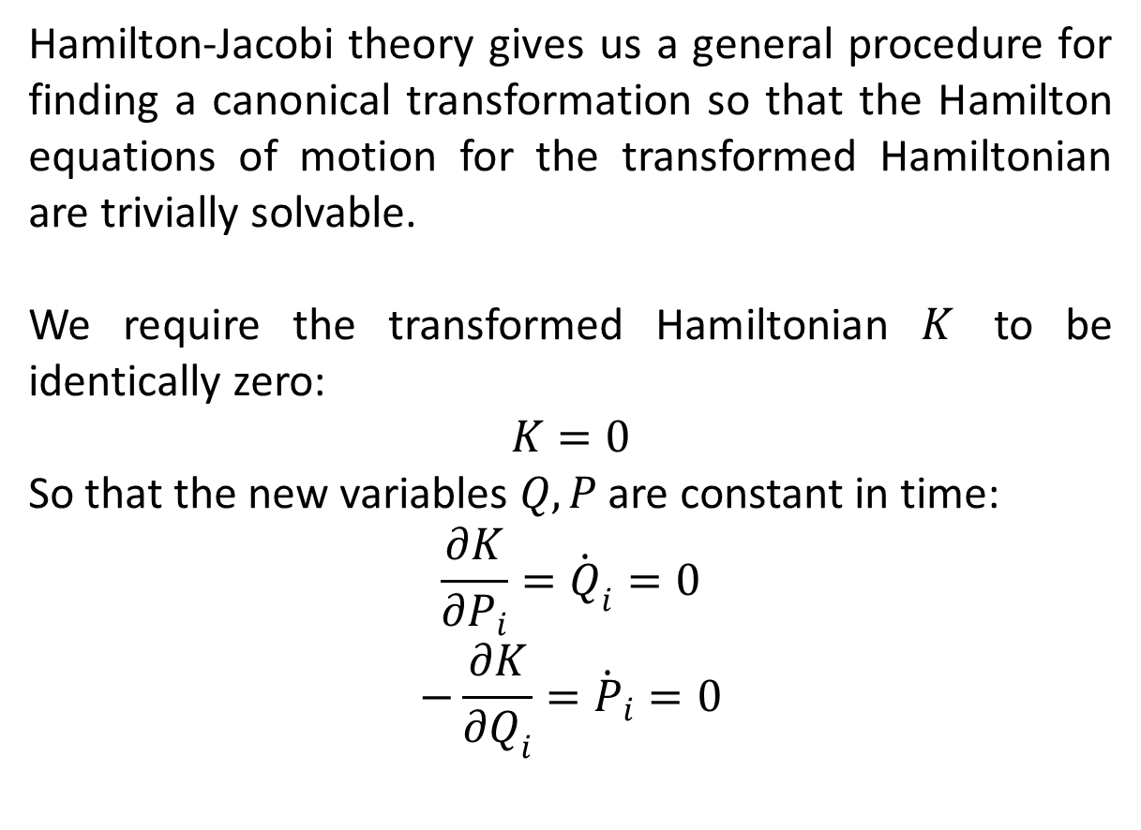
Hamilton-Jacobi Theory
Hamilton-Jacobi theory gives us a general procedure for finding a canonical transformation so that the Hamilton equations of motion for the transformed Hamiltonian are trivially solvable.
We require the transformed Hamiltonian $K$ to be identically zero:
$$K=0$$
So that the new variables $Q,P$ are constant in time:
$$\frac{∂K}{∂P_{i}}={\dot{Q}}_{i}=0$$
$$−\frac{∂K}{∂Q_{i}}={\dot{P}}_{i}=0$$

Slide 10
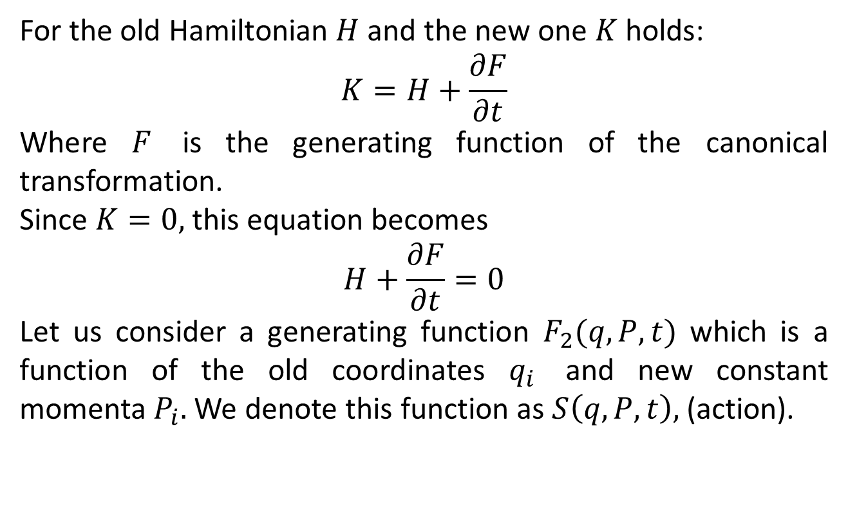
For the old Hamiltonian $H$ and the new one $K$ holds:
$$K=H+\frac{∂F}{∂t}$$
Where $F$ is the generating function of the canonical transformation.
Since $K=0,$ this equation becomes
$$H+\frac{∂F}{∂t}=0$$
Let us consider a generating function $F_{2}(q,P,t)$ which is a function of the old coordinates $q_{i}$ and new constant momenta $P_{i}.$ We denote this function as $S\left(q,P,t\right),$ (action).

Slide 11
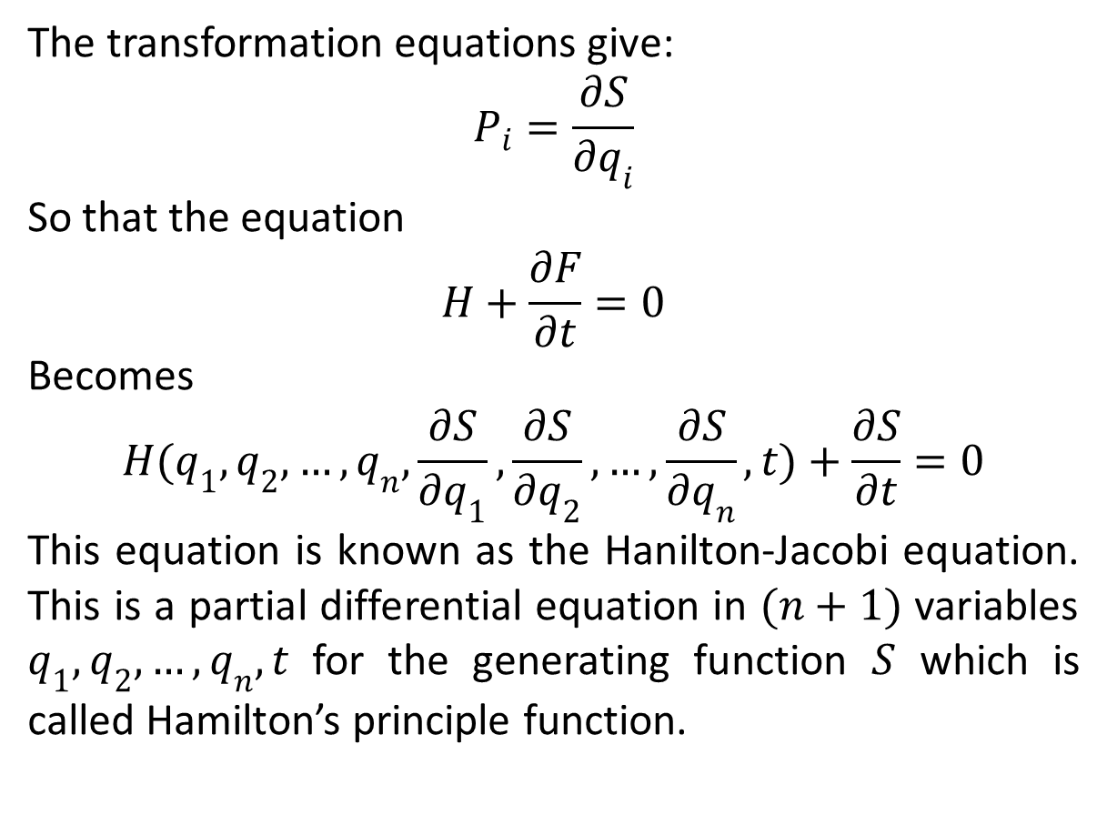
The transformation equations give:
$$P_{i}=\frac{∂S}{∂q_{i}}$$
So that the equation
$$H+\frac{∂F}{∂t}=0$$
Becomes
$$H(q_{1},q_{2},…,q_{n},\frac{∂S}{∂q_{1}},\frac{∂S}{∂q_{2}},…,\frac{∂S}{∂q_{n}},t)+\frac{∂S}{∂t}=0$$
This equation is known as the Hanilton-Jacobi equation. This is a partial differential equation in $(n+1)$ variables $q_{1},q_{2},…,q_{n},t$ for the generating function $S$ which is called Hamilton’s principle function.

Slide 12
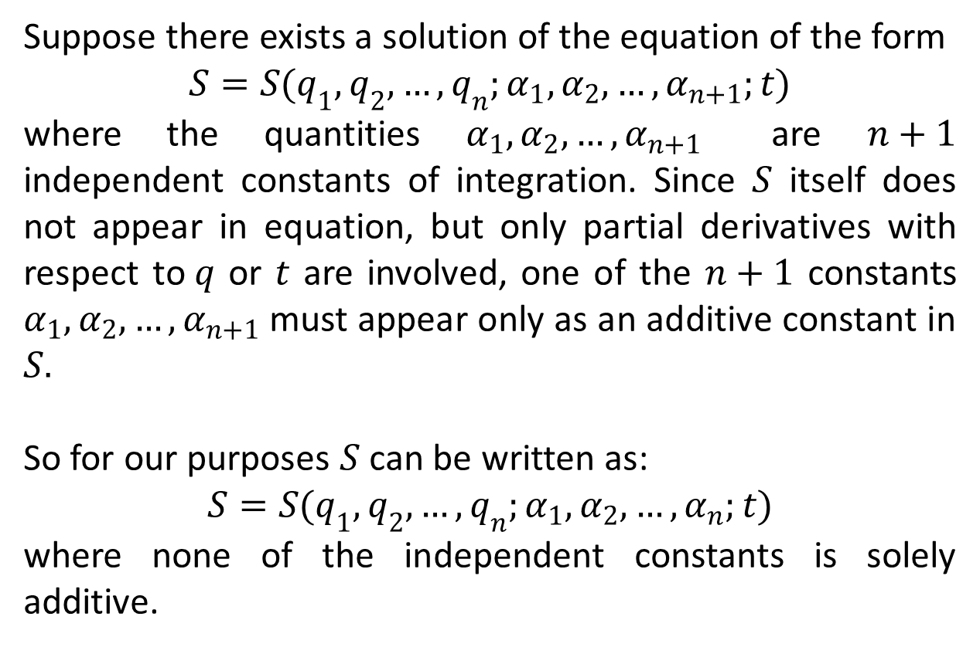
Suppose there exists a solution of the equation of the form
$$S=S(q_{1},q_{2},…,q_{n};α_{1},α_{2},…,α_{n+1};t)$$
where the quantities $α_{1},α_{2},…,α_{n+1}$ are $n+1$ independent constants of integration. Since $S$ itself does not appear in equation, but only partial derivatives with respect to$q$ or $t$ are involved, one of the $n+1$ constants $α_{1},α_{2},…,α_{n+1}$ must appear only as an additive constant in $S.$
So for our purposes $S$ can be written as:
$$S=S(q_{1},q_{2},…,q_{n};α_{1},α_{2},…,α_{n};t)$$
where none of the independent constants is solely additive.

Slide 13
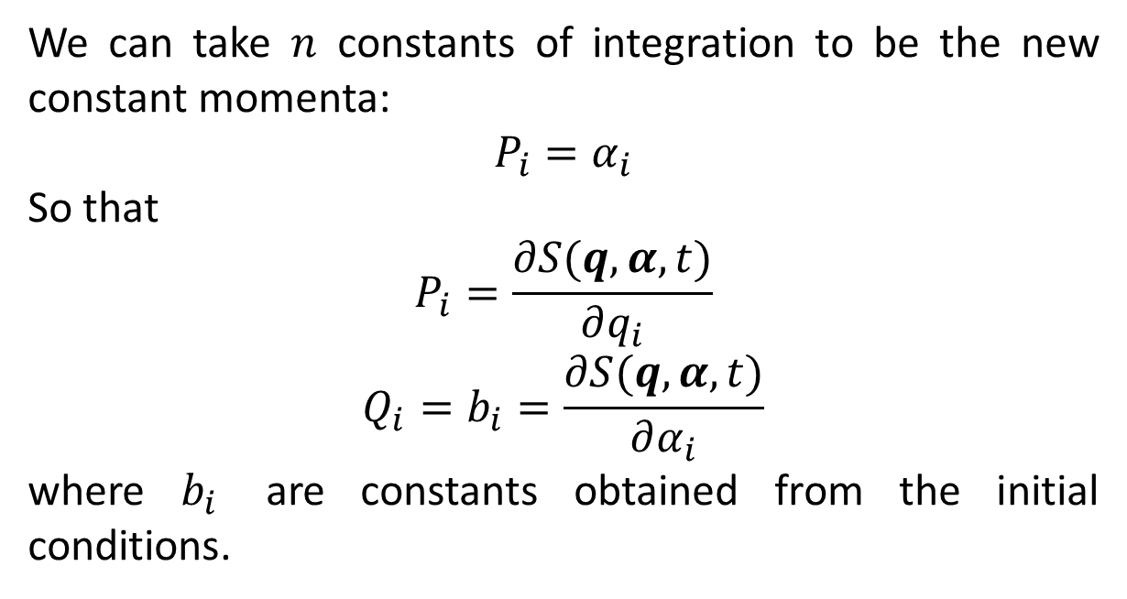
We can take $n$ constants of integration to be the new constant momenta:
$$P_{i}=α_{i}$$
So that
$$P_{i}=\frac{∂S(q,α,t)}{∂q_{i}}$$
$$Q_{i}=b_{i}=\frac{∂S(q,α,t)}{∂α_{i}}$$
where $b_{i}$ are constants obtained from the initial conditions.

Slide 14
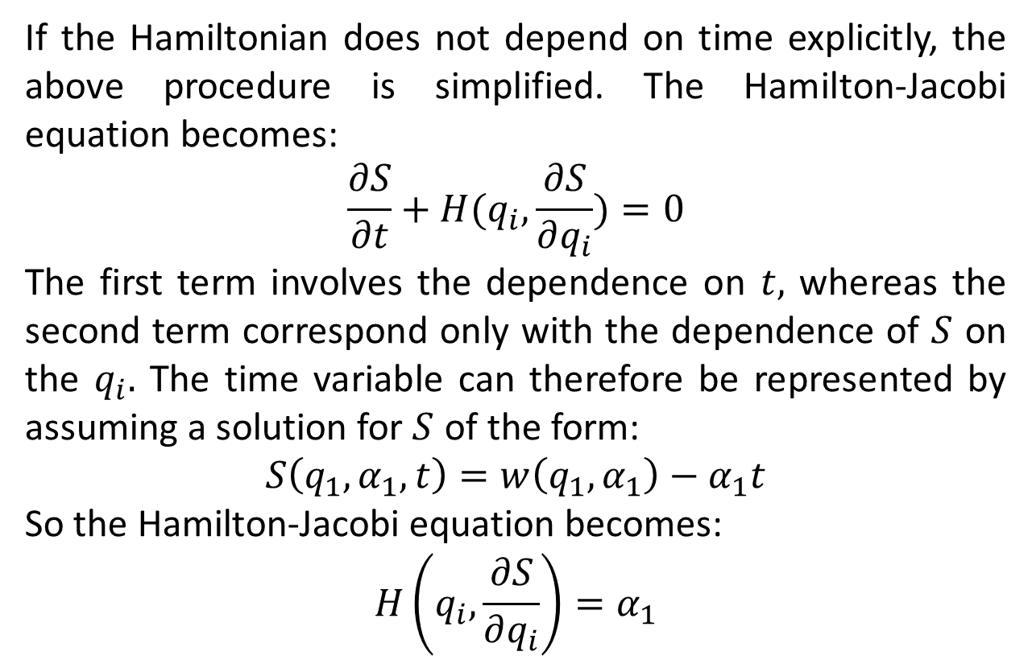
If the Hamiltonian does not depend on time explicitly, the above procedure is simplified. The Hamilton-Jacobi equation becomes:
$$\frac{∂S}{∂t}+H(q_{i},\frac{∂S}{∂q_{i}})=0$$
The first term involves the dependence on $t,$ whereas the second term correspond only with the dependence of $S$ on the $q_{i}.$ The time variable can therefore be represented by assuming a solution for $S$ of the form:
$$S\left(q_{1},α_{1},t\right)=w\left(q_{1},α_{1}\right)−α_{1}t$$
So the Hamilton-Jacobi equation becomes:
$$H\left(q_{i},\frac{∂S}{∂q_{i}}\right)=α_{1}$$

Slide 15
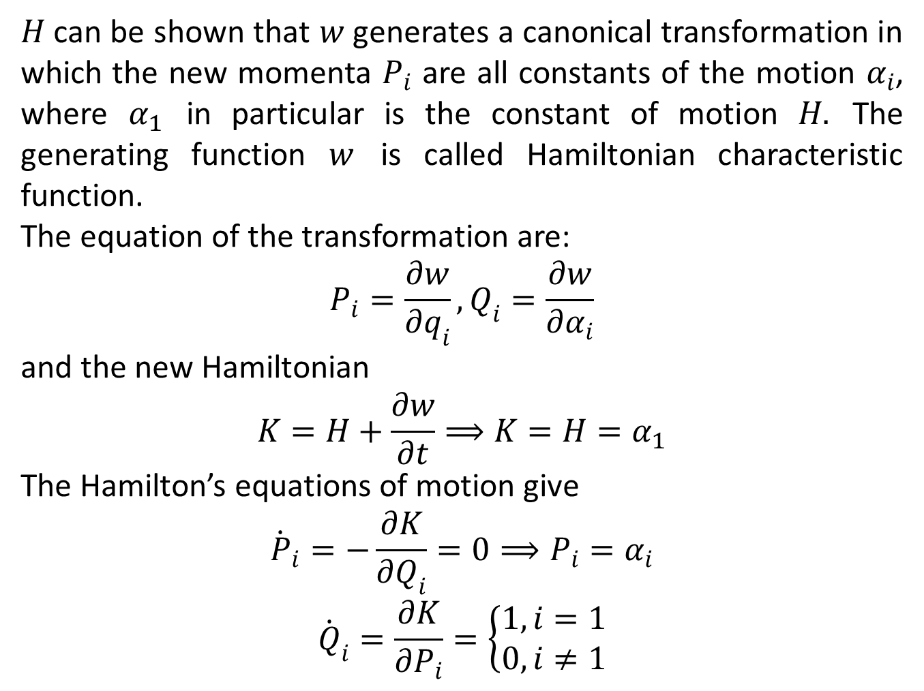
$H$ can be shown that $w$ generates a canonical transformation in which the new momenta $P_{i}$ are all constants of the motion $α_{i}$, where $α_{1}$ in particular is the constant of motion $H.$ The generating function $w$ is called Hamiltonian characteristic function.
The equation of the transformation are:
$$P_{i}=\frac{∂w}{∂q_{i}},Q_{i}=\frac{∂w}{∂α_{i}}$$
and the new Hamiltonian
$$K=H+\frac{∂w}{∂t}⟹K=H=α_{1}$$
The Hamilton’s equations of motion give
$${\dot{P}}_{i}=−\frac{∂K}{∂Q_{i}}=0⟹P_{i}=α_{i}$$
$${\dot{Q}}_{i}=\frac{∂K}{∂P_{i}}=\left\{\begin{aligned}1,i=1 \\ 0,i≠1\end{aligned}\right.$$

Slide 16
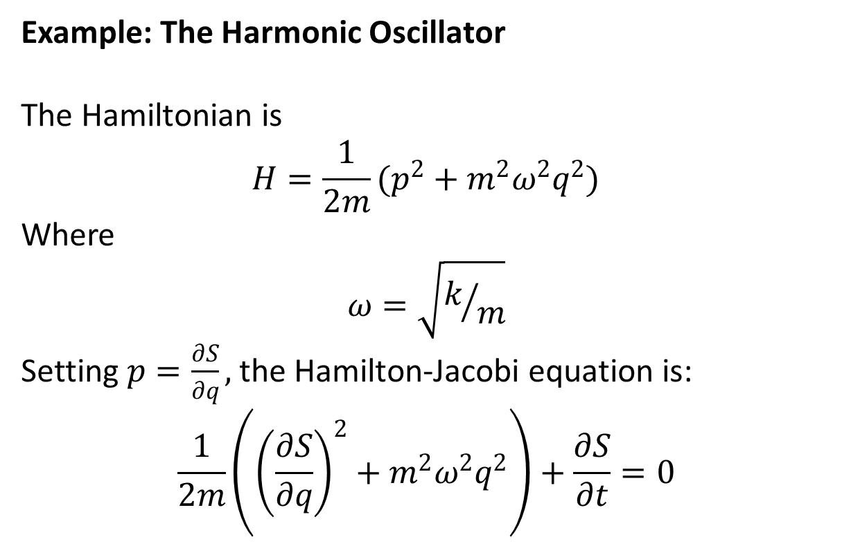
Example: The Harmonic Oscillator
The Hamiltonian is
$$H=\frac{1}{2m}(p^{2}+m^{2}ω^{2}q^{2})$$
Where
$$ω=\sqrt{k/m}$$
Setting $p=\frac{∂S}{∂q},$ the Hamilton-Jacobi equation is:
$$\frac{1}{2m}\left({\left(\frac{∂S}{∂q}\right)}^{2}+m^{2}ω^{2}q^{2}\right)+\frac{∂S}{∂t}=0$$

Slide 17
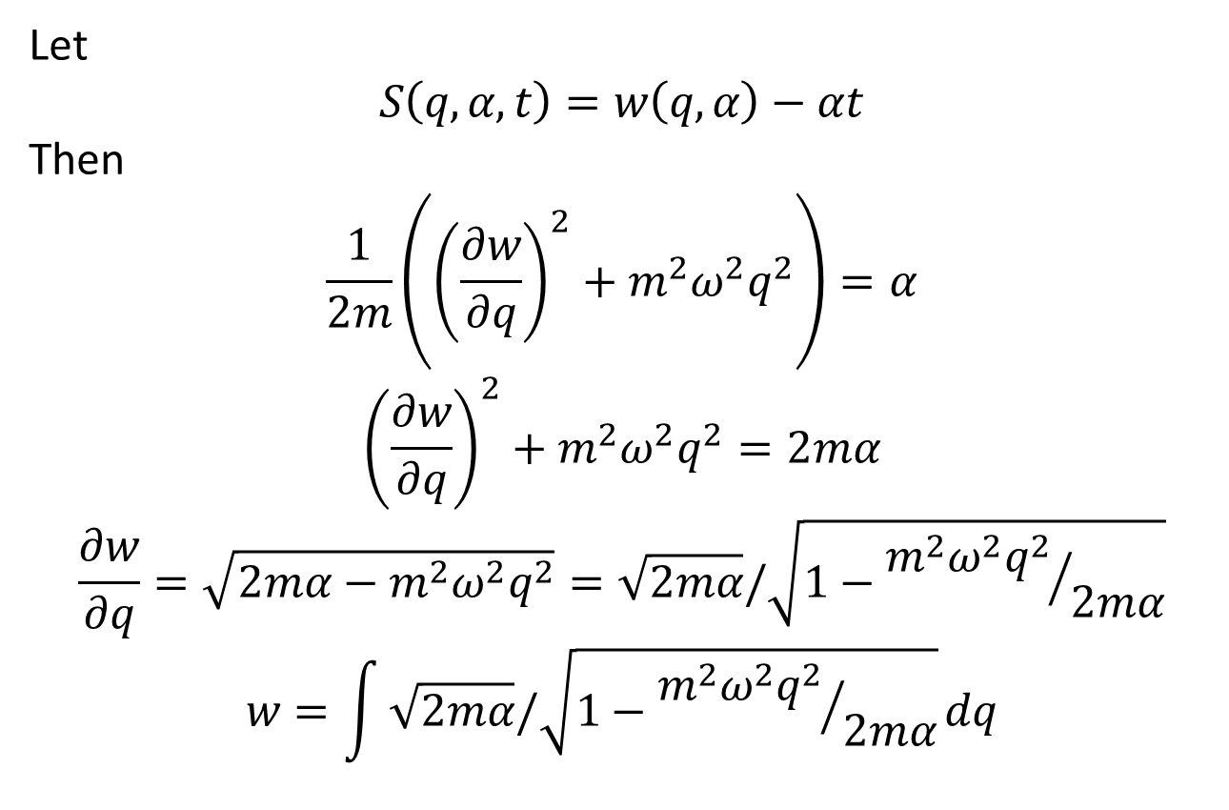
Let
$$S\left(q,α,t\right)=w\left(q,α\right)−αt$$
Then
$$\frac{1}{2m}\left({\left(\frac{∂w}{∂q}\right)}^{2}+m^{2}ω^{2}q^{2}\right)=α$$
$${\left(\frac{∂w}{∂q}\right)}^{2}+m^{2}ω^{2}q^{2}=2mα$$
$$\frac{∂w}{∂q}=\sqrt{2mα−m^{2}ω^{2}q^{2}}=\sqrt{2mα}/\sqrt{1−{m^{2}ω^{2}q^{2}}/{2mα}}$$
$$w=\int{\sqrt{2mα}/\sqrt{1−{m^{2}ω^{2}q^{2}}/{2mα}}}dq$$

Slide 18
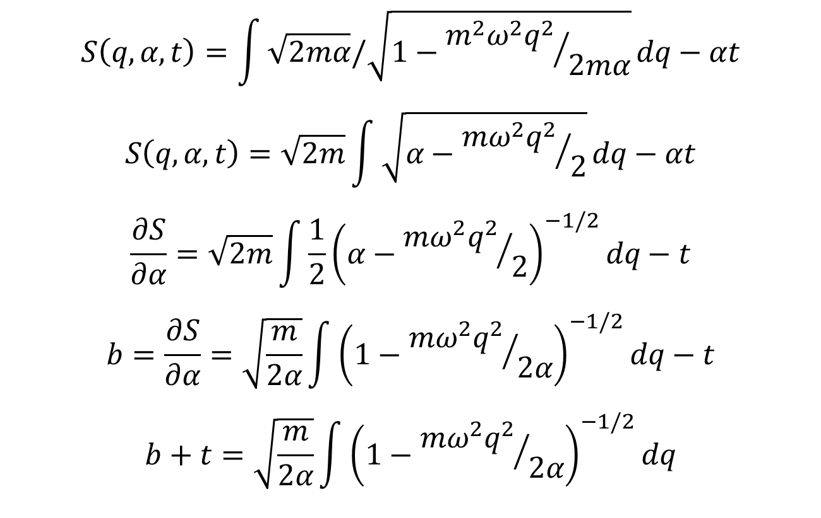
$$S\left(q,α,t\right)=\int{\sqrt{2mα}/\sqrt{1−{m^{2}ω^{2}q^{2}}/{2mα}}}dq−αt$$
$$S\left(q,α,t\right)=\sqrt{2m}\int{\sqrt{α−{mω^{2}q^{2}}/2}}dq−αt$$
$$\frac{∂S}{∂α}=\sqrt{2m}\int{\frac{1}{2}{\left(α−{mω^{2}q^{2}}/2\right)}^{−1/2}}dq−t$$
$$b=\frac{∂S}{∂α}=\sqrt{\frac{m}{2α}}\int{{\left(1−{mω^{2}q^{2}}/{2α}\right)}^{−1/2}}dq−t$$
$$b+t=\sqrt{\frac{m}{2α}}\int{{\left(1−{mω^{2}q^{2}}/{2α}\right)}^{−1/2}}dq$$

Slide 19
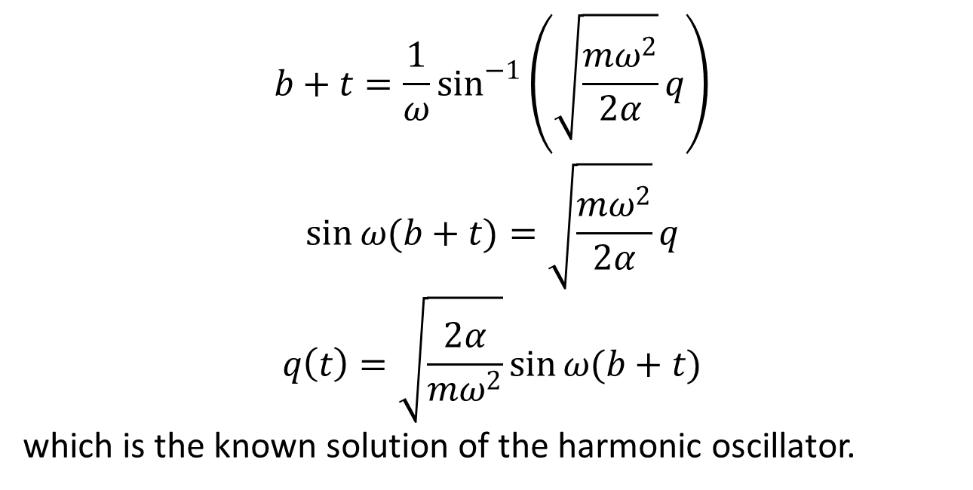
$$b+t=\frac{1}{ω}\sin^{−1}\left(\sqrt{\frac{mω^{2}}{2α}}q\right)$$
$$\sin{ω(b+t)}=\sqrt{\frac{mω^{2}}{2α}}q$$
$$q\left(t\right)=\sqrt{\frac{2α}{mω^{2}}}\sin{ω(b+t)}$$
which is the known solution of the harmonic oscillator.

Slide 20
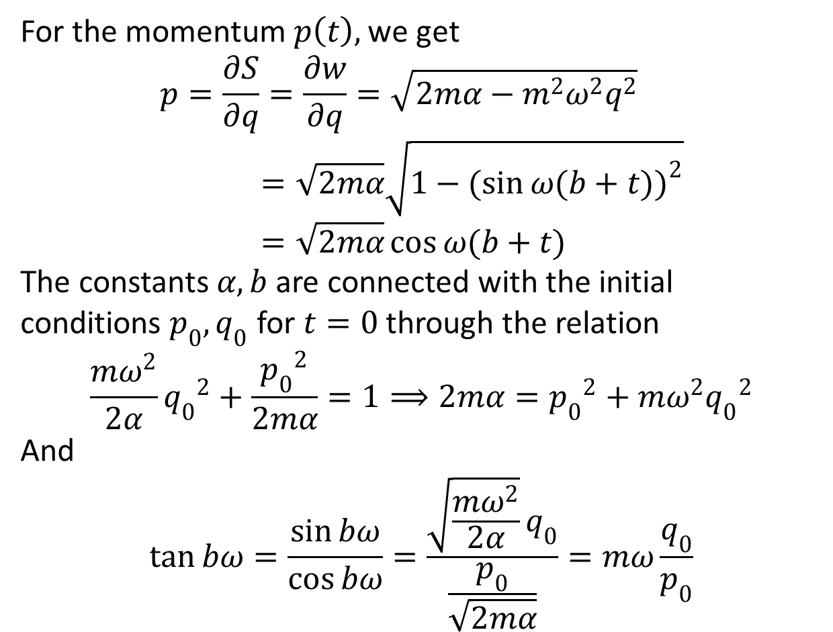
For the momentum $p\left(t\right),$ we get
$$p=\frac{∂S}{∂q}=\frac{∂w}{∂q}=\sqrt{2mα−m^{2}ω^{2}q^{2}}=\sqrt{2mα}\sqrt{1−{(sin{ω(b+t)})}^{2}}=\sqrt{2mα}\cos{ω(b+t)}$$
The constants $α,b$ are connected with the initial conditions $p_{0},q_{0}$ for $t=0$ through the relation
$$\frac{mω^{2}}{2α}{q_{0}}^{2}+\frac{{p_{0}}^{2}}{2mα}=1⟹2mα={p_{0}}^{2}+mω^{2}{q_{0}}^{2}$$
And
$$\tan{bω}=\frac{\sin{bω}}{\cos{bω}}=\frac{\sqrt{\frac{mω^{2}}{2α}}q_{0}}{\frac{p_{0}}{\sqrt{2mα}}}=mω\frac{q_{0}}{p_{0}}$$

Slide 22
The End

