Slide 1
Revision
Previous lecture was about
Variational Principle
Euler-Lagrange Equation
Hamilton’s Principle

Slide 2
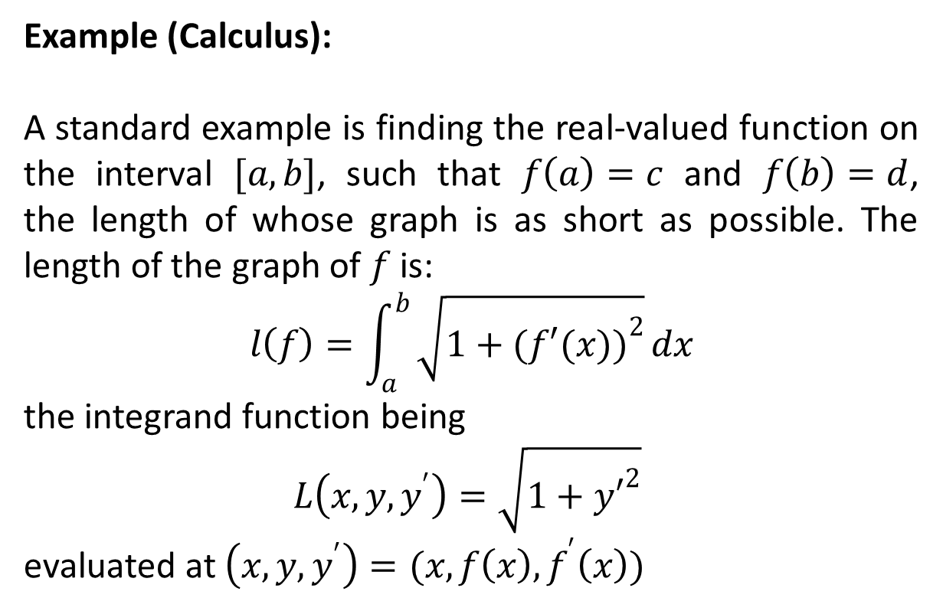
Euler-Lagrange Equations (Again)
Example (Calculus):
A standard example is finding the real-valued function on the interval $[a,b]$, such that $f\left(a\right)=c$ and $f\left(b\right)=d$, the length of whose graph is as short as possible. The length of the graph of $f$ is:
$$l\left(f\right)=\int_{a}^{b}{\sqrt{1+{(f′(x))}^{2}}}dx$$
the integrand function being
$L\left(x,y,y^{′}\right)=\sqrt{1+{y′}^{2}}$
evaluated at $\left(x,y,y^{′}\right)=(x,f\left(x\right),f^{′}\left(x\right))$

Slide 4
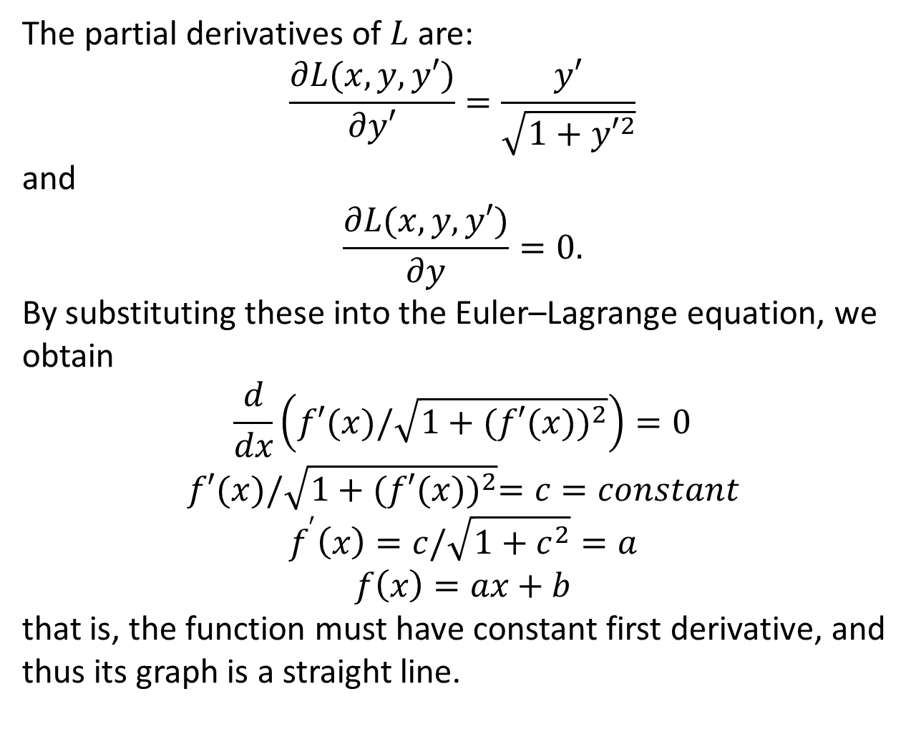
The partial derivatives of $L$ are:
$$\frac{∂L(x,y,y′)}{∂y′}=\frac{y′}{\sqrt{1+{y′}^{2}}}$$
and
$$\frac{∂L(x,y,y′)}{∂y}=0.$$
By substituting these into the Euler–Lagrange equation, we obtain
$$\frac{d}{dx}\left(f′(x)/\sqrt{1+{(f′(x))}^{2}}\right)=0$$
$$f′(x)/\sqrt{1+{(f′(x))}^{2}}=c=constant$$
$$f^{′}\left(x\right)=c/\sqrt{1+c^{2}}=a$$
$$f\left(x\right)=ax+b$$
that is, the function must have constant first derivative, and thus its graph is a straight line.

Slide 5
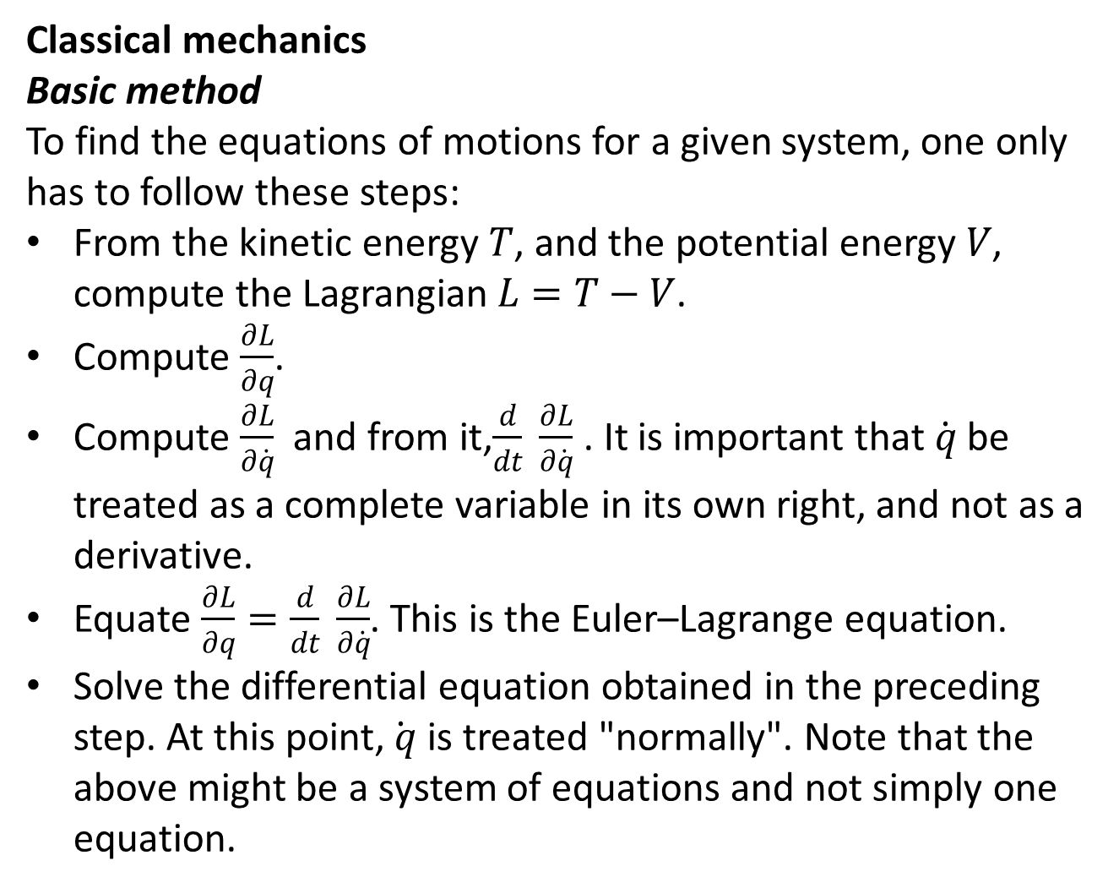
Classical mechanics
Basic method
To find the equations of motions for a given system, one only has to follow these steps:
From the kinetic energy $T$, and the potential energy $V$, compute the Lagrangian $L=T−V$.
Compute $\frac{∂L}{∂q}$.
Compute $\frac{∂L}{∂\dot{q}}$ and from it,$\frac{d}{dt} \frac{∂L}{∂\dot{q}}$ . It is important that $\dot{q}$ be treated as a complete variable in its own right, and not as a derivative.
Equate $\frac{∂L}{∂q}=\frac{d}{dt} \frac{∂L}{∂\dot{q}}$. This is the Euler–Lagrange equation.
Solve the differential equation obtained in the preceding step. At this point,$\dot{ q}$ is treated "normally". Note that the above might be a system of equations and not simply one equation.

Slide 6
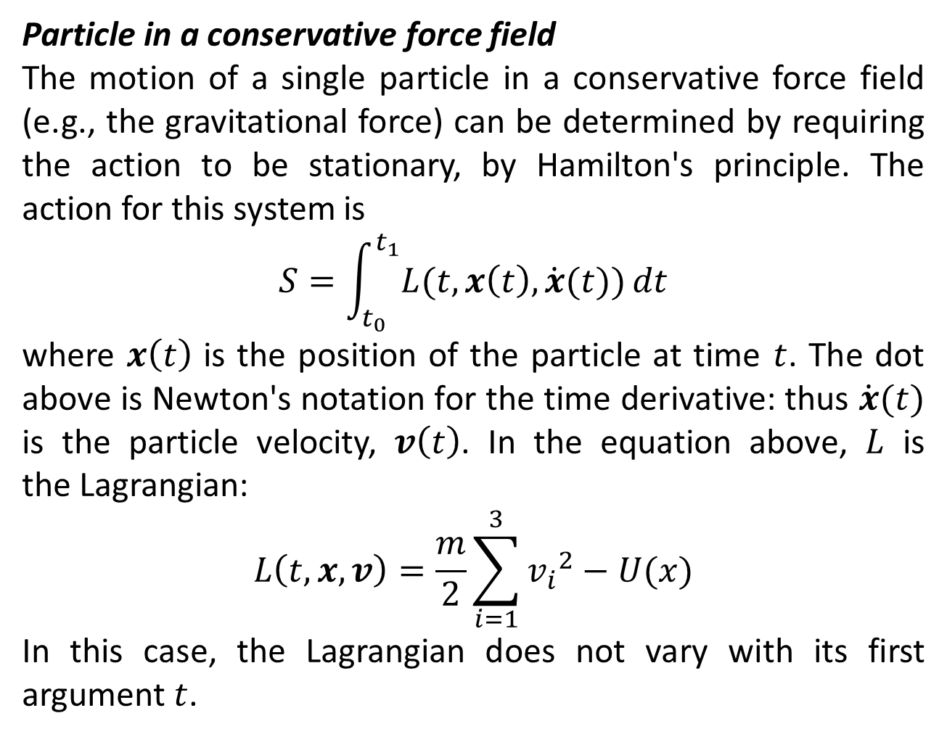
Particle in a conservative force field
The motion of a single particle in a conservative force field (e.g., the gravitational force) can be determined by requiring the action to be stationary, by Hamilton's principle. The action for this system is
$$S=\int_{t_{0}}^{t_{1}}{L(t,x\left(t\right),\dot{x}(t))}dt$$
where $x\left(t\right)$ is the position of the particle at time $t$. The dot above is Newton's notation for the time derivative: thus $\dot{x}(t)$ is the particle velocity, $v\left(t\right)$. In the equation above, $L$ is the Lagrangian:
$$L\left(t,x,v\right)=\frac{m}{2}\sum_{i=1}^{3}{{v_{i}}^{2}}−U(x)$$
In this case, the Lagrangian does not vary with its first argument $t$.

Slide 8
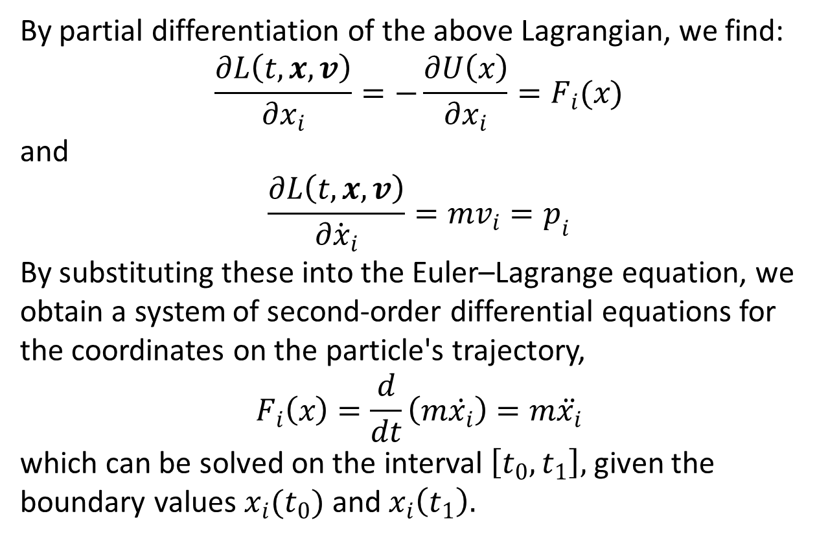
By partial differentiation of the above Lagrangian, we find:
$$\frac{∂L\left(t,x,v\right)}{∂x_{i}}=−\frac{∂U\left(x\right)}{∂x_{i}}=F_{i}(x)$$
and
$$\frac{∂L\left(t,x,v\right)}{∂{\dot{x}}_{i}}=mv_{i}=p_{i}$$
By substituting these into the Euler–Lagrange equation, we obtain a system of second-order differential equations for the coordinates on the particle's trajectory,
$$F_{i}\left(x\right)=\frac{d}{dt}\left(m\dot{x_{i}}\right)=m\ddot{x_{i}}$$
which can be solved on the interval $\left[t_{0},t_{1}\right],$ given the boundary values $x_{i}(t_{0})$ and $x_{i}\left(t_{1}\right).$

Slide 9
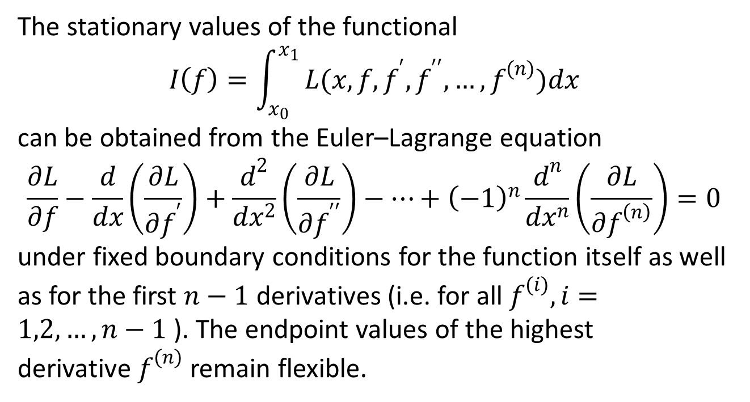
Single function of single variable with higher derivatives
The stationary values of the functional
$$I\left(f\right)=\int_{x_{0}}^{x_{1}}{L(x,f,f^{′},f^{′′},…,f^{(n)})dx}$$
can be obtained from the Euler–Lagrange equation
$$\frac{∂L}{∂f}−\frac{d}{dx}\left(\frac{∂L}{∂f^{′}}\right)+\frac{d^{2}}{dx^{2}}\left(\frac{∂L}{∂f^{′′}}\right)−…+{\left(−1\right)}^{n}\frac{d^{n}}{dx^{n}}\left(\frac{∂L}{∂f^{\left(n\right)}}\right)=0$$
under fixed boundary conditions for the function itself as well as for the first $n−1$ derivatives (i.e. for all $f^{(i)},i=1,2,…,n−1$ ). The endpoint values of the highest derivative $f^{(n)}$ remain flexible.

Slide 10
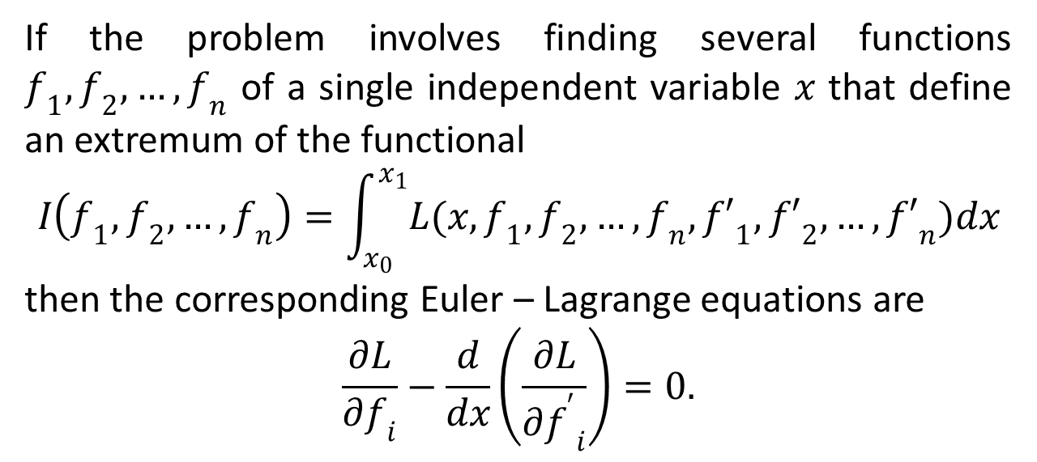
Several functions of one variable
If the problem involves finding several functions $f_{1},f_{2},…,f_{n}$ of a single independent variable $x$ that define an extremum of the functional
$$I\left(f_{1},f_{2},…,f_{n}\right)=\int_{x_{0}}^{x_{1}}{L(x,f_{1},f_{2},…,f_{n},{f′}_{1},{f′}_{2},…,{f′}_{n})dx}$$
then the corresponding Euler – Lagrange equations are
$$\frac{∂L}{∂f_{i}}−\frac{d}{dx}\left(\frac{∂L}{∂{f^{′}}_{i}}\right)=0.$$

Slide 11
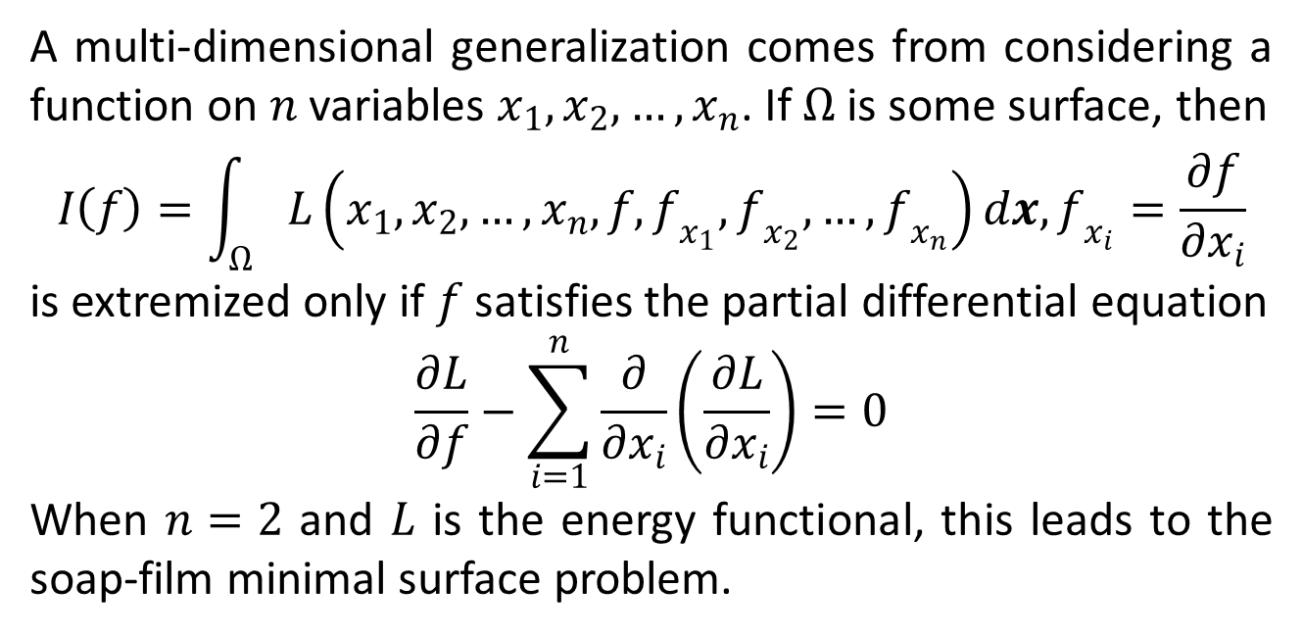
Single function of several variables
A multi-dimensional generalization comes from considering a function on $n$ variables $x_{1},x_{2},…,x_{n}$. If $Ω$ is some surface, then
$$I\left(f\right)=\int_{Ω}{L\left(x_{1},x_{2},…,x_{n},f,f_{x_{1}},f_{x_{2}},…,f_{x_{n}}\right)dx, f_{x_{i}}=\frac{∂f}{∂x_{i}}}$$
is extremized only if $f$satisfies the partial differential equation
$$\frac{∂L}{∂f}−\sum_{i=1}^{n}{\frac{∂}{∂x_{i}}}\left(\frac{∂L}{∂x_{i}}\right)=0$$
When $n=2$ and $L$ is the energy functional, this leads to the soap-film minimal surface problem.

Slide 13
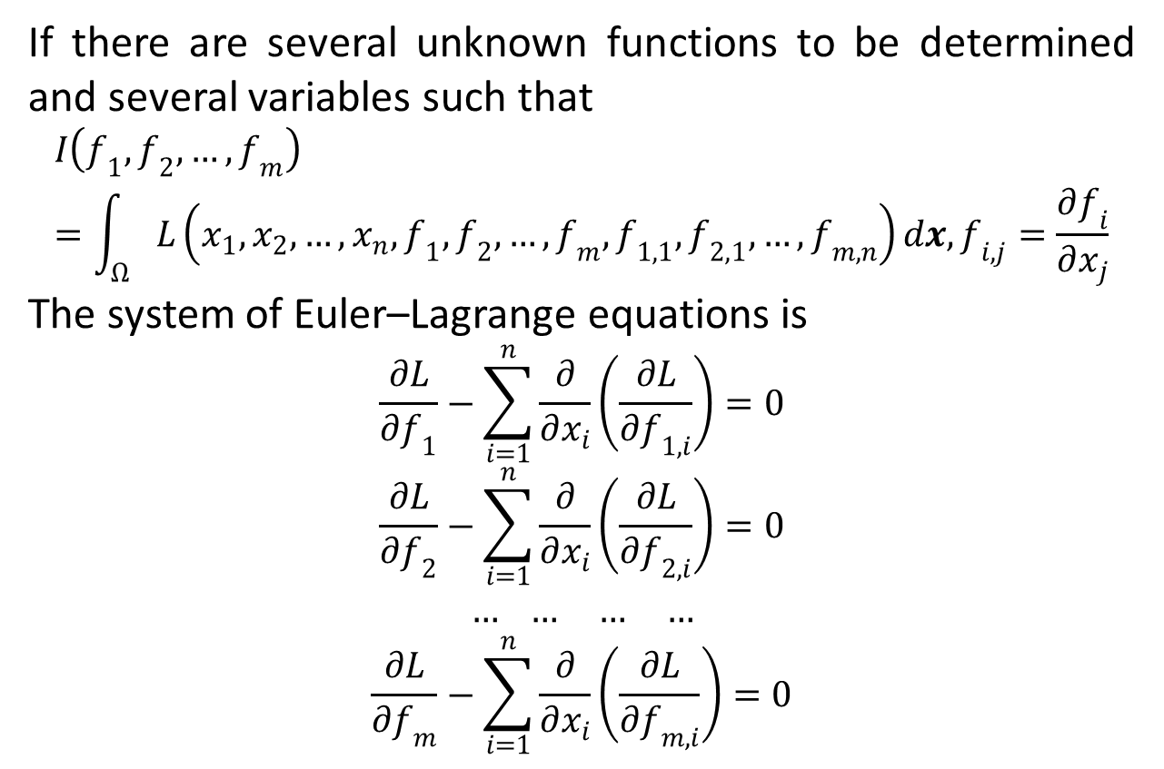
Several functions of several variables
If there are several unknown functions to be determined and several variables such that
$$I\left(f_{1},f_{2},…,f_{m}\right)=\int_{Ω}{L\left(x_{1},x_{2},…,x_{n},f_{1},f_{2},…,f_{m},f_{1,1},f_{2,1},…,f_{m,n}\right)dx, f_{i,j}=\frac{∂f_{i}}{∂x_{j}}}$$
The system of Euler–Lagrange equations is
$$\frac{∂L}{∂f_{1}}−\sum_{i=1}^{n}{\frac{∂}{∂x_{i}}}\left(\frac{∂L}{∂f_{1,i}}\right)=0$$
$$\frac{∂L}{∂f_{2}}−\sum_{i=1}^{n}{\frac{∂}{∂x_{i}}}\left(\frac{∂L}{∂f_{2,i}}\right)=0$$
$$… … … …$$
$$\frac{∂L}{∂f_{m}}−\sum_{i=1}^{n}{\frac{∂}{∂x_{i}}}\left(\frac{∂L}{∂f_{m,i}}\right)=0$$

Slide 15
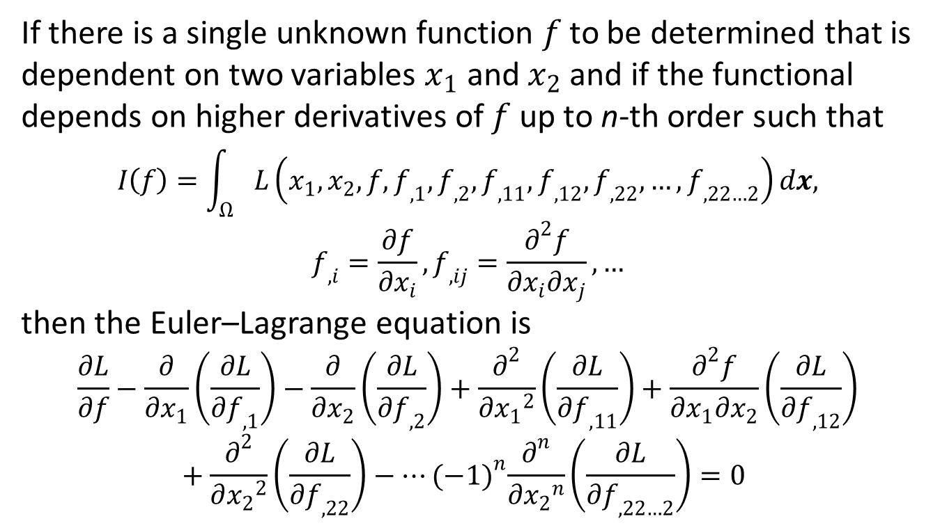
Single function of two variables with higher derivatives
If there is a single unknown function $f$ to be determined that is dependent on two variables $x_{1}$ and $x_{2}$ and if the functional depends on higher derivatives of $f$ up to n-th order such that
$$I\left(f\right)=\int_{Ω}{L\left(x_{1},x_{2},f,f_{,1},f_{,2},f_{,11},f_{,12},f_{,22},…,f_{,22…2}\right)dx,}$$
$$f_{,i}=\frac{∂f}{∂x_{i}},f_{,ij}=\frac{∂^{2}f}{∂x_{i}∂x_{j}},…$$
then the Euler–Lagrange equation is
$$\frac{∂L}{∂f}−\frac{∂}{∂x_{1}}\left(\frac{∂L}{∂f_{,1}}\right)−\frac{∂}{∂x_{2}}\left(\frac{∂L}{∂f_{,2}}\right)+\frac{∂^{2}}{∂{x_{1}}^{2}}\left(\frac{∂L}{∂f_{,11}}\right)+\frac{∂^{2}f}{∂x_{1}∂x_{2}}\left(\frac{∂L}{∂f_{,12}}\right)+\frac{∂^{2}}{∂{x_{2}}^{2}}\left(\frac{∂L}{∂f_{,22}}\right)−…{(−1)}^{n}\frac{∂^{n}}{∂{x_{2}}^{n}}\left(\frac{∂L}{∂f_{,22…2}}\right)=0$$

Slide 16
The End

