Slide 1
Revision
Previous lecture was about
Canonical Transformation
Liouville’s Theorem
Calculus of Variations

Slide 2
Variational Principle
A variational principle (action principle) is a scientific principle used within the calculus of variations, which develops general methods for finding functions which minimize or maximize the value of quantities that depend upon those functions. For example, to answer this question: "What is the shape of a chain suspended at both ends?" we can use the variational principle that the shape must minimize the gravitational potential energy.

Slide 3
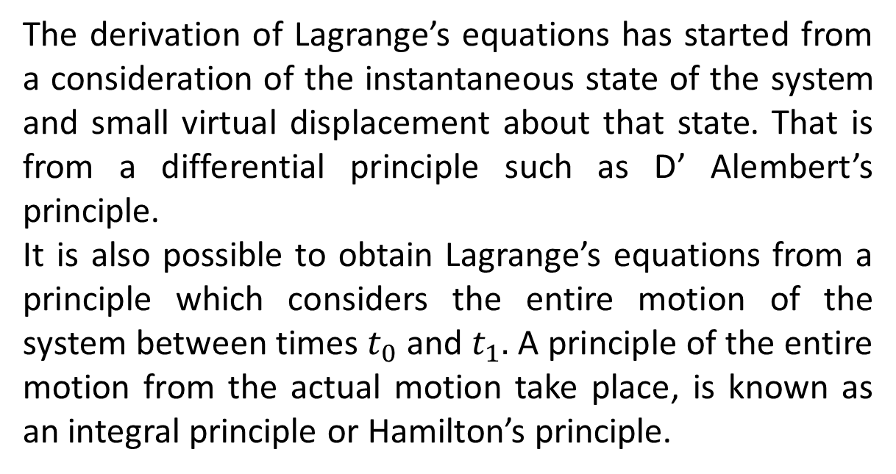

Slide 4
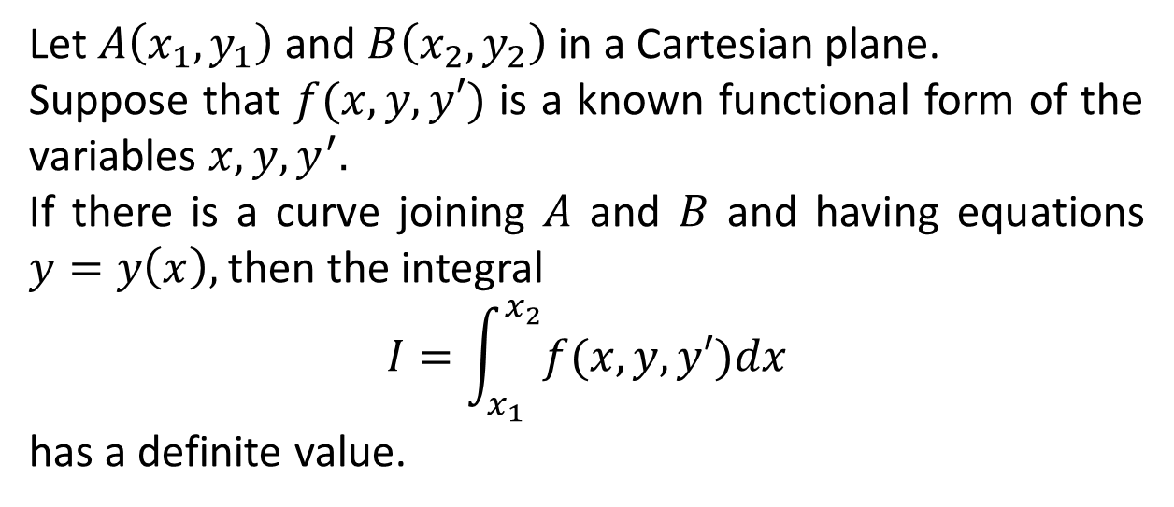
Euler-Lagrange Equations

Slide 5
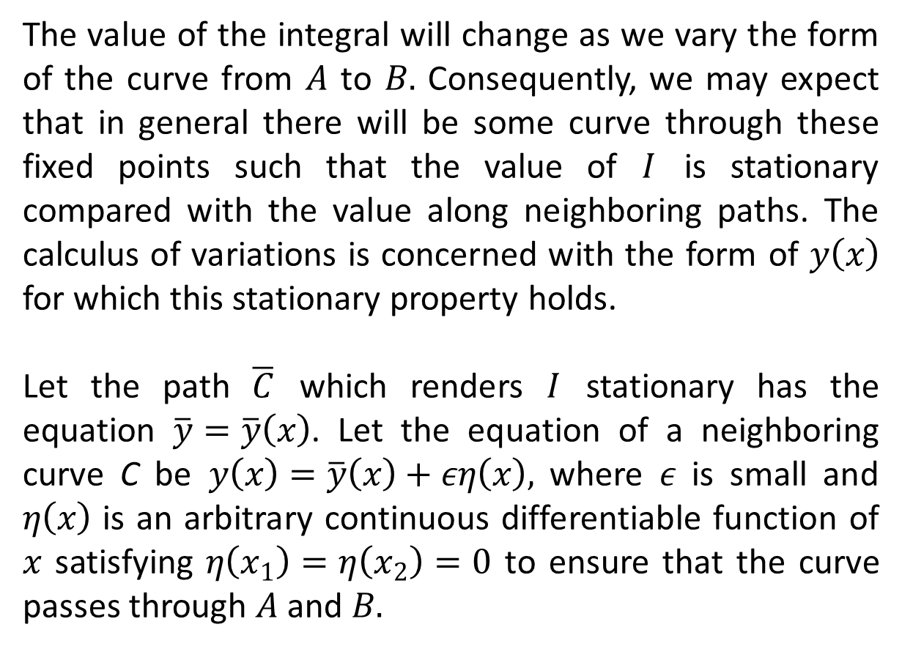
The value of the integral will change as we vary the form of the curve from $A$ to $B.$ Consequently, we may expect that in general there will be some curve through these fixed points such that the value of $I$ is stationary compared with the value along neighboring paths. The calculus of variations is concerned with the form of $y\left(x\right)$ for which this stationary property holds.
Let the path $\overline{C}$ which renders $I$ stationary has the equation $\overline{y}=\overline{y}\left(x\right)$. Let the equation of a neighboring curve C be $y\left(x\right)=\overline{y}\left(x\right)+εη\left(x\right),$ where $ε$ is small and $η\left(x\right)$ is an arbitrary continuous differentiable function of $x$ satisfying $η\left(x_{1}\right)=η\left(x_{2}\right)=0$ to ensure that the curve passes through $A$ and $B.$

Slide 6
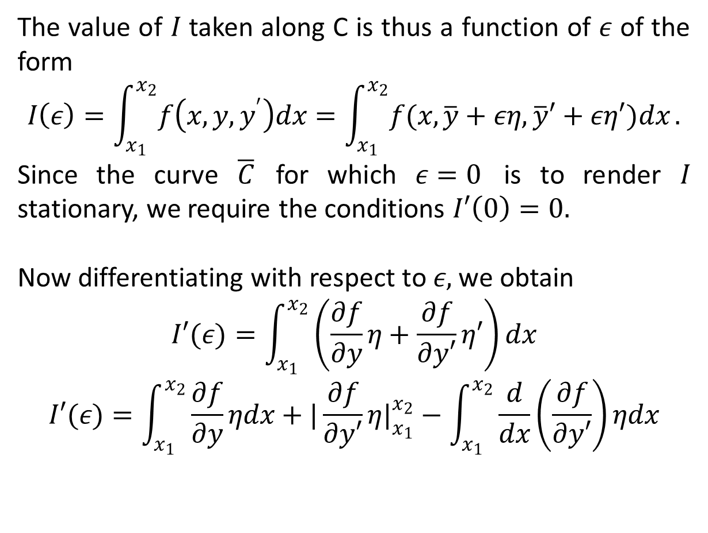
The value of $I$ taken along C is thus a function of $ε$ of the form
$$I\left(ε\right)=\int_{x_{1}}^{x_{2}}{f\left(x,y,y^{′}\right)dx}=\int_{x_{1}}^{x_{2}}{f(x,\overline{y}+εη,\overline{y}′+εη′)dx}.$$
Since the curve $\overline{C}$ for which $ε=0$ is to render $I$ stationary, we require the conditions $I′\left(0\right)=0.$
Now differentiating with respect to $ε,$ we obtain
$$I′(ε)=\int_{x_{1}}^{x_{2}}{\left(\frac{∂f}{∂y}η+\frac{∂f}{∂y′}η′\right)dx}$$
$$I′(ε)=\int_{x_{1}}^{x_{2}}{\frac{∂f}{∂y}ηdx+|\frac{∂f}{∂y′}η|_{x_{1}}^{x_{2}}−\int_{x_{1}}^{x_{2}}{\frac{d}{dx}\left(\frac{∂f}{∂y′}\right)ηdx}}$$

Slide 8
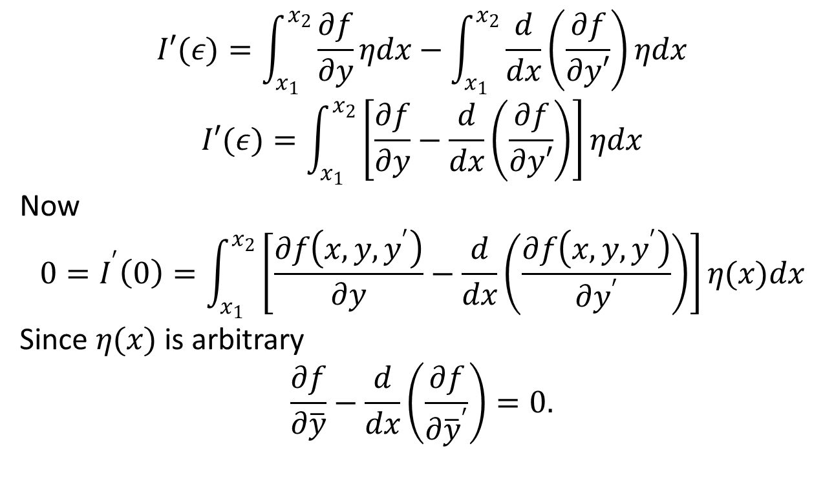
$$I′(ε)=\int_{x_{1}}^{x_{2}}{\frac{∂f}{∂y}ηdx−\int_{x_{1}}^{x_{2}}{\frac{d}{dx}\left(\frac{∂f}{∂y′}\right)ηdx}}$$
$$I′(ε)=\int_{x_{1}}^{x_{2}}{\left[\frac{∂f}{∂y}−\frac{d}{dx}\left(\frac{∂f}{∂y′}\right)\right]ηdx}$$
Now
$$0=I^{′}\left(0\right)=\int_{x_{1}}^{x_{2}}{\left[\frac{∂f\left(x,y,y^{′}\right)}{∂y}−\frac{d}{dx}\left(\frac{∂f\left(x,y,y^{′}\right)}{∂y^{′}}\right)\right]η(x)dx}$$
Since $η(x)$ is arbitrary
$$\frac{∂f}{∂\overline{y}}−\frac{d}{dx}\left(\frac{∂f}{∂{\overline{y}}^{′}}\right)=0.$$

Slide 9
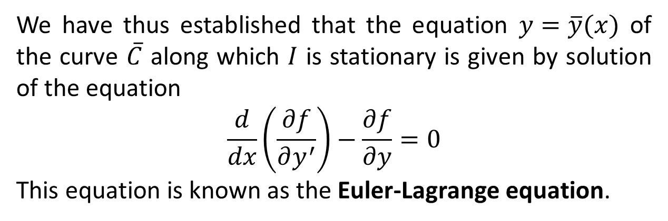
We have thus established that the equation $y=\overline{y}(x)$ of the curve $\overline{C}$ along which $I$ is stationary is given by solution of the equation
$$\frac{d}{dx}\left(\frac{∂f}{∂y^{′}}\right)−\frac{∂f}{∂y}=0$$
This equation is known as the Euler-Lagrange equation.

Slide 10
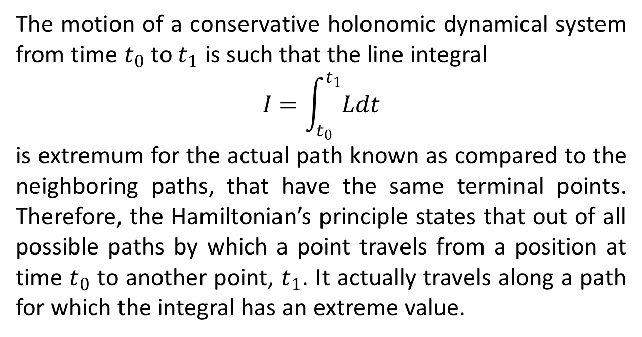
Hamilton’s Principle
The motion of a conservative holonomic dynamical system from time $t_{0}$ to $t_{1}$ is such that the line integral
$$I=\int_{t_{0}}^{t_{1}}{Ldt}$$
is extremum for the actual path known as compared to the neighboring paths, that have the same terminal points. Therefore, the Hamiltonian’s principle states that out of all possible paths by which a point travels from a position at time $t_{0}$ to another point, $t_{1}$. It actually travels along a path for which the integral has an extreme value.

Slide 11
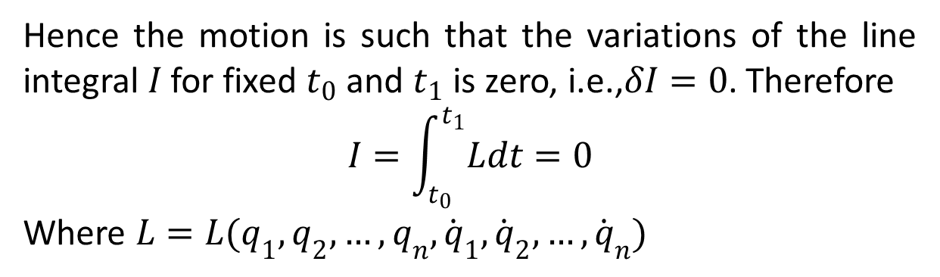
Hence the motion is such that the variations of the line integral $I$ for fixed $t_{0}$ and $t_{1}$ is zero, i.e.,$δI=0$. Therefore
$$I=\int_{t_{0}}^{t_{1}}{Ldt}=0$$
Where $L=L(q_{1},q_{2},…,q_{n},{\dot{q}}_{1},{\dot{q}}_{2},…,{\dot{q}}_{n})$

Slide 12
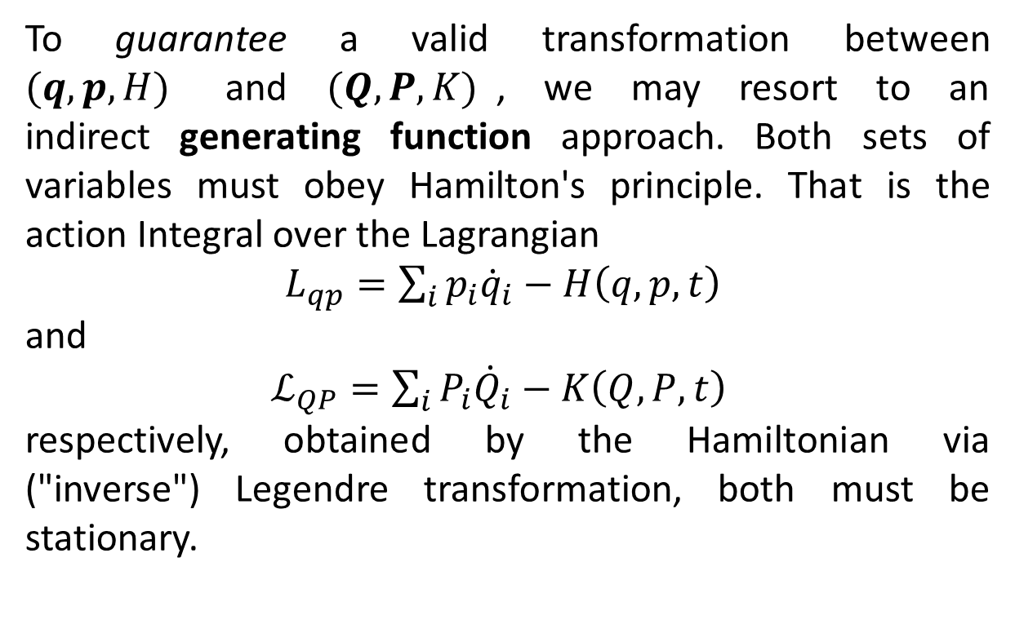
Generating Function Approach
To guarantee a valid transformation between $(q,p,H)$ and $(Q,P,K)$, we may resort to an indirect generating function approach. Both sets of variables must obey Hamilton's principle. That is the action Integral over the Lagrangian
$L_{qp}=\sum_{i}{p_{i}{\dot{q}}_{i}−H\left(q,p,t\right)}$
and
$ℒ_{QP}=\sum_{i}{P_{i}{\dot{Q}}_{i}−K\left(Q,P,t\right)}$
respectively, obtained by the Hamiltonian via ("inverse") Legendre transformation, both must be stationary.

Slide 13
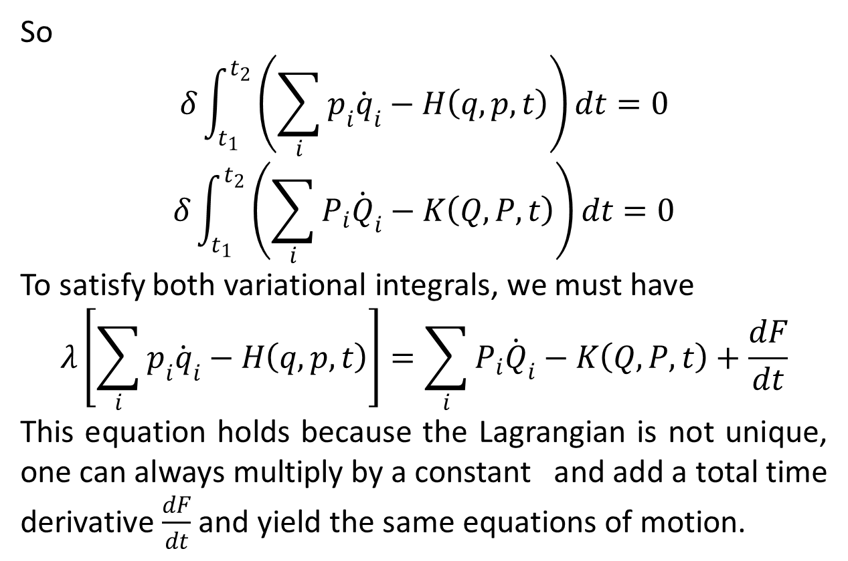
So
$$δ\int_{t_{1}}^{t_{2}}{\left(\sum_{i}{p_{i}{\dot{q}}_{i}−H\left(q,p,t\right)}\right)dt=0}$$
$$δ\int_{t_{1}}^{t_{2}}{\left(\sum_{i}{P_{i}{\dot{Q}}_{i}−K\left(Q,P,t\right)}\right)dt=0}$$
To satisfy both variational integrals, we must have
$$λ\left[\sum_{i}{p_{i}{\dot{q}}_{i}−H\left(q,p,t\right)}\right]=\sum_{i}{P_{i}{\dot{Q}}_{i}−K\left(Q,P,t\right)}+\frac{dF}{dt}$$
This equation holds because the Lagrangian is not unique, one can always multiply by a constant and add a total time derivative $\frac{dF}{dt}$ and yield the same equations of motion.

Slide 14
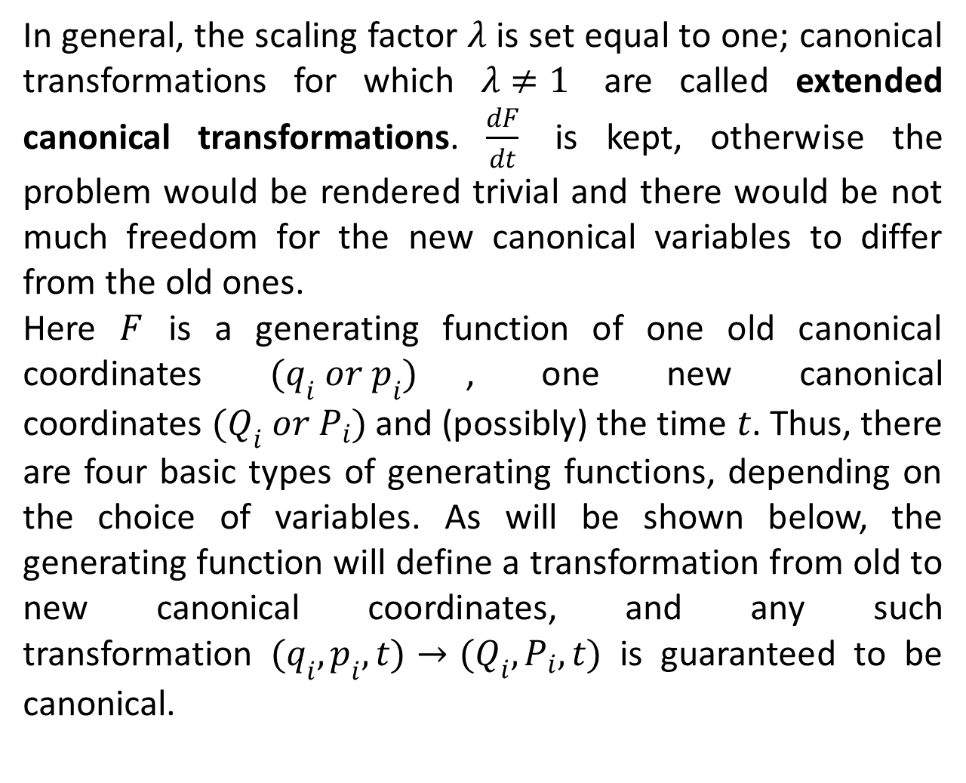
In general, the scaling factor $λ$ is set equal to one; canonical transformations for which $λ≠1$ are called extended canonical transformations. $\frac{dF}{dt}$ is kept, otherwise the problem would be rendered trivial and there would be not much freedom for the new canonical variables to differ from the old ones.
Here $F$ is a generating function of one old canonical coordinates $(q_{i} or p_{i})$, one new canonical coordinates $(Q_{i} or P_{i})$ and (possibly) the time $t$. Thus, there are four basic types of generating functions, depending on the choice of variables. As will be shown below, the generating function will define a transformation from old to new canonical coordinates, and any such transformation $(q_{i},p_{i},t)→(Q_{i},P_{i},t)$is guaranteed to be canonical.

Slide 15
The End

