Slide 1
Revision
Previous lecture was about
Canonical Transformation
Canonical Coordinates

Slide 2
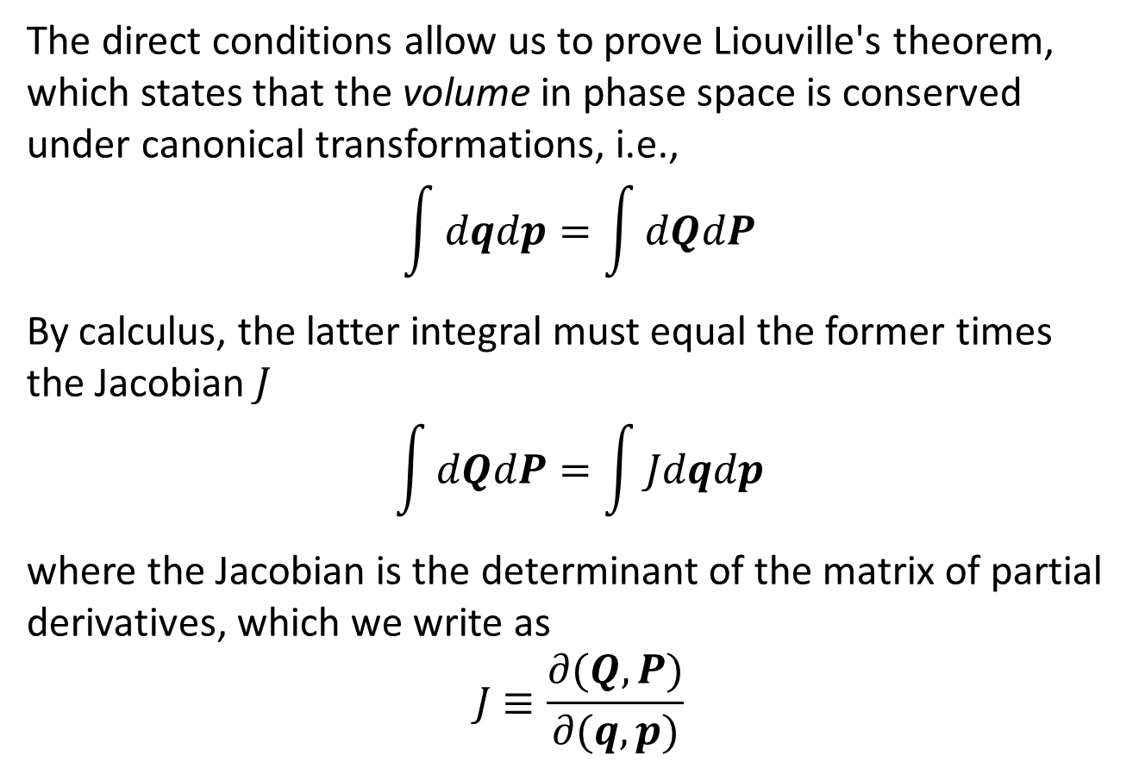
Lioville’s Theorem
The direct conditions allow us to prove Liouville's theorem, which states that the volume in phase space is conserved under canonical transformations, i.e.,
$$\int{dqdp}=\int{dQdP}$$
By calculus, the latter integral must equal the former times the Jacobian $J$
$$\int{dQdP}=\int{Jdqdp}$$
where the Jacobian is the determinant of the matrix of partial derivatives, which we write as
$$J≡\frac{∂(Q,P)}{∂(q,p)}$$

Slide 3
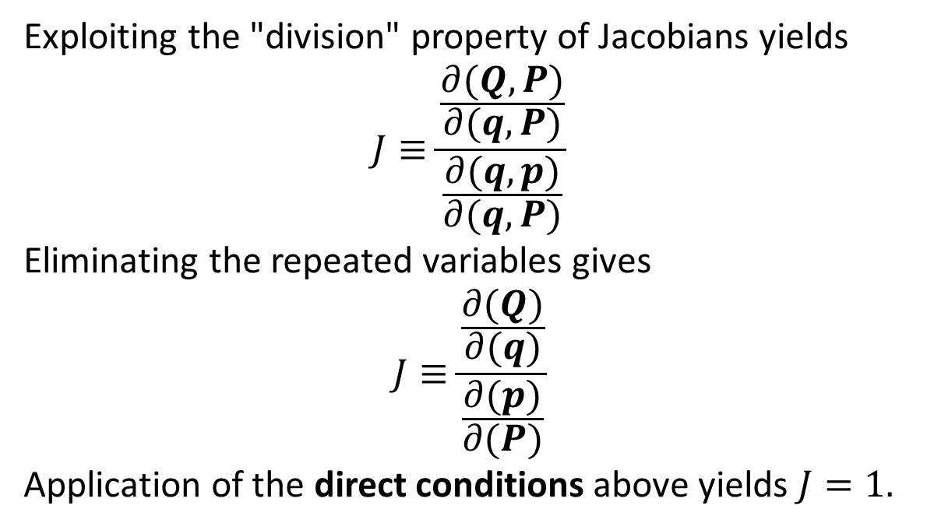
Exploiting the "division" property of Jacobians yields
$$J≡\frac{\frac{∂(Q,P)}{∂(q,P)}}{\frac{∂(q,p)}{∂(q,P)}}$$
Eliminating the repeated variables gives
$$J≡\frac{\frac{∂(Q)}{∂(q)}}{\frac{∂(p)}{∂(P)}}$$
Application of the direct conditions above yields $J=1.$

Slide 5
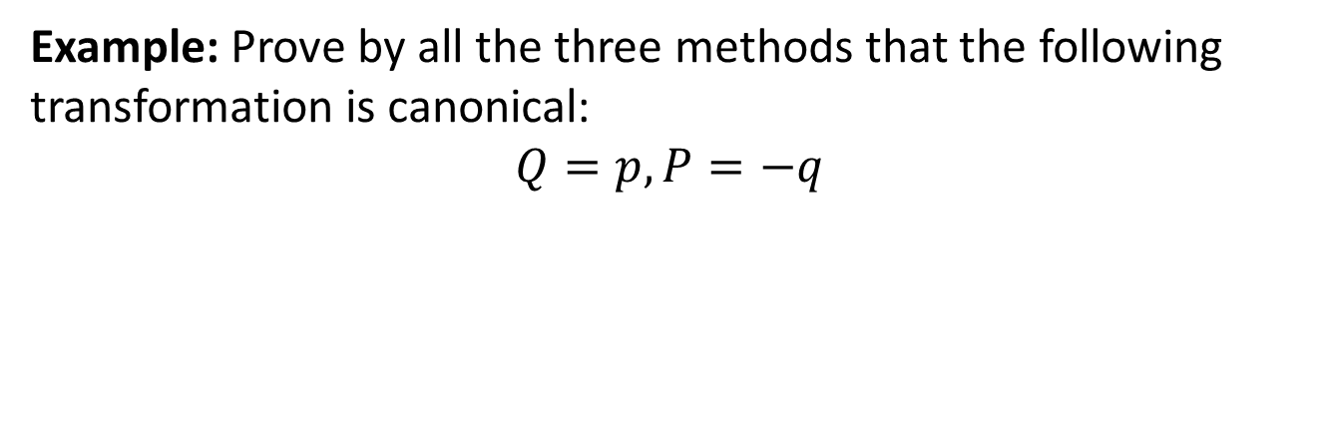
Example: Prove by all the three methods that the following transformation is canonical:
$$Q=p,P=−q$$

Slide 7
Calculus of Variations
Calculus of variations is a field of mathematical analysis that deals with maximizing or minimizing functionals (which are mappings from a set of functions to the real numbers). Functionals are often expressed as definite integrals involving functions and their derivatives. The interest is in extremal functions that make the functional attain a maximum or minimum value – or stationary functions – those where the rate of change of the functional is zero.

Slide 8
A simple example of such a problem is to find the curve of shortest length connecting two points. If there are no constraints, the solution is obviously a straight line between the points. However, if the curve is constrained to lie on a surface in space, then the solution is less obvious, and possibly many solutions may exist. Such solutions are known as geodesics. A related problem is posed by Fermat's principle: light follows the path of shortest optical length connecting two points, where the optical length depends upon the material of the medium.

Slide 9
Many important problems involve functions of several variables. Solutions of boundary value problems for the Laplace equation satisfy the Dirichlet principle. Plateau's problem requires finding a surface of minimal area that spans a given contour in space: a solution can often be found by dipping a frame in a solution of soap suds etc.

Slide 10
Variational Principle
A variational principle (action principle) is a scientific principle used within the calculus of variations, which develops general methods for finding functions which minimize or maximize the value of quantities that depend upon those functions. For example, to answer this question: "What is the shape of a chain suspended at both ends?" we can use the variational principle that the shape must minimize the gravitational potential energy.

Slide 11
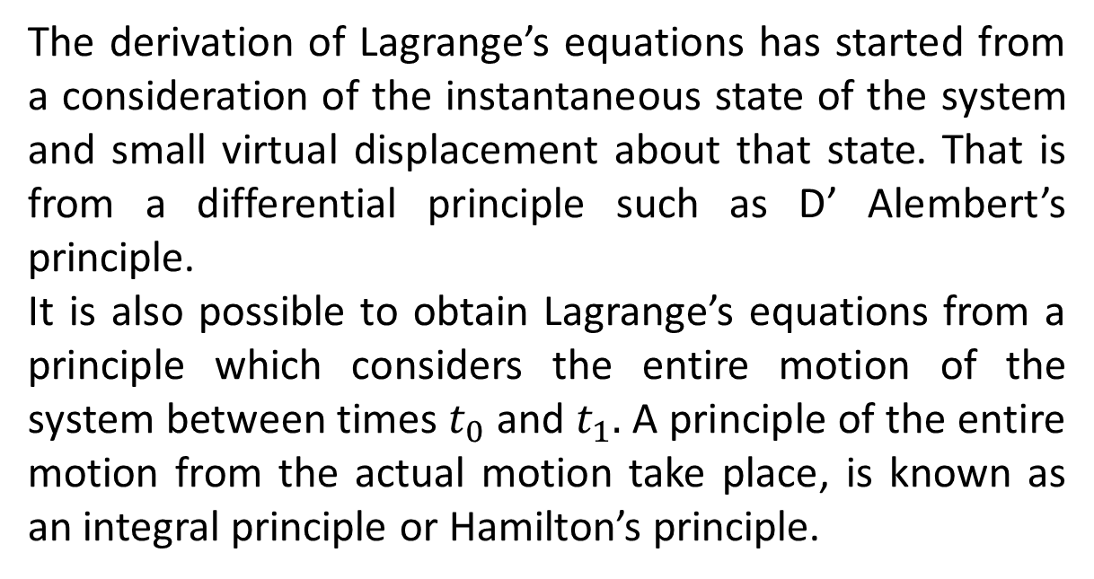
The derivation of Lagrange’s equations has started from a consideration of the instantaneous state of the system and small virtual displacement about that state. That is from a differential principle such as D’ Alembert’s principle.
It is also possible to obtain Lagrange’s equations from a principle which considers the entire motion of the system between times $t_{0}$ and $t_{1}.$ A principle of the entire motion from the actual motion take place, is known as an integral principle or Hamilton’s principle.

Slide 12
The End

