Slide 1
Revision
Previous lectures was about
Brackets

Slide 2
Canonical Coordinates
In mathematics and classical mechanics, canonical coordinates are sets of coordinates which can be used to describe a physical system at any given point in time (locating the system within phase space). Canonical coordinates are used in the Hamiltonian formulation of classical mechanics.

Slide 3
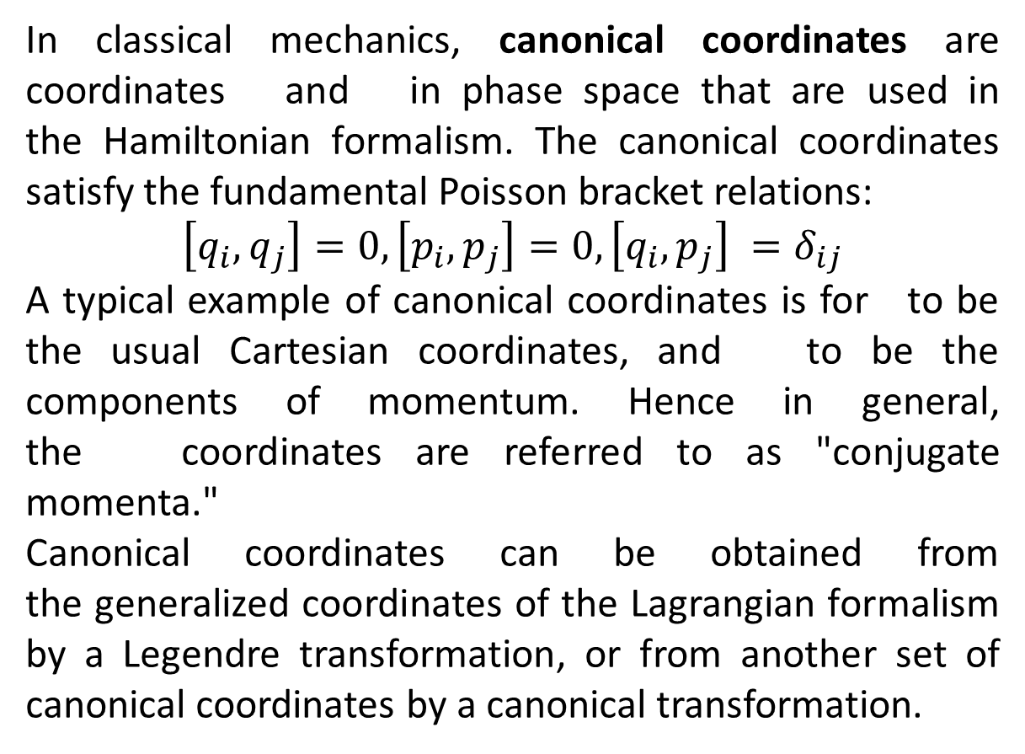
In classical mechanics, canonical coordinates are coordinates and in phase space that are used in the Hamiltonian formalism. The canonical coordinates satisfy the fundamental Poisson bracket relations:
$$\left[q_{i},q_{j}\right]=0,\left[p_{i},p_{j}\right]=0,\left[q_{i},p_{j}\right] =δ_{ij}$$
A typical example of canonical coordinates is for to be the usual Cartesian coordinates, and to be the components of momentum. Hence in general, the coordinates are referred to as "conjugate momenta."
Canonical coordinates can be obtained from the generalized coordinates of the Lagrangian formalism by a Legendre transformation, or from another set of canonical coordinates by a canonical transformation.

Slide 4
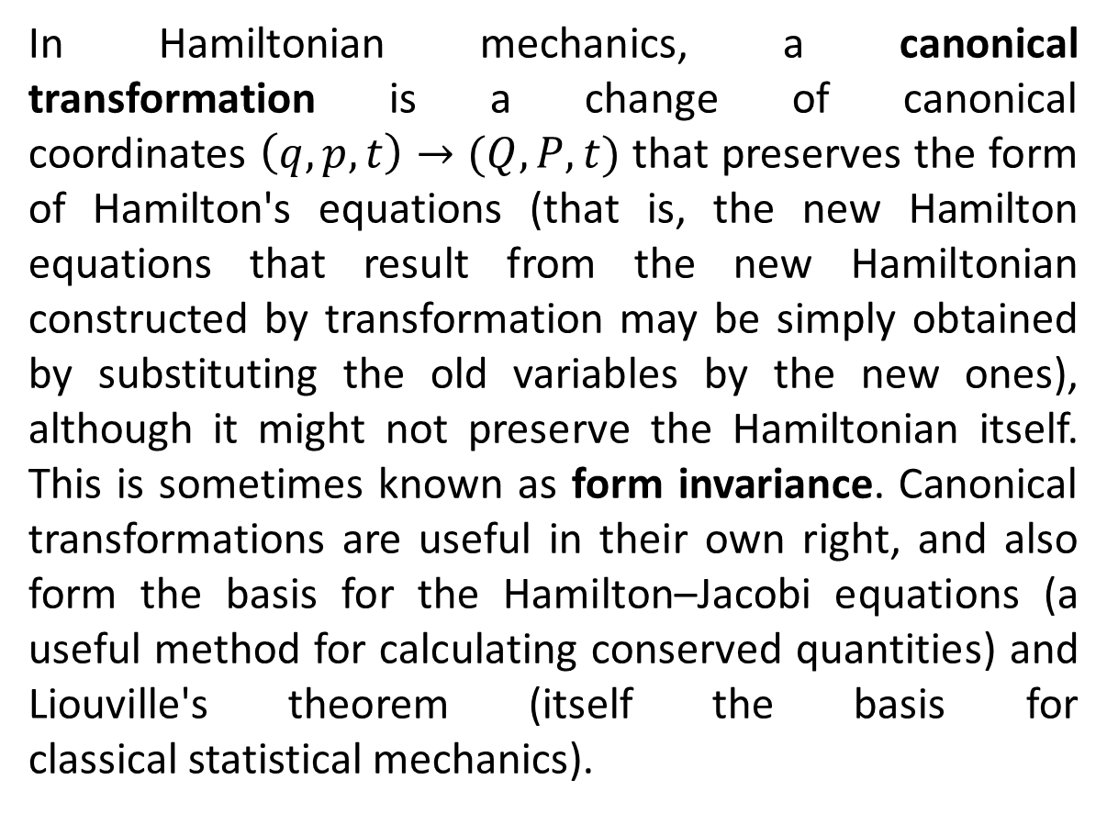
In Hamiltonian mechanics, a canonical transformation is a change of canonical coordinates $\left(q,p,t\right)→(Q,P,t)$ that preserves the form of Hamilton's equations (that is, the new Hamilton equations that result from the new Hamiltonian constructed by transformation may be simply obtained by substituting the old variables by the new ones), although it might not preserve the Hamiltonian itself. This is sometimes known as form invariance. Canonical transformations are useful in their own right, and also form the basis for the Hamilton–Jacobi equations (a useful method for calculating conserved quantities) and Liouville's theorem (itself the basis for classical statistical mechanics).

Slide 5
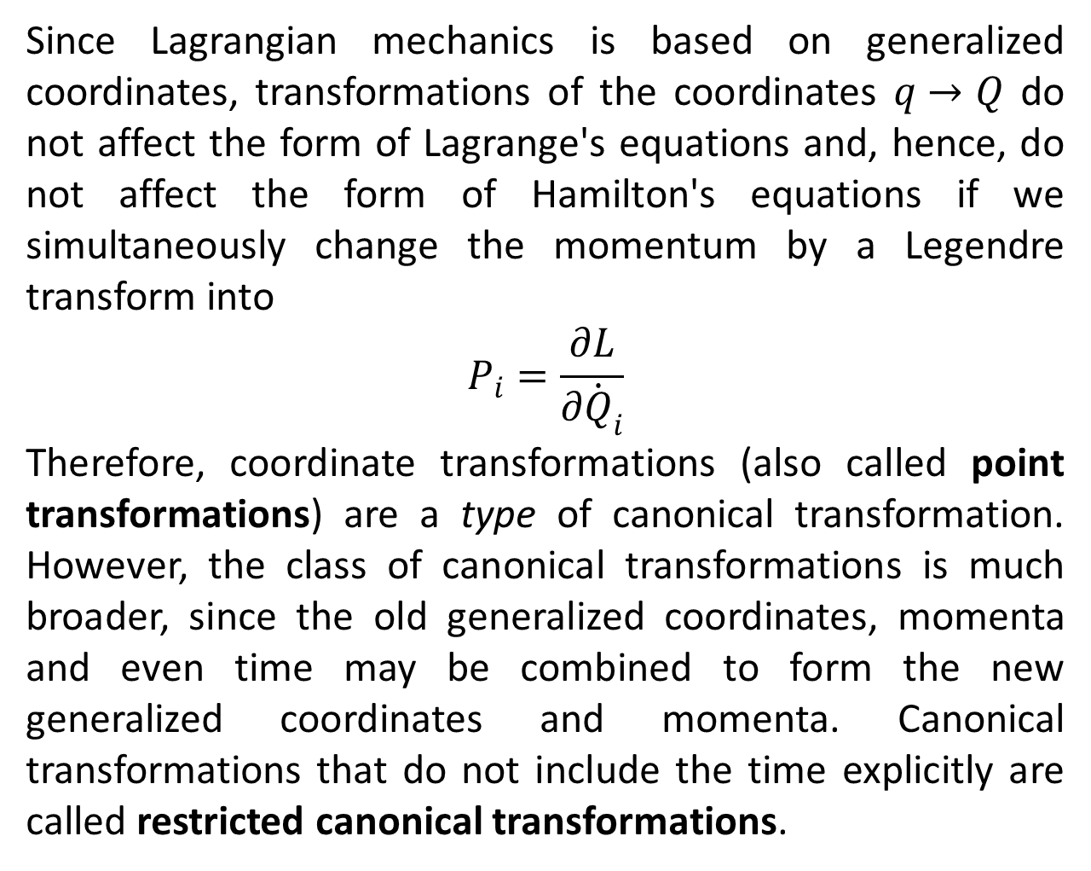
Since Lagrangian mechanics is based on generalized coordinates, transformations of the coordinates $q→Q$ do not affect the form of Lagrange's equations and, hence, do not affect the form of Hamilton's equations if we simultaneously change the momentum by a Legendre transform into
$$P_{i}=\frac{∂L}{∂{\dot{Q}}_{i}}$$
Therefore, coordinate transformations (also called point transformations) are a type of canonical transformation. However, the class of canonical transformations is much broader, since the old generalized coordinates, momenta and even time may be combined to form the new generalized coordinates and momenta. Canonical transformations that do not include the time explicitly are called restricted canonical transformations.

Slide 6
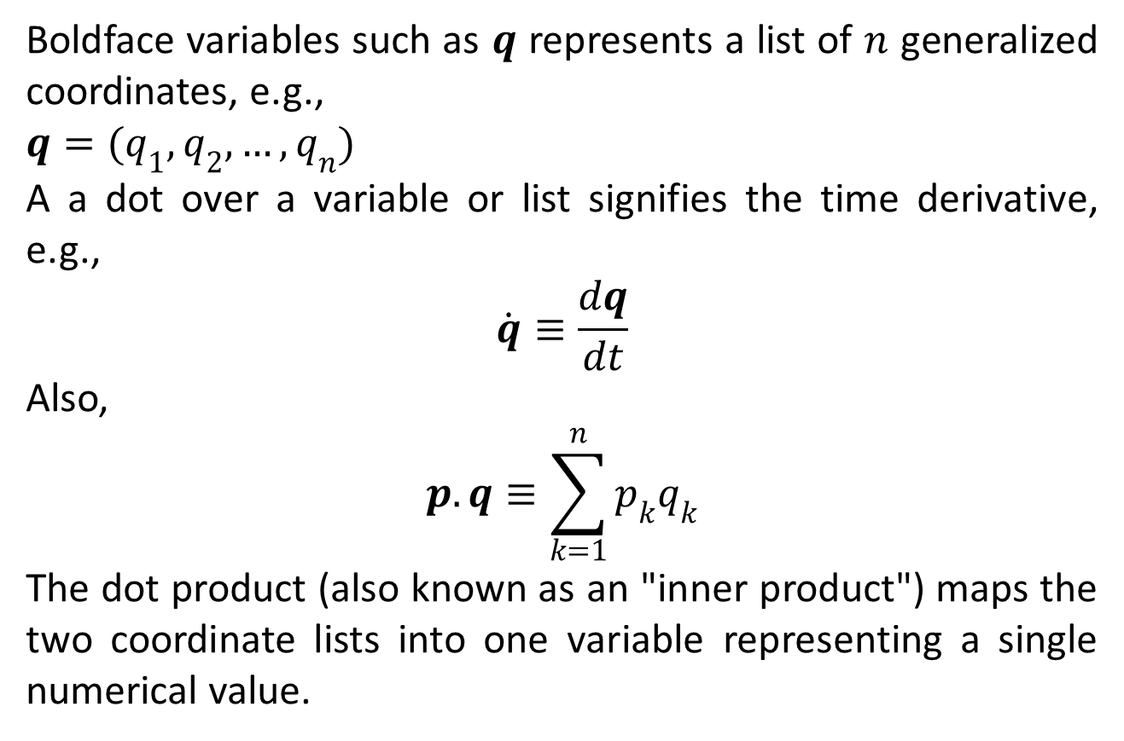
Direct Approach
Boldface variables such as $q$ represents a list of $n$ generalized coordinates, e.g.,
$q=(q_{1},q_{2},…,q_{n})$
A a dot over a variable or list signifies the time derivative, e.g.,
$$\dot{q}≡\frac{dq}{dt}$$
Also,
$$p.q≡\sum_{k=1}^{n}{p_{k}q_{k}}$$
The dot product (also known as an "inner product") maps the two coordinate lists into one variable representing a single numerical value.

Slide 7
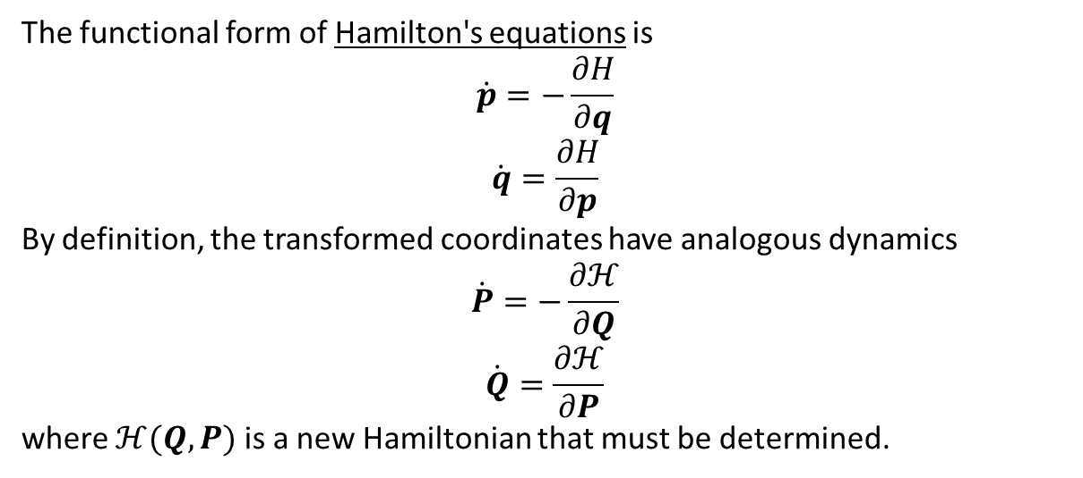

Slide 8
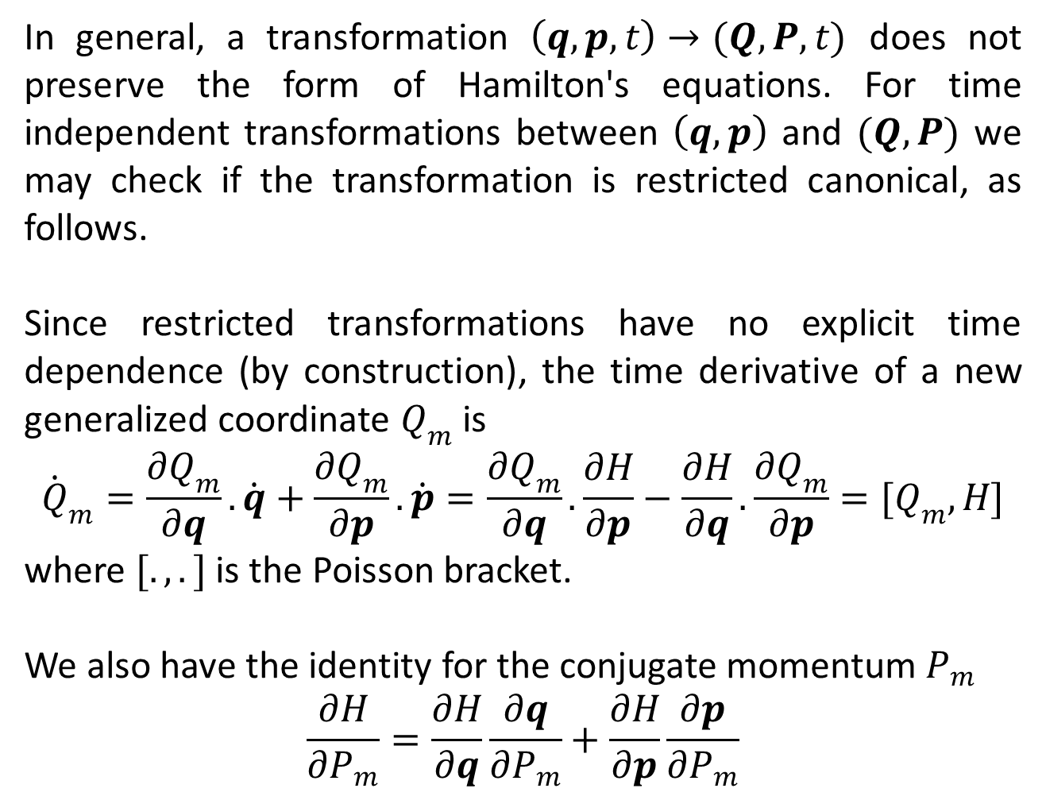
In general, a transformation $\left(q,p,t\right)→(Q,P,t)$ does not preserve the form of Hamilton's equations. For time independent transformations between $\left(q,p\right)$ and $(Q,P)$ we may check if the transformation is restricted canonical, as follows.
Since restricted transformations have no explicit time dependence (by construction), the time derivative of a new generalized coordinate $Q_{m}$ is
$${\dot{Q}}_{m}=\frac{∂Q_{m}}{∂q}.\dot{q}+\frac{∂Q_{m}}{∂p}.\dot{p}=\frac{∂Q_{m}}{∂q}.\frac{∂H}{∂p}−\frac{∂H}{∂q}.\frac{∂Q_{m}}{∂p}=[Q_{m},H]$$
where $[.,.]$ is the Poisson bracket.
We also have the identity for the conjugate momentum $P_{m}$
$$\frac{∂H}{∂P_{m}}=\frac{∂H}{∂q}\frac{∂q}{∂P_{m}}+\frac{∂H}{∂p}\frac{∂p}{∂P_{m}}$$

Slide 9
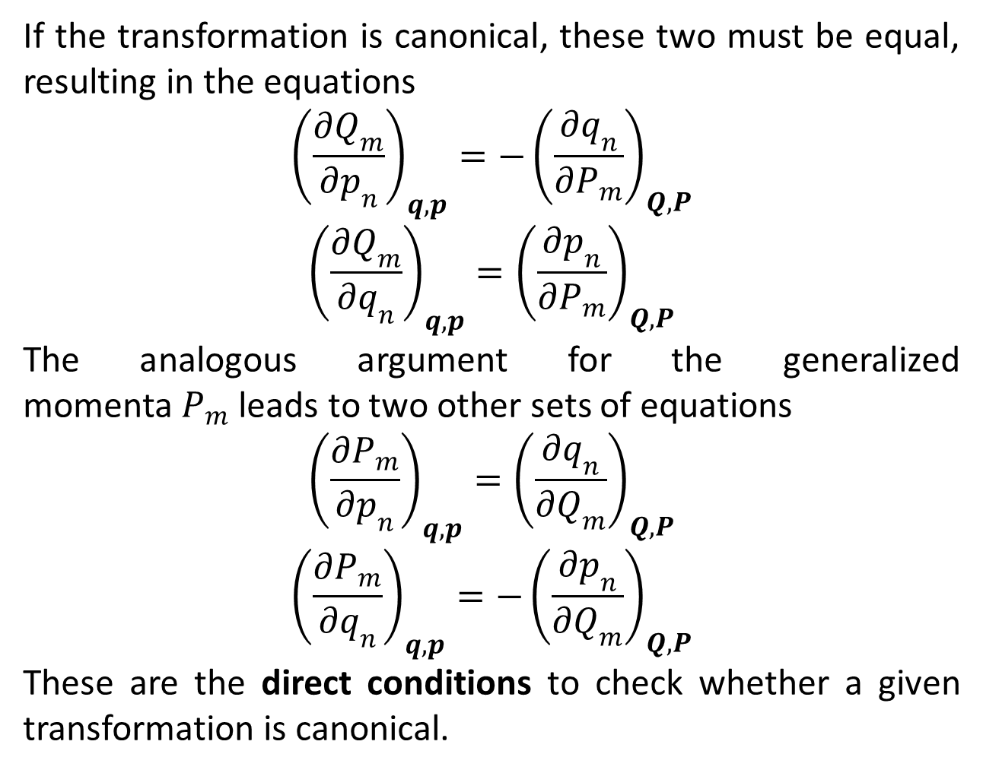
If the transformation is canonical, these two must be equal, resulting in the equations
$${\left(\frac{∂Q_{m}}{∂p_{n}}\right)}_{q,p}=−{\left(\frac{∂q_{n}}{∂P_{m}}\right)}_{Q,P}$$
$${\left(\frac{∂Q_{m}}{∂q_{n}}\right)}_{q,p}={\left(\frac{∂p_{n}}{∂P_{m}}\right)}_{Q,P}$$
The analogous argument for the generalized momenta $P_{m}$ leads to two other sets of equations
$${\left(\frac{∂P_{m}}{∂p_{n}}\right)}_{q,p}={\left(\frac{∂q_{n}}{∂Q_{m}}\right)}_{Q,P}$$
$${\left(\frac{∂P_{m}}{∂q_{n}}\right)}_{q,p}=−{\left(\frac{∂p_{n}}{∂Q_{m}}\right)}_{Q,P}$$
These are the direct conditions to check whether a given transformation is canonical.

Slide 10

An interesting fact is that
$$\sum{p_{i}{dq}_{i}}−\sum{P_{i}{dQ}_{i}}=constant$$

Slide 11
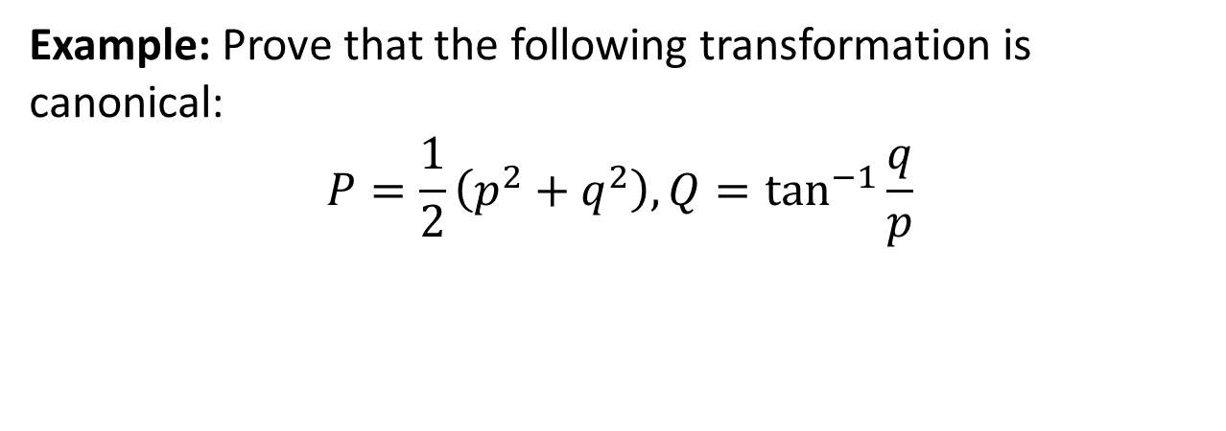
Example: Prove that the following transformation is canonical:
$$P=\frac{1}{2}\left(p^{2}+q^{2}\right),Q=\tan^{−1}{\frac{q}{p}}$$

Slide 14
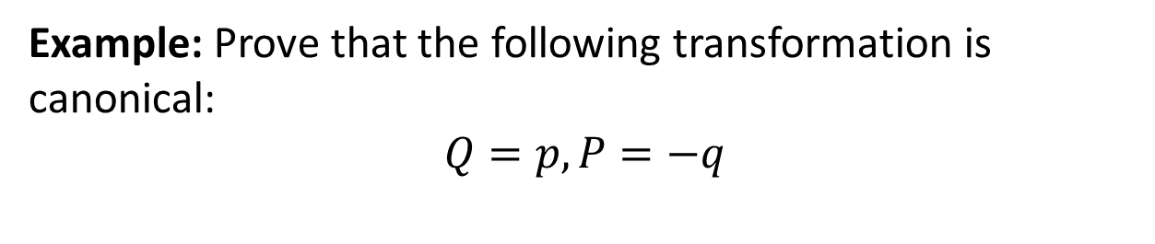
Example: Prove that the following transformation is canonical:
$$Q=p,P=−q$$

Slide 17
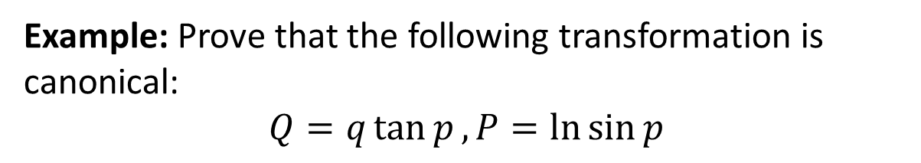
Example: Prove that the following transformation is canonical:
$$Q=q\tan{p}, P=\ln{\sin{p}}$$

Slide 18
The End

