Slide 1
REVISION
In previous lecture, we have discussed
Phase Space
Liouvillie’s Theorem
Hamiltonian
Hamilton’s Equations of Motion

Slide 2
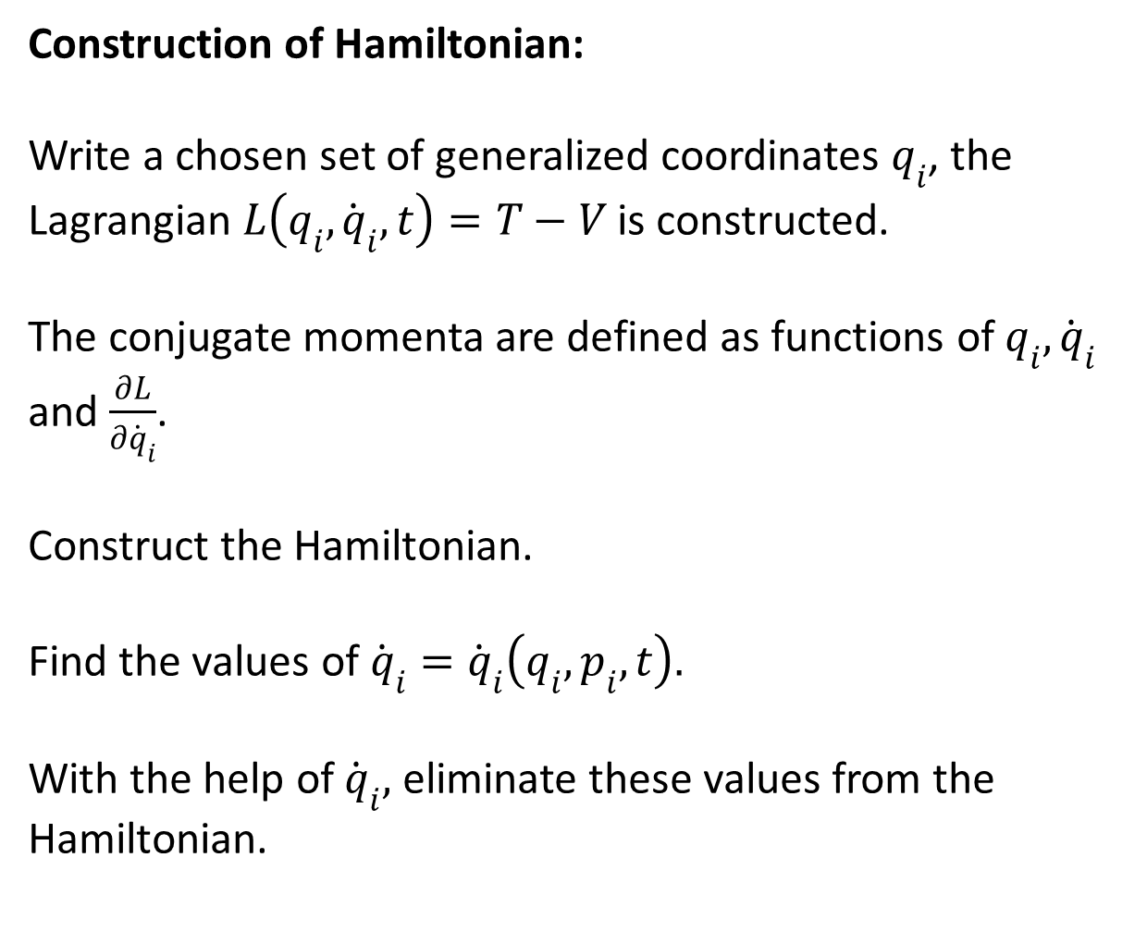
Construction of Hamiltonian:
Write a chosen set of generalized coordinates $q_{i}$, the Lagrangian$L\left(q_{i},{\dot{q}}_{i},t\right)=T−V$ is constructed.
The conjugate momenta are defined as functions of$q_{i},{\dot{q}}_{i}$ and $\frac{∂L}{∂{\dot{q}}_{i}}$.
Construct the Hamiltonian.
Find the values of ${\dot{q}}_{i}={\dot{q}}_{i}\left(q_{i},p_{i},t\right).$
With the help of ${\dot{q}}_{i},$ eliminate these values from the Hamiltonian.

Slide 3
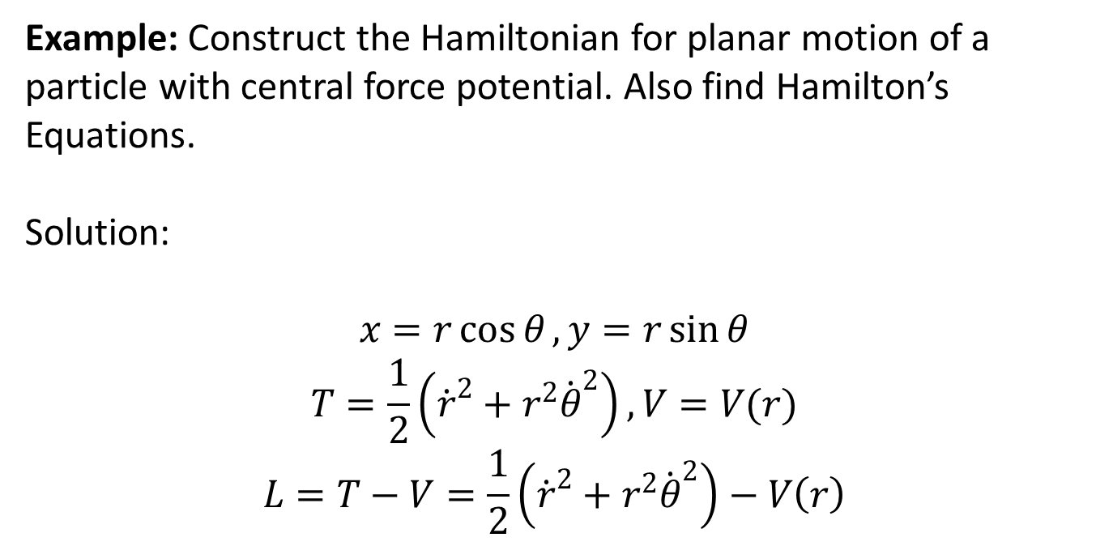
Construction of Hamiltonian
Example: Construct the Hamiltonian for planar motion of a particle with central force potential. Also find Hamilton’s Equations.
Solution:
$$x=r\cos{θ}, y=r\sin{θ}$$
$$T=\frac{1}{2}\left({\dot{r}}^{2}+r^{2}{\dot{θ}}^{2}\right),V=V(r)$$
$$L=T−V=\frac{1}{2}\left({\dot{r}}^{2}+r^{2}{\dot{θ}}^{2}\right)−V\left(r\right)$$

Slide 5
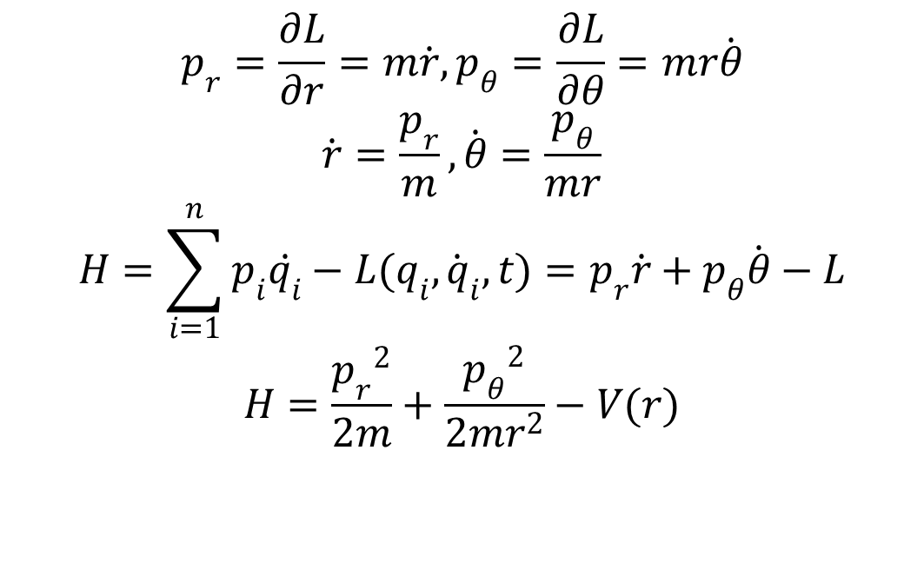
$$p_{r}=\frac{∂L}{∂r}=m\dot{r},p_{θ}=\frac{∂L}{∂θ}=mr\dot{θ}$$
$$\dot{r}=\frac{p_{r}}{m},\dot{θ}=\frac{p_{θ}}{mr}$$
$$H=\sum_{i=1}^{n}{p_{i}\dot{q_{i}}−L(q_{i},{\dot{q}}_{i},t)}=p_{r}\dot{r}+p_{θ}\dot{θ}−L$$
$$H=\frac{{p_{r}}^{2}}{2m}+\frac{{p_{θ}}^{2}}{2mr^{2}}−V(r)$$

Slide 7
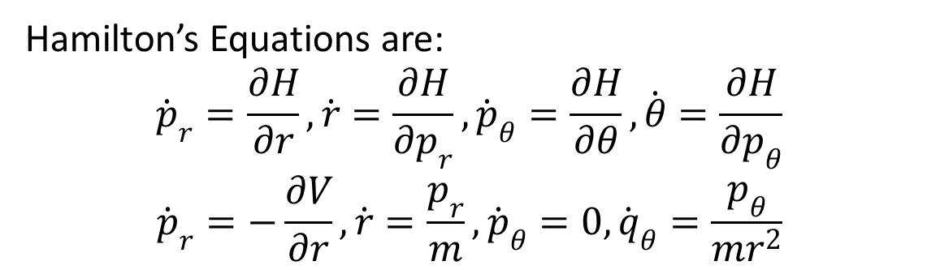
Hamilton’s Equations are:
$${\dot{p}}_{r}=\frac{∂H}{∂r},\dot{r}=\frac{∂H}{∂p_{r}},{\dot{p}}_{θ}=\frac{∂H}{∂θ},\dot{θ}=\frac{∂H}{∂p_{θ}}$$
$${\dot{p}}_{r}=−\frac{∂V}{∂r},\dot{r}=\frac{p_{r}}{m},{\dot{p}}_{θ}=0,{\dot{q}}_{θ}=\frac{p_{θ}}{mr^{2}}$$

Slide 8
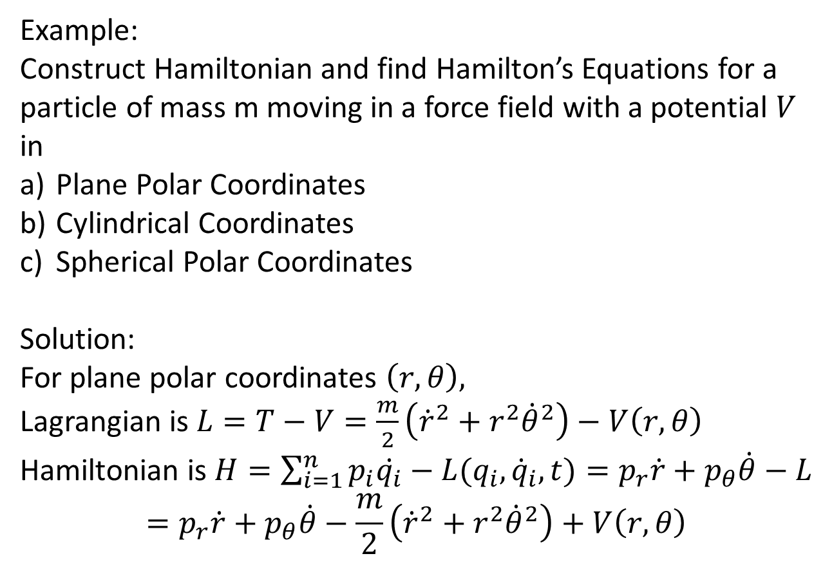
Example:
Construct Hamiltonian and find Hamilton’s Equations for a particle of mass m moving in a force field with a potential $V$ in
Plane Polar Coordinates
Cylindrical Coordinates
Spherical Polar Coordinates
Solution:
For plane polar coordinates $\left(r,θ\right),$
Lagrangian is $L=T−V=\frac{m}{2}\left({\dot{r}}^{2}+r^{2}{\dot{θ}}^{2}\right)−V\left(r,θ\right)$
Hamiltonian is $H=\sum_{i=1}^{n}{p_{i}\dot{q_{i}}−L(q_{i},{\dot{q}}_{i},t)}=p_{r}\dot{r}+p_{θ}\dot{θ}−L$
$$=p_{r}\dot{r}+p_{θ}\dot{θ}−\frac{m}{2}\left({\dot{r}}^{2}+r^{2}{\dot{θ}}^{2}\right)+V\left(r,θ\right)$$

Slide 14
The End

