Slide 1
Revision
Previous lecture was about
Some applications of Lagrangian and Lagrange Equations of Motion

Slide 2
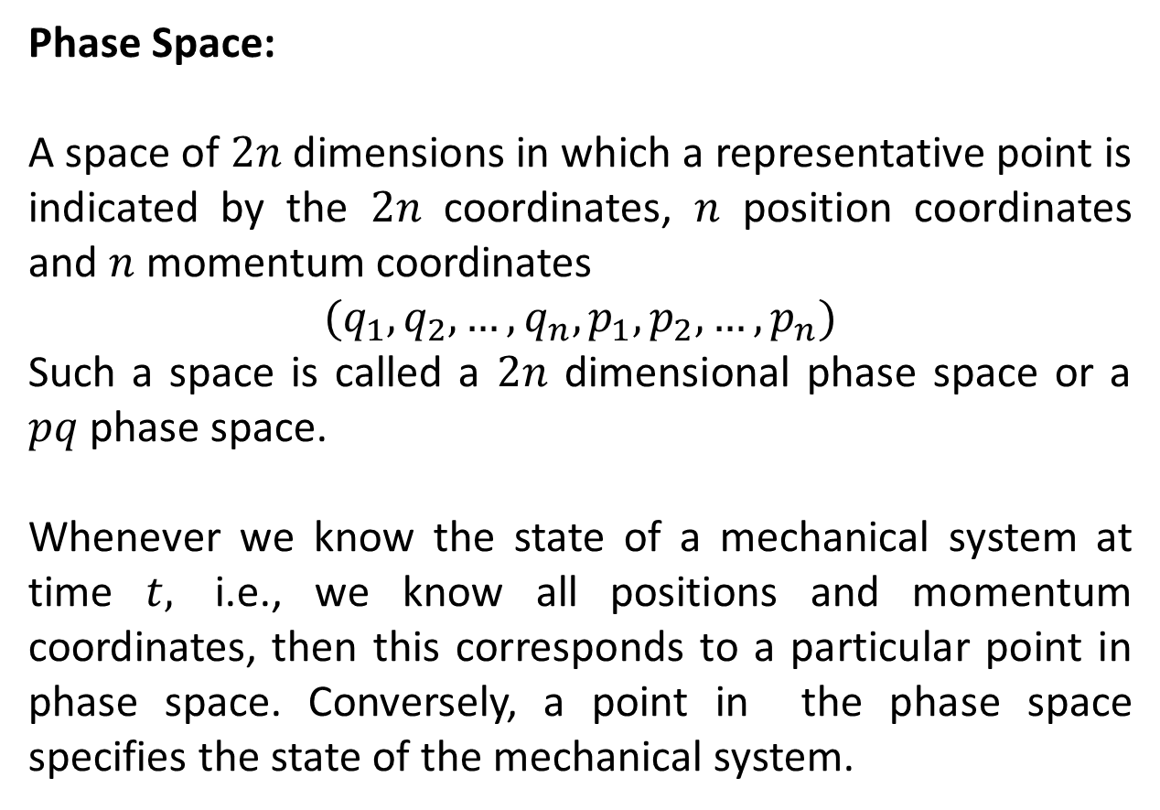
Phase Space and Liouville’s Theorem
Phase Space:
A space of $2n$ dimensions in which a representative point is indicated by the $2n$ coordinates, $n$ position coordinates and $n$ momentum coordinates
$${(q}_{1},q_{2},…,q_{n},p_{1},p_{2},…,p_{n})$$
Such a space is called a $2n$dimensional phase space or a $pq$ phase space.
Whenever we know the state of a mechanical system at time $t,$ i.e., we know all positions and momentum coordinates, then this corresponds to a particular point in phase space. Conversely, a point in the phase space specifies the state of the mechanical system.

Slide 3
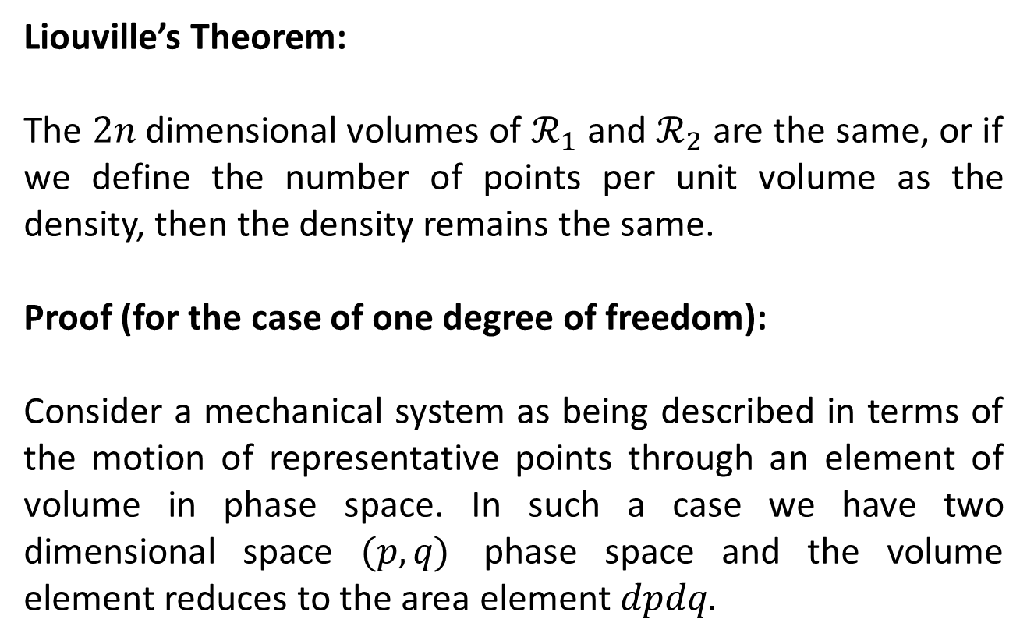
Liouville’s Theorem:
The $2n$dimensional volumes of $ℛ_{1}$ and $ℛ_{2}$ are the same, or if we define the number of points per unit volume as the density, then the density remains the same.
Proof (for the case of one degree of freedom):
Consider a mechanical system as being described in terms of the motion of representative points through an element of volume in phase space. In such a case we have two dimensional space $(p,q)$ phase space and the volume element reduces to the area element $dpdq.$

Slide 4
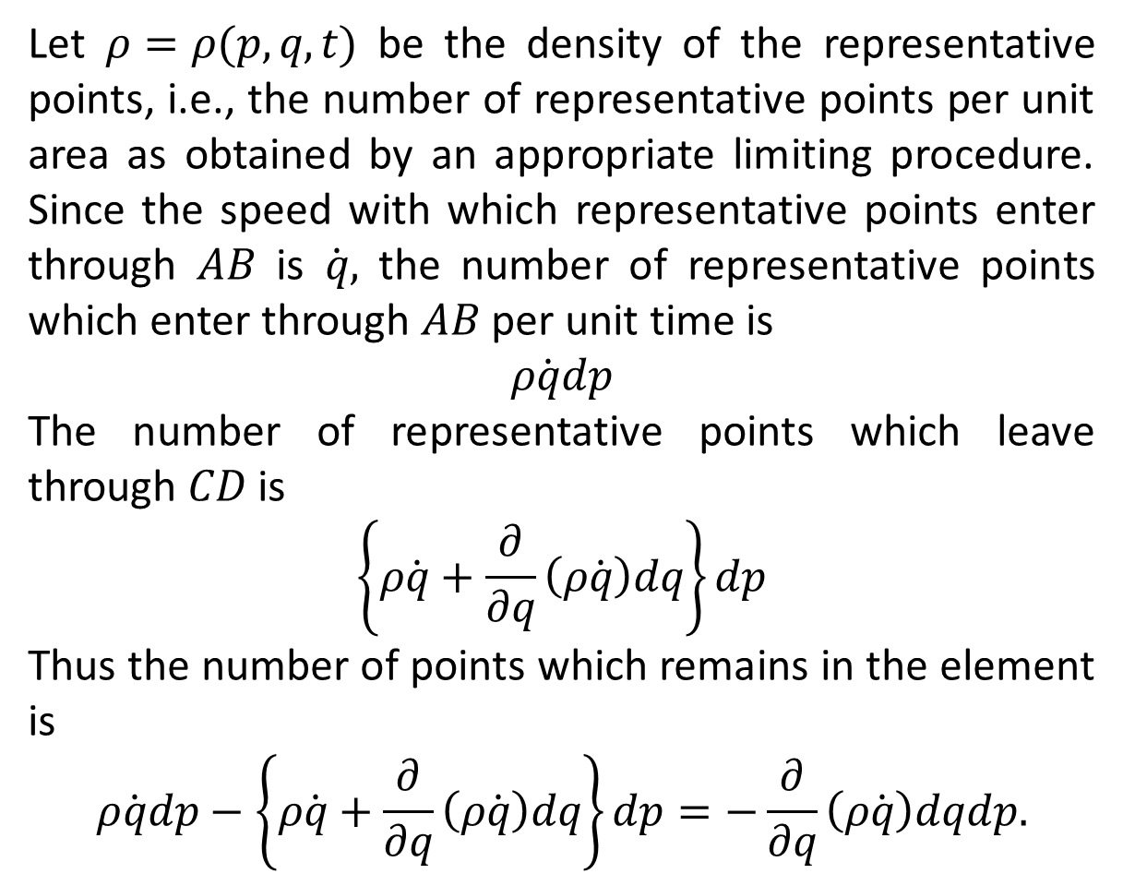
Let $ρ=ρ(p,q,t)$ be the density of the representative points, i.e., the number of representative points per unit area as obtained by an appropriate limiting procedure. Since the speed with which representative points enter through $AB$ is $\dot{q},$ the number of representative points which enter through $AB$ per unit time is
$$ρ\dot{q}dp$$
The number of representative points which leave through $CD$ is
$$\left\{ρ\dot{q}+\frac{∂}{∂q}\left(ρ\dot{q}\right)dq\right\}dp$$
Thus the number of points which remains in the element is
$$ρ\dot{q}dp−\left\{ρ\dot{q}+\frac{∂}{∂q}\left(ρ\dot{q}\right)dq\right\}dp=−\frac{∂}{∂q}\left(ρ\dot{q}\right)dqdp.$$

Slide 5
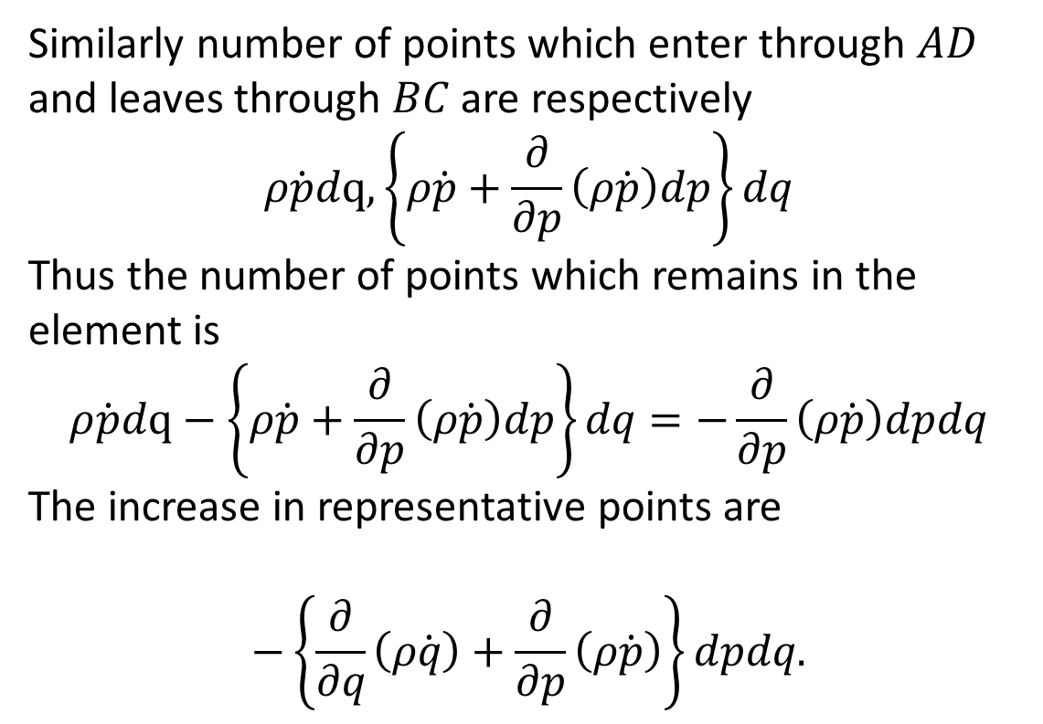
Similarly number of points which enter through $AD$ and leaves through $BC$ are respectively
$$ρ\dot{p}dq,\left\{ρ\dot{p}+\frac{∂}{∂p}\left(ρ\dot{p}\right)dp\right\}dq$$
Thus the number of points which remains in the element is
$$ρ\dot{p}dq−\left\{ρ\dot{p}+\frac{∂}{∂p}\left(ρ\dot{p}\right)dp\right\}dq=−\frac{∂}{∂p}\left(ρ\dot{p}\right)dpdq$$
The increase in representative points are
$$−\left\{\frac{∂}{∂q}\left(ρ\dot{q}\right)+\frac{∂}{∂p}\left(ρ\dot{p}\right)\right\}dpdq.$$

Slide 6
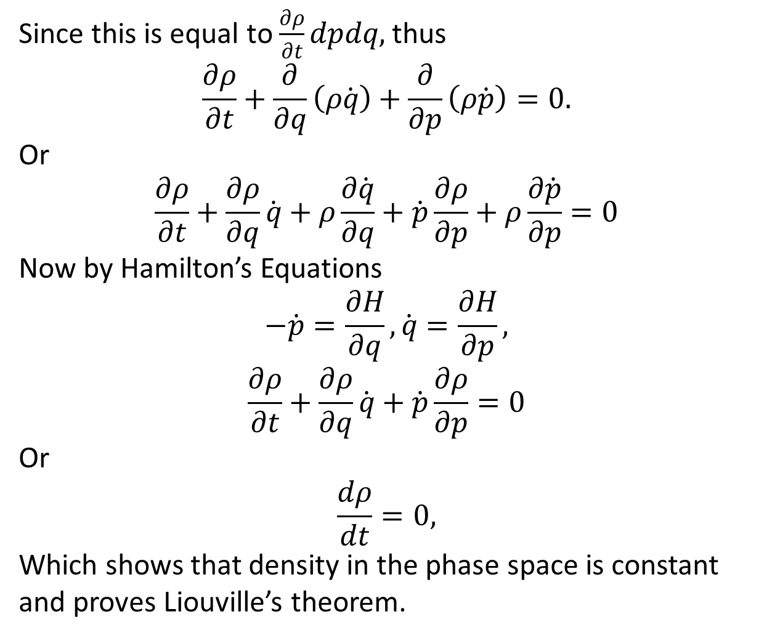
Since this is equal to $\frac{∂ρ}{∂t}dpdq,$ thus
$$\frac{∂ρ}{∂t}+\frac{∂}{∂q}\left(ρ\dot{q}\right)+\frac{∂}{∂p}\left(ρ\dot{p}\right)=0.$$
Or
$$\frac{∂ρ}{∂t}+\frac{∂ρ}{∂q}\dot{q}+ρ\frac{∂\dot{q}}{∂q}+\dot{p}\frac{∂ρ}{∂p}+ρ\frac{∂\dot{p}}{∂p}=0$$
Now by Hamilton’s Equations
$$−\dot{p}=\frac{∂H}{∂q},\dot{q}=\frac{∂H}{∂p},$$
$$\frac{∂ρ}{∂t}+\frac{∂ρ}{∂q}\dot{q}+\dot{p}\frac{∂ρ}{∂p}=0$$
Or
$$\frac{dρ}{dt}=0,$$
Which shows that density in the phase space is constant and proves Liouville’s theorem.

Slide 7
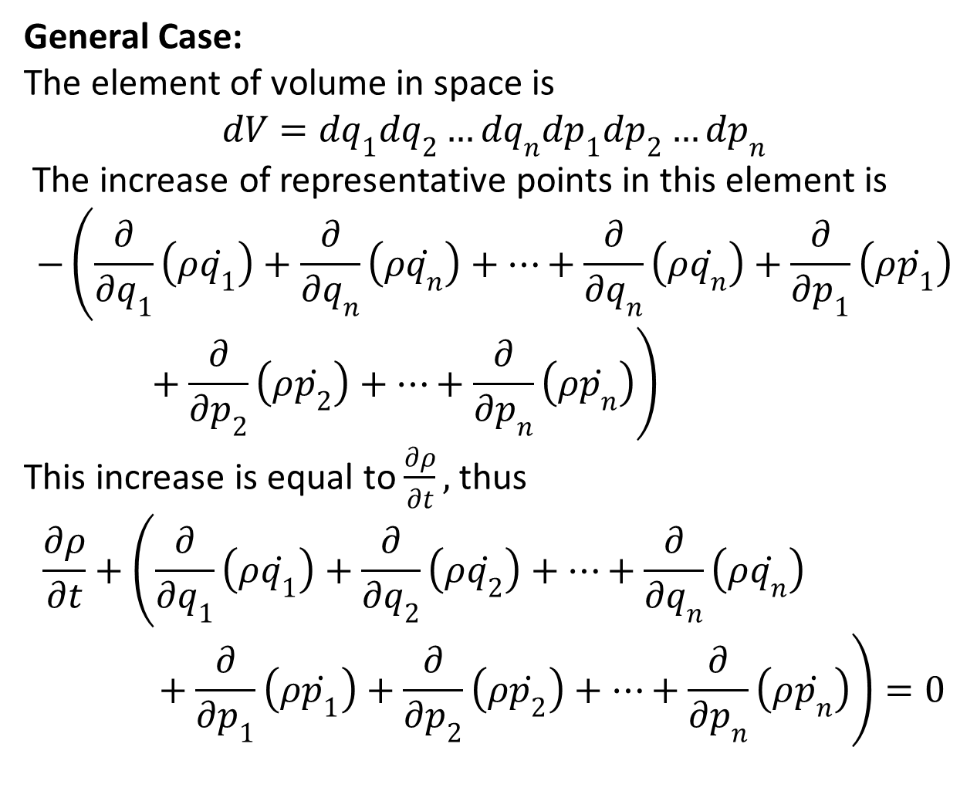
General Case:
The element of volume in space is
$$dV=dq_{1}dq_{2}…dq_{n}dp_{1}dp_{2}…dp_{n}$$
The increase of representative points in this element is
$$−\left(\frac{∂}{∂q_{1}}\left(ρ\dot{q_{1}}\right)+\frac{∂}{∂q_{n}}\left(ρ\dot{q_{n}}\right)+…+\frac{∂}{∂q_{n}}\left(ρ\dot{q_{n}}\right)+\frac{∂}{∂p_{1}}\left(ρ\dot{p_{1}}\right)+\frac{∂}{∂p_{2}}\left(ρ\dot{p_{2}}\right)+…+\frac{∂}{∂p_{n}}\left(ρ\dot{p_{n}}\right)\right)$$
This increase is equal to $\frac{∂ρ}{∂t},$ thus
$$\frac{∂ρ}{∂t}+\left(\frac{∂}{∂q_{1}}\left(ρ\dot{q_{1}}\right)+\frac{∂}{∂q_{2}}\left(ρ\dot{q_{2}}\right)+…+\frac{∂}{∂q_{n}}\left(ρ\dot{q_{n}}\right)+\frac{∂}{∂p_{1}}\left(ρ\dot{p_{1}}\right)+\frac{∂}{∂p_{2}}\left(ρ\dot{p_{2}}\right)+…+\frac{∂}{∂p_{n}}\left(ρ\dot{p_{n}}\right)\right)=0$$

Slide 8
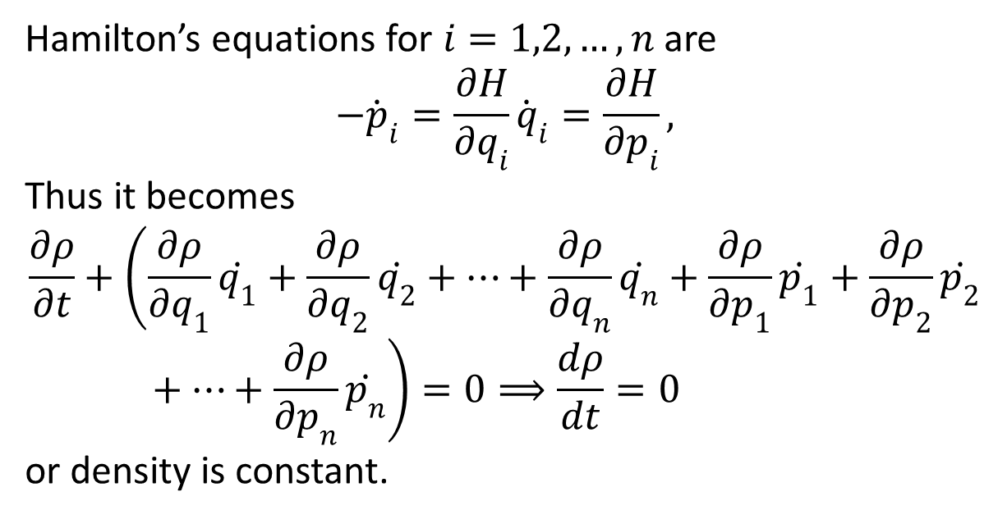
Hamilton’s equations for $i=1,2,…,n$ are
$$−{\dot{p}}_{i}=\frac{∂H}{∂q_{i}}{\dot{q}}_{i}=\frac{∂H}{∂p_{i}},$$
Thus it becomes
$$\frac{∂ρ}{∂t}+\left(\frac{∂ρ}{∂q_{1}}\dot{q_{1}}+\frac{∂ρ}{∂q_{2}}\dot{q_{2}}+…+\frac{∂ρ}{∂q_{n}}\dot{q_{n}}+\frac{∂ρ}{∂p_{1}}\dot{p_{1}}+\frac{∂ρ}{∂p_{2}}\dot{p_{2}}+…+\frac{∂ρ}{∂p_{n}}\dot{p_{n}}\right)=0⟹\frac{dρ}{dt}=0$$
or density is constant.

Slide 9
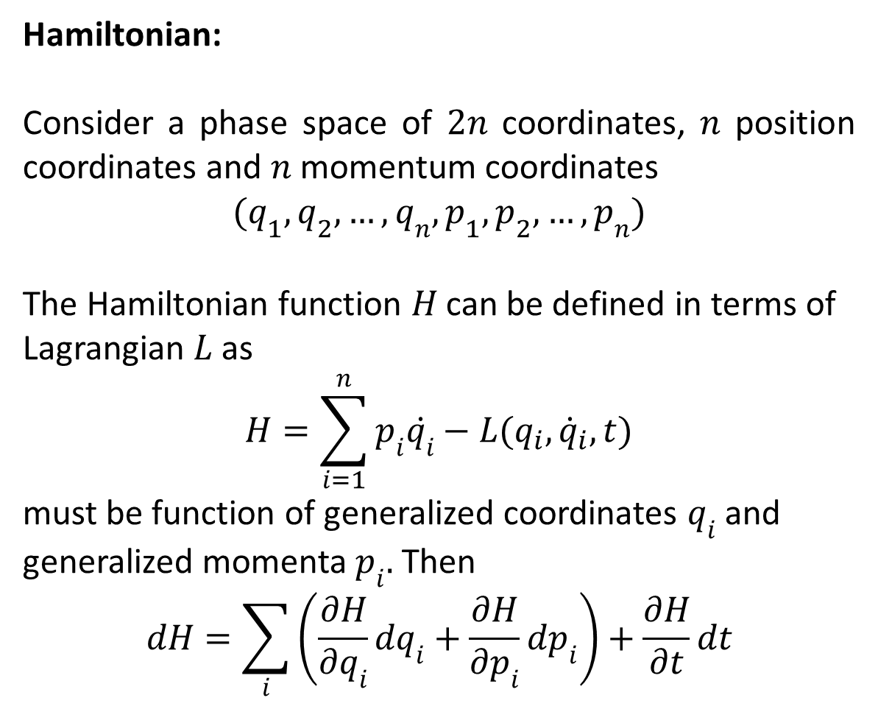
Hamiltonian:
Consider a phase space of $2n$ coordinates, $n$ position coordinates and $n$ momentum coordinates
$${(q}_{1},q_{2},…,q_{n},p_{1},p_{2},…,p_{n})$$
The Hamiltonian function $H$ can be defined in terms of Lagrangian$L$ as
$$H=\sum_{i=1}^{n}{p_{i}\dot{q_{i}}−L(q_{i},{\dot{q}}_{i},t)}$$
must be function of generalized coordinates $q_{i}$ and generalized momenta $p_{i}.$ Then
$$dH=\sum_{i}{\left(\frac{∂H}{∂q_{i}}dq_{i}+\frac{∂H}{∂p_{i}}dp_{i}\right)+\frac{∂H}{∂t}dt}$$

Slide 10
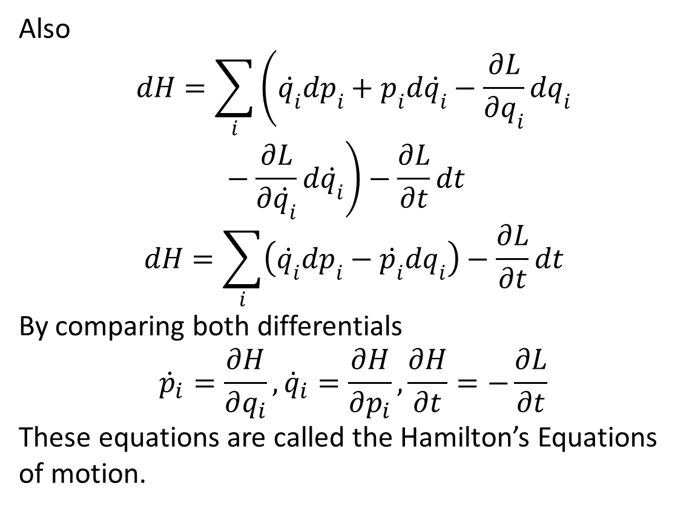
Also
$$dH=\sum_{i}{\left(\dot{q_{i}}dp_{i}+p_{i}d\dot{q_{i}}−\frac{∂L}{∂q_{i}}dq_{i}−\frac{∂L}{∂\dot{q_{i}}}d\dot{q_{i}}\right)−\frac{∂L}{∂t}dt}$$
$$dH=\sum_{i}{\left(\dot{q_{i}}dp_{i}−\dot{p_{i}}dq_{i}\right)−\frac{∂L}{∂t}dt}$$
By comparing both differentials
$${\dot{p}}_{i}=\frac{∂H}{∂q_{i}},{\dot{q}}_{i}=\frac{∂H}{∂p_{i}},\frac{∂H}{∂t}=−\frac{∂L}{∂t}$$
These equations are called the Hamilton’s Equations of motion.

Slide 11
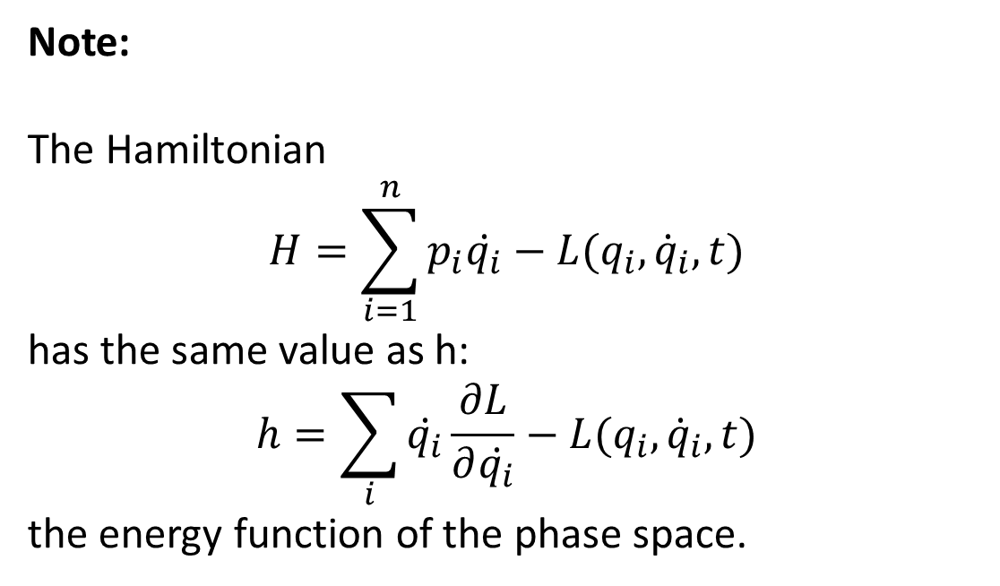
Note:
The Hamiltonian
$$H=\sum_{i=1}^{n}{p_{i}\dot{q_{i}}−L(q_{i},{\dot{q}}_{i},t)}$$
has the same value as h:
$$h=\sum_{i}{\dot{q_{i}}\frac{∂L}{∂\dot{q_{i}}}−L(q_{i},{\dot{q}}_{i},t)}$$
the energy function of the phase space.

