Slide 1
Revision
Previous lectures were about
Transformation of coordinates

Slide 2
Example:
Find the equations of motion for a particle of mass m in
Plane polar coordinate
Cylindrical polar coordinates
Spherical polar coordinates

Slide 10
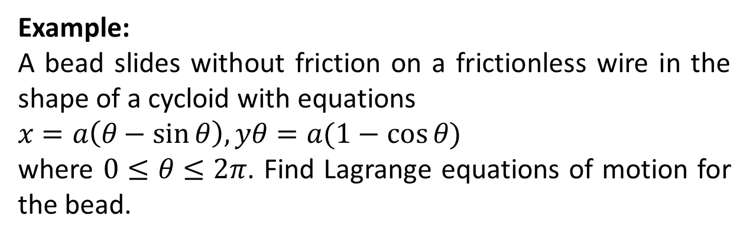
Example:
A bead slides without friction on a frictionless wire in the shape of a cycloid with equations
$x=a\left(θ−\sin{θ}\right), yθ=a(1−\cos{θ})$
where $0≤θ≤2π$. Find Lagrange equations of motion for the bead.

Slide 12
Example:
A bead of mass m is constraint to move on a frictionless wire AB fixed at point A on a vertical axis OA such that AB rotates about OA with constant angular velocity w. Find the equation of motion for the bead.

Slide 14
Example:
Two equal masses are connected by spring having equal spring constant k, so that the masses are free to slide on a frictionless table AB. The walls at A and B to which the ends of the spring are attached are fixed. Find equations of motion for the springs.

Slide 17
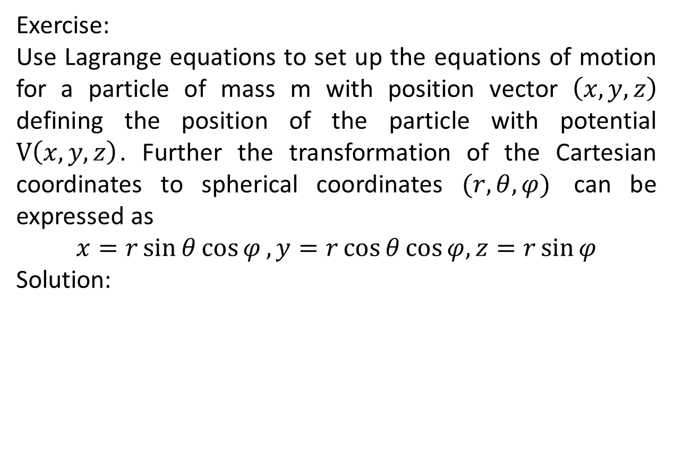
Exercise:
Use Lagrange equations to set up the equations of motion for a particle of mass m with position vector $\left(x,y,z\right)$ defining the position of the particle with potential $V\left(x,y,z\right)$. Further the transformation of the Cartesian coordinates to spherical coordinates $(r,θ,φ)$ can be expressed as
$$x=r\sin{θ\cos{φ},}y=r\cos{θ}\cos{φ}{,}z=r\sin{φ}$$
Solution:

Slide 20
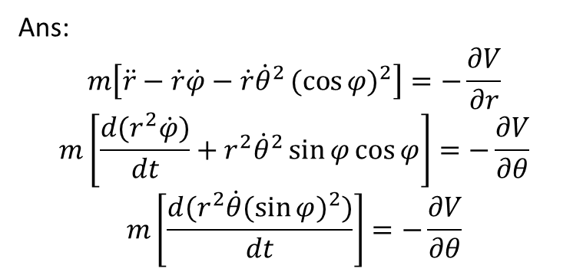
Ans:
$$m\left[\ddot{r}−\dot{r}\dot{φ}−\dot{r}{\dot{θ}}^{2}{(cos{φ)}}^{2}\right]=−\frac{∂V}{∂r}$$
$$m\left[\frac{d(r^{2}\dot{φ})}{dt}+r^{2}{\dot{θ}}^{2}\sin{φ}\cos{φ}\right]=−\frac{∂V}{∂θ}$$
$$m\left[\frac{d(r^{2}\dot{θ}{(\sin{φ})}^{2})}{dt}\right]=−\frac{∂V}{∂θ}$$

Slide 21
The End

