Slide 1
Revision
Previous lecture consists of:
Plane Polar Coordinates

Slide 2
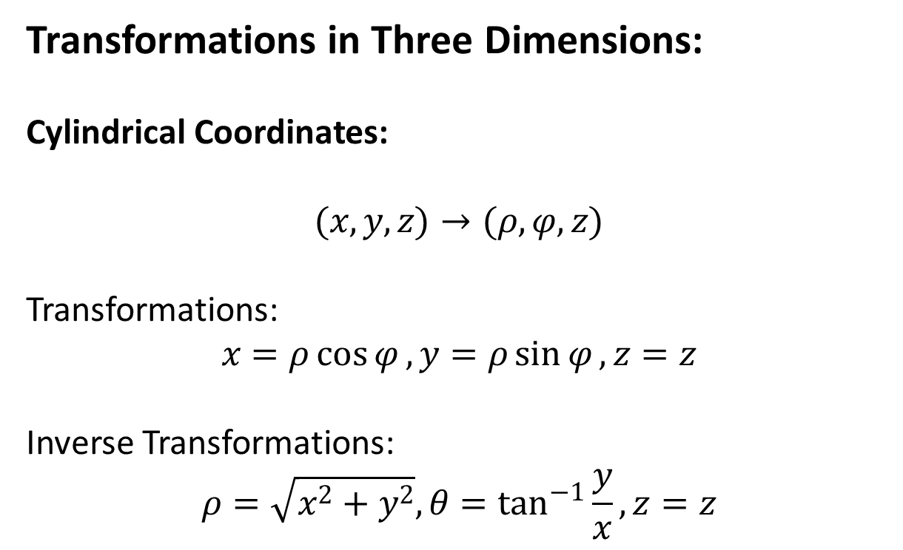
Transformations in Three Dimensions:
Cylindrical Coordinates:
$$(x,y,z)→(ρ,φ,z)$$
Transformations:
$$x=ρ\cos{φ}, y=ρ\sin{φ}, z=z$$
Inverse Transformations:
$$ρ=\sqrt{x^{2}+y^{2}}, θ=\tan^{−1}{\frac{y}{x}}, z=z$$

Slide 4
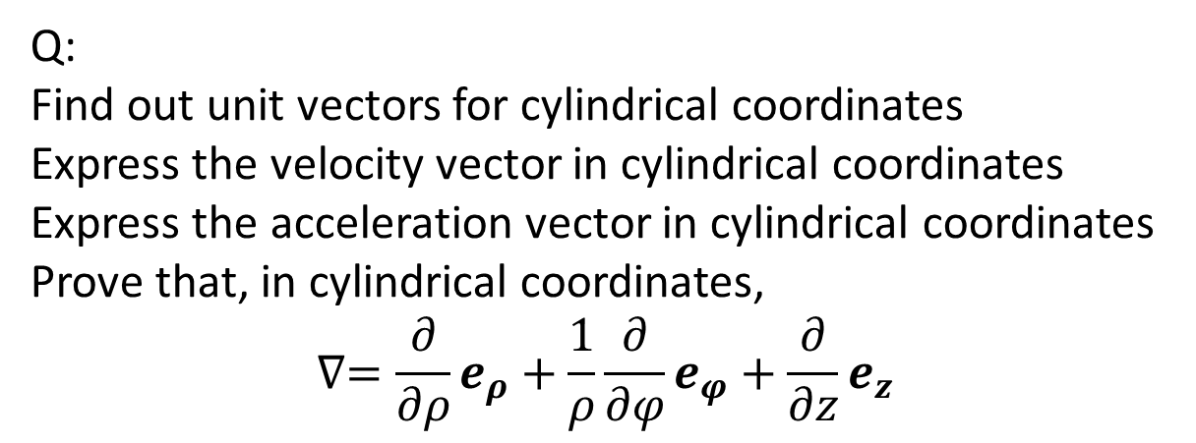
Q:
Find out unit vectors for cylindrical coordinates
Express the velocity vector in cylindrical coordinates
Express the acceleration vector in cylindrical coordinates
Prove that, in cylindrical coordinates,
$$∇=\frac{∂}{∂ρ}e_{ρ}+\frac{1}{ρ}\frac{∂}{∂φ}e_{φ}+\frac{∂}{∂z}e_{z}$$

Slide 6
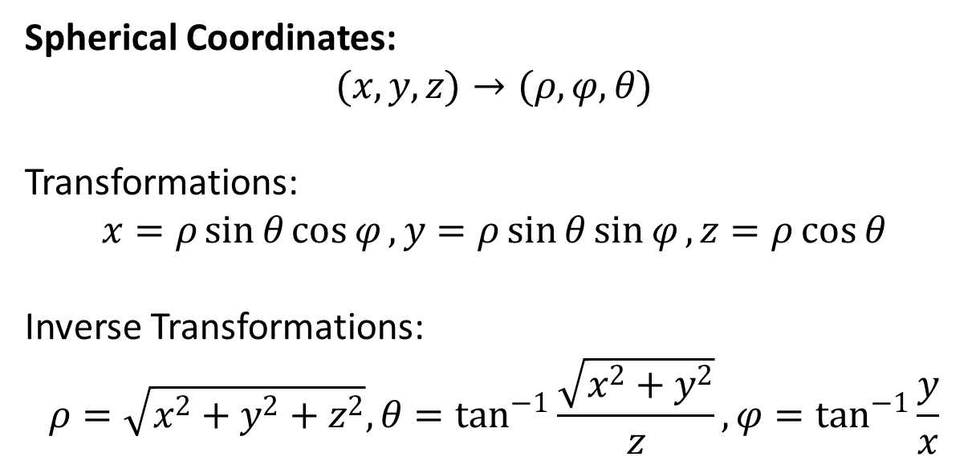
Spherical Coordinates:
$$(x,y,z)→(ρ,φ,θ)$$
Transformations:
$$x=ρ\sin{θ}\cos{φ}, y=ρ\sin{θ}\sin{φ}, z=ρ\cos{θ}$$
Inverse Transformations:
$$ρ=\sqrt{x^{2}+y^{2}+z^{2}}, θ=\tan^{−1}{\frac{\sqrt{x^{2}+y^{2}}}{z}},φ=\tan^{−1}{\frac{y}{x}}$$

Slide 8
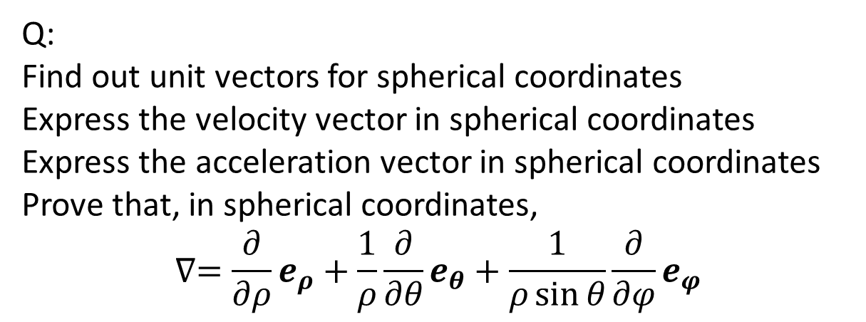
Q:
Find out unit vectors for spherical coordinates
Express the velocity vector in spherical coordinates
Express the acceleration vector in spherical coordinates
Prove that, in spherical coordinates,
$$∇=\frac{∂}{∂ρ}e_{ρ}+\frac{1}{ρ}\frac{∂}{∂θ}e_{θ}+\frac{1}{ρ\sin{θ}}\frac{∂}{∂φ}e_{φ}$$

Slide 10
Q: A particle of mass m moving in a conservative force field. Set up Lagrangian and find the equations of motion in
Plane polar coordinates
Cylindrical coordinates
Spherical polar coordinates

Slide 12
The End

