Slide 1
Revision
Previous lecture consists of:
Lagrange Equations

Slide 2
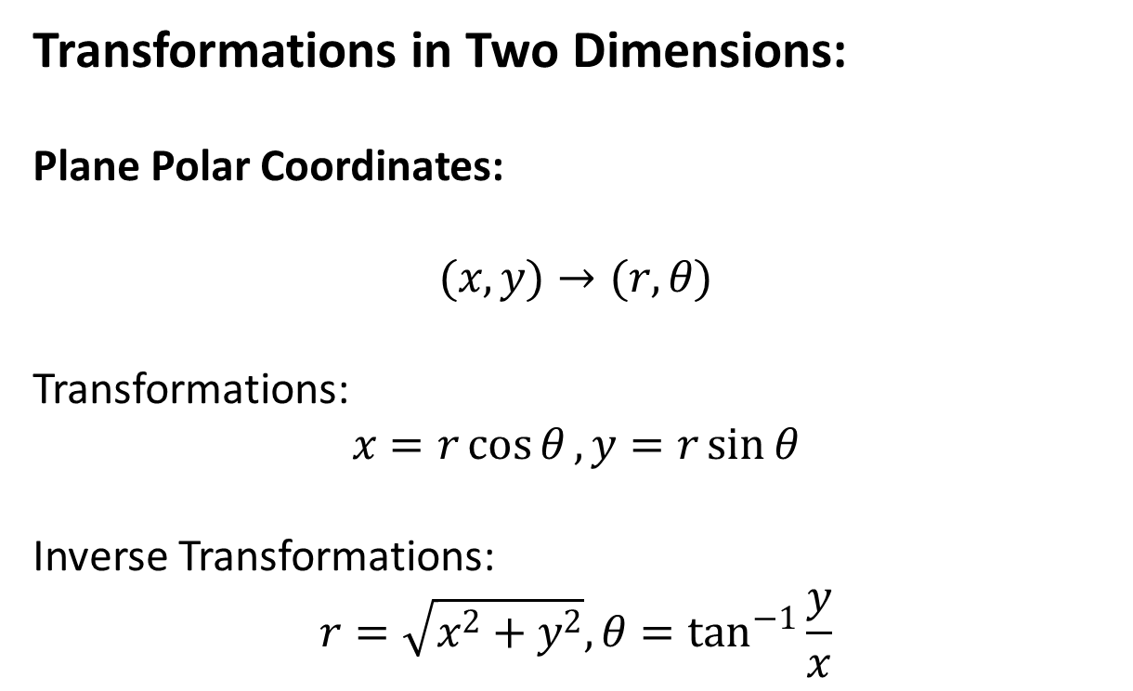
Coordinate Transformations
Transformations in Two Dimensions:
Plane Polar Coordinates:
$$(x,y)→(r,θ)$$
Transformations:
$$x=r\cos{θ}, y=r\sin{θ}$$
Inverse Transformations:
$$r=\sqrt{x^{2}+y^{2}}, θ=\tan^{−1}{\frac{y}{x}}$$

Slide 4
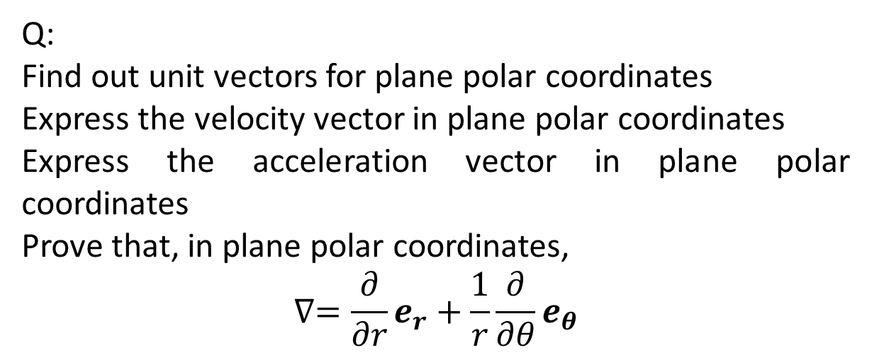
Q:
Find out unit vectors for plane polar coordinates
Express the velocity vector in plane polar coordinates
Express the acceleration vector in plane polar coordinates
Prove that, in plane polar coordinates,
$$∇=\frac{∂}{∂r}e_{r}+\frac{1}{r}\frac{∂}{∂θ}e_{θ}$$

Slide 6
The End

