Slide 1
Revision
In previous lecture we have discussed
Lagrange Equations for Non-Holonomic Systems
Lagrange Equations for Non-Conservative Systems
Lagrange Equations with Impulsive Forces

Slide 2
Some Exercises
Determine the degrees of freedom in each of the following cases.
Problem | Degrees of freedom
A particle moving on a plane curve | 1
Two particles moving on a space curve and having a constant distance between them | 1
Three particles moving in space with constant distance between any two | 6

Slide 3
Classify each of the following according as they are:
scleronomic or rheonomic
holonomic or non-holonomic
conservative or non-conservative
A sphere rolling down from the top of a fixed sphere:
Scleronomic (constraint does not involve time)
Non-holonomic (rolling sphere leaves the fixed sphere at some point)
Conservative (gravitational force acting is derivable from a potential)

Slide 4
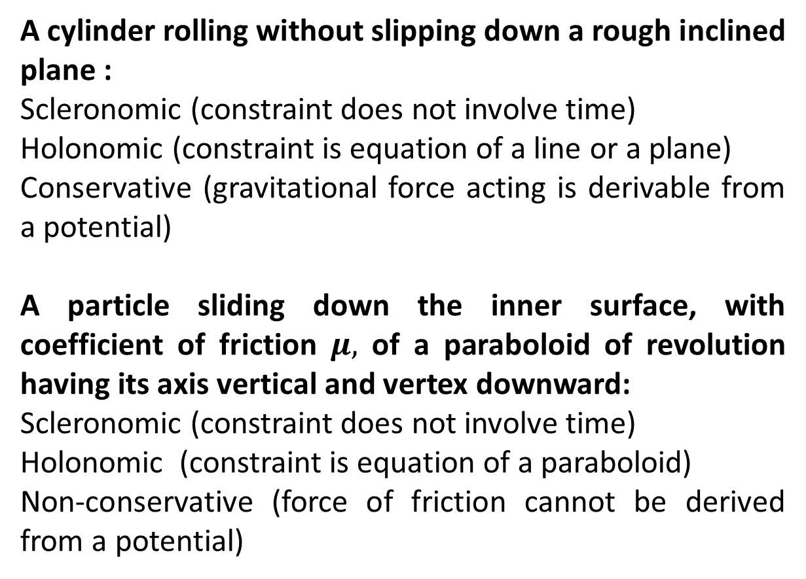
A cylinder rolling without slipping down a rough inclined plane :
Scleronomic (constraint does not involve time)
Holonomic (constraint is equation of a line or a plane)
Conservative (gravitational force acting is derivable from a potential)
A particle sliding down the inner surface, with coefficient of friction $μ,$ of a paraboloid of revolution having its axis vertical and vertex downward:
Scleronomic (constraint does not involve time)
Holonomic (constraint is equation of a paraboloid)
Non-conservative (force of friction cannot be derived from a potential)

Slide 5
A particle moving on a very long frictionless wire which rotates with constant angular speed about a horizontal axis:
Rheonomic (constraint involves time)
Holonomic (constraint is the equation of rotating wire)
Conservative (gravitational force acting is derivable from a potential)
A horizontal cylinder of radius a rolling inside a perfectly rough hollow cylinder of radius b>a:
Scleronomic (constraint does not involve time)
Holonomic (constraint is equation of a hollow cylinder)
Conservative (gravitational force acting is derivable from a potential)

Slide 6
A cylinder rolling (a possibly sliding) down an inclined plane of angle a:
Scleronomic (constraint does not involve time)
Non-holonomic (cylinder leaves the inclined plane at some point)
Conservative (gravitational force acting is derivable from a potential)
A sphere rolling down another sphere which is rolling with a uniform speed along a horizontal plane:
Rheonomic (constraint involves time)
Non-holonomic (sphere leaves the other sphere at some point)
Conservative (gravitational force acting is derivable from a potential)

Slide 7
A particle constrained to move along a line under the influence of a force which is inversely proportional to the square of its distance from a fixed point and a damping force proportional to the square of the instantaneous speed:
Scleronomic (constraint does not involve time)
Holonomic (constraint is equation of a line)
Non-conservative (acting forces cannot be derived from a potential)

Slide 8
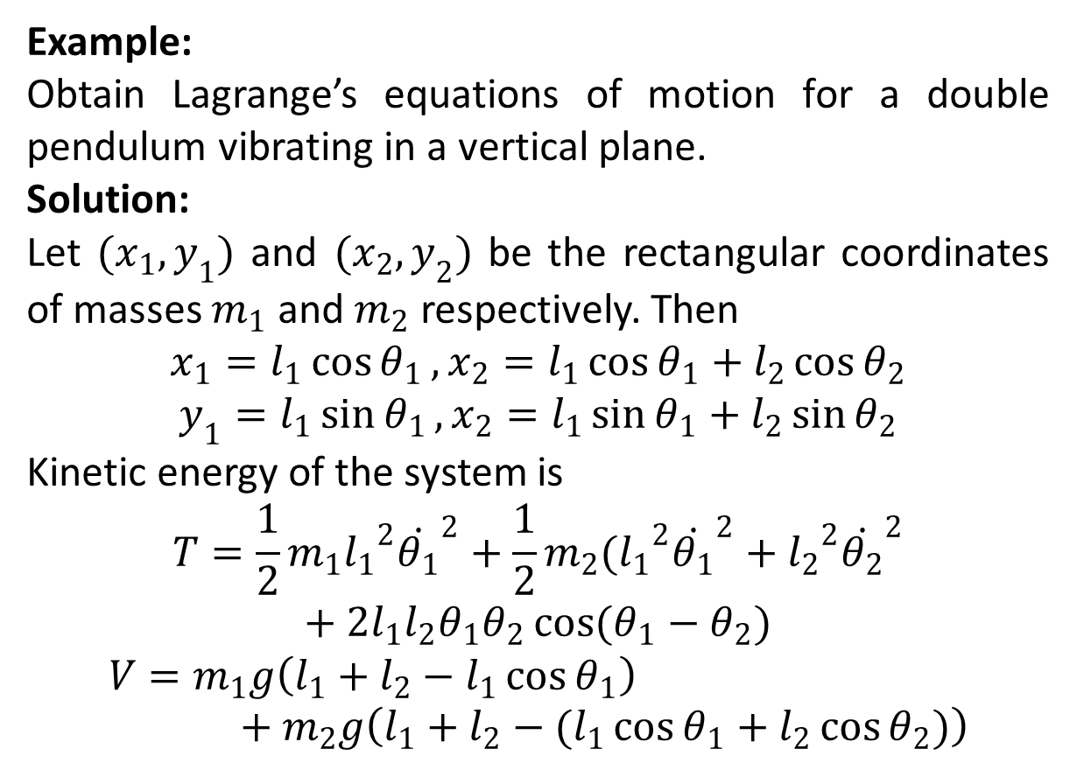
Example:
Obtain Lagrange’s equations of motion for a double pendulum vibrating in a vertical plane.
Solution:
Let $(x_{1},y_{1})$ and $(x_{2},y_{2})$ be the rectangular coordinates of masses $m_{1}$ and $m_{2}$ respectively. Then
$$x_{1}=l_{1}\cos{θ_{1}}, x_{2}=l_{1}\cos{θ_{1}}+l_{2}\cos{θ_{2}}$$
$$y_{1}=l_{1}\sin{θ_{1}}, x_{2}=l_{1}\sin{θ_{1}}+l_{2}\sin{θ_{2}}$$
Kinetic energy of the system is
$$T=\frac{1}{2}m_{1}{l_{1}}^{2}{\dot{θ_{1}}}^{2}+\frac{1}{2}m_{2}({l_{1}}^{2}{\dot{θ_{1}}}^{2}+{l_{2}}^{2}{\dot{θ_{2}}}^{2}+2l_{1}l_{2}θ_{1}θ_{2}\cos{(θ_{1}−θ_{2})}$$
$$V=m_{1}g\left(l_{1}+l_{2}−l_{1}\cos{θ_{1}}\right)+m_{2}g\left(l_{1}+l_{2}−(l_{1}\cos{θ_{1}+l_{2}\cos{θ_{2}})}\right)$$

Slide 11
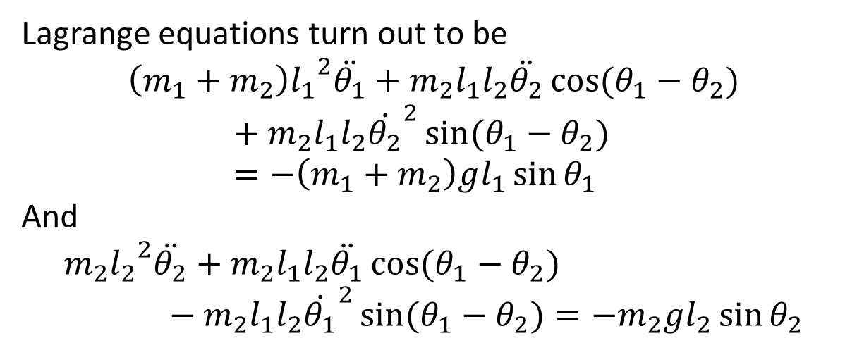
Lagrange equations turn out to be
$$\left(m_{1}+m_{2}\right){l_{1}}^{2}\ddot{θ_{1}}+m_{2}l_{1}l_{2}\ddot{θ_{2}}\cos{(θ_{1}−θ_{2})}+m_{2}l_{1}l_{2}{\dot{θ_{2}}}^{2}\sin{(θ_{1}−θ_{2})}=−\left(m_{1}+m_{2}\right)gl_{1}\sin{θ_{1}}$$
And
$${{m_{2}l}_{2}}^{2}\ddot{θ_{2}}+m_{2}l_{1}l_{2}\ddot{θ_{1}}\cos{(θ_{1}−θ_{2})}−m_{2}l_{1}l_{2}{\dot{θ_{1}}}^{2}\sin{(θ_{1}−θ_{2})}=−m_{2}gl_{2}\sin{θ_{2}}$$

Slide 12
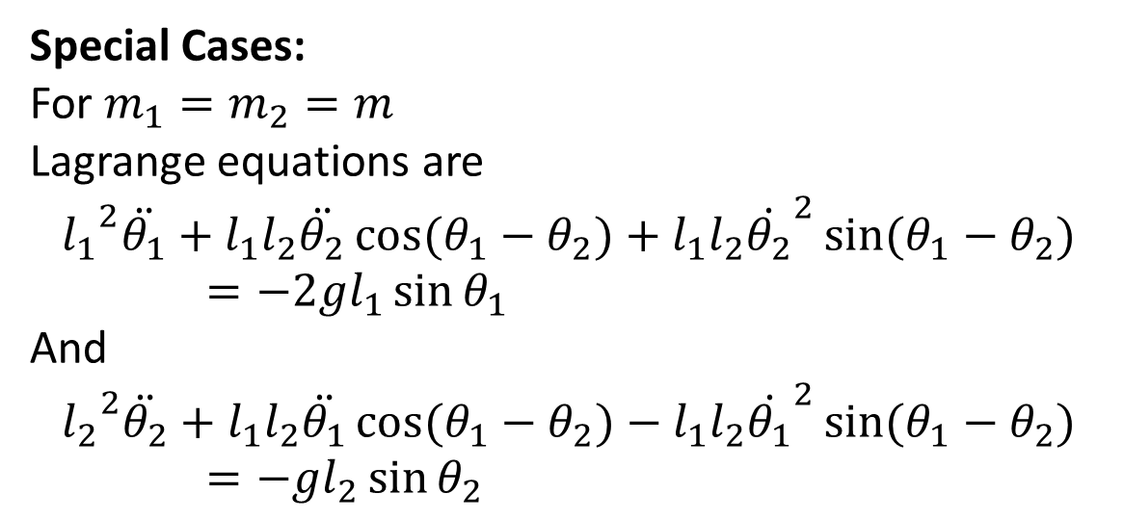
Special Cases:
For $m_{1}=m_{2}=m$
Lagrange equations are
$${l_{1}}^{2}\ddot{θ_{1}}+l_{1}l_{2}\ddot{θ_{2}}\cos{(θ_{1}−θ_{2})}+l_{1}l_{2}{\dot{θ_{2}}}^{2}\sin{(θ_{1}−θ_{2})}=−2gl_{1}\sin{θ_{1}}$$
And
$${l_{2}}^{2}\ddot{θ_{2}}+l_{1}l_{2}\ddot{θ_{1}}\cos{(θ_{1}−θ_{2})}−l_{1}l_{2}{\dot{θ_{1}}}^{2}\sin{(θ_{1}−θ_{2})}=−gl_{2}\sin{θ_{2}}$$

Slide 13
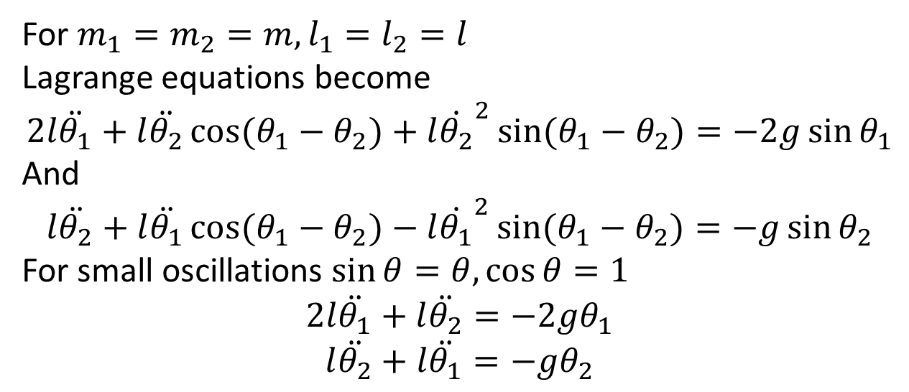
For $m_{1}=m_{2}=m,l_{1}=l_{2}=l$
Lagrange equations become
$$2l\ddot{θ_{1}}+l\ddot{θ_{2}}\cos{(θ_{1}−θ_{2})}+l{\dot{θ_{2}}}^{2}\sin{(θ_{1}−θ_{2})}=−2g\sin{θ_{1}}$$
And
$$l\ddot{θ_{2}}+l\ddot{θ_{1}}\cos{(θ_{1}−θ_{2})}−l{\dot{θ_{1}}}^{2}\sin{(θ_{1}−θ_{2})}=−g\sin{θ_{2}}$$
For small oscillations $\sin{θ}=θ,\cos{θ}=1$
$$2l\ddot{θ_{1}}+l\ddot{θ_{2}}=−2gθ_{1}$$
$$l\ddot{θ_{2}}+l\ddot{θ_{1}}=−gθ_{2}$$

Slide 14
Exercises:
Set up a Lagrangian and find the equations of motion for a triple pendulum vibrating in a vertical plane. Specify the problem by taking equal masses and equal length of massless string.

Slide 15
The End

