Slide 1
Summary
In previous lecture we have discussed
Dynamical Systems
Generalized Coordinates
Degrees of Freedom
Classification of Dynamical System
Constraints
Classification of Constraints

Slide 2
Virtual Displacement:
The displacement of a particle P proportional to its possible velocity at a point is called its virtual displacement at the point. Thus, a virtual displacement has a direction of the possible velocity but an arbitrary magnitude.

Slide 3
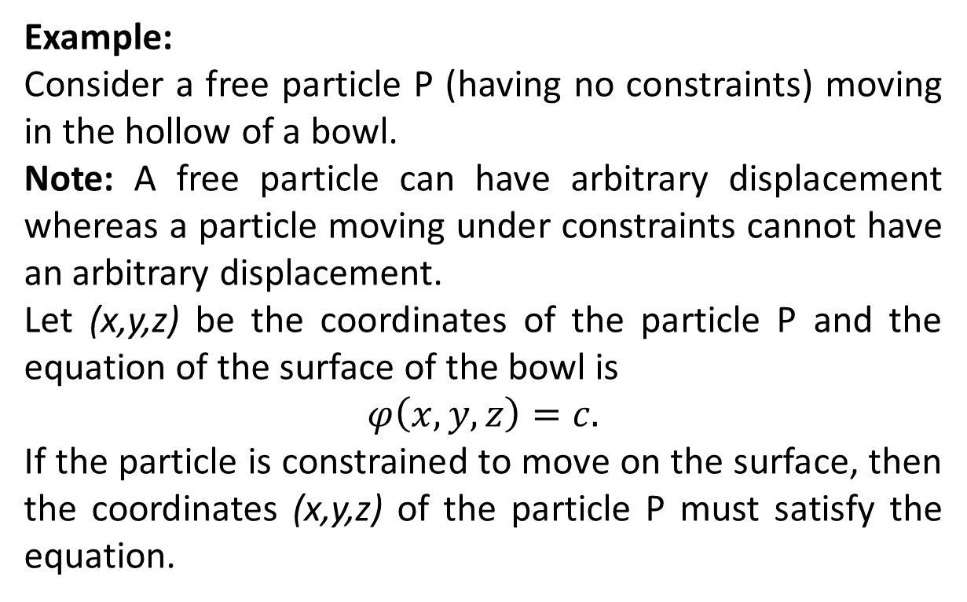
Example:
Consider a free particle P (having no constraints) moving in the hollow of a bowl.
Note: A free particle can have arbitrary displacement whereas a particle moving under constraints cannot have an arbitrary displacement.
Let (x,y,z) be the coordinates of the particle P and the equation of the surface of the bowl is
$$φ\left(x,y,z\right)=c.$$
If the particle is constrained to move on the surface, then the coordinates (x,y,z) of the particle P must satisfy the equation.

Slide 4
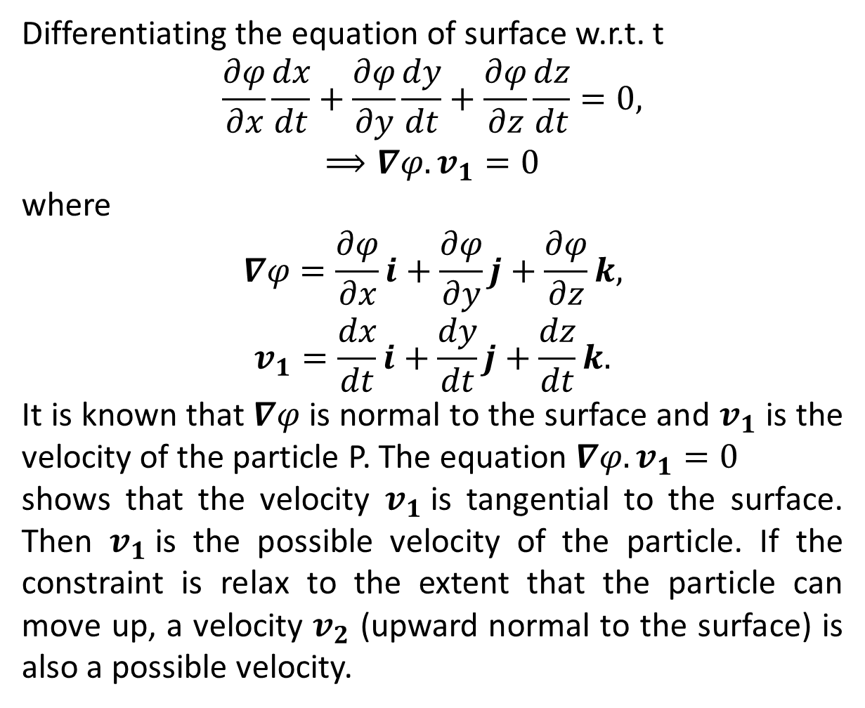
Differentiating the equation of surface w.r.t. t
$$\frac{∂φ}{∂x}\frac{dx}{dt}+\frac{∂φ}{∂y}\frac{dy}{dt}+\frac{∂φ}{∂z}\frac{dz}{dt}=0,$$
$$⟹∇φ.v_{1}=0$$
where
$$∇φ=\frac{∂φ}{∂x}i+\frac{∂φ}{∂y}j+\frac{∂φ}{∂z}k,$$
$$v_{1}=\frac{dx}{dt}i+\frac{dy}{dt}j+\frac{dz}{dt}k.$$
It is known that $∇φ$ is normal to the surface and $v_{1}$ is the velocity of the particle P. The equation $∇φ.v_{1}=0$
shows that the velocity $v_{1}$is tangential to the surface. Then $v_{1}$is the possible velocity of the particle. If the constraint is relax to the extent that the particle can move up, a velocity $v_{2}$ (upward normal to the surface) is also a possible velocity.

Slide 5
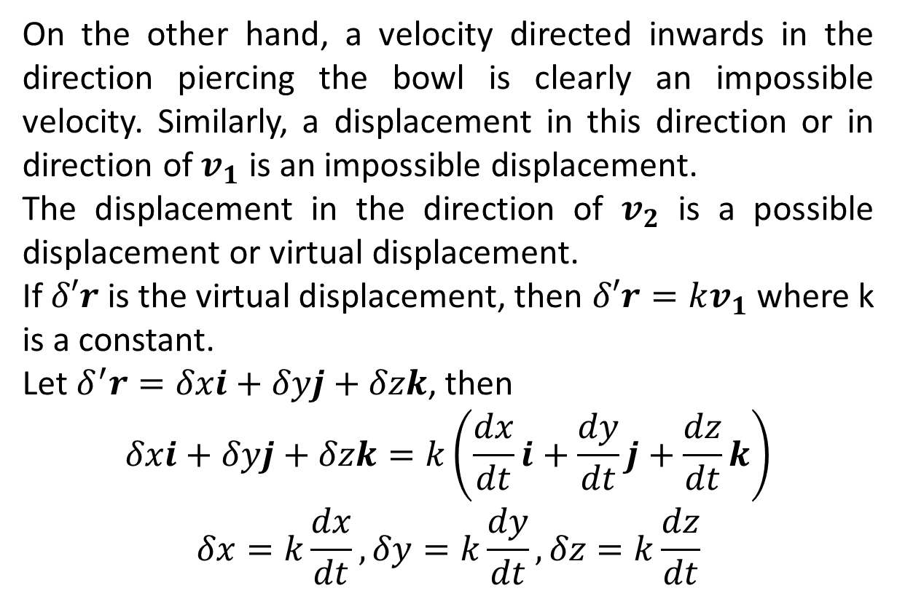
On the other hand, a velocity directed inwards in the direction piercing the bowl is clearly an impossible velocity. Similarly, a displacement in this direction or in direction of $v_{1}$ is an impossible displacement.
The displacement in the direction of $v_{2}$ is a possible displacement or virtual displacement.
If $δ′r$ is the virtual displacement, then $δ′r=kv_{1}$ where k is a constant.
Let $δ^{′}r=δxi+δyj+δzk$, then
$$δxi+δyj+δzk=k\left(\frac{dx}{dt}i+\frac{dy}{dt}j+\frac{dz}{dt}k\right)$$
$$δx=k\frac{dx}{dt},δy=k\frac{dy}{dt},δz=k\frac{dz}{dt}$$

Slide 6
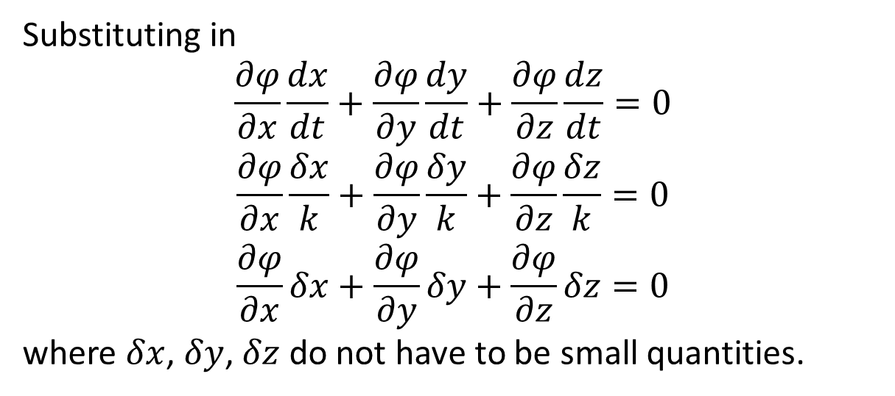
Substituting in
$$\frac{∂φ}{∂x}\frac{dx}{dt}+\frac{∂φ}{∂y}\frac{dy}{dt}+\frac{∂φ}{∂z}\frac{dz}{dt}=0$$
$$\frac{∂φ}{∂x}\frac{δx}{k}+\frac{∂φ}{∂y}\frac{δy}{k}+\frac{∂φ}{∂z}\frac{δz}{k}=0$$
$$\frac{∂φ}{∂x}δx+\frac{∂φ}{∂y}δy+\frac{∂φ}{∂z}δz=0$$
where $δx$, $δy$, $δz$ do not have to be small quantities.

Slide 7
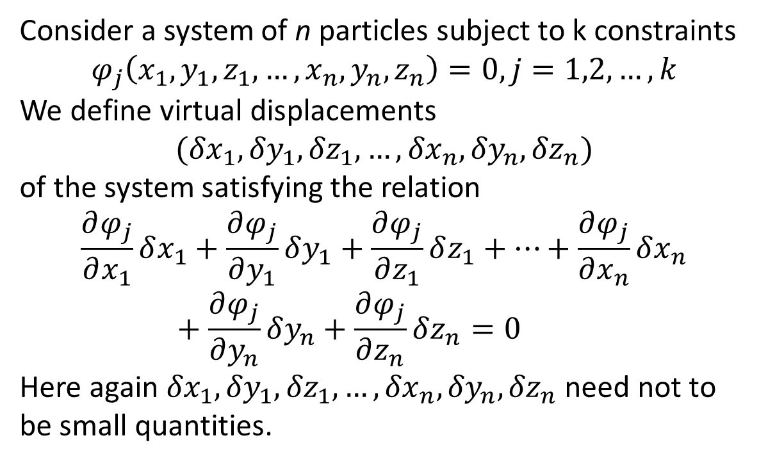
Consider a system of n particles subject to k constraints
$$φ_{j}\left(x_{1},{y_{1},z_{1},…,x}_{n},y_{n},z_{n}\right)=0, j=1,2,…,k$$
We define virtual displacements
$$({δx}_{1},{δy}_{1},{δz}_{1},…,{δx}_{n},{δy}_{n},{δz}_{n})$$
of the system satisfying the relation
$$\frac{∂φ_{j}}{∂x_{1}}δx_{1}+\frac{∂φ_{j}}{∂y_{1}}δy_{1}+\frac{∂φ_{j}}{∂z_{1}}δz_{1}+…+\frac{∂φ_{j}}{∂x_{n}}δx_{n}+\frac{∂φ_{j}}{∂y_{n}}δy_{n}+\frac{∂φ_{j}}{∂z_{n}}δz_{n}=0$$
Here again ${δx}_{1},{δy}_{1},{δz}_{1},…,{δx}_{n},{δy}_{n},{δz}_{n}$ need not to be small quantities.

Slide 8
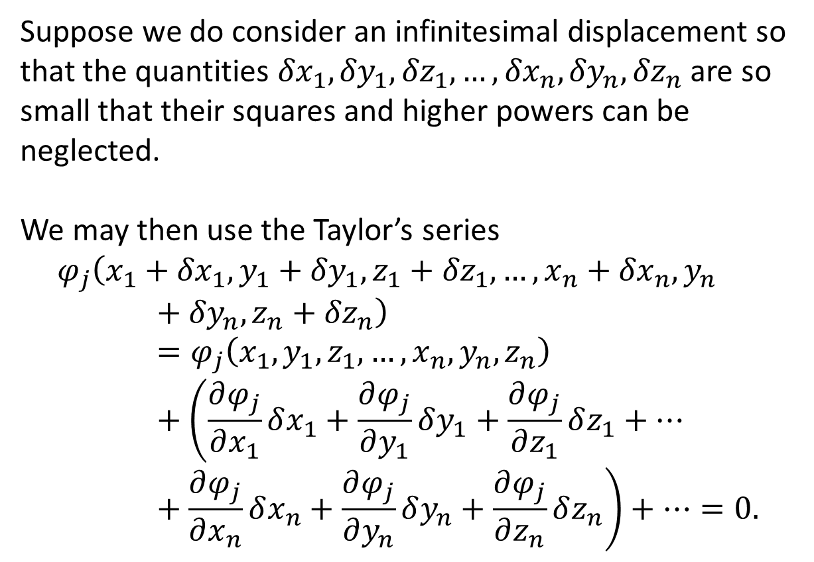
Suppose we do consider an infinitesimal displacement so that the quantities ${δx}_{1},{δy}_{1},{δz}_{1},…,{δx}_{n},{δy}_{n},{δz}_{n}$ are so small that their squares and higher powers can be neglected.
We may then use the Taylor’s series
$$φ_{j}\left(x_{1}+{δx}_{1},{y_{1}+{δy}_{1},z_{1}+{δz}_{1},…,x}_{n}+{δx}_{n},y_{n}+{δy}_{n},z_{n}+{δz}_{n}\right)=φ_{j}\left(x_{1},{y_{1},z_{1},…,x}_{n},y_{n},z_{n}\right)+\left(\frac{∂φ_{j}}{∂x_{1}}δx_{1}+\frac{∂φ_{j}}{∂y_{1}}δy_{1}+\frac{∂φ_{j}}{∂z_{1}}δz_{1}+…+\frac{∂φ_{j}}{∂x_{n}}δx_{n}+\frac{∂φ_{j}}{∂y_{n}}δy_{n}+\frac{∂φ_{j}}{∂z_{n}}δz_{n}\right)+…=0.$$

Slide 9
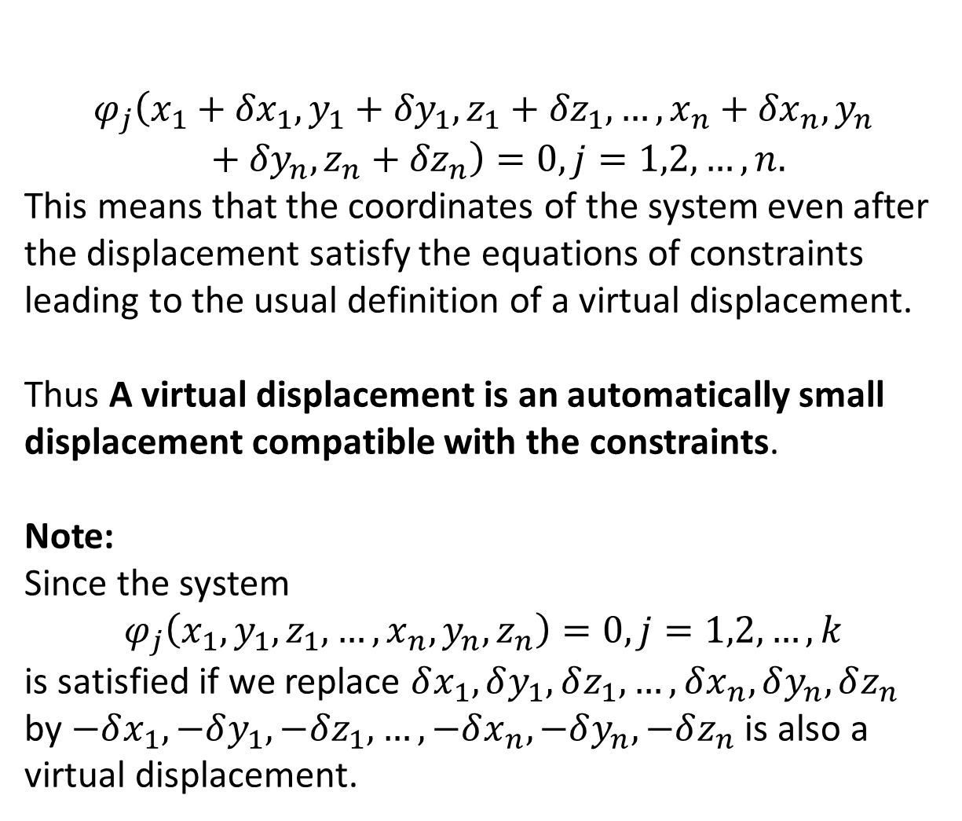
$$φ_{j}\left(x_{1}+{δx}_{1},{y_{1}+{δy}_{1},z_{1}+{δz}_{1},…,x}_{n}+{δx}_{n},y_{n}+{δy}_{n},z_{n}+{δz}_{n}\right)=0, j=1,2,…,n.$$
This means that the coordinates of the system even after the displacement satisfy the equations of constraints leading to the usual definition of a virtual displacement.
Thus A virtual displacement is an automatically small displacement compatible with the constraints.
Note:
Since the system
$$φ_{j}\left(x_{1},{y_{1},z_{1},…,x}_{n},y_{n},z_{n}\right)=0, j=1,2,…,k$$
is satisfied if we replace $δx_{1}, δy_{1}, δz_{1},…,δx_{n}, δy_{n}, δz_{n}$ by $−δx_{1}, −δy_{1}, −δz_{1},…,−δx_{n}, −δy_{n}, −δz_{n}$ is also a virtual displacement.

Slide 10
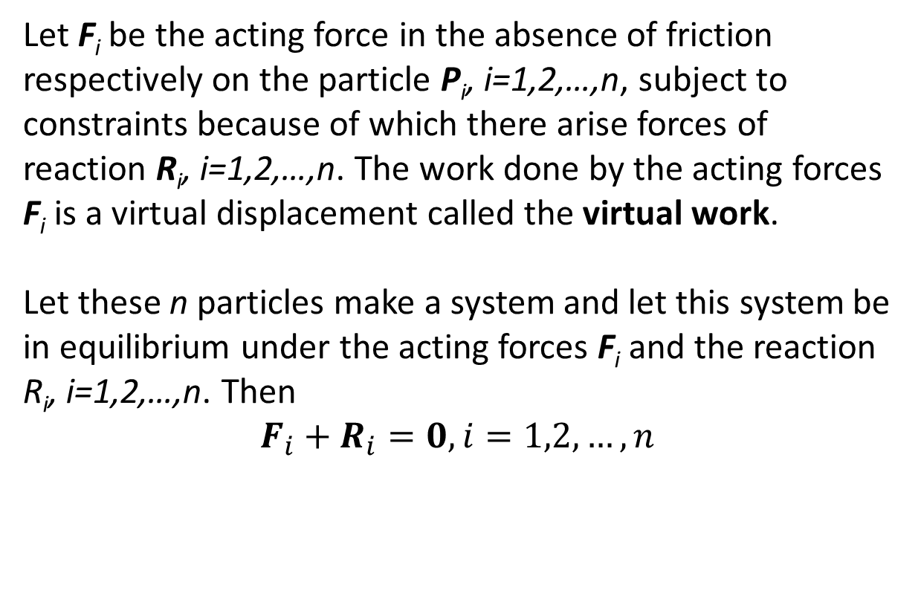
The Principle of Virtual Work

Slide 11
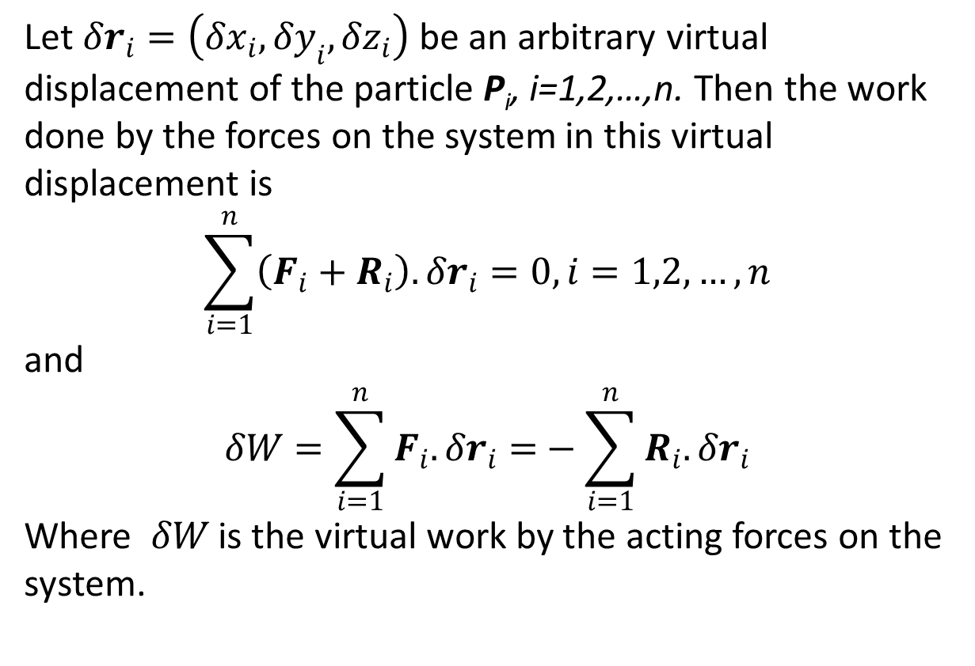
Let $δr_{i}=\left(δx_{i},δy_{i},δz_{i}\right)$ be an arbitrary virtual displacement of the particle P_{i}, i=1,2,…,n. Then the work done by the forces on the system in this virtual displacement is
$$\sum_{i=1}^{n}{\left(F_{i}+R_{i}\right).δr_{i}=0, i=1,2,…,n}$$
and
$$δW=\sum_{i=1}^{n}{F_{i}.δr_{i}=}−\sum_{i=1}^{n}{R_{i}.δr_{i}}$$
Where $δW$ is the virtual work by the acting forces on the system.

Slide 12
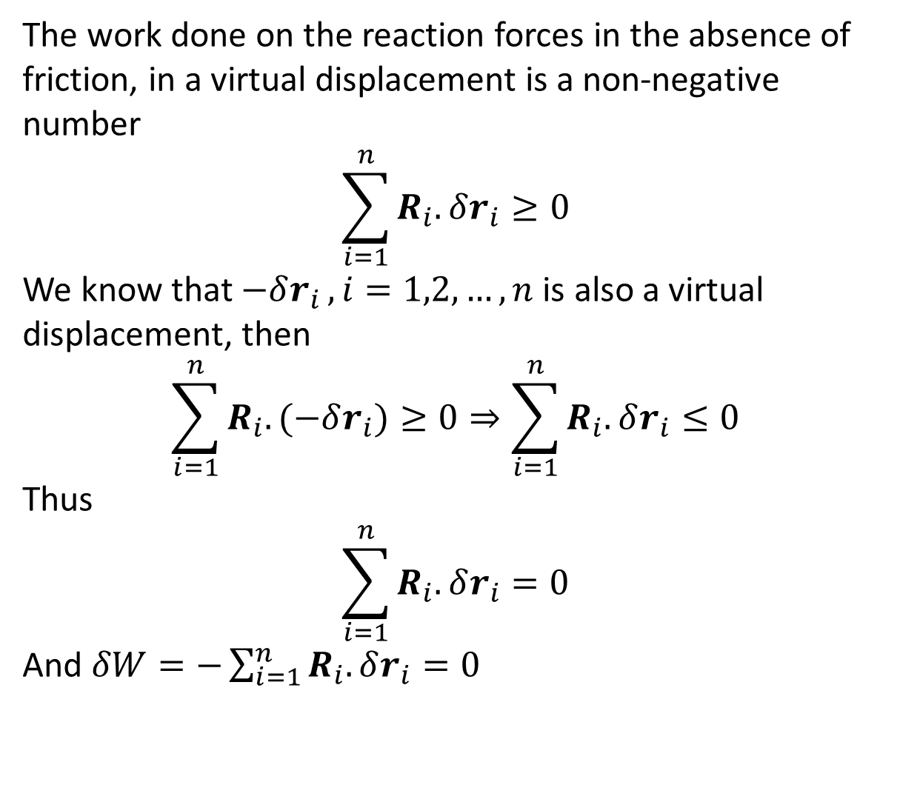
The work done on the reaction forces in the absence of friction, in a virtual displacement is a non-negative number
$$\sum_{i=1}^{n}{R_{i}.δr_{i}}≥0$$
We know that $−δr_{i }, i=1,2,…,n$ is also a virtual displacement, then
$$\sum_{i=1}^{n}{R_{i}.(−δr_{i})}≥0⇒\sum_{i=1}^{n}{R_{i}.δr_{i}}≤0$$
Thus
$$\sum_{i=1}^{n}{R_{i}.δr_{i}}=0$$
And $δW=−\sum_{i=1}^{n}{R_{i}.δr_{i}}=0$

