Slide 1
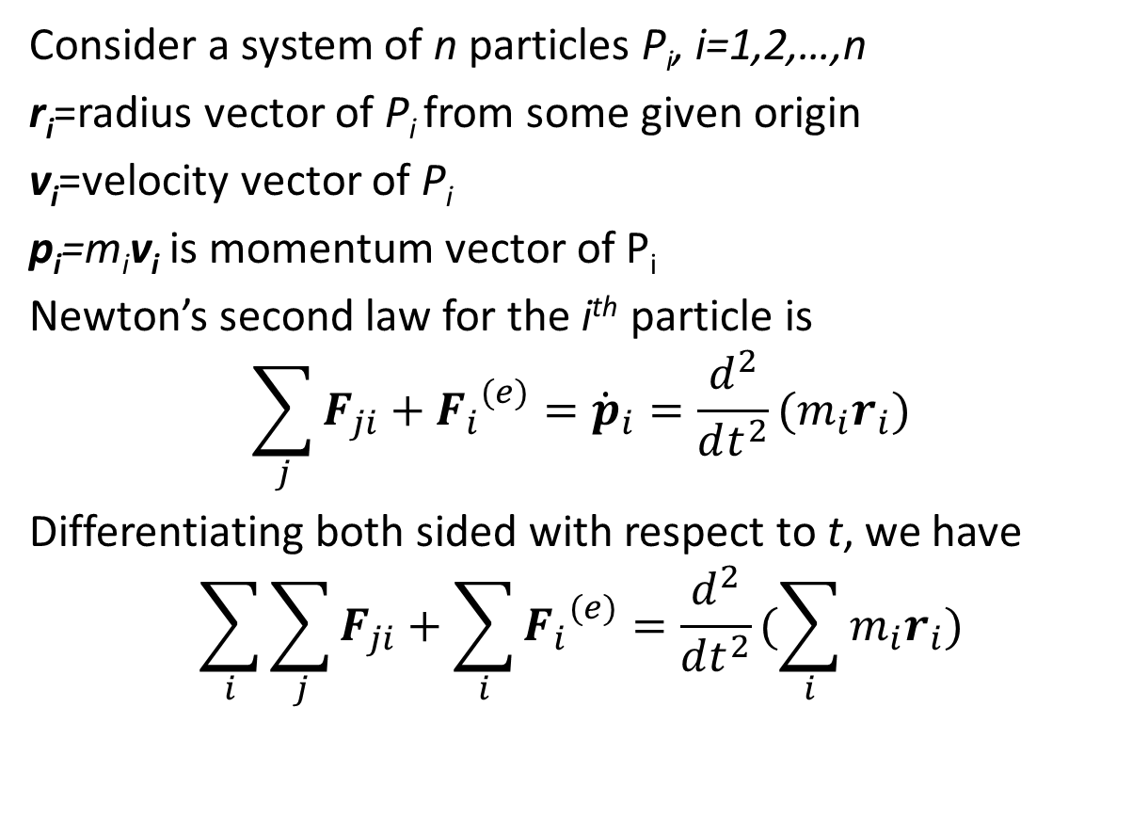
Mechanics of a System of Particles
Consider a system of n particles P_{i}, i=1,2,…,n
r_{i}=radius vector of P_{i} from some given origin
v_{i}=velocity vector of P_{i}
p_{i}=m_{i}v_{i}is momentum vector of P_{i}
Newton’s second law for the i^{th} particle is
$$\sum_{j}{F_{ji}}+{F_{i}}^{(e)}={\dot{p}}_{i}=\frac{d^{2}}{dt^{2}}(m_{i}r_{i})$$
Differentiating both sided with respect to t, we have
$$\sum_{i}{\sum_{j}{F_{ji}}}+\sum_{i}{{F_{i}}^{(e)}}=\frac{d^{2}}{dt^{2}}(\sum_{i}{m_{i}r_{i}})$$

Slide 2
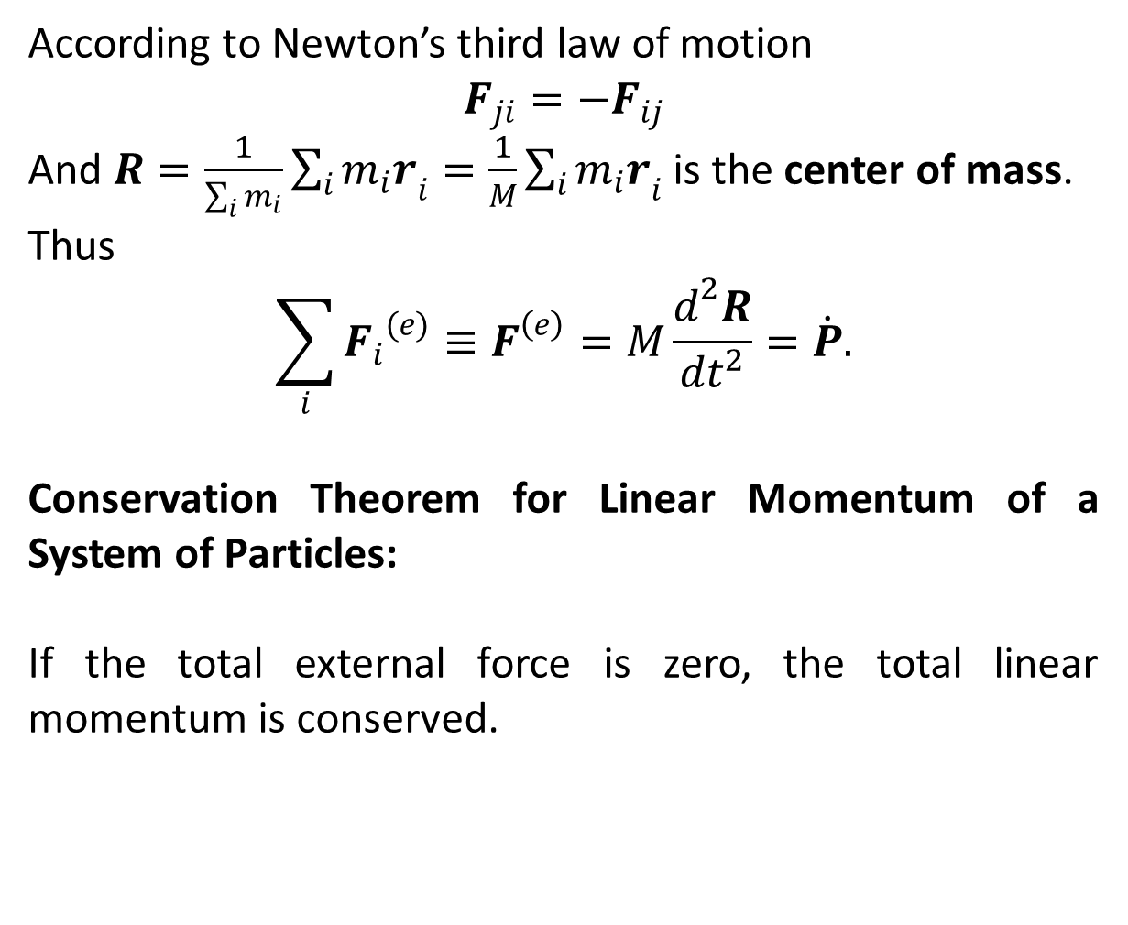
According to Newton’s third law of motion
$$F_{ji}={−F}_{ij}$$
And $R=\frac{1}{\sum_{i}{m_{i}}}\sum_{i}{{m_{i}r}_{i}}=\frac{1}{M}\sum_{i}{{m_{i}r}_{i}}$ is the center of mass.
Thus
$$\sum_{i}{{F_{i}}^{(e)}≡F^{\left(e\right)}=M\frac{d^{2}R}{dt^{2}}=\dot{P}.}$$
Conservation Theorem for Linear Momentum of a System of Particles:
If the total external force is zero, the total linear momentum is conserved.

Slide 3
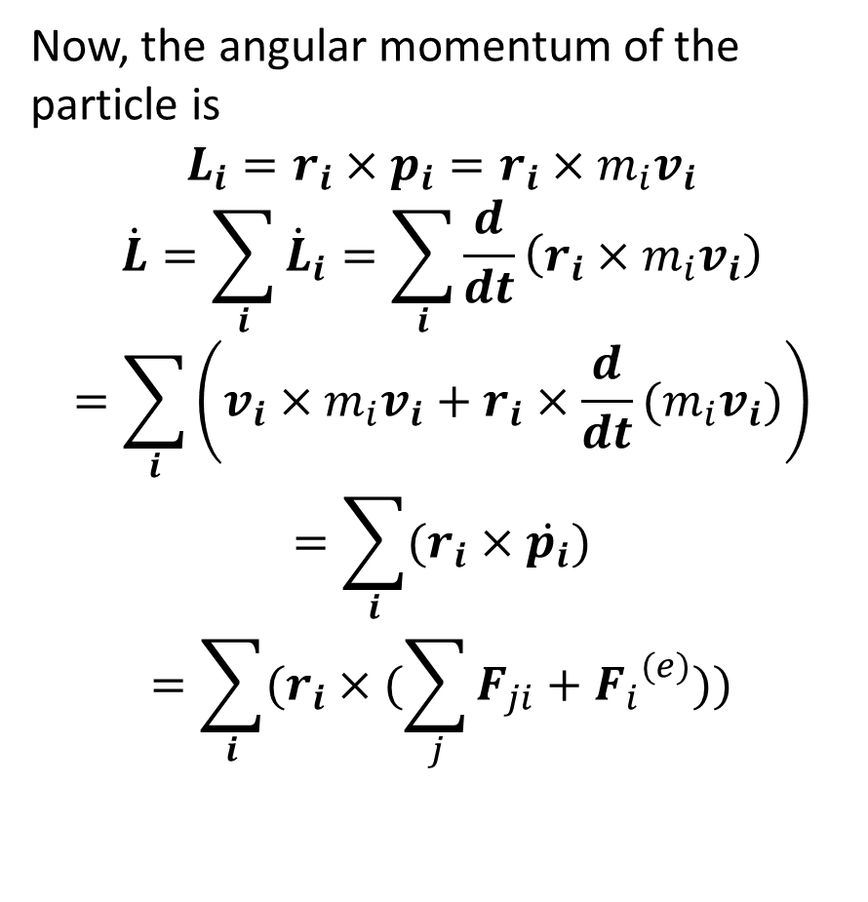
Now, the angular momentum of the particle is
$$L_{i}=r_{i}×p_{i}=r_{i}×m_{i}v_{i}$$
$$\dot{L}=\sum_{i}{{\dot{L}}_{i}}=\sum_{i}{\frac{d}{dt}\left(r_{i}×m_{i}v_{i}\right)}$$
$$=\sum_{i}{\left(v_{i}×m_{i}v_{i}+r_{i}×\frac{d}{dt}(m_{i}v_{i})\right)}$$
$$=\sum_{i}{(r_{i}×\dot{p_{i}})}$$
$$=\sum_{i}{(r_{i}×(\sum_{j}{F_{ji}}+{F_{i}}^{(e)}))}$$

Slide 4
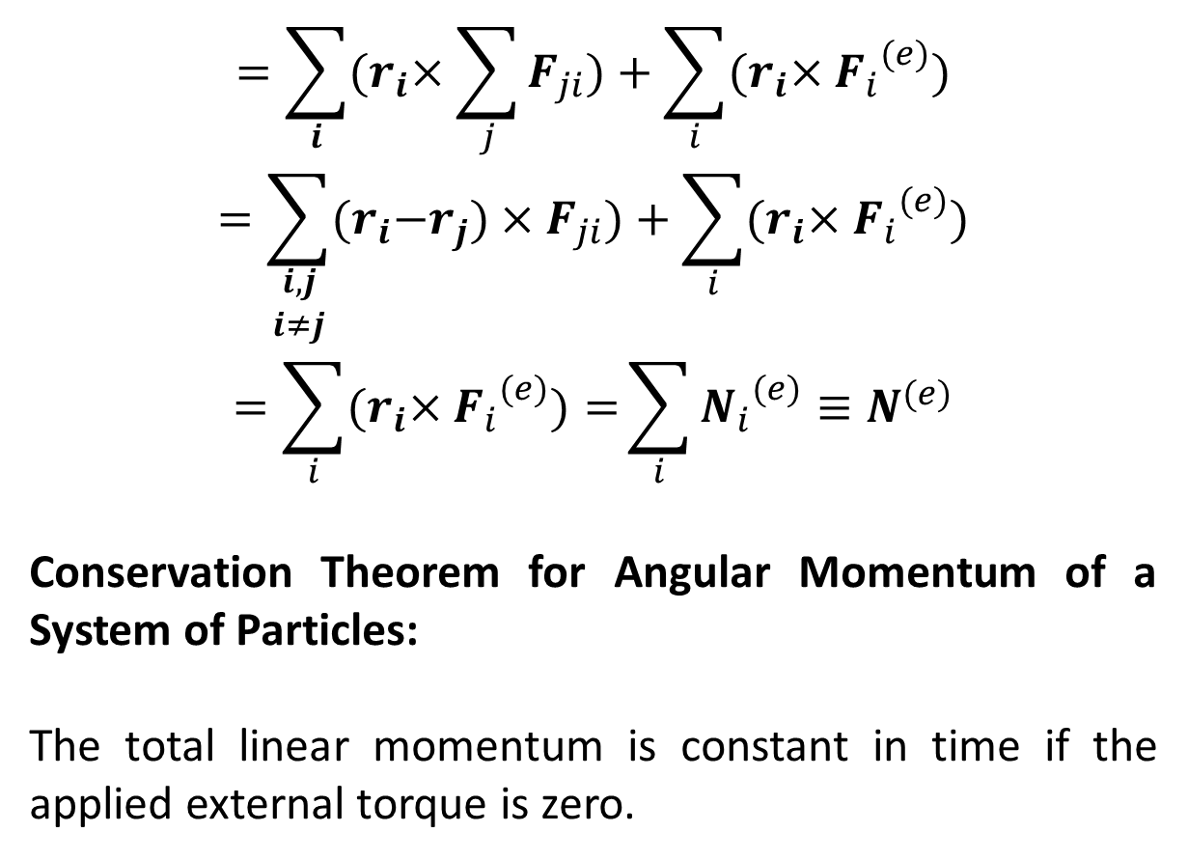
$$=\sum_{i}{{(r}_{i}×\sum_{j}{F_{ji}})+\sum_{i}{{(r}_{i}×{F_{i}}^{(e)})}}$$
$$=\sum_{\begin{aligned}i,j \\ i≠j\end{aligned}}{{(r}_{i}−r_{j})×F_{ji})+\sum_{i}{{(r}_{i}×{F_{i}}^{(e)})}}$$
$$=\sum_{i}{{(r}_{i}×{F_{i}}^{(e)})=}\sum_{i}{{N_{i}}^{(e)}≡N^{(e)}}$$
Conservation Theorem for Angular Momentum of a System of Particles:
The total linear momentum is constant in time if the applied external torque is zero.

Slide 5
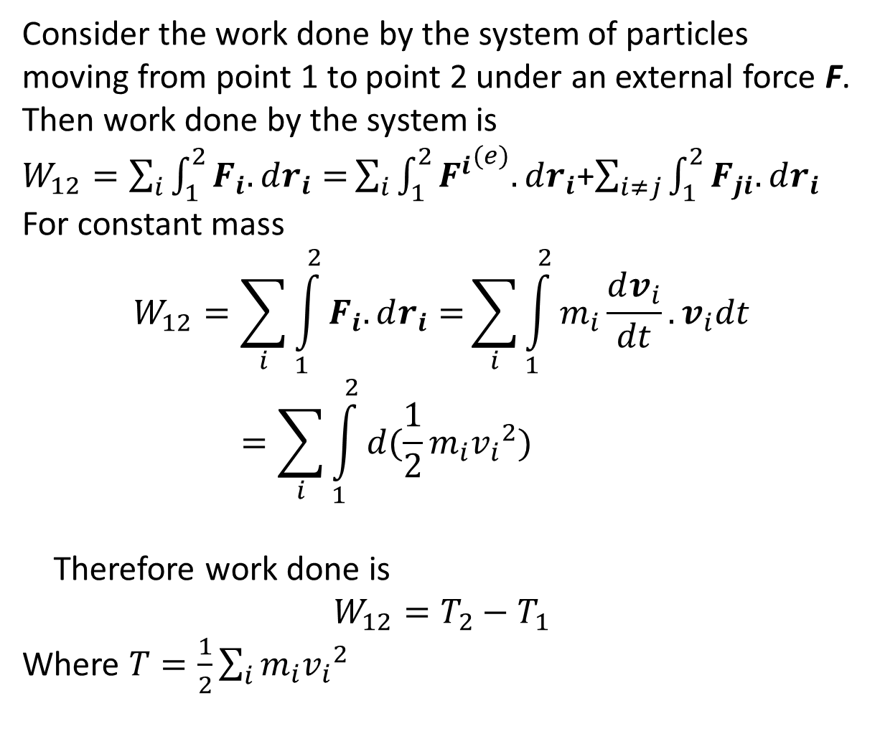
Consider the work done by the system of particles moving from point 1 to point 2 under an external force F. Then work done by the system is
$W_{12}=\sum_{i}{\int_{1}^{2}{F_{i}.dr_{i}}=}\sum_{i}{\int_{1}^{2}{{F^{i}}^{(e)}.dr_{i}}}$+$\sum_{i≠j}{\int_{1}^{2}{F_{ji}.dr_{i}}}$
For constant mass
$$W_{12}=\sum_{i}{\int_{1}^{2}{F_{i}.dr_{i}}=}\sum_{i}{\int_{1}^{2}{m_{i}\frac{dv_{i}}{dt}.v_{i}dt}}=\sum_{i}{\int_{1}^{2}{d(\frac{1}{2}m_{i}{v_{i}}^{2})}}$$
Therefore work done is
$$W_{12}=T_{2}−T_{1}$$
Where $T=\frac{1}{2}\sum_{i}{m_{i}{v_{i}}^{2}}$

Slide 6
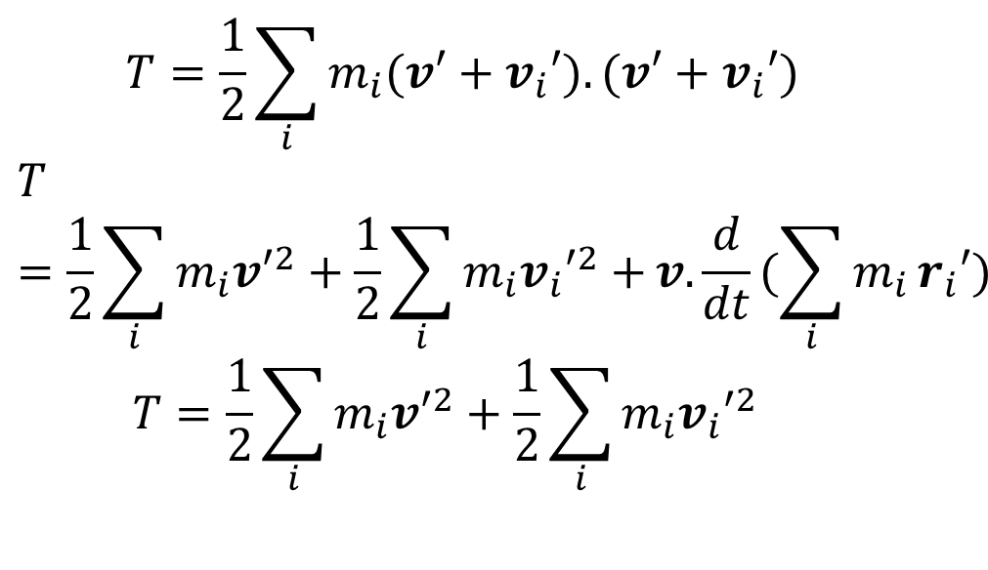
$$T=\frac{1}{2}\sum_{i}{m_{i}{(v′+v}_{i}′).{(v′+v}_{i}′)}$$
$$T=\frac{1}{2}\sum_{i}{m_{i}{v′}^{2}+{\frac{1}{2}\sum_{i}{m_{i}{v_{i}′}^{2}+}v.\frac{d}{dt}(\sum_{i}{m_{i}}r}_{i}′)}$$
$$T=\frac{1}{2}\sum_{i}{m_{i}{v′}^{2}+{\frac{1}{2}\sum_{i}{m_{i}{v_{i}′}^{2}}}_{}}$$

Slide 7
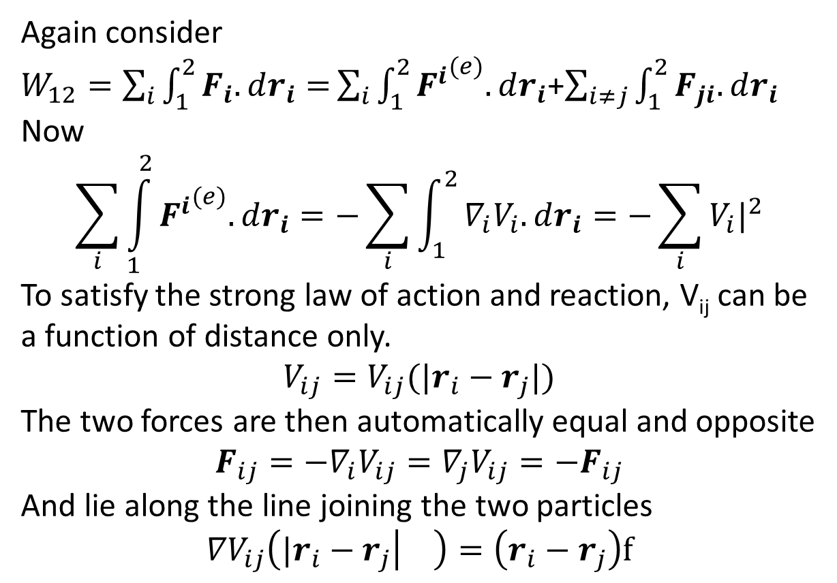
Again consider
$W_{12}=\sum_{i}{\int_{1}^{2}{F_{i}.dr_{i}}=}\sum_{i}{\int_{1}^{2}{{F^{i}}^{(e)}.dr_{i}}}$+$\sum_{i≠j}{\int_{1}^{2}{F_{ji}.dr_{i}}}$
Now
$$\sum_{i}{\int_{1}^{2}{{F^{i}}^{(e)}.dr_{i}}=−\sum_{i}{\int_{1}^{2}{∇_{i}V_{i}.dr_{i}=−\sum_{i}{V_{i}|_{}^{2}}}}}$$
To satisfy the strong law of action and reaction, V_{ij} can be a function of distance only.
$$V_{ij}=V_{ij}({|r}_{i}−r_{j}|)$$
The two forces are then automatically equal and opposite
$$F_{ij}=−∇_{i}V_{ij}=∇_{j}V_{ij}=−F_{ij}$$
And lie along the line joining the two particles
$${∇V}_{ij}\left({|r}_{i}−r_{j} | \right)=\left(r_{i}−r_{j}\right)f$$

Slide 8
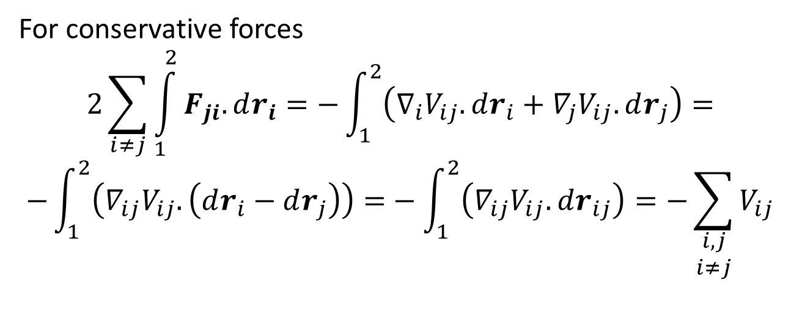
For conservative forces
$$2\sum_{i≠j}{\int_{1}^{2}{F_{ji}.dr_{i}}}=−\int_{1}^{2}{\left(∇_{i}V_{ij}.dr_{i}+∇_{j}V_{ij}.dr_{j}\right)=}$$
$$−\int_{1}^{2}{\left(∇_{ij}V_{ij}.\left(dr_{i}−dr_{j}\right)\right)=}−\int_{1}^{2}{\left(∇_{ij}V_{ij}.dr_{ij}\right)}=−\sum_{\begin{aligned}i,j \\ i≠j\end{aligned}}{V_{ij}}$$

