Slide 1
Revision
Previous lectures were about
Hamiltonian, Construction of Hamiltonian, Hamilton’s Equations, Some applications of Hamiltonian and Hamilton’s Equations of Motion

Slide 2
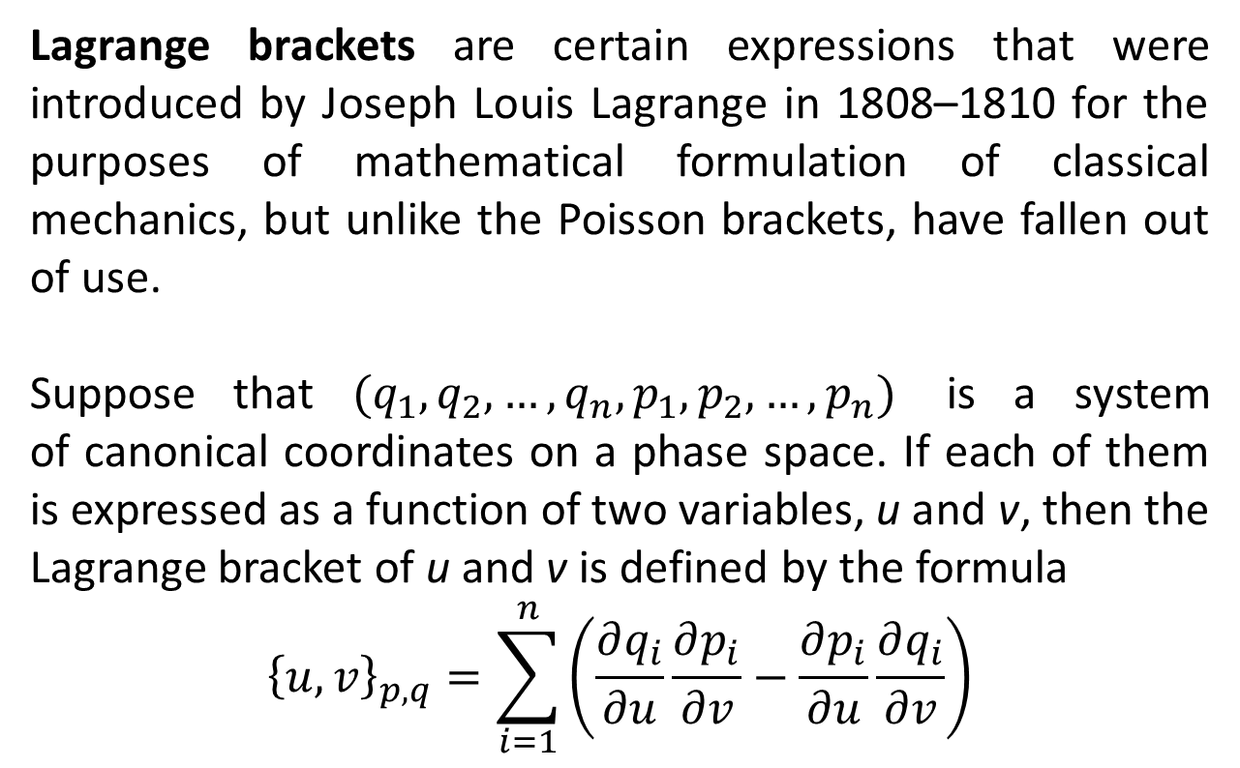
Lagrange Brackets
Lagrange brackets are certain expressions that were introduced by Joseph Louis Lagrange in 1808–1810 for the purposes of mathematical formulation of classical mechanics, but unlike the Poisson brackets, have fallen out of use.
Suppose that ${(q}_{1},q_{2},…,q_{n},p_{1},p_{2},…,p_{n})$ is a system of canonical coordinates on a phase space. If each of them is expressed as a function of two variables, u and v, then the Lagrange bracket of u and v is defined by the formula
$${\left\{u,v\right\}}_{p,q}=\sum_{i=1}^{n}{\left(\frac{∂q_{i}}{∂u}\frac{∂p_{i}}{∂v}−\frac{∂p_{i}}{∂u}\frac{∂q_{i}}{∂v}\right)}$$

Slide 3
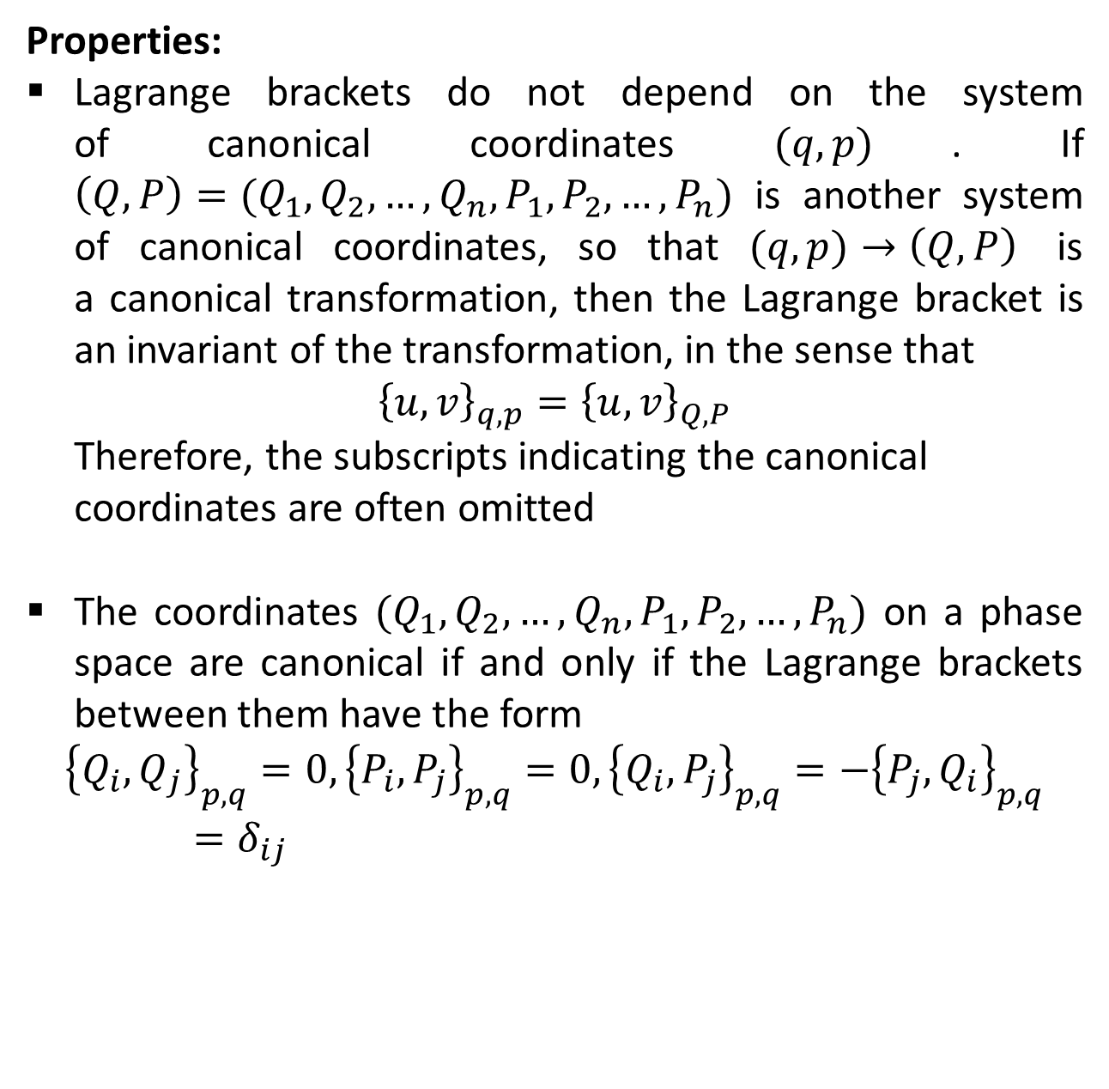
Properties:
Lagrange brackets do not depend on the system of canonical coordinates $(q,p)$. If $\left(Q,P\right)=(Q_{1},Q_{2},…,Q_{n},P_{1},P_{2},…,P_{n})$ is another system of canonical coordinates, so that $(q,p)→\left(Q,P\right)$ is a canonical transformation, then the Lagrange bracket is an invariant of the transformation, in the sense that
$${\left\{u,v\right\}}_{q,p}={\left\{u,v\right\}}_{Q,P}$$
Therefore, the subscripts indicating the canonical
coordinates are often omitted
The coordinates $(Q_{1},Q_{2},…,Q_{n},P_{1},P_{2},…,P_{n})$ on a phase space are canonical if and only if the Lagrange brackets between them have the form
$${\left\{Q_{i},Q_{j}\right\}}_{p,q}=0, {\left\{P_{i},P_{j}\right\}}_{p,q}=0,{\left\{Q_{i},P_{j}\right\}}_{p,q}={−\left\{{P_{j},Q}_{i}\right\}}_{p,q}=δ_{ij}$$

Slide 5
Poisson Brackets
In mathematics and classical mechanics, the Poisson bracket is an important binary operation in Hamiltonian mechanics, playing a central role in Hamilton's equations of motion, which govern the time-evolution of a Hamiltonian dynamical system. The Poisson bracket also distinguishes a certain class of coordinate-transformations, called canonical transformations, which maps canonical coordinate systems into canonical coordinate systems. (A "canonical coordinate system" consists of canonical position and momentum variables that satisfy canonical Poisson-bracket relations).

Slide 6
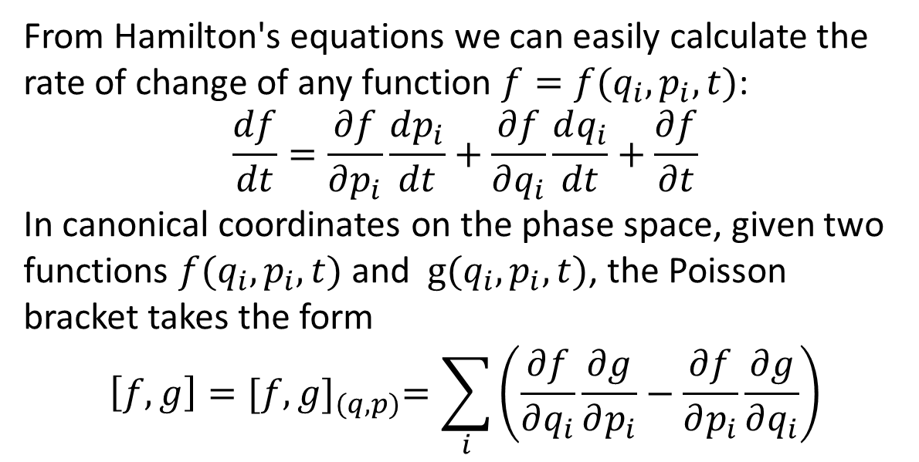
From Hamilton's equations we can easily calculate the rate of change of any function $f=f(q_{i},p_{i},t)$:
$$\frac{df}{dt}=\frac{∂f}{∂p_{i}}\frac{dp_{i}}{dt}+\frac{∂f}{∂q_{i}}\frac{dq_{i}}{dt}+\frac{∂f}{∂t}$$
In canonical coordinates on the phase space, given two functions $f(q_{i},p_{i},t)$and $g(q_{i},p_{i},t)$, the Poisson bracket takes the form
$$\left[f,g\right]={[f,g]}_{(q,p)}=\sum_{i}{\left(\frac{∂f}{∂q_{i}}\frac{∂g}{∂p_{i}}−\frac{∂f}{∂p_{i}}\frac{∂g}{∂q_{i}}\right)}$$

Slide 8
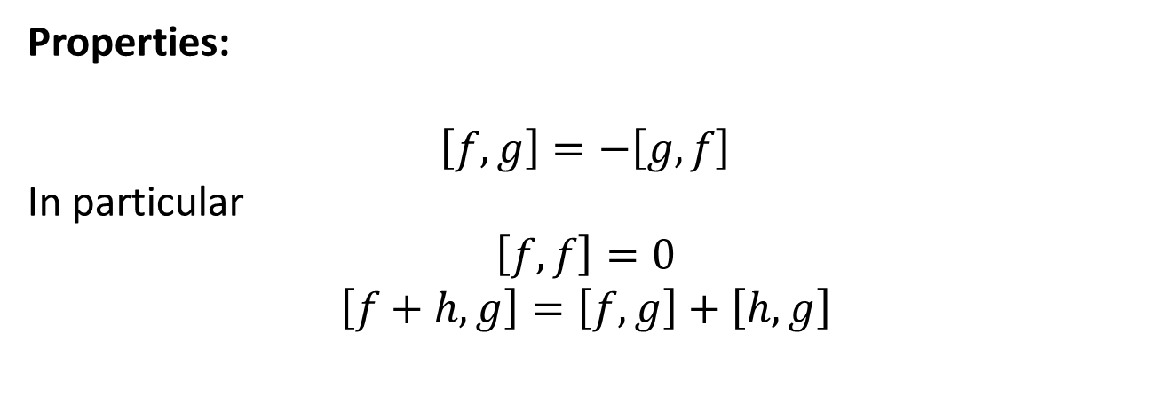
Properties:
$$\left[f,g\right]=−\left[g,f\right]$$
In particular
$$\left[f,f\right]=0$$
$$\left[f+h,g\right]=\left[f,g\right]+\left[h,g\right]$$

Slide 9

$$\left[fh,g\right]=f\left[h,g\right]+\left[f,g\right]h$$
$$\left[f,gh\right]=\left[f,g\right]h+\left[f,h\right]g$$

Slide 10

$$\frac{∂}{∂t}\left[f,g\right]=\left[\frac{∂f}{∂t},g\right]+\left[f,\frac{∂g}{∂t}\right]$$
$$\frac{d}{dt}\left[f,g\right]=\left[\frac{df}{dt},g\right]+\left[f,\frac{dg}{dt}\right]$$

Slide 11
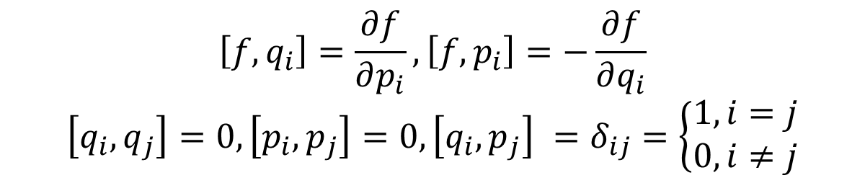
$$\left[f,q_{i}\right]=\frac{∂f}{∂p_{i}},\left[f,p_{i}\right]=−\frac{∂f}{∂q_{i}}$$
$$\left[q_{i},q_{j}\right]=0,\left[p_{i},p_{j}\right]=0,\left[q_{i},p_{j}\right] =δ_{ij}=\left\{\begin{aligned}1,i=j \\ 0,i≠j\end{aligned}\right.$$

Slide 12

$$\left[f,\left[g,h\right]\right]+\left[g,\left[h,f\right]\right]+\left[h,\left[f,g\right]\right]=0$$
This is called the Jacobi’s Identity.

Slide 13
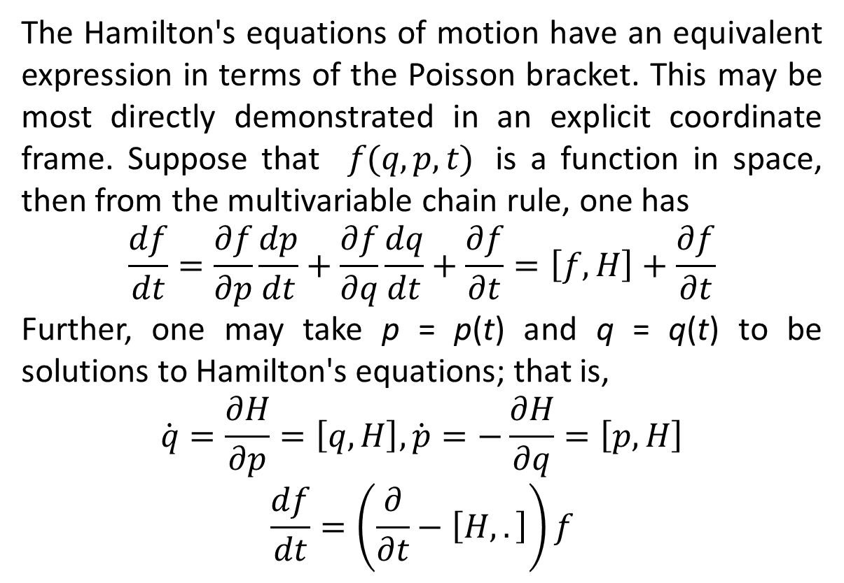
The Hamilton's equations of motion have an equivalent expression in terms of the Poisson bracket. This may be most directly demonstrated in an explicit coordinate frame. Suppose that $f(q,p,t)$ is a function in space, then from the multivariable chain rule, one has
$$\frac{df}{dt}=\frac{∂f}{∂p}\frac{dp}{dt}+\frac{∂f}{∂q}\frac{dq}{dt}+\frac{∂f}{∂t}=\left[f,H\right]+\frac{∂f}{∂t}$$
Further, one may take p = p(t) and q = q(t) to be solutions to Hamilton's equations; that is,
$$\dot{q}=\frac{∂H}{∂p}=\left[q,H\right],\dot{p}=−\frac{∂H}{∂q}=\left[p,H\right]$$
$$\frac{df}{dt}=\left(\frac{∂}{∂t}−\left[H,.\right]\right)f$$

Slide 16
The End

