Slide 1
Revision
Previous lecture consists of:

Slide 2
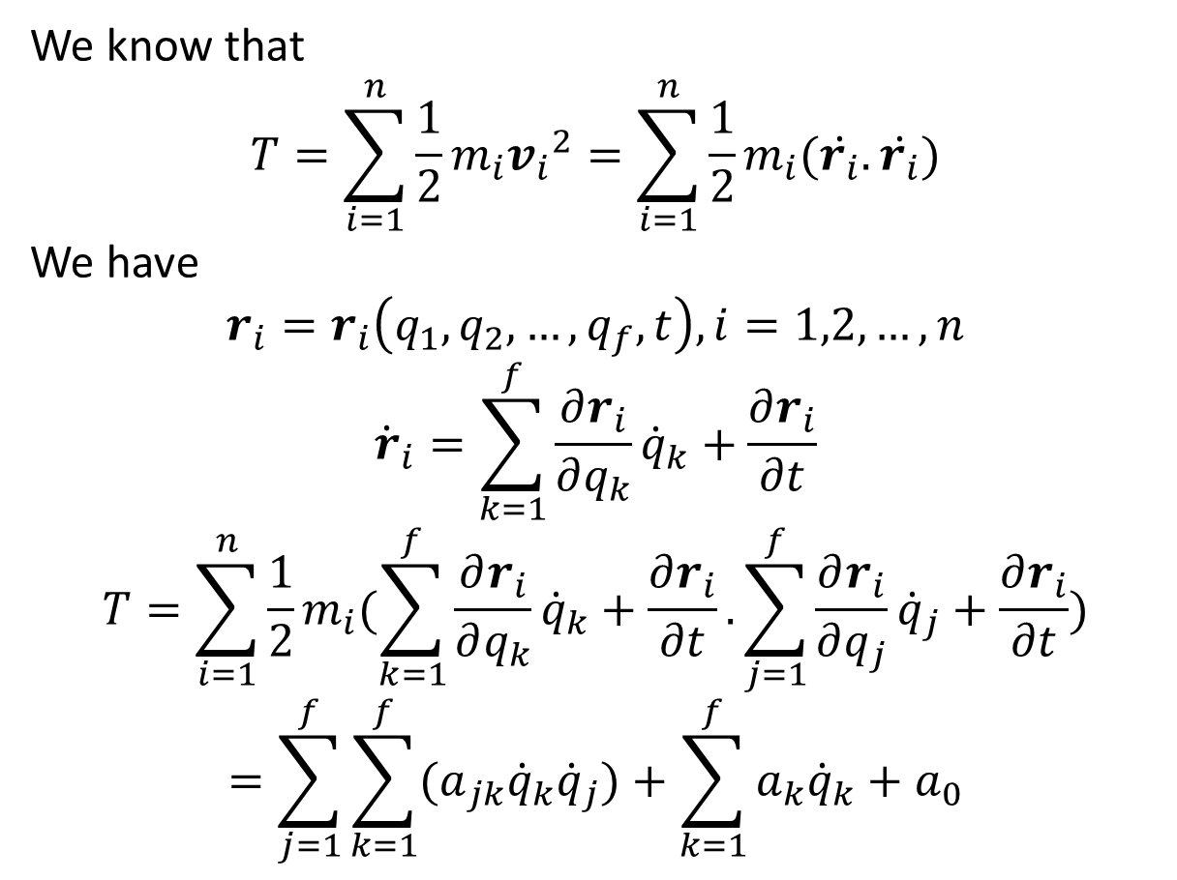
Kinetic Energy
We know that
$$T=\sum_{i=1}^{n}{\frac{1}{2}m_{i}{v_{i}}^{2}}=\sum_{i=1}^{n}{\frac{1}{2}m_{i}(\dot{r_{i}}.\dot{r_{i}})}$$
We have
$$r_{i}=r_{i}\left(q_{1},q_{2},…,q_{f},t\right), i=1,2,…,n$$
$${\dot{r}}_{i}=\sum_{k=1}^{f}{\frac{∂r_{i}}{∂q_{k}}{\dot{q}}_{k}+\frac{∂r_{i}}{∂t}}$$
$$T=\sum_{i=1}^{n}{\frac{1}{2}m_{i}(\sum_{k=1}^{f}{\frac{∂r_{i}}{∂q_{k}}{\dot{q}}_{k}+\frac{∂r_{i}}{∂t}}.\sum_{j=1}^{f}{\frac{∂r_{i}}{∂q_{j}}{\dot{q}}_{j}+\frac{∂r_{i}}{∂t}})}$$
$$=\sum_{j=1}^{f}{\sum_{k=1}^{f}{{(a}_{jk}{\dot{q}}_{k}{\dot{q}}_{j})+\sum_{k=1}^{f}{{a_{k}\dot{q}}_{k}}+a_{0}}}$$

Slide 3
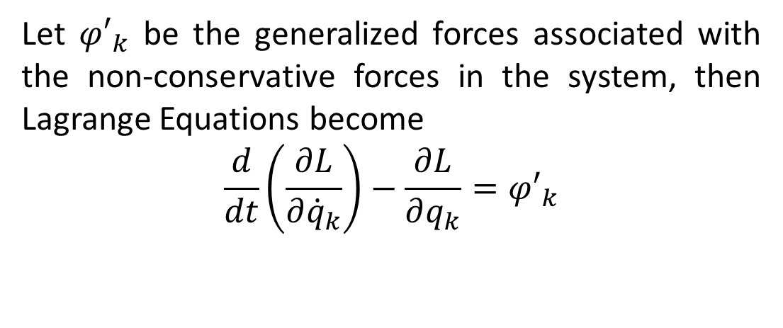
Lagrange Equations for Non-Conservative Systems
Let ${φ′}_{k}$ be the generalized forces associated with the non-conservative forces in the system, then Lagrange Equations become
$$\frac{d}{dt}\left(\frac{∂L}{∂{\dot{q}}_{k}}\right)−\frac{∂L}{∂q_{k}}={φ′}_{k}$$

Slide 4
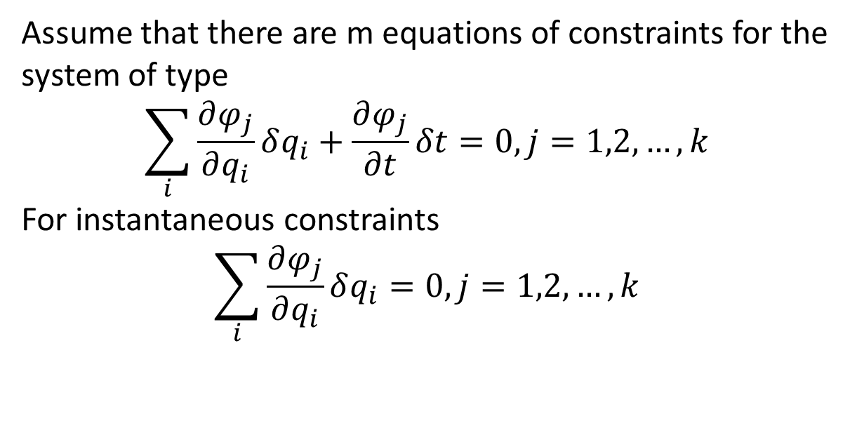
Lagrange Equations for Non-Holonomic Systems
Assume that there are m equations of constraints for the system of type
$$\sum_{i}{\frac{∂φ_{j}}{∂q_{i}}δq_{i}+\frac{∂φ_{j}}{∂t}δt=0, j=1,2,…,k}$$
For instantaneous constraints
$$\sum_{i}{\frac{∂φ_{j}}{∂q_{i}}δq_{i}=0, j=1,2,…,k}$$

Slide 5
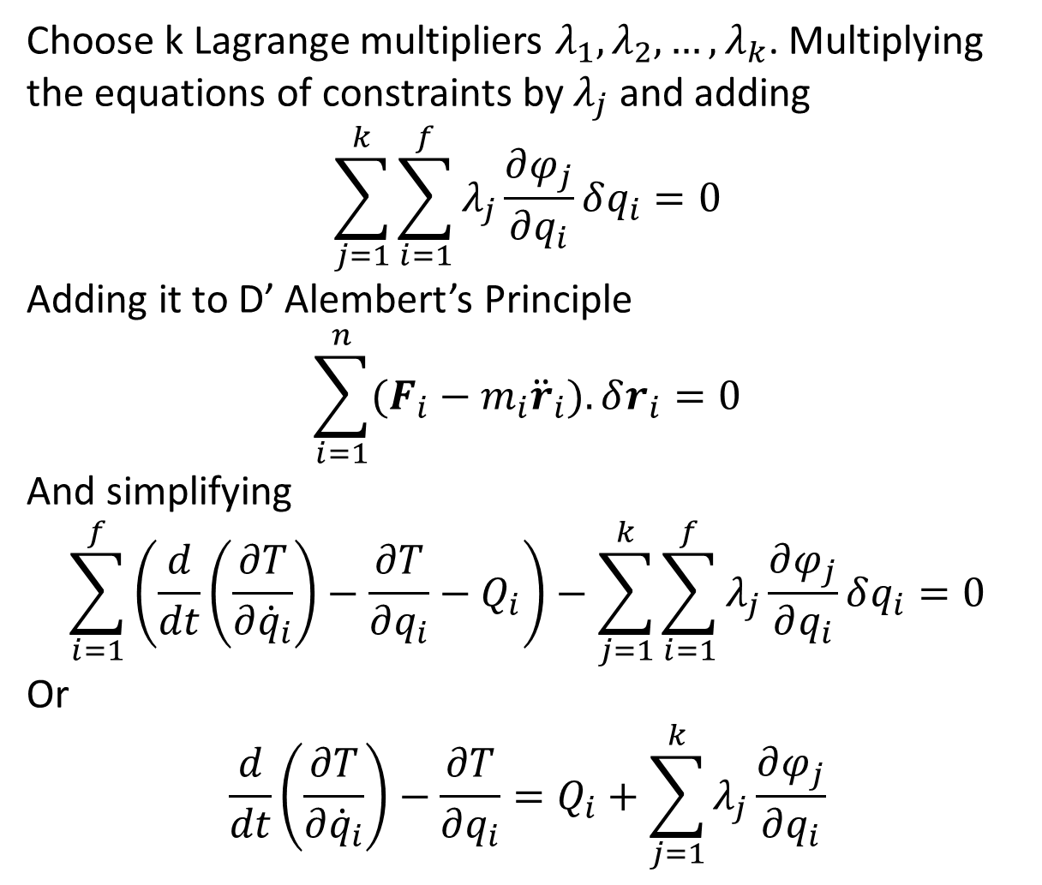
Choose k Lagrange multipliers $λ_{1},λ_{2},…,λ_{k}$. Multiplying the equations of constraints by $λ_{j}$ and adding
$$\sum_{j=1}^{k}{\sum_{i=1}^{f}{λ_{j}\frac{∂φ_{j}}{∂q_{i}}δq_{i}}}=0$$
Adding it to D’ Alembert’s Principle
$$\sum_{i=1}^{n}{(F_{i}−m_{i}{\ddot{r}}_{i}).δr_{i}}=0$$
And simplifying
$$\sum_{i=1}^{f}{\left(\frac{d}{dt}\left(\frac{∂T}{∂{\dot{q}}_{i}}\right)−\frac{∂T}{∂q_{i}}−Q_{i}\right)}−\sum_{j=1}^{k}{\sum_{i=1}^{f}{λ_{j}\frac{∂φ_{j}}{∂q_{i}}δq_{i}}}=0$$
Or
$$\frac{d}{dt}\left(\frac{∂T}{∂{\dot{q}}_{i}}\right)−\frac{∂T}{∂q_{i}}=Q_{i}+\sum_{j=1}^{k}{λ_{j}\frac{∂φ_{j}}{∂q_{i}}}$$

Slide 6
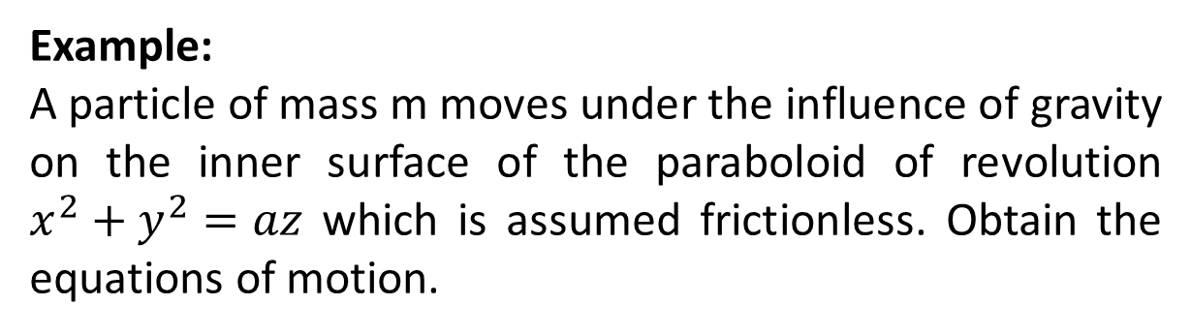
Example:
A particle of mass m moves under the influence of gravity on the inner surface of the paraboloid of revolution $x^{2}+y^{2}=az$ which is assumed frictionless. Obtain the equations of motion.

Slide 8
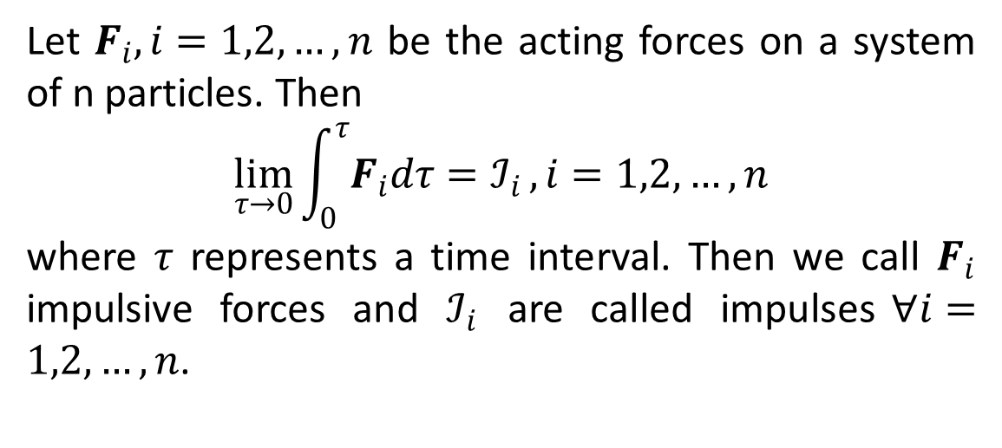
Lagrange Equations with Impulsive Forces
Let $F_{i},i=1,2,…,n$ be the acting forces on a system of n particles. Then
$$\lim_{τ→0}{\int_{0}^{τ}{F_{i}dτ}=ℐ_{i}}, i=1,2,…,n$$
where $τ$ represents a time interval. Then we call $F_{i}$ impulsive forces and $ℐ_{i}$ are called impulses$∀i=1,2,…,n$.

Slide 9
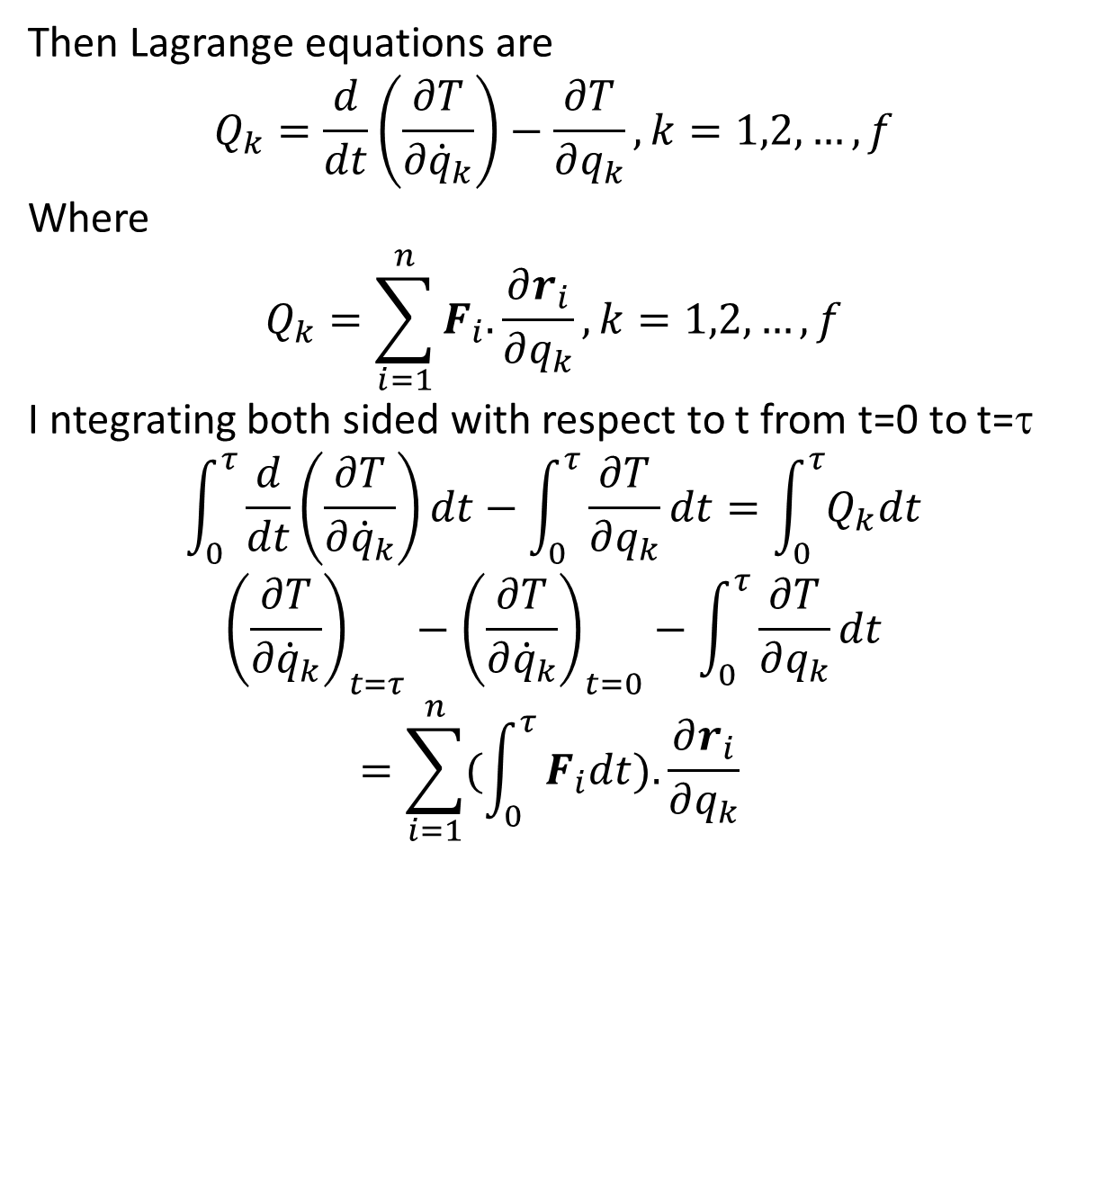
Then Lagrange equations are
$$Q_{k}=\frac{d}{dt}\left(\frac{∂T}{∂{\dot{q}}_{k}}\right)−\frac{∂T}{∂q_{k}}, k=1,2,…,f$$
Where
$$Q_{k}=\sum_{i=1}^{n}{F_{i}.}\frac{∂r_{i}}{∂q_{k}},k=1,2,…,f$$
I ntegrating both sided with respect to t from t=0 to t=τ
$$\int_{0}^{τ}{\frac{d}{dt}\left(\frac{∂T}{∂{\dot{q}}_{k}}\right)dt}−\int_{0}^{τ}{\frac{∂T}{∂q_{k}}dt}=\int_{0}^{τ}{Q_{k}dt}$$
$${\left(\frac{∂T}{∂{\dot{q}}_{k}}\right)}_{t=τ}−{\left(\frac{∂T}{∂{\dot{q}}_{k}}\right)}_{t=0}−\int_{0}^{τ}{\frac{∂T}{∂q_{k}}dt}=\sum_{i=1}^{n}{(\int_{0}^{τ}{F_{i}dt).\frac{∂r_{i}}{∂q_{k}}}}$$

Slide 10
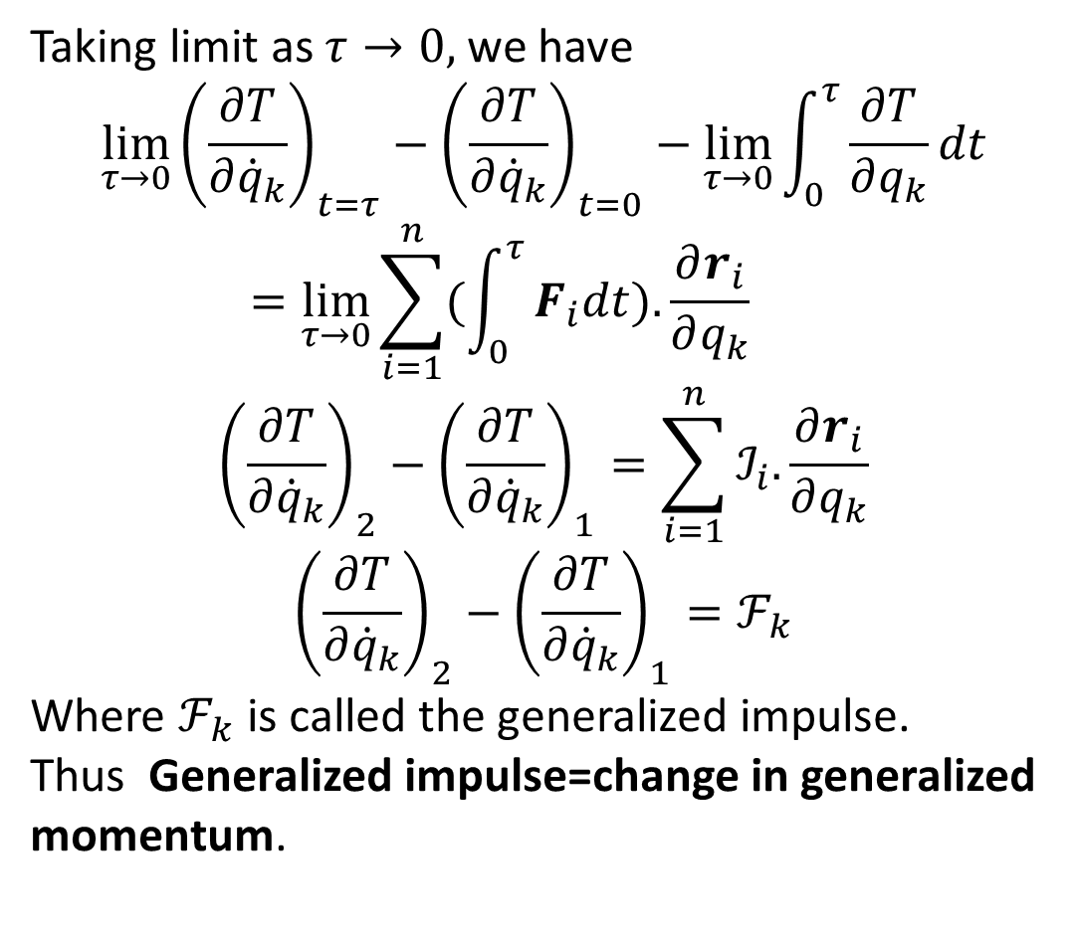
Taking limit as $τ→0,$ we have
$$\lim_{τ→0}{\left(\frac{∂T}{∂{\dot{q}}_{k}}\right)}_{t=τ}−{\left(\frac{∂T}{∂{\dot{q}}_{k}}\right)}_{t=0}−\lim_{τ→0}\int_{0}^{τ}{\frac{∂T}{∂q_{k}}dt}=\lim_{τ→0}\sum_{i=1}^{n}{(\int_{0}^{τ}{F_{i}dt).\frac{∂r_{i}}{∂q_{k}}}}$$
$${\left(\frac{∂T}{∂{\dot{q}}_{k}}\right)}_{2}−{\left(\frac{∂T}{∂{\dot{q}}_{k}}\right)}_{1}=\sum_{i=1}^{n}{ℐ_{i}.\frac{∂r_{i}}{∂q_{k}}}$$
$${\left(\frac{∂T}{∂{\dot{q}}_{k}}\right)}_{2}−{\left(\frac{∂T}{∂{\dot{q}}_{k}}\right)}_{1}=ℱ_{k}$$
Where $ℱ_{k}$ is called the generalized impulse.
Thus Generalized impulse=change in generalized momentum.

Slide 11
The End

