Slide 1
Revision
Previous lecture consists of:
Lagrange’s Generalized Coordinates
Lagrange’s Generalized Velocities
Generalized Forces
Lagrange Equations of Motion for Holonomic Systems

Slide 2
Example:
Find the Lagrange equations of motion for a particle moving in a potential field V(x,y,z).

Slide 4
Example:
Find the Lagrange equations of motion for a simple pendulum.

Slide 6
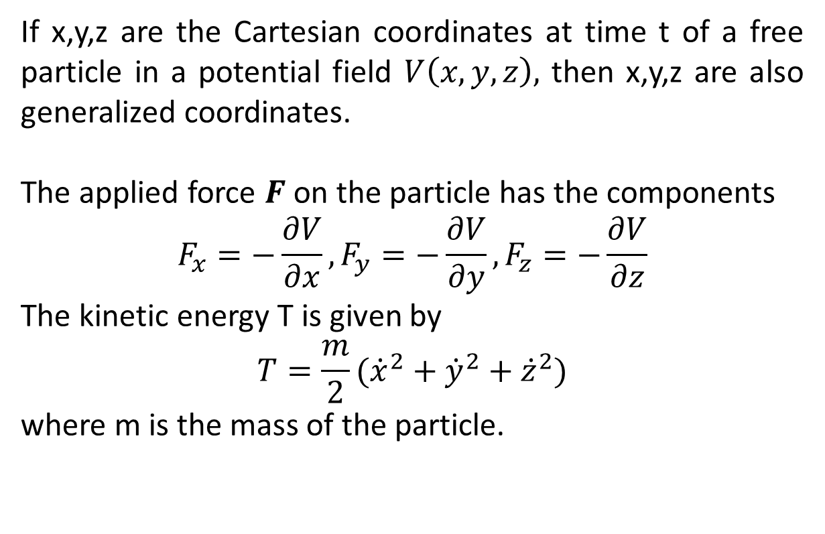
Generalized Momenta
If x,y,z are the Cartesian coordinates at time t of a free particle in a potential field $V\left(x,y,z\right),$ then x,y,z are also generalized coordinates.
The applied force $F$ on the particle has the components
$$F_{x}=−\frac{∂V}{∂x},F_{y}=−\frac{∂V}{∂y},F_{z}=−\frac{∂V}{∂z}$$
The kinetic energy T is given by
$$T=\frac{m}{2}({\dot{x}}^{2}+{\dot{y}}^{2}+{\dot{z}}^{2})$$
where m is the mass of the particle.

Slide 7
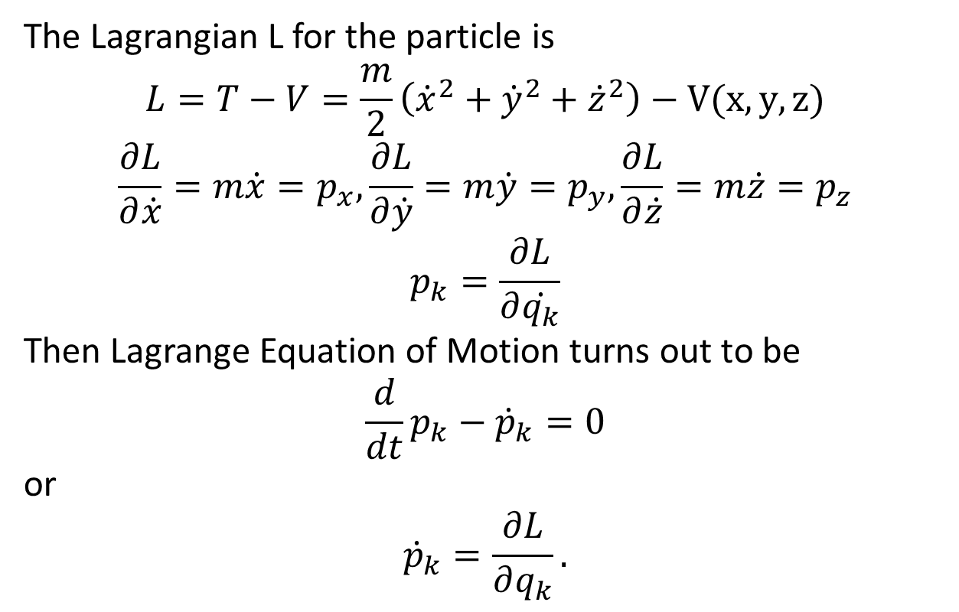
The Lagrangian L for the particle is
$$L=T−V=\frac{m}{2}\left({\dot{x}}^{2}+{\dot{y}}^{2}+{\dot{z}}^{2}\right)−V(x,y,z)$$
$$\frac{∂L}{∂\dot{x}}=m\dot{x}=p_{x},\frac{∂L}{∂\dot{y}}=m\dot{y}=p_{y},\frac{∂L}{∂\dot{z}}=m\dot{z}=p_{z}$$
$$p_{k}=\frac{∂L}{∂\dot{q_{k}}}$$
Then Lagrange Equation of Motion turns out to be
$$\frac{d}{dt}p_{k}−{\dot{p}}_{k}=0$$
or
$${\dot{p}}_{k}=\frac{∂L}{∂q_{k}}.$$

Slide 8
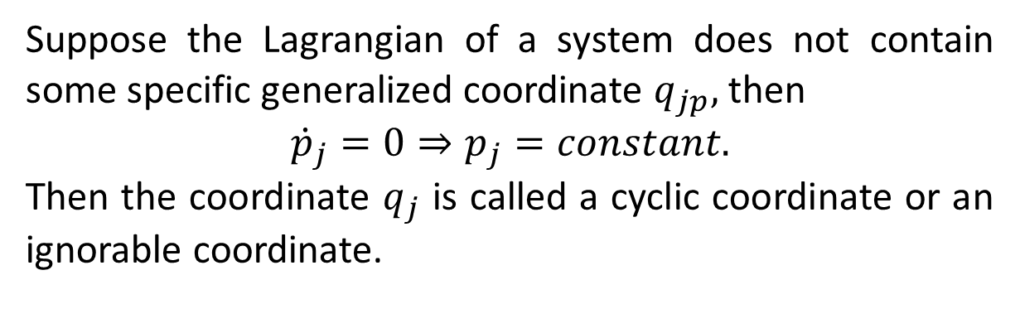
Cyclic Coordinates
Suppose the Lagrangian of a system does not contain some specific generalized coordinate $q_{jp},$ then
$${\dot{p}}_{j}=0⇒p_{j}=constant.$$
Then the coordinate $q_{j}$ is called a cyclic coordinate or an ignorable coordinate.

Slide 9
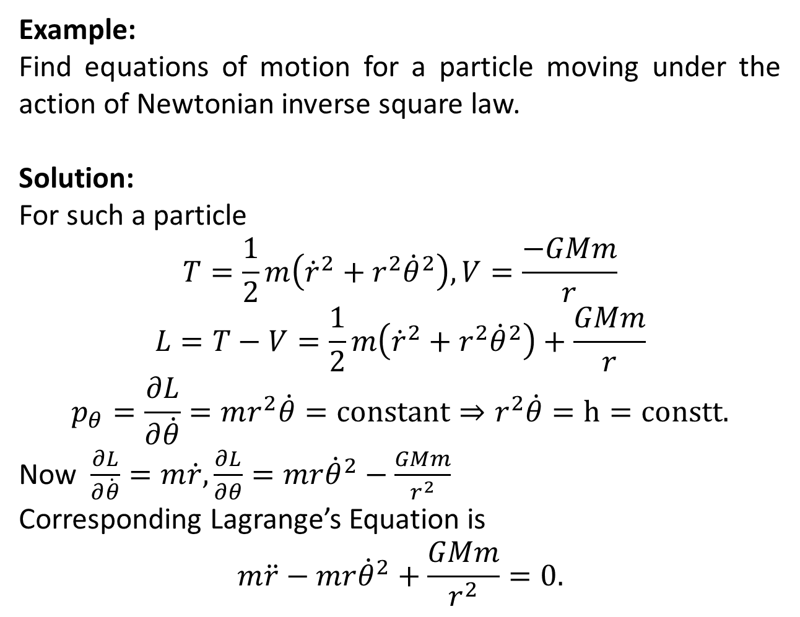
Example:
Find equations of motion for a particle moving under the action of Newtonian inverse square law.
Solution:
For such a particle
$$T=\frac{1}{2}m\left({\dot{r}}^{2}+r^{2}{\dot{θ}}^{2}\right), V=\frac{−GMm}{r}$$
$$L=T−V=\frac{1}{2}m\left({\dot{r}}^{2}+r^{2}{\dot{θ}}^{2}\right)+\frac{GMm}{r}$$
$$p_{θ}=\frac{∂L}{∂\dot{θ}}=mr^{2}\dot{θ}=constant⇒r^{2}\dot{θ}=h=constt.$$
Now $\frac{∂L}{∂\dot{θ}}=m\dot{r},\frac{∂L}{∂θ}=mr{\dot{θ}}^{2}−\frac{GMm}{r^{2}}$
Corresponding Lagrange’s Equation is
$$m\ddot{r}−mr{\dot{θ}}^{2}+\frac{GMm}{r^{2}}=0.$$

Slide 10
The End

