Slide 1
Revision
Previous lecture consists of:
Method of Lagrange Multipliers
Equation of motion for Holonomic Sytems

Slide 2
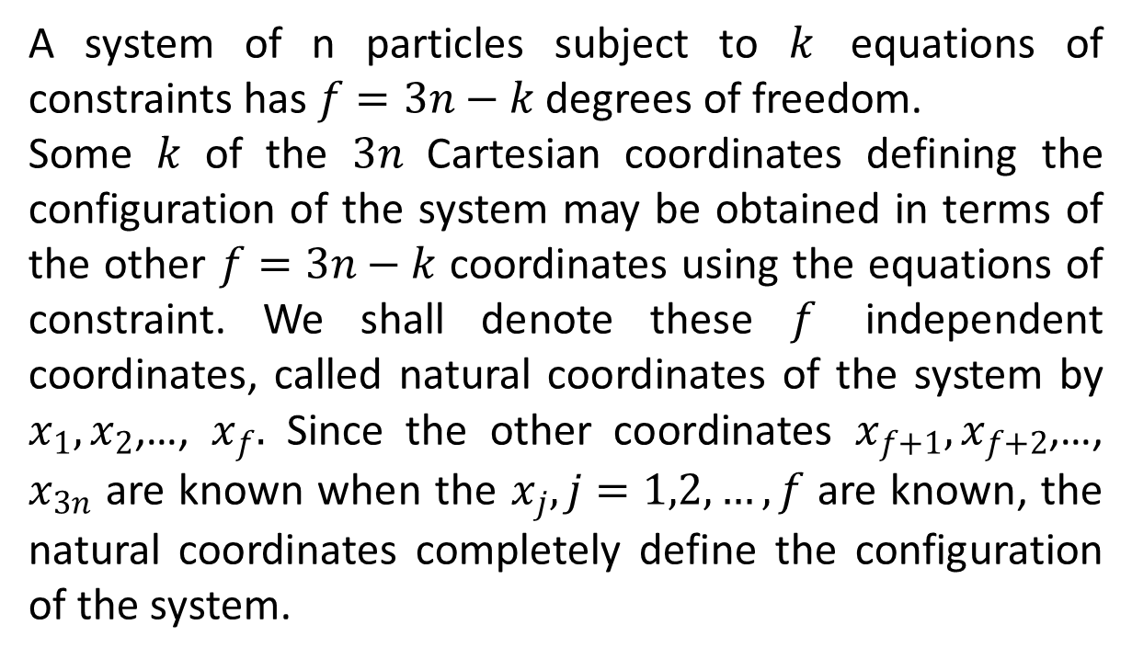
Generalized Coordinates of Lagrange
A system of n particles subject to $k$ equations of constraints has $f=3n−k$ degrees of freedom.
Some $k$ of the $3n$ Cartesian coordinates defining the configuration of the system may be obtained in terms of the other $f=3n−k$ coordinates using the equations of constraint. We shall denote these $f$ independent coordinates, called natural coordinates of the system by $x_{1},x_{2}$,…, $x_{f}.$ Since the other coordinates $x_{f+1},x_{f+2}$,…, $x_{3n}$ are known when the $x_{j}, j=1,2,…,f$ are known, the natural coordinates completely define the configuration of the system.

Slide 3
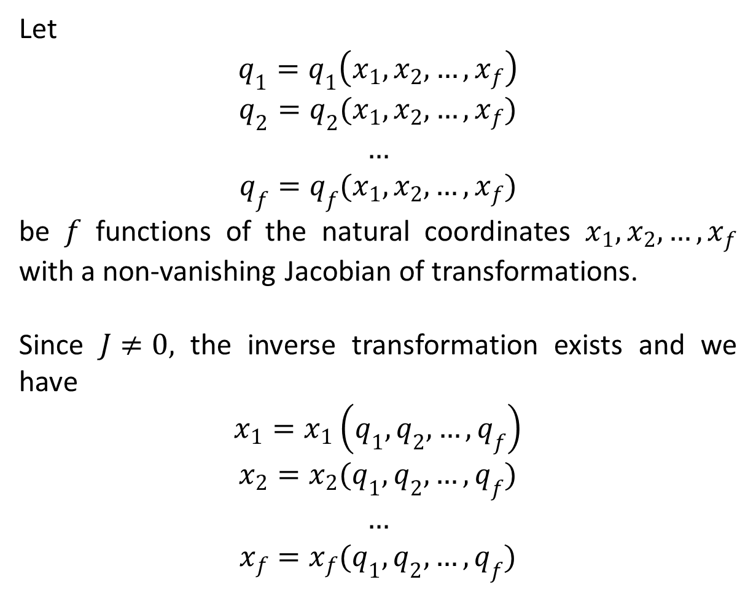
Let
$$q_{1}=q_{1}\left(x_{1},x_{2},…,x_{f}\right)$$
$$q_{2}=q_{2}(x_{1},x_{2},…,x_{f})$$
$$…$$
$$q_{f}=q_{f}(x_{1},x_{2},…,x_{f})$$
be $f$ functions of the natural coordinates $x_{1},x_{2},…,x_{f}$ with a non-vanishing Jacobian of transformations.
Since $J≠0,$ the inverse transformation exists and we have
$$x_{1}=x_{1}\left(q_{1},q_{2},…,q_{f}\right)$$
$$x_{2}=x_{2}(q_{1},q_{2},…,q_{f})$$
$$…$$
$$x_{f}=x_{f}(q_{1},q_{2},…,q_{f})$$

Slide 4
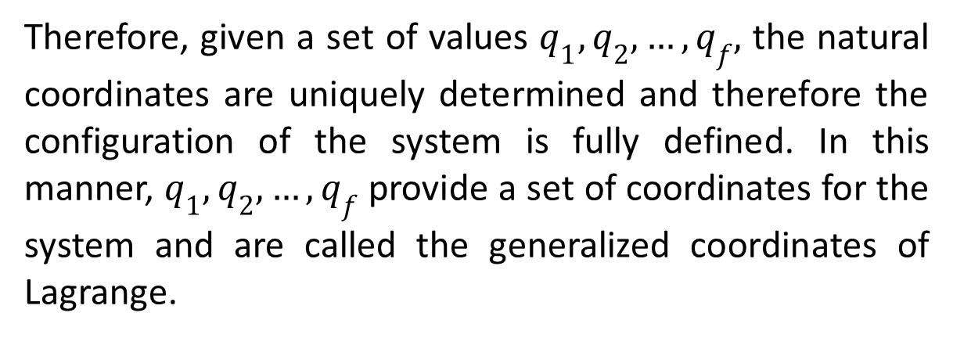
Therefore, given a set of values $q_{1},q_{2},…,q_{f},$ the natural coordinates are uniquely determined and therefore the configuration of the system is fully defined. In this manner, $q_{1},q_{2},…,q_{f}$ provide a set of coordinates for the system and are called the generalized coordinates of Lagrange.

Slide 5
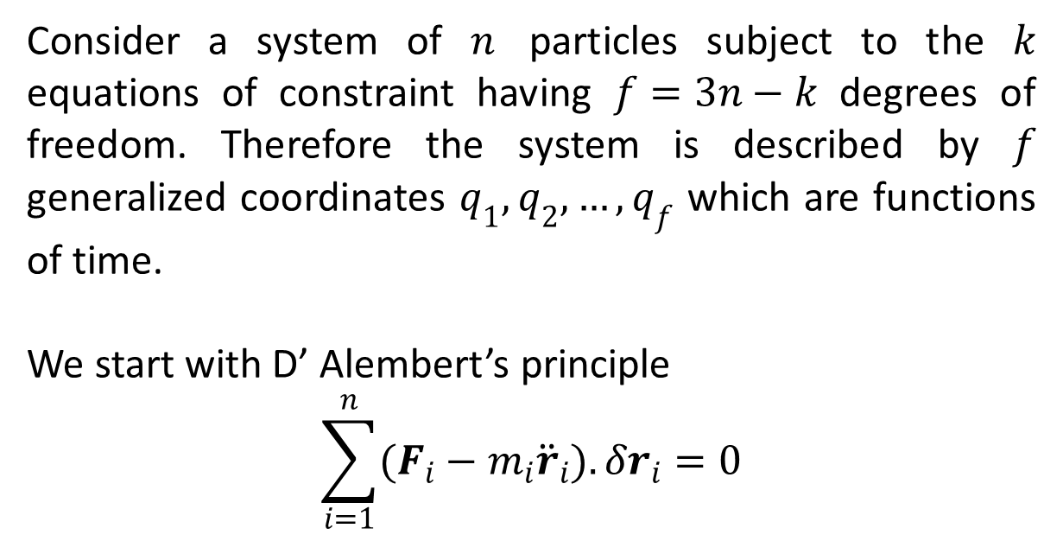
Lagrange’s Equation of Motion
Consider a system of $n$ particles subject to the $k$ equations of constraint having $f=3n−k$ degrees of freedom. Therefore the system is described by $f$ generalized coordinates $q_{1},q_{2},…,q_{f}$ which are functions of time.
We start with D’ Alembert’s principle
$$\sum_{i=1}^{n}{(F_{i}−m_{i}{\ddot{r}}_{i}).δr_{i}}=0$$

Slide 6
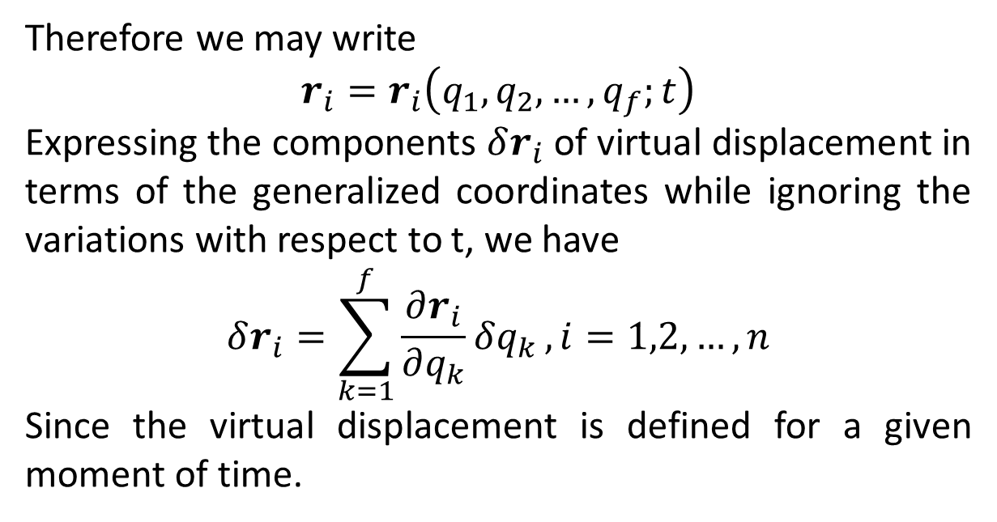
Therefore we may write
$$r_{i}=r_{i}\left(q_{1},q_{2},…,q_{f};t\right)$$
Expressing the components $δr_{i}$ of virtual displacement in terms of the generalized coordinates while ignoring the variations with respect to t, we have
$$δr_{i}=\sum_{k=1}^{f}{\frac{∂r_{i}}{∂q_{k}}δq_{k}}, i=1,2,…,n$$
Since the virtual displacement is defined for a given moment of time.

Slide 7
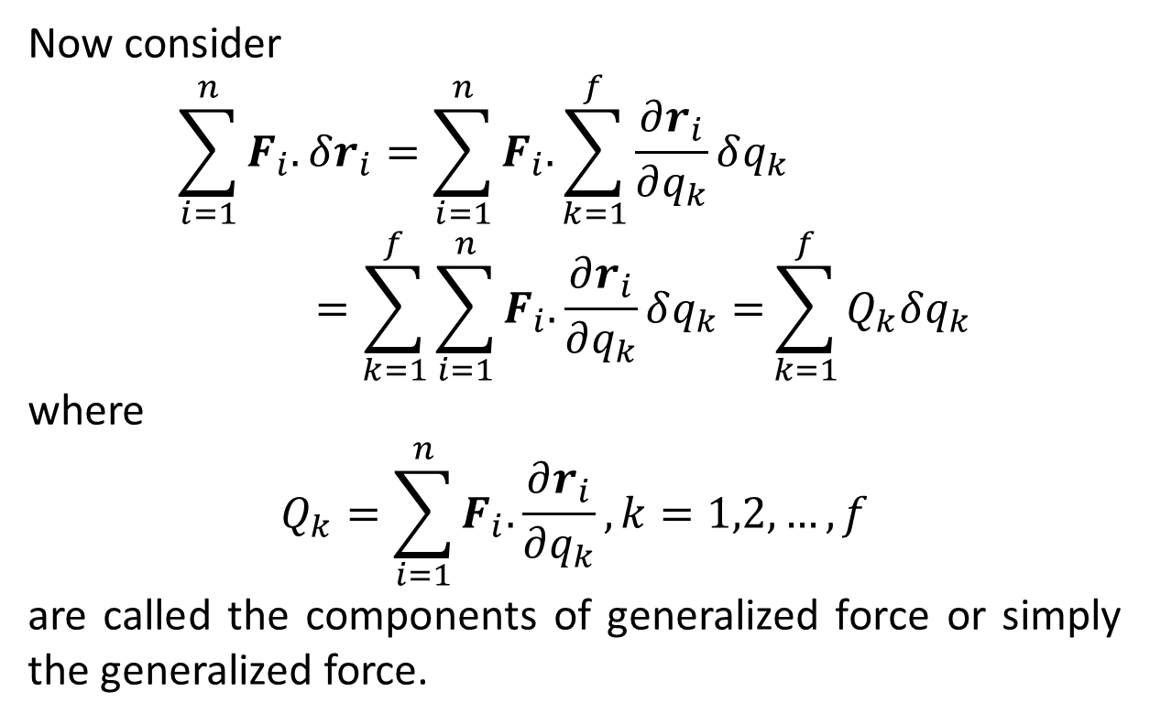
Now consider
$$\sum_{i=1}^{n}{F_{i}.}δr_{i}=\sum_{i=1}^{n}{F_{i}.}\sum_{k=1}^{f}{\frac{∂r_{i}}{∂q_{k}}δq_{k}}=\sum_{k=1}^{f}{\sum_{i=1}^{n}{F_{i}.}\frac{∂r_{i}}{∂q_{k}}δq_{k}=}\sum_{k=1}^{f}{Q_{k}δq_{k}}$$
where
$$Q_{k}=\sum_{i=1}^{n}{F_{i}.}\frac{∂r_{i}}{∂q_{k}},k=1,2,…,f$$
are called the components of generalized force or simply the generalized force.

Slide 8
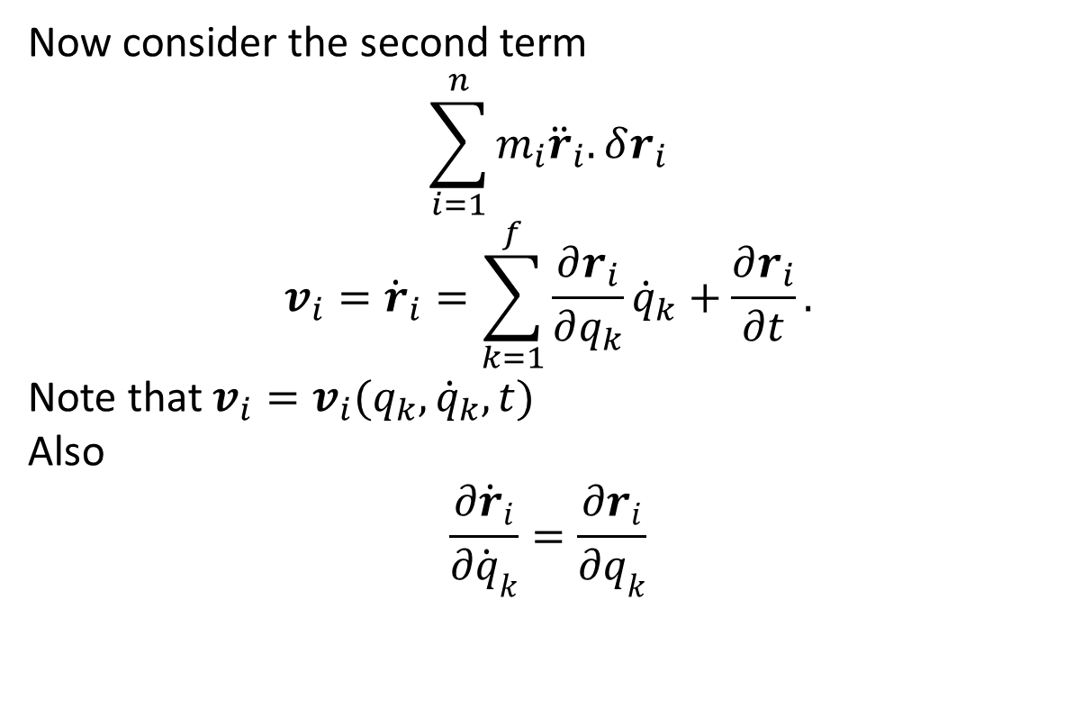
Now consider the second term
$$\sum_{i=1}^{n}{{m_{i}\ddot{r}}_{i}.}δr_{i}$$
$$v_{i}={\dot{r}}_{i}=\sum_{k=1}^{f}{\frac{∂r_{i}}{∂q_{k}}{\dot{q}}_{k}+\frac{∂r_{i}}{∂t}.}$$
Note that $v_{i}=v_{i}(q_{k},{\dot{q}}_{k},t)$
Also
$$\frac{∂{\dot{r}}_{i}}{∂{\dot{q}}_{k}}=\frac{∂r_{i}}{∂q_{k}}$$

Slide 9
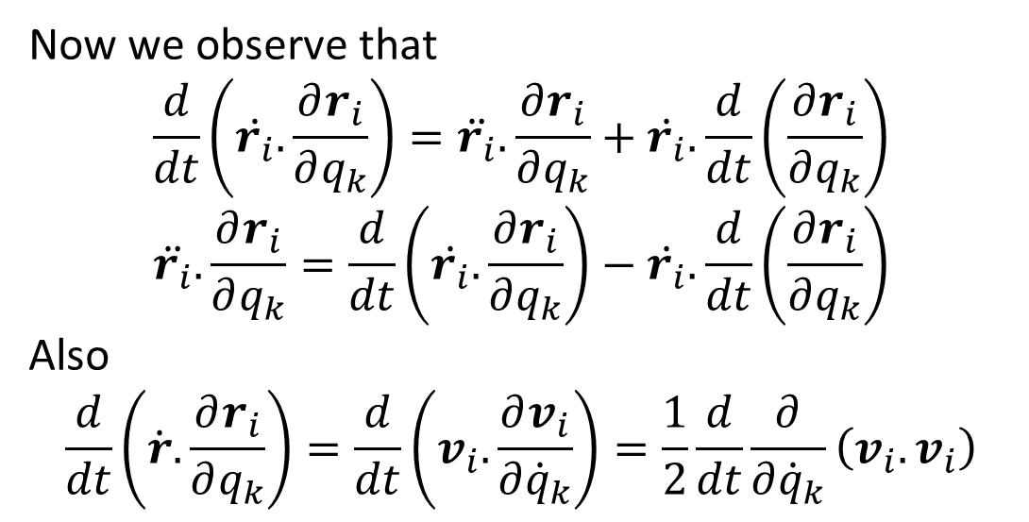
Now we observe that
$$\frac{d}{dt}\left(\dot{r_{i}}.\frac{∂r_{i}}{∂q_{k}}\right)=\ddot{r_{i}}.\frac{∂r_{i}}{∂q_{k}}+\dot{r_{i}}.\frac{d}{dt}\left(\frac{∂r_{i}}{∂q_{k}}\right)$$
$$\ddot{r_{i}}.\frac{∂r_{i}}{∂q_{k}}=\frac{d}{dt}\left(\dot{r_{i}}.\frac{∂r_{i}}{∂q_{k}}\right)−\dot{r_{i}}.\frac{d}{dt}\left(\frac{∂r_{i}}{∂q_{k}}\right)$$
Also
$$\frac{d}{dt}\left(\dot{r}.\frac{∂r_{i}}{∂q_{k}}\right)=\frac{d}{dt}\left(v_{i}.\frac{∂v_{i}}{∂{\dot{q}}_{k}}\right)=\frac{1}{2}\frac{d}{dt}\frac{∂}{∂{\dot{q}}_{k}}\left(v_{i}.v_{i}\right)$$

Slide 10
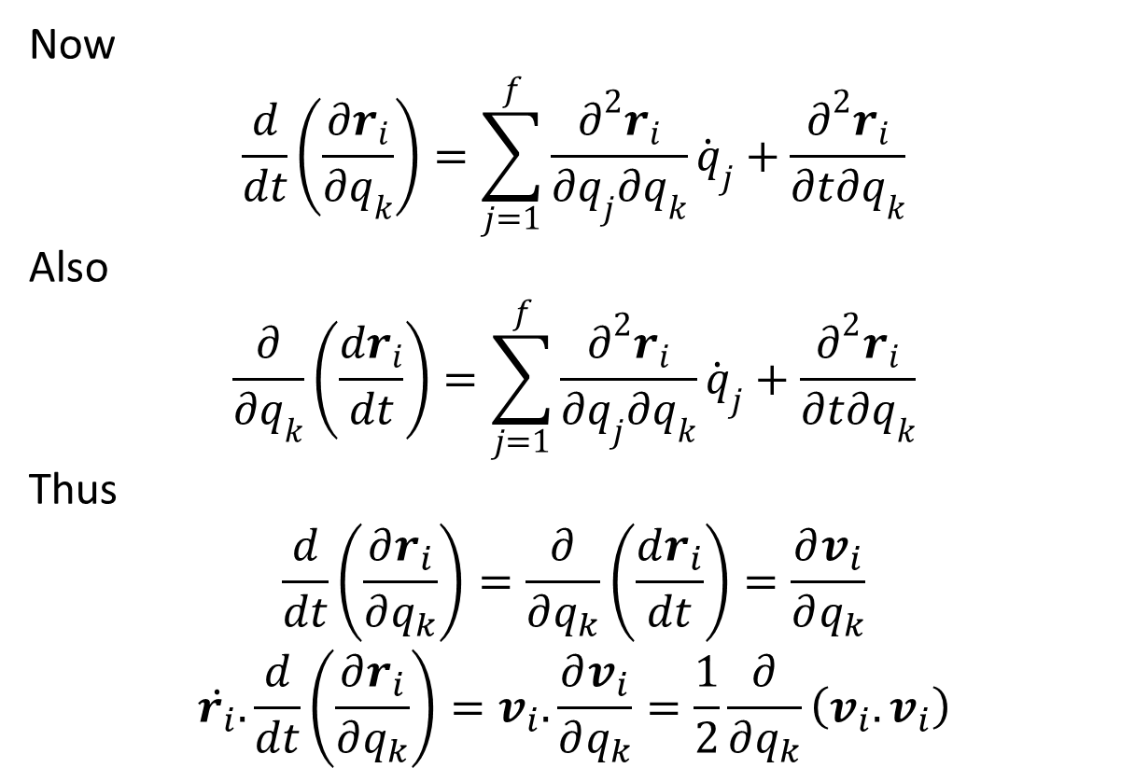
Now
$$\frac{d}{dt}\left(\frac{∂r_{i}}{∂q_{k}}\right)=\sum_{j=1}^{f}{\frac{∂^{2}r_{i}}{∂q_{j}∂q_{k}}}{\dot{q}}_{j}+\frac{∂^{2}r_{i}}{∂t∂q_{k}}$$
Also
$$\frac{∂}{∂q_{k}}\left(\frac{dr_{i}}{dt}\right)=\sum_{j=1}^{f}{\frac{∂^{2}r_{i}}{∂q_{j}∂q_{k}}}{\dot{q}}_{j}+\frac{∂^{2}r_{i}}{∂t∂q_{k}}$$
Thus
$$\frac{d}{dt}\left(\frac{∂r_{i}}{∂q_{k}}\right)=\frac{∂}{∂q_{k}}\left(\frac{dr_{i}}{dt}\right)=\frac{∂v_{i}}{∂q_{k}}$$
$$\dot{r_{i}}.\frac{d}{dt}\left(\frac{∂r_{i}}{∂q_{k}}\right)=v_{i}.\frac{∂v_{i}}{∂q_{k}}=\frac{1}{2}\frac{∂}{∂q_{k}}\left(v_{i}.v_{i}\right)$$

Slide 11
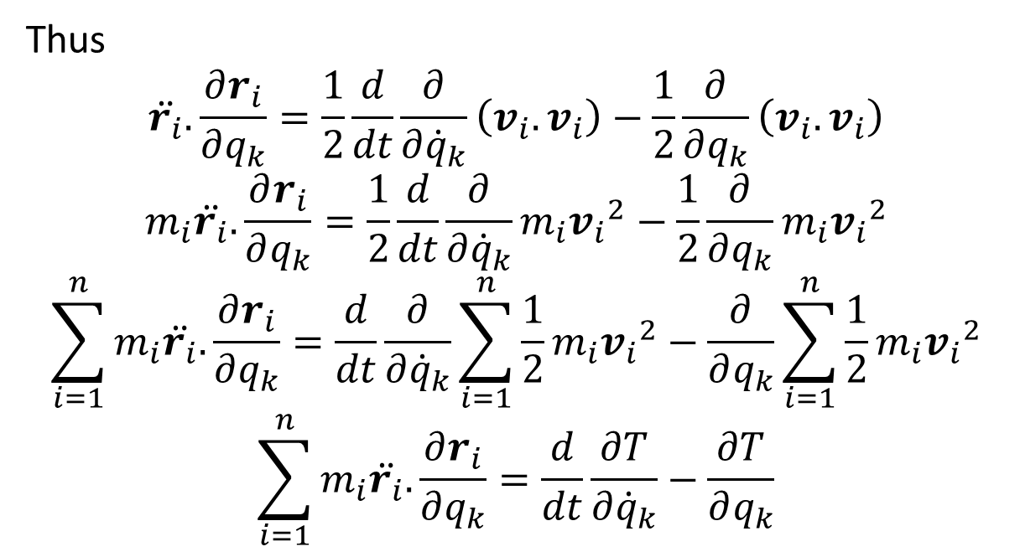
Thus
$$\ddot{r_{i}}.\frac{∂r_{i}}{∂q_{k}}=\frac{1}{2}\frac{d}{dt}\frac{∂}{∂{\dot{q}}_{k}}\left(v_{i}.v_{i}\right)−\frac{1}{2}\frac{∂}{∂q_{k}}\left(v_{i}.v_{i}\right)$$
$$m_{i}\ddot{r_{i}}.\frac{∂r_{i}}{∂q_{k}}=\frac{1}{2}\frac{d}{dt}\frac{∂}{∂{\dot{q}}_{k}}{m_{i}v_{i}}^{2}−\frac{1}{2}\frac{∂}{∂q_{k}}m_{i}{v_{i}}^{2}$$
$$\sum_{i=1}^{n}{m_{i}\ddot{r_{i}}.\frac{∂r_{i}}{∂q_{k}}}=\frac{d}{dt}\frac{∂}{∂{\dot{q}}_{k}}\sum_{i=1}^{n}{\frac{1}{2}m_{i}{v_{i}}^{2}}−\frac{∂}{∂q_{k}}\sum_{i=1}^{n}{\frac{1}{2}m_{i}{v_{i}}^{2}}$$
$$\sum_{i=1}^{n}{m_{i}\ddot{r_{i}}.\frac{∂r_{i}}{∂q_{k}}}=\frac{d}{dt}\frac{∂T}{∂{\dot{q}}_{k}}−\frac{∂T}{∂q_{k}}$$

Slide 12
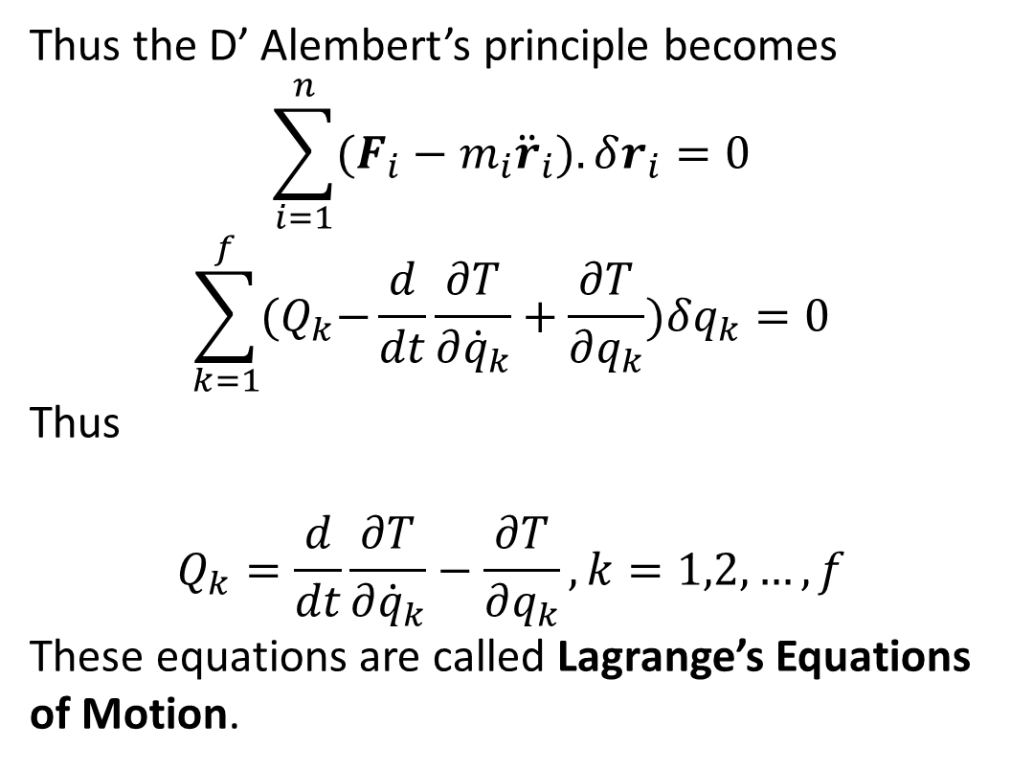
Thus the D’ Alembert’s principle becomes
$$\sum_{i=1}^{n}{(F_{i}−m_{i}{\ddot{r}}_{i}).δr_{i}}=0$$
$$\sum_{k=1}^{f}{{(Q}_{k}−\frac{d}{dt}\frac{∂T}{∂{\dot{q}}_{k}}+\frac{∂T}{∂q_{k}})δq_{k}=0}$$
Thus
$$Q_{k}=\frac{d}{dt}\frac{∂T}{∂{\dot{q}}_{k}}−\frac{∂T}{∂q_{k}}, k=1,2,…,f$$
These equations are called Lagrange’s Equations of Motion.

Slide 13
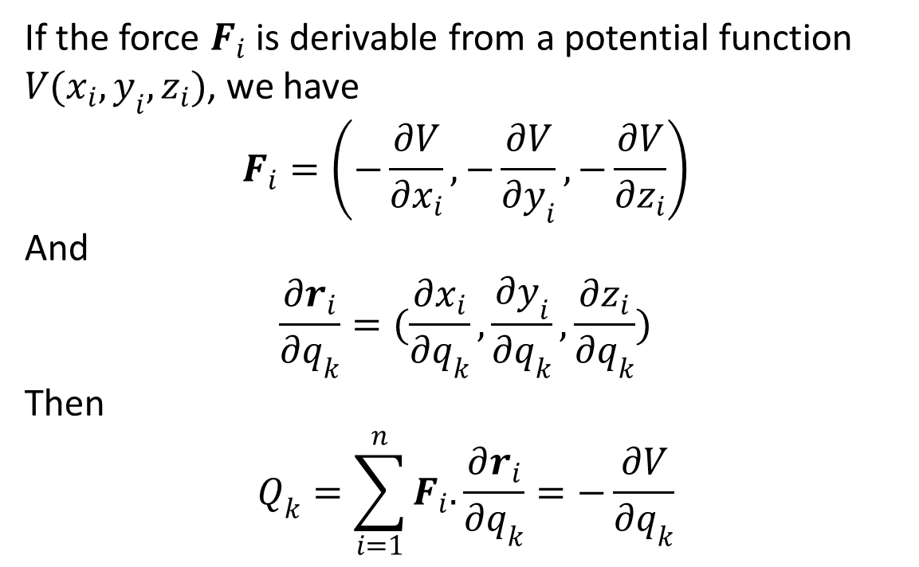
If the force $F_{i}$ is derivable from a potential function $V(x_{i},y_{i},z_{i})$, we have
$$F_{i}=\left(−\frac{∂V}{∂x_{i}},−\frac{∂V}{∂y_{i}},−\frac{∂V}{∂z_{i}}\right)$$
And
$$\frac{∂r_{i}}{∂q_{k}}=(\frac{∂x_{i}}{∂q_{k}},\frac{∂y_{i}}{∂q_{k}},\frac{∂z_{i}}{∂q_{k}})$$
Then
$$Q_{k}=\sum_{i=1}^{n}{F_{i}.}\frac{∂r_{i}}{∂q_{k}}=−\frac{∂V}{∂q_{k}}$$

Slide 14
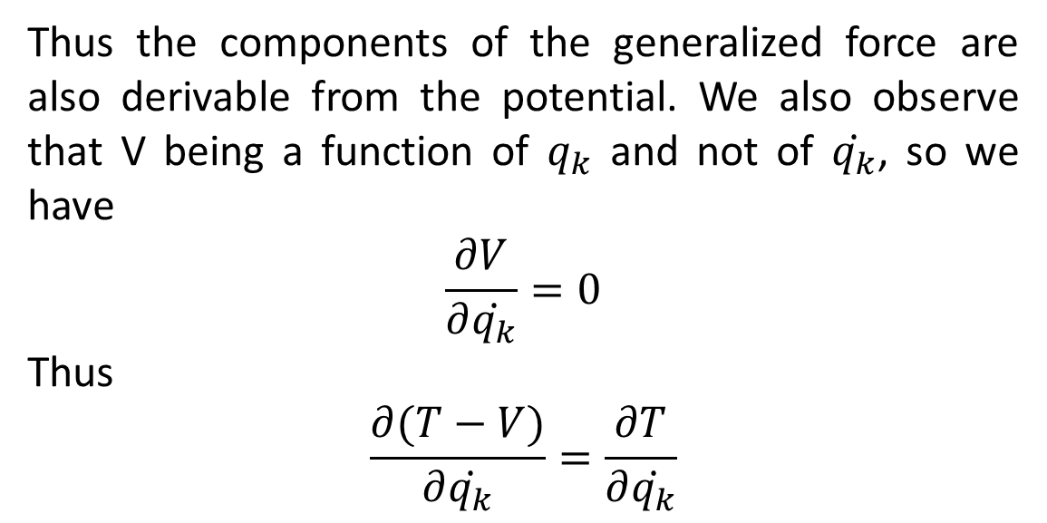
Thus the components of the generalized force are also derivable from the potential. We also observe that V being a function of $q_{k}$ and not of $\dot{q_{k}}$, so we have
$$\frac{∂V}{∂\dot{q_{k}}}=0$$
Thus
$$\frac{∂(T−V)}{∂\dot{q_{k}}}=\frac{∂T}{∂\dot{q_{k}}}$$

Slide 15
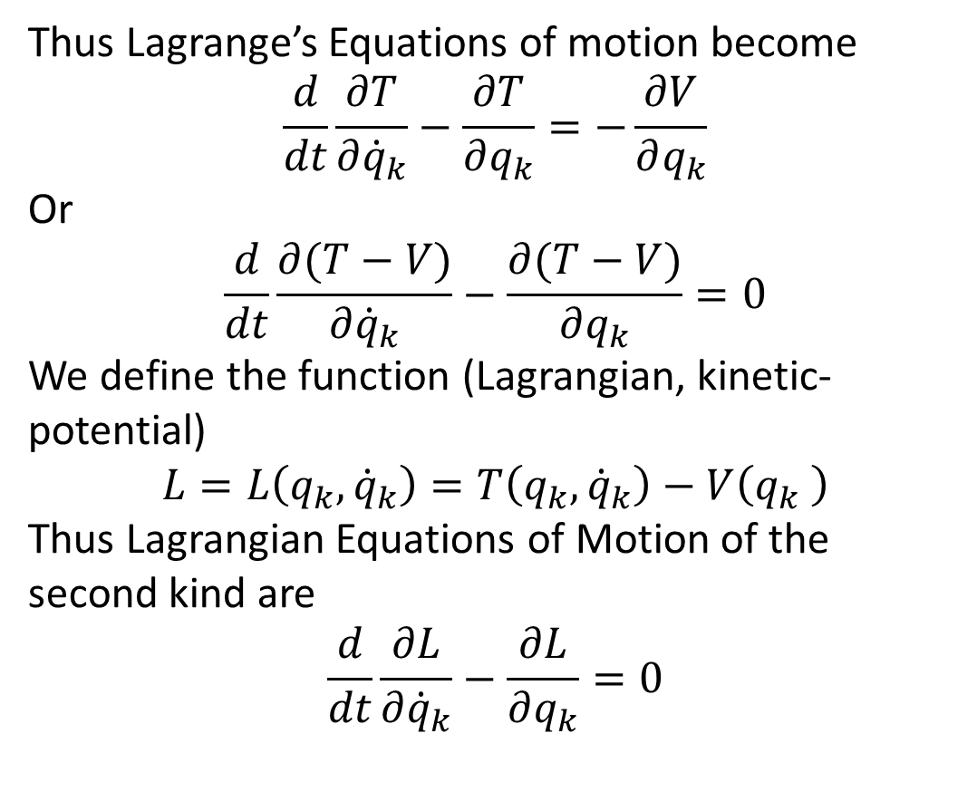
Thus Lagrange’s Equations of motion become
$$\frac{d}{dt}\frac{∂T}{∂{\dot{q}}_{k}}−\frac{∂T}{∂q_{k}}=−\frac{∂V}{∂q_{k}}$$
Or
$$\frac{d}{dt}\frac{∂(T−V)}{∂{\dot{q}}_{k}}−\frac{∂(T−V)}{∂q_{k}}=0$$
We define the function (Lagrangian, kinetic-potential)
$$L=L\left(q_{k},{\dot{q}}_{k}\right)=T\left(q_{k},{\dot{q}}_{k}\right)−V\left(q_{k} \right)$$
Thus Lagrangian Equations of Motion of the second kind are
$$\frac{d}{dt}\frac{∂L}{∂{\dot{q}}_{k}}−\frac{∂L}{∂q_{k}}=0$$

Slide 16
The End

