Slide 2
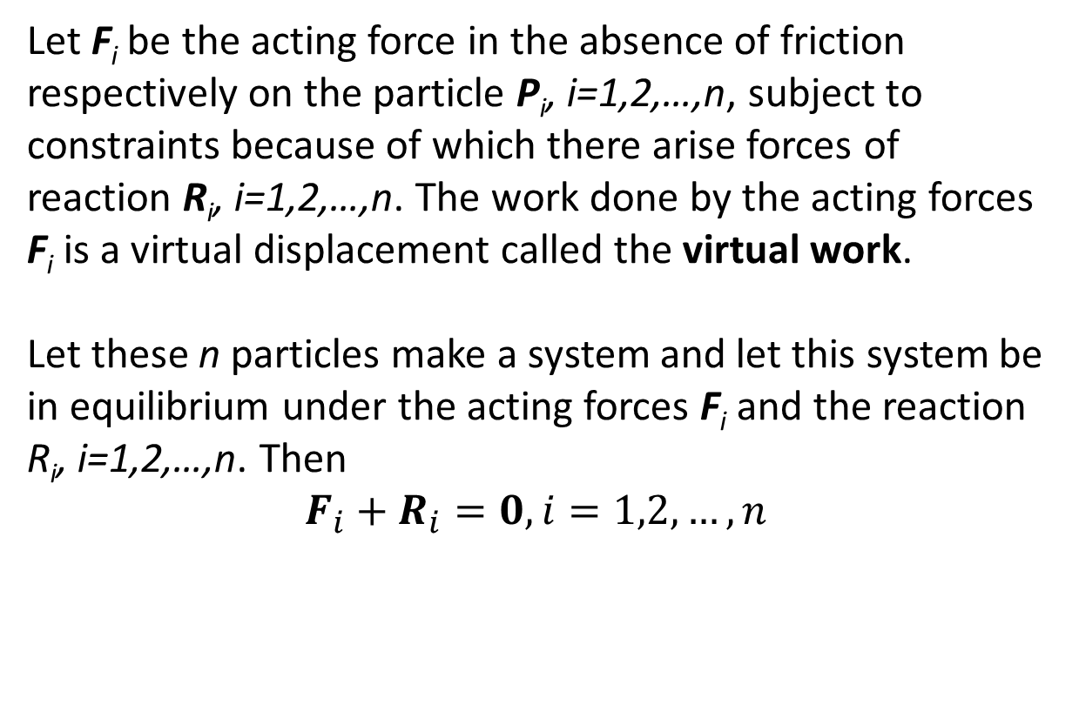
The Principle of Virtual Work
Let F_{i} be the acting force in the absence of friction respectively on the particle P_{i}, i=1,2,…,n, subject to constraints because of which there arise forces of reaction R_{i}, i=1,2,…,n. The work done by the acting forces F_{i} is a virtual displacement called the virtual work.
Let these n particles make a system and let this system be in equilibrium under the acting forces F_{i} and the reaction R_{i}, i=1,2,…,n. Then
$$F_{i}+R_{i}=0, i=1,2,…,n$$

Slide 3
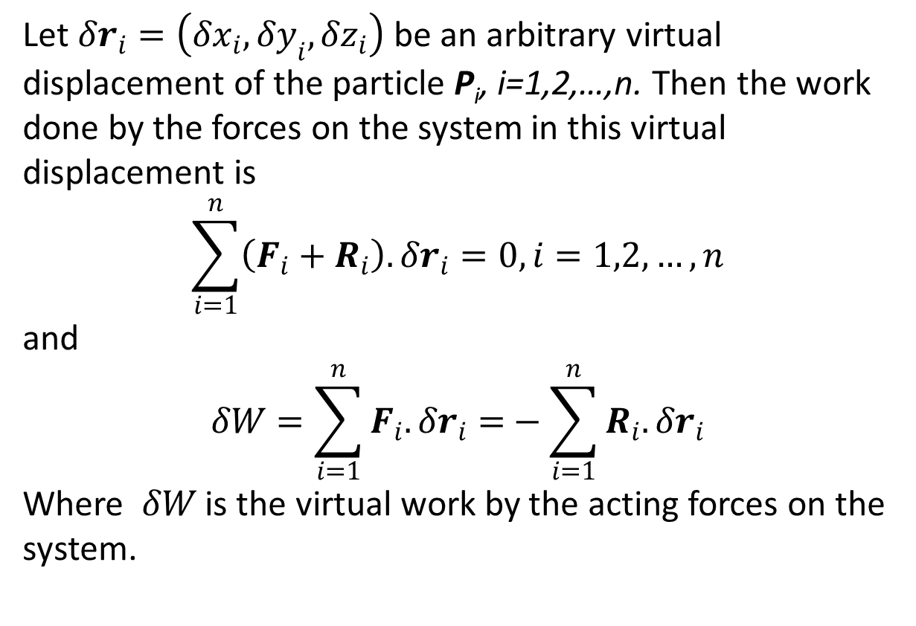
Let $δr_{i}=\left(δx_{i},δy_{i},δz_{i}\right)$ be an arbitrary virtual displacement of the particle P_{i}, i=1,2,…,n. Then the work done by the forces on the system in this virtual displacement is
$$\sum_{i=1}^{n}{\left(F_{i}+R_{i}\right).δr_{i}=0, i=1,2,…,n}$$
and
$$δW=\sum_{i=1}^{n}{F_{i}.δr_{i}=}−\sum_{i=1}^{n}{R_{i}.δr_{i}}$$
Where $δW$ is the virtual work by the acting forces on the system.

Slide 4
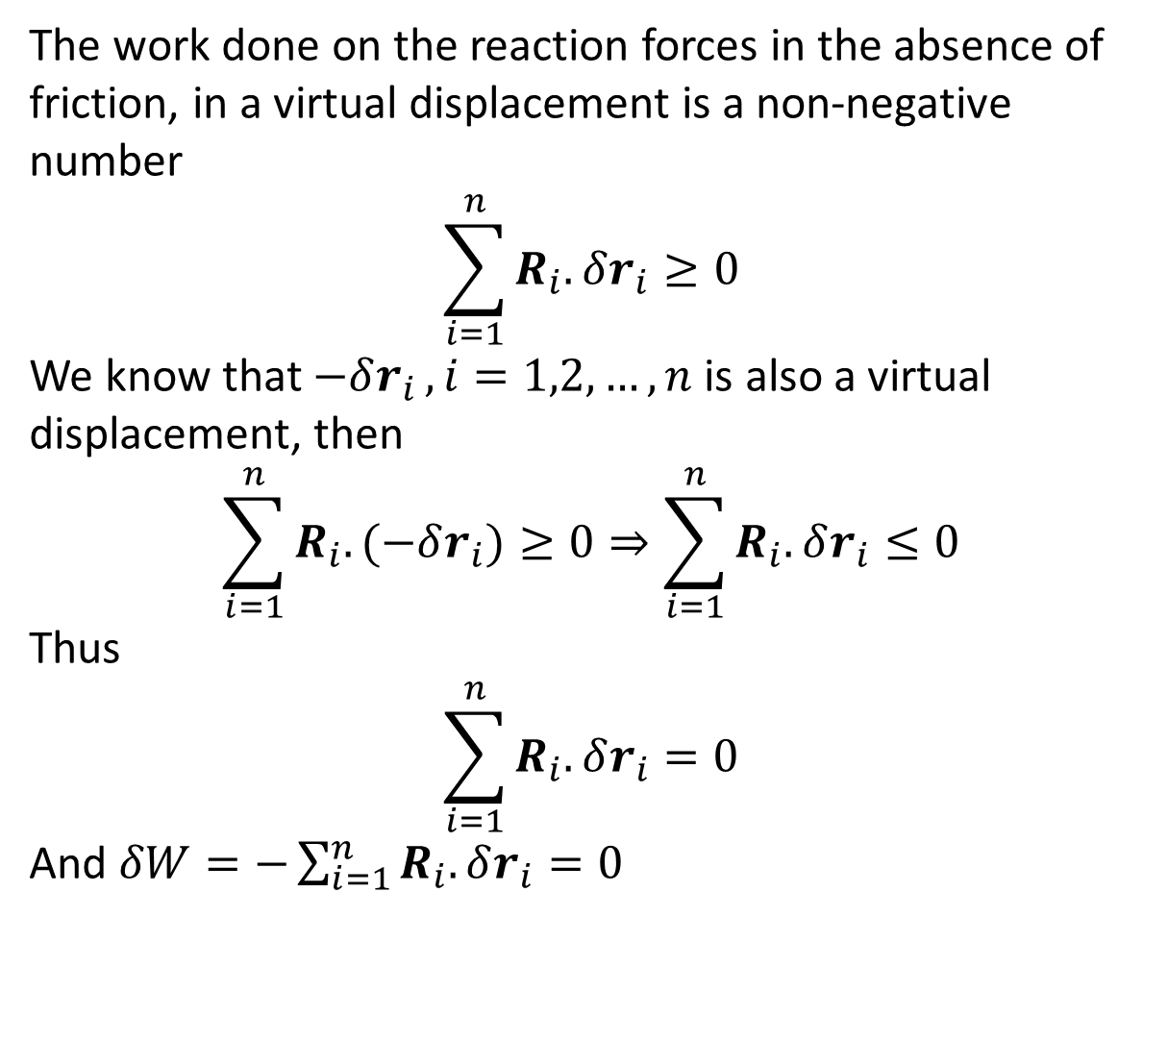
The work done on the reaction forces in the absence of friction, in a virtual displacement is a non-negative number
$$\sum_{i=1}^{n}{R_{i}.δr_{i}}≥0$$
We know that $−δr_{i }, i=1,2,…,n$ is also a virtual displacement, then
$$\sum_{i=1}^{n}{R_{i}.(−δr_{i})}≥0⇒\sum_{i=1}^{n}{R_{i}.δr_{i}}≤0$$
Thus
$$\sum_{i=1}^{n}{R_{i}.δr_{i}}=0$$
And $δW=−\sum_{i=1}^{n}{R_{i}.δr_{i}}=0$

