Slide 1
MTH-382
Analytical Dynamics
MSc Mathematics

Slide 2
Instructor: Dr Umber Sheikh
Assistant Professor 2011 – to date
Department of Mathematics
COMSATS Institute of Information Technology
Park Road, Chak Shahzad, Islamabad
Ph.D. GENERAL RELATIVITY September, 2008
University of the Punjab, Lahore, Pakistan

Slide 3
Previous Education:
M. Phil. – General Relativity (2004)
M. Sc. – Mathematics (2001)
B. Sc. – Mathematics A & B, Statistics (1999)
University of the Punjab, Lahore

Slide 4
Past Experiance:
Lecturer 2008 – 2010
Department of Mathematics
University of the Punjab, Lahore
Assistant Professor 2010 – 2011
Department of Applied Sciences
National Textile University, Faisalabad

Slide 5
Reference Books:
Classical Mechanics (3rd Edition)
by Goldstein, Poole and Safko
Mechanics (3rd Edition)
by L.D. Landau and E.M. Lifshitz
Classical Mechanics (5th Edition)
by Tom W.B. Kibble and Frank H. Berkshire
Theory and Problems of Theoretical Mechanics
with an Introduction to Lagrange Equations and Hamiltonian Theory
by Murray R. Spiegel

Slide 6
Grading
Credit hours = 3(3,0)
Total marks = 100
Sessional 1 = 10 marks
Sessional 2 = 15 marks
No. of Quizzes = 4 of 15 marks.
No. of Assignments = 4 of 10 marks.
Final Exam = 50 marks

Slide 7
Course Objectives
This is an elementary course with principal objective to develop an understanding of the fundamental principles of classical mechanics.
Furthermore it contains the master concepts in Lagrangian and Hamiltonian mechanics. All these topics provide the background to develop solid and systematic problem solving skills which lay a solid foundation for more advanced study of classical mechanics and quantum mechanics.

Slide 8
Course Outline
Kinematics (Chapter 4 + Extra)
Rotating coordinate systems, Rotation matrix,
Velocity and acceleration in cylindrical and spherical coordinates
Lagrangian Mechanics (Chapter 1 + 2)
Generalized coordinates, Constraints, Degrees of freedom, Generalized velocities, Generalized forces, Kinetic energy

Slide 9
Course Outline Cont’d...
Lagrange's Equations (Chapter 1)
Principle of d'Alembert, Lagrange equations of motion, Lagrange multipliers, Equations of motion for holonomic and nonholonomic systems with multipliers
Variational Calculus (Chapter 2 + 9 + 10)
Hamilton's principle, Canonical equations, Ignorable coordinates, Hamilton-Jacobi theory, Theory of small oscillations or canonical transformations

Slide 10
Basic Concepts
Mechanics:
Branch of physics which deals with the motion or change in the position of the physical objects
Mechanics
Kinematics
(deals with the geometry of motion)
Statics
(deals with conditions under which no motion is apparent)
Dynamics
(deals with the physical causes of the motion)

Slide 11
Revision of Basic Concepts of Mechanics
Particle:
A small localized object which can be ascribed several physical properties such as mass and volume.
A small bit of matter occupying a point in space and perhaps moving as time goes by.

Slide 12
Linear motion (Rectilinear Motion):
A motion along a straight line, and can therefore be described mathematically using only one spatial dimention.
Types of linear motion: Uniform linear motion and non uniform linear motion.
Rotation: A rotation is a circular movement of an object around a center (or point) of rotation. A three-dimensional object rotates always around an imaginary line called a rotation axis.
Types of rotation: Spin and revolution.

Slide 13
Frame of Reference:
A coordinate system or set of axes within which to measure position, orientation and other properties of objects.
Inertial Frame of Reference:
A frame of reference within which Newton’s second law of motion holds.

Slide 14
Newton’s Laws:
Every particle persists in a state of rest or of uniform motion in a straight line (i.e., with constant velocity) unless acted upon by a force.
If F is the external force acting on a particle of mass m which as a consequence is moving with velocity v, then F=d(mv)/dt=dp/dt where p=mv is called the momentum. If m is independent of time t, this becomes F=mdv/dt=ma, a = accelaration.
If particle 1 acts on particle 2 with a force F₁₂ in a direction along the line joining the particles, while particle 2 acts on particle 1 with a force F₂₁, then F₁₂=-F₂₁. In other words, to every action there is an equal and opposite reaction.

Slide 15
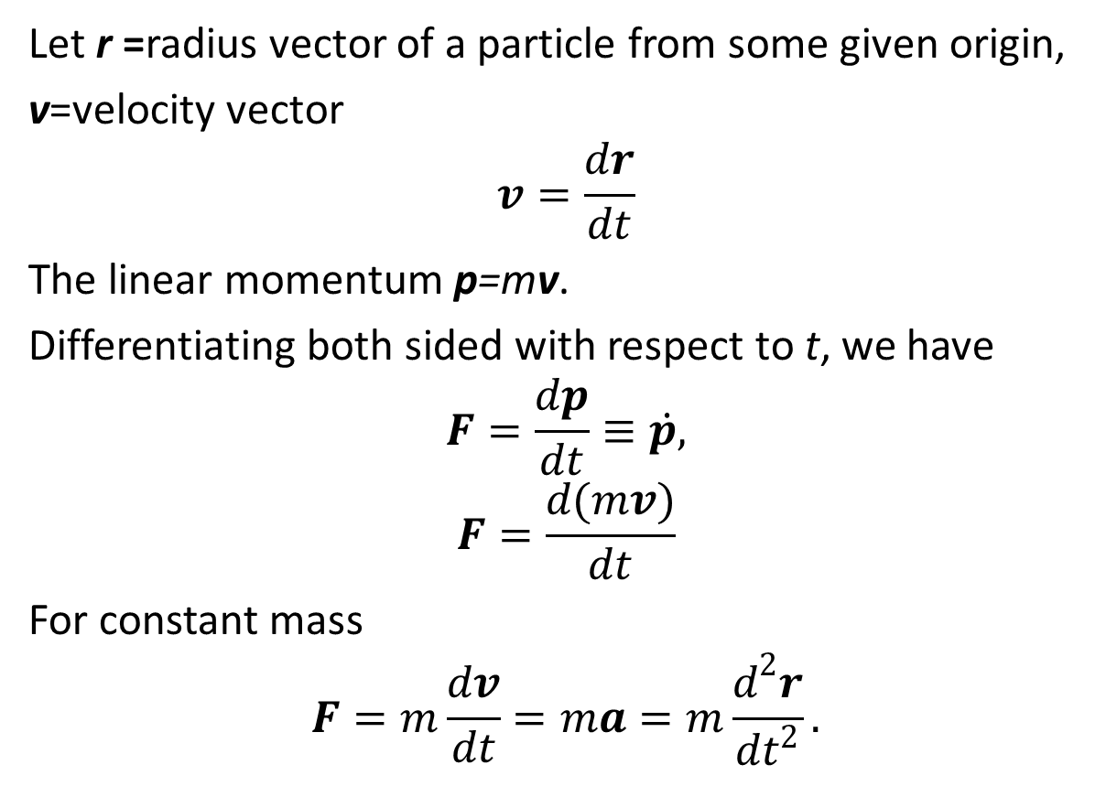
Mechanics of a Particle
Let r =radius vector of a particle from some given origin,
v=velocity vector
$$v=\frac{dr}{dt}$$
The linear momentum p=mv.
Differentiating both sided with respect to t, we have
$$F=\frac{dp}{dt}≡\dot{p,}$$
$$F=\frac{d(mv)}{dt}$$
For constant mass
$$F=m\frac{dv}{dt}=ma=m\frac{d^{2}r}{dt^{2}}.$$

Slide 16
Conservation Theorem for the Linear Momentum of a Particle:
If the total force F is zero, then p=0 and the linear momentum p, is conserved.

Slide 17
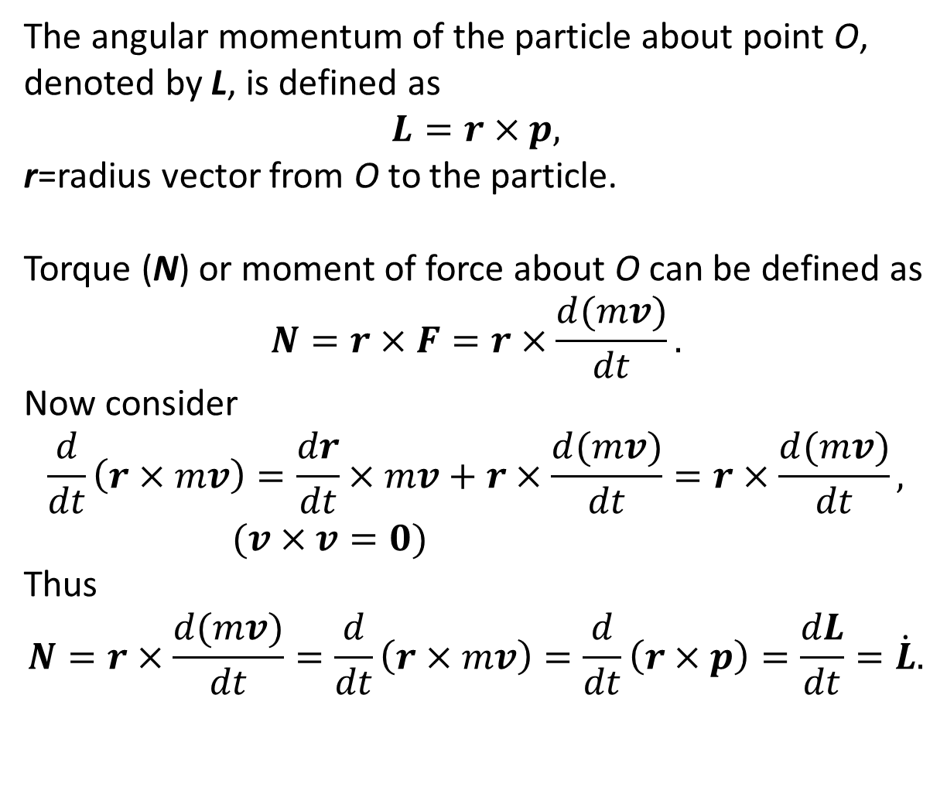
The angular momentum of the particle about point O, denoted by L, is defined as
$$L=r×p,$$
r=radius vector from O to the particle.
Torque (N) or moment of force about O can be defined as
$$N=r×F=r×\frac{d(mv)}{dt}.$$
Now consider
$$\frac{d}{dt}\left(r×mv\right)=\frac{dr}{dt}×mv+r×\frac{d(mv)}{dt}=r×\frac{d(mv)}{dt}, (v×v=0)$$
Thus
$$N=r×\frac{d(mv)}{dt}=\frac{d}{dt}\left(r×mv\right)=\frac{d}{dt}\left(r×p\right)=\frac{dL}{dt}=\dot{L}.$$

Slide 18
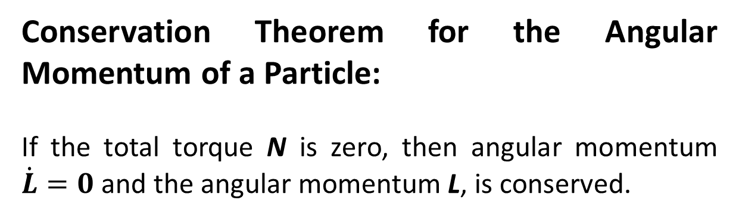
Conservation Theorem for the Angular Momentum of a Particle:
If the total torque N is zero, then angular momentum $\dot{L}=0$ and the angular momentum L, is conserved.

Slide 19
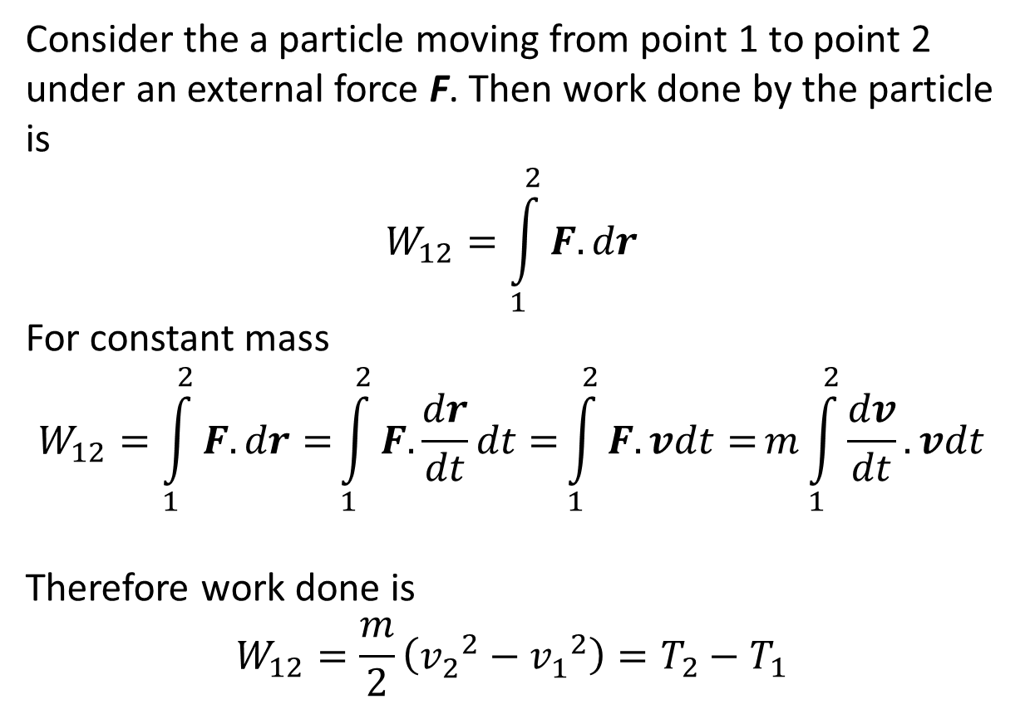
Consider the a particle moving from point 1 to point 2 under an external force F. Then work done by the particle is
$$W_{12}=\int_{1}^{2}{F.dr}$$
For constant mass
$$W_{12}=\int_{1}^{2}{F.dr=}\int_{1}^{2}{F.\frac{dr}{dt}dt=}\int_{1}^{2}{F.vdt=}m\int_{1}^{2}{\frac{dv}{dt}.vdt}$$
Therefore work done is
$$W_{12}=\frac{m}{2}\left({v_{2}^{}}^{2}−{v_{1}^{}}^{2}\right)=T_{2}−T_{1}$$

Slide 20
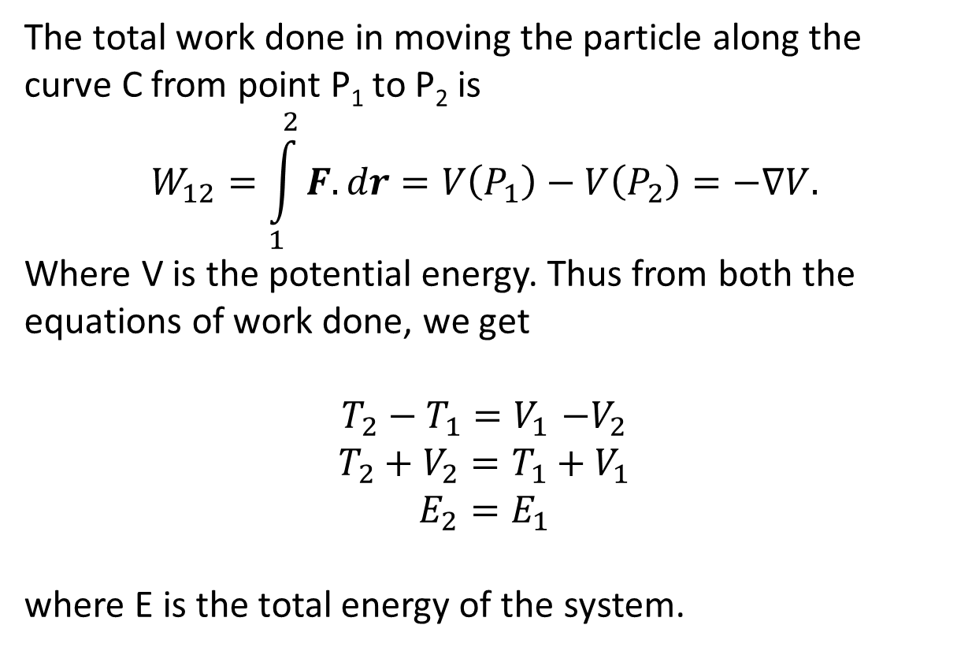
The total work done in moving the particle along the curve C from point P₁ to P₂ is
$$W_{12}=\int_{1}^{2}{F.dr}=V\left(P_{1}\right)−V\left(P_{2}\right)=−∇V.$$
Where V is the potential energy. Thus from both the equations of work done, we get
$$T_{2}−T_{1}{=V}_{1}−V_{2}$$
$$T_{2}+V_{2}{=T_{1}+V}_{1}$$
$$E_{2}{=E}_{1}$$
where E is the total energy of the system.

Slide 21
Conservation Theorem for the Energy of a Particle:
If the forces acting on a particle are conservative, then the total energy of the particle, T+V is conserved.

Slide 22
The End

Slide 23
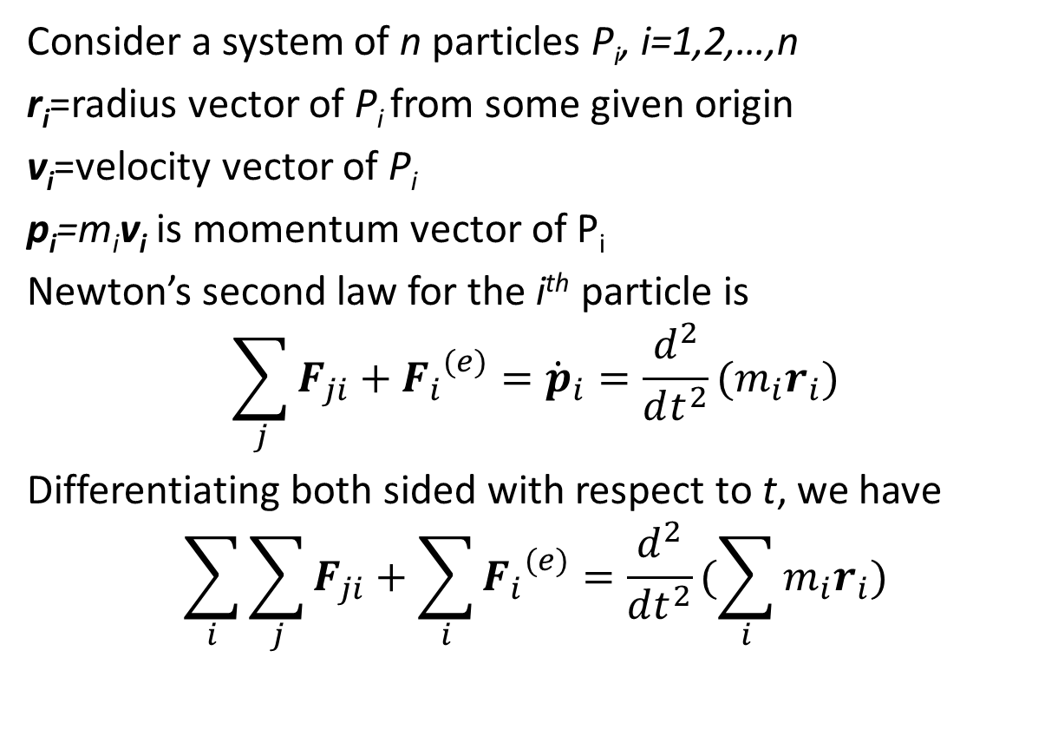
Mechanics of a System of Particles
Consider a system of n particles P_{i}, i=1,2,…,n
r_{i}=radius vector of P_{i} from some given origin
v_{i}=velocity vector of P_{i}
p_{i}=m_{i}v_{i} is momentum vector of P_{i}
Newton’s second law for the i^{th} particle is
$$\sum_{j}{F_{ji}}+{F_{i}}^{(e)}={\dot{p}}_{i}=\frac{d^{2}}{dt^{2}}(m_{i}r_{i})$$
Differentiating both sided with respect to t, we have
$$\sum_{i}{\sum_{j}{F_{ji}}}+\sum_{i}{{F_{i}}^{(e)}}=\frac{d^{2}}{dt^{2}}(\sum_{i}{m_{i}r_{i}})$$

Slide 24
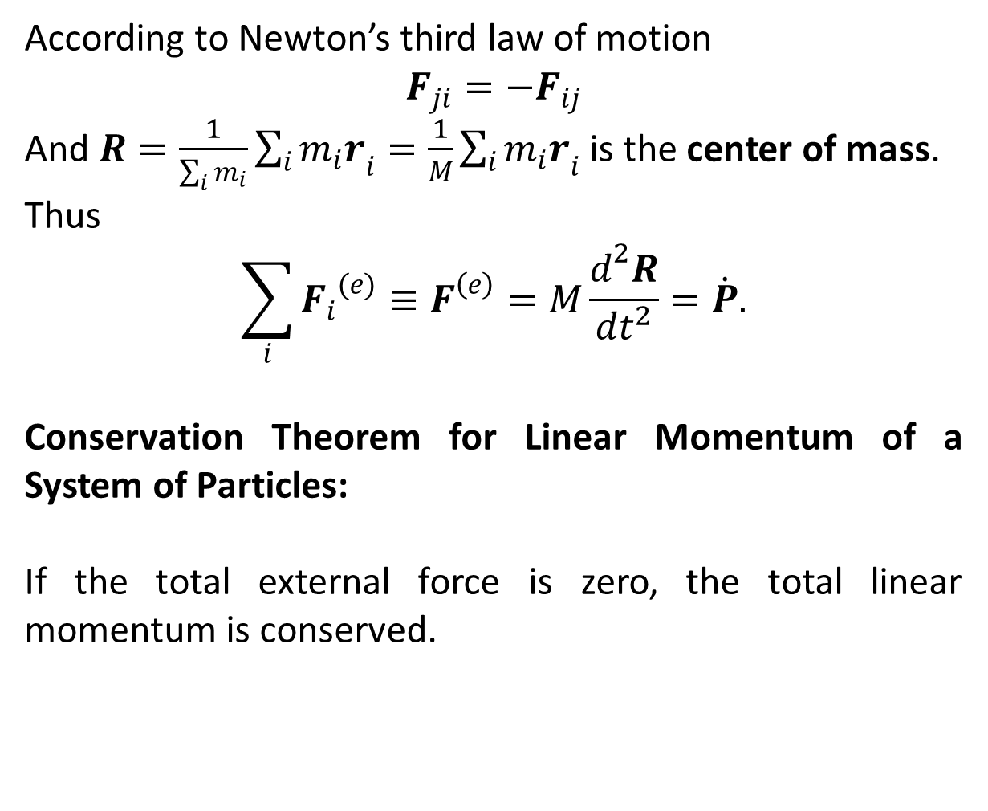
According to Newton’s third law of motion
$$F_{ji}={−F}_{ij}$$
And $R=\frac{1}{\sum_{i}{m_{i}}}\sum_{i}{{m_{i}r}_{i}}=\frac{1}{M}\sum_{i}{{m_{i}r}_{i}}$ is the center of mass.
Thus
$$\sum_{i}{{F_{i}}^{(e)}≡F^{\left(e\right)}=M\frac{d^{2}R}{dt^{2}}=\dot{P}.}$$
Conservation Theorem for Linear Momentum of a System of Particles:
If the total external force is zero, the total linear momentum is conserved.

Slide 25
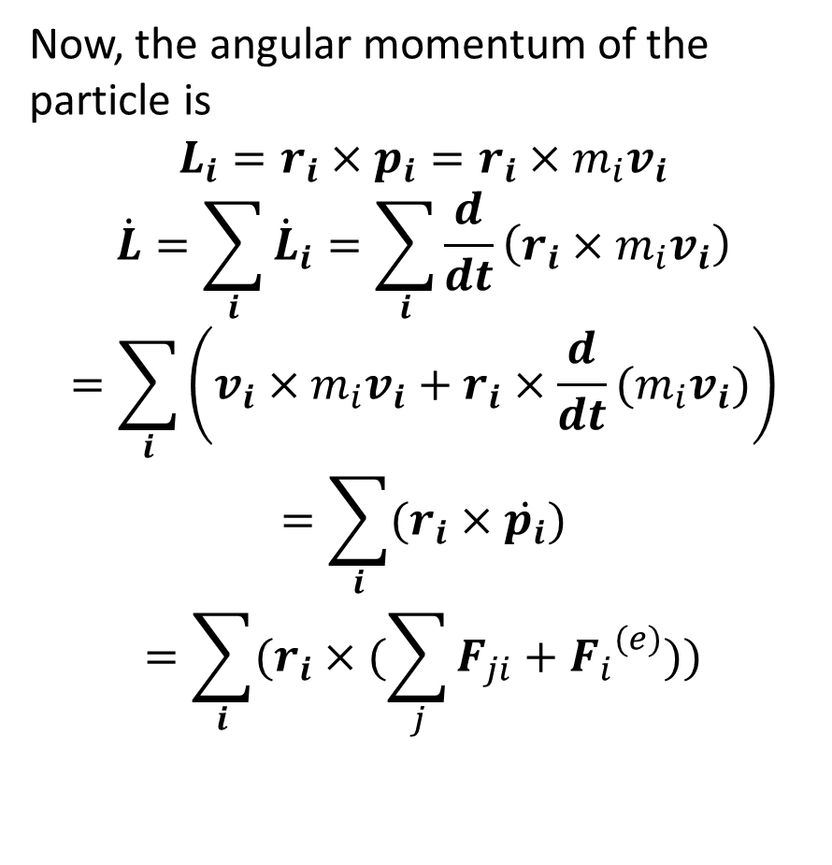
Now, the angular momentum of the particle is
$$L_{i}=r_{i}×p_{i}=r_{i}×m_{i}v_{i}$$
$$\dot{L}=\sum_{i}{{\dot{L}}_{i}}=\sum_{i}{\frac{d}{dt}\left(r_{i}×m_{i}v_{i}\right)}$$
$$=\sum_{i}{\left(v_{i}×m_{i}v_{i}+r_{i}×\frac{d}{dt}(m_{i}v_{i})\right)}$$
$$=\sum_{i}{(r_{i}×\dot{p_{i}})}$$
$$=\sum_{i}{(r_{i}×(\sum_{j}{F_{ji}}+{F_{i}}^{(e)}))}$$

Slide 26
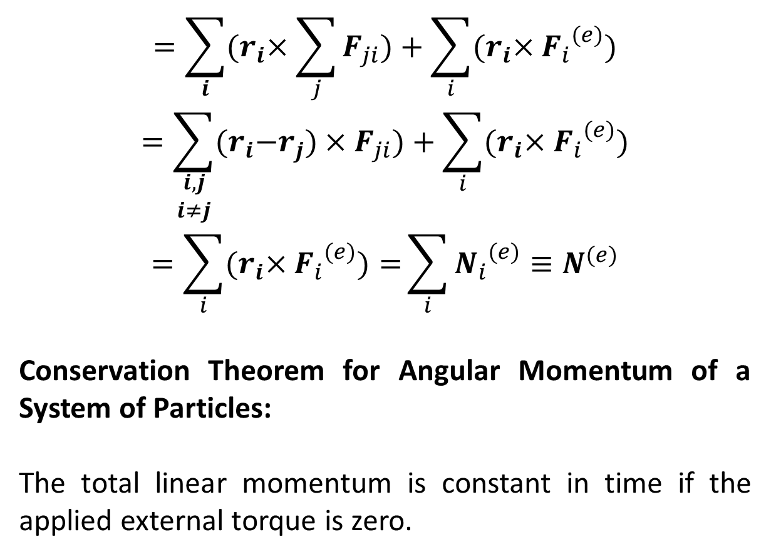
$$=\sum_{i}{{(r}_{i}×\sum_{j}{F_{ji}})+\sum_{i}{{(r}_{i}×{F_{i}}^{(e)})}}$$
$$=\sum_{\begin{aligned}i,j \\ i≠j\end{aligned}}{{(r}_{i}−r_{j})×F_{ji})+\sum_{i}{{(r}_{i}×{F_{i}}^{(e)})}}$$
$$=\sum_{i}{{(r}_{i}×{F_{i}}^{(e)})=}\sum_{i}{{N_{i}}^{(e)}≡N^{(e)}}$$
Conservation Theorem for Angular Momentum of a System of Particles:
The total linear momentum is constant in time if the applied external torque is zero.

Slide 27
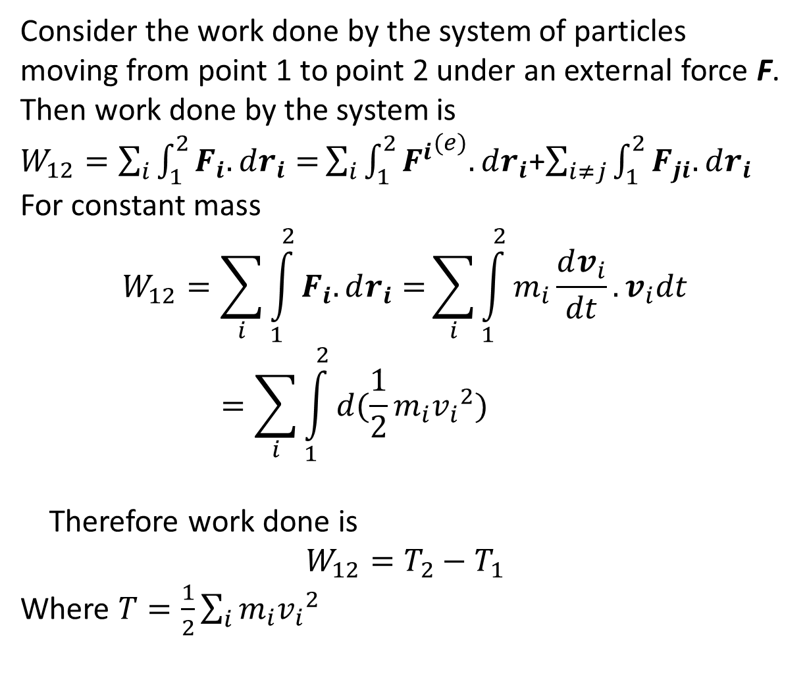
Consider the work done by the system of particles moving from point 1 to point 2 under an external force F. Then work done by the system is
$W_{12}=\sum_{i}{\int_{1}^{2}{F_{i}.dr_{i}}=}\sum_{i}{\int_{1}^{2}{{F^{i}}^{(e)}.dr_{i}}}$+$\sum_{i≠j}{\int_{1}^{2}{F_{ji}.dr_{i}}}$
For constant mass
$$W_{12}=\sum_{i}{\int_{1}^{2}{F_{i}.dr_{i}}=}\sum_{i}{\int_{1}^{2}{m_{i}\frac{dv_{i}}{dt}.v_{i}dt}}=\sum_{i}{\int_{1}^{2}{d(\frac{1}{2}m_{i}{v_{i}}^{2})}}$$
Therefore work done is
$$W_{12}=T_{2}−T_{1}$$
Where $T=\frac{1}{2}\sum_{i}{m_{i}{v_{i}}^{2}}$

Slide 28
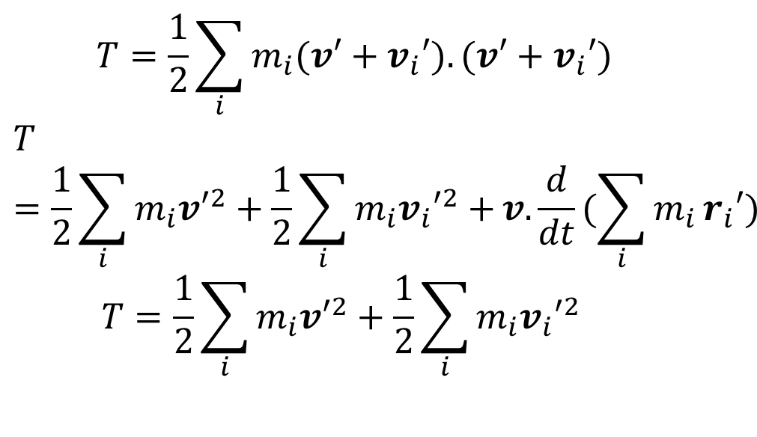
$$T=\frac{1}{2}\sum_{i}{m_{i}{(v′+v}_{i}′).{(v′+v}_{i}′)}$$
$$T=\frac{1}{2}\sum_{i}{m_{i}{v′}^{2}+{\frac{1}{2}\sum_{i}{m_{i}{v_{i}′}^{2}+}v.\frac{d}{dt}(\sum_{i}{m_{i}}r}_{i}′)}$$
$$T=\frac{1}{2}\sum_{i}{m_{i}{v′}^{2}+{\frac{1}{2}\sum_{i}{m_{i}{v_{i}′}^{2}}}_{}}$$

Slide 29
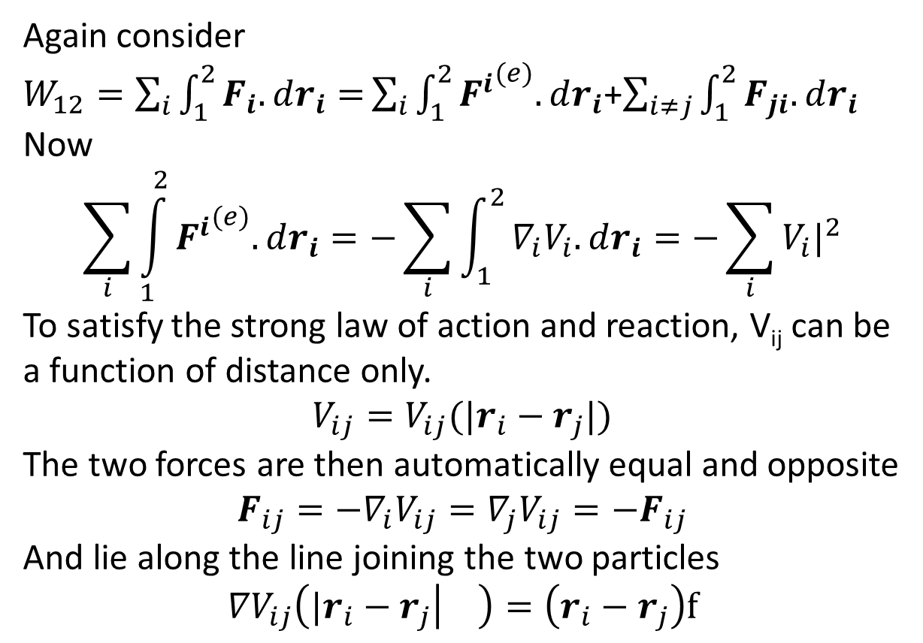
Again consider
$W_{12}=\sum_{i}{\int_{1}^{2}{F_{i}.dr_{i}}=}\sum_{i}{\int_{1}^{2}{{F^{i}}^{(e)}.dr_{i}}}$+$\sum_{i≠j}{\int_{1}^{2}{F_{ji}.dr_{i}}}$
Now
$$\sum_{i}{\int_{1}^{2}{{F^{i}}^{(e)}.dr_{i}}=−\sum_{i}{\int_{1}^{2}{∇_{i}V_{i}.dr_{i}=−\sum_{i}{V_{i}|_{}^{2}}}}}$$
To satisfy the strong law of action and reaction, V_{ij} can be a function of distance only.
$$V_{ij}=V_{ij}({|r}_{i}−r_{j}|)$$
The two forces are then automatically equal and opposite
$$F_{ij}=−∇_{i}V_{ij}=∇_{j}V_{ij}=−F_{ij}$$
And lie along the line joining the two particles
$${∇V}_{ij}\left({|r}_{i}−r_{j} | \right)=\left(r_{i}−r_{j}\right)f$$

Slide 30
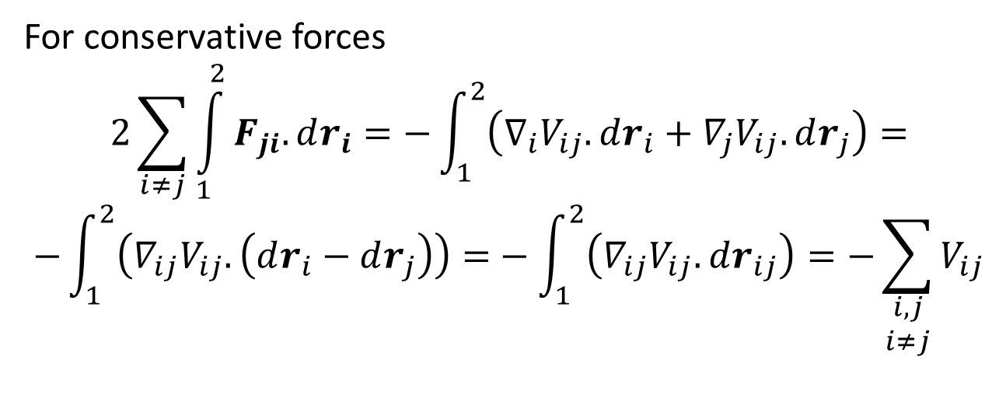
For conservative forces
$$2\sum_{i≠j}{\int_{1}^{2}{F_{ji}.dr_{i}}}=−\int_{1}^{2}{\left(∇_{i}V_{ij}.dr_{i}+∇_{j}V_{ij}.dr_{j}\right)=}$$
$$−\int_{1}^{2}{\left(∇_{ij}V_{ij}.\left(dr_{i}−dr_{j}\right)\right)=}−\int_{1}^{2}{\left(∇_{ij}V_{ij}.dr_{ij}\right)}=−\sum_{\begin{aligned}i,j \\ i≠j\end{aligned}}{V_{ij}}$$

Slide 31
Summary
In previous lecture we have discussed the mechanics of system of particles.
Conservation of Momentum:
If the total external force is zero, the total linear momentum is conserved.
Conservation of Angular Momentum:
The total linear momentum is constant in time if the applied external torque is zero.
Conservation of Energy:
If the total work done is conserved, total energy of the system is conserved.

Slide 32
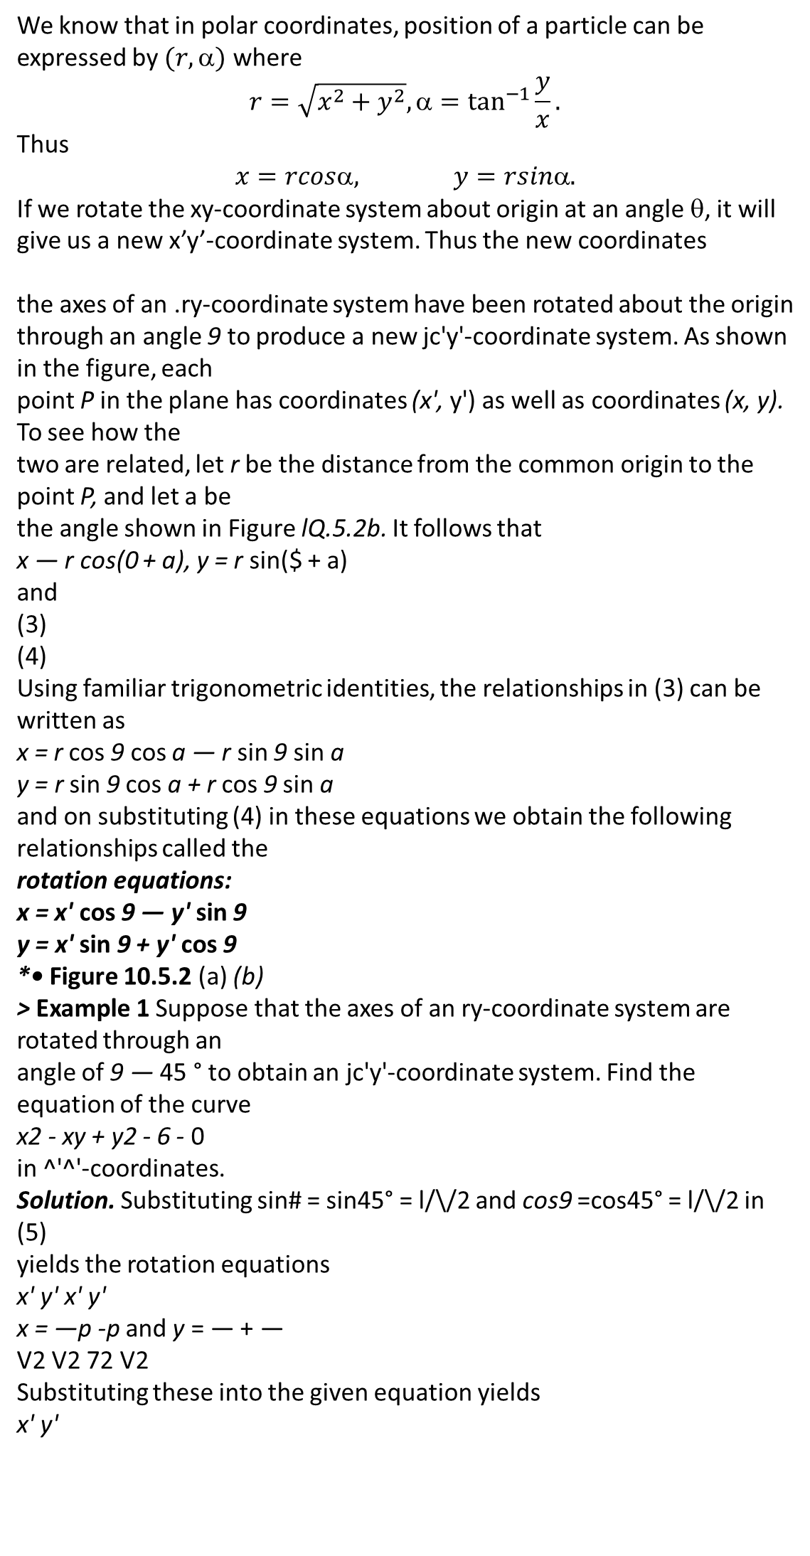
Rotation of Axes
We know that in polar coordinates, position of a particle can be expressed by $(r,\text{α})$ where
$$r=\sqrt{x^{2}+y^{2}},\text{α}=\tan^{−1}{\frac{y}{x}}.$$
Thus
$$x=rcos\text{α}, y=rsin\text{α}.$$
If we rotate the xy-coordinate system about origin at an angle θ, it will give us a new x’y’-coordinate system. Thus the new coordinates
the axes of an .ry-coordinate system have been rotated about the origin
through an angle 9 to produce a new jc'y'-coordinate system. As shown in the figure, each
point P in the plane has coordinates (x', y') as well as coordinates (x, y). To see how the
two are related, let r be the distance from the common origin to the point P, and let a be
the angle shown in Figure lQ.5.2b. It follows that
x — r cos(0 + a), y = r sin($ + a)
and
(3)
(4)
Using familiar trigonometric identities, the relationships in (3) can be written as
x = r cos 9 cos a — r sin 9 sin a
y = r sin 9 cos a + r cos 9 sin a
and on substituting (4) in these equations we obtain the following relationships called the
rotation equations:
x = x' cos 9 — y' sin 9
y = x' sin 9 + y' cos 9
*• Figure 10.5.2 (a) (b)
> Example 1 Suppose that the axes of an ry-coordinate system are rotated through an
angle of 9 — 45 ° to obtain an jc'y'-coordinate system. Find the equation of the curve
x2 - xy + y2 - 6 - 0
in ^'^'-coordinates.
Solution. Substituting sin# = sin45° = l/\/2 and cos9 =cos45° = l/\/2 in (5)
yields the rotation equations
x' y' x' y'
x = —p -p and y = — + —
V2 V2 72 V2
Substituting these into the given equation yields
x' y'

Slide 34
Some New Definitions
Dynamical System:
A system of particles is called a dynamical system.
Configuration:
The set of positions of all the particles is known as configuration of the dynamical system.
Generalized Coordinates:
The coordinates, minimum in number, required to describe the configuration of the dynamical system at any time is called the generalized coordinates of the system.
Examples:
Movement of a fly in a room.
Motion of a particle on the surface of a sphere.

Slide 35
Degrees of Freedom:
The number of generalized coordinates required to describe the configuration of a system is called the degrees of freedom.
Constraints and Forces of Constraints:
Any restriction on the motion of a system is known as constraints and the force responsible is called the force of constraint.

Slide 36
Classification of Dynamical System:
A dynamical system is called holonomic if it is possible to give arbitrary and independent variations to the generalized coordinates of the system without violating constraints, otherwise it is called non-holonomic.
Example:
Let q₁,q₂,…,q_{n} be n generalized coordinates of a dynamical system. Then for a holonomic system, we can change q_{r} to q_{r}+δq_{r}, r=1,2,…,n, without making any changes in the remaining n-1 coordinates.

Slide 37
Classification of Constraints:
Holonomic Constraints: If the conditions of constraints can be expressed as equations connecting the coordinates of the particles and the time as f(t,r₁,r₂,…,r_{n})=0, then the constraints are said to be holonomic.

Slide 38
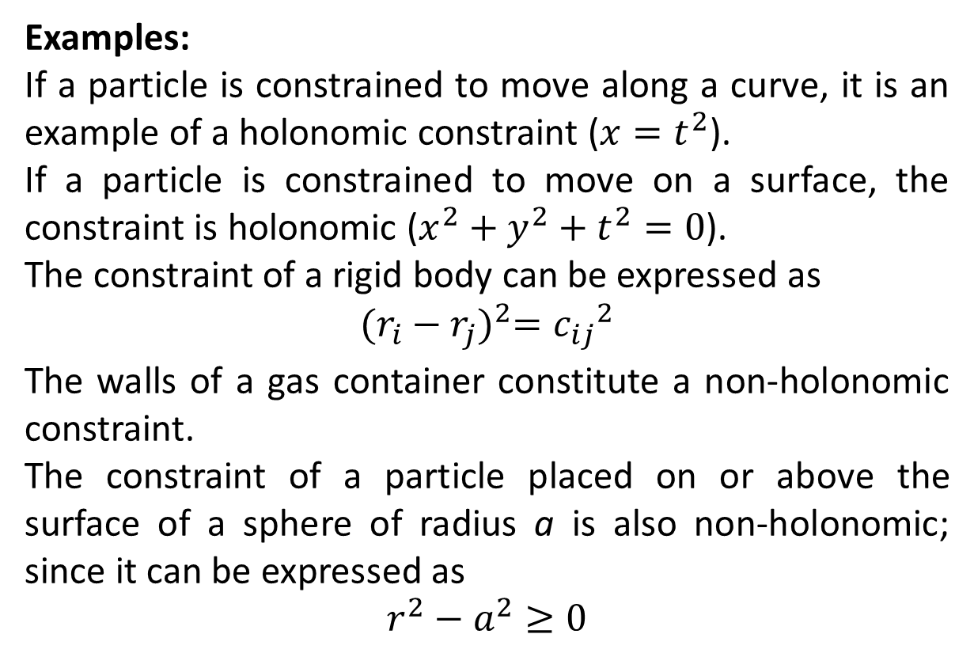
Examples:
If a particle is constrained to move along a curve, it is an example of a holonomic constraint (${x=t}^{2}$).
If a particle is constrained to move on a surface, the constraint is holonomic ($x^{2}+y^{2}+t^{2}=0$).
The constraint of a rigid body can be expressed as
$${(r_{i}−r_{j})}^{2}={c_{ij}}_{}^{2}$$
The walls of a gas container constitute a non-holonomic constraint.
The constraint of a particle placed on or above the surface of a sphere of radius a is also non-holonomic; since it can be expressed as
$$r^{2}−a^{2}≥0$$

Slide 39
Scleronomic and Rheonomic Constraints: Constraints can be further classified according as they are independent of time (scleronomic) or contains time explicitly (rheonomic). In other words, a scleronomic system is one which has only ‘fixed’ constraints, whereas a rheonomic system has ‘moving’ constraints.
Examples:
A pendulum with a fixed support is scleronomic whereas the pendulum for which the point of support is given an assigned motion is rheonomic.

Slide 40
Constraint produce two types of difficulties in the solution of mechanical problems. First, the coordinates ri are no longer all independent, since they are connected by the equations of constraints. Secondly, the forces of constraint are not furnished a priori. They are among the unknown of the problem.

Slide 41
Virtual Displacement:
The displacement of a particle P proportional to its possible velocity at a point is called its virtual displacement at the point. Thus, a virtual displacement has a direction of the possible velocity but an arbitrary magnitude.

Slide 42
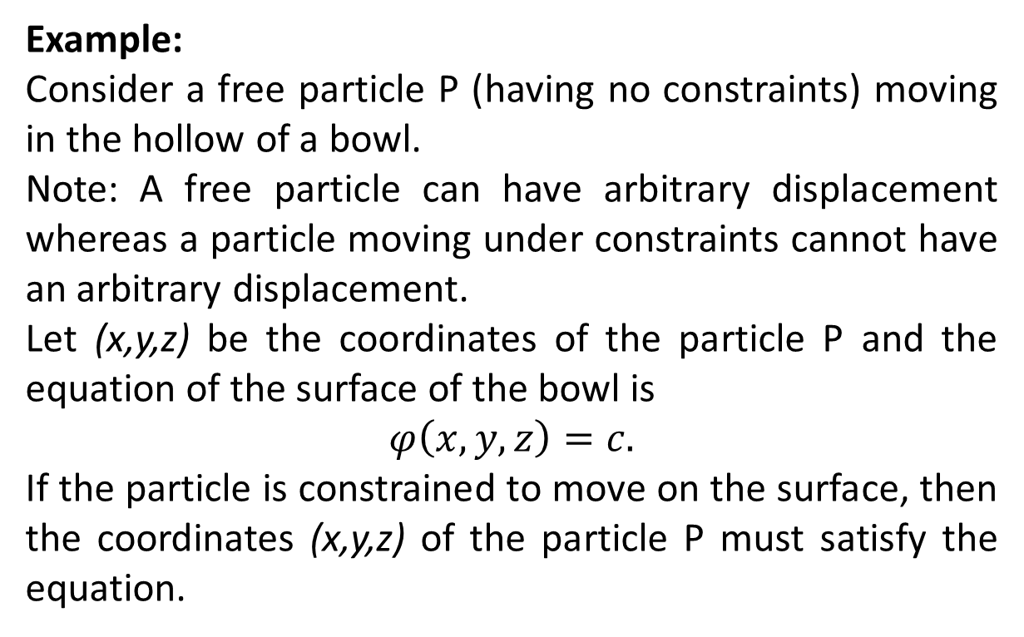
Example:
Consider a free particle P (having no constraints) moving in the hollow of a bowl.
Note: A free particle can have arbitrary displacement whereas a particle moving under constraints cannot have an arbitrary displacement.
Let (x,y,z) be the coordinates of the particle P and the equation of the surface of the bowl is
$$φ\left(x,y,z\right)=c.$$
If the particle is constrained to move on the surface, then the coordinates (x,y,z) of the particle P must satisfy the equation.

Slide 43
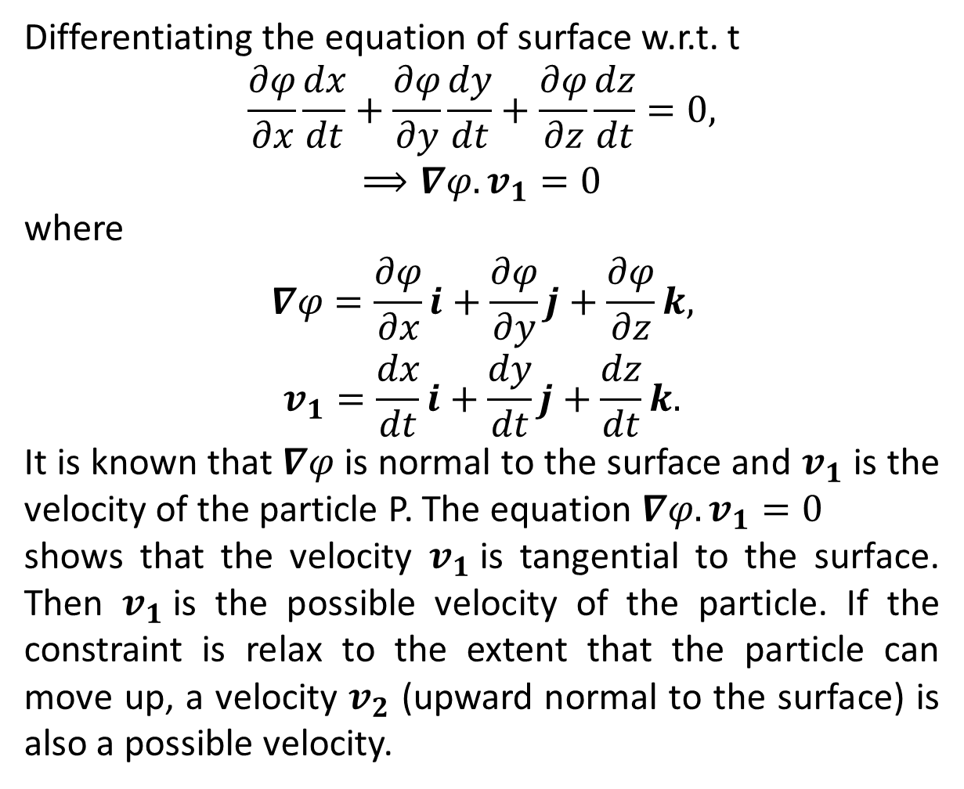
Differentiating the equation of surface w.r.t. t
$$\frac{∂φ}{∂x}\frac{dx}{dt}+\frac{∂φ}{∂y}\frac{dy}{dt}+\frac{∂φ}{∂z}\frac{dz}{dt}=0,$$
$$⟹∇φ.v_{1}=0$$
where
$$∇φ=\frac{∂φ}{∂x}i+\frac{∂φ}{∂y}j+\frac{∂φ}{∂z}k,$$
$$v_{1}=\frac{dx}{dt}i+\frac{dy}{dt}j+\frac{dz}{dt}k.$$
It is known that $∇φ$ is normal to the surface and $v_{1}$ is the velocity of the particle P. The equation $∇φ.v_{1}=0$
shows that the velocity $v_{1}$is tangential to the surface. Then $v_{1}$is the possible velocity of the particle. If the constraint is relax to the extent that the particle can move up, a velocity $v_{2}$ (upward normal to the surface) is also a possible velocity.

Slide 44
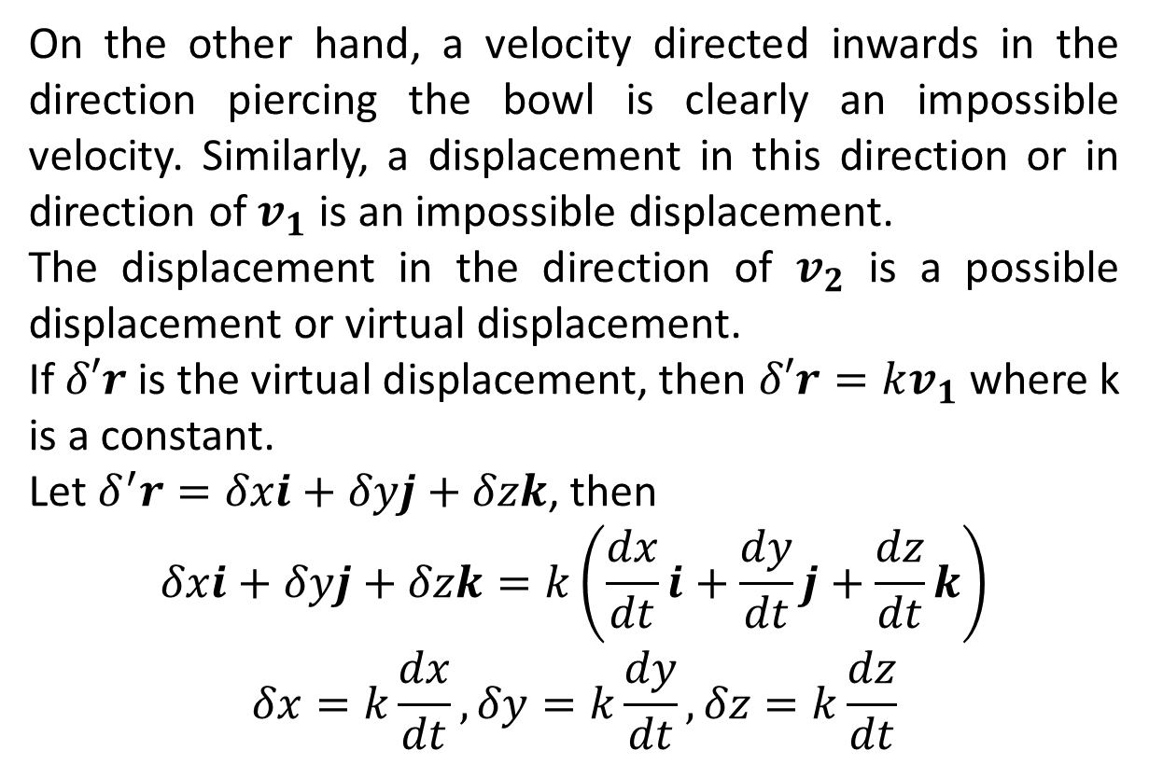
On the other hand, a velocity directed inwards in the direction piercing the bowl is clearly an impossible velocity. Similarly, a displacement in this direction or in direction of $v_{1}$ is an impossible displacement.
The displacement in the direction of $v_{2}$ is a possible displacement or virtual displacement.
If $δ′r$ is the virtual displacement, then $δ′r=kv_{1}$ where k is a constant.
Let $δ^{′}r=δxi+δyj+δzk$, then
$$δxi+δyj+δzk=k\left(\frac{dx}{dt}i+\frac{dy}{dt}j+\frac{dz}{dt}k\right)$$
$$δx=k\frac{dx}{dt},δy=k\frac{dy}{dt},δz=k\frac{dz}{dt}$$

Slide 45
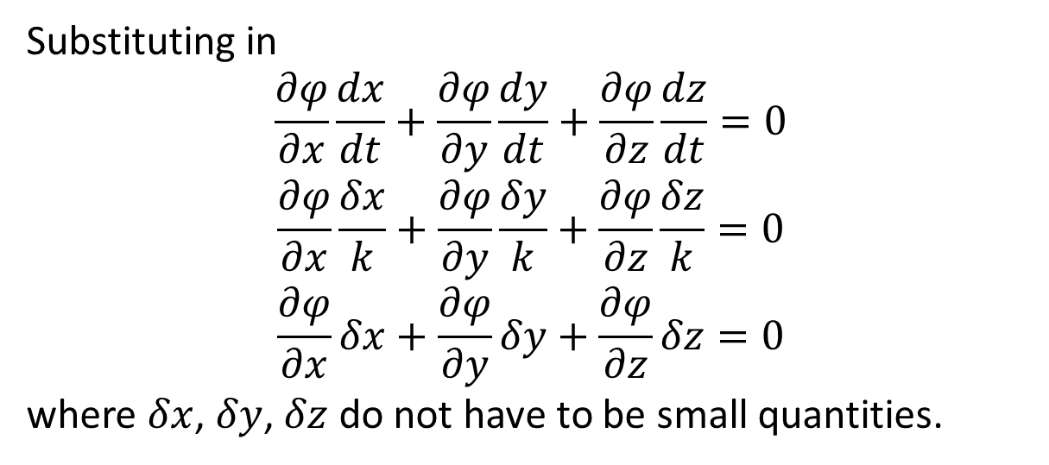
Substituting in
$$\frac{∂φ}{∂x}\frac{dx}{dt}+\frac{∂φ}{∂y}\frac{dy}{dt}+\frac{∂φ}{∂z}\frac{dz}{dt}=0$$
$$\frac{∂φ}{∂x}\frac{δx}{k}+\frac{∂φ}{∂y}\frac{δy}{k}+\frac{∂φ}{∂z}\frac{δz}{k}=0$$
$$\frac{∂φ}{∂x}δx+\frac{∂φ}{∂y}δy+\frac{∂φ}{∂z}δz=0$$
where $δx$, $δy$, $δz$ do not have to be small quantities.

Slide 46
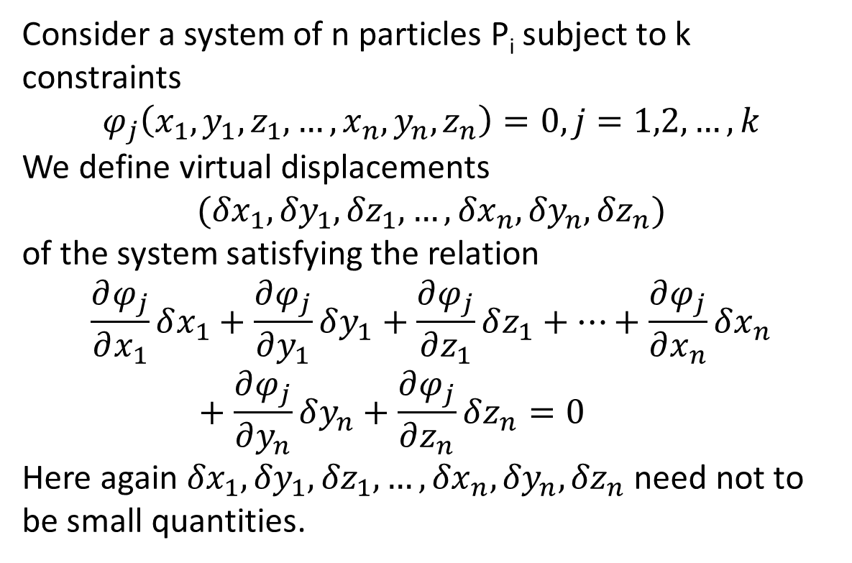
Consider a system of n particles P_{i} subject to k constraints
$$φ_{j}\left(x_{1},{y_{1},z_{1},…,x}_{n},y_{n},z_{n}\right)=0, j=1,2,…,k$$
We define virtual displacements
$$({δx}_{1},{δy}_{1},{δz}_{1},…,{δx}_{n},{δy}_{n},{δz}_{n})$$
of the system satisfying the relation
$$\frac{∂φ_{j}}{∂x_{1}}δx_{1}+\frac{∂φ_{j}}{∂y_{1}}δy_{1}+\frac{∂φ_{j}}{∂z_{1}}δz_{1}+…+\frac{∂φ_{j}}{∂x_{n}}δx_{n}+\frac{∂φ_{j}}{∂y_{n}}δy_{n}+\frac{∂φ_{j}}{∂z_{n}}δz_{n}=0$$
Here again ${δx}_{1},{δy}_{1},{δz}_{1},…,{δx}_{n},{δy}_{n},{δz}_{n}$ need not to be small quantities.

Slide 47
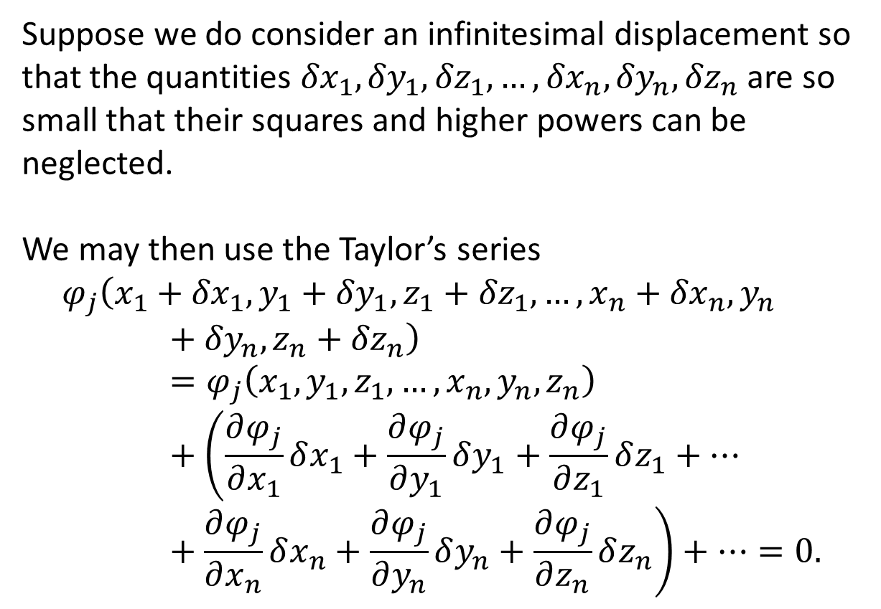
Suppose we do consider an infinitesimal displacement so that the quantities ${δx}_{1},{δy}_{1},{δz}_{1},…,{δx}_{n},{δy}_{n},{δz}_{n}$ are so small that their squares and higher powers can be neglected.
We may then use the Taylor’s series
$$φ_{j}\left(x_{1}+{δx}_{1},{y_{1}+{δy}_{1},z_{1}+{δz}_{1},…,x}_{n}+{δx}_{n},y_{n}+{δy}_{n},z_{n}+{δz}_{n}\right)=φ_{j}\left(x_{1},{y_{1},z_{1},…,x}_{n},y_{n},z_{n}\right)+\left(\frac{∂φ_{j}}{∂x_{1}}δx_{1}+\frac{∂φ_{j}}{∂y_{1}}δy_{1}+\frac{∂φ_{j}}{∂z_{1}}δz_{1}+…+\frac{∂φ_{j}}{∂x_{n}}δx_{n}+\frac{∂φ_{j}}{∂y_{n}}δy_{n}+\frac{∂φ_{j}}{∂z_{n}}δz_{n}\right)+…=0.$$

Slide 48
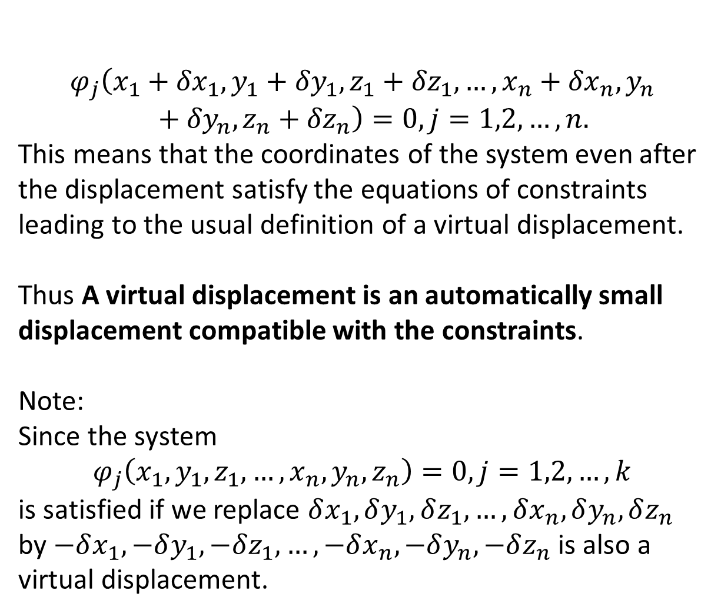
$$φ_{j}\left(x_{1}+{δx}_{1},{y_{1}+{δy}_{1},z_{1}+{δz}_{1},…,x}_{n}+{δx}_{n},y_{n}+{δy}_{n},z_{n}+{δz}_{n}\right)=0, j=1,2,…,n.$$
This means that the coordinates of the system even after the displacement satisfy the equations of constraints leading to the usual definition of a virtual displacement.
Thus A virtual displacement is an automatically small displacement compatible with the constraints.
Note:
Since the system
$$φ_{j}\left(x_{1},{y_{1},z_{1},…,x}_{n},y_{n},z_{n}\right)=0, j=1,2,…,k$$
is satisfied if we replace $δx_{1}, δy_{1}, δz_{1},…,δx_{n}, δy_{n}, δz_{n}$ by $−δx_{1}, −δy_{1}, −δz_{1},…,−δx_{n}, −δy_{n}, −δz_{n}$ is also a virtual displacement.

