Slide 1
Summary
In previous lecture we have discussed the mechanics of system of particles.
Conservation of Momentum:
If the total external force is zero, the total linear momentum is conserved.
Conservation of Angular Momentum:
The total linear momentum is constant in time if the applied external torque is zero.
Conservation of Energy:
If the total work done is conserved, total energy of the system is conserved.

Slide 2
Some New Definitions
Dynamical System:
A system of particles is called a dynamical system.
Configuration:
The set of positions of all the particles is known as configuration of the dynamical system.
Generalized Coordinates:
The coordinates, minimum in number, required to describe the configuration of the dynamical system at any time is called the generalized coordinates of the system.
Examples:
Movement of a fly in a room.
Motion of a particle on the surface of a sphere.

Slide 3
Degrees of Freedom:
The number of generalized coordinates required to describe the configuration of a system is called the degrees of freedom.
Constraints and Forces of Constraints:
Any restriction on the motion of a system is known as constraints and the force responsible is called the force of constraint.

Slide 4
Classification of Dynamical System:
A dynamical system is called holonomic if it is possible to give arbitrary and independent variations to the generalized coordinates of the system without violating constraints, otherwise it is called non-holonomic.
Example:
Let q₁,q₂,…,q_{n} be n generalized coordinates of a dynamical system. Then for a holonomic system, we can change q_{r} to q_{r}+δq_{r}, r=1,2,…,n, without making any changes in the remaining n-1 coordinates.

Slide 5
Classification of Constraints:
Holonomic Constraints: If the conditions of constraints can be expressed as equations connecting the coordinates of the particles and the time as f(t,r₁,r₂,…,r_{n})=0, then the constraints are said to be holonomic. If this condition is not satisfied, the constraints are said to be non-holonomic.
Example:
A particle motion restricted to the surface of a sphere of radius a (r²=a²) is said to be a holonomic constraint. A particle’s motion restricted to r²≤a² is a non-holonomic constraint.

Slide 6
Scleronomic and Rheonomic Constraints: Constraints can be further classified according as they are independent of time (scleronomic) or contains time explicitly (rheonomic). In other words, a scleronomic system is one which has only ‘fixed’ constraints, whereas a rheonomic system has ‘moving’ constraints.
Examples:
A pendulum with a fixed support is scleronomic whereas the pendulum for which the point of support is given an assigned motion is rheonomic.

Slide 7
Constraint produce two types of difficulties in the solution of mechanical problems. First, the coordinates r_{i} are no longer all independent, since they are connected by the equations of constraints. Secondly, the forces of constraint are not furnished a priori. They are among the unknown of the problem.

Slide 8
Virtual Displacement:
The displacement of a particle P proportional to its possible velocity at a point is called its virtual displacement at the point. Thus, a virtual displacement has a direction of the possible velocity but an arbitrary magnitude.

Slide 9
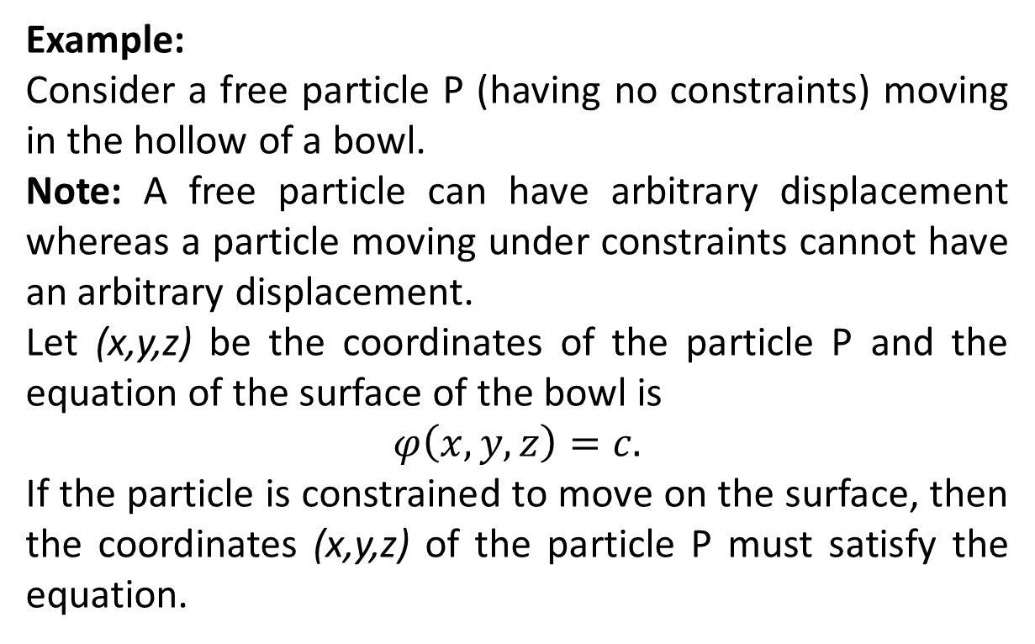
Example:
Consider a free particle P (having no constraints) moving in the hollow of a bowl.
Note: A free particle can have arbitrary displacement whereas a particle moving under constraints cannot have an arbitrary displacement.
Let (x,y,z) be the coordinates of the particle P and the equation of the surface of the bowl is
$$φ\left(x,y,z\right)=c.$$
If the particle is constrained to move on the surface, then the coordinates (x,y,z) of the particle P must satisfy the equation.

Slide 10
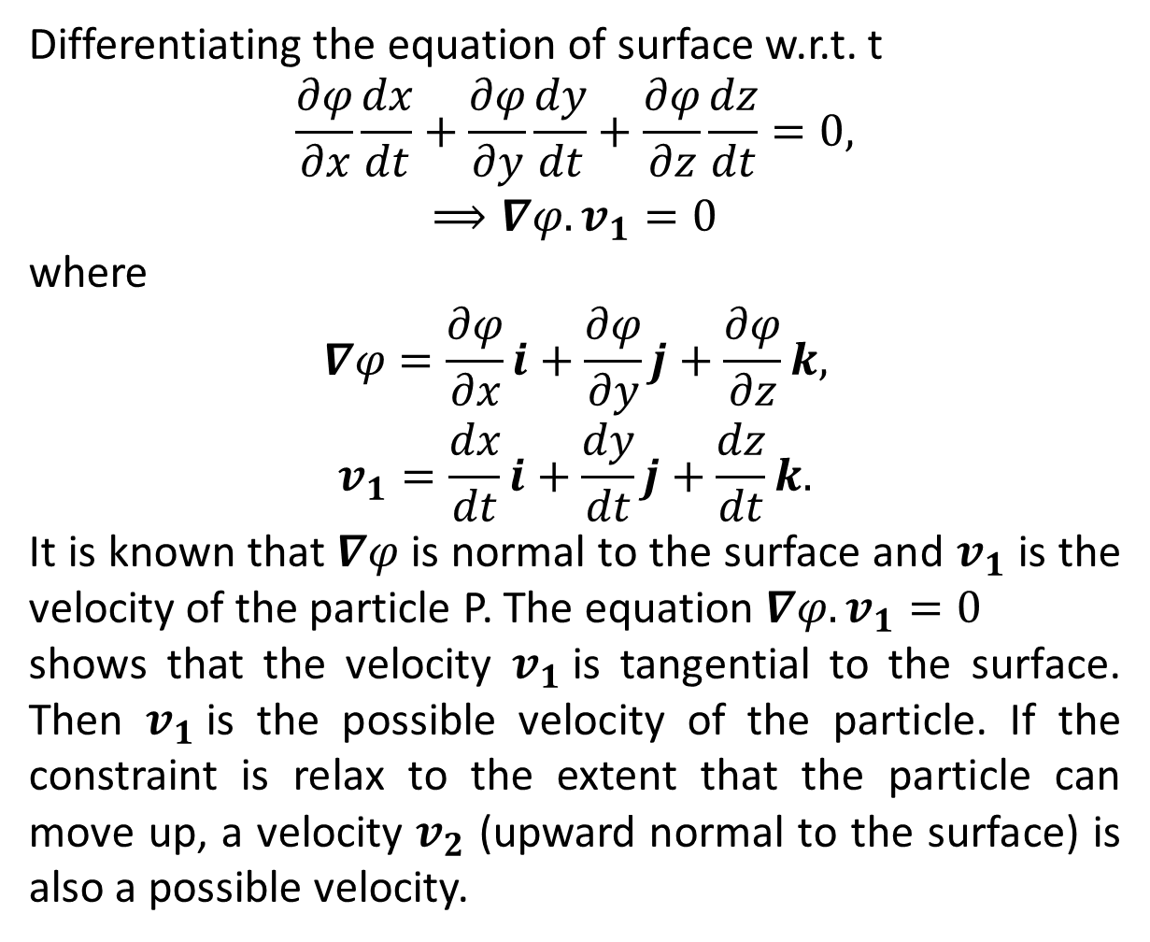
Differentiating the equation of surface w.r.t. t
$$\frac{∂φ}{∂x}\frac{dx}{dt}+\frac{∂φ}{∂y}\frac{dy}{dt}+\frac{∂φ}{∂z}\frac{dz}{dt}=0,$$
$$⟹∇φ.v_{1}=0$$
where
$$∇φ=\frac{∂φ}{∂x}i+\frac{∂φ}{∂y}j+\frac{∂φ}{∂z}k,$$
$$v_{1}=\frac{dx}{dt}i+\frac{dy}{dt}j+\frac{dz}{dt}k.$$
It is known that $∇φ$ is normal to the surface and $v_{1}$ is the velocity of the particle P. The equation $∇φ.v_{1}=0$
shows that the velocity $v_{1}$is tangential to the surface. Then $v_{1}$is the possible velocity of the particle. If the constraint is relax to the extent that the particle can move up, a velocity $v_{2}$ (upward normal to the surface) is also a possible velocity.

Slide 11
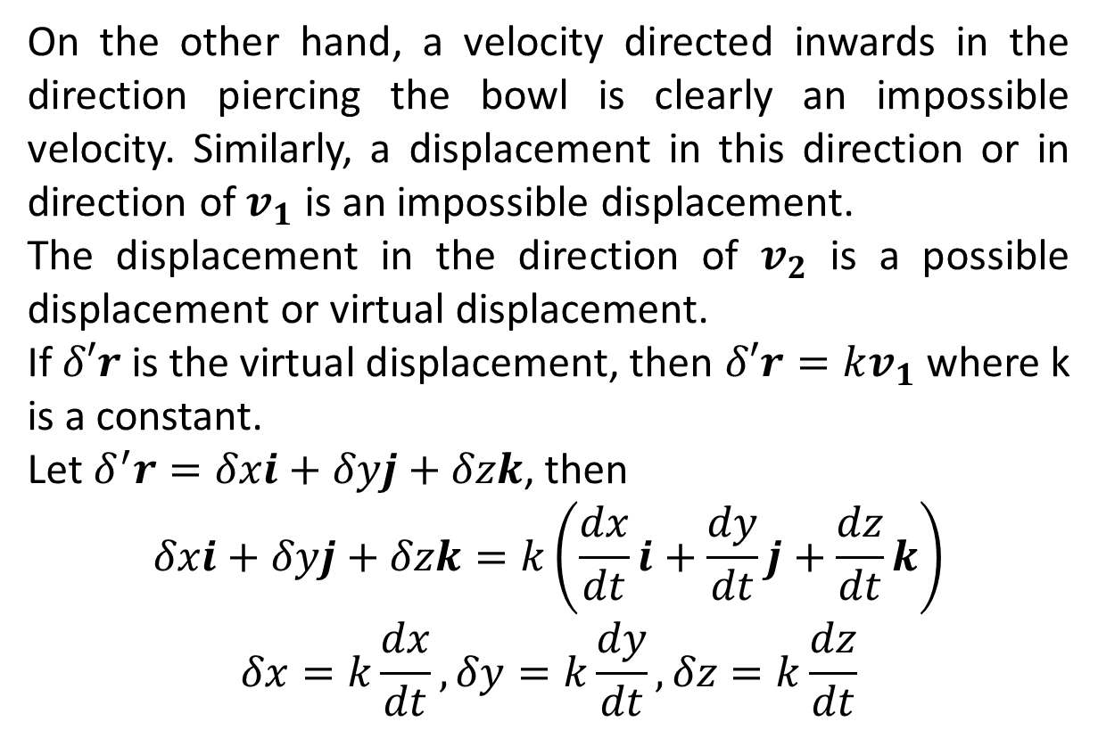
On the other hand, a velocity directed inwards in the direction piercing the bowl is clearly an impossible velocity. Similarly, a displacement in this direction or in direction of $v_{1}$ is an impossible displacement.
The displacement in the direction of $v_{2}$ is a possible displacement or virtual displacement.
If $δ′r$ is the virtual displacement, then $δ′r=kv_{1}$ where k is a constant.
Let $δ^{′}r=δxi+δyj+δzk$, then
$$δxi+δyj+δzk=k\left(\frac{dx}{dt}i+\frac{dy}{dt}j+\frac{dz}{dt}k\right)$$
$$δx=k\frac{dx}{dt},δy=k\frac{dy}{dt},δz=k\frac{dz}{dt}$$

Slide 12
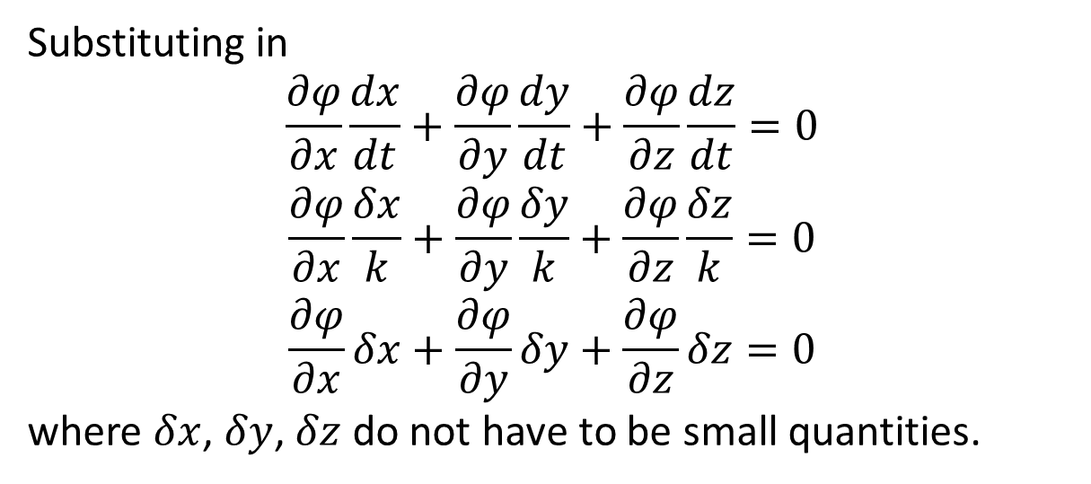
Substituting in
$$\frac{∂φ}{∂x}\frac{dx}{dt}+\frac{∂φ}{∂y}\frac{dy}{dt}+\frac{∂φ}{∂z}\frac{dz}{dt}=0$$
$$\frac{∂φ}{∂x}\frac{δx}{k}+\frac{∂φ}{∂y}\frac{δy}{k}+\frac{∂φ}{∂z}\frac{δz}{k}=0$$
$$\frac{∂φ}{∂x}δx+\frac{∂φ}{∂y}δy+\frac{∂φ}{∂z}δz=0$$
where $δx$, $δy$, $δz$ do not have to be small quantities.

Slide 13
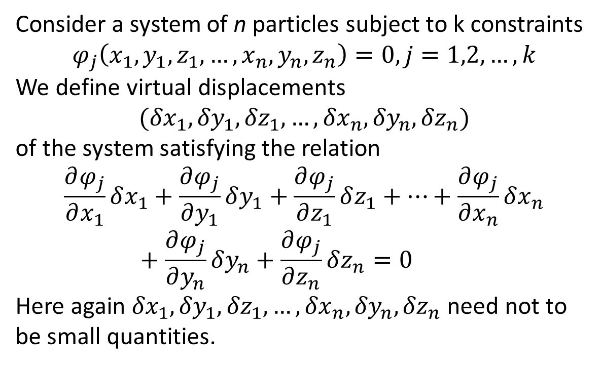
Consider a system of n particles subject to k constraints
$$φ_{j}\left(x_{1},{y_{1},z_{1},…,x}_{n},y_{n},z_{n}\right)=0, j=1,2,…,k$$
We define virtual displacements
$$({δx}_{1},{δy}_{1},{δz}_{1},…,{δx}_{n},{δy}_{n},{δz}_{n})$$
of the system satisfying the relation
$$\frac{∂φ_{j}}{∂x_{1}}δx_{1}+\frac{∂φ_{j}}{∂y_{1}}δy_{1}+\frac{∂φ_{j}}{∂z_{1}}δz_{1}+…+\frac{∂φ_{j}}{∂x_{n}}δx_{n}+\frac{∂φ_{j}}{∂y_{n}}δy_{n}+\frac{∂φ_{j}}{∂z_{n}}δz_{n}=0$$
Here again ${δx}_{1},{δy}_{1},{δz}_{1},…,{δx}_{n},{δy}_{n},{δz}_{n}$ need not to be small quantities.

Slide 14
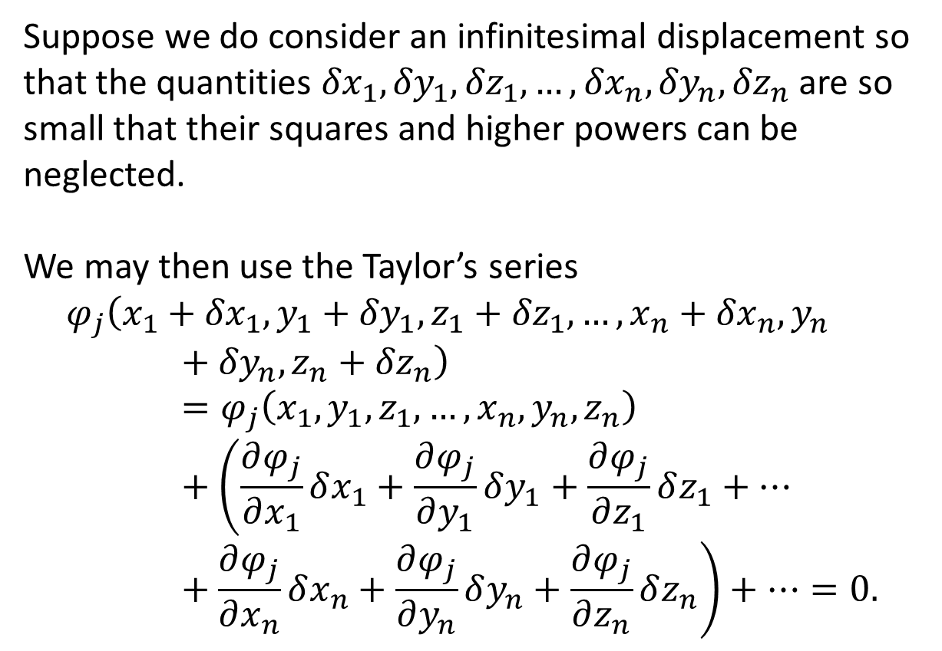
Suppose we do consider an infinitesimal displacement so that the quantities ${δx}_{1},{δy}_{1},{δz}_{1},…,{δx}_{n},{δy}_{n},{δz}_{n}$ are so small that their squares and higher powers can be neglected.
We may then use the Taylor’s series
$$φ_{j}\left(x_{1}+{δx}_{1},{y_{1}+{δy}_{1},z_{1}+{δz}_{1},…,x}_{n}+{δx}_{n},y_{n}+{δy}_{n},z_{n}+{δz}_{n}\right)=φ_{j}\left(x_{1},{y_{1},z_{1},…,x}_{n},y_{n},z_{n}\right)+\left(\frac{∂φ_{j}}{∂x_{1}}δx_{1}+\frac{∂φ_{j}}{∂y_{1}}δy_{1}+\frac{∂φ_{j}}{∂z_{1}}δz_{1}+…+\frac{∂φ_{j}}{∂x_{n}}δx_{n}+\frac{∂φ_{j}}{∂y_{n}}δy_{n}+\frac{∂φ_{j}}{∂z_{n}}δz_{n}\right)+…=0.$$

Slide 15
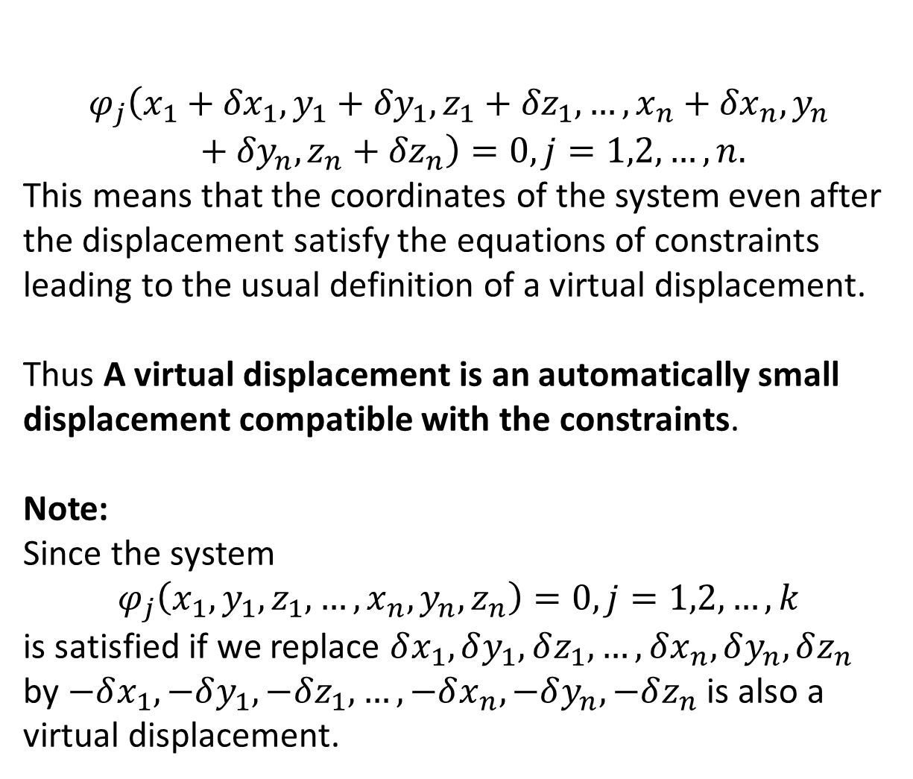
$$φ_{j}\left(x_{1}+{δx}_{1},{y_{1}+{δy}_{1},z_{1}+{δz}_{1},…,x}_{n}+{δx}_{n},y_{n}+{δy}_{n},z_{n}+{δz}_{n}\right)=0, j=1,2,…,n.$$
This means that the coordinates of the system even after the displacement satisfy the equations of constraints leading to the usual definition of a virtual displacement.
Thus A virtual displacement is an automatically small displacement compatible with the constraints.
Note:
Since the system
$$φ_{j}\left(x_{1},{y_{1},z_{1},…,x}_{n},y_{n},z_{n}\right)=0, j=1,2,…,k$$
is satisfied if we replace $δx_{1}, δy_{1}, δz_{1},…,δx_{n}, δy_{n}, δz_{n}$ by $−δx_{1}, −δy_{1}, −δz_{1},…,−δx_{n}, −δy_{n}, −δz_{n}$ is also a virtual displacement.

