Slide 1
Revision

Slide 2
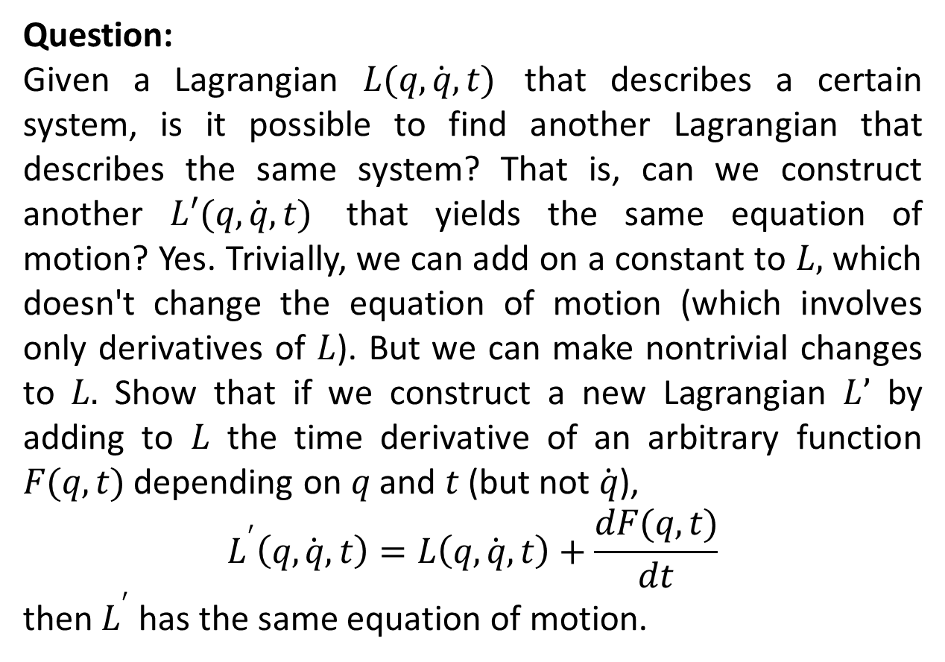
Miscellaneous Problems
Question:
Given a Lagrangian $L(q, \dot{q},t)$ that describes a certain system, is it possible to find another Lagrangian that describes the same system? That is, can we construct another $L′(q, \dot{q},t)$ that yields the same equation of motion? Yes. Trivially, we can add on a constant to $L,$ which doesn't change the equation of motion (which involves only derivatives of $L$). But we can make nontrivial changes to $L.$ Show that if we construct a new Lagrangian $L’$ by adding to $L$ the time derivative of an arbitrary function $F(q,t)$ depending on $q$ and $t$ (but not $\dot{q}$),
$$L^{′}\left(q, \dot{q},t\right)=L\left(q, \dot{q},t\right)+\frac{dF(q,t)}{dt}$$
then $L^{′}$ has the same equation of motion.

Slide 3
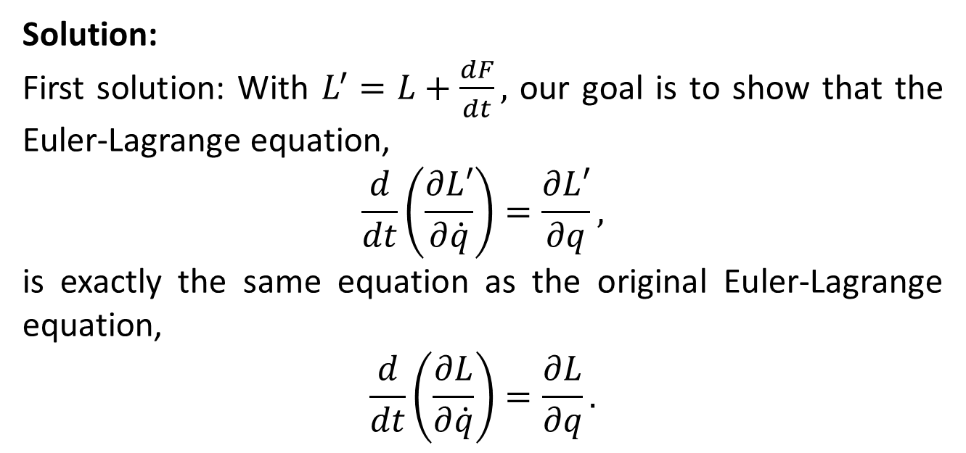
Solution:
First solution: With $L^{′}=L+\frac{dF}{dt},$ our goal is to show that the Euler-Lagrange equation,
$$\frac{d}{dt}\left(\frac{∂L′}{∂\dot{q}}\right)=\frac{∂L′}{∂q},$$
is exactly the same equation as the original Euler-Lagrange equation,
$$\frac{d}{dt}\left(\frac{∂L}{∂\dot{q}}\right)=\frac{∂L}{∂q}.$$

Slide 4
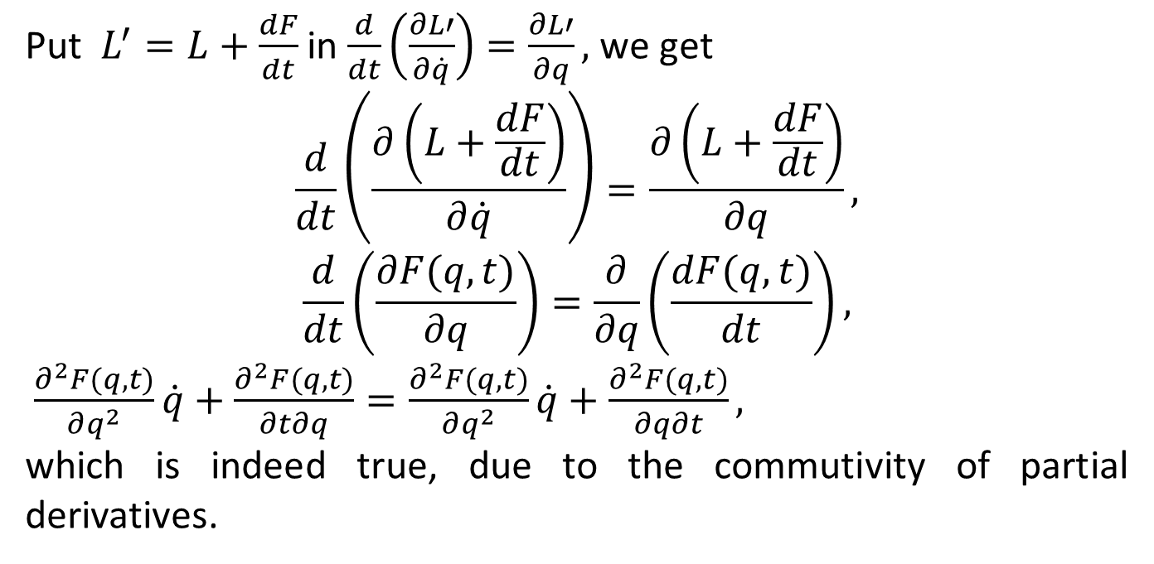
Put $L^{′}=L+\frac{dF}{dt}$ in $\frac{d}{dt}\left(\frac{∂L′}{∂\dot{q}}\right)=\frac{∂L′}{∂q},$ we get
$$\frac{d}{dt}\left(\frac{∂\left(L+\frac{dF}{dt}\right)}{∂\dot{q}}\right)=\frac{∂\left(L+\frac{dF}{dt}\right)}{∂q},$$
$$\frac{d}{dt}\left(\frac{∂F(q,t)}{∂q}\right)=\frac{∂}{∂q}\left(\frac{dF(q,t)}{dt}\right),$$
$\frac{∂^{2}F(q,t)}{∂q^{2}}\dot{q}+\frac{∂^{2}F(q,t)}{∂t∂q}=\frac{∂^{2}F(q,t)}{∂q^{2}}\dot{q}+\frac{∂^{2}F(q,t)}{∂q∂t},$
which is indeed true, due to the commutivity of partial derivatives.

Slide 5
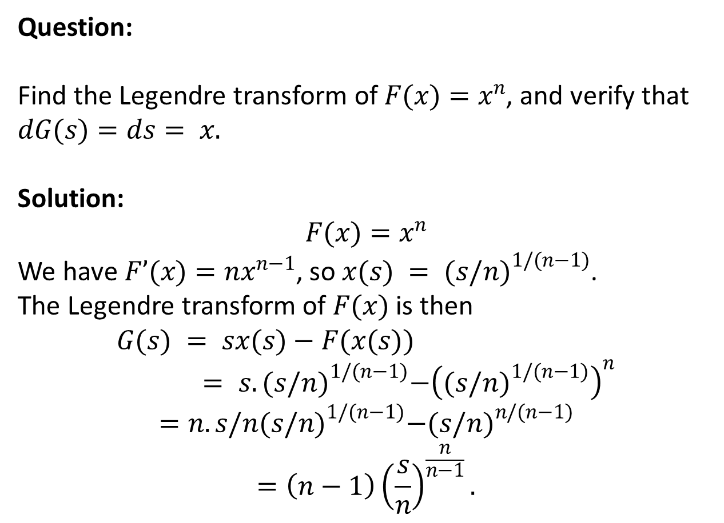
Question:
Find the Legendre transform of $F(x)=x^{n}$, and verify that $dG(s)=ds= x.$
Solution:
$$F(x)=x^{n}$$
We have $F’(x)=nx^{n−1}$, so $x(s) = {(s/n)}^{1/(n−1)}$.
The Legendre transform of $F(x)$ is then
$$G(s) = sx(s)−F(x(s))= s. {(s/n)}^{1/(n−1)}−{\left({(s/n)}^{1/(n−1)}\right)}^{n}$$
$$=n.s/n{(s/n)}^{1/(n−1)}−{(s/n)}^{n/(n−1)}$$
$$=\left(n−1\right){\left(\frac{s}{n}\right)}^{\frac{n}{n−1}}.$$

Slide 6
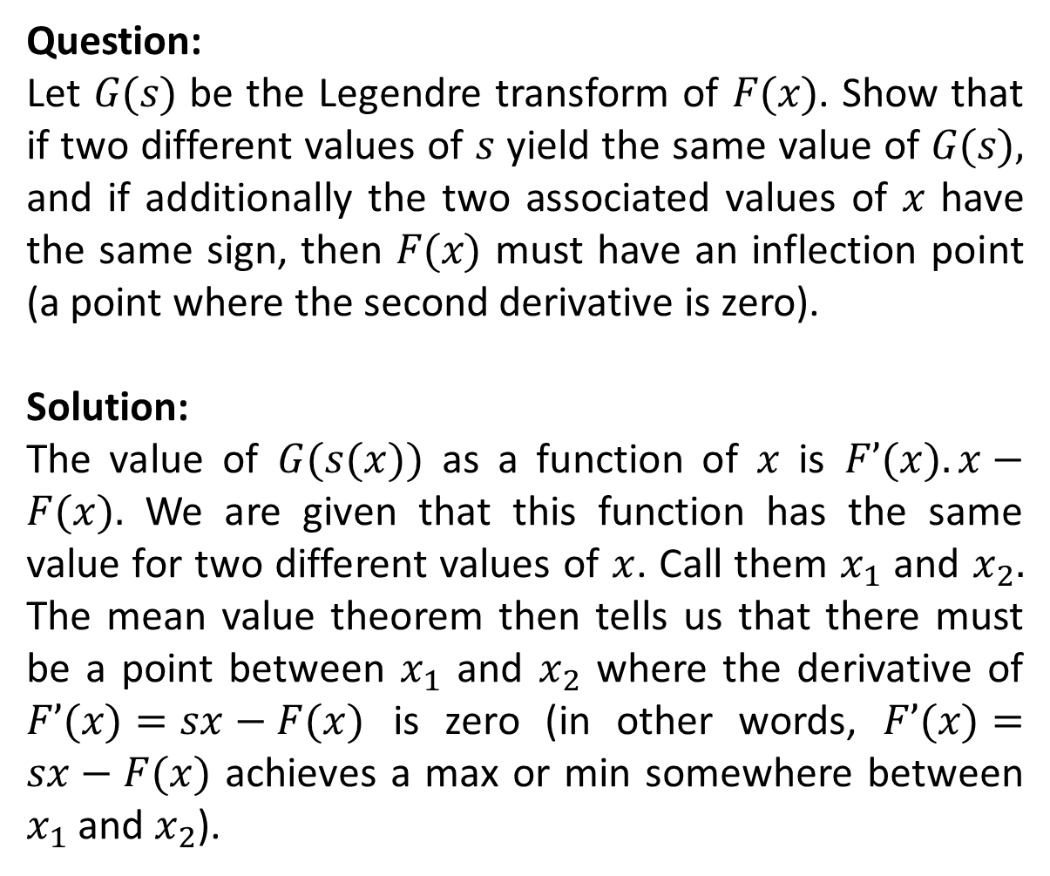
Question:
Let $G(s)$ be the Legendre transform of $F(x)$. Show that if two different values of $s$ yield the same value of $G(s),$ and if additionally the two associated values of $x$ have the same sign, then $F(x)$ must have an inflection point (a point where the second derivative is zero).
Solution:
The value of $G(s(x))$ as a function of $x$ is $F’(x).x−F(x).$ We are given that this function has the same value for two different values of $x$. Call them $x_{1}$ and $x_{2}.$ The mean value theorem then tells us that there must be a point between $x_{1}$ and $x_{2}$ where the derivative of $F’(x)=sx−F(x)$ is zero (in other words, $F’(x)=sx−F(x)$ achieves a max or min somewhere between $x_{1}$ and $x_{2}$).

Slide 7
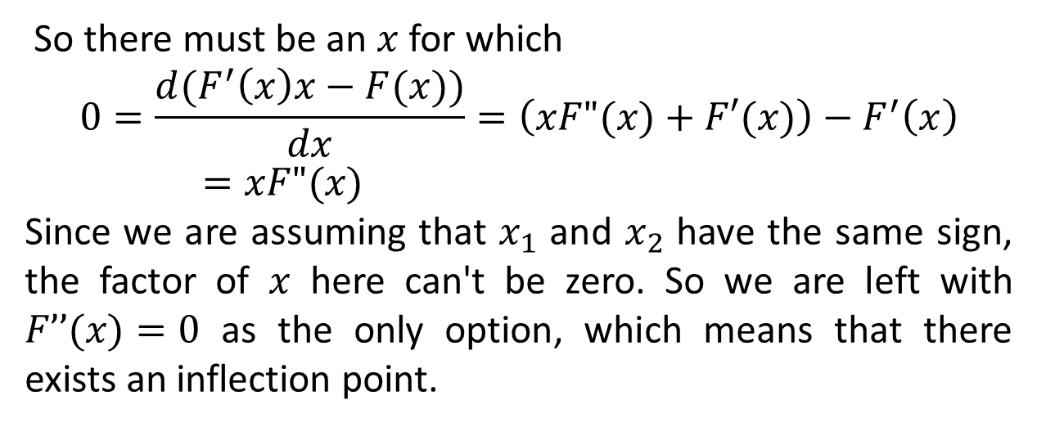
So there must be an $x$ for which
$$0=\frac{d(F^{′}\left(x\right)x−F(x))}{dx}=\left(xF"(x)+F′(x)\right)−F^{′}\left(x\right)=xF"(x)$$
Since we are assuming that $x_{1}$ and $x_{2}$ have the same sign, the factor of $x$ here can't be zero. So we are left with $F’’(x)=0$ as the only option, which means that there exists an inflection point.

Slide 8
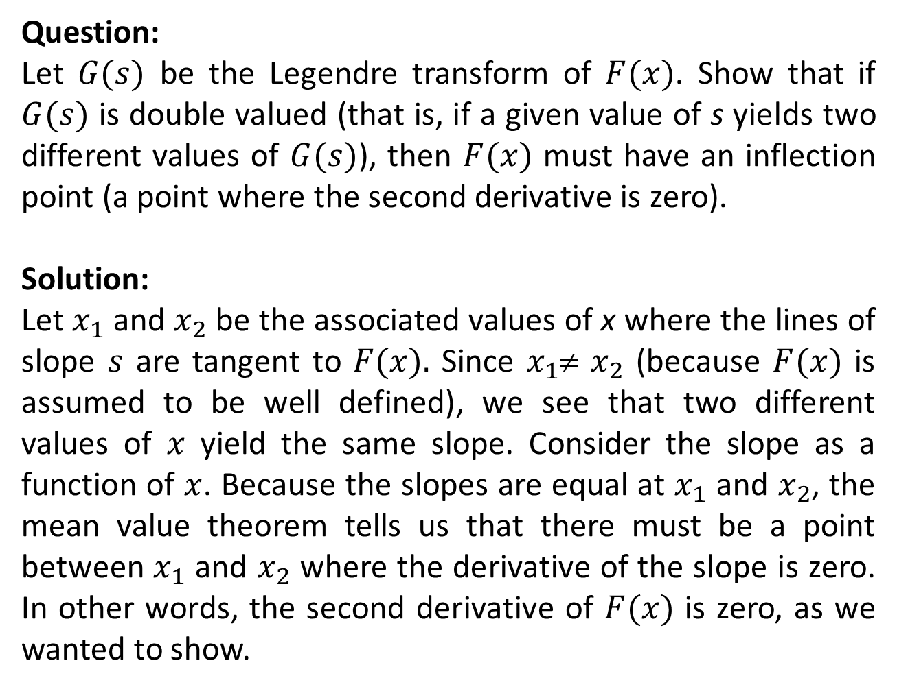
Question:
Let $G(s)$ be the Legendre transform of $F(x)$. Show that if $G(s)$ is double valued (that is, if a given value of s yields two different values of $G(s)$), then $F(x)$ must have an inflection point (a point where the second derivative is zero).
Solution:
Let $x_{1}$ and $x_{2}$ be the associated values of x where the lines of slope $s$ are tangent to $F(x).$ Since $x_{1}$≠ $x_{2}$ (because $F(x)$ is assumed to be well defined), we see that two different values of $x$ yield the same slope. Consider the slope as a function of $x$. Because the slopes are equal at $x_{1}$ and $x_{2}$, the mean value theorem tells us that there must be a point between $x_{1}$ and $x_{2}$ where the derivative of the slope is zero. In other words, the second derivative of $F(x)$ is zero, as we wanted to show.

Slide 9
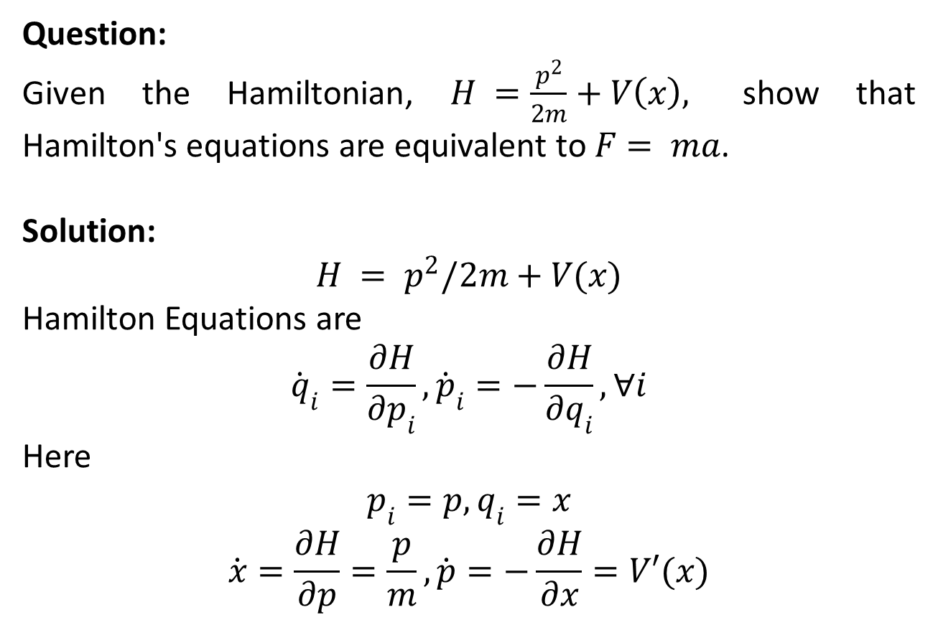
Question:
Given the Hamiltonian, $H =\frac{p^{2}}{2m}+V\left(x\right),$ show that Hamilton's equations are equivalent to $F= ma$.
Solution:
$$H = p^{2}/2m+V(x)$$
Hamilton Equations are
$${\dot{q}}_{i}=\frac{∂H}{∂p_{i}},{\dot{p}}_{i}=−\frac{∂H}{∂q_{i}},∀i$$
Here
$$p_{i}=p,q_{i}=x$$
$$\dot{x}=\frac{∂H}{∂p}=\frac{p}{m},\dot{p}=−\frac{∂H}{∂x}=V′(x)$$

Slide 10
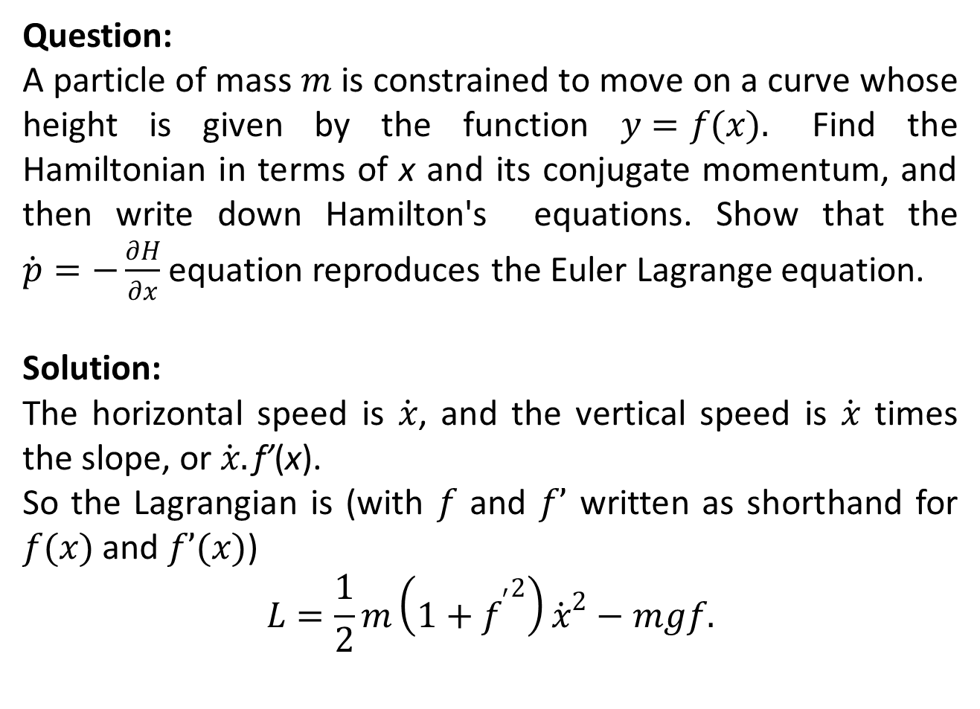
Question:
A particle of mass $m$ is constrained to move on a curve whose height is given by the function $y=f(x).$ Find the Hamiltonian in terms of x and its conjugate momentum, and then write down Hamilton's equations. Show that the $\dot{p}=−\frac{∂H}{∂x}$ equation reproduces the Euler Lagrange equation.
Solution:
The horizontal speed is $\dot{x}$, and the vertical speed is $\dot{x}$ times the slope, or $\dot{x}.\text{f}\text{’}\text{(}\text{x}\text{).}$
So the Lagrangian is (with $f$ and $f’$ written as shorthand for $f(x)$ and $f’(x)$)
$$L=\frac{1}{2}m\left(1+{f^{′}}^{2}\right){\dot{x}}^{2}−mgf.$$

Slide 11
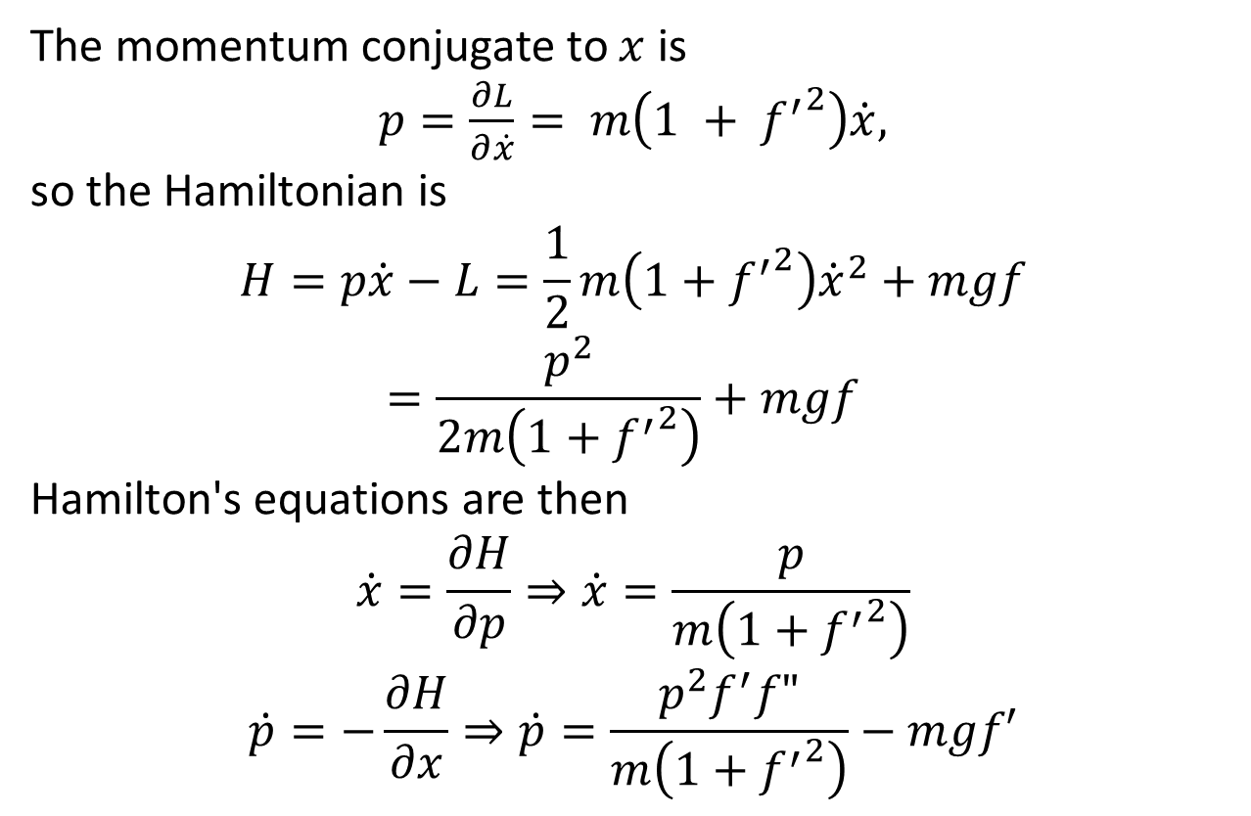
The momentum conjugate to $x$ is
$p=\frac{∂L}{∂\dot{x}}= m\left(1 + {f^{′}}^{2}\right)\dot{x},$
so the Hamiltonian is
$$H=p\dot{x}−L=\frac{1}{2}m\left(1+{f^{′}}^{2}\right){\dot{x}}^{2}+mgf=\frac{p^{2}}{2m\left(1+{f^{′}}^{2}\right)}+mgf$$
Hamilton's equations are then
$$\dot{x}=\frac{∂H}{∂p}⇒\dot{x}=\frac{p}{m\left(1+{f^{′}}^{2}\right)}$$
$$\dot{p}=−\frac{∂H}{∂x}⇒\dot{p}=\frac{p^{2}f^{′}f"}{m\left(1+{f^{′}}^{2}\right)}−mgf′$$

Slide 12
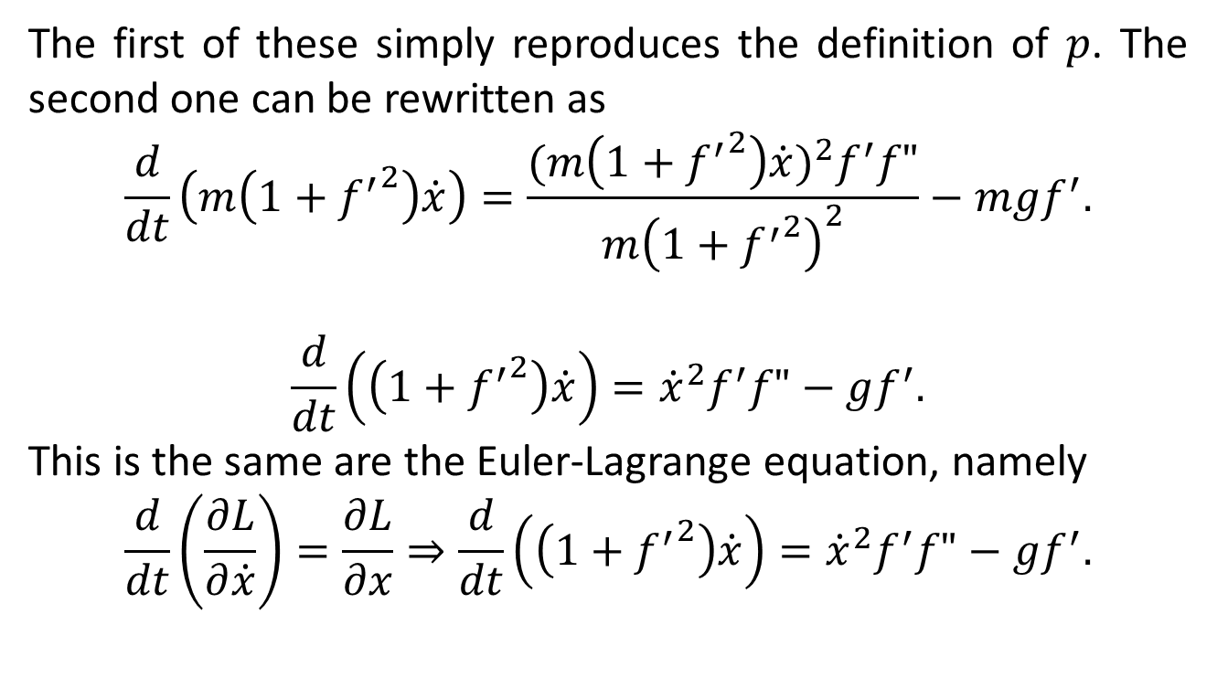
The first of these simply reproduces the definition of $p$. The second one can be rewritten as
$$\frac{d}{dt}\left(m\left(1+{f^{′}}^{2}\right)\dot{x}\right)=\frac{{(m\left(1+{f^{′}}^{2}\right)\dot{x})}^{2}f^{′}f"}{m{\left(1+{f^{′}}^{2}\right)}^{2}}−mgf^{′}.$$
$$\frac{d}{dt}\left(\left(1+{f^{′}}^{2}\right)\dot{x}\right)={\dot{x}}^{2}f^{′}f"−gf^{′}.$$
This is the same are the Euler-Lagrange equation, namely
$$\frac{d}{dt}\left(\frac{∂L}{∂\dot{x}}\right)=\frac{∂L}{∂x}⇒\frac{d}{dt}\left(\left(1+{f^{′}}^{2}\right)\dot{x}\right)={\dot{x}}^{2}f^{′}f"−gf^{′}.$$

Slide 13
The End

