Slide 1
Revision
Previous lecture consists of:
D’ Alembert’s Principle for a particle
D’ Alembert’s Principle for a system of n particle
Example related to Virtual Work
Example related to D’ Alembert’s Principle

Slide 2
Lagrange’s Multiplier
Significance of Lagrange’s Multiplier:
If a physical system is constrained in its motion, then its degrees of freedom are reduced. We use the equations of constraint to eliminate dependent variables. Sometimes it is difficult or inconvenient to eliminate the dependent variables. Under these circumstances use of Lagrange multipliers gives an alternative technique to solve the problem.

Slide 3
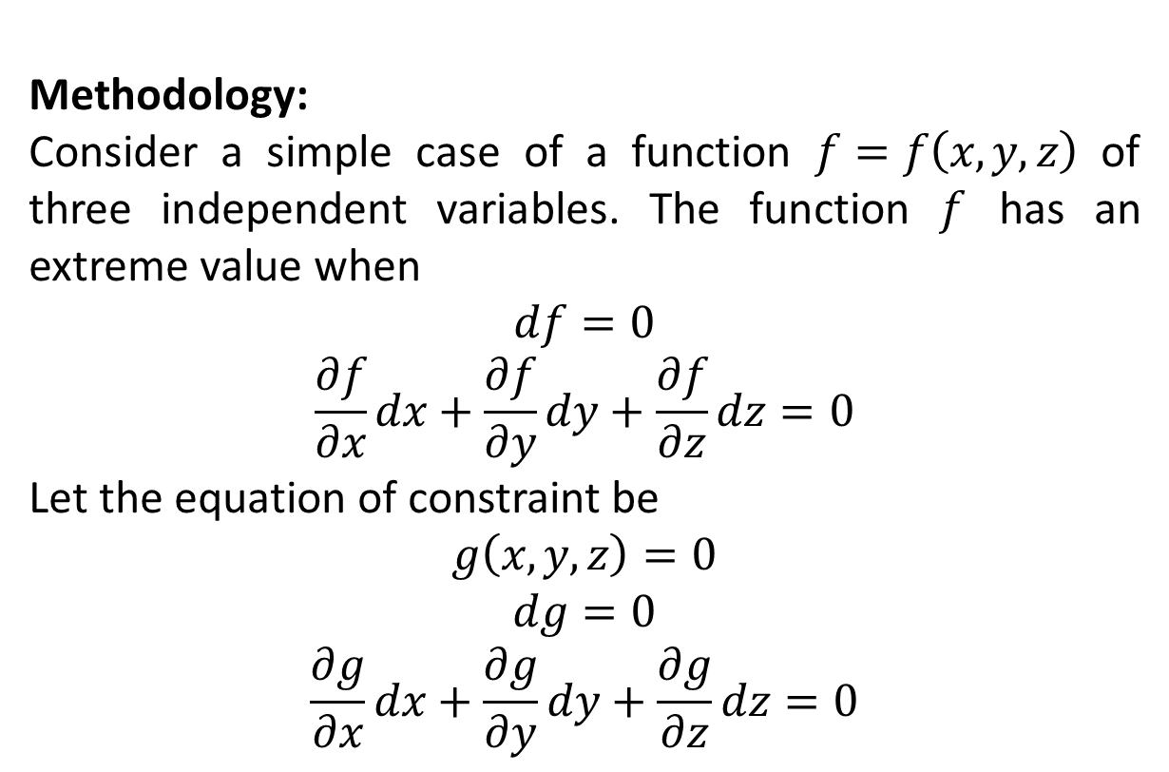
Methodology:
Consider a simple case of a function $f=f\left(x,y,z\right)$ of three independent variables. The function $f$ has an extreme value when
$$df=0$$
$$\frac{∂f}{∂x}dx+\frac{∂f}{∂y}dy+\frac{∂f}{∂z}dz=0$$
Let the equation of constraint be
$$g\left(x,y,z\right)=0$$
$$dg=0$$
$$\frac{∂g}{∂x}dx+\frac{∂g}{∂y}dy+\frac{∂g}{∂z}dz=0$$

Slide 4
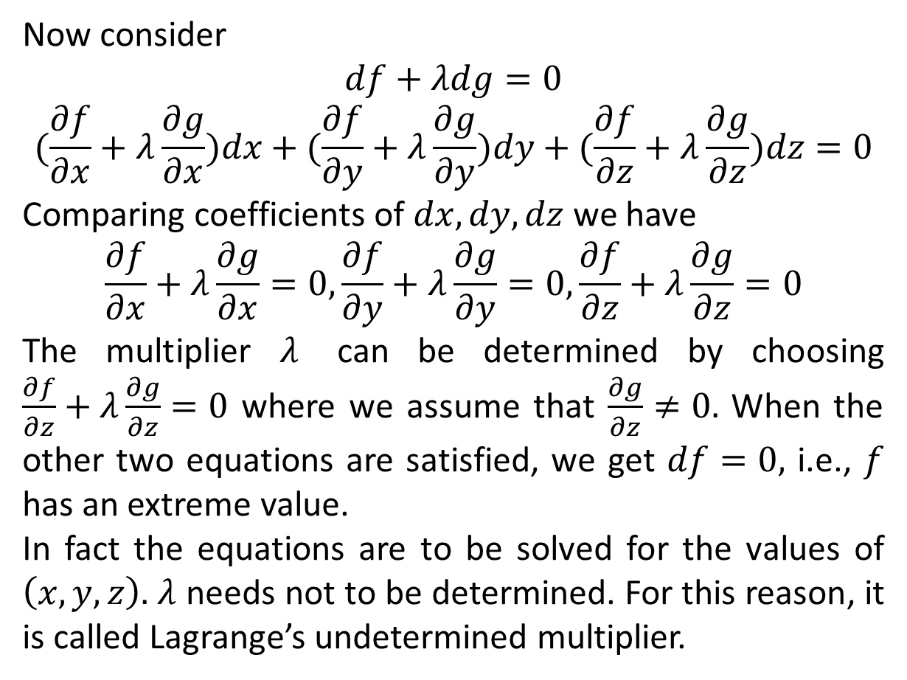
Now consider
$$df+λdg=0$$
$$(\frac{∂f}{∂x}+λ\frac{∂g}{∂x})dx+(\frac{∂f}{∂y}+λ\frac{∂g}{∂y})dy+(\frac{∂f}{∂z}+λ\frac{∂g}{∂z})dz=0$$
Comparing coefficients of $dx, dy, dz$ we have
$$\frac{∂f}{∂x}+λ\frac{∂g}{∂x}=0,\frac{∂f}{∂y}+λ\frac{∂g}{∂y}=0,\frac{∂f}{∂z}+λ\frac{∂g}{∂z}=0$$
The multiplier $λ$ can be determined by choosing $\frac{∂f}{∂z}+λ\frac{∂g}{∂z}=0$ where we assume that $\frac{∂g}{∂z}≠0.$ When the other two equations are satisfied, we get $df=0,$ i.e., $f$ has an extreme value.
In fact the equations are to be solved for the values of $\left(x, y, z\right).$ $λ$ needs not to be determined. For this reason, it is called Lagrange’s undetermined multiplier.

Slide 5
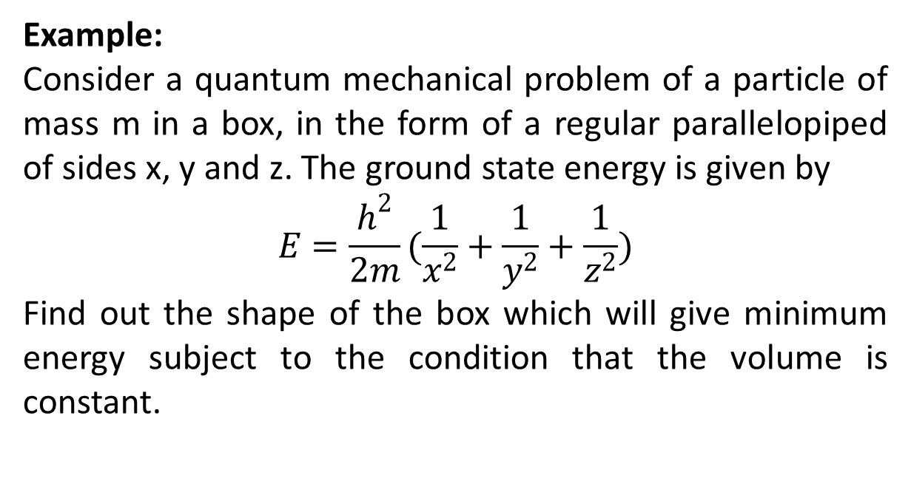
Example:
Consider a quantum mechanical problem of a particle of mass m in a box, in the form of a regular parallelopiped of sides x, y and z. The ground state energy is given by
$$E=\frac{h^{2}}{2m}(\frac{1}{x^{2}}+\frac{1}{y^{2}}+\frac{1}{z^{2}})$$
Find out the shape of the box which will give minimum energy subject to the condition that the volume is constant.

Slide 6
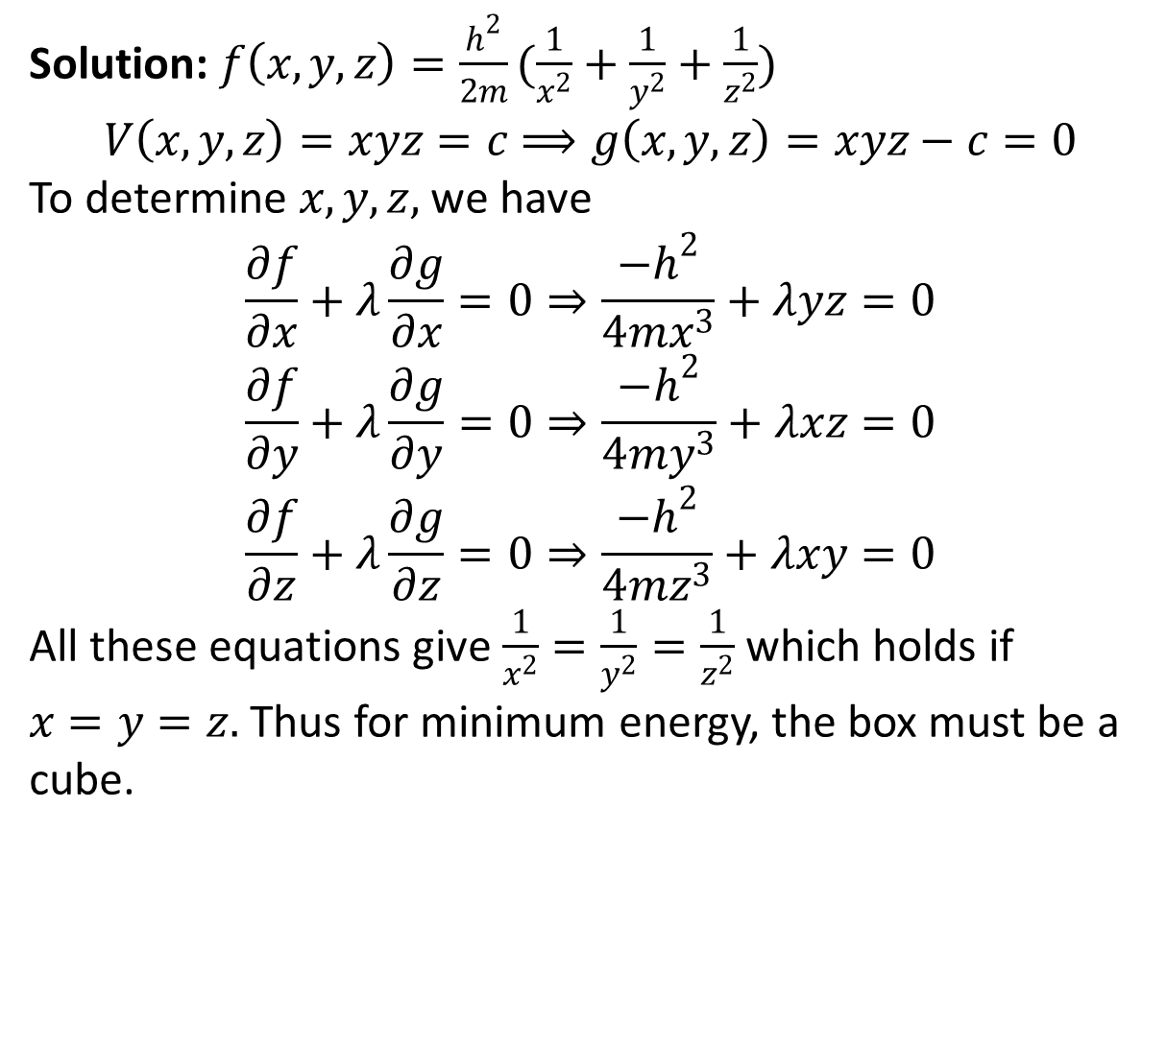
Solution: $f\left(x,y,z\right)=\frac{h^{2}}{2m}(\frac{1}{x^{2}}+\frac{1}{y^{2}}+\frac{1}{z^{2}})$
$$V\left(x,y,z\right)=xyz=c⟹g\left(x,y,z\right)=xyz−c=0$$
To determine $x,y,z,$ we have
$$\frac{∂f}{∂x}+λ\frac{∂g}{∂x}=0⇒\frac{{−h}^{2}}{4mx^{3}}+λyz=0$$
$$\frac{∂f}{∂y}+λ\frac{∂g}{∂y}=0⇒\frac{{−h}^{2}}{4my^{3}}+λxz=0$$
$$\frac{∂f}{∂z}+λ\frac{∂g}{∂z}=0⇒\frac{{−h}^{2}}{4mz^{3}}+λxy=0$$
All these equations give $\frac{1}{x^{2}}=\frac{1}{y^{2}}=\frac{1}{z^{2}}$ which holds if $x=y=z.$ Thus for minimum energy, the box must be a cube.

Slide 7
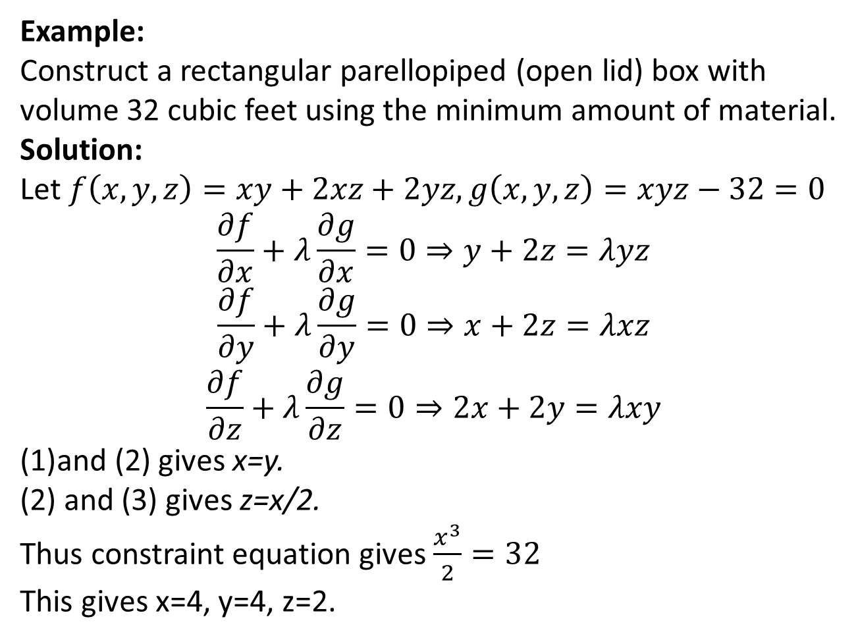
Example:
Construct a rectangular parellopiped (open lid) box with volume 32 cubic feet using the minimum amount of material.
Solution:
Let $f\left(x,y,z\right)=xy+2xz+2yz, g\left(x,y,z\right)=xyz−32=0$
$$\frac{∂f}{∂x}+λ\frac{∂g}{∂x}=0⇒y+2z=λyz$$
$$\frac{∂f}{∂y}+λ\frac{∂g}{∂y}=0⇒x+2z=λxz$$
$$\frac{∂f}{∂z}+λ\frac{∂g}{∂z}=0⇒2x+2y=λxy$$
and (2) gives x=y.
(2) and (3) gives z=x/2.
Thus constraint equation gives $\frac{x^{3}}{2}=32$
This gives x=4, y=4, z=2.

Slide 8
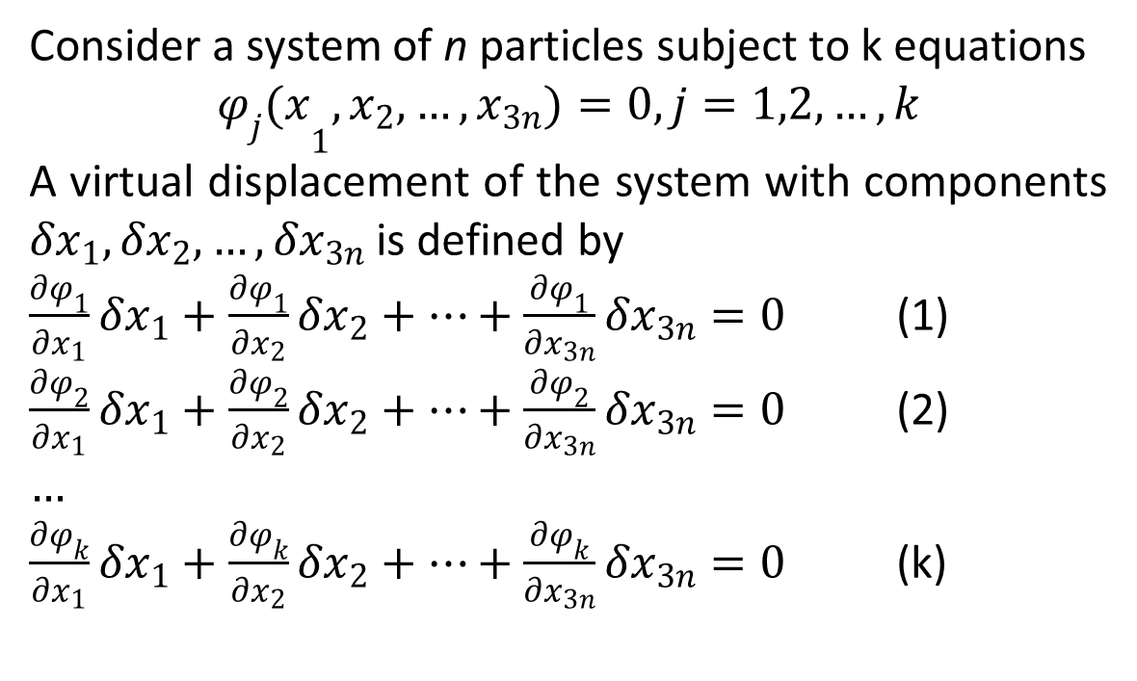
Equations of Motion for Holonomic Systems
Consider a system of n particles subject to k equations
$${φ_{j}(x}_{1},x_{2},…, x_{3n})=0, j=1,2,…,k$$
A virtual displacement of the system with components ${δx}_{1},{δx}_{2},…, δx_{3n}$ is defined by
$\frac{∂φ_{1}}{∂x_{1}}δx_{1}+\frac{∂φ_{1}}{∂x_{2}}δx_{2}+…+\frac{∂φ_{1}}{∂x_{3n}}δx_{3n}=0$ (1)
$\frac{∂φ_{2}}{∂x_{1}}δx_{1}+\frac{∂φ_{2}}{∂x_{2}}δx_{2}+…+\frac{∂φ_{2}}{∂x_{3n}}δx_{3n}=0$ (2)
$…$
$\frac{∂φ_{k}}{∂x_{1}}δx_{1}+\frac{∂φ_{k}}{∂x_{2}}δx_{2}+…+\frac{∂φ_{k}}{∂x_{3n}}δx_{3n}=0$ (k)

Slide 9
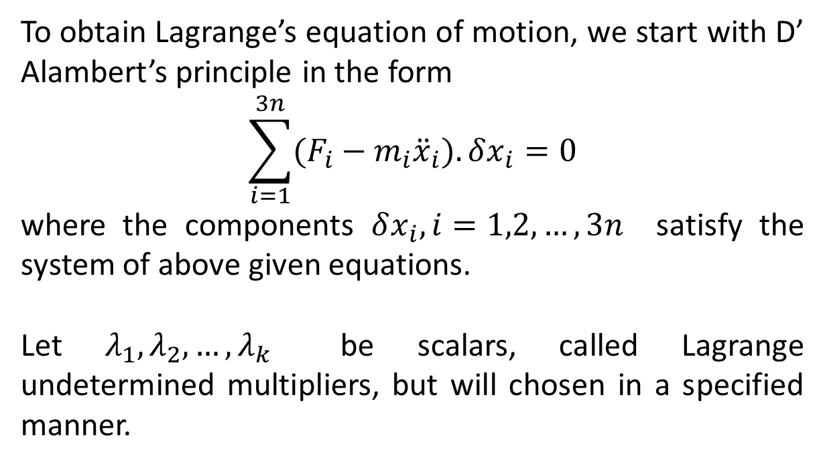
To obtain Lagrange’s equation of motion, we start with D’ Alambert’s principle in the form
$$\sum_{i=1}^{3n}{(F_{i}−m_{i}{\ddot{x}}_{i}).δx_{i}}=0$$
where the components $δx_{i},i=1,2,…,3n$ satisfy the system of above given equations.
Let $λ_{1},λ_{2},…,λ_{k}$ be scalars, called Lagrange undetermined multipliers, but will chosen in a specified manner.

Slide 10
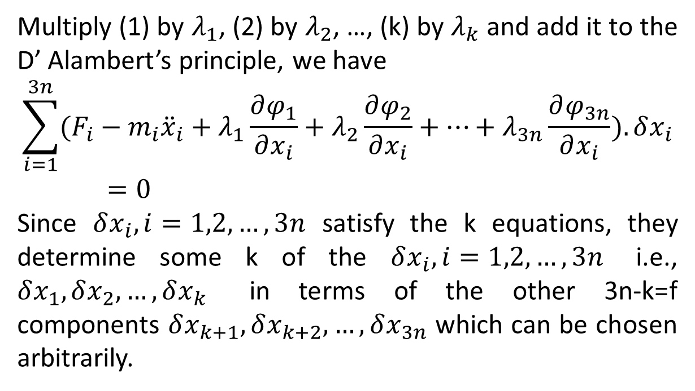
Multiply (1) by $λ_{1}$, (2) by $λ_{2}$, …, (k) by $λ_{k}$ and add it to the D’ Alambert’s principle, we have
$$\sum_{i=1}^{3n}{(F_{i}−m_{i}{\ddot{x}}_{i}+λ_{1}\frac{∂φ_{1}}{∂x_{i}}+λ_{2}\frac{∂φ_{2}}{∂x_{i}}+…+λ_{3n}\frac{∂φ_{3n}}{∂x_{i}}).δx_{i}}=0$$
Since $δx_{i}, i=1,2,…,3n$ satisfy the k equations, they determine some k of the $δx_{i}, i=1,2, …,3n$ i.e., $δx_{1},δx_{2},…,δx_{k}$ in terms of the other 3n-k=f components $δx_{k+1},δx_{k+2},…,δx_{3n}$ which can be chosen arbitrarily.

Slide 11
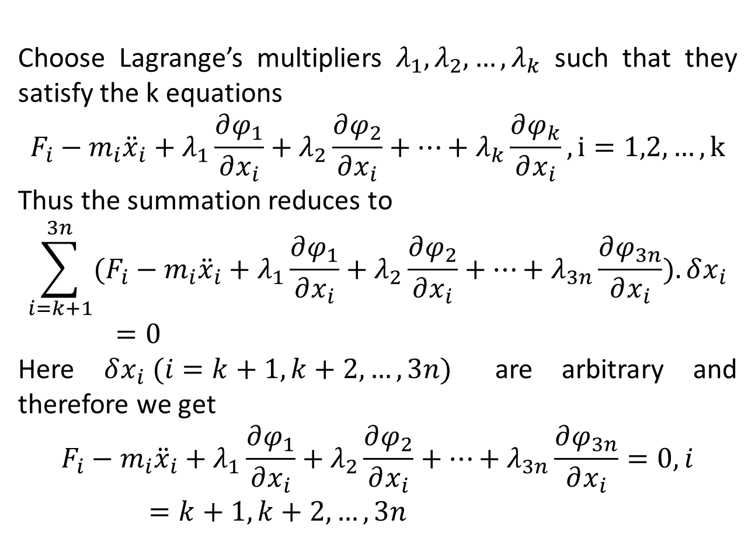
Choose Lagrange’s multipliers $λ_{1},λ_{2},…,λ_{k}$ such that they satisfy the k equations
$$F_{i}−m_{i}{\ddot{x}}_{i}+λ_{1}\frac{∂φ_{1}}{∂x_{i}}+λ_{2}\frac{∂φ_{2}}{∂x_{i}}+…+λ_{k}\frac{∂φ_{k}}{∂x_{i}}, i=1,2,…,k$$
Thus the summation reduces to
$$\sum_{i=k+1}^{3n}{(F_{i}−m_{i}{\ddot{x}}_{i}+λ_{1}\frac{∂φ_{1}}{∂x_{i}}+λ_{2}\frac{∂φ_{2}}{∂x_{i}}+…+λ_{3n}\frac{∂φ_{3n}}{∂x_{i}}).δx_{i}}=0$$
Here $δx_{i} (i=k+1,k+2,…,3n)$ are arbitrary and therefore we get
$$F_{i}−m_{i}{\ddot{x}}_{i}+λ_{1}\frac{∂φ_{1}}{∂x_{i}}+λ_{2}\frac{∂φ_{2}}{∂x_{i}}+…+λ_{3n}\frac{∂φ_{3n}}{∂x_{i}}=0,i=k+1,k+2,…,3n$$

Slide 12
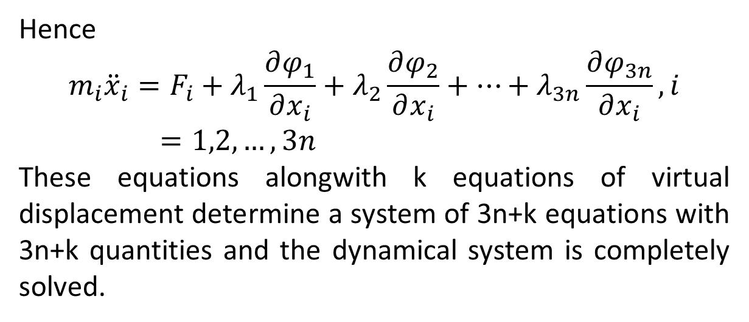
Hence
$${m_{i}{\ddot{x}}_{i}=F}_{i}+λ_{1}\frac{∂φ_{1}}{∂x_{i}}+λ_{2}\frac{∂φ_{2}}{∂x_{i}}+…+λ_{3n}\frac{∂φ_{3n}}{∂x_{i}},i=1,2,…,3n$$
These equations alongwith k equations of virtual displacement determine a system of 3n+k equations with 3n+k quantities and the dynamical system is completely solved.

Slide 13
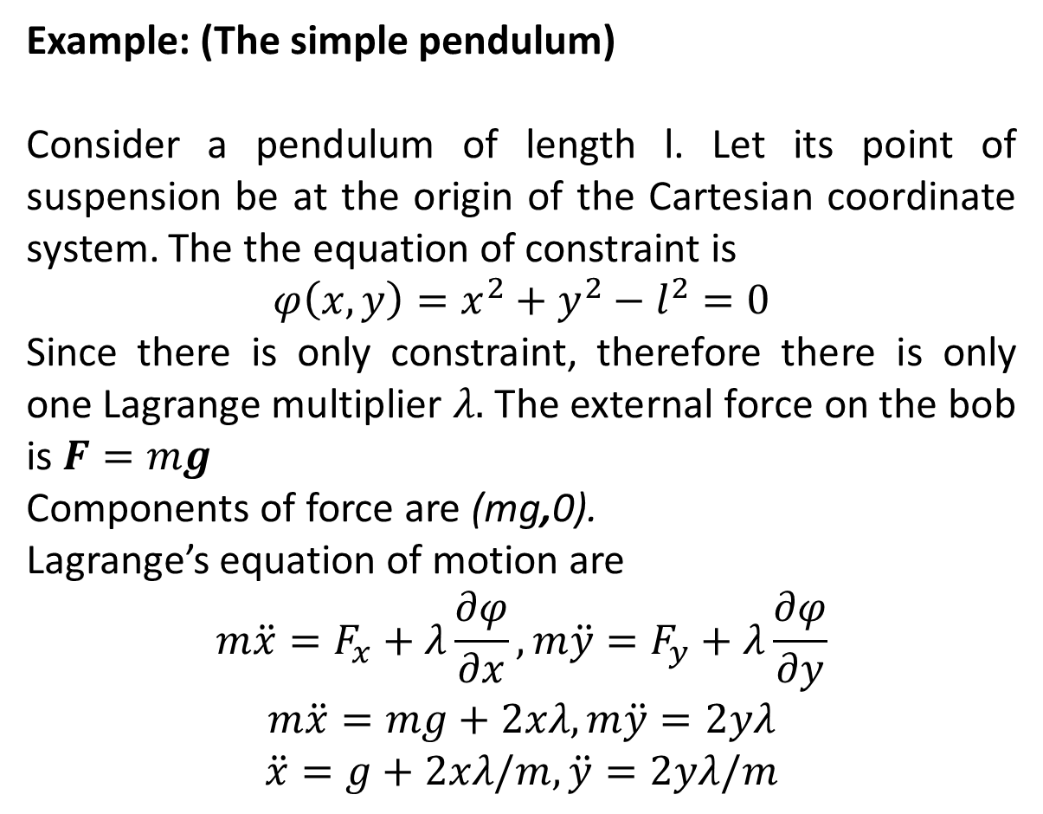
Example: (The simple pendulum)
Consider a pendulum of length l. Let its point of suspension be at the origin of the Cartesian coordinate system. The the equation of constraint is
$$φ\left(x,y\right)=x^{2}+y^{2}−l^{2}=0$$
Since there is only constraint, therefore there is only one Lagrange multiplier $λ.$ The external force on the bob is $F=mg$
Components of force are (mg,0).
Lagrange’s equation of motion are
$$m\ddot{x}=F_{x}+λ\frac{∂φ}{∂x},m\ddot{y}=F_{y}+λ\frac{∂φ}{∂y}$$
$$m\ddot{x}=mg+2xλ,m\ddot{y}=2yλ$$
$$\ddot{x}=g+2xλ/m,\ddot{y}=2yλ/m$$

Slide 14
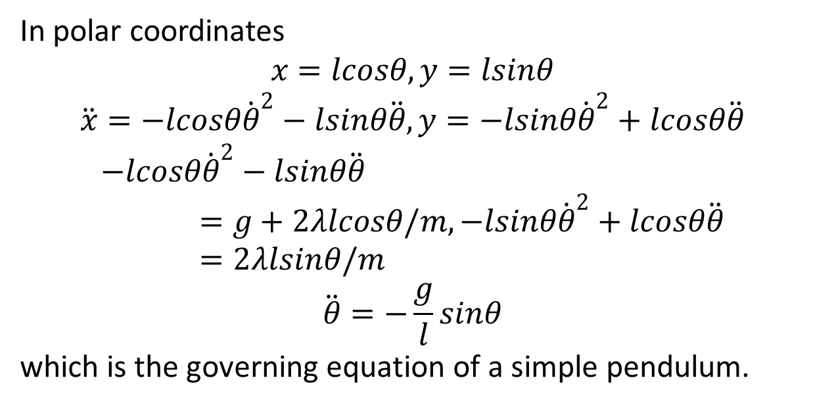
In polar coordinates
$$x=lcosθ, y=lsinθ$$
$$\ddot{x}=−lcosθ{\dot{θ}}^{2}−lsinθ\ddot{θ}, y=−lsinθ{\dot{θ}}^{2}+lcosθ\ddot{θ}$$
$$−lcosθ{\dot{θ}}^{2}−lsinθ\ddot{θ}=g+2λlcosθ/m,−lsinθ{\dot{θ}}^{2}+lcosθ\ddot{θ}=2λlsinθ/m$$
$$\ddot{θ}=−\frac{g}{l}sinθ$$
which is the governing equation of a simple pendulum.

Slide 15
The End

