Slide 1
Summary
Previous lecture consists of:
Definition of virtual displacement
Equation for virtual displacement
Definition of virtual work
Equation for virtual work

Slide 2
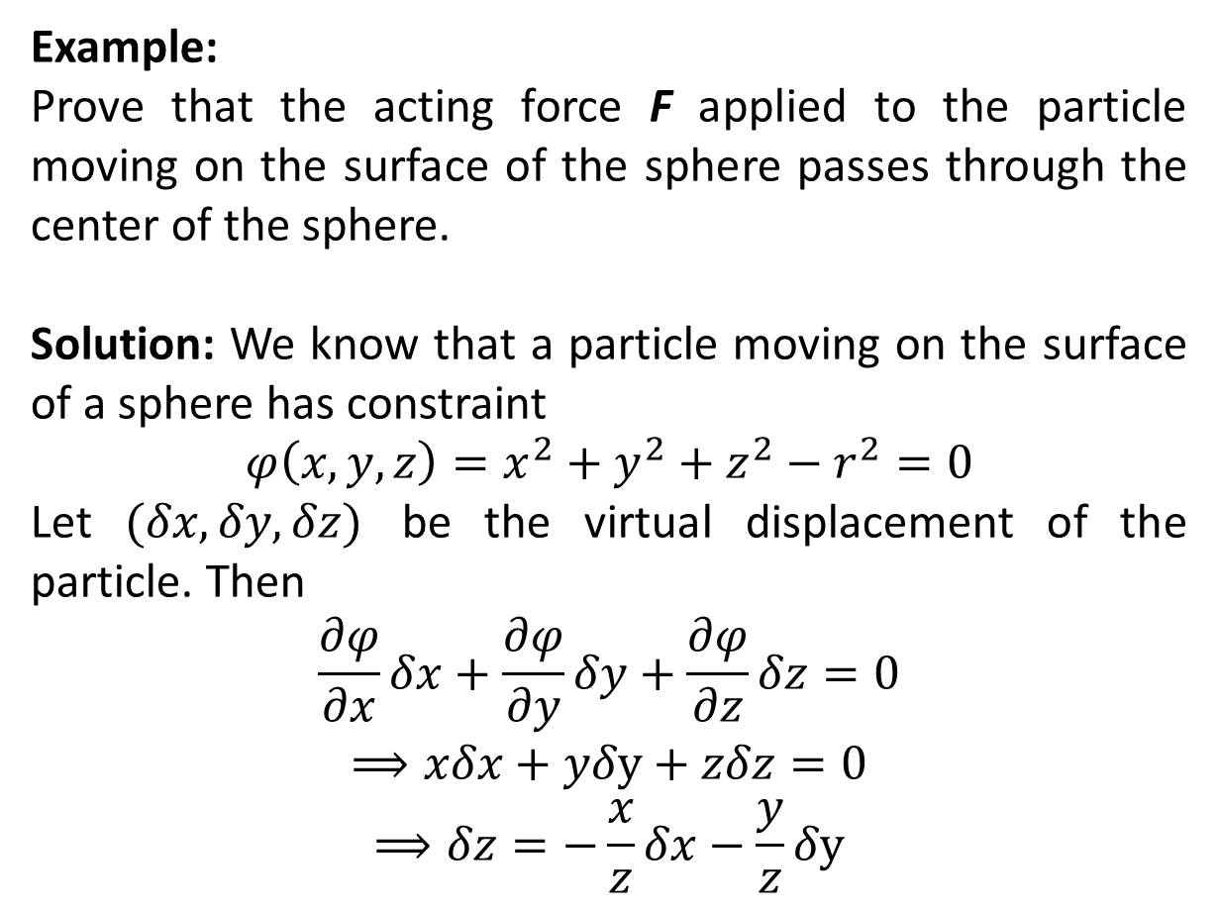
Example:
Prove that the acting force F applied to the particle moving on the surface of the sphere passes through the center of the sphere.
Solution: We know that a particle moving on the surface of a sphere has constraint
$$φ\left(x,y,z\right)=x^{2}+y^{2}+z^{2}−r^{2}=0$$
Let $(δx, δy, δz)$ be the virtual displacement of the particle. Then
$$\frac{∂φ}{∂x}δx+\frac{∂φ}{∂y}δy+\frac{∂φ}{∂z}δz=0$$
$$⟹xδx+yδy+zδz=0$$
$$⟹δz=−\frac{x}{z}δx−\frac{y}{z}δy$$

Slide 3
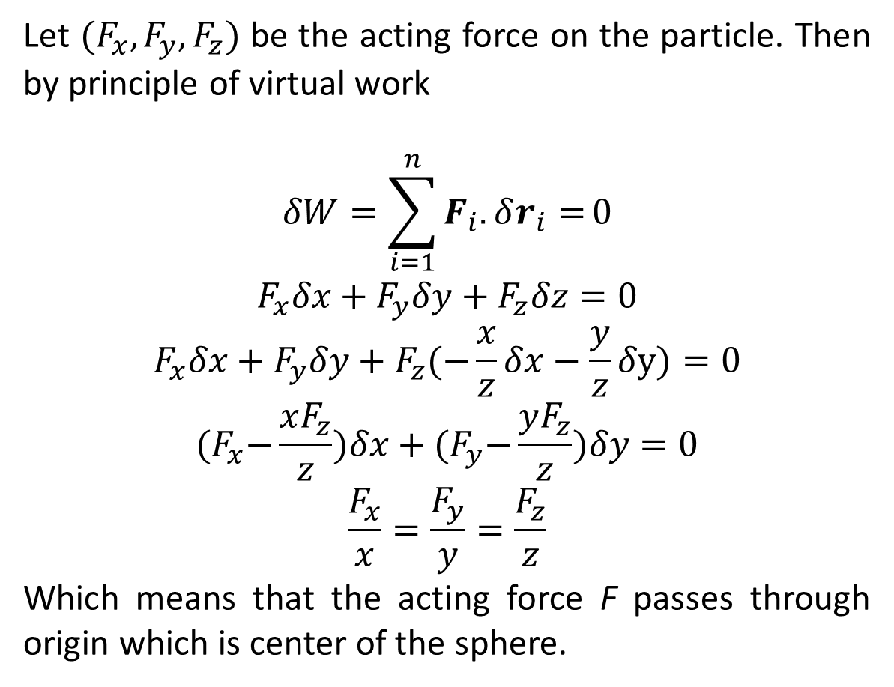
Let $(F_{x},F_{y},F_{z})$ be the acting force on the particle. Then by principle of virtual work
$$δW=\sum_{i=1}^{n}{F_{i}.δr_{i}=}0$$
$$F_{x}δx+F_{y}δy+F_{z}δz=0$$
$$F_{x}δx+F_{y}δy+F_{z}(−\frac{x}{z}δx−\frac{y}{z}δy)=0$$
$${(F}_{x}−\frac{xF_{z}}{z})δx+{(F}_{y}−\frac{yF_{z}}{z})δy=0$$
$$\frac{F_{x}}{x}=\frac{F_{y}}{y}=\frac{F_{z}}{z}$$
Which means that the acting force F passes through origin which is center of the sphere.

Slide 4
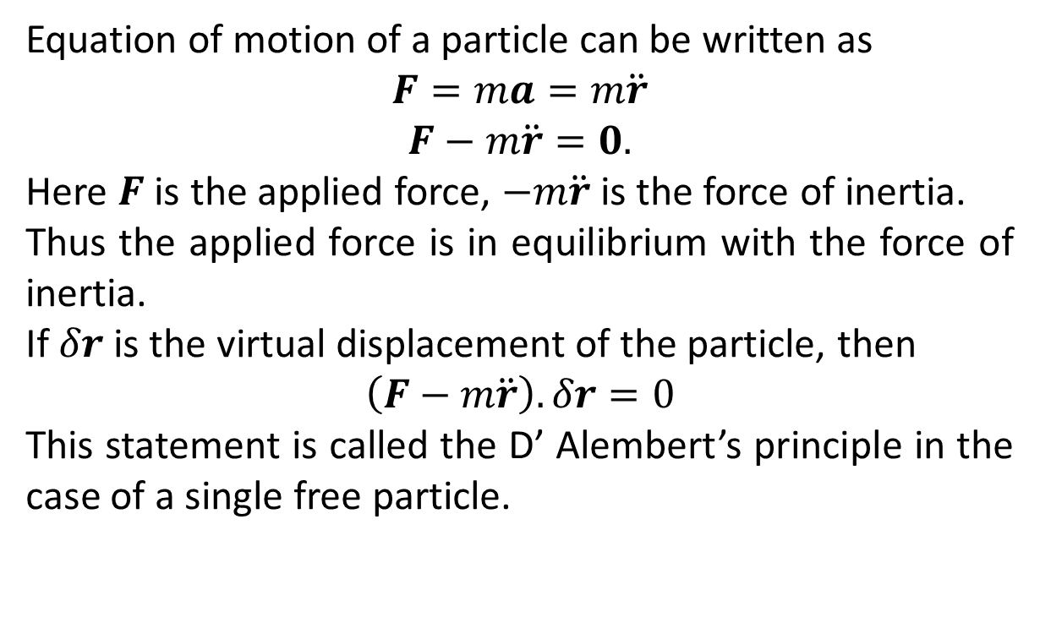
D’ Alembert’s Principle
Equation of motion of a particle can be written as
$$F=ma=m\ddot{r}$$
$$F−m\ddot{r}=0.$$
Here $F$ is the applied force, $−m\ddot{r}$ is the force of inertia.
Thus the applied force is in equilibrium with the force of inertia.
If $δr$ is the virtual displacement of the particle, then
$$\left(F−m\ddot{r}\right).δr=0$$
This statement is called the D’ Alembert’s principle in the case of a single free particle.

Slide 5
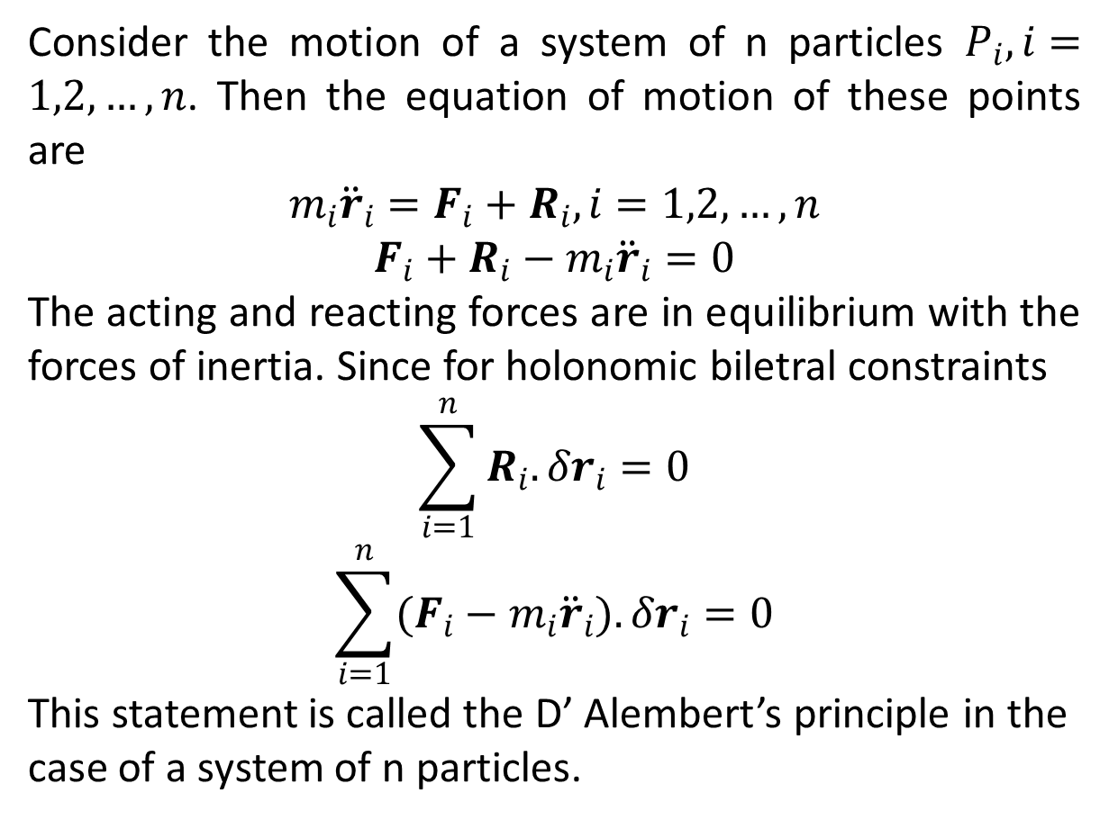
Consider the motion of a system of n particles $P_{i}, i=1,2,…,n$. Then the equation of motion of these points are
$$m_{i}{\ddot{r}}_{i}=F_{i}+R_{i}, i=1,2,…,n$$
$$F_{i}+R_{i}−m_{i}{\ddot{r}}_{i}=0$$
The acting and reacting forces are in equilibrium with the forces of inertia. Since for holonomic biletral constraints
$$\sum_{i=1}^{n}{R_{i}.δr_{i}}=0$$
$$\sum_{i=1}^{n}{(F_{i}−m_{i}{\ddot{r}}_{i}).δr_{i}}=0$$
This statement is called the D’ Alembert’s principle in the case of a system of n particles.

Slide 6
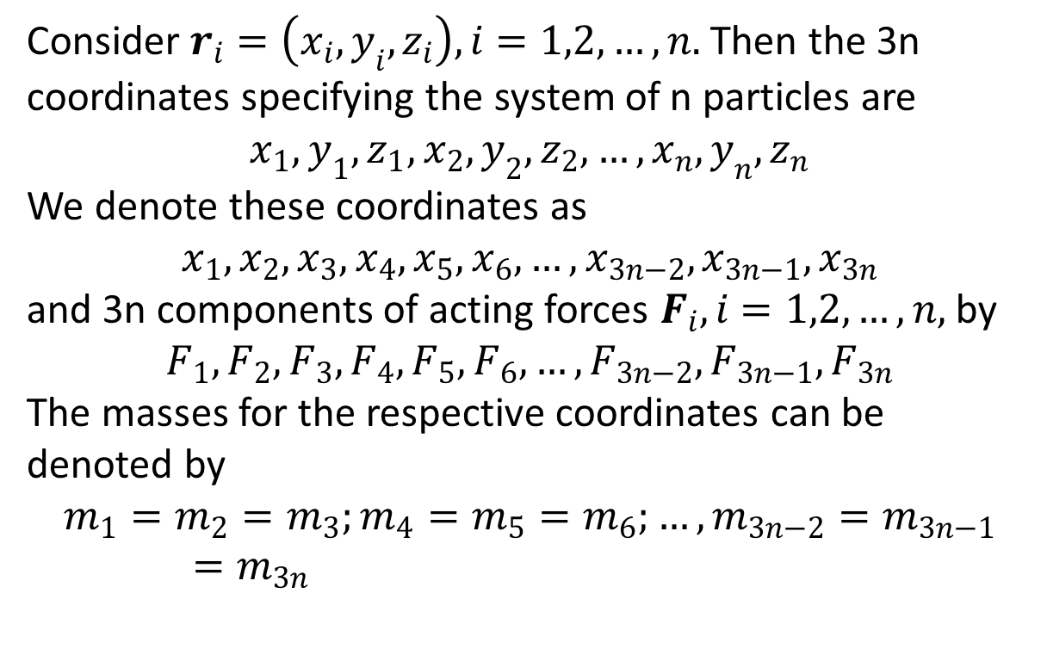
Consider $r_{i}=\left(x_{i},y_{i},z_{i}\right), i=1,2,…,n.$ Then the 3n coordinates specifying the system of n particles are
$$x_{1},y_{1},z_{1},x_{2},y_{2},z_{2},…,x_{n},y_{n},z_{n}$$
We denote these coordinates as
$$x_{1},x_{2},x_{3},x_{4},x_{5},x_{6},…,x_{3n−2},x_{3n−1},x_{3n}$$
and 3n components of acting forces $F_{i}, i=1,2,…,n,$ by
$$F_{1},F_{2},F_{3},F_{4},F_{5},F_{6},…,F_{3n−2},F_{3n−1},F_{3n}$$
The masses for the respective coordinates can be denoted by
$$m_{1}=m_{2}=m_{3};m_{4}=m_{5}=m_{6};…,m_{3n−2}=m_{3n−1}=m_{3n}$$

Slide 7
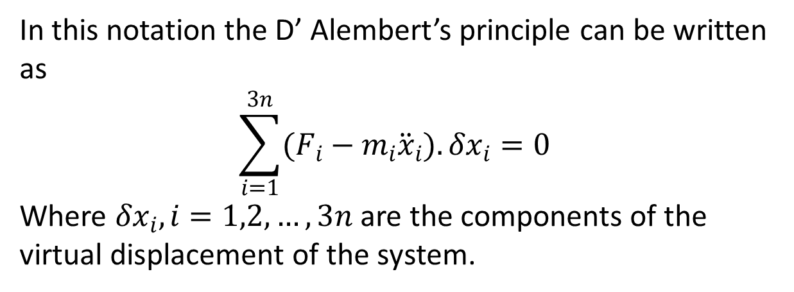
In this notation the D’ Alembert’s principle can be written as
$$\sum_{i=1}^{3n}{(F_{i}−m_{i}{\ddot{x}}_{i}).δx_{i}}=0$$
Where $δx_{i}, i=1,2,…,3n$ are the components of the virtual displacement of the system.

Slide 8
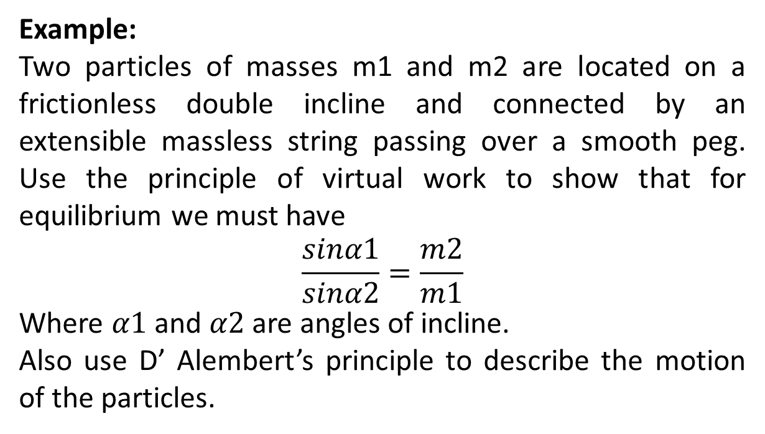
Example:
Two particles of masses m1 and m2 are located on a frictionless double incline and connected by an extensible massless string passing over a smooth peg. Use the principle of virtual work to show that for equilibrium we must have
$$\frac{sinα1}{sinα2}=\frac{m2}{m1}$$
Where $α1$ and $α2$ are angles of incline.
Also use D’ Alembert’s principle to describe the motion of the particles.

Slide 10
The End

