Slide 1
Revision
Previous lecture was about
Harmonic Oscillator

Slide 2
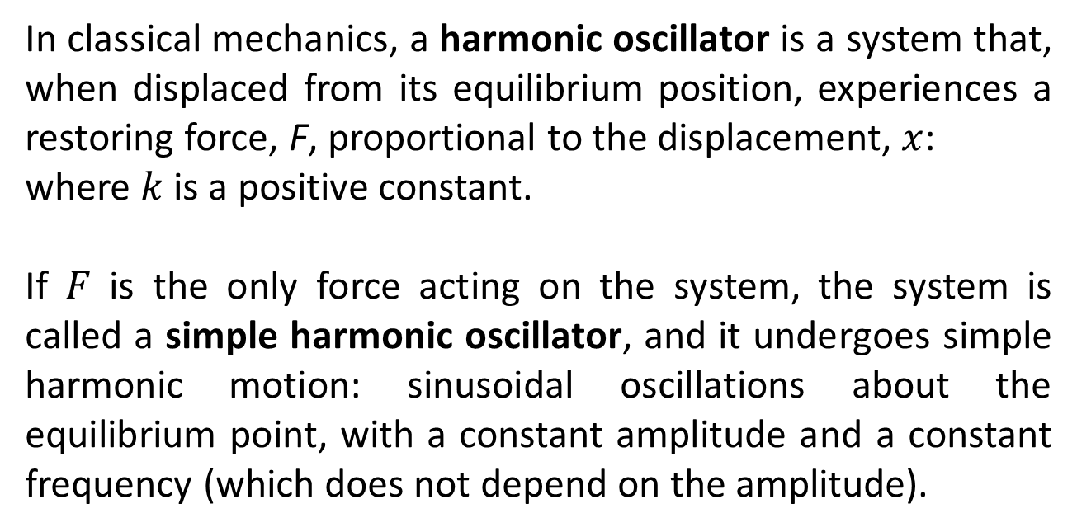
Simple Harmonic Oscillator
In classical mechanics, a harmonic oscillator is a system that, when displaced from its equilibrium position, experiences a restoring force, F, proportional to the displacement, $x$:
where $k$ is a positive constant.
If $F$ is the only force acting on the system, the system is called a simple harmonic oscillator, and it undergoes simple harmonic motion: sinusoidal oscillations about the equilibrium point, with a constant amplitude and a constant frequency (which does not depend on the amplitude).

Slide 3
If a frictional force (damping) proportional to the velocity is also present, the harmonic oscillator is described as a damped oscillator. Depending on the friction coefficient, the system can:
Oscillate with a frequency smaller than in the non-damped case, and an amplitude decreasing with time (underdamped oscillator).
Decay to the equilibrium position, without oscillations (overdamped oscillator).
The boundary solution between an underdamped oscillator and an overdamped oscillator occurs at a particular value of the friction coefficient and is called "critically damped."
If an external time dependent force is present, the harmonic oscillator is described as a driven oscillator.

Slide 4
Mechanical examples include pendula (with small angles of displacement), masses connected to springs, and acoustical systems. Other analogous systems include electrical harmonic oscillators such as RLC circuits. The harmonic oscillator model is very important in physics, because any mass subject to a force in stable equilibrium acts as a harmonic oscillator for small vibrations. Harmonic oscillators occur widely in nature and are exploited in many manmade devices, such as clocks and radio circuits. They are the source of virtually all sinusoidal vibrations and waves.

Slide 5
Constant of Motion
In mechanics, a constant of motion is a quantity that is conserved throughout the motion, imposing in effect a constraint on the motion. However, it is a mathematical constraint, the natural consequence of the equations of motion, rather than a physical constraint (which would require extra constraint forces). Common examples include energy, linear momentum, angular momentum and the Laplace–Runge–Lenz vector (for inverse-square force laws).

Slide 6
Applications
Constants of motion are useful because they allow properties of the motion to be derived without solving the equations of motion. In fortunate cases, even the trajectory of the motion can be derived as the intersection of isosurfaces corresponding to the constants of motion. For example, the torque-free rotation of a rigid body is the intersection of a sphere (conservation of total angular momentum) and an ellipsoid (conservation of energy), a trajectory that might be otherwise hard to derive and visualize. Therefore, the identification of constants of motion is an important objective in mechanics.

Slide 7
Methods for identifying constants of motion
There are several methods for identifying constants of motion.
The simplest but least systematic approach is the intuitive ("psychic") derivation, in which a quantity is hypothesized to be constant (perhaps because of experimental data) and later shown mathematically to be conserved throughout the motion.
The Hamilton–Jacobi equations provide a commonly used and straightforward method for identifying constants of motion, particularly when the Hamiltonian adopts recognizable functional forms in orthogonal coordinates.
A quantity is conserved if it is not explicitly time-dependent and if its Poisson bracket with the Hamiltonian is zero

Slide 8
Another useful result is Poisson's theorem, which states that if two quantities and are constants of motion, so is their Poisson bracket.
A system with n degrees of freedom, and n constants of motion, such that the Poisson bracket of any pair of constants of motion vanishes, is known as a completely integrable system. Such a collection of constants of motion are said to be in involution with each other.

Slide 10
The End

Slide 11
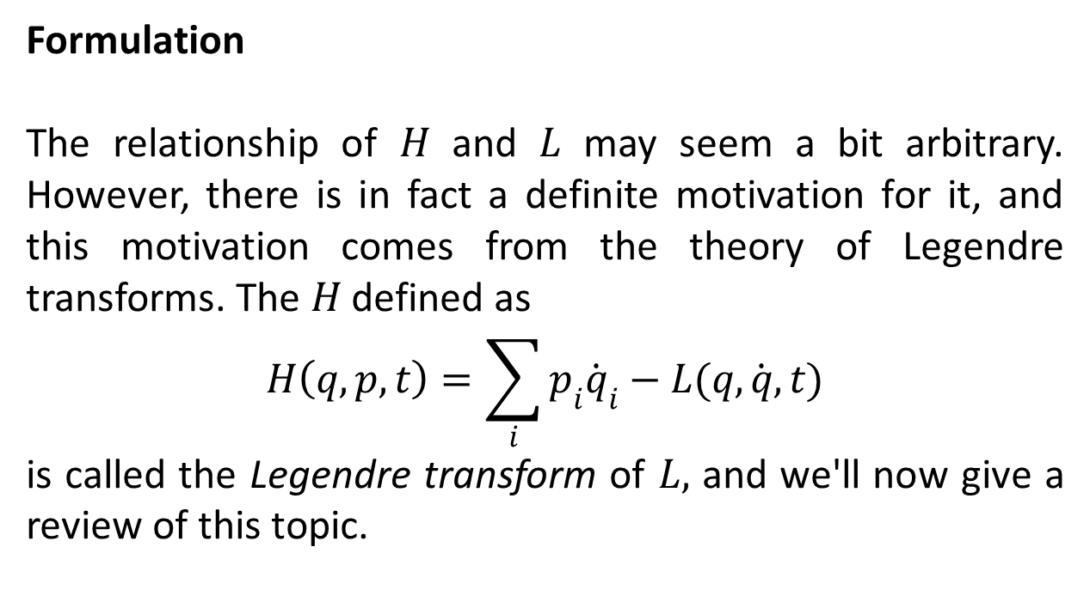
Legendre Transforms
Formulation
The relationship of $H$ and $L$ may seem a bit arbitrary. However, there is in fact a definite motivation for it, and this motivation comes from the theory of Legendre transforms. The $H$ defined as
$$H\left(q,p,t\right)=\sum_{i}{p_{i}{\dot{q}}_{i}}−L(q,\dot{q},t)$$
is called the Legendre transform of $L,$ and we'll now give a review of this topic.

Slide 12
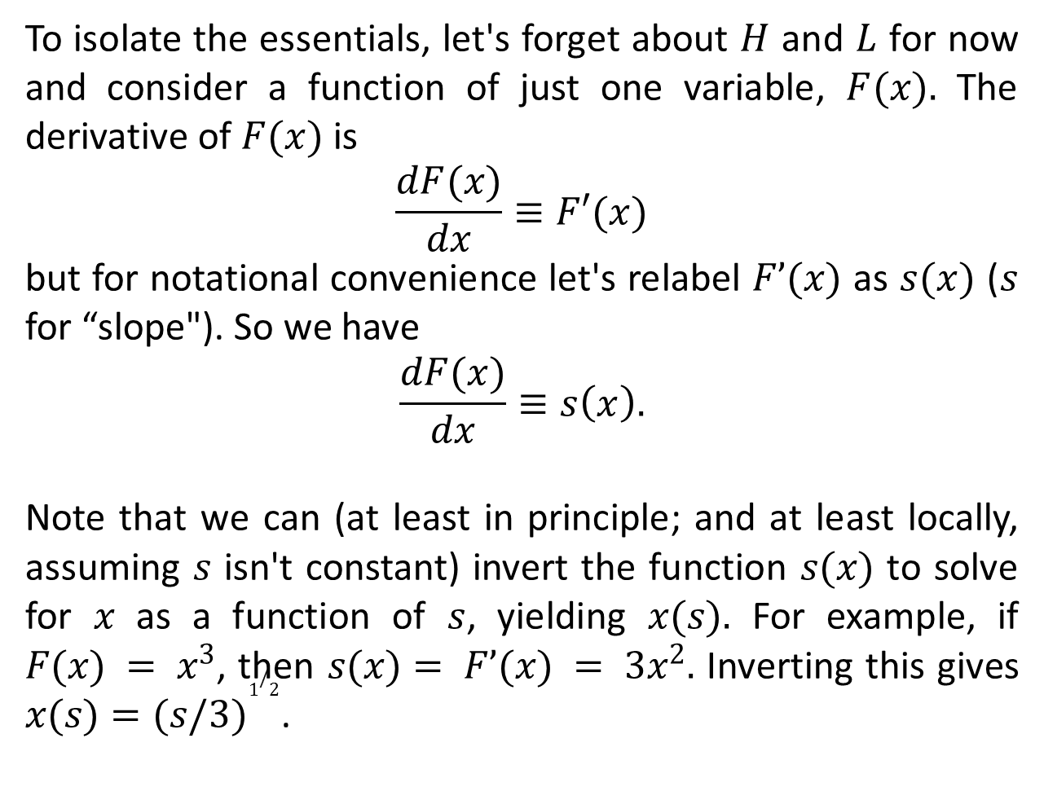
To isolate the essentials, let's forget about $H$ and $L$ for now and consider a function of just one variable, $F(x).$ The derivative of $F(x)$ is
$$\frac{dF(x)}{dx}≡F′(x)$$
but for notational convenience let's relabel $F’(x)$ as $s(x)$ ($s$ for “slope"). So we have
$$\frac{dF(x)}{dx}≡s\left(x\right).$$
Note that we can (at least in principle; and at least locally, assuming $s$ isn't constant) invert the function $s(x)$ to solve for $x$ as a function of $s$, yielding $x(s).$ For example, if $F(x) = x^{3}$, then $s(x)= F’(x) = 3x^{2}.$ Inverting this gives $x(s)={(s/3)}^{1/2}$.

Slide 13
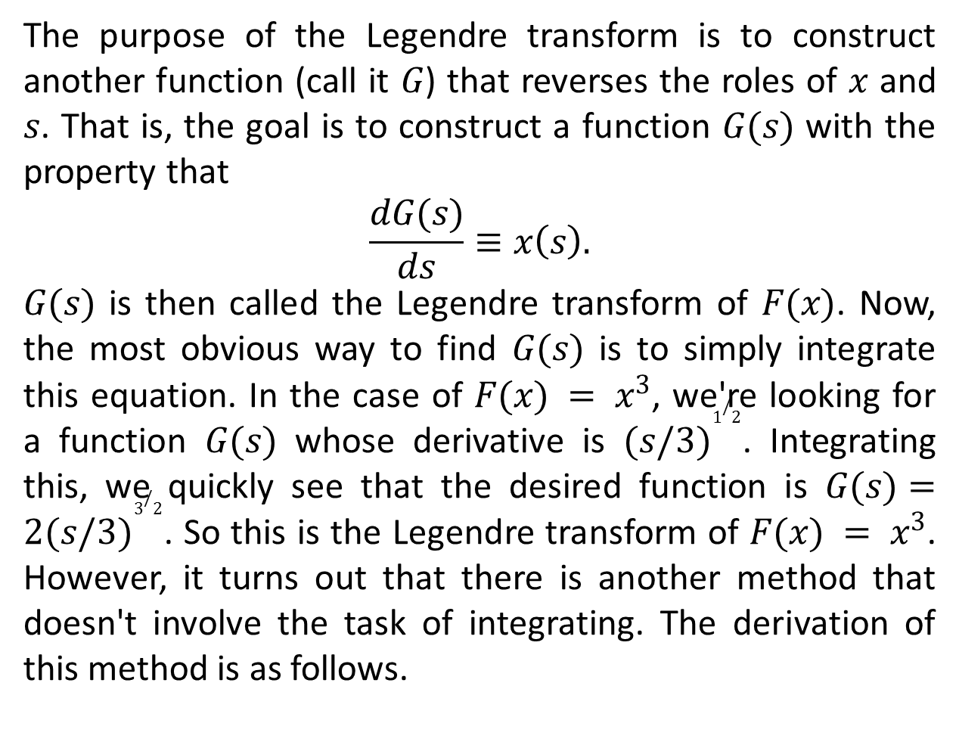
The purpose of the Legendre transform is to construct another function (call it $G$) that reverses the roles of $x$ and $s$. That is, the goal is to construct a function $G(s)$ with the property that
$$\frac{dG(s)}{ds}≡x\left(s\right).$$
$G(s)$ is then called the Legendre transform of $F(x)$. Now, the most obvious way to find $G(s)$ is to simply integrate this equation. In the case of $F(x) = x^{3}$, we're looking for a function $G(s)$ whose derivative is ${(s/3)}^{1/2}$. Integrating this, we quickly see that the desired function is $G(s)={2(s/3)}^{3/2}$. So this is the Legendre transform of $F(x) = x^{3}$. However, it turns out that there is another method that doesn't involve the task of integrating. The derivation of this method is as follows.

Slide 14
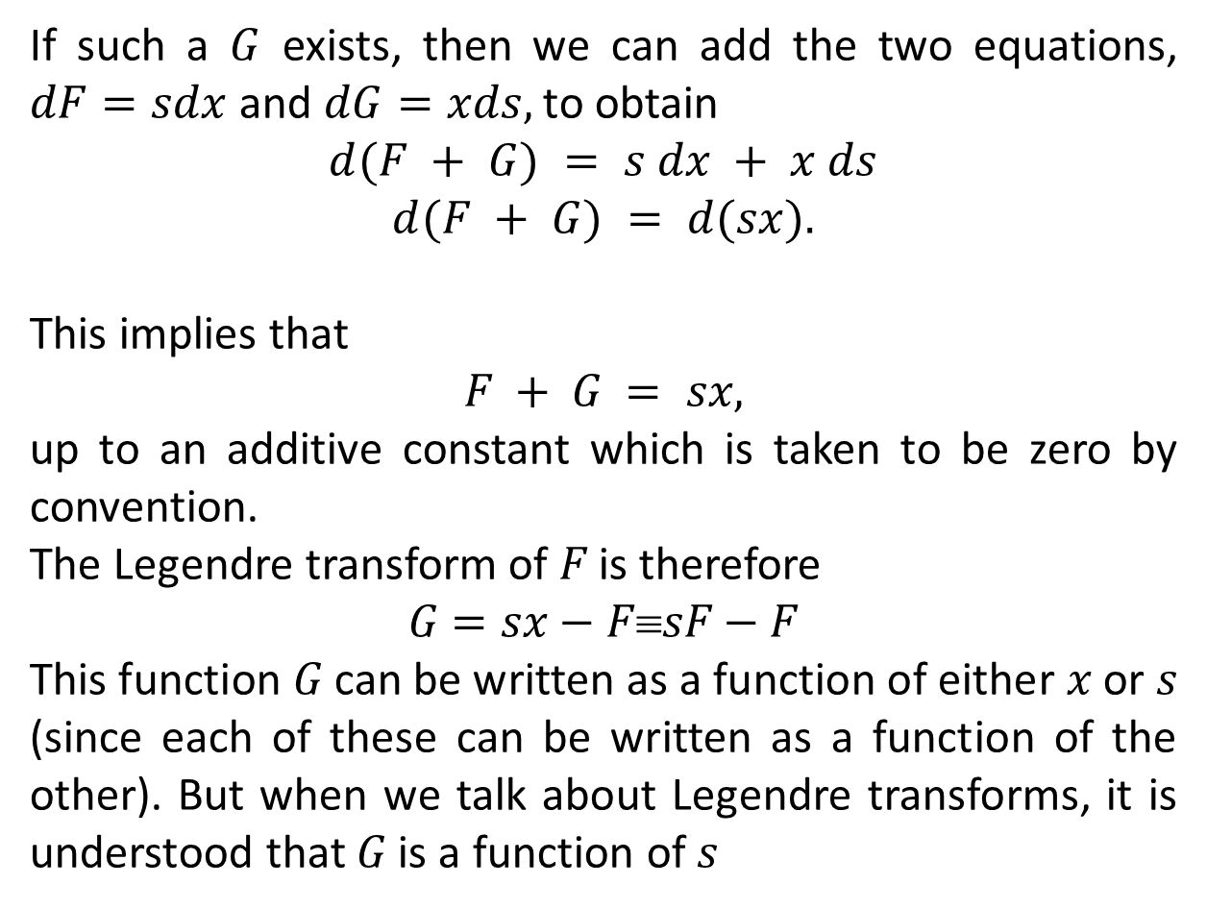
If such a $G$ exists, then we can add the two equations, $dF=sdx$ and $dG=xds,$ to obtain
$$d(F + G) = s dx + x ds$$
$$d(F + G) = d(sx).$$
This implies that
$$F + G = sx,$$
up to an additive constant which is taken to be zero by convention.
The Legendre transform of $F$ is therefore
$$G=sx−FsF−F$$
This function $G$ can be written as a function of either $x$ or $s$ (since each of these can be written as a function of the other). But when we talk about Legendre transforms, it is understood that $G$ is a function of $s$

Slide 15
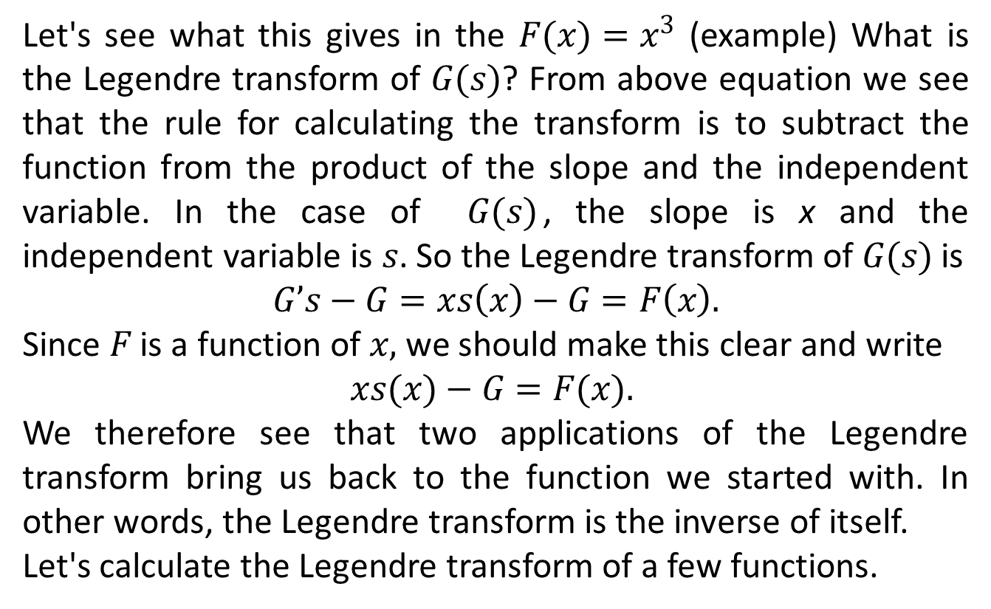
Let's see what this gives in the $F(x)=x^{3}$ (example) What is the Legendre transform of $G(s)$? From above equation we see that the rule for calculating the transform is to subtract the function from the product of the slope and the independent variable. In the case of $G(s)$, the slope is x and the independent variable is $s$. So the Legendre transform of $G(s)$ is
$$G’s−G=xs\left(x\right)−G=F\left(x\right).$$
Since $F$ is a function of $x,$ we should make this clear and write
$$xs(x)−G=F(x).$$
We therefore see that two applications of the Legendre transform bring us back to the function we started with. In other words, the Legendre transform is the inverse of itself.
Let's calculate the Legendre transform of a few functions.

Slide 16
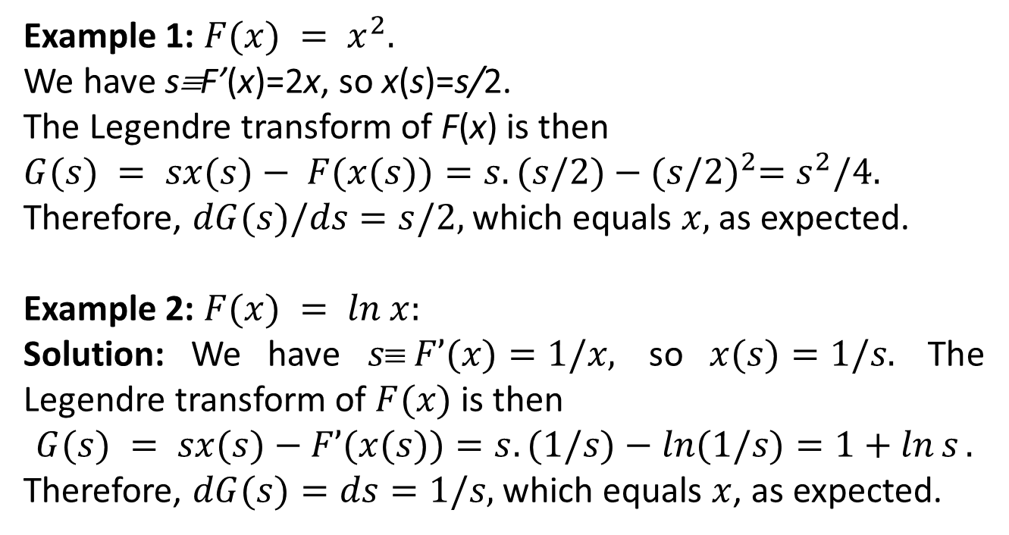
Example 1: $F(x) = x^{2}.$
We have s≡F’(x)=2x, so x(s)=s/2.
The Legendre transform of F(x) is then
$G(s) = sx(s)− F(x(s))=s.(s/2)−{(s/2)}^{2}=s^{2}/4.$
Therefore, $dG(s)/ds=s/2,$ which equals $x,$ as expected.
Example 2: $F(x) = ln x:$
Solution: We have $s F’(x)=1/x,$ so $x(s)=1/s.$ The Legendre transform of $F(x)$ is then
$$G(s) = sx(s)−F’(x(s))=s.(1/s)−ln(1/s)=1+\ln{s}.$$
Therefore, $dG(s)=ds=1/s,$ which equals $x$, as expected.

Slide 17
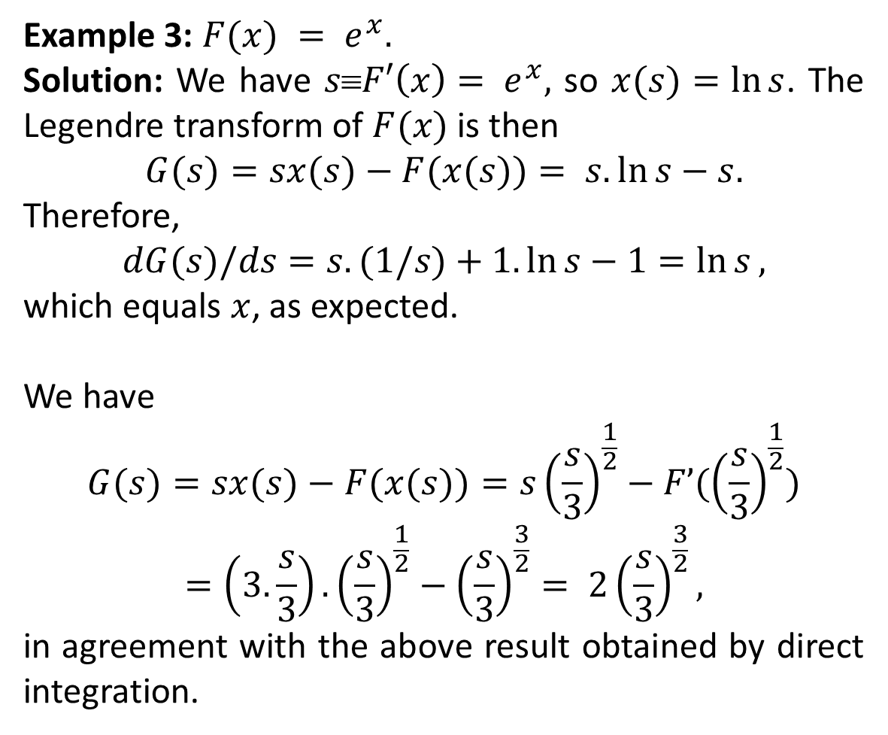
Example 3: $F(x) = e^{x}.$
Solution: We have $s≡F′\left(x\right)= e^{x},$ so $x(s)=\ln{s}$. The Legendre transform of $F(x)$ is then
$$G(s)=sx(s)−F(x(s))= s.\ln{s}−s.$$
Therefore,
$$dG(s)/ds=s.(1/s)+1.\ln{s}−1=\ln{s},$$
which equals $x$, as expected.
We have
$$G(s)=sx(s)−F(x(s))=s{\left(\frac{s}{3}\right)}^{\frac{1}{2}}−F’({\left(\frac{s}{3}\right)}^{\frac{1}{2}})$$
$$=\left(3.\frac{s}{3}\right).{\left(\frac{s}{3}\right)}^{\frac{1}{2}}−{\left(\frac{s}{3}\right)}^{\frac{3}{2}}= 2{\left(\frac{s}{3}\right)}^{\frac{3}{2}},$$
in agreement with the above result obtained by direct integration.

Slide 18
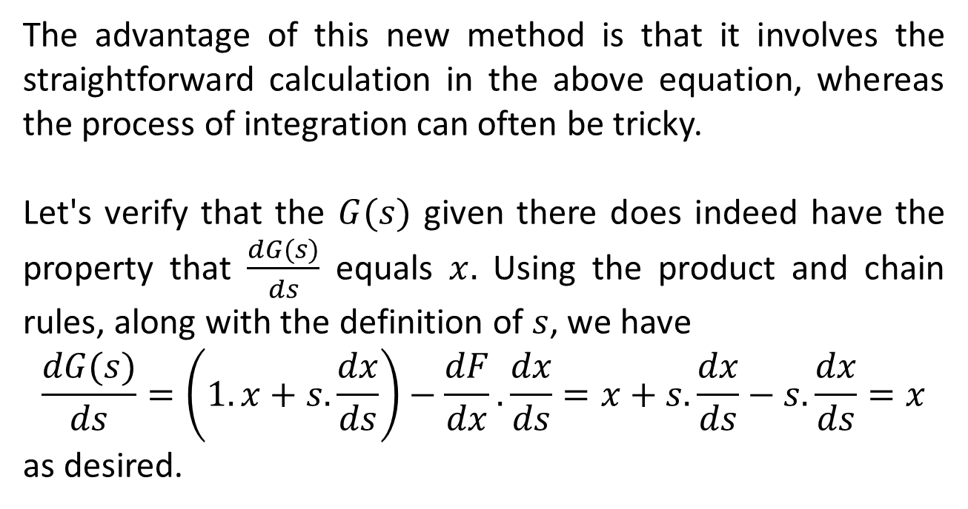
The advantage of this new method is that it involves the straightforward calculation in the above equation, whereas the process of integration can often be tricky.
Let's verify that the $G(s)$ given there does indeed have the property that $\frac{dG(s)}{ds}$ equals $x.$ Using the product and chain rules, along with the definition of $s$, we have
$$\frac{dG(s)}{ds}=\left(1.x+s.\frac{dx}{ds}\right)−\frac{dF}{dx}.\frac{dx}{ds}=x+s.\frac{dx}{ds}−s.\frac{dx}{ds}=x$$
as desired.

Slide 19
The End

