Slide 1
Revision
Previous lecture was about
Lagrangian Mechanics
Hamiltonian Mechanics
Hamilton-Jacobi Equations
Applications of Hamiltonian-Jacobi Equations

Slide 2
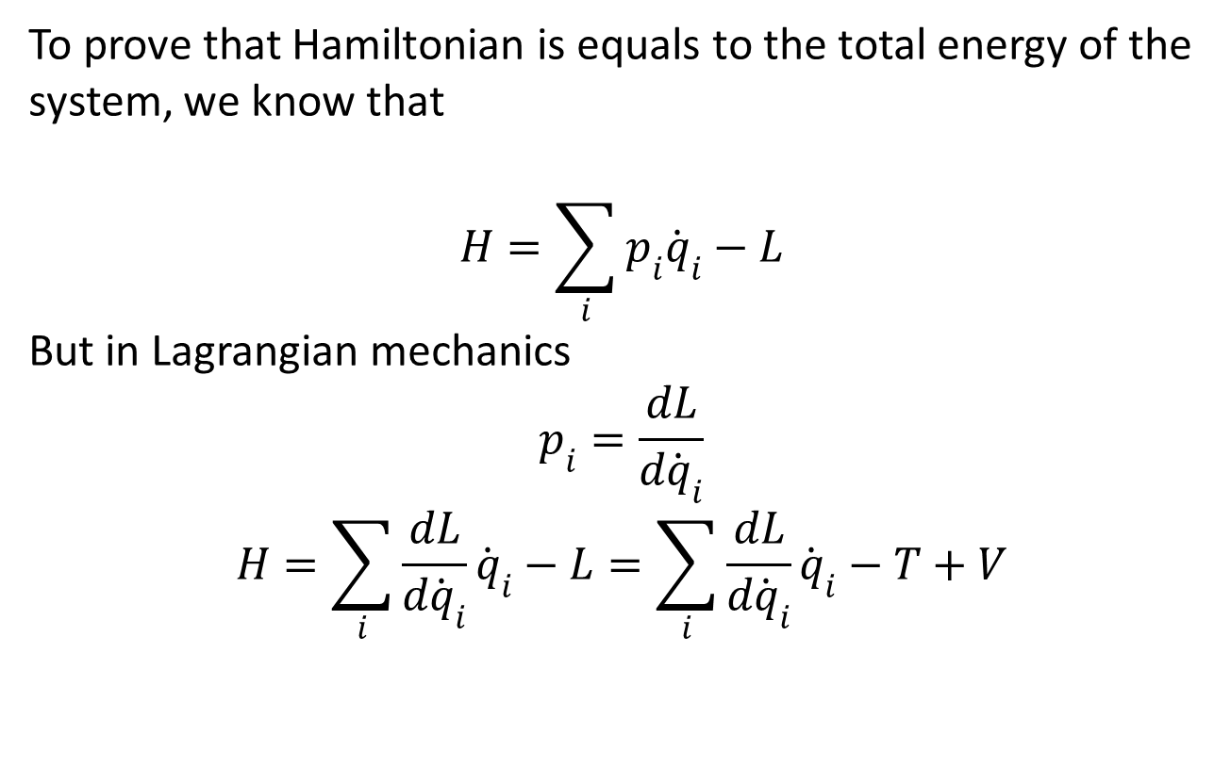
Hamiltonian as Total Energy
To prove that Hamiltonian is equals to the total energy of the system, we know that
$$H=\sum_{i}{p_{i}{\dot{q}}_{i}}−L$$
But in Lagrangian mechanics
$$p_{i}=\frac{dL}{d{\dot{q}}_{i}}$$
$$H=\sum_{i}{\frac{dL}{d{\dot{q}}_{i}}{\dot{q}}_{i}}−L=\sum_{i}{\frac{dL}{d{\dot{q}}_{i}}{\dot{q}}_{i}}−T+V$$

Slide 3
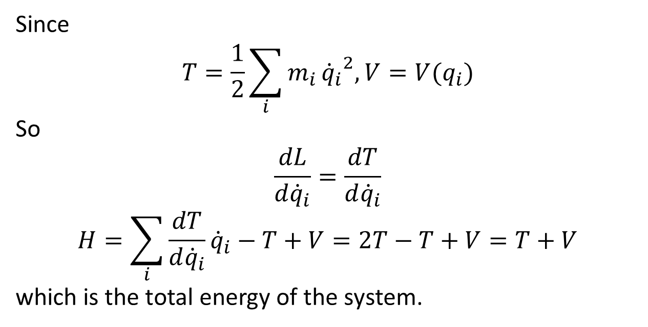
Since
$$T=\frac{1}{2}\sum_{i}{m_{i}}{{\dot{q}}_{i}}^{2}, V=V(q_{i})$$
So
$$\frac{dL}{d{\dot{q}}_{i}}=\frac{dT}{d{\dot{q}}_{i}}$$
$$H=\sum_{i}{\frac{dT}{d{\dot{q}}_{i}}{\dot{q}}_{i}}−T+V=2T−T+V=T+V$$
which is the total energy of the system.

Slide 4
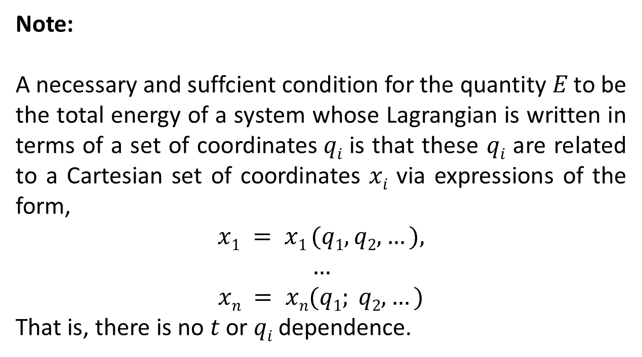
Note:
A necessary and suffcient condition for the quantity $E$ to be the total energy of a system whose Lagrangian is written in terms of a set of coordinates$qi$ is that these $qi$ are related to a Cartesian set of coordinates $xi$ via expressions of the form,
$$x1 = x1 (q1,q2,…),$$
$$…$$
$$xn = xn(q1; q2,…)$$
That is, there is no $t$ or $qi$ dependence.

Slide 5
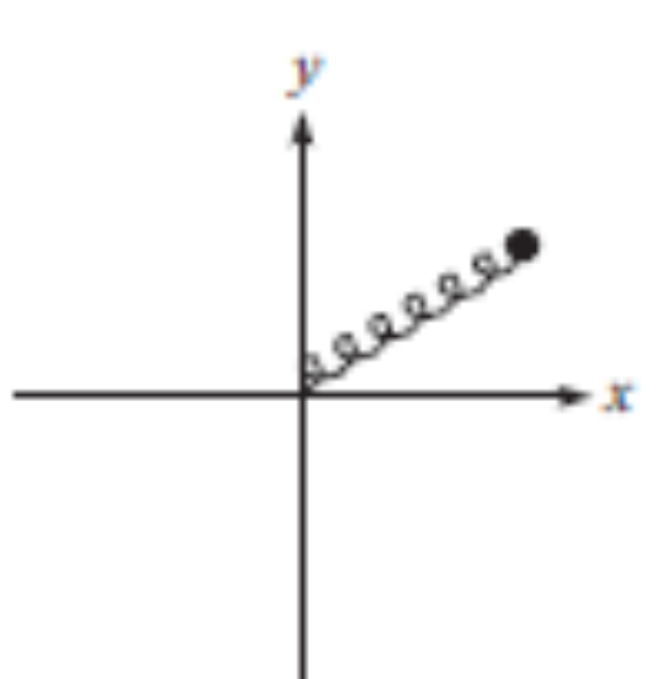
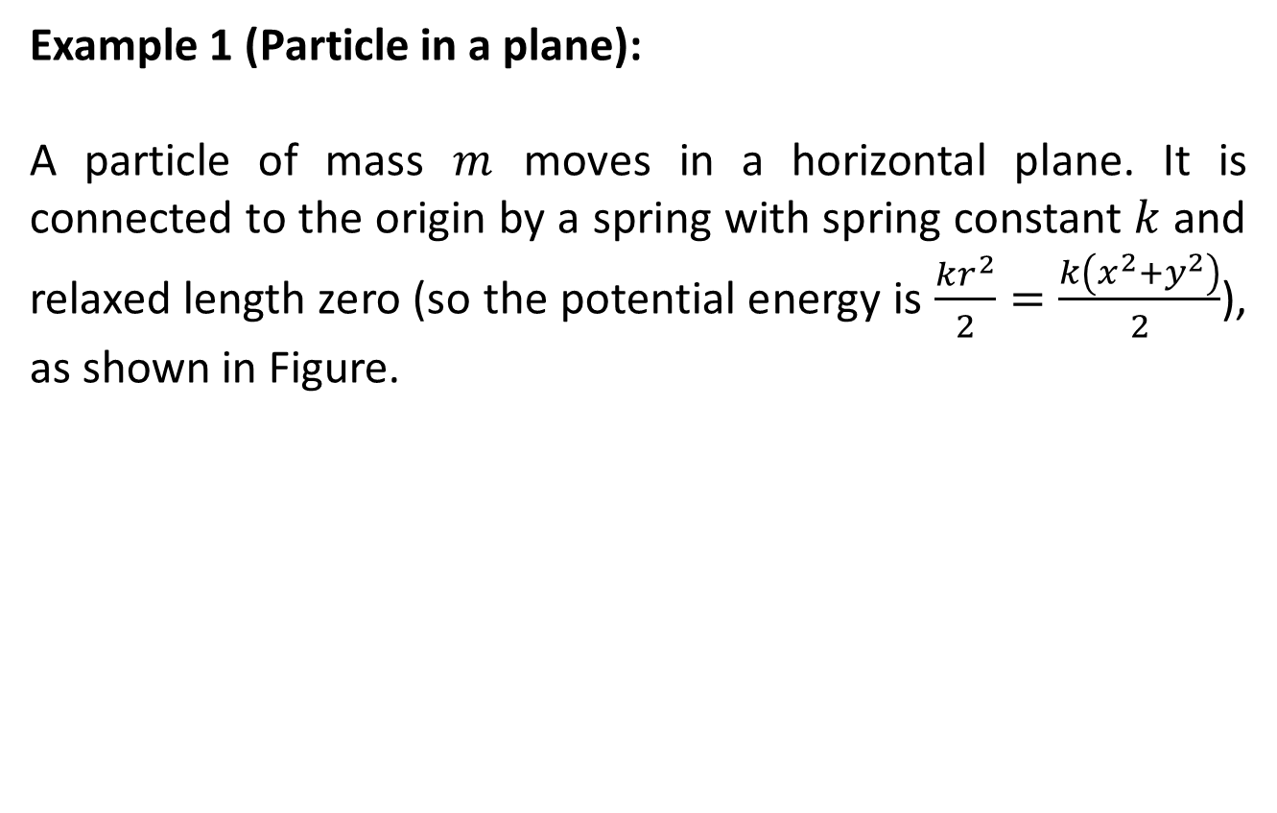
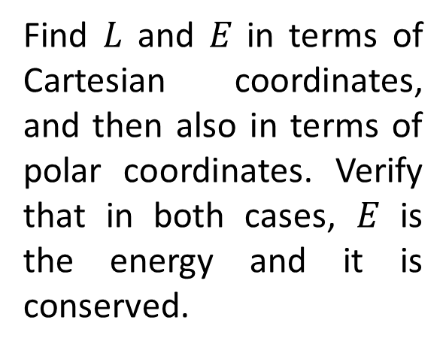
Example 1 (Particle in a plane):
A particle of mass $m$ moves in a horizontal plane. It is connected to the origin by a spring with spring constant $k$ and relaxed length zero (so the potential energy is $\frac{kr^{2}}{2}=\frac{k\left(x^{2}+y^{2}\right)}{2}$), as shown in Figure.
Find $L$ and $E$ in terms of Cartesian coordinates, and then also in terms of polar coordinates. Verify that in both cases, $E$ is the energy and it is conserved.

Slide 6
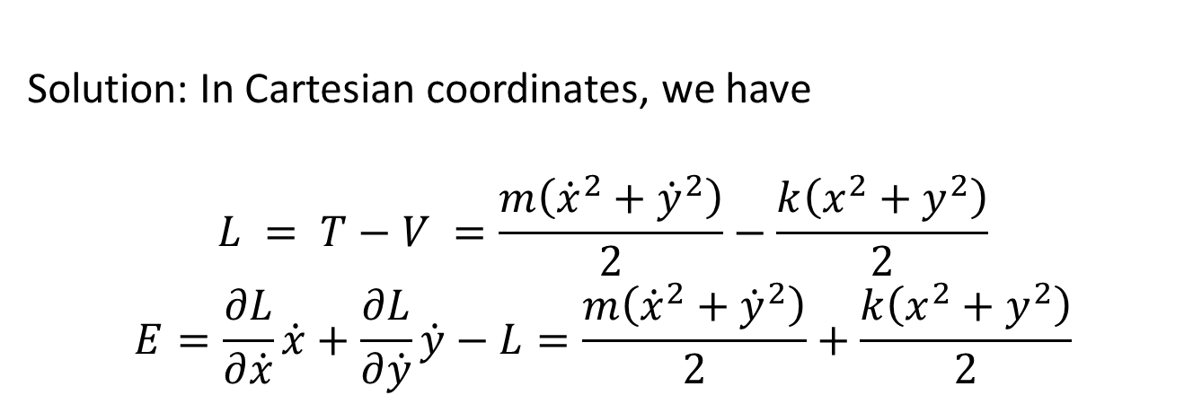
Solution: In Cartesian coordinates, we have
$$L = T−V =\frac{m\left({\dot{x}}^{2}+{\dot{y}}^{2}\right)}{2}−\frac{k\left(x^{2}+y^{2}\right)}{2}$$
$$E=\frac{∂L}{∂\dot{x}}\dot{x}+\frac{∂L}{∂\dot{y}}\dot{y}−L=\frac{m\left({\dot{x}}^{2}+{\dot{y}}^{2}\right)}{2}+\frac{k\left(x^{2}+y^{2}\right)}{2}$$

Slide 7
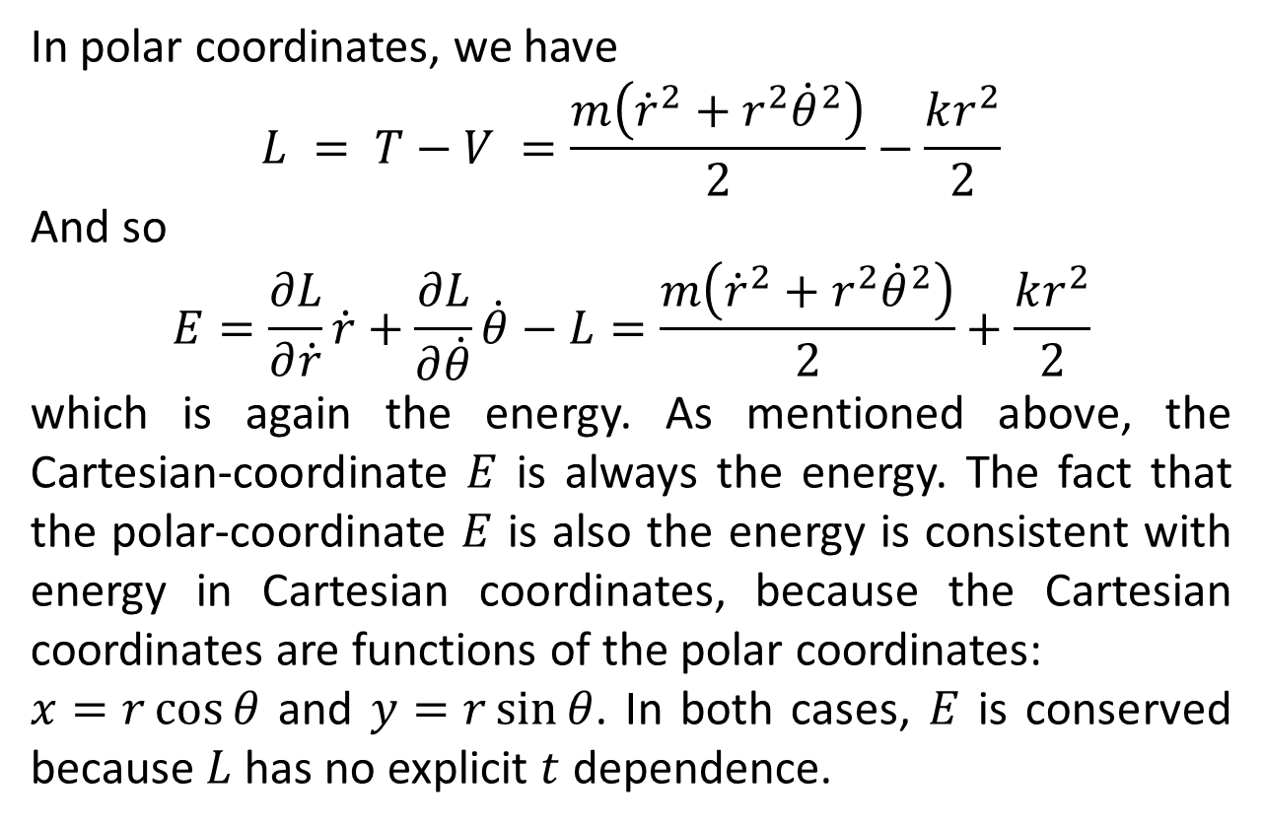
In polar coordinates, we have
$$L = T−V =\frac{m\left({\dot{r}}^{2}+r^{2}{\dot{θ}}^{2}\right)}{2}−\frac{kr^{2}}{2}$$
And so
$$E=\frac{∂L}{∂\dot{r}}\dot{r}+\frac{∂L}{∂\dot{θ}}\dot{θ}−L=\frac{m\left({\dot{r}}^{2}+r^{2}{\dot{θ}}^{2}\right)}{2}+\frac{kr^{2}}{2}$$
which is again the energy. As mentioned above, the Cartesian-coordinate $E$ is always the energy. The fact that the polar-coordinate $E$ is also the energy is consistent with energy in Cartesian coordinates, because the Cartesian coordinates are functions of the polar coordinates:
$x=r\cos{θ}$ and $y=r\sin{θ}$. In both cases, $E$ is conserved because $L$ has no explicit $t$ dependence.

Slide 8
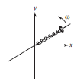
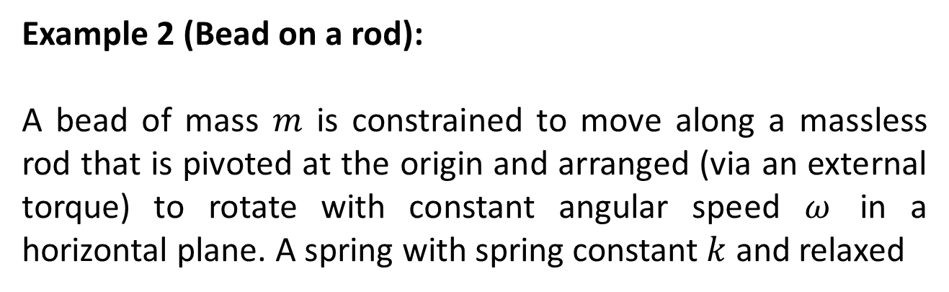
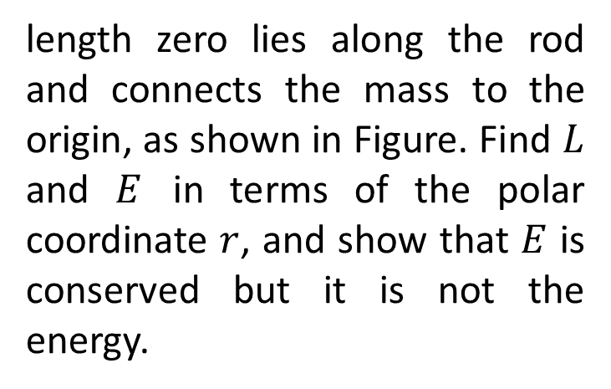
Example 2 (Bead on a rod):
A bead of mass $m$ is constrained to move along a massless rod that is pivoted at the origin and arranged (via an external torque) to rotate with constant angular speed $ω$ in a horizontal plane. A spring with spring constant $k$ and relaxed
length zero lies along the rod and connects the mass to the origin, as shown in Figure. Find $L$ and $E$ in terms of the polar coordinate $r$, and show that $E$ is conserved but it is not the energy.

Slide 9
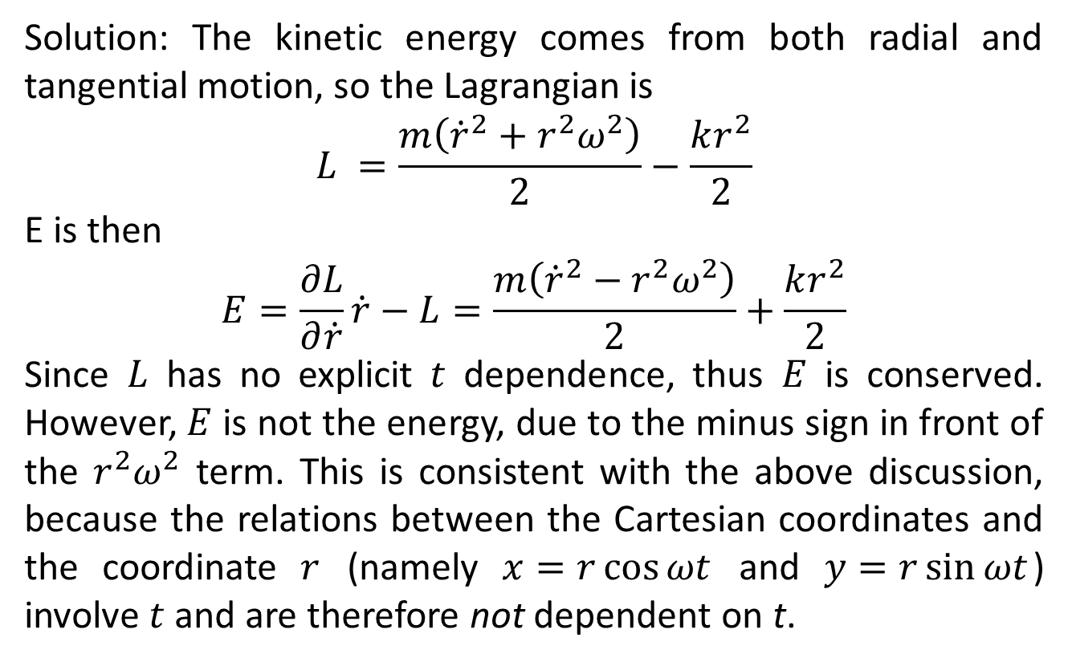
Solution: The kinetic energy comes from both radial and tangential motion, so the Lagrangian is
$$L =\frac{m\left({\dot{r}}^{2}+r^{2}ω^{2}\right)}{2}−\frac{kr^{2}}{2}$$
E is then
$$E=\frac{∂L}{∂\dot{r}}\dot{r}−L=\frac{m\left({\dot{r}}^{2}−r^{2}ω^{2}\right)}{2}+\frac{kr^{2}}{2}$$
Since $L$ has no explicit $t$ dependence, thus $E$ is conserved. However, $E$ is not the energy, due to the minus sign in front of the $r^{2}ω^{2}$ term. This is consistent with the above discussion, because the relations between the Cartesian coordinates and the coordinate $r$ (namely $x=r\cos{ωt}$ and $y=r\sin{ωt}$) involve $t$ and are therefore not dependent on t.

Slide 10

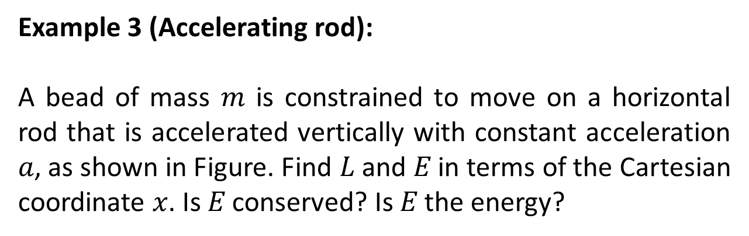
Example 3 (Accelerating rod):
A bead of mass $m$ is constrained to move on a horizontal rod that is accelerated vertically with constant acceleration $a$, as shown in Figure. Find $L$ and $E$ in terms of the Cartesian coordinate $x$. Is $E$ conserved? Is $E$ the energy?

Slide 11
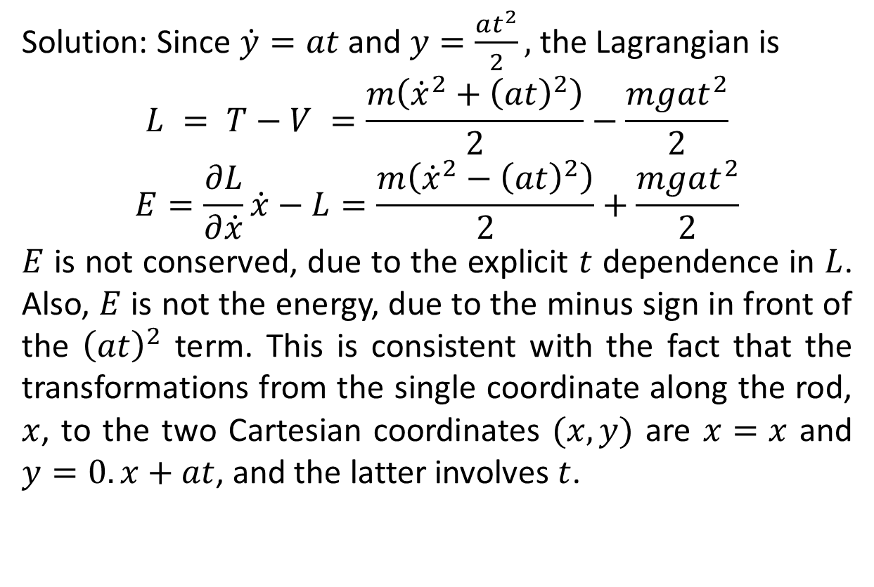
Solution: Since $\dot{y}=at$ and $y=\frac{at^{2}}{2},$ the Lagrangian is
$$L = T−V =\frac{m\left({\dot{x}}^{2}+{\left(at\right)}^{2}\right)}{2}−\frac{mgat^{2}}{2}$$
$$E=\frac{∂L}{∂\dot{x}}\dot{x}−L=\frac{m\left({\dot{x}}^{2}−{\left(at\right)}^{2}\right)}{2}+\frac{mgat^{2}}{2}$$
$E$ is not conserved, due to the explicit $t$ dependence in $L$. Also, $E$ is not the energy, due to the minus sign in front of the ${\left(at\right)}^{2}$ term. This is consistent with the fact that the transformations from the single coordinate along the rod, $x$, to the two Cartesian coordinates $(x,y)$ are $x=x$ and $y=0.x+at$, and the latter involves $t$.

Slide 12
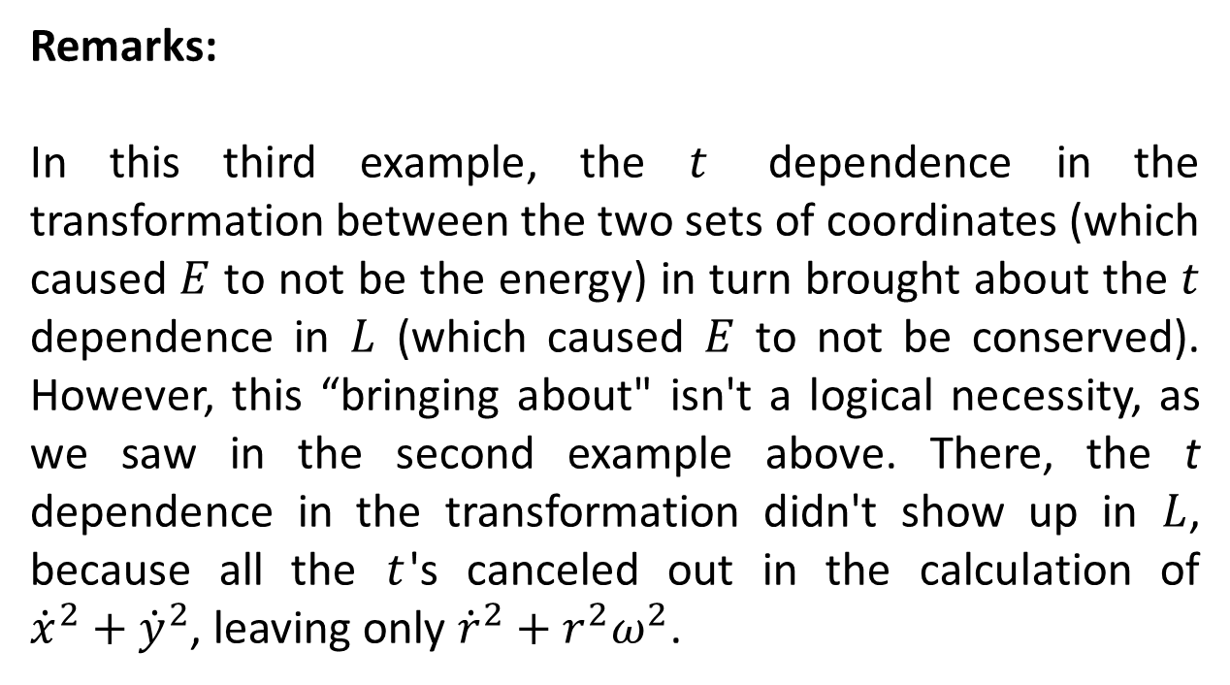
Remarks:
In this third example, the $t$ dependence in the transformation between the two sets of coordinates (which caused $E$ to not be the energy) in turn brought about the $t$ dependence in $L$ (which caused $E$ to not be conserved). However, this “bringing about" isn't a logical necessity, as we saw in the second example above. There, the t dependence in the transformation didn't show up in $L$, because all the $t$'s canceled out in the calculation of ${\dot{x}}^{2}+{\dot{y}}^{2}$, leaving only ${\dot{r}}^{2}+r^{2}ω^{2}$.

Slide 13
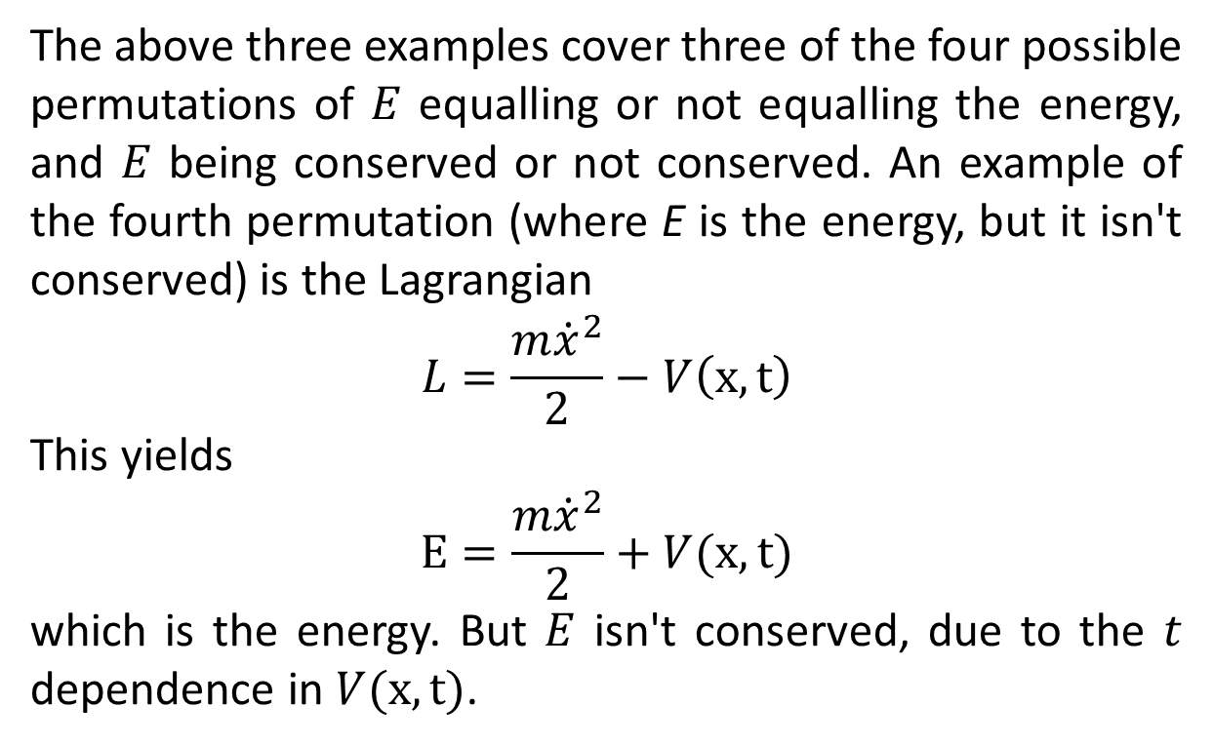
The above three examples cover three of the four possible permutations of $E$ equalling or not equalling the energy, and $E$ being conserved or not conserved. An example of the fourth permutation (where E is the energy, but it isn't conserved) is the Lagrangian
$$L=\frac{m{\dot{x}}^{2}}{2}−V\left(x,t\right)$$
This yields
$$E=\frac{m{\dot{x}}^{2}}{2}+V(x,t)$$
which is the energy. But $E$ isn't conserved, due to the $t$ dependence in $V(x,t)$.

Slide 14
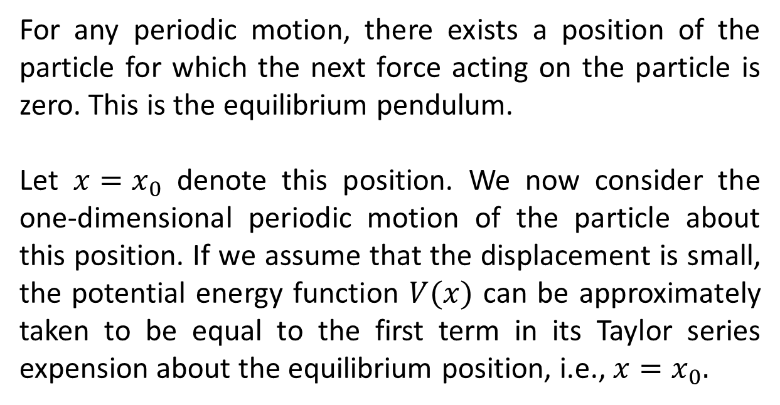
Simple Harmonic Oscillator
For any periodic motion, there exists a position of the particle for which the next force acting on the particle is zero. This is the equilibrium pendulum.
Let $x=x_{0}$ denote this position. We now consider the one-dimensional periodic motion of the particle about this position. If we assume that the displacement is small, the potential energy function $V(x)$ can be approximately taken to be equal to the first term in its Taylor series expension about the equilibrium position, i.e., $x=x_{0}.$

Slide 15
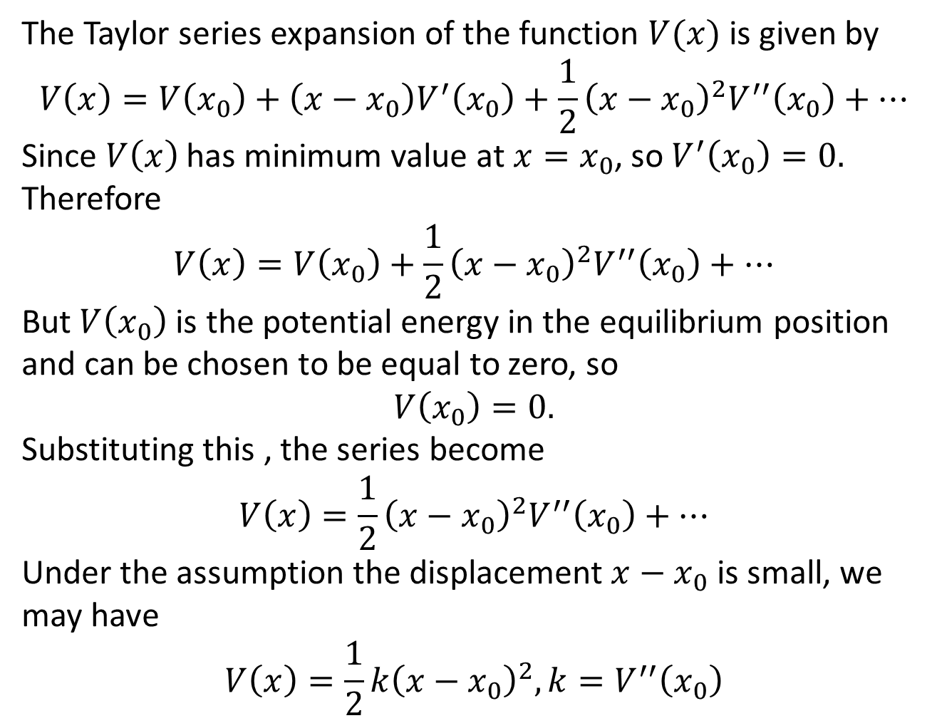
The Taylor series expansion of the function $V(x)$ is given by
$$V\left(x\right)=V\left(x_{0}\right)+\left(x−x_{0}\right)V^{′}\left(x_{0}\right)+\frac{1}{2}{\left(x−x_{0}\right)}^{2}V^{′′}\left(x_{0}\right)+…$$
Since $V\left(x\right)$ has minimum value at $x=x_{0}$, so $V^{′}\left(x_{0}\right)=0.$ Therefore
$$V\left(x\right)=V\left(x_{0}\right)+\frac{1}{2}{\left(x−x_{0}\right)}^{2}V^{′′}\left(x_{0}\right)+…$$
But $V\left(x_{0}\right)$ is the potential energy in the equilibrium position and can be chosen to be equal to zero, so
$$V\left(x_{0}\right)=0.$$
Substituting this , the series become
$$V\left(x\right)=\frac{1}{2}{\left(x−x_{0}\right)}^{2}V^{′′}\left(x_{0}\right)+…$$
Under the assumption the displacement $x−x_{0}$ is small, we may have
$$V\left(x\right)=\frac{1}{2}k{\left(x−x_{0}\right)}^{2}, k=V^{′′}\left(x_{0}\right)$$

Slide 16
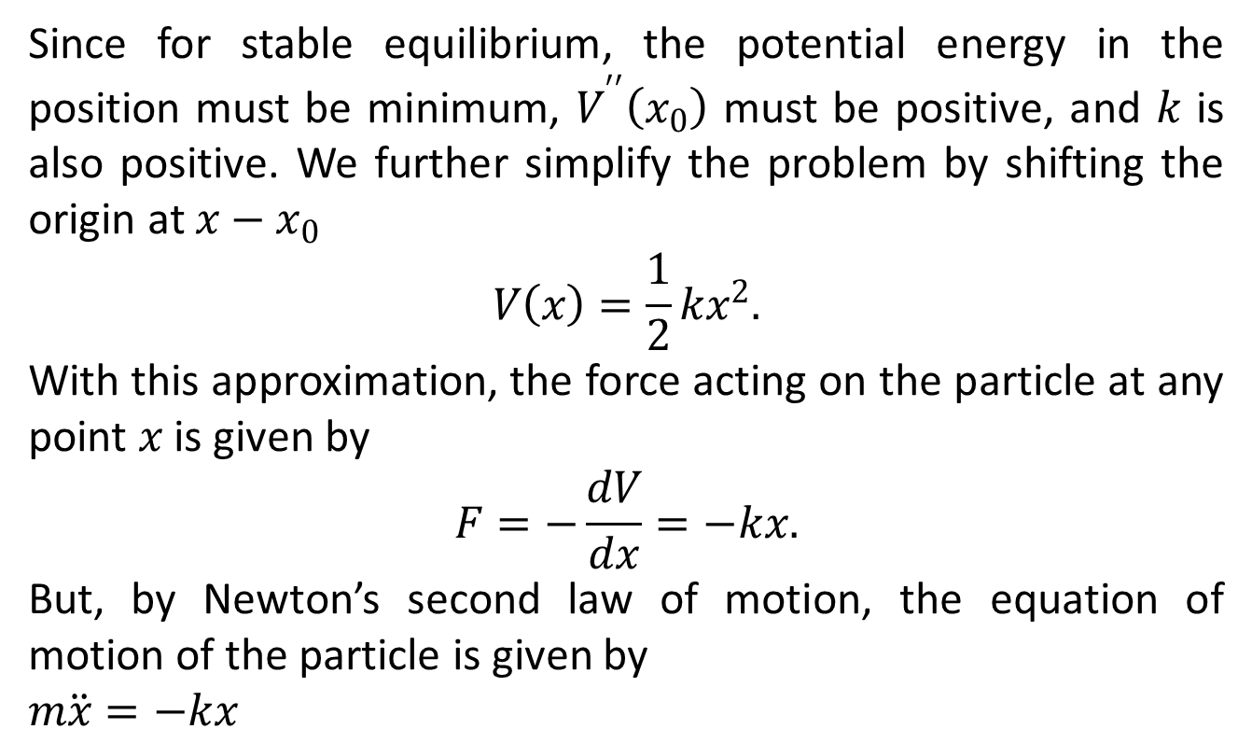
Since for stable equilibrium, the potential energy in the position must be minimum, $V^{′′}\left(x_{0}\right)$ must be positive, and $k$ is also positive. We further simplify the problem by shifting the origin at $x−x_{0}$
$$V\left(x\right)=\frac{1}{2}kx^{2}.$$
With this approximation, the force acting on the particle at any point $x$ is given by
$$F=−\frac{dV}{dx}=−kx.$$
But, by Newton’s second law of motion, the equation of motion of the particle is given by
$m\ddot{x}=−kx$

Slide 17
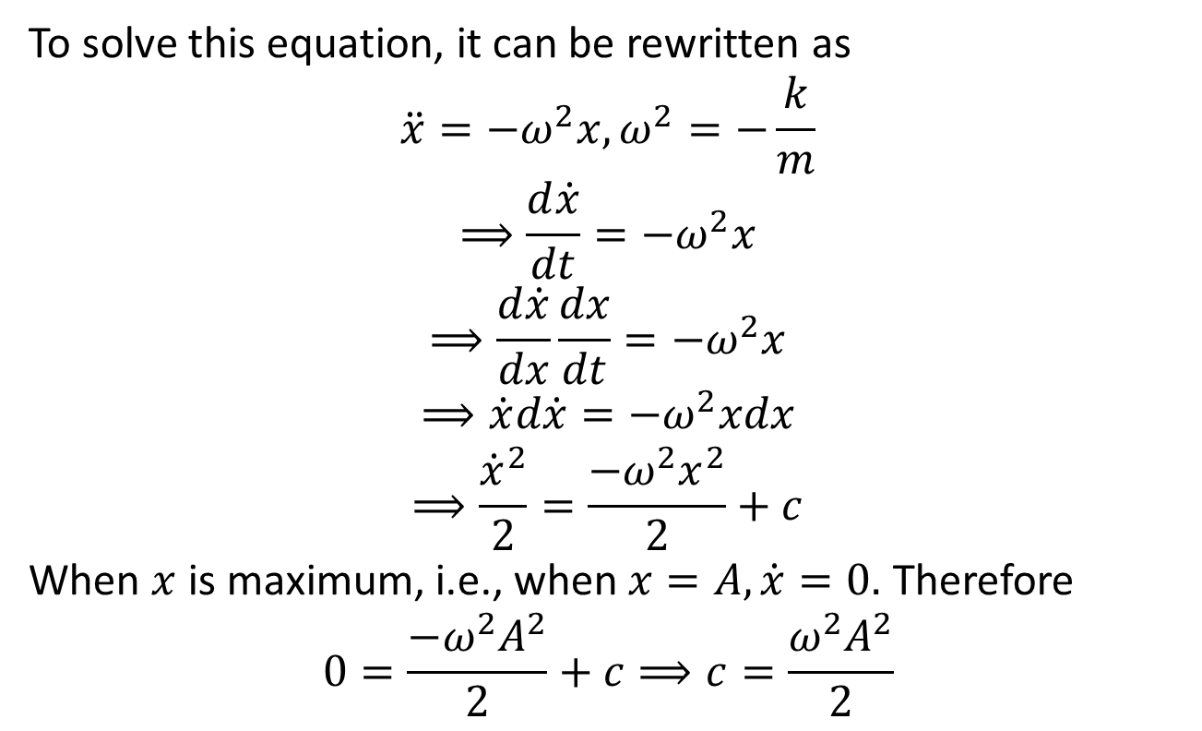
To solve this equation, it can be rewritten as
$$\ddot{x}=−ω^{2}x,ω^{2}=−\frac{k}{m}$$
$$⟹\frac{d\dot{x}}{dt}=−ω^{2}x$$
$$⟹\frac{d\dot{x}}{dx}\frac{dx}{dt}=−ω^{2}x$$
$$⟹\dot{x}d\dot{x}=−ω^{2}xdx$$
$$⟹\frac{{\dot{x}}^{2}}{2}=\frac{{−ω^{2}x}^{2}}{2}+c$$
When $x$ is maximum, i.e., when $x=A, \dot{x}=0.$ Therefore
$$0=\frac{{−ω^{2}A}^{2}}{2}+c⟹c=\frac{{ω^{2}A}^{2}}{2}$$

Slide 18
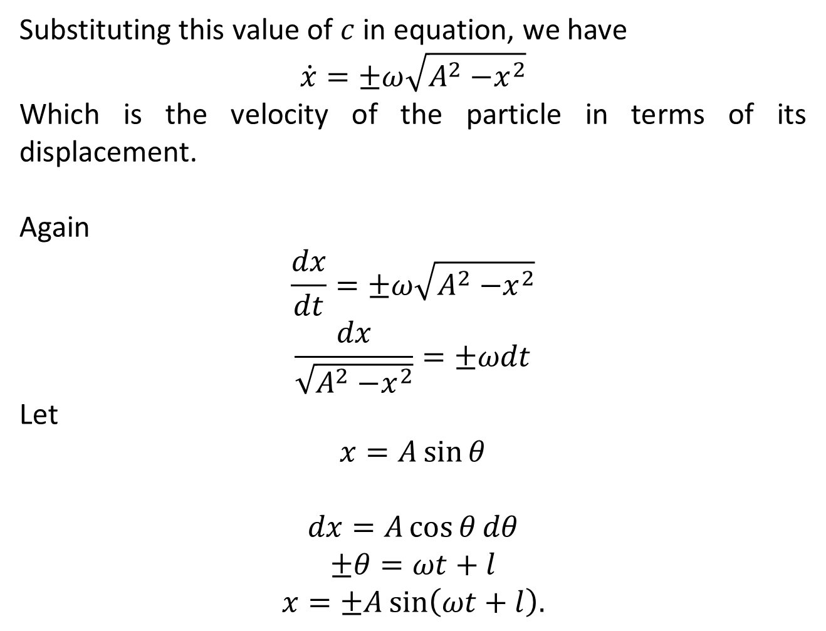
Substituting this value of $c$ in equation, we have
$$\dot{x}=±ω\sqrt{A^{2}{−x}^{2}}$$
Which is the velocity of the particle in terms of its displacement.
Again
$$\frac{dx}{dt}=±ω\sqrt{A^{2}{−x}^{2}}$$
$$\frac{dx}{\sqrt{A^{2}{−x}^{2}}}=±ωdt$$
Let
$$x=A\sin{θ}$$
$$dx=A\cos{θ}dθ$$
$$±θ=ωt+l$$
$$x=±A\sin\left(ωt+l\right).$$

Slide 19
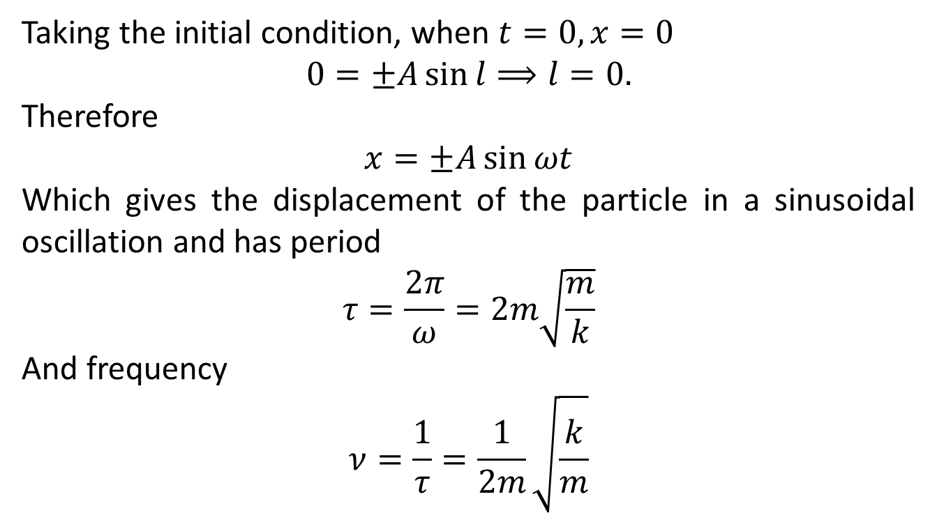
Taking the initial condition, when $t=0,x=0$
$$0=±A\sin{l⟹l=0.}$$
Therefore
$$x=±A\sin{ωt}$$
Which gives the displacement of the particle in a sinusoidal oscillation and has period
$$τ=\frac{2π}{ω}=2m\sqrt{\frac{m}{k}}$$
And frequency
$$ν=\frac{1}{τ}=\frac{1}{2m}\sqrt{\frac{k}{m}}$$

Slide 20
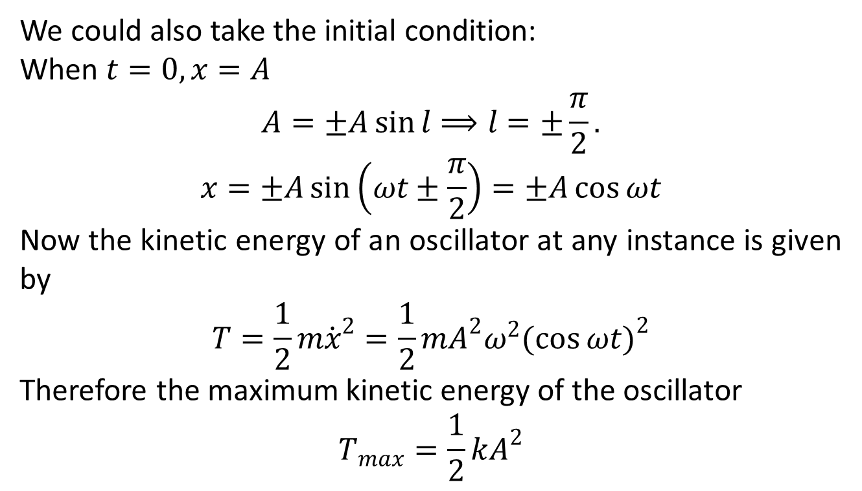
We could also take the initial condition:
When $t=0,x=A$
$$A=±A\sin{l⟹l=±\frac{π}{2}.}$$
$$x=±A\sin\left(ωt±\frac{π}{2}\right)=±A\cos{ωt}$$
Now the kinetic energy of an oscillator at any instance is given by
$$T=\frac{1}{2}m{\dot{x}}^{2}=\frac{1}{2}mA^{2}ω^{2}{(\cos{ωt})}^{2}$$
Therefore the maximum kinetic energy of the oscillator
$$T_{max}=\frac{1}{2}kA^{2}$$

Slide 21
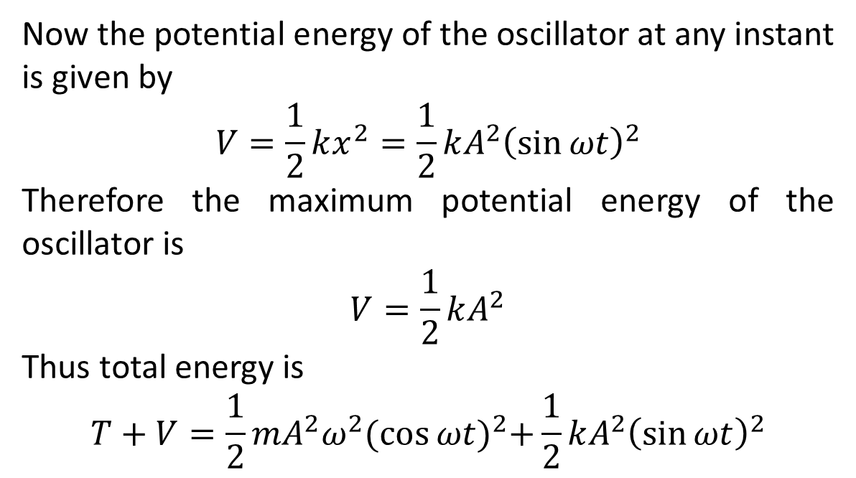
Now the potential energy of the oscillator at any instant is given by
$$V=\frac{1}{2}kx^{2}=\frac{1}{2}kA^{2}{\left(\sin{ωt}\right)}^{2}$$
Therefore the maximum potential energy of the oscillator is
$$V=\frac{1}{2}kA^{2}$$
Thus total energy is
$$T+V=\frac{1}{2}mA^{2}ω^{2}{(\cos{ωt})}^{2}+\frac{1}{2}kA^{2}{\left(\sin{ωt}\right)}^{2}$$

Slide 24
The End

