Slide 1
Revision
Previous lecture was about
Generating Function Approach

Slide 2
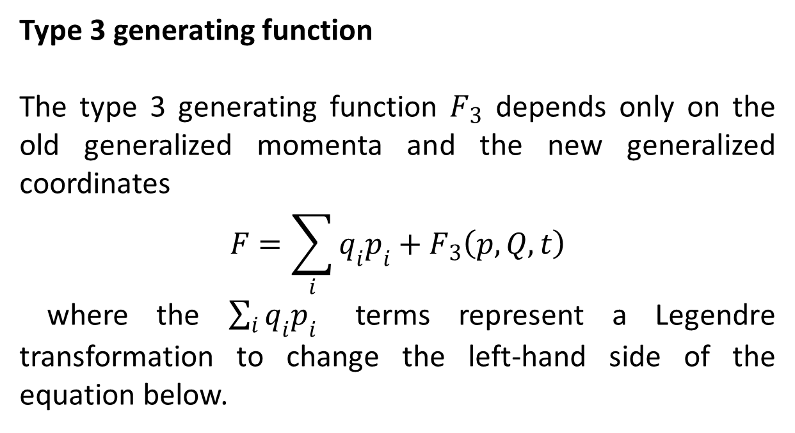
Type 3 generating function
The type 3 generating function $F_{3}$ depends only on the old generalized momenta and the new generalized coordinates
$$F=\sum_{i}{q_{i}p_{i}}+F_{3}\left(p,Q,t\right)$$
where the $\sum_{i}{q_{i}p_{i}}$ terms represent a Legendre transformation to change the left-hand side of the equation below.

Slide 3
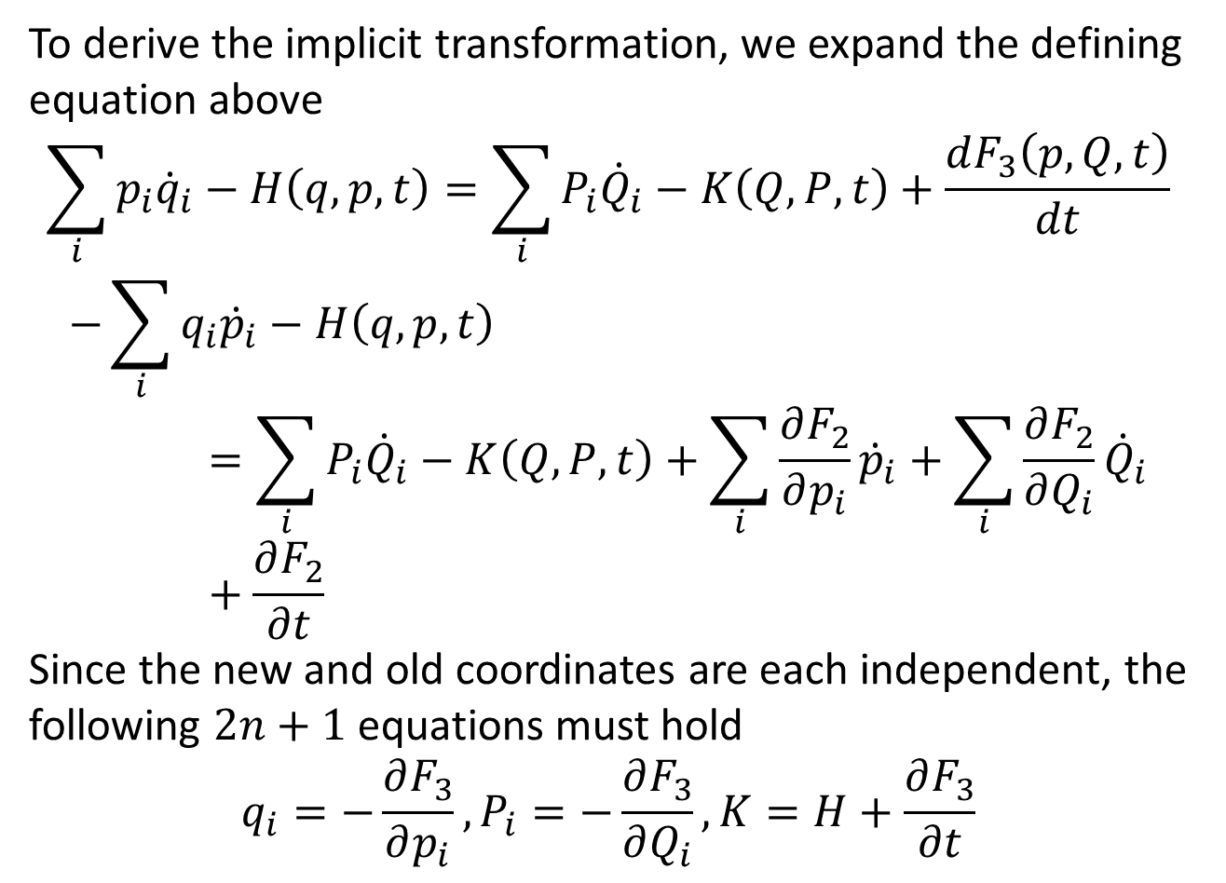
To derive the implicit transformation, we expand the defining equation above
$$\sum_{i}{p_{i}{\dot{q}}_{i}−H\left(q,p,t\right)}=\sum_{i}{P_{i}{\dot{Q}}_{i}−K\left(Q,P,t\right)}+\frac{dF_{3}\left(p,Q,t\right)}{dt}$$
$$−\sum_{i}{q_{i}{\dot{p}}_{i}−H\left(q,p,t\right)}=\sum_{i}{P_{i}{\dot{Q}}_{i}−K\left(Q,P,t\right)}+\sum_{i}{\frac{∂F_{2}}{∂p_{i}}{\dot{p}}_{i}}+\sum_{i}{\frac{∂F_{2}}{∂Q_{i}}{\dot{Q}}_{i}}+\frac{∂F_{2}}{∂t}$$
Since the new and old coordinates are each independent, the following $2n+1$ equations must hold
$$q_{i}=−\frac{∂F_{3}}{∂p_{i}},P_{i}=−\frac{∂F_{3}}{∂Q_{i}},K=H+\frac{∂F_{3}}{∂t}$$

Slide 5
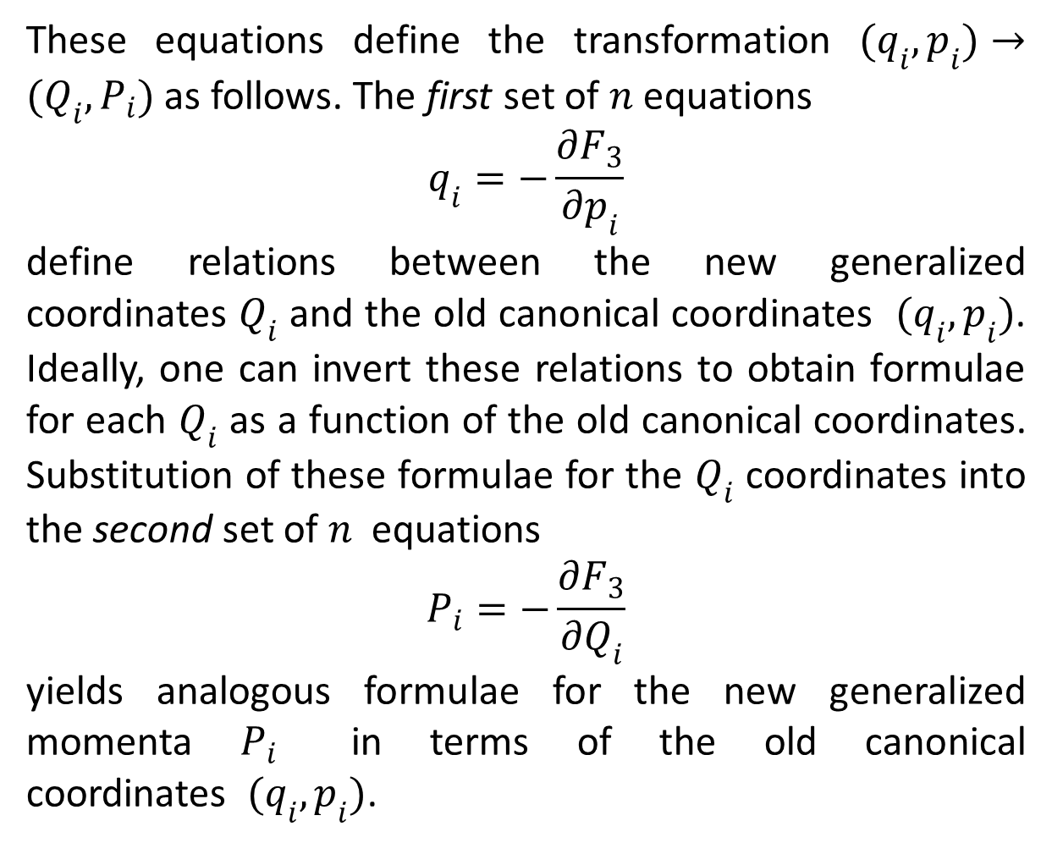
These equations define the transformation $(q_{i},p_{i})→(Q_{i},P_{i})$ as follows. The first set of $n$ equations
$$q_{i}=−\frac{∂F_{3}}{∂p_{i}}$$
define relations between the new generalized coordinates $Q_{i}$ and the old canonical coordinates $(q_{i},p_{i})$. Ideally, one can invert these relations to obtain formulae for each $Q_{i}$ as a function of the old canonical coordinates. Substitution of these formulae for the $Q_{i}$ coordinates into the second set of $n$ equations
$$P_{i}=−\frac{∂F_{3}}{∂Q_{i}}$$
yields analogous formulae for the new generalized momenta $P_{i}$ in terms of the old canonical coordinates $(q_{i},p_{i})$.

Slide 6
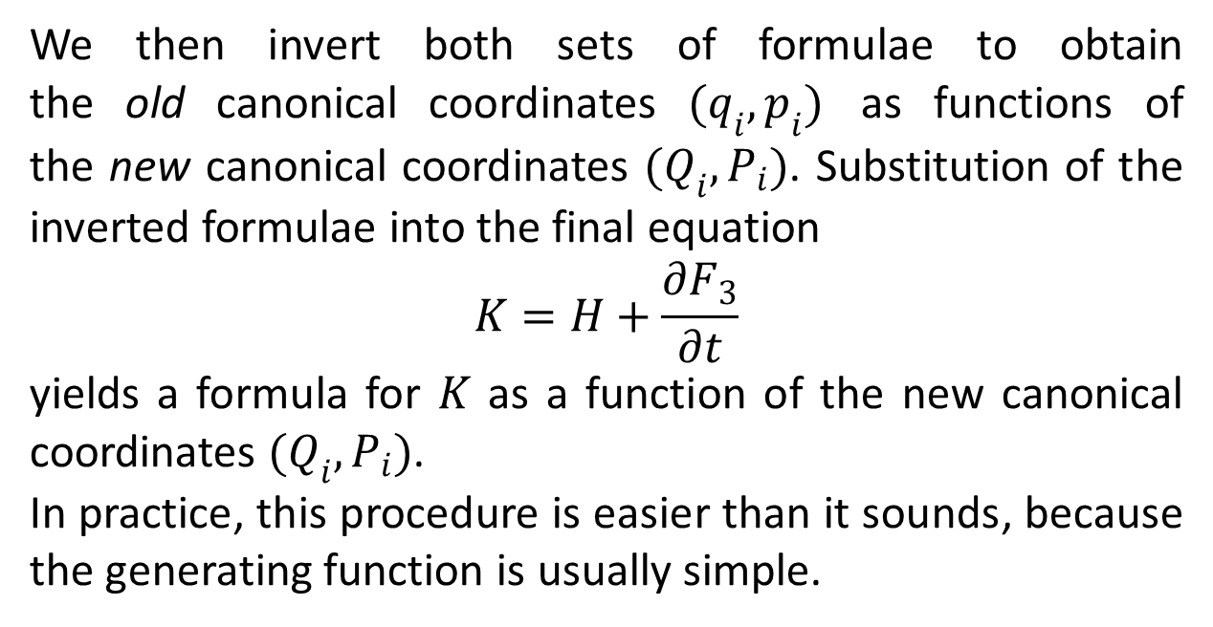
We then invert both sets of formulae to obtain the old canonical coordinates $(q_{i},p_{i})$ as functions of the new canonical coordinates $(Q_{i},P_{i})$. Substitution of the inverted formulae into the final equation
$$K=H+\frac{∂F_{3}}{∂t}$$
yields a formula for $K$ as a function of the new canonical coordinates $(Q_{i},P_{i})$.
In practice, this procedure is easier than it sounds, because the generating function is usually simple.

Slide 7
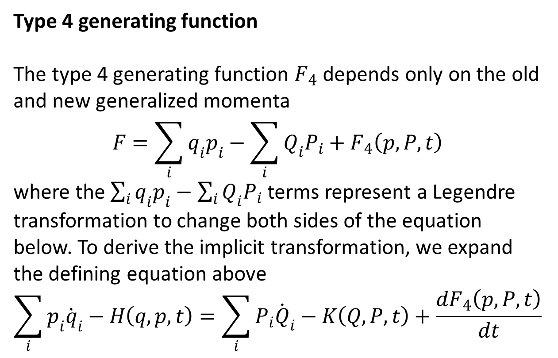
Type 4 generating function
The type 4 generating function $F_{4}$ depends only on the old and new generalized momenta
$$F=\sum_{i}{q_{i}p_{i}}−\sum_{i}{Q_{i}P_{i}}+F_{4}\left(p,P,t\right)$$
where the $\sum_{i}{q_{i}p_{i}}−\sum_{i}{Q_{i}P_{i}}$ terms represent a Legendre transformation to change both sides of the equation below. To derive the implicit transformation, we expand the defining equation above
$$\sum_{i}{p_{i}{\dot{q}}_{i}−H\left(q,p,t\right)}=\sum_{i}{P_{i}{\dot{Q}}_{i}−K\left(Q,P,t\right)}+\frac{dF_{4}\left(p,P,t\right)}{dt}$$

Slide 8
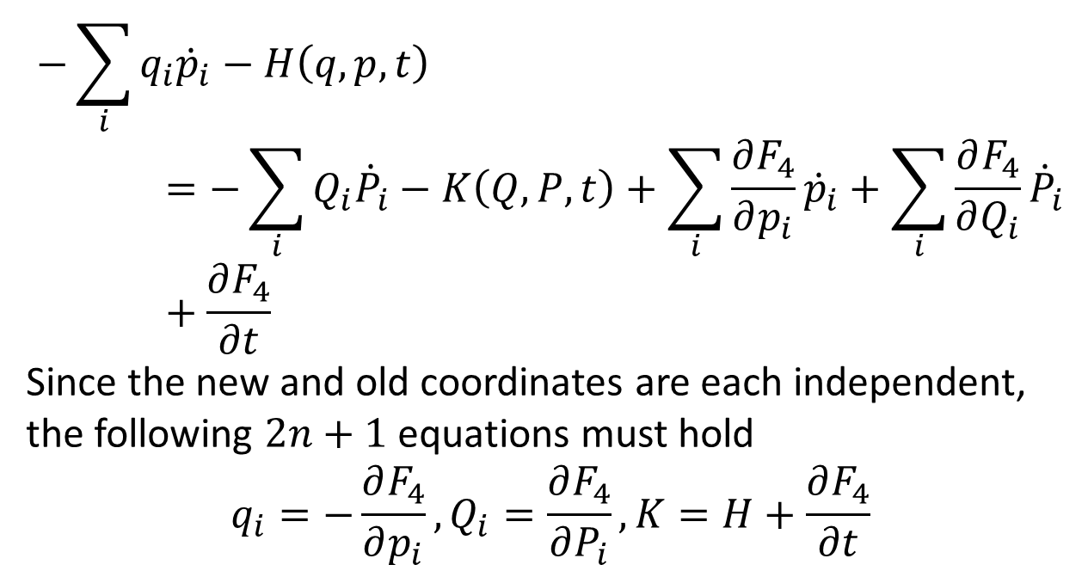
$$−\sum_{i}{q_{i}{\dot{p}}_{i}−H\left(q,p,t\right)}=−\sum_{i}{Q_{i}{\dot{P}}_{i}−K\left(Q,P,t\right)}+\sum_{i}{\frac{∂F_{4}}{∂p_{i}}{\dot{p}}_{i}}+\sum_{i}{\frac{∂F_{4}}{∂Q_{i}}{\dot{P}}_{i}}+\frac{∂F_{4}}{∂t}$$
Since the new and old coordinates are each independent, the following $2n+1$ equations must hold
$$q_{i}=−\frac{∂F_{4}}{∂p_{i}},Q_{i}=\frac{∂F_{4}}{∂P_{i}},K=H+\frac{∂F_{4}}{∂t}$$

Slide 10
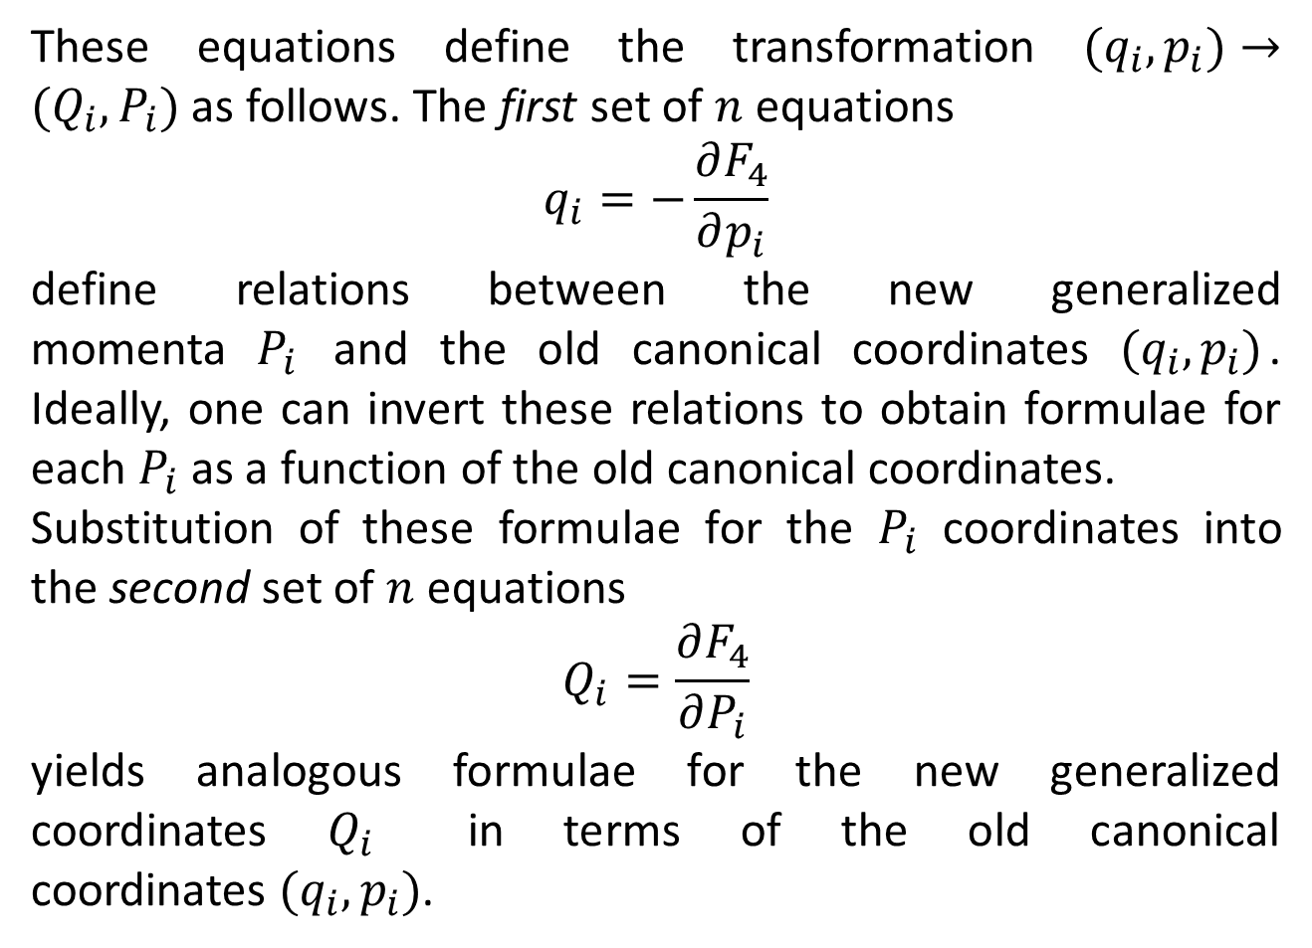
These equations define the transformation $(q_{i},p_{i})→(Q_{i},P_{i})$ as follows. The first set of $n$ equations
$$q_{i}=−\frac{∂F_{4}}{∂p_{i}}$$
define relations between the new generalized momenta $P_{i}$ and the old canonical coordinates $(q_{i},p_{i})$. Ideally, one can invert these relations to obtain formulae for each $P_{i}$ as a function of the old canonical coordinates.
Substitution of these formulae for the $P_{i}$ coordinates into the second set of $n$ equations
$$Q_{i}=\frac{∂F_{4}}{∂P_{i}}$$
yields analogous formulae for the new generalized coordinates $Q_{i}$ in terms of the old canonical coordinates $(q_{i},p_{i})$.

Slide 11
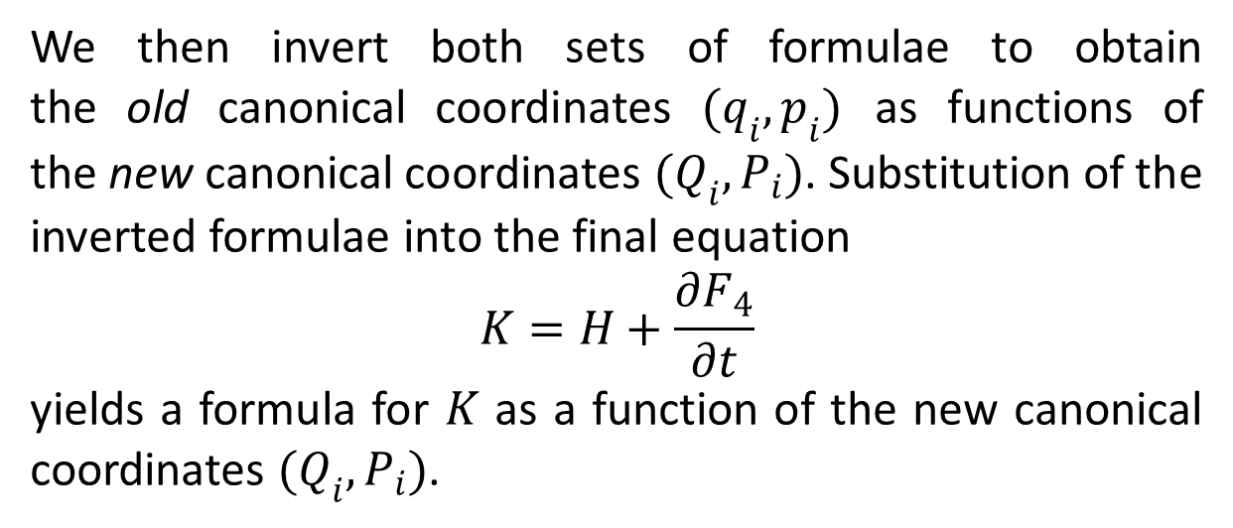
We then invert both sets of formulae to obtain the old canonical coordinates $(q_{i},p_{i})$ as functions of the new canonical coordinates $(Q_{i},P_{i})$. Substitution of the inverted formulae into the final equation
$$K=H+\frac{∂F_{4}}{∂t}$$
yields a formula for $K$ as a function of the new canonical coordinates $(Q_{i},P_{i})$.

Slide 12
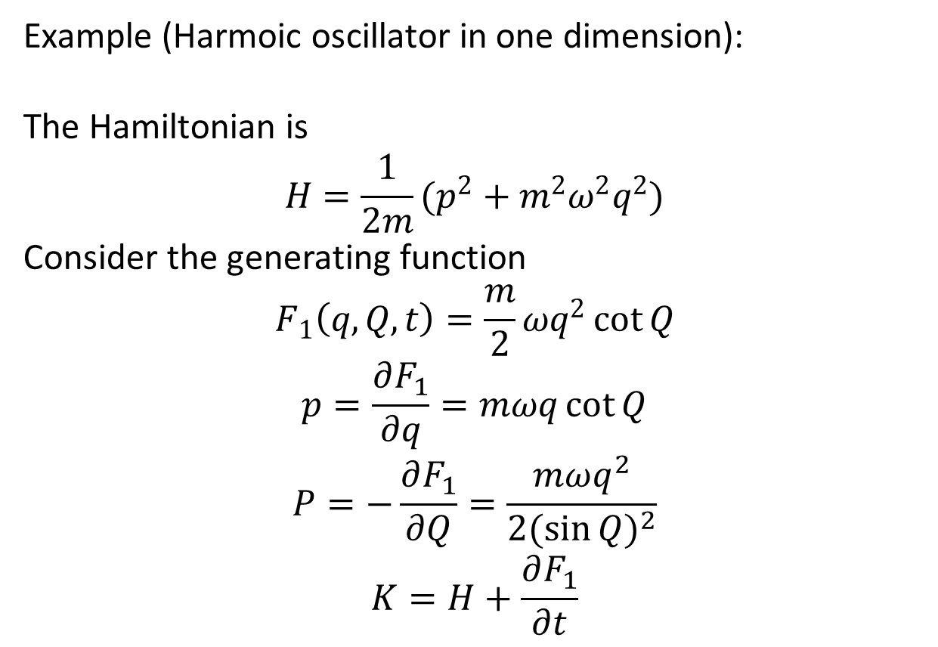
Example (Harmoic oscillator in one dimension):
The Hamiltonian is
$$H=\frac{1}{2m}(p^{2}+m^{2}ω^{2}q^{2})$$
Consider the generating function
$$F_{1}\left(q,Q,t\right)=\frac{m}{2}ωq^{2}\cot{Q}$$
$$p=\frac{∂F_{1}}{∂q}=mωq\cot{Q}$$
$$P=−\frac{∂F_{1}}{∂Q}=\frac{mωq^{2}}{2{(\sin{Q})}^{2}}$$
$$K=H+\frac{∂F_{1}}{∂t}$$

Slide 13
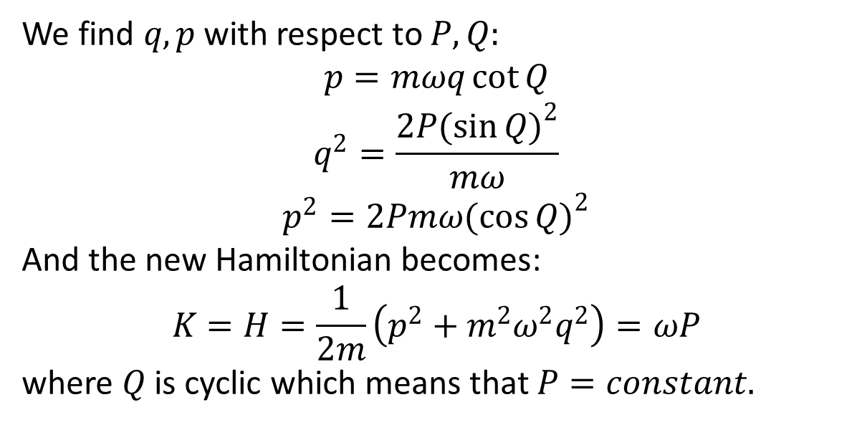
We find $q,p$ with respect to $P,Q:$
$$p=mωq\cot{Q}$$
$$q^{2}=\frac{2P{(\sin{Q})}^{2}}{mω}$$
$$p^{2}=2Pmω{(\cos{Q})}^{2}$$
And the new Hamiltonian becomes:
$$K=H=\frac{1}{2m}\left(p^{2}+m^{2}ω^{2}q^{2}\right)=ωP$$
where $Q$ is cyclic which means that $P=constant.$

Slide 14
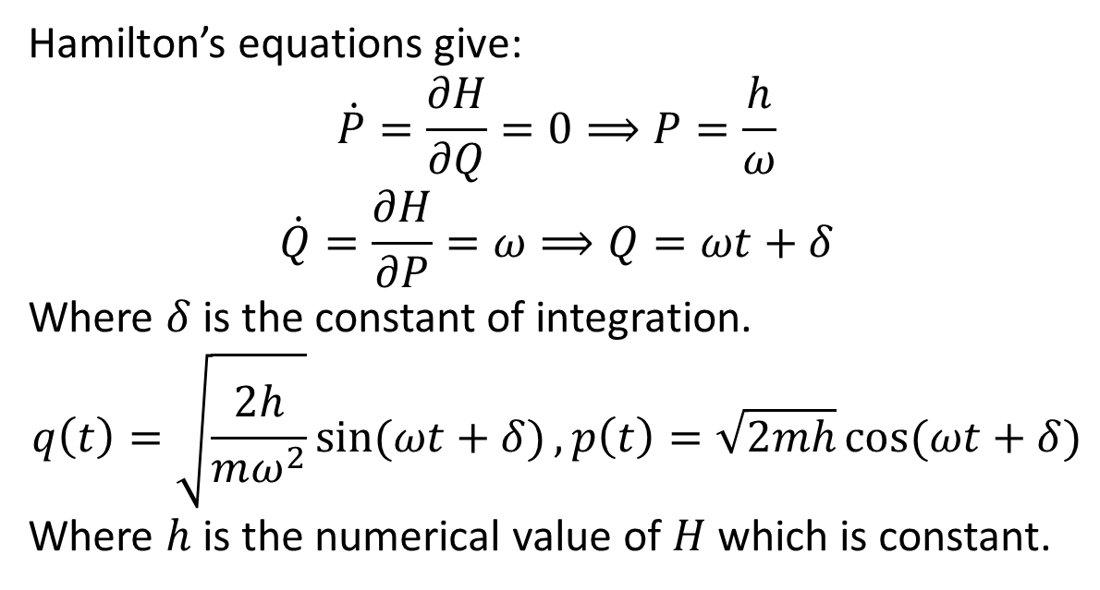
Hamilton’s equations give:
$$\dot{P}=\frac{∂H}{∂Q}=0⟹P=\frac{h}{ω}$$
$$\dot{Q}=\frac{∂H}{∂P}=ω⟹Q=ωt+δ$$
Where $δ$ is the constant of integration.
$$q\left(t\right)=\sqrt{\frac{2h}{mω^{2}}}\sin{(ωt+δ)},p\left(t\right)=\sqrt{2mh}\cos{(ωt+δ)}$$
Where $h$ is the numerical value of $H$ which is constant.

Slide 15
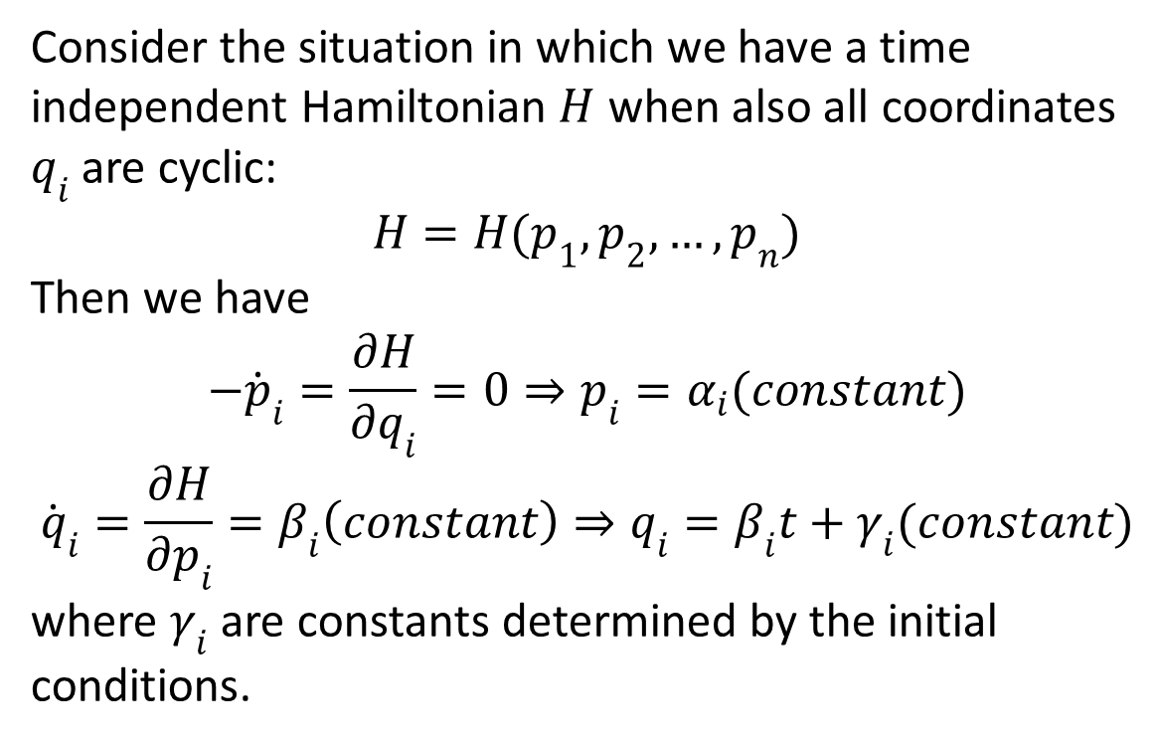
Cyclic Coordinates in Hamiltonian
Consider the situation in which we have a time independent Hamiltonian $H$ when also all coordinates $q_{i}$ are cyclic:
$$H=H(p_{1},p_{2},…,p_{n})$$
Then we have
$$−{\dot{p}}_{i}=\frac{∂H}{∂q_{i}}=0⇒p_{i}=α_{i}(constant)$$
$${\dot{q}}_{i}=\frac{∂H}{∂p_{i}}=β_{i}\left(constant\right)⇒q_{i}=β_{i}t+γ_{i}(constant)$$
where $γ_{i}$ are constants determined by the initial conditions.

Slide 16
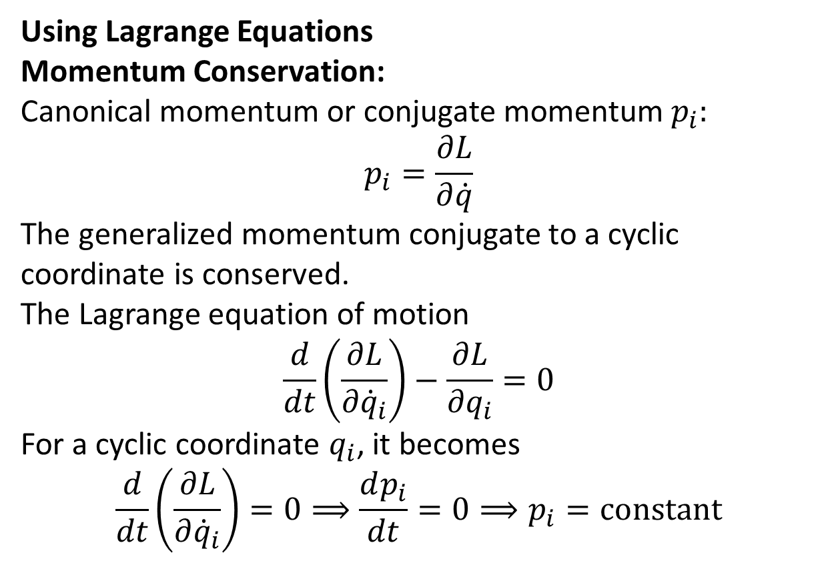
Conservation Theorems
Using Lagrange Equations
Momentum Conservation:
Canonical momentum or conjugate momentum $p_{i}:$
$$p_{i}=\frac{∂L}{∂\dot{q}}$$
The generalized momentum conjugate to a cyclic coordinate is conserved.
The Lagrange equation of motion
$$\frac{d}{dt}\left(\frac{∂L}{∂{\dot{q}}_{i}}\right)−\frac{∂L}{∂q_{i}}=0$$
For a cyclic coordinate $q_{i}$, it becomes
$$\frac{d}{dt}\left(\frac{∂L}{∂{\dot{q}}_{i}}\right)=0⟹\frac{dp_{i}}{dt}=0⟹p_{i}=constant$$

Slide 17
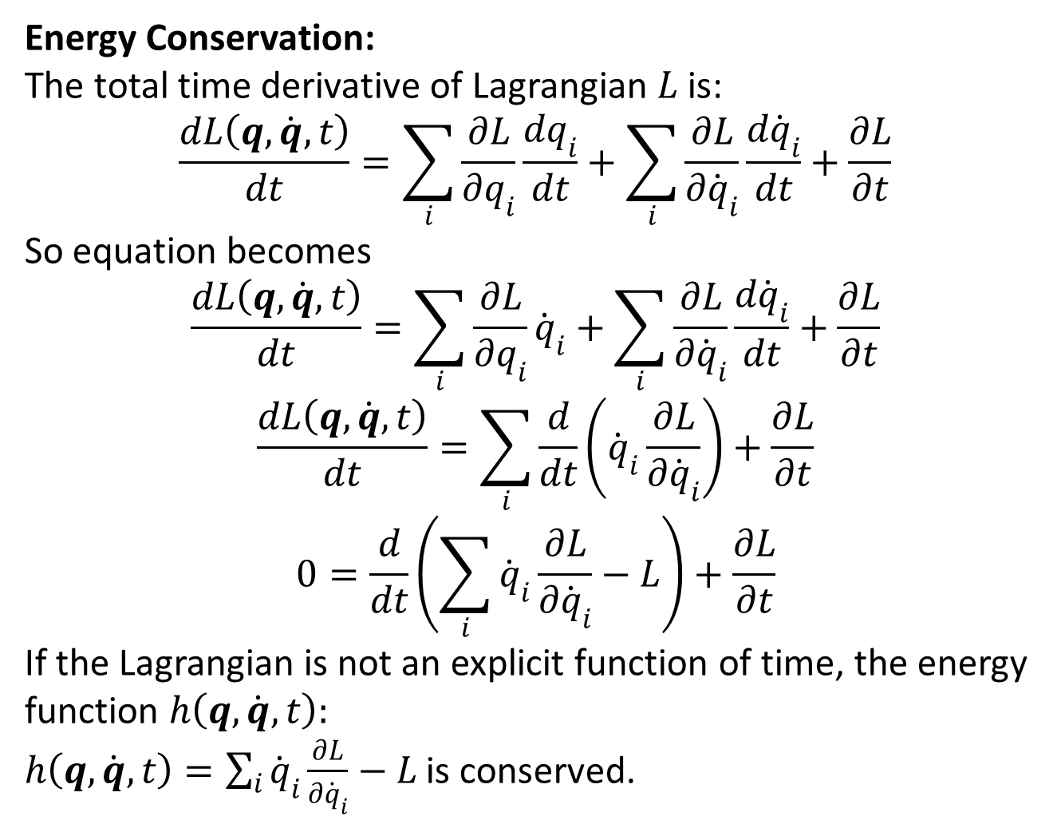
Energy Conservation:
The total time derivative of Lagrangian $L$ is:
$$\frac{dL\left(q,\dot{q},t\right)}{dt}=\sum_{i}{\frac{∂L}{∂q_{i}}\frac{dq_{i}}{dt}}+\sum_{i}{\frac{∂L}{∂{\dot{q}}_{i}}\frac{d{\dot{q}}_{i}}{dt}}+\frac{∂L}{∂t}$$
So equation becomes
$$\frac{dL\left(q,\dot{q},t\right)}{dt}=\sum_{i}{\frac{∂L}{∂q_{i}}{\dot{q}}_{i}}+\sum_{i}{\frac{∂L}{∂{\dot{q}}_{i}}\frac{d{\dot{q}}_{i}}{dt}}+\frac{∂L}{∂t}$$
$$\frac{dL\left(q,\dot{q},t\right)}{dt}=\sum_{i}{\frac{d}{dt}\left({\dot{q}}_{i}\frac{∂L}{∂{\dot{q}}_{i}}\right)}+\frac{∂L}{∂t}$$
$$0=\frac{d}{dt}\left(\sum_{i}{{\dot{q}}_{i}\frac{∂L}{∂{\dot{q}}_{i}}}−L\right)+\frac{∂L}{∂t}$$
If the Lagrangian is not an explicit function of time, the energy function $h\left(q,\dot{q},t\right):$
$h\left(q,\dot{q},t\right)=\sum_{i}{{\dot{q}}_{i}\frac{∂L}{∂{\dot{q}}_{i}}}−L$ is conserved.

Slide 18
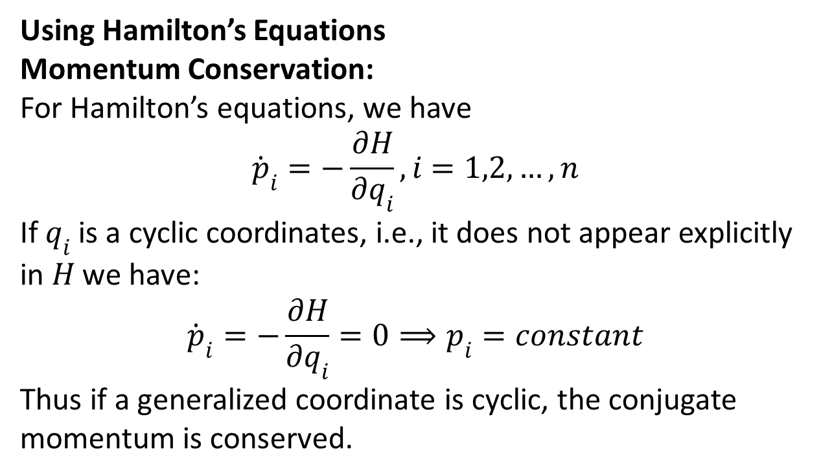
Using Hamilton’s Equations
Momentum Conservation:
For Hamilton’s equations, we have
$${\dot{p}}_{i}=−\frac{∂H}{∂q_{i}}, i=1,2,…,n$$
If $q_{i}$ is a cyclic coordinates, i.e., it does not appear explicitly in $H$ we have:
$${\dot{p}}_{i}=−\frac{∂H}{∂q_{i}}=0⟹p_{i}=constant$$
Thus if a generalized coordinate is cyclic, the conjugate momentum is conserved.

Slide 19
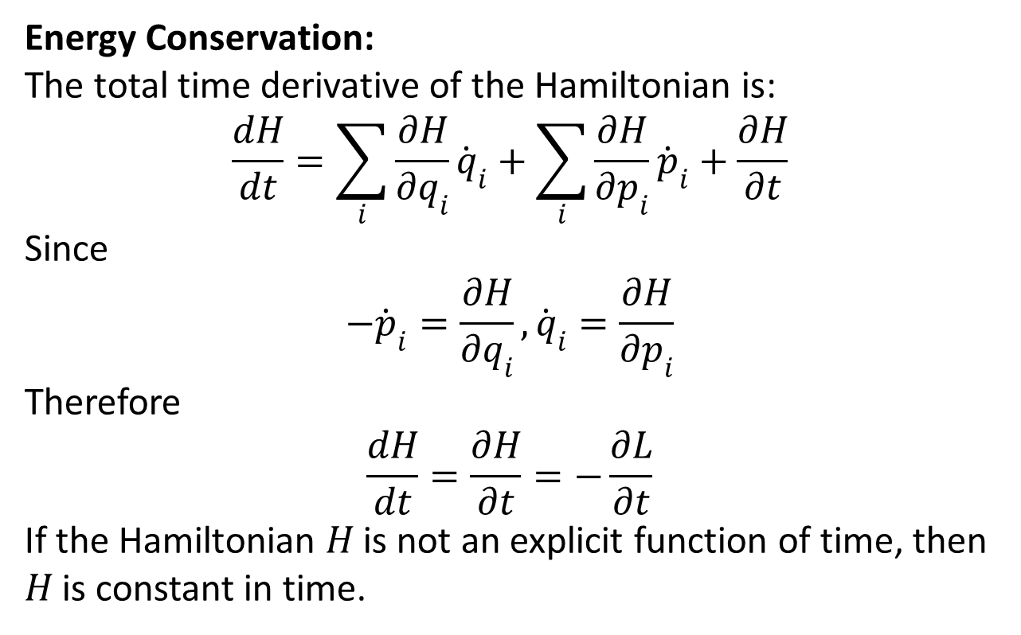
Energy Conservation:
The total time derivative of the Hamiltonian is:
$$\frac{dH}{dt}=\sum_{i}{\frac{∂H}{∂q_{i}}{\dot{q}}_{i}}+\sum_{i}{\frac{∂H}{∂p_{i}}{\dot{p}}_{i}}+\frac{∂H}{∂t}$$
Since
$$−{\dot{p}}_{i}=\frac{∂H}{∂q_{i}},{\dot{q}}_{i}=\frac{∂H}{∂p_{i}}$$
Therefore
$$\frac{dH}{dt}=\frac{∂H}{∂t}=−\frac{∂L}{∂t}$$
If the Hamiltonian $H$ is not an explicit function of time, then $H$ is constant in time.

Slide 20
The End

