Slide 1
Revision
Previous lecture was about
Some Applications of Lagrangian and Hamiltonian

Slide 2
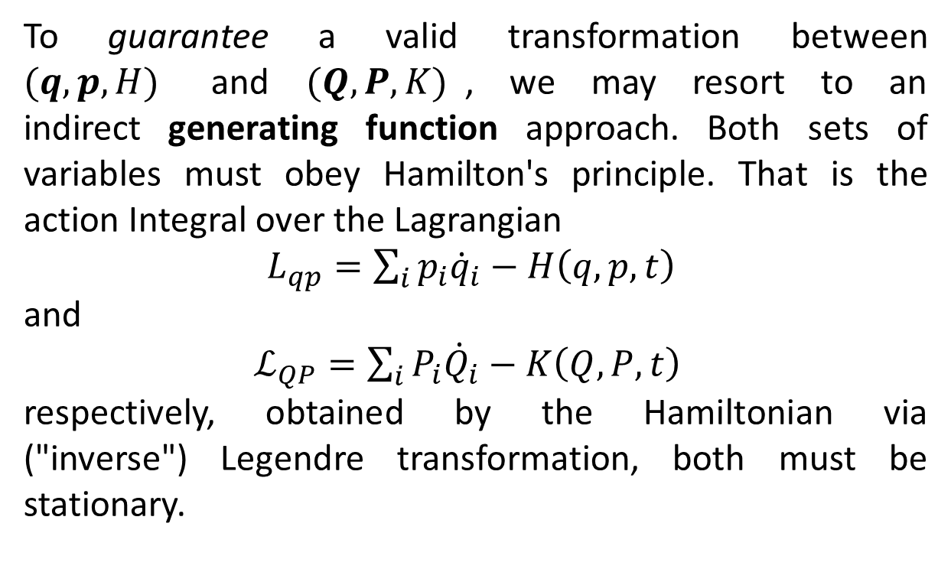
Generating Function Approach
To guarantee a valid transformation between $(q,p,H)$ and $(Q,P,K)$, we may resort to an indirect generating function approach. Both sets of variables must obey Hamilton's principle. That is the action Integral over the Lagrangian
$L_{qp}=\sum_{i}{p_{i}{\dot{q}}_{i}−H\left(q,p,t\right)}$
and
$ℒ_{QP}=\sum_{i}{P_{i}{\dot{Q}}_{i}−K\left(Q,P,t\right)}$
respectively, obtained by the Hamiltonian via ("inverse") Legendre transformation, both must be stationary.

Slide 3
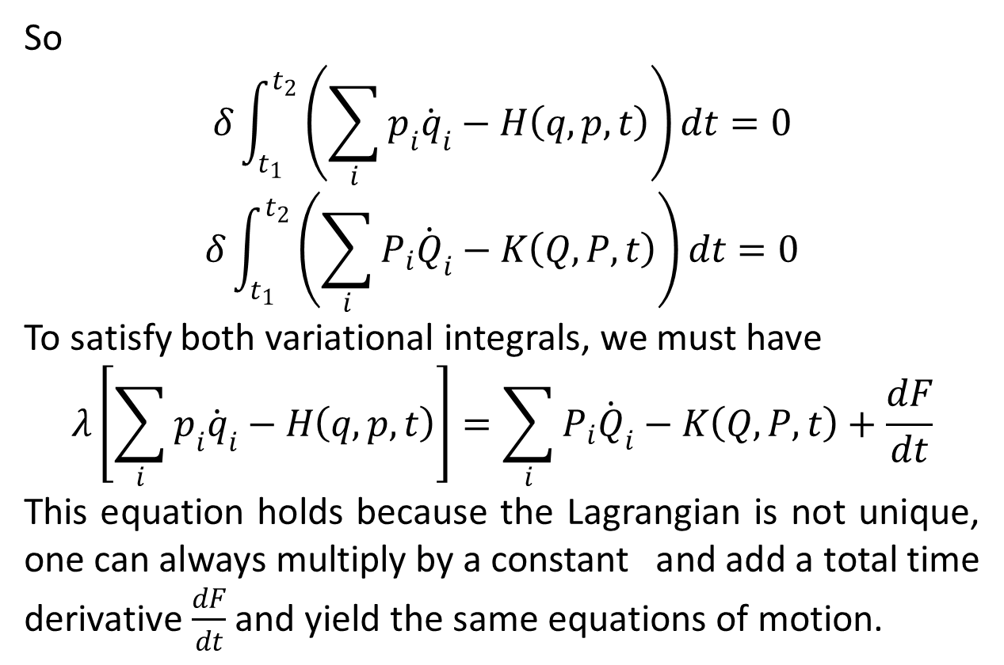
So
$$δ\int_{t_{1}}^{t_{2}}{\left(\sum_{i}{p_{i}{\dot{q}}_{i}−H\left(q,p,t\right)}\right)dt=0}$$
$$δ\int_{t_{1}}^{t_{2}}{\left(\sum_{i}{P_{i}{\dot{Q}}_{i}−K\left(Q,P,t\right)}\right)dt=0}$$
To satisfy both variational integrals, we must have
$$λ\left[\sum_{i}{p_{i}{\dot{q}}_{i}−H\left(q,p,t\right)}\right]=\sum_{i}{P_{i}{\dot{Q}}_{i}−K\left(Q,P,t\right)}+\frac{dF}{dt}$$
This equation holds because the Lagrangian is not unique, one can always multiply by a constant and add a total time derivative $\frac{dF}{dt}$ and yield the same equations of motion.

Slide 4
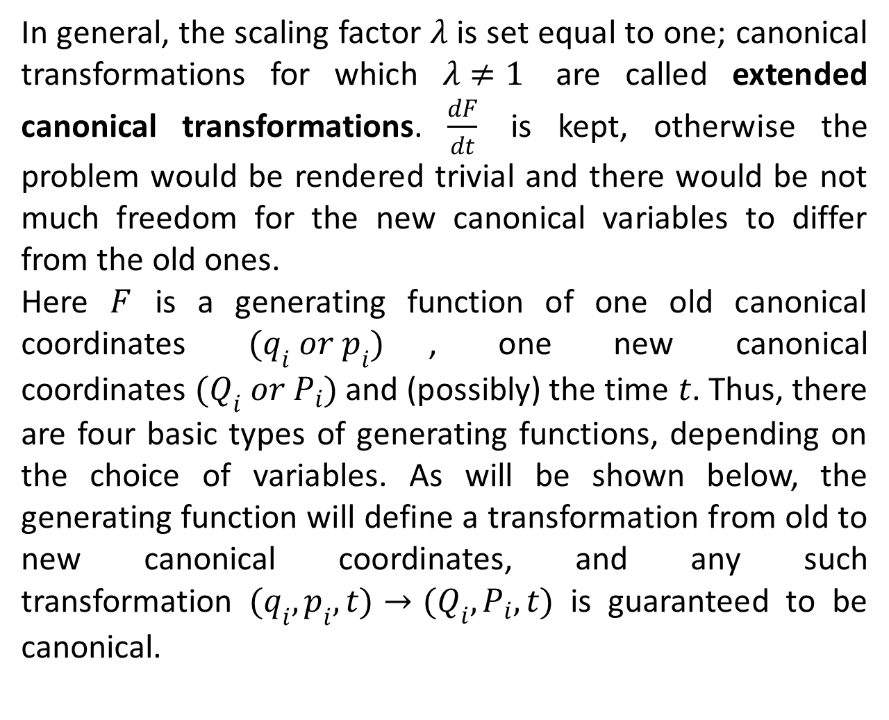
In general, the scaling factor $λ$ is set equal to one; canonical transformations for which $λ≠1$ are called extended canonical transformations. $\frac{dF}{dt}$ is kept, otherwise the problem would be rendered trivial and there would be not much freedom for the new canonical variables to differ from the old ones.
Here $F$ is a generating function of one old canonical coordinates $(q_{i} or p_{i})$, one new canonical coordinates $(Q_{i} or P_{i})$ and (possibly) the time $t$. Thus, there are four basic types of generating functions, depending on the choice of variables. As will be shown below, the generating function will define a transformation from old to new canonical coordinates, and any such transformation $(q_{i},p_{i},t)→(Q_{i},P_{i},t)$ is guaranteed to be canonical.

Slide 5
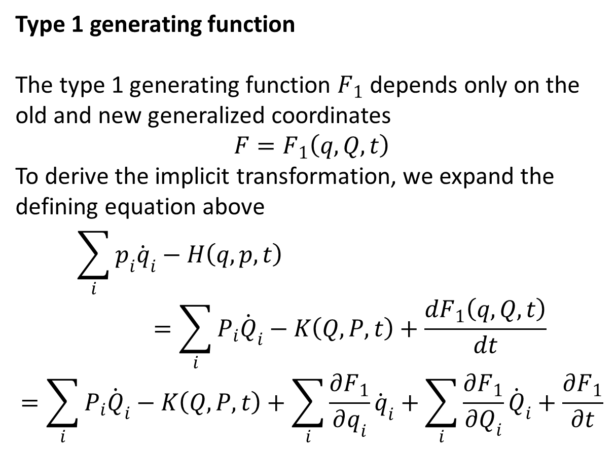
Type 1 generating function
The type 1 generating function $F_{1}$ depends only on the old and new generalized coordinates
$$F=F_{1}\left(q,Q,t\right)$$
To derive the implicit transformation, we expand the defining equation above
$$\sum_{i}{p_{i}{\dot{q}}_{i}−H\left(q,p,t\right)}=\sum_{i}{P_{i}{\dot{Q}}_{i}−K\left(Q,P,t\right)}+\frac{dF_{1}\left(q,Q,t\right)}{dt}$$
$$=\sum_{i}{P_{i}{\dot{Q}}_{i}}−K\left(Q,P,t\right)+\sum_{i}{\frac{∂F_{1}}{∂q_{i}}{\dot{q}}_{i}}+\sum_{i}{\frac{∂F_{1}}{∂Q_{i}}{\dot{Q}}_{i}}+\frac{∂F_{1}}{∂t}$$

Slide 7
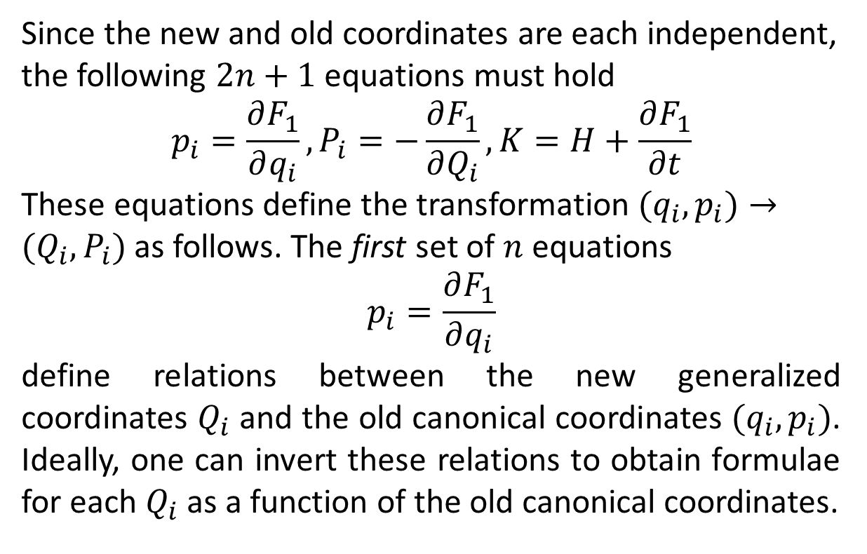
Since the new and old coordinates are each independent, the following $2n+1$ equations must hold
$$p_{i}=\frac{∂F_{1}}{∂q_{i}},P_{i}=−\frac{∂F_{1}}{∂Q_{i}},K=H+\frac{∂F_{1}}{∂t}$$
These equations define the transformation $(q_{i},p_{i})→(Q_{i},P_{i})$ as follows. The first set of $n$ equations
$$p_{i}=\frac{∂F_{1}}{∂q_{i}}$$
define relations between the new generalized coordinates $Q_{i}$ and the old canonical coordinates $(q_{i},p_{i})$. Ideally, one can invert these relations to obtain formulae for each $Q_{i}$ as a function of the old canonical coordinates.

Slide 8
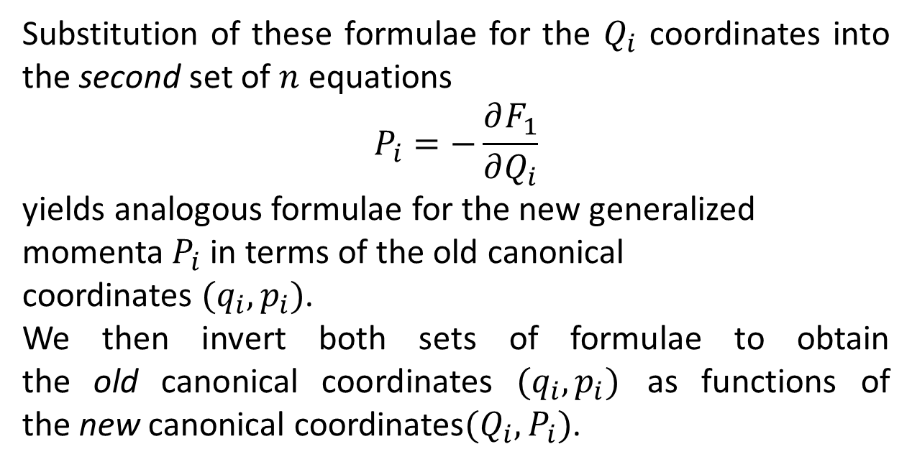
Substitution of these formulae for the $Q_{i}$ coordinates into the second set of $n$ equations
$$P_{i}=−\frac{∂F_{1}}{∂Q_{i}}$$
yields analogous formulae for the new generalized momenta $P_{i}$ in terms of the old canonical coordinates $(q_{i},p_{i})$.
We then invert both sets of formulae to obtain the old canonical coordinates $(q_{i},p_{i})$ as functions of the new canonical coordinates$(Q_{i},P_{i})$.

Slide 9
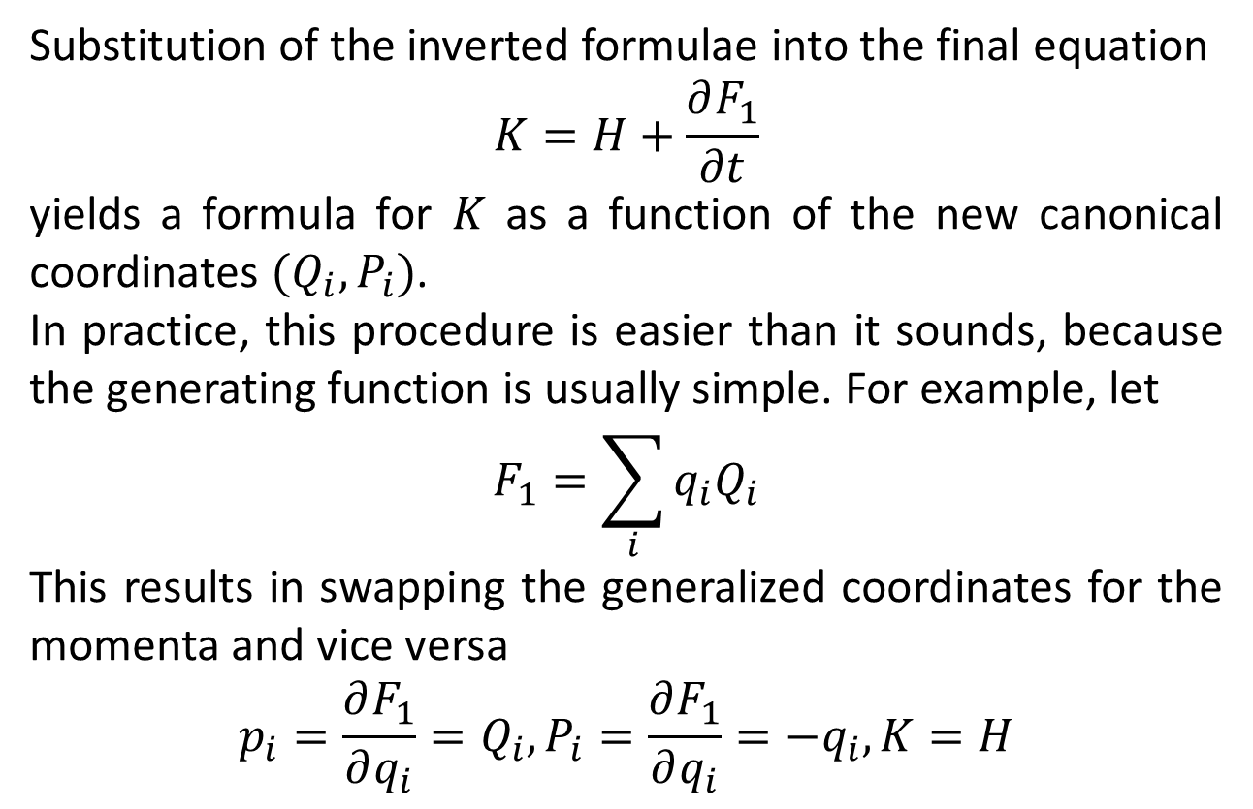
Substitution of the inverted formulae into the final equation
$$K=H+\frac{∂F_{1}}{∂t}$$
yields a formula for $K$ as a function of the new canonical coordinates $(Q_{i},P_{i})$.
In practice, this procedure is easier than it sounds, because the generating function is usually simple. For example, let
$$F_{1}=\sum_{i}{q_{i}Q_{i}}$$
This results in swapping the generalized coordinates for the momenta and vice versa
$$p_{i}=\frac{∂F_{1}}{∂q_{i}}=Q_{i}, P_{i}=\frac{∂F_{1}}{∂q_{i}}={−q}_{i}, K=H$$

Slide 10
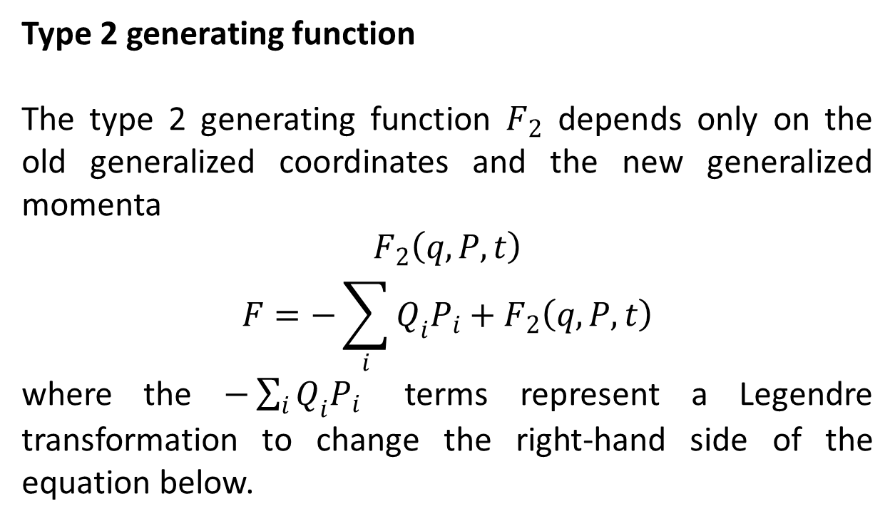
Type 2 generating function
The type 2 generating function $F_{2}$ depends only on the old generalized coordinates and the new generalized momenta
$$F_{2}\left(q,P,t\right)$$
$$F=−\sum_{i}{Q_{i}P_{i}}+F_{2}\left(q,P,t\right)$$
where the $−\sum_{i}{Q_{i}P_{i}}$ terms represent a Legendre transformation to change the right-hand side of the equation below.

Slide 11
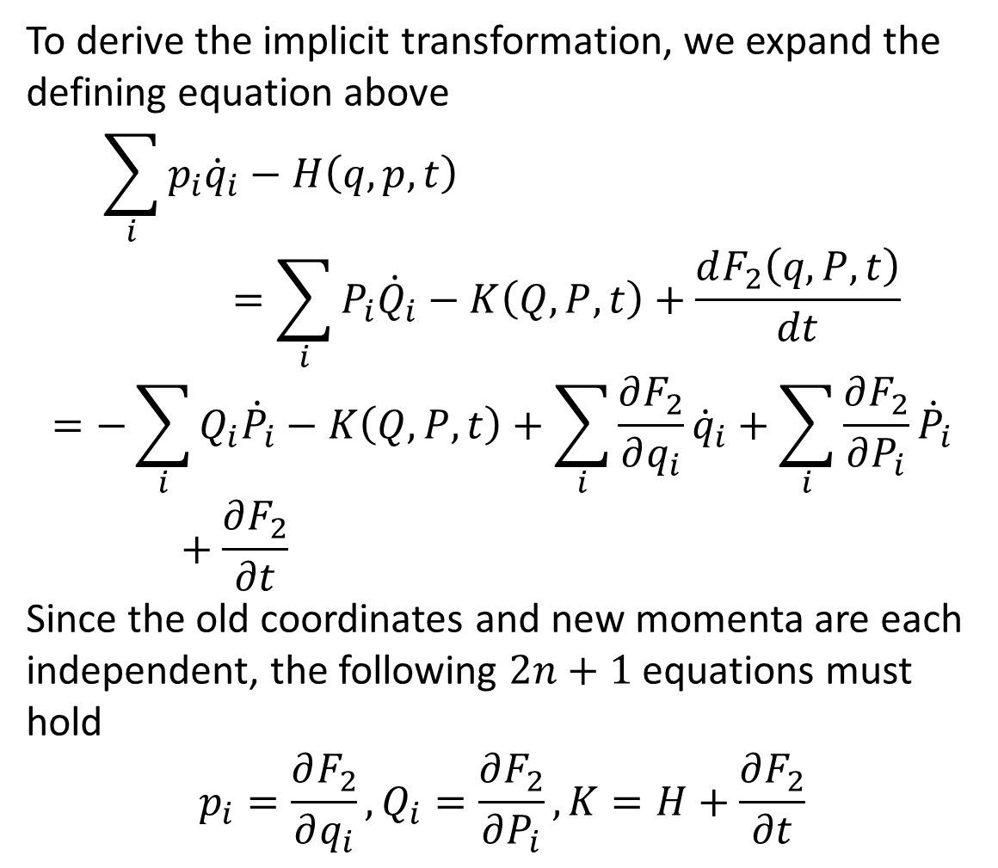
To derive the implicit transformation, we expand the defining equation above
$$\sum_{i}{p_{i}{\dot{q}}_{i}−H\left(q,p,t\right)}=\sum_{i}{P_{i}{\dot{Q}}_{i}−K\left(Q,P,t\right)}+\frac{dF_{2}\left(q,P,t\right)}{dt}$$
$$=−\sum_{i}{Q_{i}{\dot{P}}_{i}−K\left(Q,P,t\right)}+\sum_{i}{\frac{∂F_{2}}{∂q_{i}}{\dot{q}}_{i}}+\sum_{i}{\frac{∂F_{2}}{∂P_{i}}{\dot{P}}_{i}}+\frac{∂F_{2}}{∂t}$$
Since the old coordinates and new momenta are each independent, the following $2n+1$ equations must hold
$$p_{i}=\frac{∂F_{2}}{∂q_{i}},Q_{i}=\frac{∂F_{2}}{∂P_{i}},K=H+\frac{∂F_{2}}{∂t}$$

Slide 13
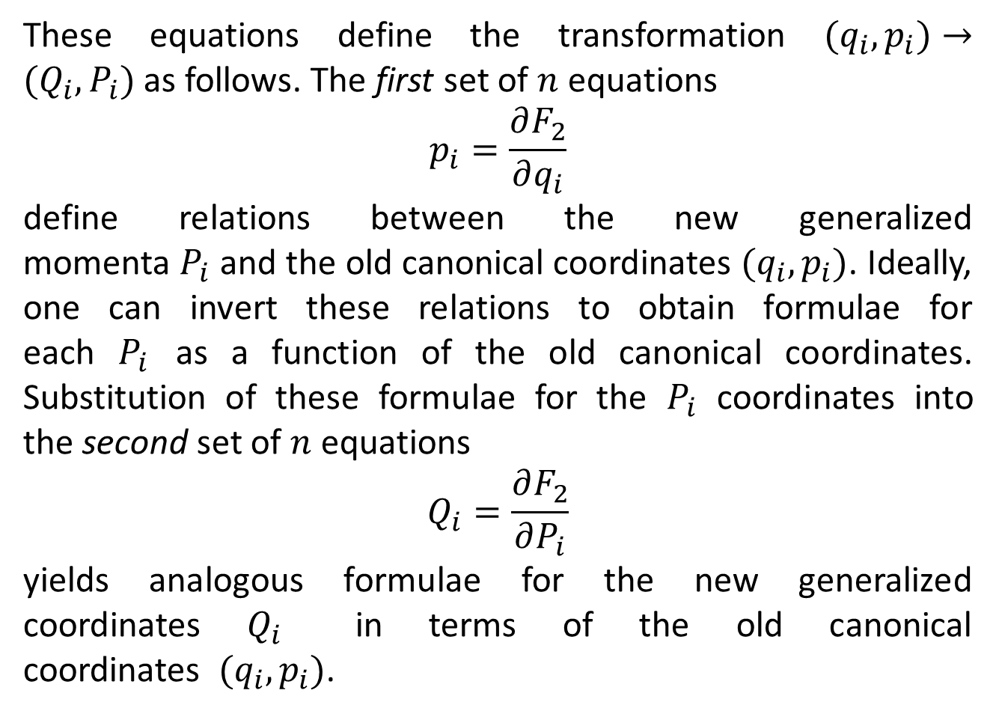
These equations define the transformation $(q_{i},p_{i})→(Q_{i},P_{i})$ as follows. The first set of $n$ equations
$$p_{i}=\frac{∂F_{2}}{∂q_{i}}$$
define relations between the new generalized momenta $P_{i}$ and the old canonical coordinates $(q_{i},p_{i})$. Ideally, one can invert these relations to obtain formulae for each $P_{i}$ as a function of the old canonical coordinates. Substitution of these formulae for the $P_{i}$ coordinates into the second set of $n$ equations
$$Q_{i}=\frac{∂F_{2}}{∂P_{i}}$$
yields analogous formulae for the new generalized coordinates $Q_{i}$ in terms of the old canonical coordinates $(q_{i},p_{i})$.

Slide 14
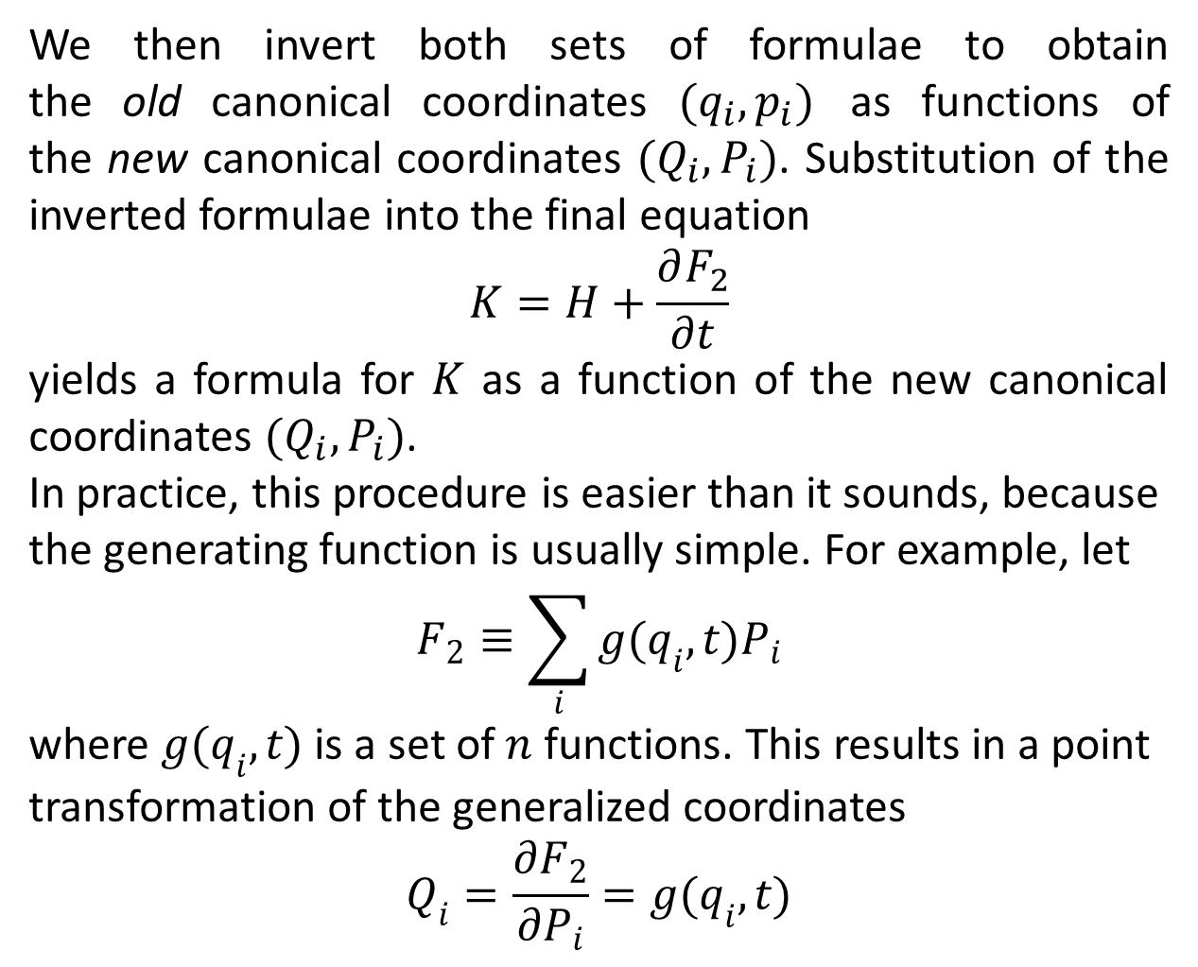
We then invert both sets of formulae to obtain the old canonical coordinates $(q_{i},p_{i})$ as functions of the new canonical coordinates $(Q_{i},P_{i})$. Substitution of the inverted formulae into the final equation
$$K=H+\frac{∂F_{2}}{∂t}$$
yields a formula for $K$ as a function of the new canonical coordinates $(Q_{i},P_{i})$.
In practice, this procedure is easier than it sounds, because the generating function is usually simple. For example, let
$$F_{2}≡\sum_{i}{g(q_{i},t)P_{i}}$$
where $g(q_{i},t)$ is a set of $n$ functions. This results in a point transformation of the generalized coordinates
$$Q_{i}=\frac{∂F_{2}}{∂P_{i}}=g(q_{i},t)$$

Slide 15
The End

