Slide 1
Revision
Previous lecture was about
Applications of Euler-Lagrange Equations
Euler-Lagrange Equations (Different Forms)

Slide 2
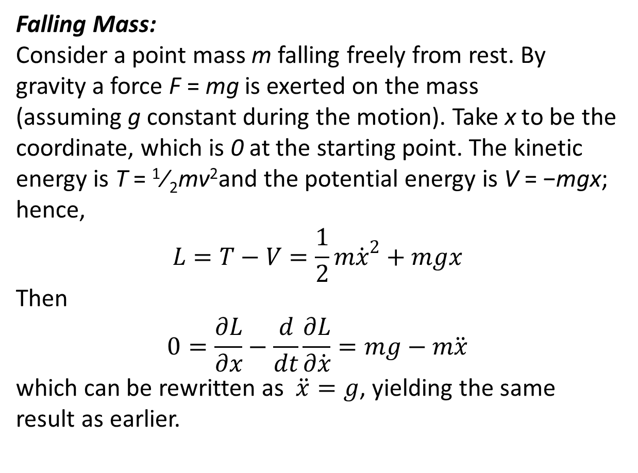
Some Examples related to Lagrangian and Hamiltonian
Falling Mass:
Consider a point mass m falling freely from rest. By gravity a force F = mg is exerted on the mass (assuming g constant during the motion). Take x to be the coordinate, which is 0 at the starting point. The kinetic energy is T = ¹⁄₂mv²and the potential energy is V = −mgx; hence,
$$L=T−V=\frac{1}{2}m{\dot{x}}^{2}+mgx$$
Then
$$0=\frac{∂L}{∂x}−\frac{d}{dt}\frac{∂L}{∂\dot{x}}=mg−m\ddot{x}$$
which can be rewritten as $\ddot{x}=g$, yielding the same result as earlier.

Slide 3
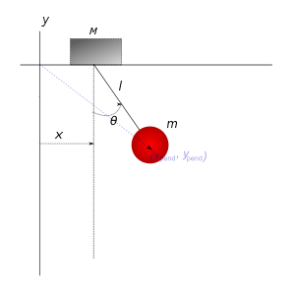
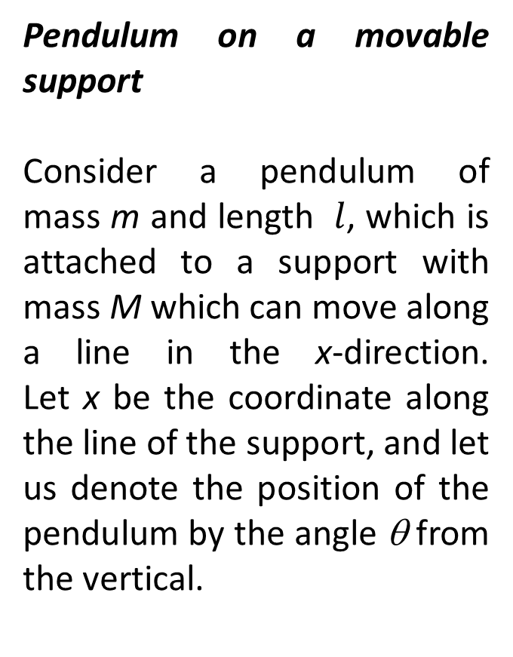
Pendulum on a movable support
Consider a pendulum of mass m and length $l$, which is attached to a support with mass M which can move along a line in the x-direction. Let x be the coordinate along the line of the support, and let us denote the position of the pendulum by the angle θ from the vertical.

Slide 4
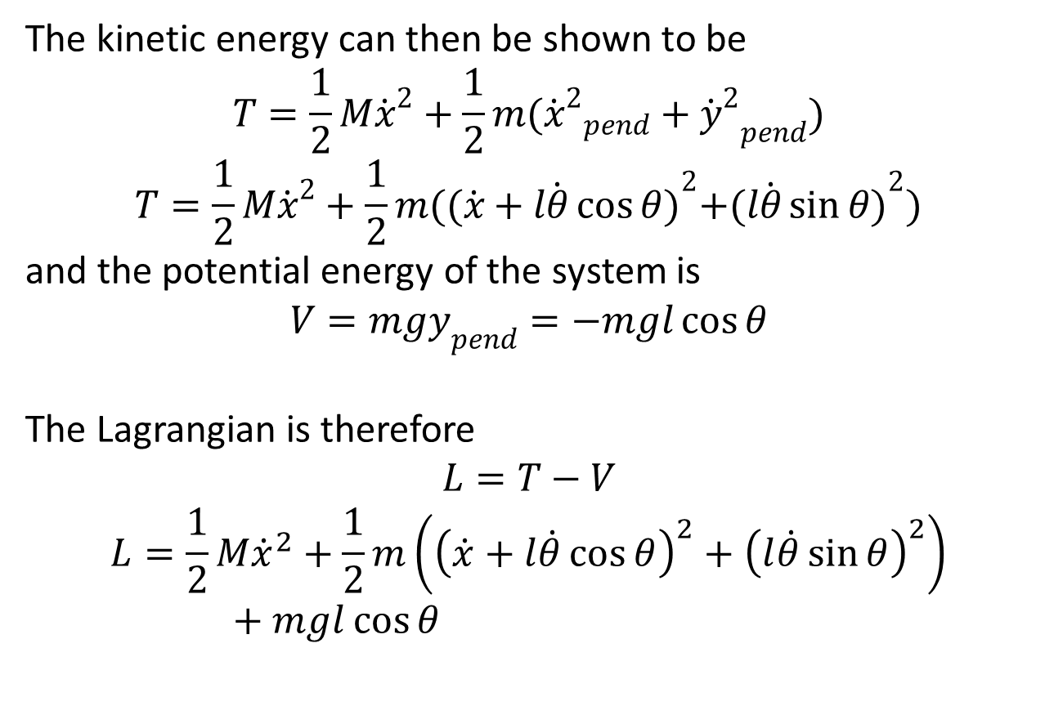
The kinetic energy can then be shown to be
$$T=\frac{1}{2}M{\dot{x}}^{2}+\frac{1}{2}m({{\dot{x}}^{2}}_{pend}+{{\dot{y}}^{2}}_{pend})$$
$$T=\frac{1}{2}M{\dot{x}}^{2}+\frac{1}{2}m({(\dot{x}+l\dot{θ}\cos{θ})}^{2}+{(l\dot{θ}\sin{θ})}^{2})$$
and the potential energy of the system is
$$V=mgy_{pend}=−mgl\cos{θ}$$
The Lagrangian is therefore
$$L=T−V$$
$$L=\frac{1}{2}M{\dot{x}}^{2}+\frac{1}{2}m\left({\left(\dot{x}+l\dot{θ}\cos{θ}\right)}^{2}+{\left(l\dot{θ}\sin{θ}\right)}^{2}\right)+mgl\cos{θ}$$

Slide 6
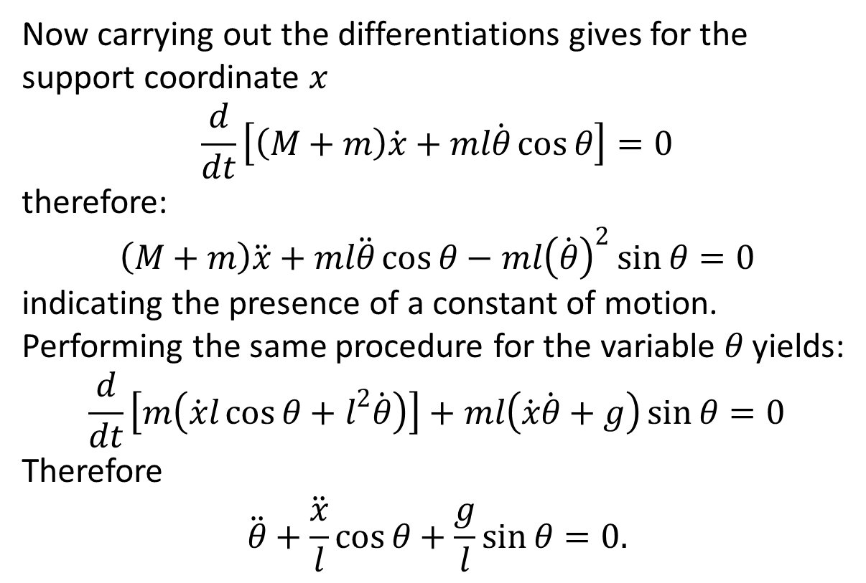
Now carrying out the differentiations gives for the support coordinate $x$
$$\frac{d}{dt}\left[\left(M+m\right)\dot{x}+ml\dot{θ}\cos{θ}\right]=0$$
therefore:
$$\left(M+m\right)\ddot{x}+ml\ddot{θ}\cos{θ}−ml{\left(\dot{θ}\right)}^{2}\sin{θ}=0$$
indicating the presence of a constant of motion. Performing the same procedure for the variable $θ$ yields:
$$\frac{d}{dt}\left[m\left(\dot{x}l\cos{θ}+l^{2}\dot{θ}\right)\right]+ml\left(\dot{x}\dot{θ}+g\right)\sin{θ}=0$$
Therefore
$$\ddot{θ}+\frac{\ddot{x}}{l}\cos{θ}+\frac{g}{l}\sin{θ}=0.$$

Slide 8
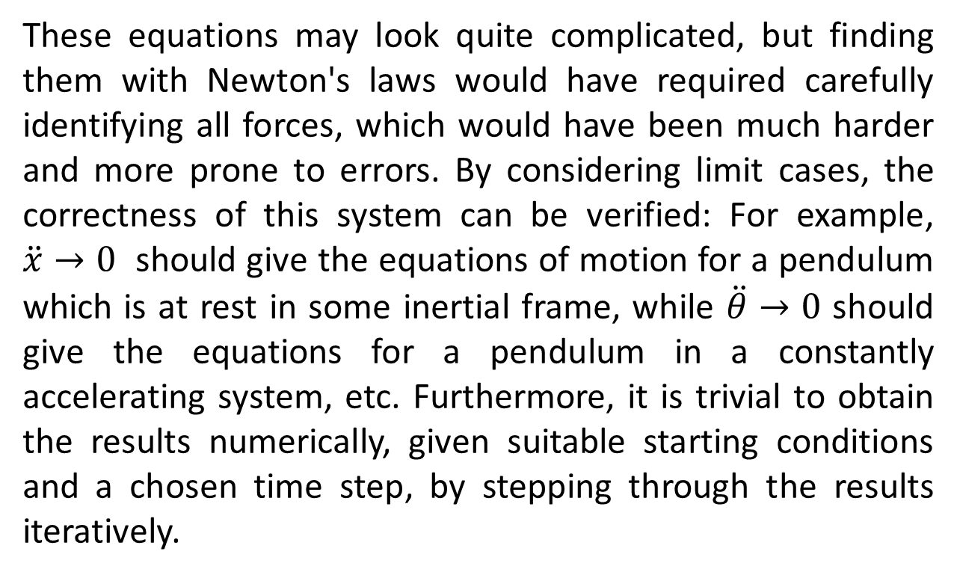
These equations may look quite complicated, but finding them with Newton's laws would have required carefully identifying all forces, which would have been much harder and more prone to errors. By considering limit cases, the correctness of this system can be verified: For example, $\ddot{x}→0$ should give the equations of motion for a pendulum which is at rest in some inertial frame, while $\ddot{θ}→0$ should give the equations for a pendulum in a constantly accelerating system, etc. Furthermore, it is trivial to obtain the results numerically, given suitable starting conditions and a chosen time step, by stepping through the results iteratively.

Slide 9
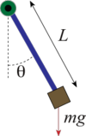
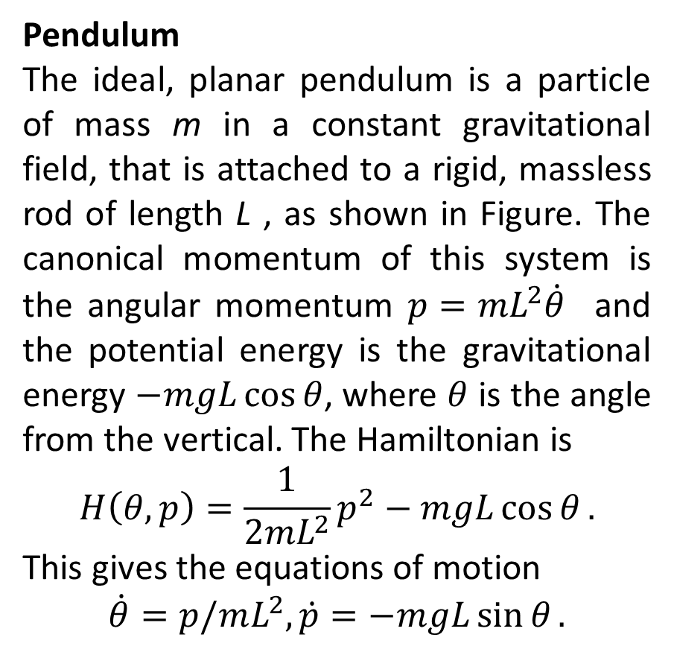
Pendulum
The ideal, planar pendulum is a particle of mass m in a constant gravitational field, that is attached to a rigid, massless rod of length L , as shown in Figure. The canonical momentum of this system is the angular momentum $p=mL^{2}\dot{θ}$ and the potential energy is the gravitational energy $−mgL\cos{θ}$, where $θ$ is the angle from the vertical. The Hamiltonian is
$$H\left(θ,p\right)=\frac{1}{2mL^{2}}p^{2}−mgL\cos{θ}.$$
This gives the equations of motion
$$\dot{θ}=p/mL^{2},\dot{p}=−mgL\sin{θ}.$$

Slide 11
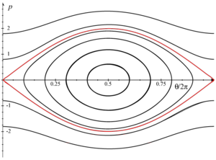
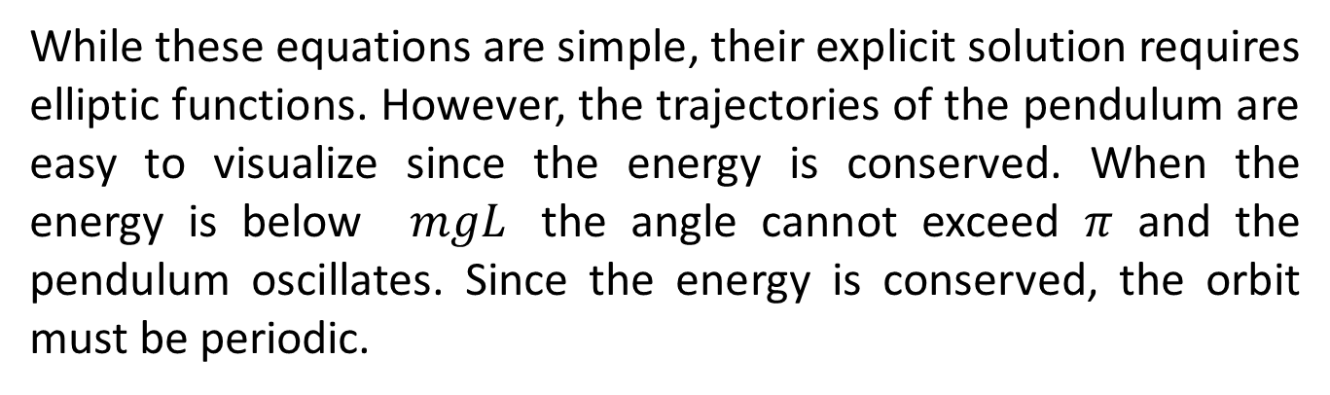
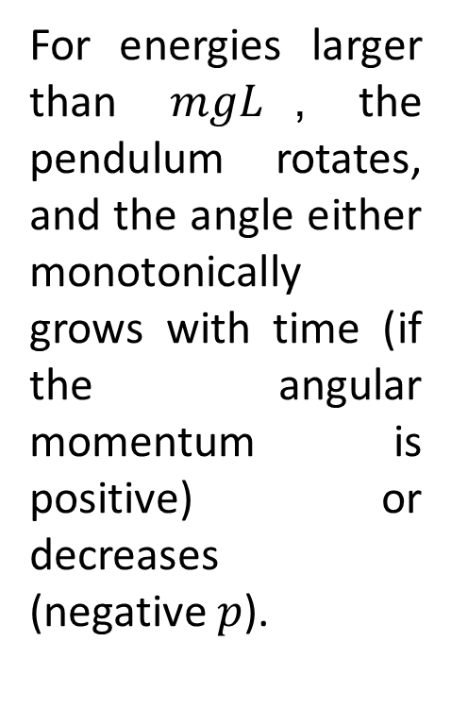
While these equations are simple, their explicit solution requires elliptic functions. However, the trajectories of the pendulum are easy to visualize since the energy is conserved. When the energy is below $mgL$ the angle cannot exceed $π$ and the pendulum oscillates. Since the energy is conserved, the orbit must be periodic.
For energies larger than $mgL$, the pendulum rotates, and the angle either monotonically grows with time (if the angular momentum is positive) or decreases (negative $p$).

Slide 12

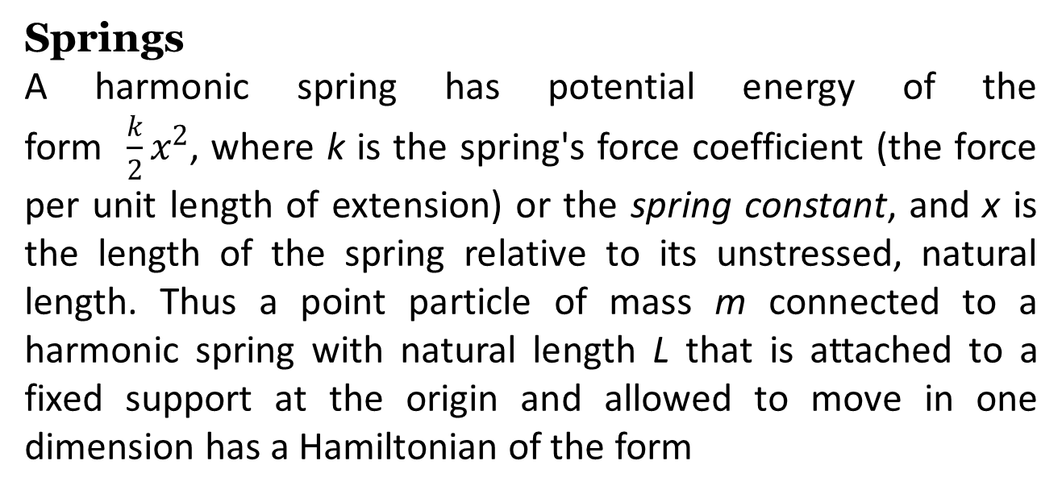
Springs
A harmonic spring has potential energy of the form $\frac{k}{2}x^{2}$, where k is the spring's force coefficient (the force per unit length of extension) or the spring constant, and x is the length of the spring relative to its unstressed, natural length. Thus a point particle of mass m connected to a harmonic spring with natural length L that is attached to a fixed support at the origin and allowed to move in one dimension has a Hamiltonian of the form

Slide 14
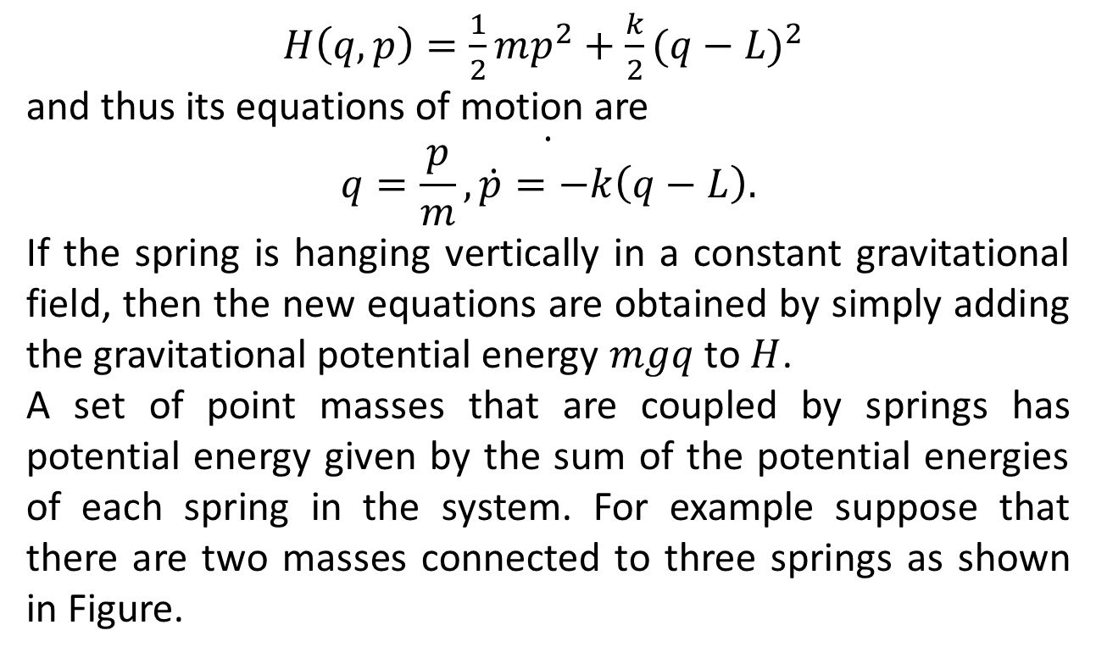
$H\left(q,p\right)=\frac{1}{2}mp^{2}+\frac{k}{2}{(q−L)}^{2}$
and thus its equations of motion are
$$\dot{q=\frac{p}{m},\dot{p}=−k\left(q−L\right).}$$
If the spring is hanging vertically in a constant gravitational field, then the new equations are obtained by simply adding the gravitational potential energy $mgq$ to $H$.
A set of point masses that are coupled by springs has potential energy given by the sum of the potential energies of each spring in the system. For example suppose that there are two masses connected to three springs as shown in Figure.

Slide 15
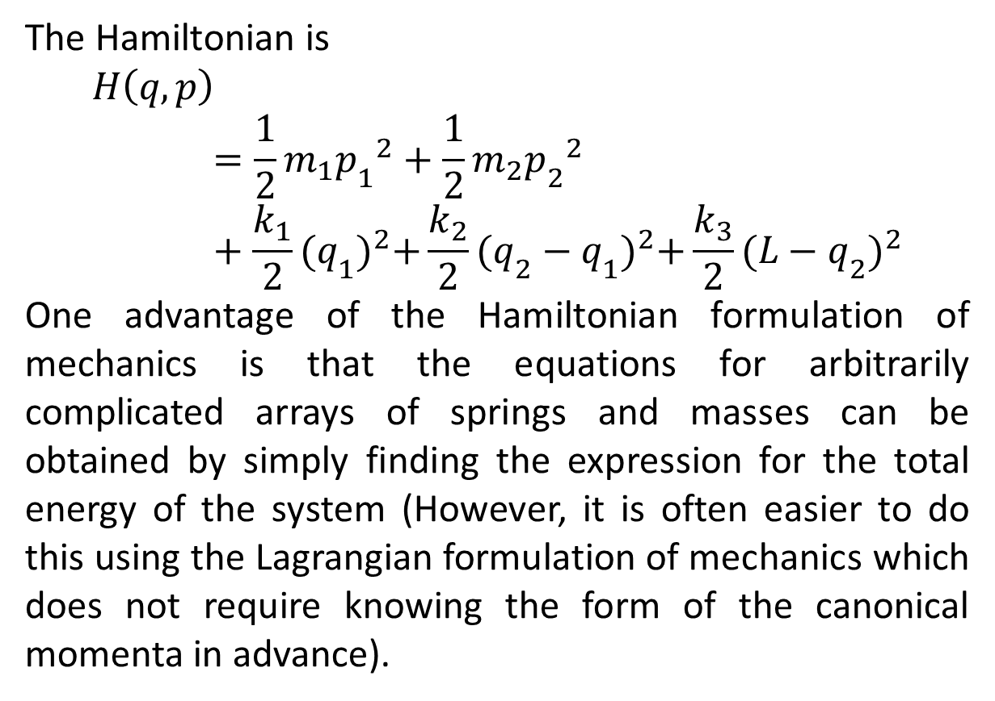
The Hamiltonian is
$$H\left(q,p\right)=\frac{1}{2}m_{1}{p_{1}}^{2}+\frac{1}{2}m_{2}{p_{2}}^{2}+\frac{k_{1}}{2}{(q_{1})}^{2}+\frac{k_{2}}{2}{(q_{2}−q_{1})}^{2}+\frac{k_{3}}{2}{(L−q_{2})}^{2}$$
One advantage of the Hamiltonian formulation of mechanics is that the equations for arbitrarily complicated arrays of springs and masses can be obtained by simply finding the expression for the total energy of the system (However, it is often easier to do this using the Lagrangian formulation of mechanics which does not require knowing the form of the canonical momenta in advance).

Slide 17
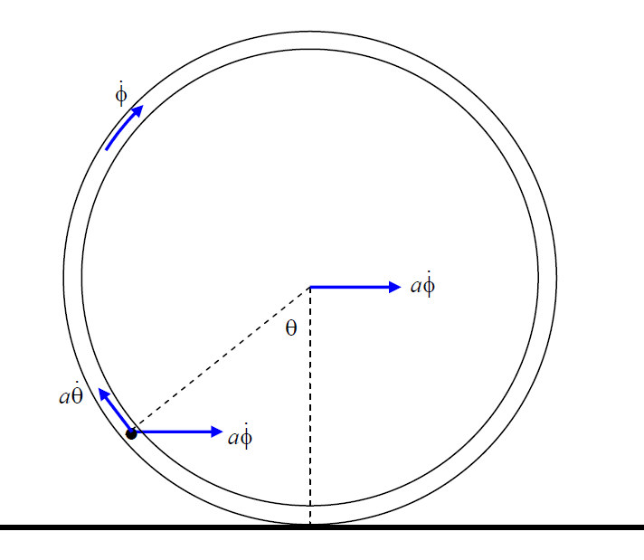
Problem:
A torus of mass M and radius a rolls without slipping on a horizontal plane. A pearl of mass m slides smoothly around inside the torus. Describe the motion.

Slide 18
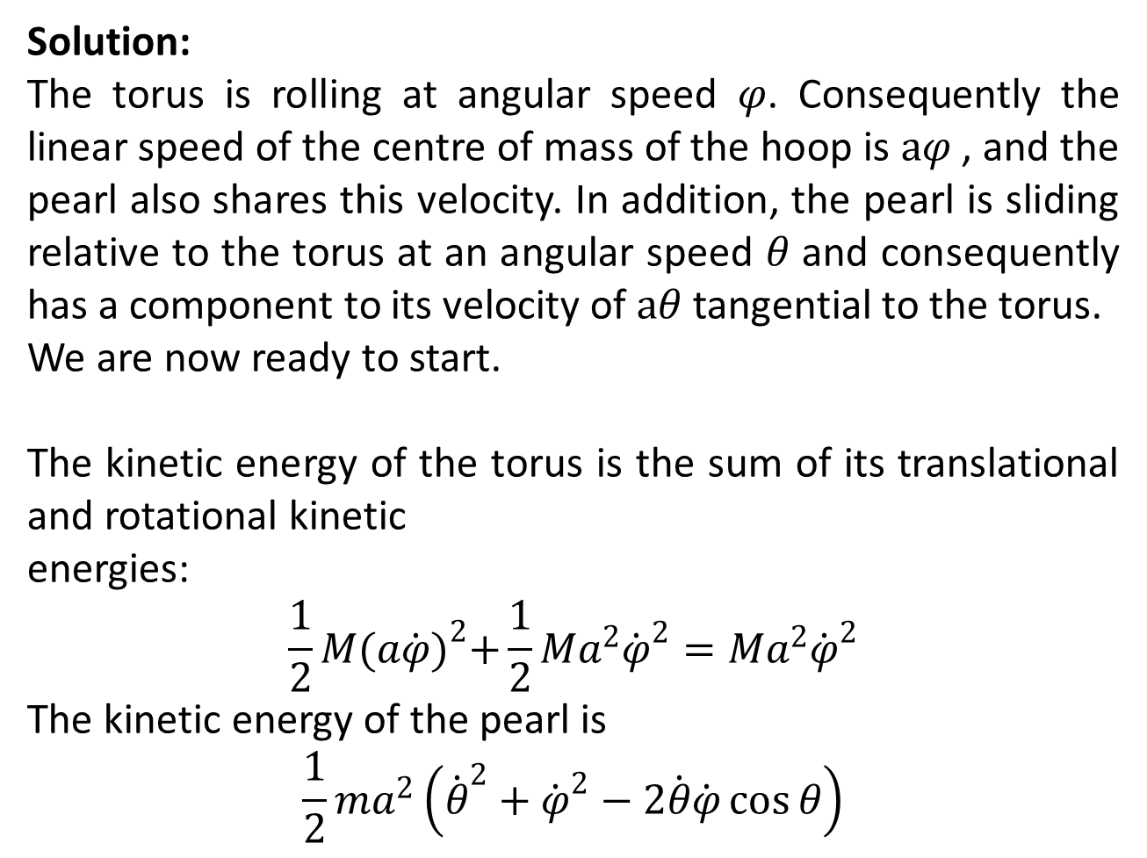
Solution:
The torus is rolling at angular speed $φ$. Consequently the linear speed of the centre of mass of the hoop is $aφ$ , and the pearl also shares this velocity. In addition, the pearl is sliding relative to the torus at an angular speed $θ$ and consequently has a component to its velocity of $aθ$ tangential to the torus.
We are now ready to start.
The kinetic energy of the torus is the sum of its translational and rotational kinetic
energies:
$$\frac{1}{2}M{(a\dot{φ})}^{2}+\frac{1}{2}Ma^{2}{\dot{φ}}^{2}=Ma^{2}{\dot{φ}}^{2}$$
The kinetic energy of the pearl is
$$\frac{1}{2}ma^{2}\left({\dot{θ}}^{2}+{\dot{φ}}^{2}−2\dot{θ}\dot{φ}\cos{θ}\right)$$

Slide 21
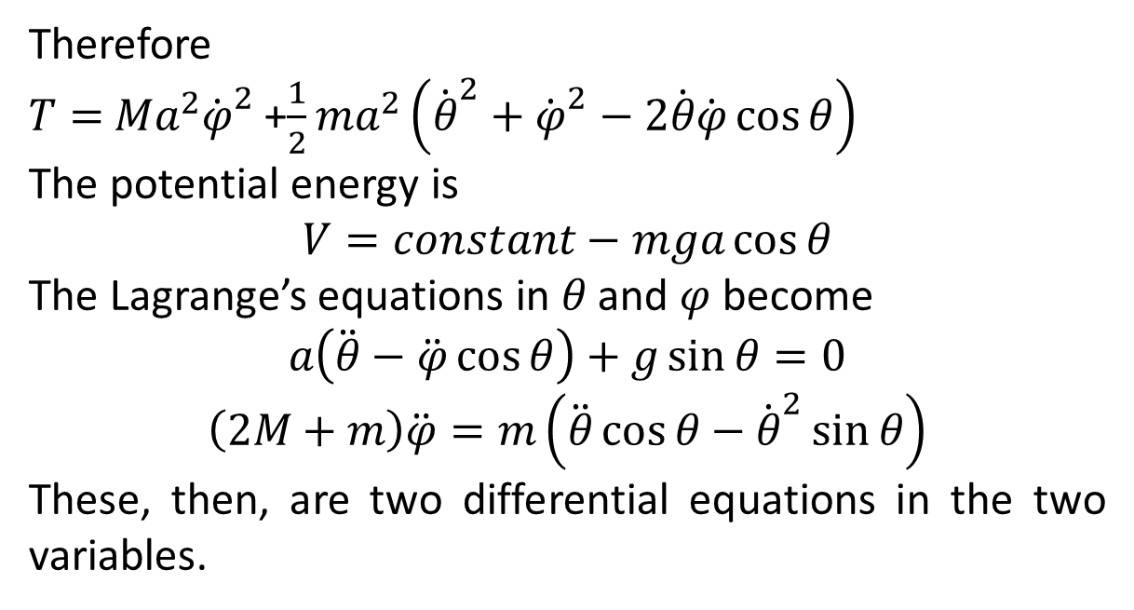
Therefore
$T=$ $Ma^{2}{\dot{φ}}^{2}$+$\frac{1}{2}ma^{2}\left({\dot{θ}}^{2}+{\dot{φ}}^{2}−2\dot{θ}\dot{φ}\cos{θ}\right)$
The potential energy is
$$V=constant−mga\cos{θ}$$
The Lagrange’s equations in $θ$ and $φ$ become
$$a\left(\ddot{θ}−\ddot{φ}\cos{θ}\right)+g\sin{θ}=0$$
$$\left(2M+m\right)\ddot{φ}=m\left(\ddot{θ}\cos{θ}−{\dot{θ}}^{2}\sin{θ}\right)$$
These, then, are two differential equations in the two variables.

Slide 23
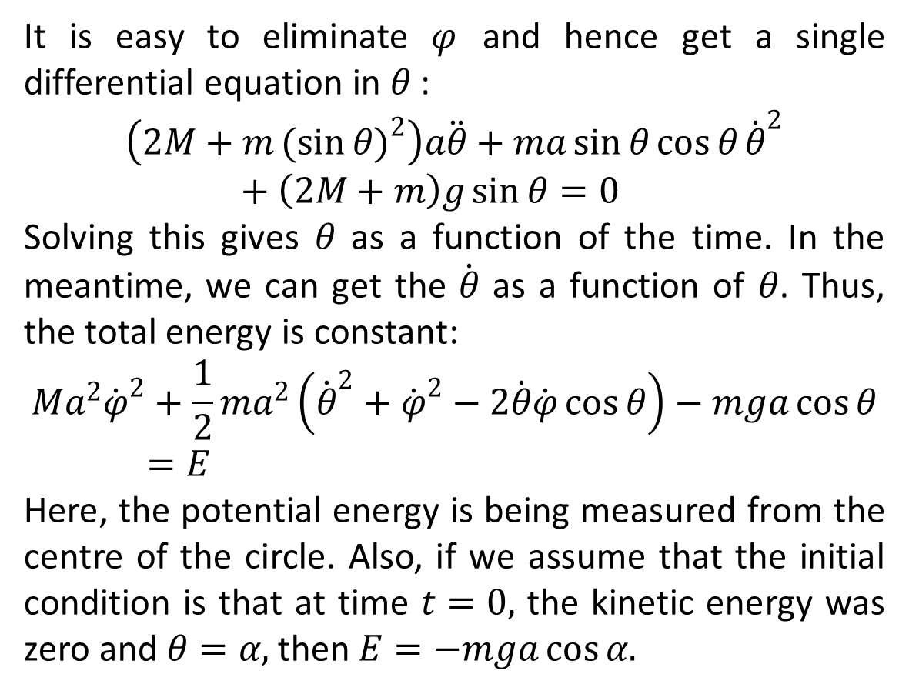
It is easy to eliminate $φ$ and hence get a single differential equation in $θ$:
$$\left(2M+m{(sin{θ)}}^{2}\right)a\ddot{θ}+ma\sin{θ}\cos{θ}{\dot{θ}}^{2}+\left(2M+m\right)g\sin{θ}=0$$
Solving this gives $θ$ as a function of the time. In the meantime, we can get the $\dot{θ}$ as a function of $θ$. Thus, the total energy is constant:
$$Ma^{2}{\dot{φ}}^{2}+\frac{1}{2}ma^{2}\left({\dot{θ}}^{2}+{\dot{φ}}^{2}−2\dot{θ}\dot{φ}\cos{θ}\right)−mga\cos{θ}=E$$
Here, the potential energy is being measured from the centre of the circle. Also, if we assume that the initial condition is that at time $t=0,$ the kinetic energy was zero and $θ=α,$ then $E=−mga\cos{α.}$

Slide 24
The End

