Slide 1
MTH376: Algebra
For
Master of Mathematics
By
Dr. M. Fazeel Anwar
Assistant Professor
Department of Mathematics, CIIT Islamabad

Slide 2
Lecture 09

Slide 3
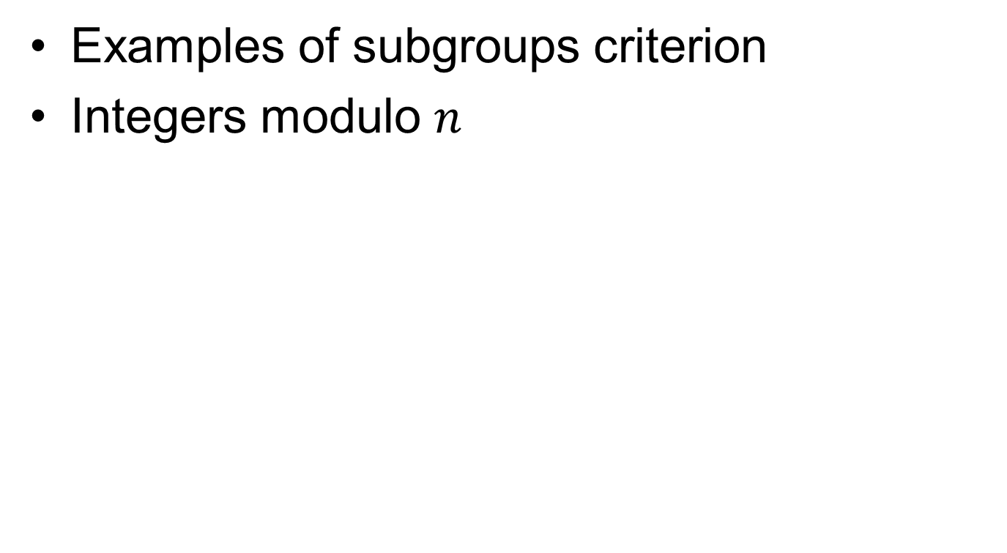
Recap
Examples of subgroups criterion
Integers modulo $n$

Slide 4

Integers modulo $n$

Slide 5

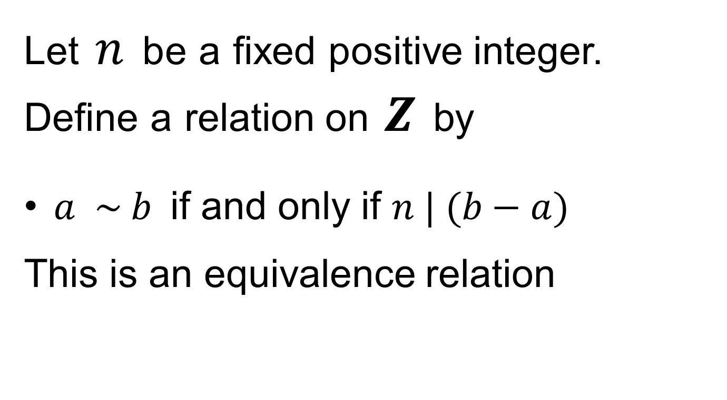
Integers modulo $n$…
Let$n$beafixedpositive integer. Definearelation on$Z$by
$a \sim b$if and only if $n | (b−a)$
This is an equivalence relation

Slide 6
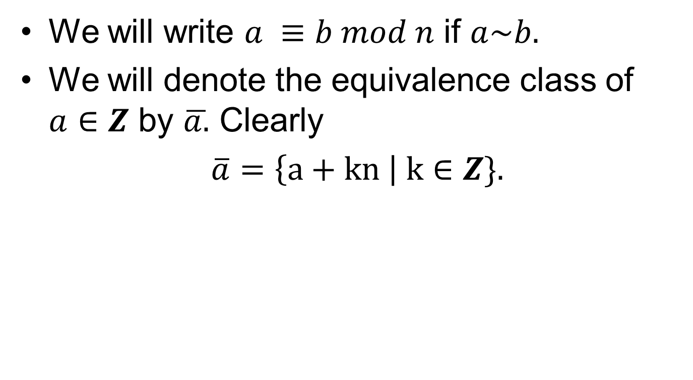
Integers modulo $n$…
We will write $a ≡b mod n$ if $a\sim b.$
We will denote the equivalence class of $a∈Z$by $\overline{a.}$Clearly
$\overline{a}=\left\{a+kn \right| k∈Z\}.$

Slide 7
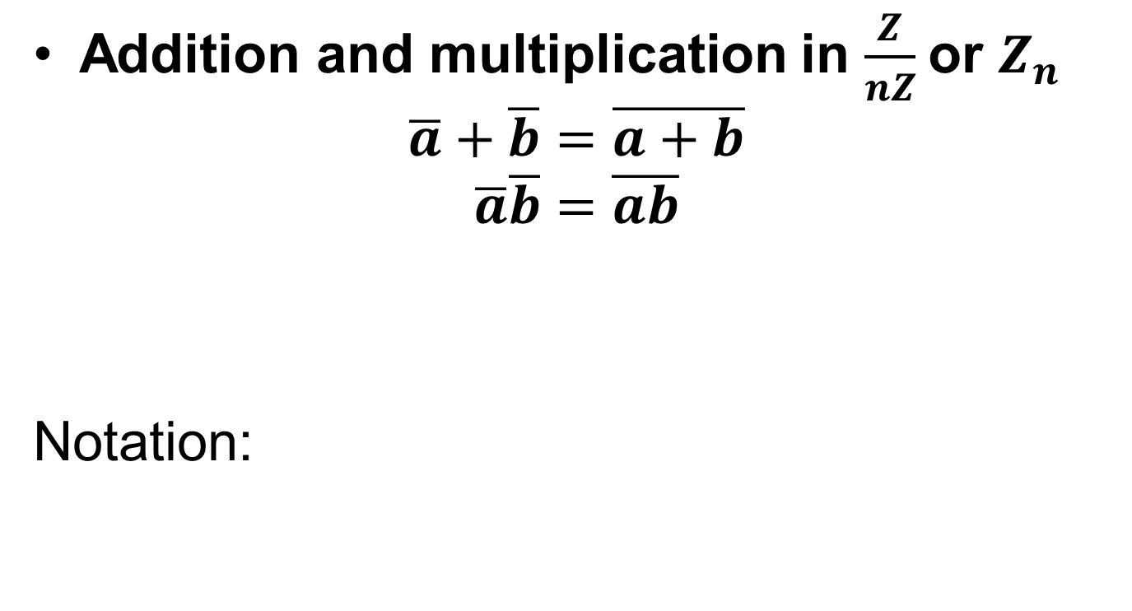
Integers modulo $n$…
Addition and multiplication in $\frac{Z}{nZ}$or $Z_{n}$
$$\overline{a}+\overline{b}=\overline{a+b}$$
$$\overline{a}\overline{b}=\overline{ab}$$
Notation:

Slide 9
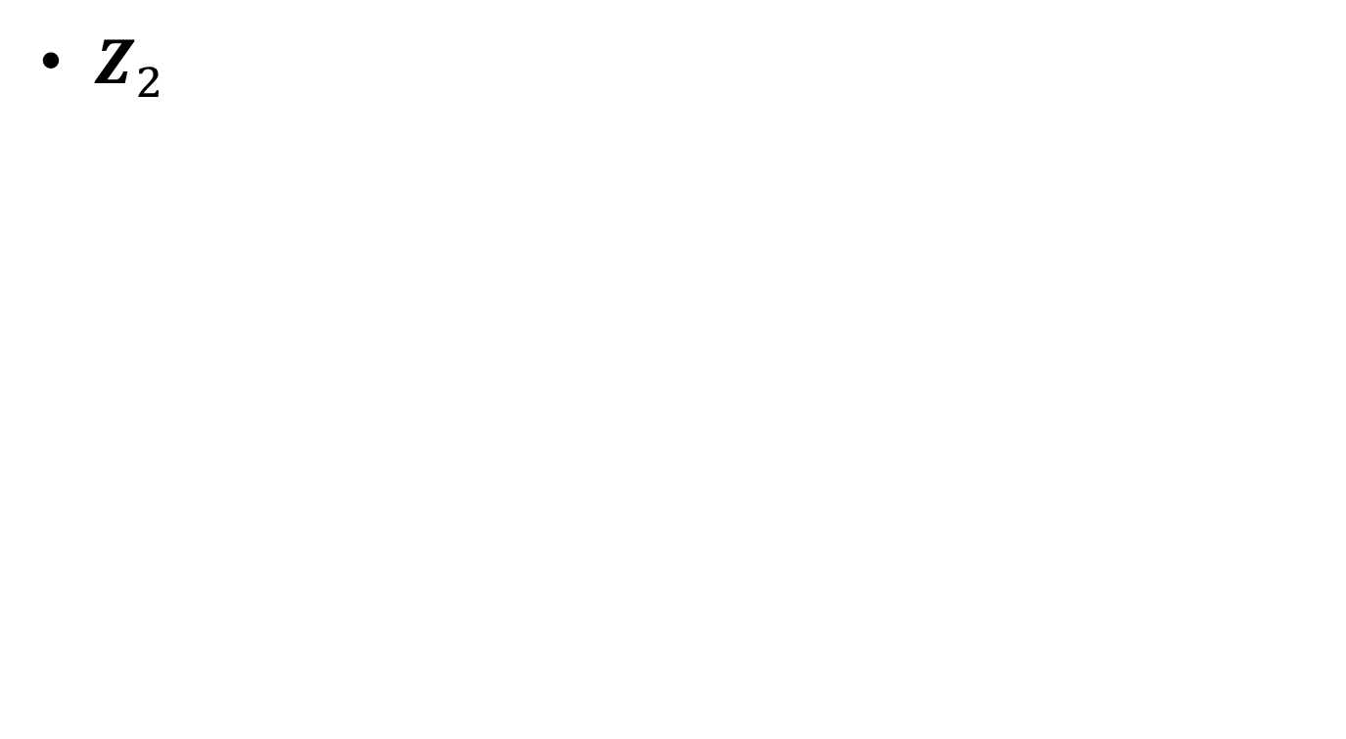
Modulo Groups
$Z_{2}$

Slide 11

Modulo Groups
$Z_{3}$

Slide 13
Summary

Slide 14
Thank You

