Slide 1
MTH376: Algebra
For
Master of Mathematics
By
Dr. M. Fazeel Anwar
Assistant Professor
Department of Mathematics, CIIT Islamabad

Slide 2
Lecture 08

Slide 3
Recap
Examples of Subgroups
Subgroups criterion

Slide 5

Integers modulo $n$

Slide 6

Integers modulo $n$.

Slide 7

Integers modulo $n$..

Slide 8

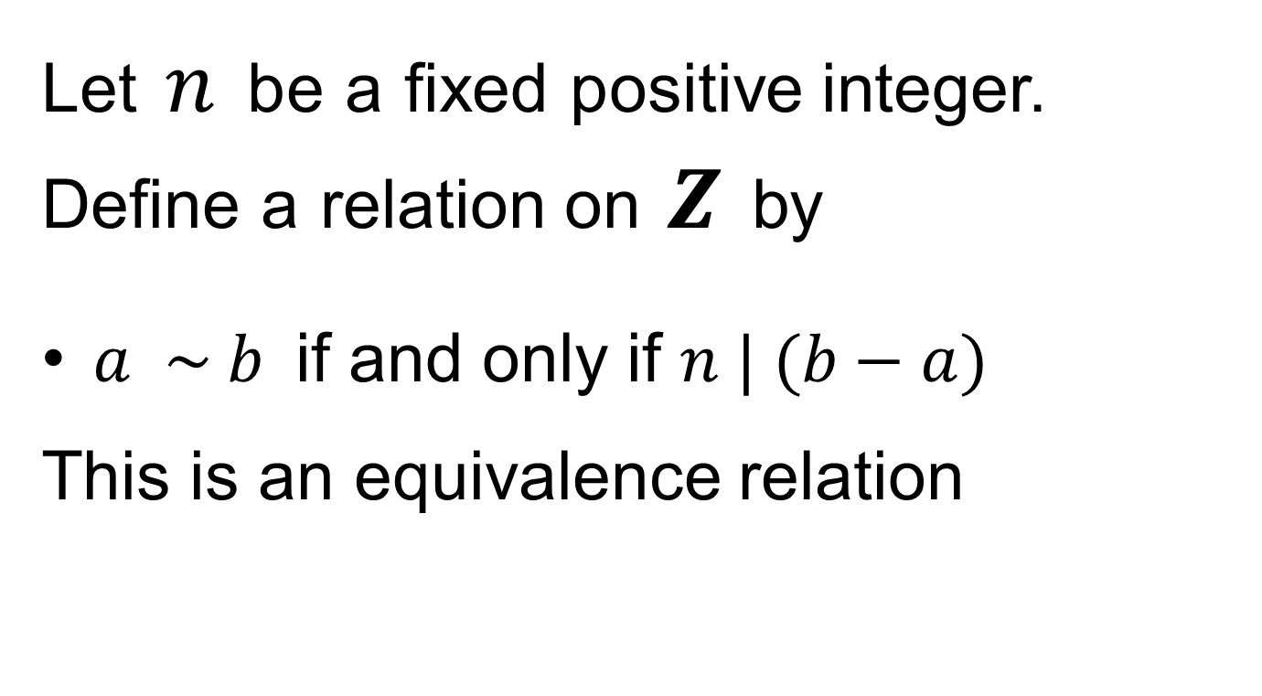
Integers modulo $n$…
Let$n$beafixedpositive integer. Definearelation on$Z$by
$a \sim b$if and only if $n | (b−a)$
This is an equivalence relation

Slide 9
Equivalence Relation

Slide 10
Summary

Slide 11
Thank You

