Slide 1
MTH376: Algebra
For
Master of Mathematics
By
Dr. M. Fazeel Anwar
Assistant Professor
Department of Mathematics, CIIT Islamabad

Slide 2
Lecture 07

Slide 3
Recap
Subsets
Subgroups
Examples of Subgroups

Slide 4
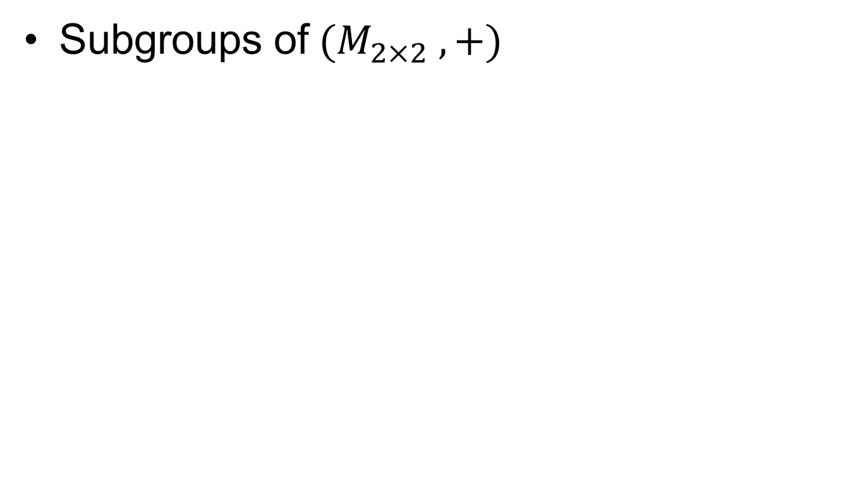
Examples...
Subgroups of$(M_{2×2} ,+)$

Slide 5
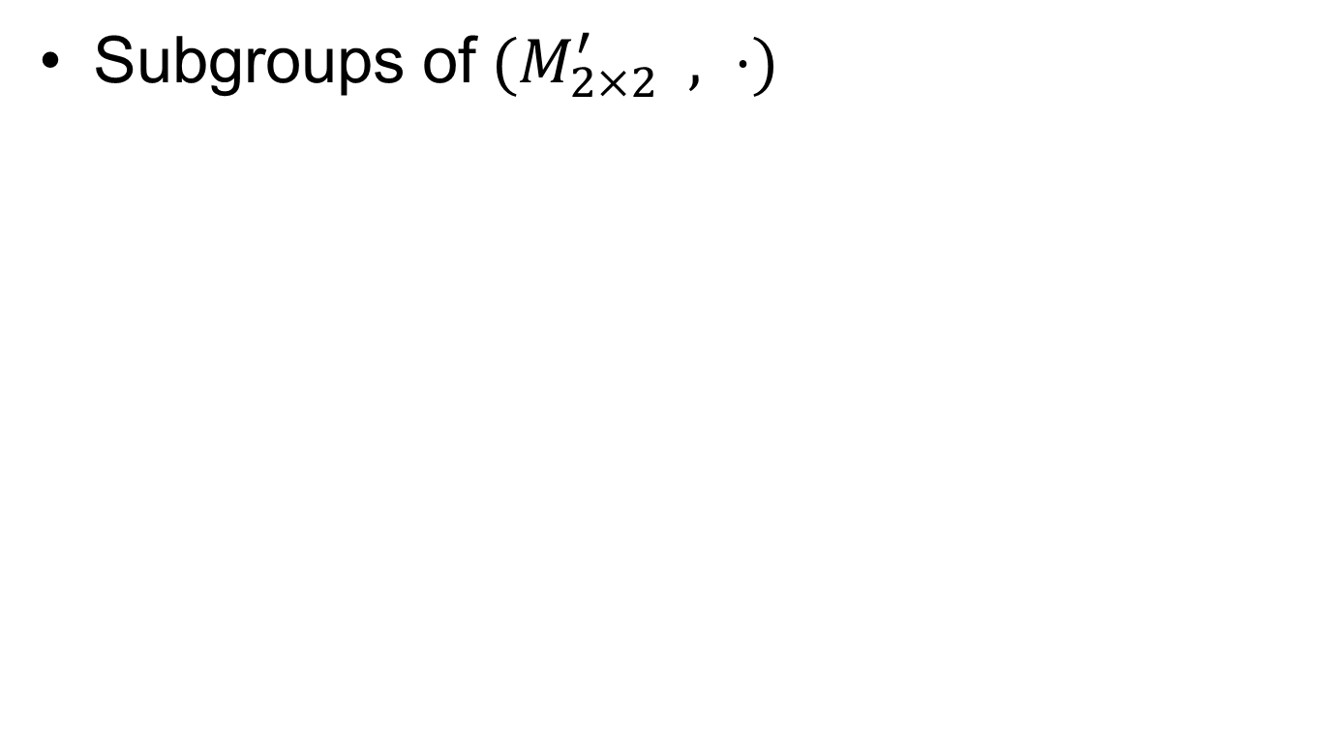
Examples....
Subgroups of$(M_{2×2}^{′} , ⋅)$

Slide 6
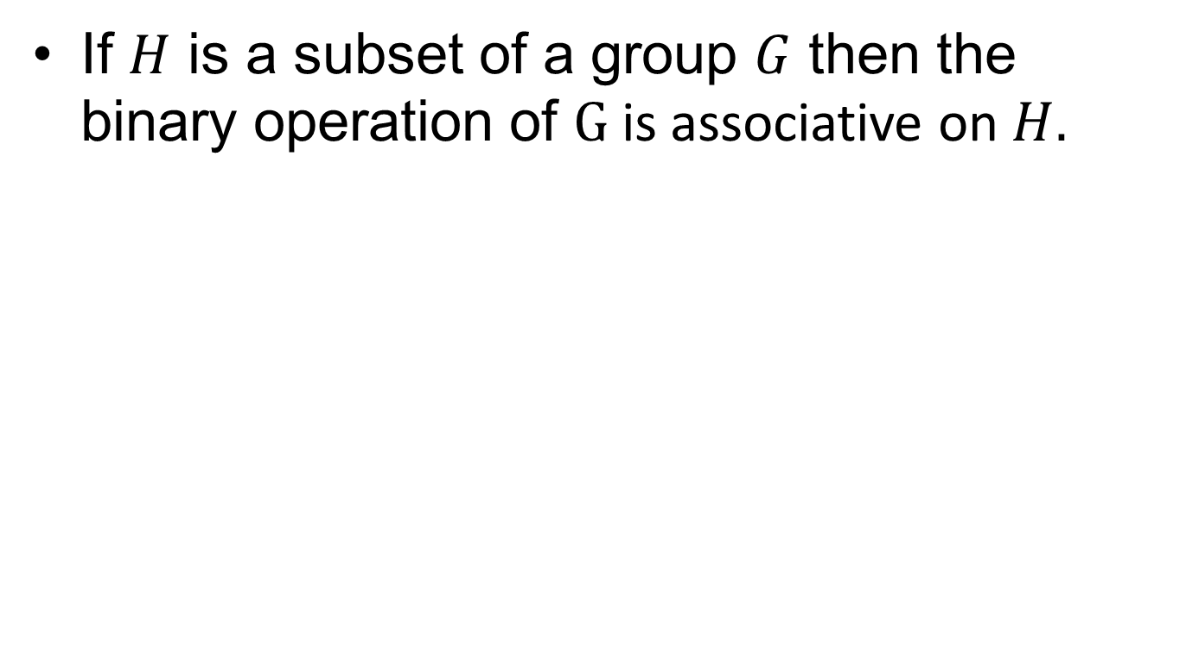
Fact
If $H$ is a subset of a group $G$ then the binary operation of $G$is associative on $H.$

Slide 7
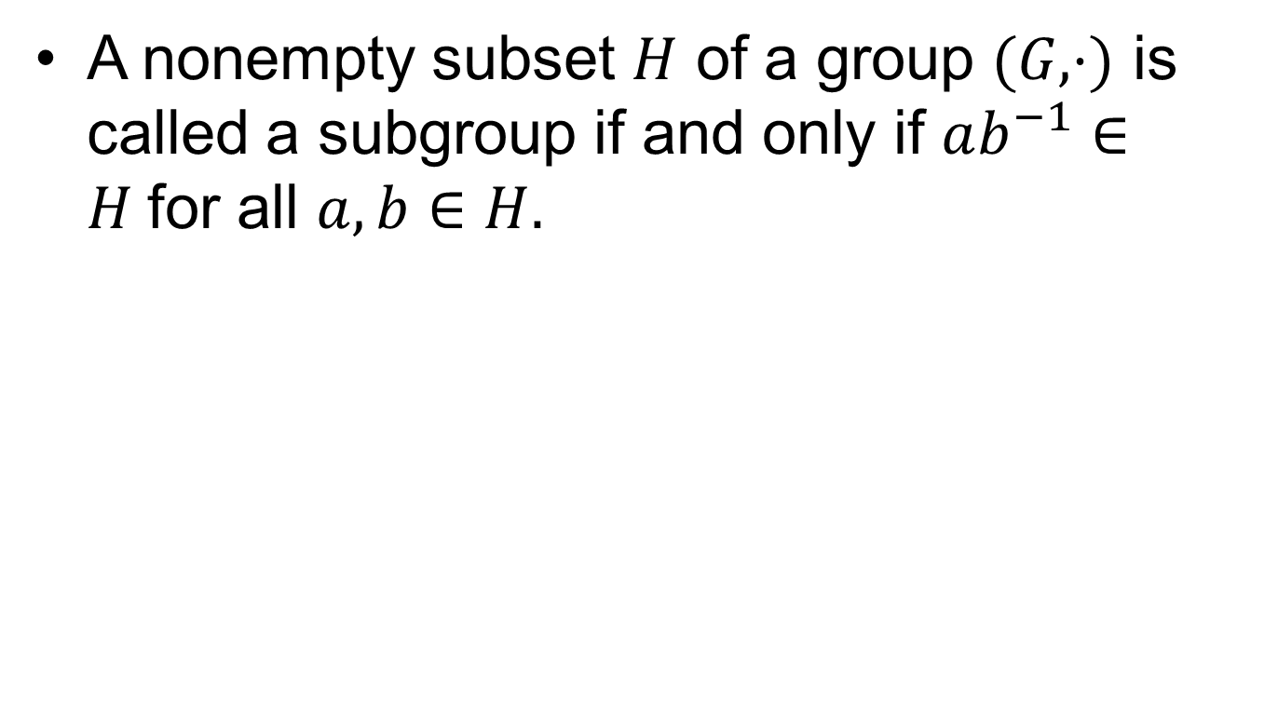
Subgroup Criterion
A nonempty subset $H$ of a group $(G, ⋅)$ is called a subgroup if and only if $ab^{−1}∈H$for all $a,b∈H.$

Slide 8
Proof

Slide 9
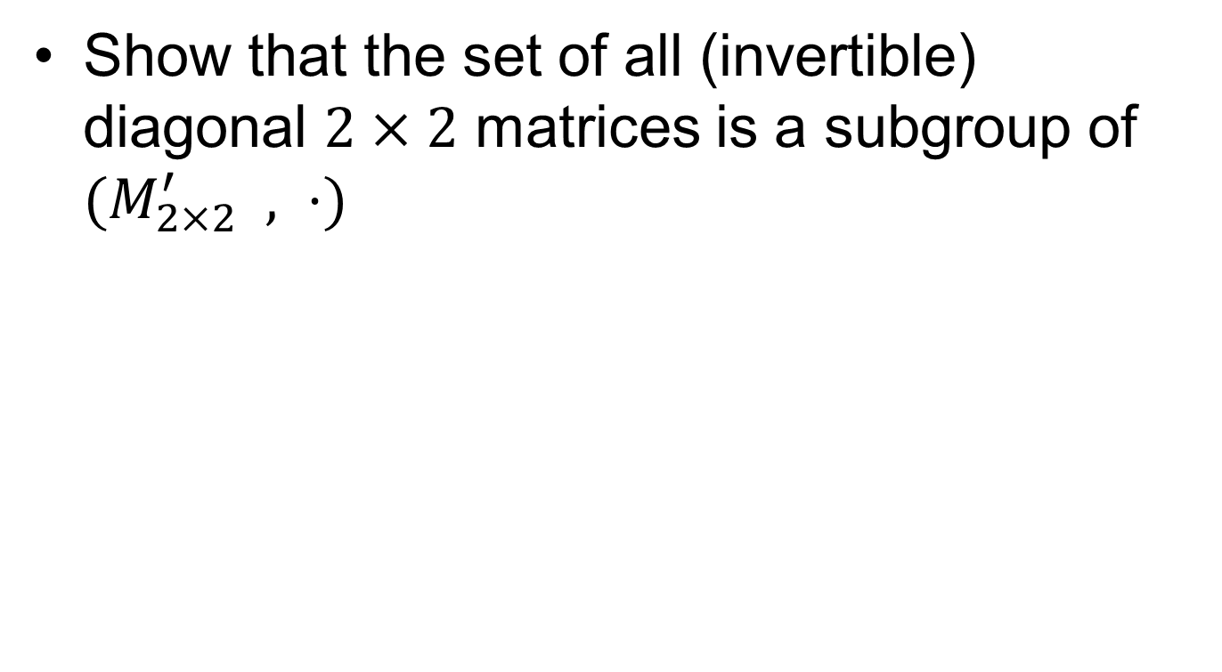
Using the subgroup Criterion
Show that the set of all (invertible) diagonal $2×2$ matrices is a subgroup of $(M_{2×2}^{′} , ⋅)$

Slide 10

Integers modulo $n$

Slide 11
Summary

Slide 12
Thank You

